Slide 1
PS-SPS Transfer
A Short Summary of Previous Studies
H. Damerau, E. Shaposhnikova (2011/2012), H. Timko,
BE-RF

Slide 2
Motivation for the studies
The transfer of unmatched, rotated bunches from the PS to the SPS is leading to non-negligible losses. Optimising the rotation in the PS and using increased rotation voltage can reduce the losses and/or allow for transferring higher-emittance bunches, as the SPS bucket is already full at injection with present settings.
Studies in 2012 Experimental + simulation studies of
    Optimised rotation timings Increased 40 MHz and 80 MHz voltage
    Simulations performed with ESME
Studies in 2015 Measurements with two 40 MHz cavities
    Measurements incomplete due to problems in PS
    BLonD benchmarks done; scans to be repeated

Slide 3
Bunch rotation
Bunch rotation is done with a sudden increase of RF voltage; after ¼ of a synchrotron period, the bunch rotates in phase space and the spread in time & energy are ‘exchanged’.
  Results in a shorter bunch length compared to adiabatic voltage increase
  For a large bunch, centre and tail have different synchrotron frequencies → characteristic S-shape

Slide 4
STUDIES in 2012
Simulations & Measurements

Slide 5
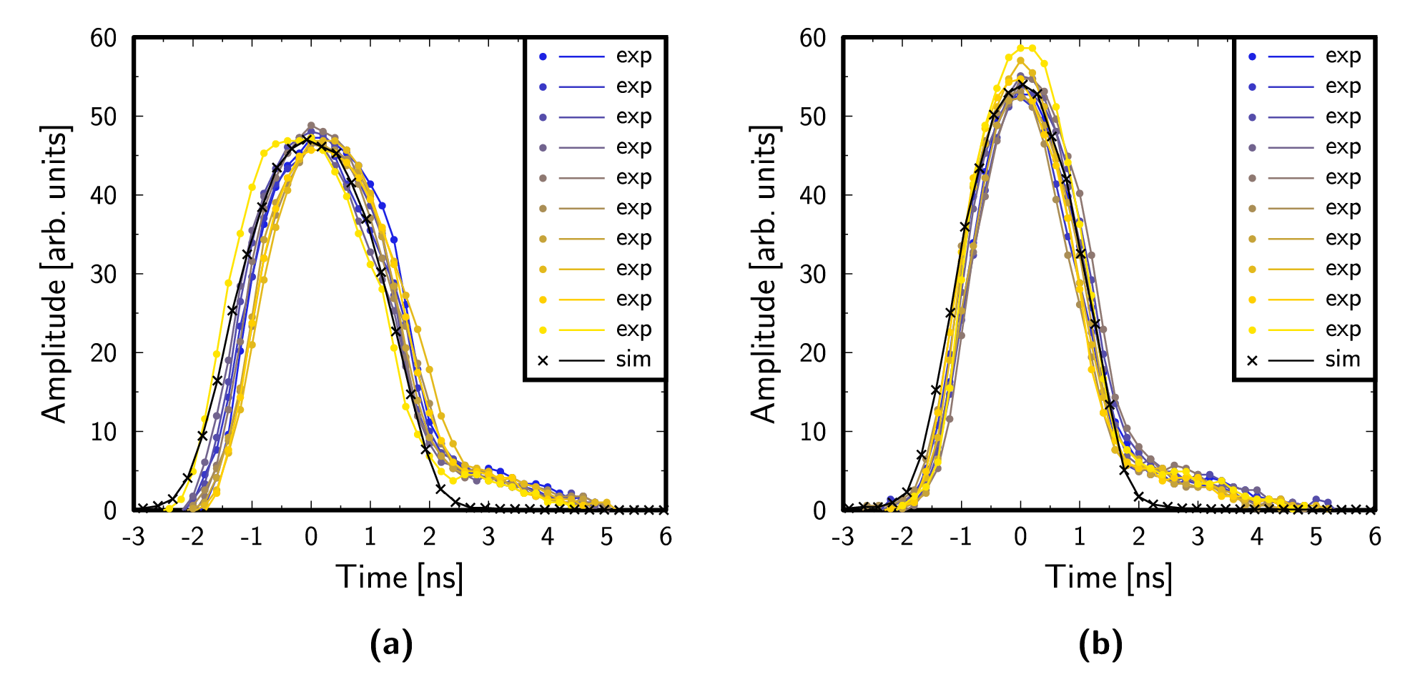
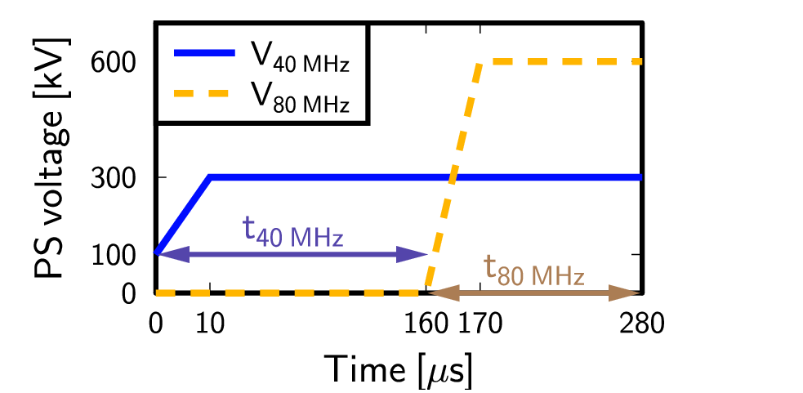
About the simulations
Using ESME w/ single bunches and w/o intensity effects
  Tracking reconstructed distributions through double-splittings and rotation at PS flat top till end of flat top (double RF) in SPS
    Experimentally, measure transmission after the start of the ramp
Profiles of acquired and simulated distributions
Rotation voltages & timings

Slide 6
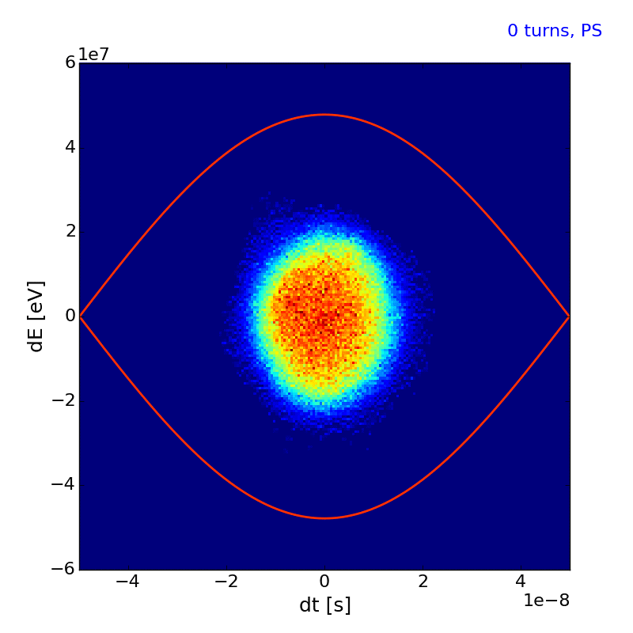


Simulated with BLonD in 2015
PS-SPS transfer using BLonD

Slide 7
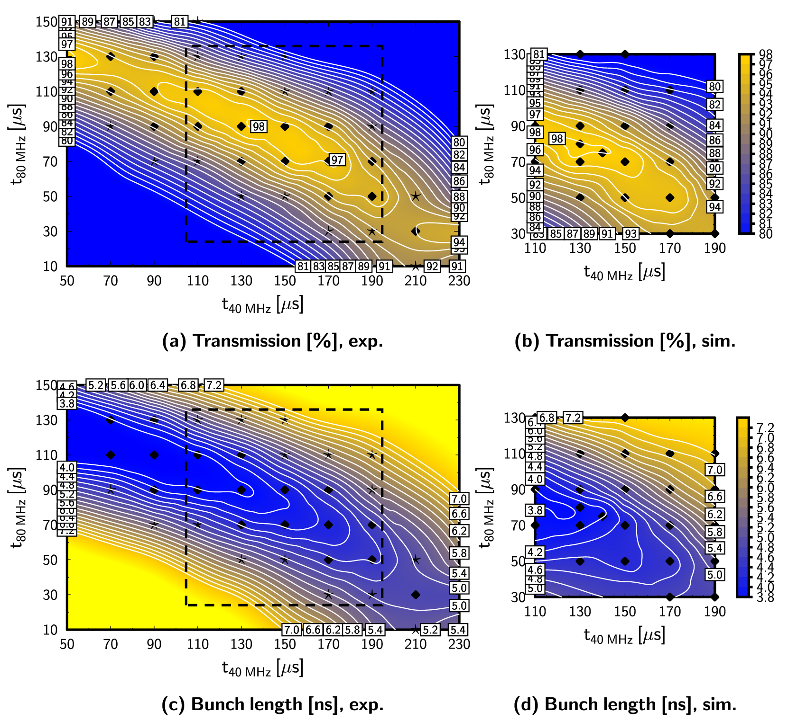
Optimisation of timings with two 40 MHz and two 80 MHz cavities
Scans of rotation timings performed with
V_{40MHz} = 600 kV
V_{80MHz} = 600 kV
and
constant emittance

Slide 8
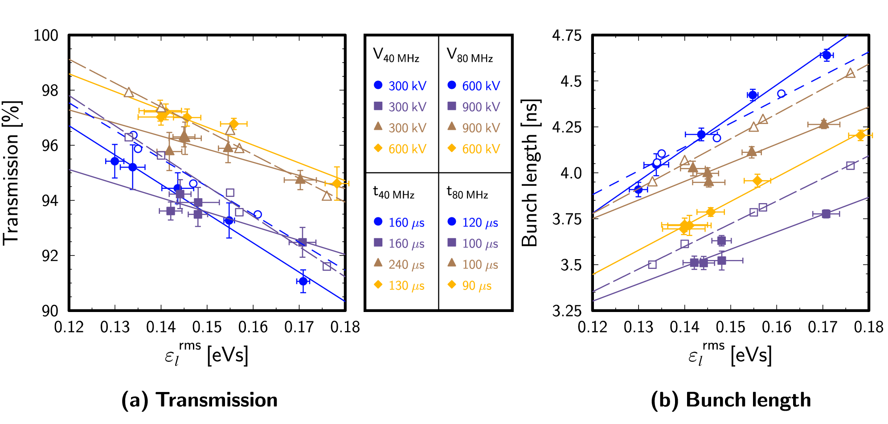
Emittance dependence
Optimal transmission and corresponding bunch length for different emittances & voltages
Measurement: full markers, continuous lines
Simulations: empty markers, dashed lines
With spare 40 MHz, can transfer a 40 % larger emittance for the same transmission!

Slide 9
STUDIES in 2015
Measurements with spare 40 MHz cavity

Slide 10
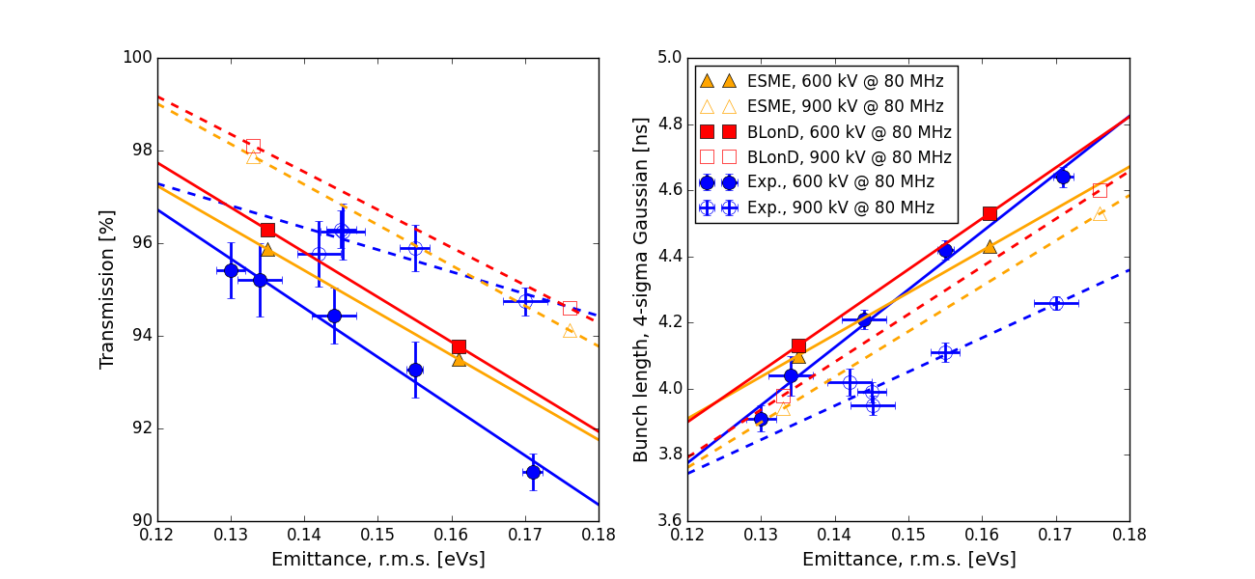
BLonD benchmarking
Good agreement (within ± 1 turn) with ESME

Slide 11
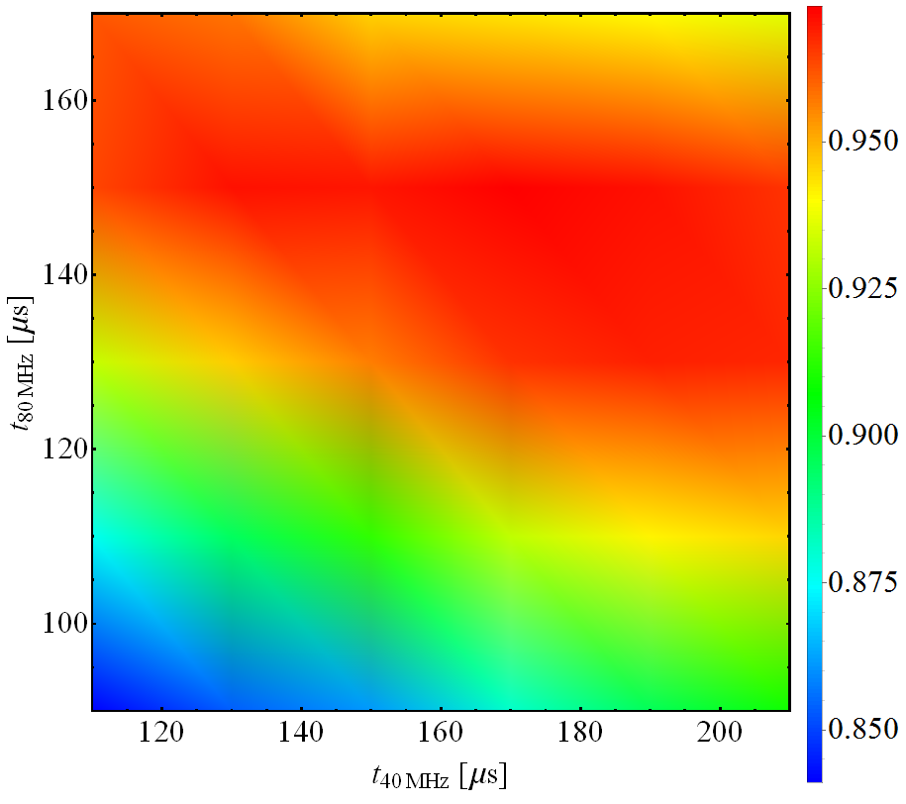
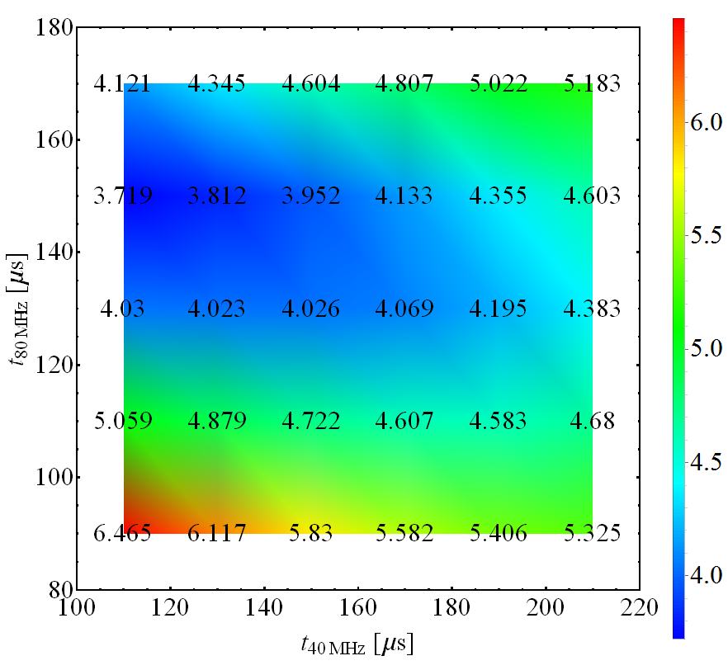
Measurements: single 40 MHz cavity
Transmission
Bunch length

Slide 12
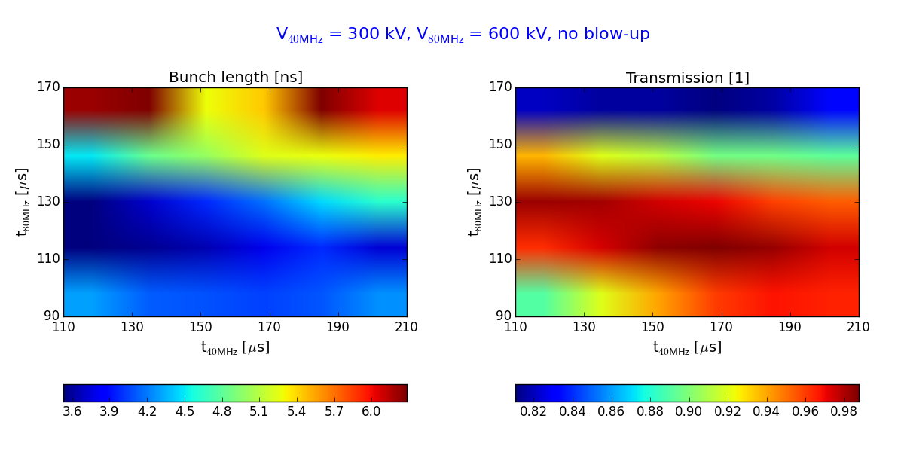
Simulations: single 40 MHz cavity

Slide 13
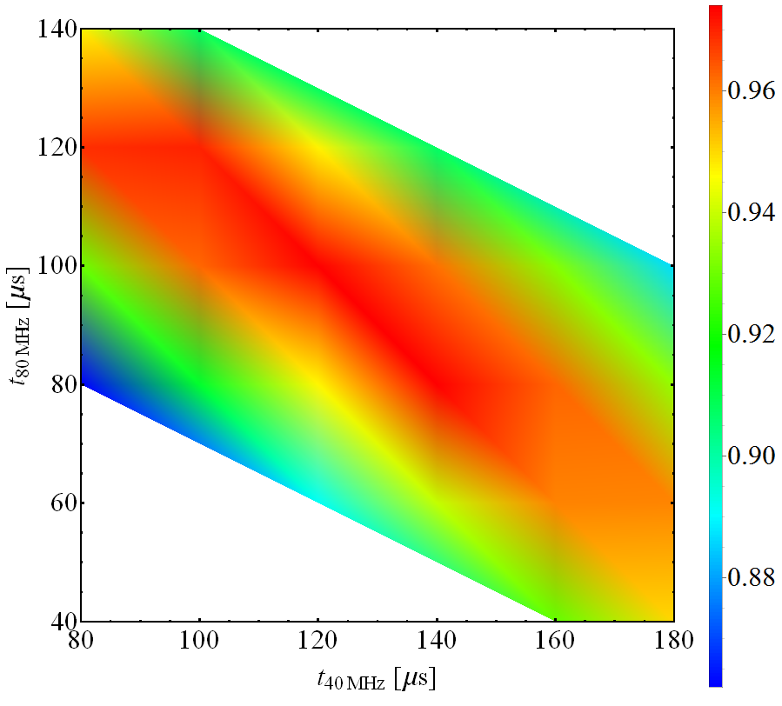
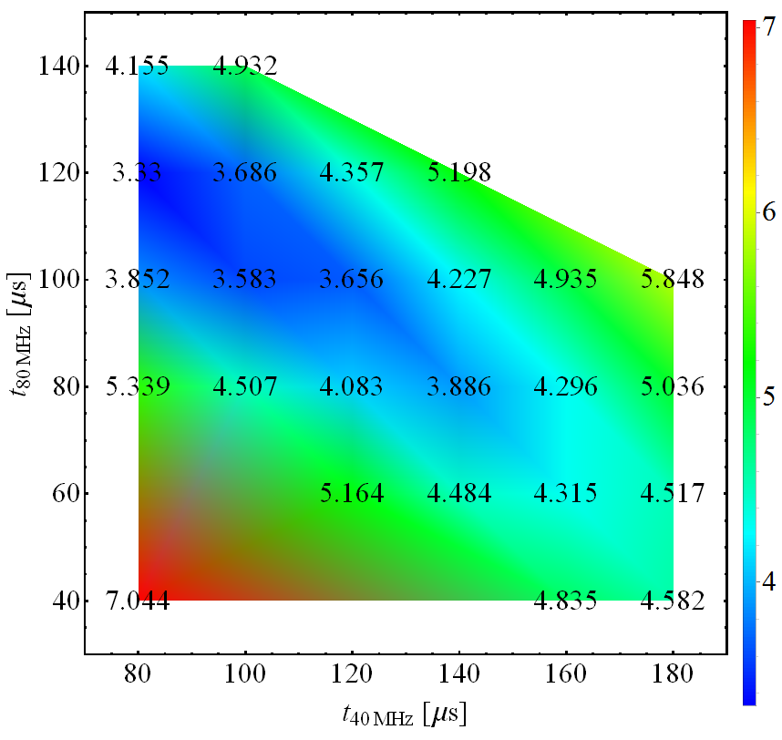
Measurements: two 40 MHz cavities
Transmission
Bunch length

