Slide 1
Studies of LHC beam losses at PS/SPS transfer
H. Bartosik, T. Bohl, S. Cettour Cave, V. Kain,
C. Kornelis, E. Shaposhnikova, A. Lasheen
LIU-SPS BD, 04.08.2016

Slide 2
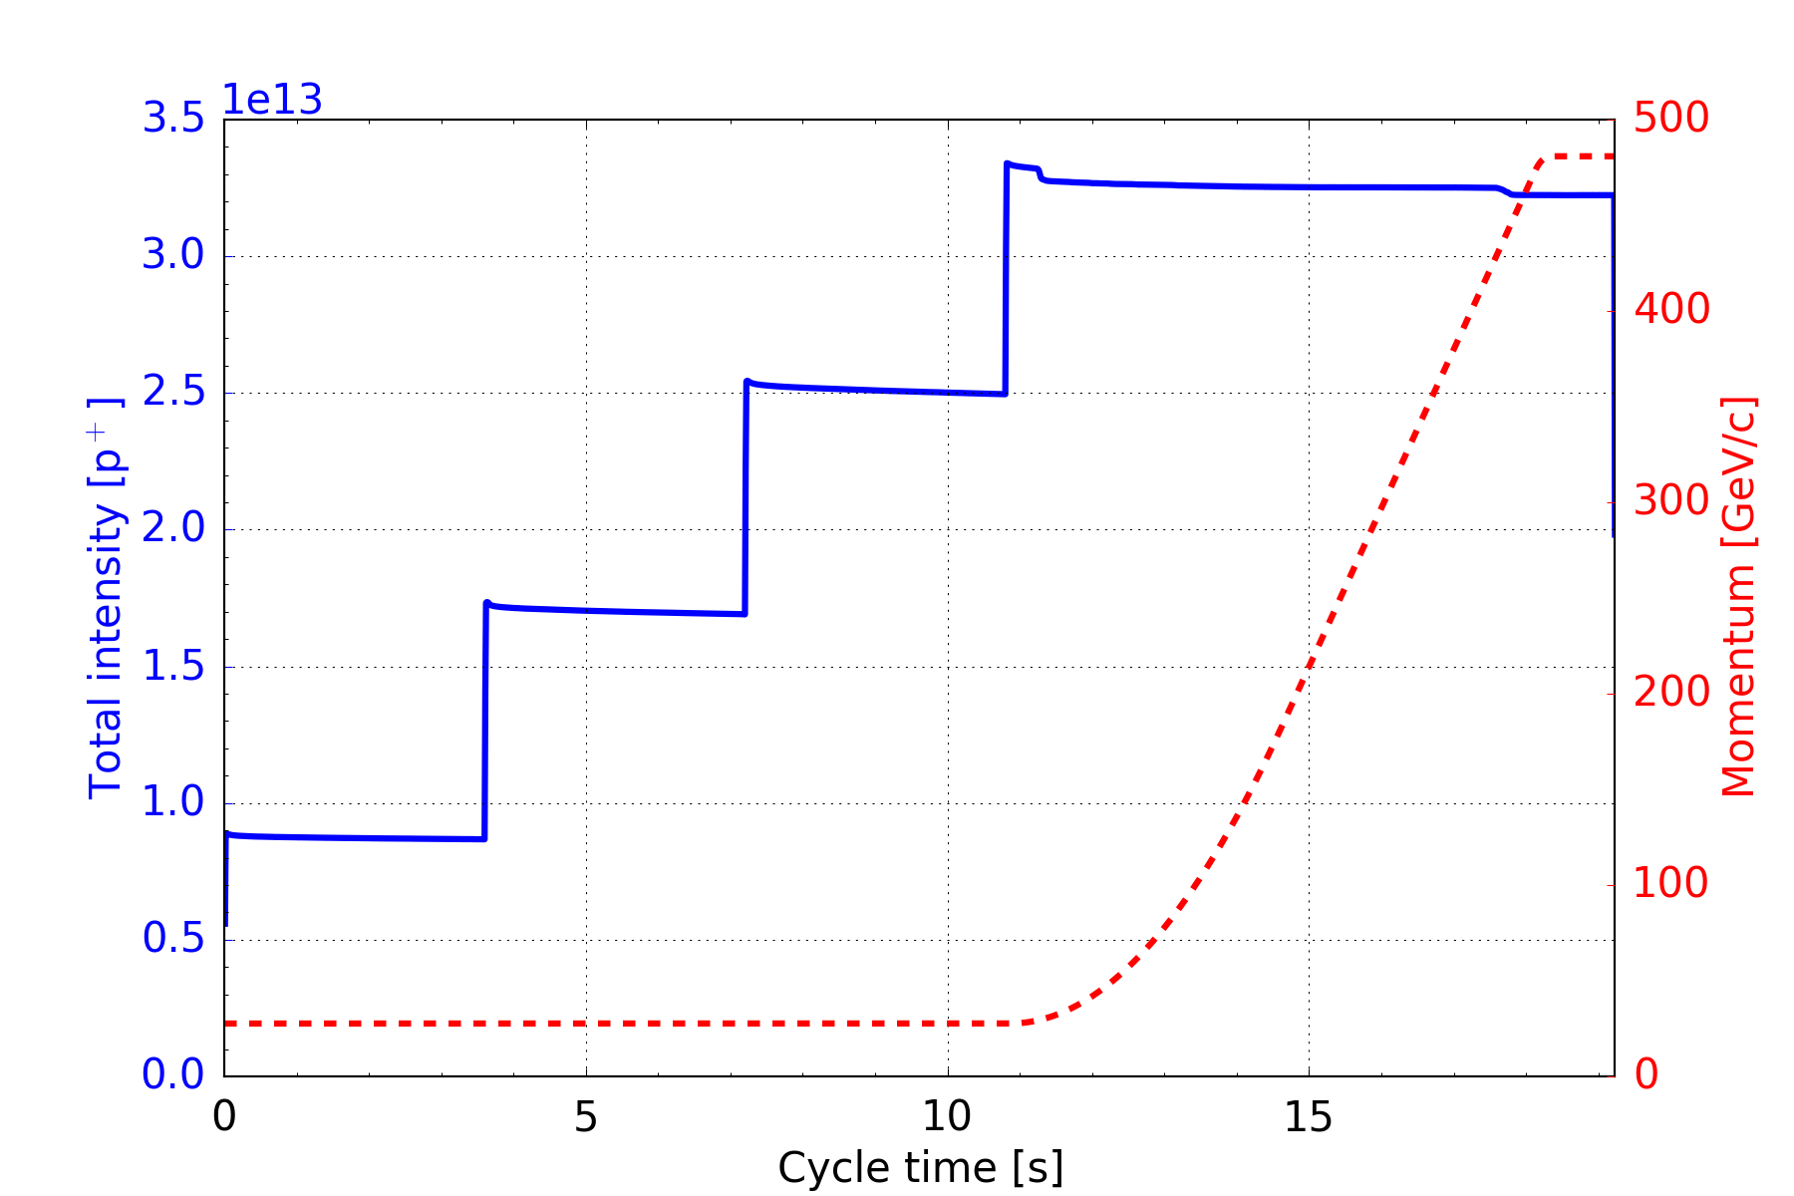
Introduction: SPS cycle (nominal intensity)
Within 11 s, 4 batches of 72 bunches each are injected at 26 GeV/c.
Loss of circulating un-captured beam due to injection kicker
Questions
What is the nature of the incoherent losses on flat bottom?
How will these losses behave with LIU intensity?
incoherent losses
total losses ~5%

Slide 3
Effect of 800 MHz RF
BCMS beam on LHC25NS cycle (9 bp flat bottom)
  48 bunches, ~1.4e11 p/b injected, 4 ns bunch length at injection
  Beam dump at 30 GeV/c (maximum energy for TIDH)
  800 MHz RF voltage at 10% of 200 MHz
  DC-BCT averaged over >25 shots
  800 MHz enhances losses on flat bottom, but same total transmission!

Slide 4
Losses with and without 800 MHz
800 MHz OFF

Slide 5
Acceleration to 28 GeV/c flat portion
BCMS beam on special MD cycle (6 bp flat bottom + ramp to 28 GeV/c plateau)
  48 bunches, ~1.35e11 p/b injected, 4 ns bunch length at injection
  Programmed constant bucket area of 0.6 eVs
  Still losses at 28 GeV/c plateau (but less) and also when starting to ramp to 30 GeV/c

Slide 6
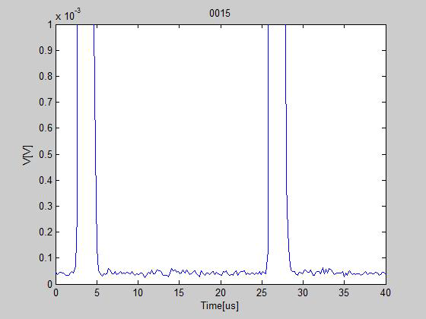
200 MHz component on spectrum analyzer

Slide 7
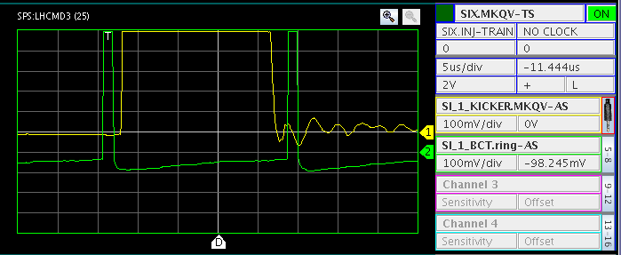
Cleaning of un-captured beam with Q-kicker
BCMS beam on special MD cycle (6 bp flat bottom + ramp to 28 GeV/c plateau)
  48 bunches, ~1.35e11 p/b injected
  Programmed constant bucket area of 0.6 eVs
  Maximum vertical tune kicker strength on empty buckets

Slide 8
Cleaning of un-captured beam with Q-kicker
BCMS beam on special MD cycle (6 bp flat bottom + ramp to 28 GeV/c plateau)
  48 bunches, ~1.35e11 p/b injected, 4 ns bunch length at injection
  Programmed constant bucket area of 0.6 eVs
  Maximum vertical tune kicker strength on empty buckets
  About 3.5% losses due to uncaptured beam
  About 2% loses at start of acceleration due to particles spilling out of the bucket
enhanced
loss rate
same loss rate
loss rate like 800 MHz OFF
tune kicker
tune kicker
same total transmission

Slide 9
Cleaning of un-captured beam with Q-kicker
BCMS beam on special MD cycle (6 bp flat bottom + ramp to 28 GeV/c plateau)
  48 bunches, ~1.35e11 p/b injected, 4 ns bunch length at injection
  Programmed constant bucket area of 0.6 eVs
  Maximum vertical tune kicker strength on empty buckets
  About 3.5% losses due to uncaptured beam
  About 2% loses at start of acceleration due to particles spilling out of the bucket
enhanced
loss rate
loss rate like 800 MHz OFF

Slide 10
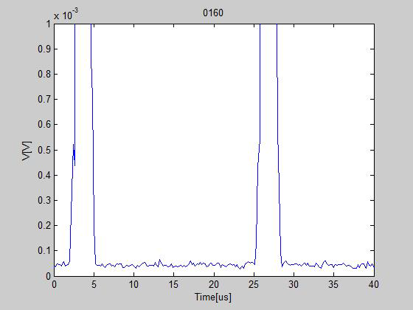
200 MHz component on spectrum analyzer
with tune kick at 2 s

Slide 11
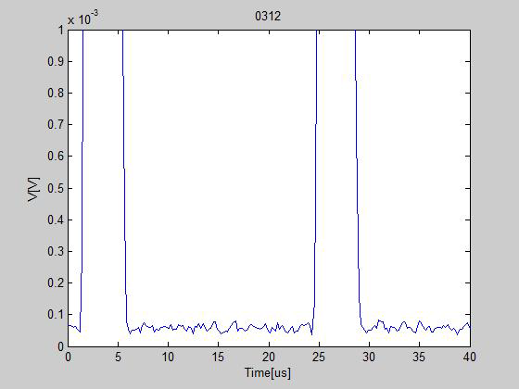
200 MHz component on spectrum analyzer
with tune kick at 2 s
… zoomed

Slide 12
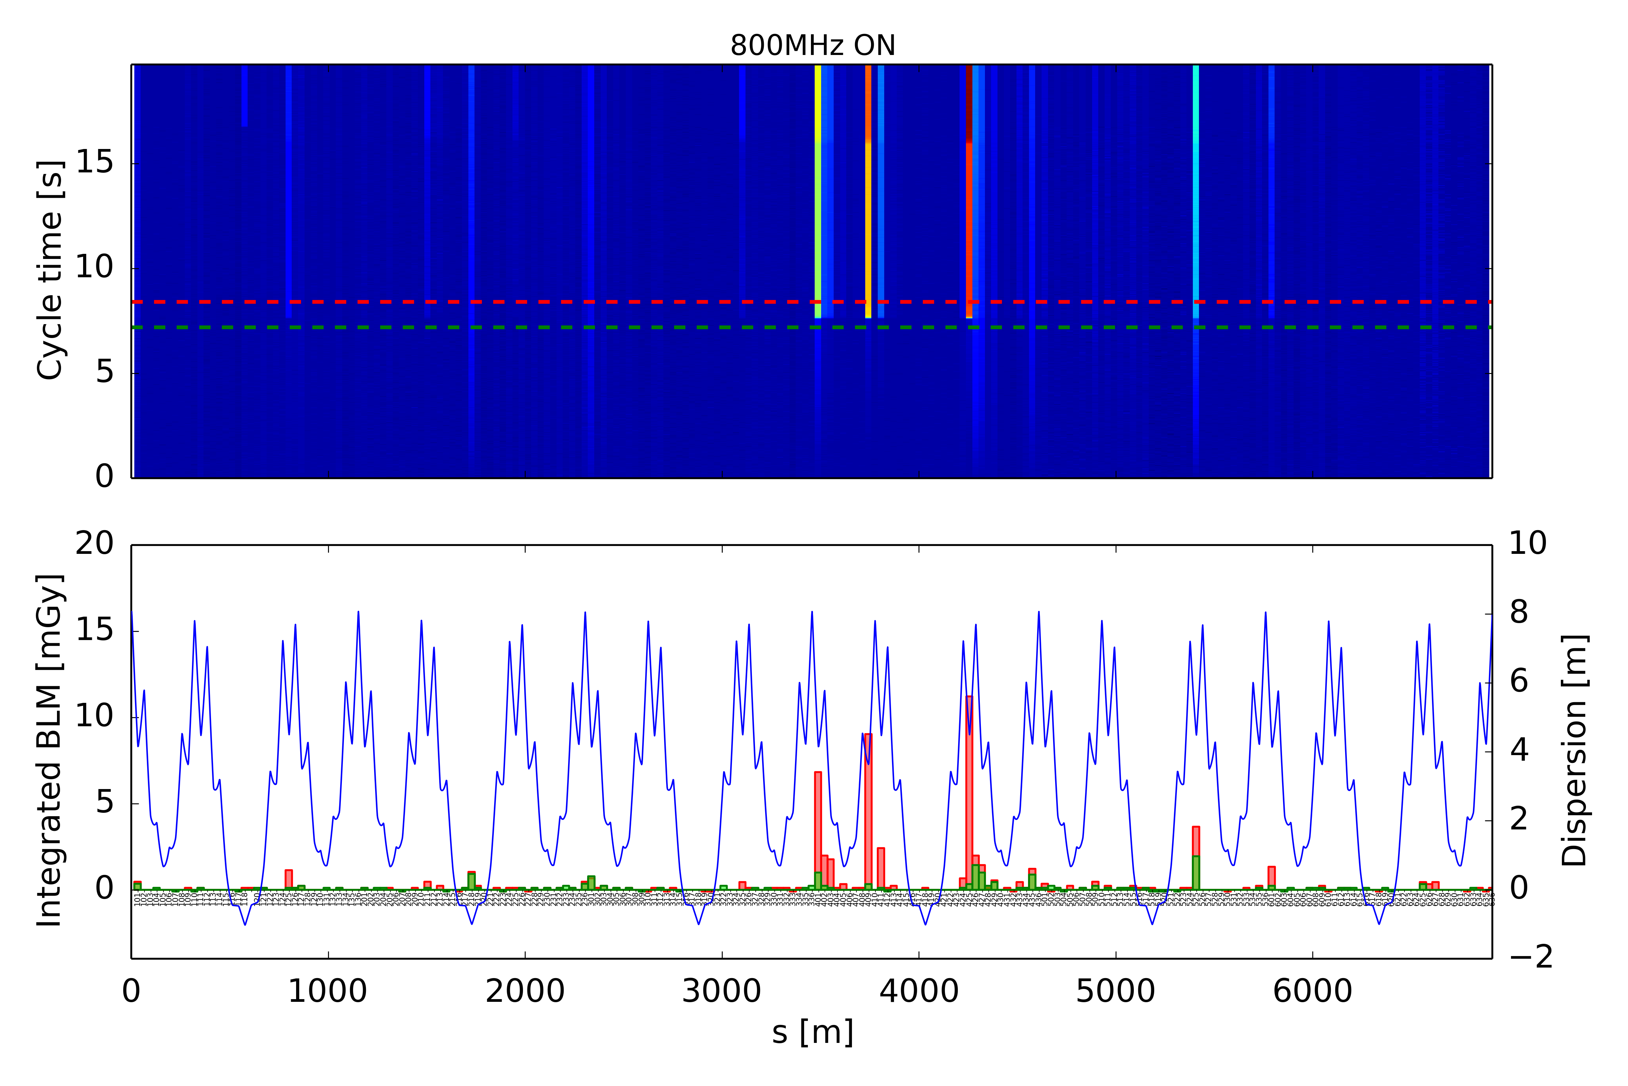
BLMS without tune kick – 800 MHz ON
28 GeV/c
26 GeV/c
losses in high dispersive regions
ZS activation

Slide 13
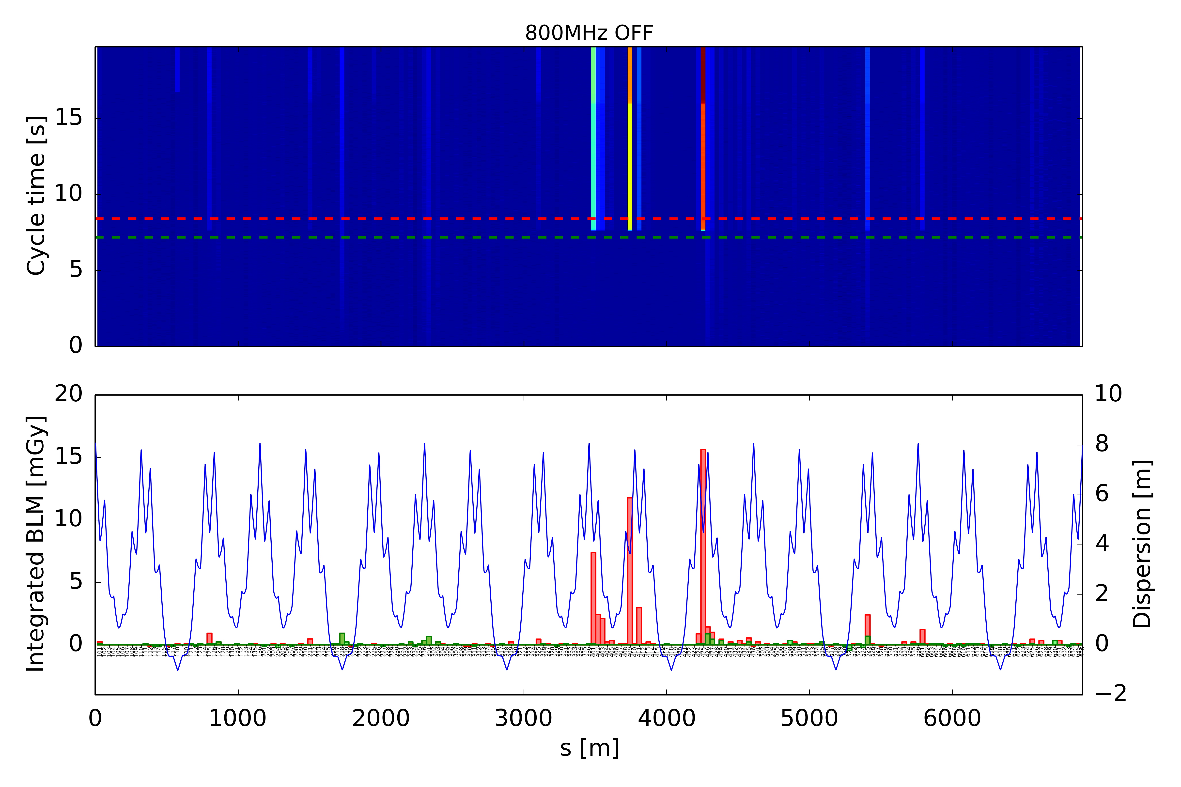
BLMS without tune kick – 800 MHz OFF
28 GeV/c
26 GeV/c
losses in high dispersive regions
ZS activation

Slide 14
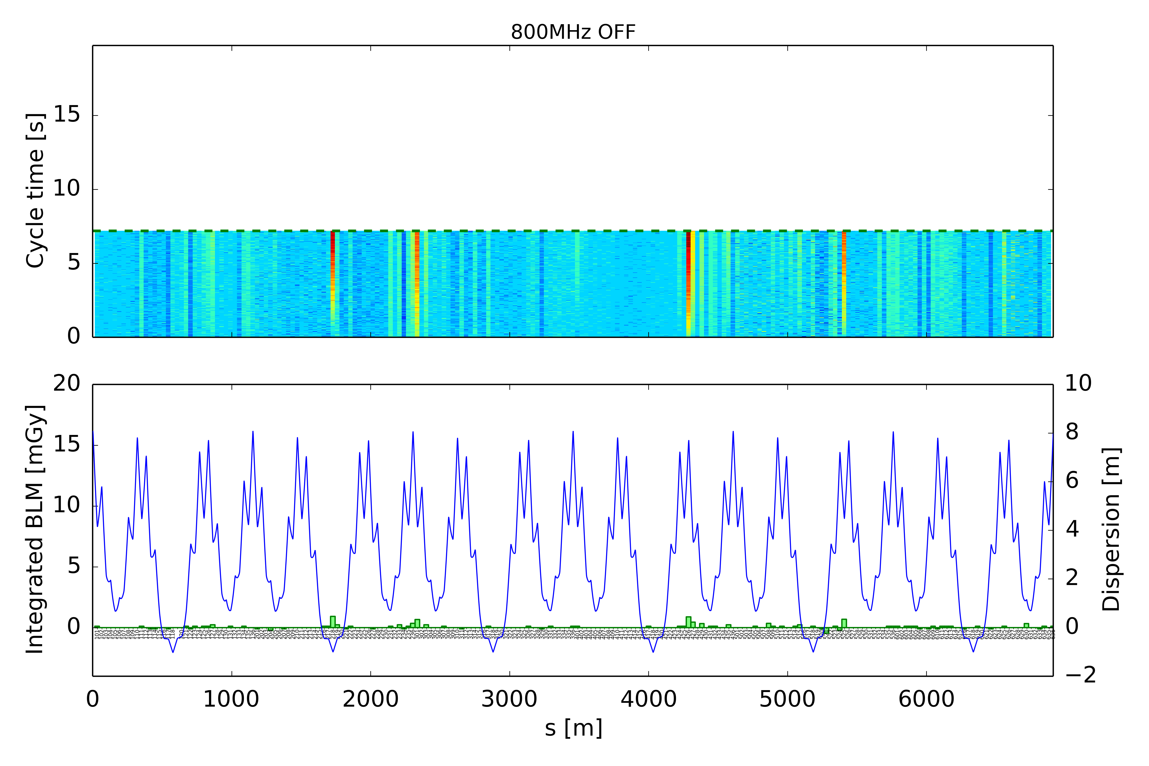
BLMS without tune kick – 800 MHz OFF
26 GeV/c
losses in high dispersive regions
ZS activation

Slide 15
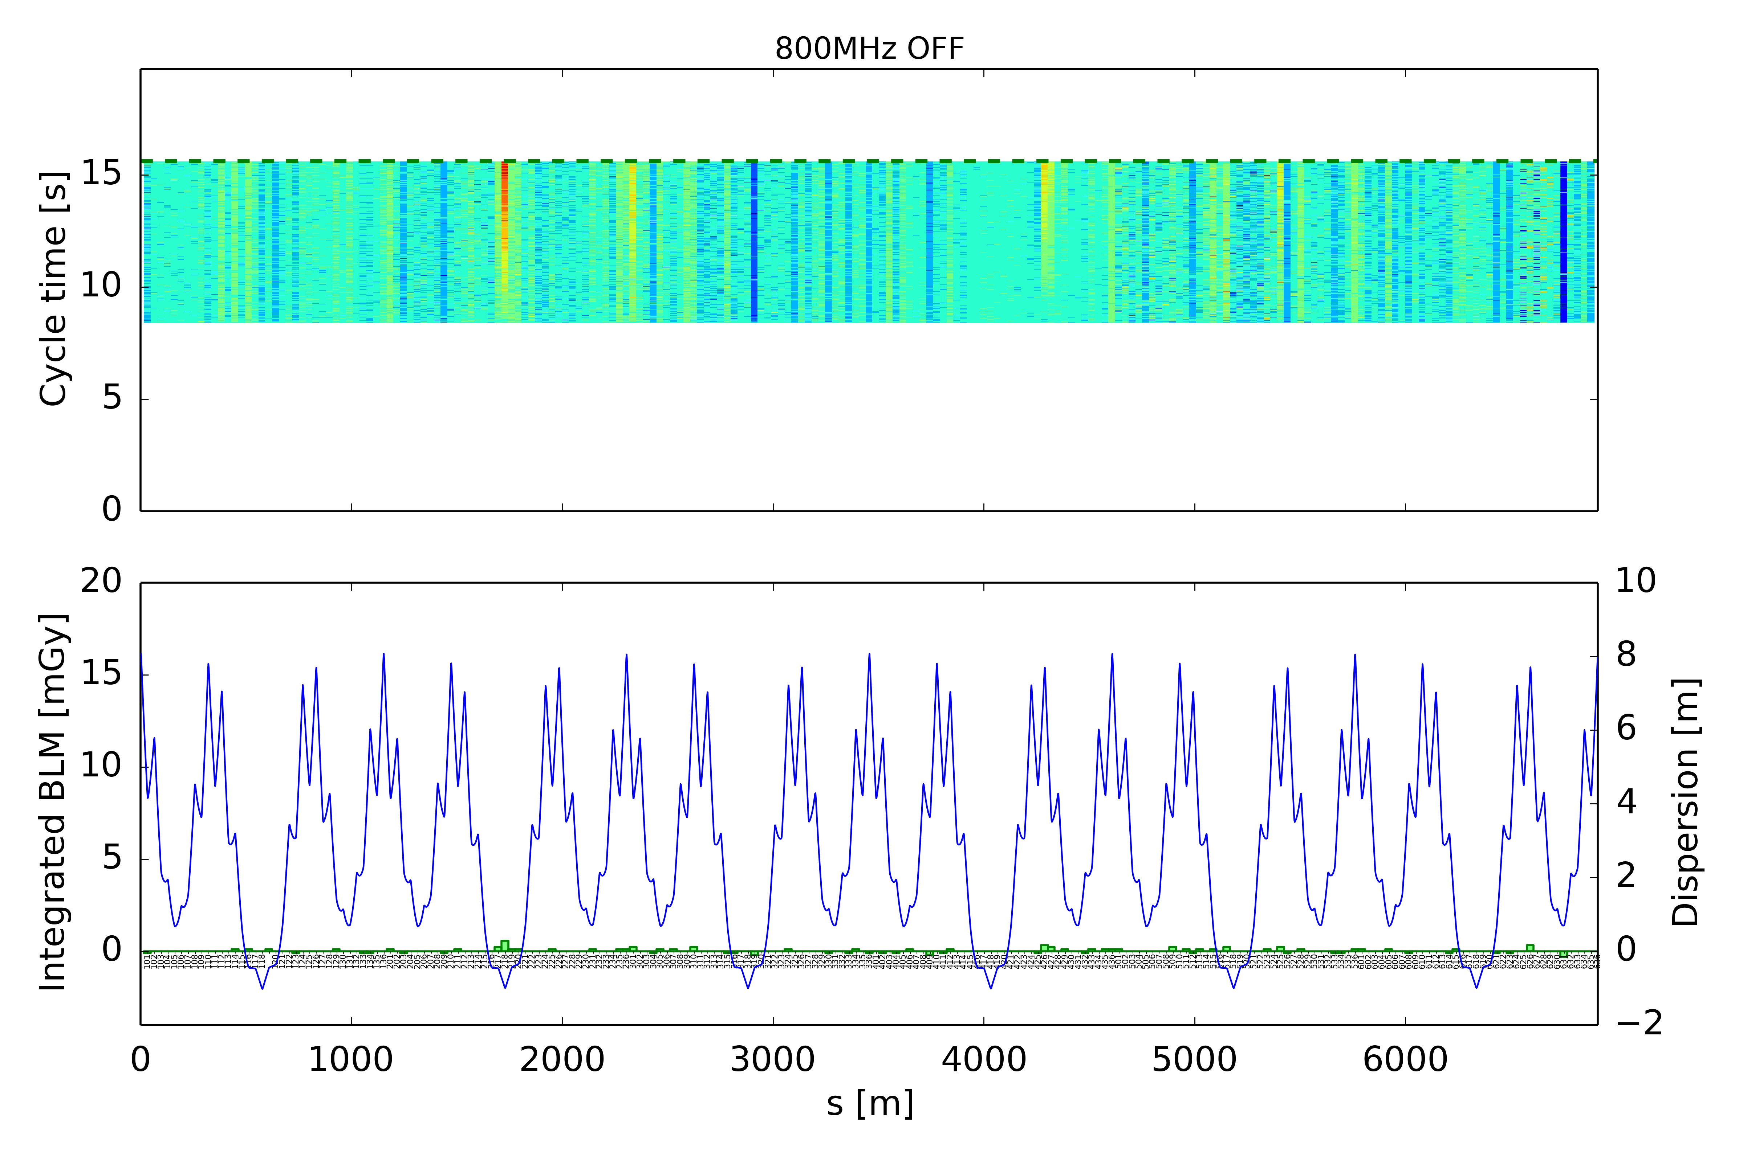
BLMS without tune kick – 800 MHz OFF
28 GeV/c
losses in high dispersive regions
ZS activation

Slide 16
Losses as function of SPS bucket area
BCMS beam on special MD cycle (6 bp flat bottom + ramp to 28 GeV/c plateau)
  48 bunches, ~1.3e11 p/b injected, 4 ns bunch length at injection
  Constant bucket area along the cycle
Comparison of losses at flat bottom and total losses until 28 GeV/c plateau
  800 MHz enhances losses on flat bottom, but no impact on total transmission

Slide 17
25 ns nominal intensity summary
Losses mainly longitudinal
  About 3.5% losses due to uncaptured beam (4 ns bunch length at injection)
  About 2% loses at start of acceleration due to particles spilling out of the bucket
  BLMs show losses in high dispersive regions for both flat bottom and acceleration
  Particles spilling out of bucket observed on spectrum analyzer when arriving at 28 GeV/c plateau
  Losses observed even on 28 GeV/c plateau (also longitudinal?)
  Without 800 MHz, losses on flat bottom only about 1% over 7.2 s (could still be due to uncaptured beam since BLMs show losses in high dispersive regions)
  800 MHz RF enhances losses of uncaptured beam on flat bottom, no impact on total transmission since the same particles would be lost anyhow (loss mechanism to be understood)
Bucket area scan
  Below operational setting of 0.6 eVs, bucket area too small for incoming distribution
  Above 0.65 eVs the total losses start to increase because of momentum acceptance
  800 MHz enhances loss of uncaptured beam on flat bottom, but practically no impact on total losses

Slide 18
Outlook
Try to minimize longitudinal losses
  Use additional 40 MHz (or 80 MHz) cavity with optimal timing for bunch rotation in PS in routine operation → continue studies of PS-to-SPS transfer
  Reduce initial SPS ramp rate to minimize losses out of the bucket
  Start to investigate alternative options in view of LIU parameters (e.g. RF capture system in SPS, further optimization of bunch rotation in PS with additional RF, ways to reduce longitudinal emittance in PS while maintaining beam stability)
Experimental studies to distinguish e-cloud from longitudinal impedance effects
  Scaling of bunch-by-bunch losses as function of intensity and train length
  Further characterization of losses with high intensity 25 ns beam (like 2015 scrubbing run)
  8b+4e vs. 25 ns standard/BCMS
Simulations to compare e-cloud with longitudinal impedance for LIU intensity
  Stable phase shift due to e-cloud for best guess of SEYs
  Bunch-to-bunch stable phase shift due to longitudinal impedance for 72 bunches

Slide 19
Thank you for your attention!

