Slide 1
TWC 200 MHz impedance in BLonD and its effect on beam stability s LIU-SPS Beam Dynamics Working Group 03/11/2016
J. Repond

Slide 2
Outline
Motivations
Simulations overview
TWC 200 MHz impedance
HOMs
Main harmonic, feedback and feed-forward
Conclusion and future work

Slide 3
Motivations

Slide 4
Motivations
Accelerating cavities known to be the main contributor to the impedance.

Slide 5
Motivations
Accelerating cavities known to be the main contributor to the impedance.
Two major tasks in simulation

Slide 6
Motivations
Accelerating cavities known to be the main contributor to the impedance.
Two major tasks in simulation
Study different parts of the impedance model (TWC200) and their impact on the dynamic.

Slide 7
Motivations
Accelerating cavities known to be the main contributor to the impedance.
Two major tasks in simulation
Study different parts of the impedance model (TWC200) and their impact on the dynamic.
Modelize correctly the low-level RF acting directly on the impedance seen by the beam.

Slide 8
Simulations
SPS Flat-Top (451.15 GeV).
72 bunches spaced by 25ns.
Double RF (800 MHz), bunch shortening mode, 10% of the 200 MHz.
Two models of impedance and RF
2x4 sections + 2x5 sections TWC 200 MHz + Flanges + max 7 MV available.
4x3 sections + 2x4 sections TWC 200 MHz + Flanges impedance reduction from J.Vasela (factor 20) + max 10 MV available.
Parameters : 1 million macroparticles and 256 slices per bunch.

Slide 9
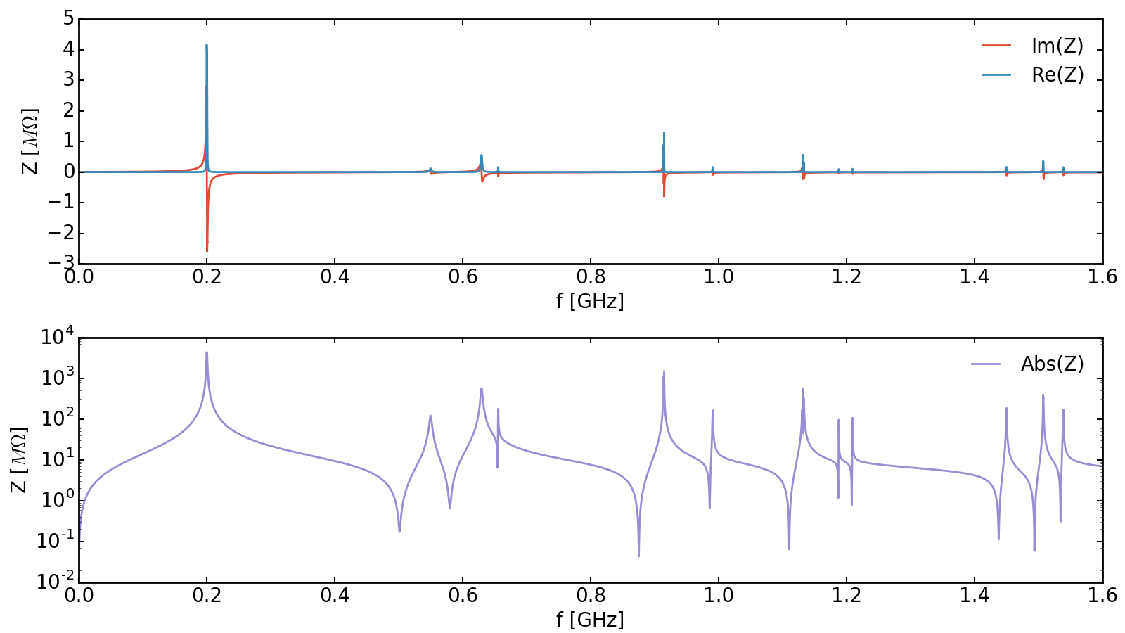
TWC 200 MHz impedance

Slide 10
TWC 200 MHz impedance
Two 4 tank 200 MHz Cavities
Two 5 tank 200 MHz Cavities
fr [GHz] | Rsh [kOhm] | Q | R/Q [Ohm]
0.1997 | 850 | 450 | 1888. 9
0.2003 | 2060 | 400 | 5150
0.201 | 850 | 425 | 2000
0.6289 | 80 | 700 | 114.3
0.6299 | 220 | 250 | 880
0.914 | 770 | 5000 | 154
0.9148 | 772 | 5000 | 154.4
1.1319 | 132 | 4000 | 33
1.1331 | 156 | 5000 | 31.2
1.1335 | 160 | 5000 | 32
1.5073 | 174 | 8000 | 21.75
1.5076 | 236 | 8000 | 29.5
fr [GHz] | Rsh [kOhm] | Q | R/Q [Ohm]
0.1999 | 600 | 600 | 1000
0.2 | 2400 | 370 | 6486.5
0.2006 | 2200 | 600 | 3666.7
0.6291 | 260 | 300 | 866.7
0.6299 | 140 | 500 | 280
0.9142 | 940 | 4500 | 208.9
0.9148 | 720 | 4500 | 160
1.1317 | 520 | 4000 | 130
1.1332 | 196 | 4500 | 43.6
1.5074 | 240 | 7000 | 34.3
1.5078 | 184 | 7000 | 26.3

Slide 11
TWC 200 MHz impedance
Two 4 tank 200 MHz Cavities
Two 5 tank 200 MHz Cavities
fr [GHz] | Rsh [kOhm] | Q | R/Q [Ohm]
0.1997 | 850 | 450 | 1888. 9
0.2003 | 2060 | 400 | 5150
0.201 | 850 | 425 | 2000
0.6289 | 80 | 700 | 114.3
0.6299 | 220 | 250 | 880
0.914 | 770 | 5000 | 154
0.9148 | 772 | 5000 | 154.4
1.1319 | 132 | 4000 | 33
1.1331 | 156 | 5000 | 31.2
1.1335 | 160 | 5000 | 32
1.5073 | 174 | 8000 | 21.75
1.5076 | 236 | 8000 | 29.5
fr [GHz] | Rsh [kOhm] | Q | R/Q [Ohm]
0.1999 | 600 | 600 | 1000
0.2 | 2400 | 370 | 6486.5
0.2006 | 2200 | 600 | 3666.7
0.6291 | 260 | 300 | 866.7
0.6299 | 140 | 500 | 280
0.9142 | 940 | 4500 | 208.9
0.9148 | 720 | 4500 | 160
1.1317 | 520 | 4000 | 130
1.1332 | 196 | 4500 | 43.6
1.5074 | 240 | 7000 | 34.3
1.5078 | 184 | 7000 | 26.3

Slide 12
TWC 200 MHz HOMs
630MHz
915MHz

Slide 13
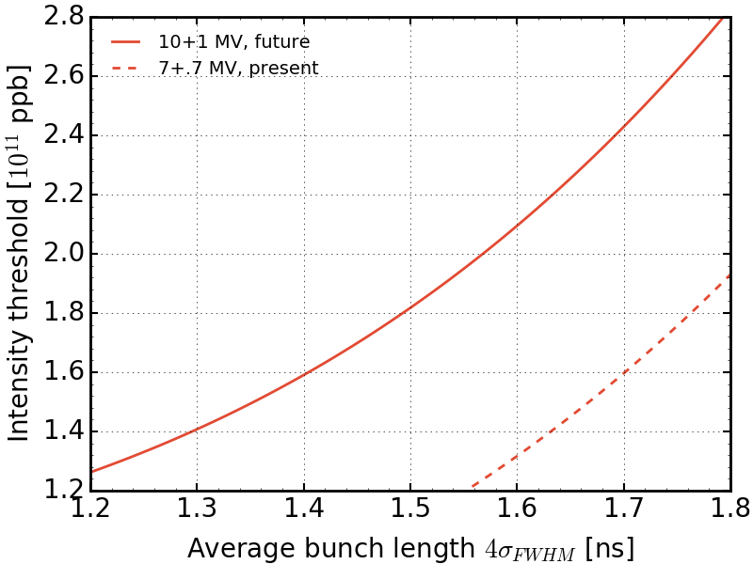
TWC 200 MHz HOMs

Slide 14
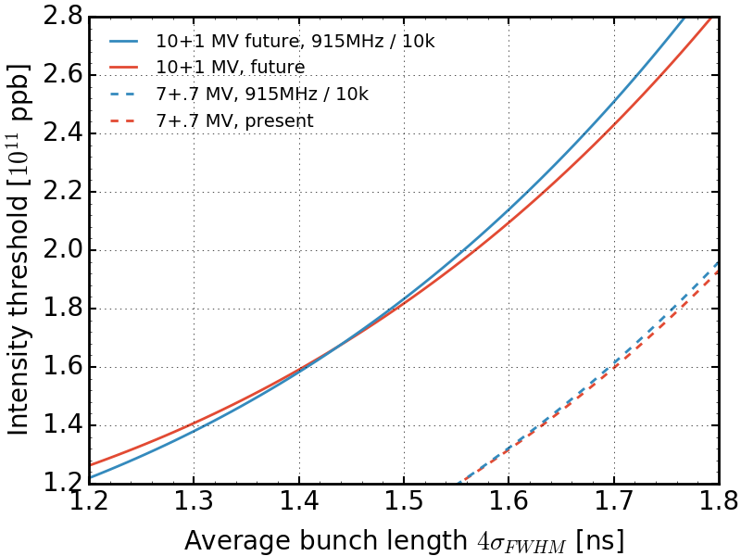
TWC 200 MHz HOMs
R/Q = cst

Slide 15
TWC 200 MHz HOMs
R/Q = cst
Effects of the 915MHz negligible

Slide 16
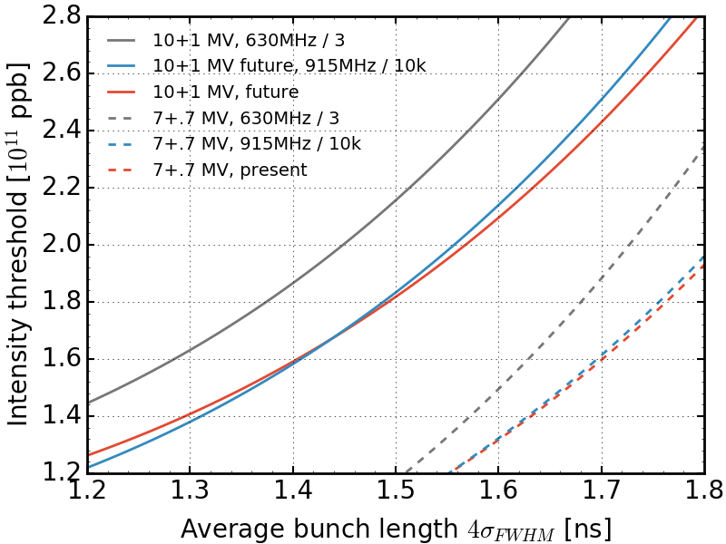
TWC 200 MHz HOMs

Slide 17
TWC 200 MHz HOMs

Slide 18
TWC 200 MHz HOMs
630 MHz HOM damping improves the situation already with small factor.
Present : 14% increase in threshold at 1.65 ns.
Future : 17% increase in threshold at 1.65 ns.
Worth to damp this harmonic.

Slide 19
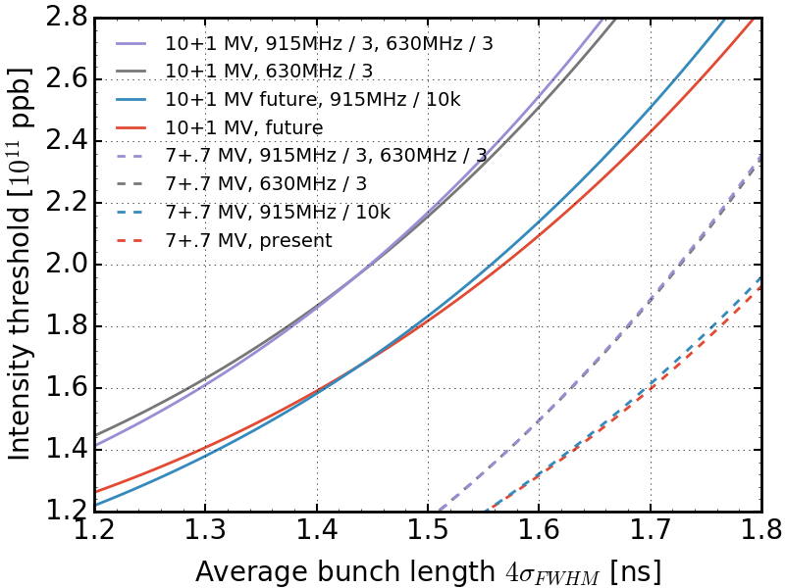
TWC 200 MHz HOMs

Slide 20
TWC200 impedance
Two 4 tank 200 MHz Cavities
Two 5 tank 200 MHz Cavities
fr [GHz] | Rsh [kOhm] | Q | R/Q [Ohm]
0.1997 | 850 | 450 | 1888. 9
0.2003 | 2060 | 400 | 5150
0.201 | 850 | 425 | 2000
0.6289 | 80 | 700 | 114.3
0.6299 | 220 | 250 | 880
0.914 | 770 | 5000 | 154
0.9148 | 772 | 5000 | 154.4
1.1319 | 132 | 4000 | 33
1.1331 | 156 | 5000 | 31.2
1.1335 | 160 | 5000 | 32
1.5073 | 174 | 8000 | 21.75
1.5076 | 236 | 8000 | 29.5
fr [GHz] | Rsh [kOhm] | Q | R/Q [Ohm]
0.1999 | 600 | 600 | 1000
0.2 | 2400 | 370 | 6486.5
0.2006 | 2200 | 600 | 3666.7
0.6291 | 260 | 300 | 866.7
0.6299 | 140 | 500 | 280
0.9142 | 940 | 4500 | 208.9
0.9148 | 720 | 4500 | 160
1.1317 | 520 | 4000 | 130
1.1332 | 196 | 4500 | 43.6
1.5074 | 240 | 7000 | 34.3
1.5078 | 184 | 7000 | 26.3

Slide 21
TWC 200 MHz HOMs
1130 MHz
1500 MHz

Slide 22
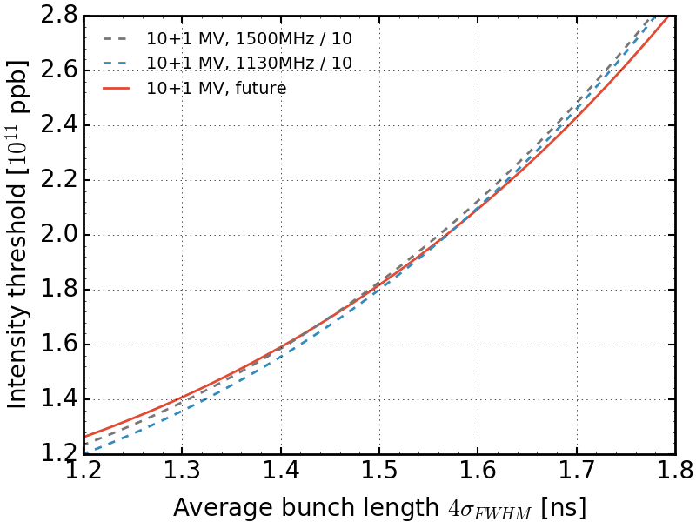
TWC 200 MHz HOMs

Slide 23
TWC 200 MHz HOMs
Effects of higher HOM negligible

Slide 24
TWC 200 MHz Main Harmonic
Two 4 tank 200 MHz Cavities
Two 5 tank 200 MHz Cavities
fr [GHz] | Rsh [kOhm] | Q | R/Q [Ohm]
0.1997 | 850 | 450 | 1888. 9
0.2003 | 2060 | 400 | 5150
0.201 | 850 | 425 | 2000
0.6289 | 80 | 700 | 114.3
0.6299 | 220 | 250 | 880
0.914 | 770 | 5000 | 154
0.9148 | 772 | 5000 | 154.4
1.1319 | 132 | 4000 | 33
1.1331 | 156 | 5000 | 31.2
1.1335 | 160 | 5000 | 32
1.5073 | 174 | 8000 | 21.75
1.5076 | 236 | 8000 | 29.5
fr [GHz] | Rsh [kOhm] | Q | R/Q [Ohm]
0.1999 | 600 | 600 | 1000
0.2 | 2400 | 370 | 6486.5
0.2006 | 2200 | 600 | 3666.7
0.6291 | 260 | 300 | 866.7
0.6299 | 140 | 500 | 280
0.9142 | 940 | 4500 | 208.9
0.9148 | 720 | 4500 | 160
1.1317 | 520 | 4000 | 130
1.1332 | 196 | 4500 | 43.6
1.5074 | 240 | 7000 | 34.3
1.5078 | 184 | 7000 | 26.3

Slide 25
TWC 200 MHz Main Harmonic
200 MHz

Slide 26
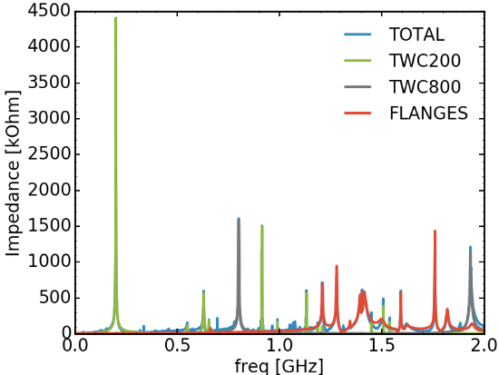
TWC 200 MHz Main Harmonic
Main contribution to all the impedance.

Slide 27
TWC 200 MHz Main Harmonic
Main contribution to all the impedance.
Beam loading effect

Slide 28
TWC 200 MHz Main Harmonic
Main contribution to all the impedance.
Beam loading effect
Voltage seen by the beam smaller.
Synchronous phase shifted.
Thank to T. Argyropoulos for the figure.

Slide 29
TWC 200 MHz Main Harmonic
Main contribution to all the impedance.
Beam loading effect
Voltage seen by the beam smaller.
Synchronous phase shifted.
FF and FB try to correct phase
and voltage -> First approx.
20 dB reduction.
-20dB
Thank to T. Argyropoulos for the figure.

Slide 30
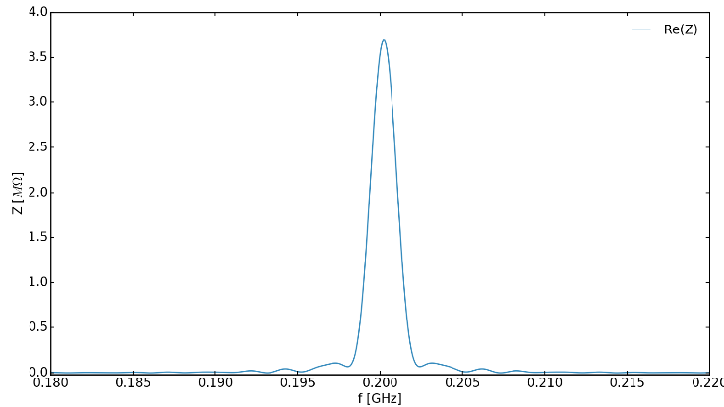
Beam loading and FF/FB
FF and FB act on a window in frequency (+- 6MHz both sides).

Slide 31
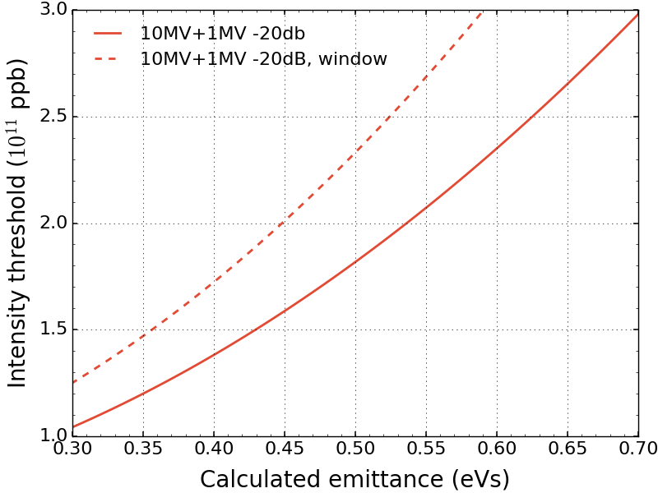
Beam loading and FF/FB
FF and FB act on a window in frequency (+- 6MHz both sides).
Model not sufficient to simulate the effects of FF/FB.
Synchronous phase shift.

Slide 32
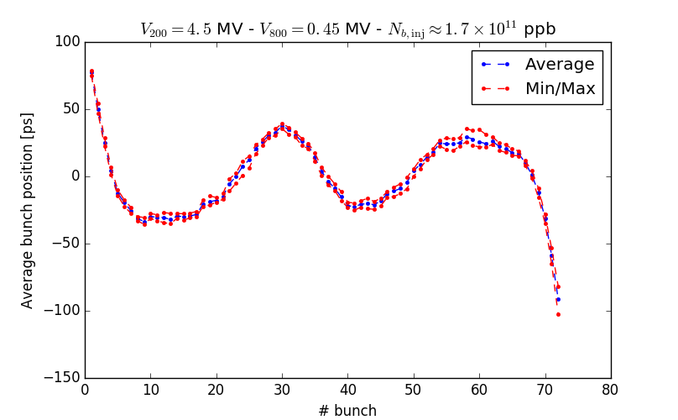
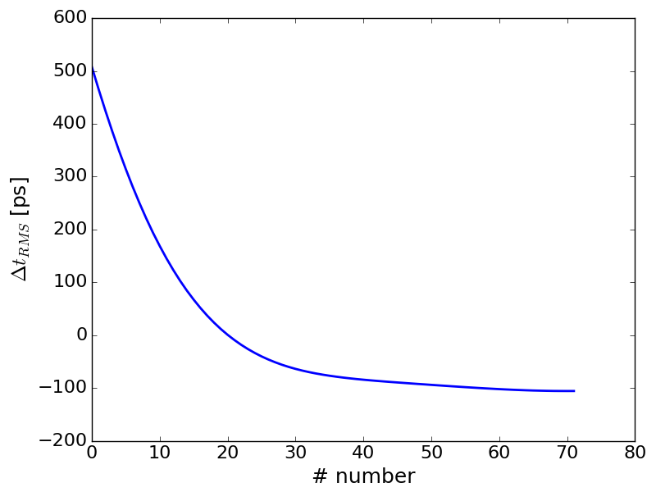
Synchronous phase shift
Synchronous phase shift, measurements 21.09.2016.
Synchronous phase shift, simulations without FB,FF.

Slide 33
Beam loading and FF/FB
$$Z_{bc}=\frac{Z_{b}−H_{FF}Z_{rf}}{1+H_{FB}Z_{rf}}$$
(see T. Argyropoulos thesis)
Thank to T. Argyropoulos for the figure.

Slide 34
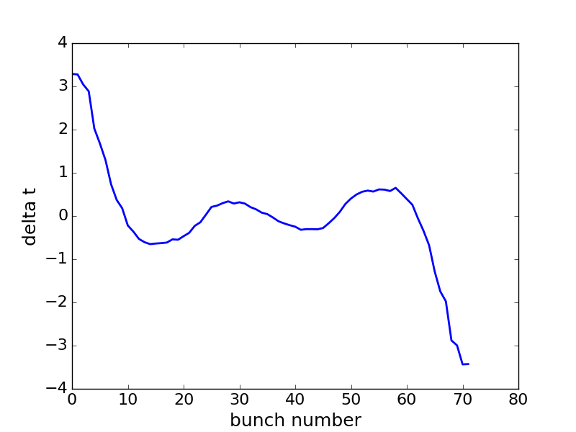
Synchronous phase shift
Synchronous phase shift, measurements 21.09.2016.
Synchronous phase shift, simulations using more accurate model of FB,FF.
Need qualibration of Hff and Hfb, simulations running.

Slide 35
Conclusion
The most important HOM is the 630 MHz one.
Compensation of the beam loading needs a more accurate model.
Future work
Qualibrate the FF/FB impedance reduction and check old predictions.
Take into account the maximum power available (maximum voltage)

Slide 36
Thank you for your attention !
Acknowledgement
Many thanks to the BLonD team for countless fruitful discussions.
Thank to T. Argyropoulos for priceless discussions about the FB/FF and the figures.
Thank to G. Hagmann for the help with the feedback.

