Slide 1
Simulations of FB & FF on SPS flat top/bottom
T. Argyropoulos
LIU-SPS BD WG meeting 03/11/2016

Slide 2
Introduction
Study of the Longitudinal Controlled Emittance Blow-up → no uniform blow-up for the bunches along the batch.
Calculation of the phase variation of the bunches in the batch due to beam loading with FB\FF (simplified model for the reduced impedance)
Explains the phase variation that was measured
Introduced later the model for multi-particle simulation but not used for long simulations (beam instabilities, beam losses…)

Slide 3
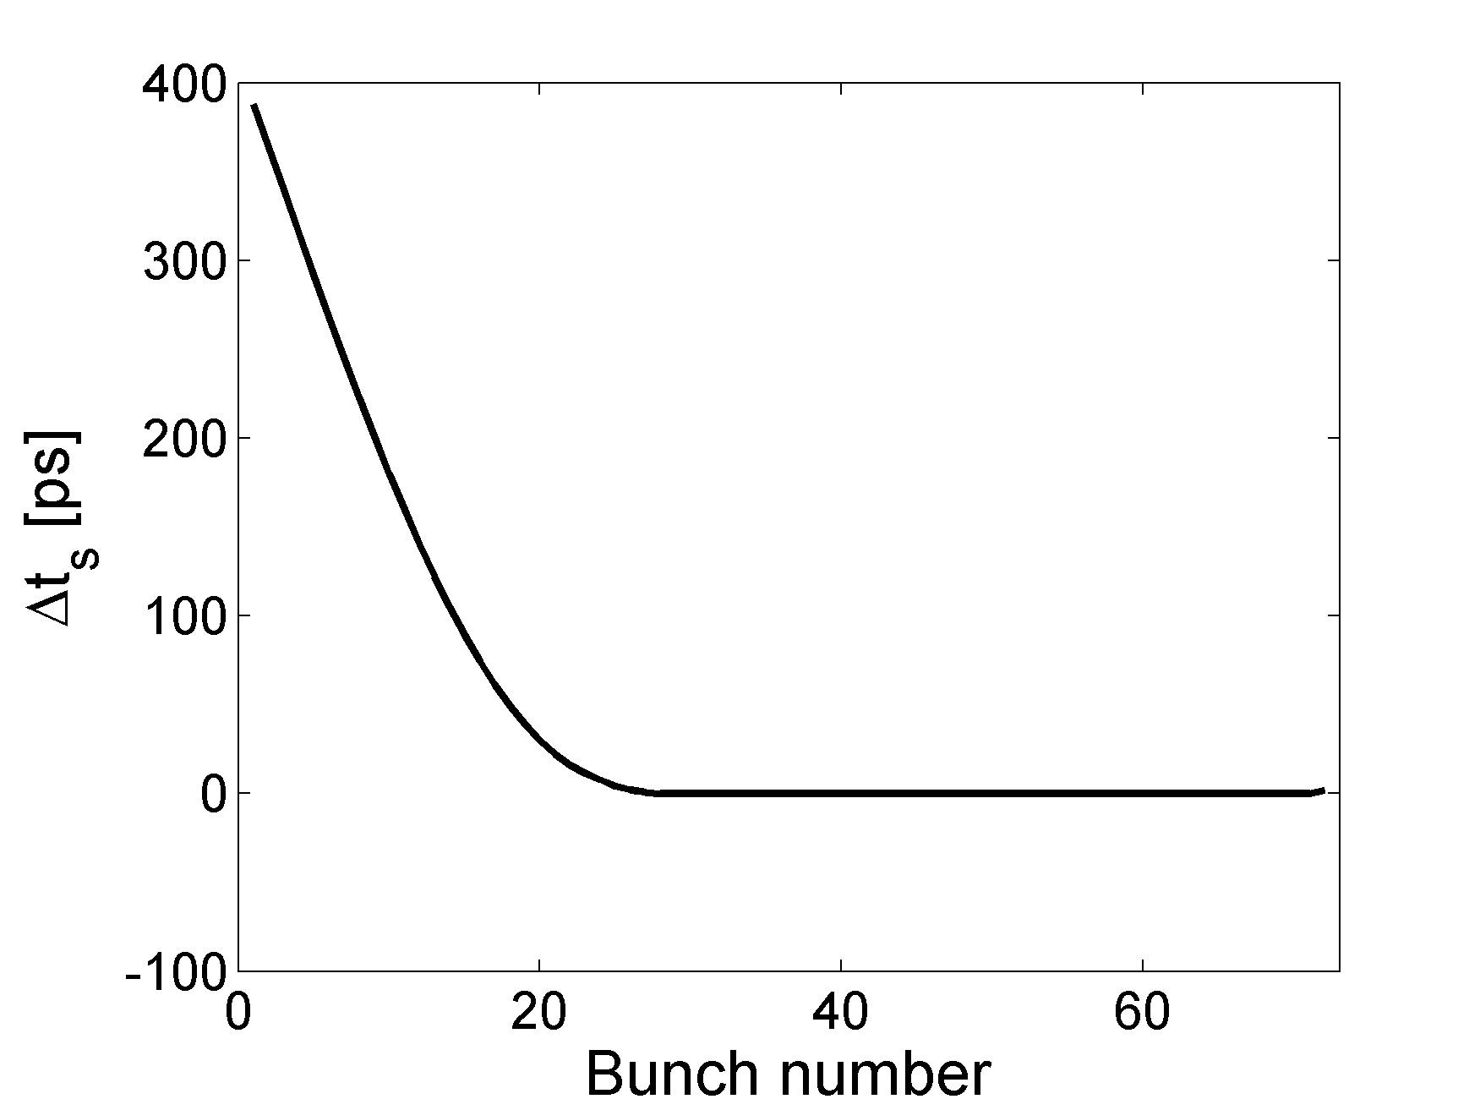
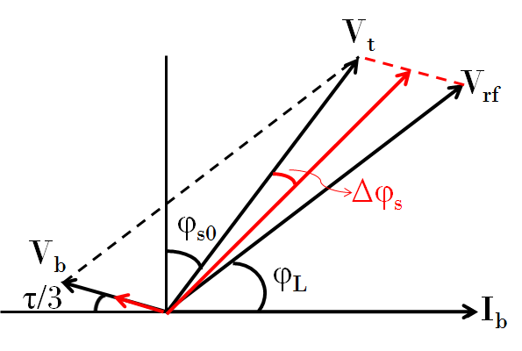
Beam loading in the SPS 200 MHz TWC
Beam loading impedance of a TWC
$Z_{b}=\frac{V_{b}}{I_{b}}=−\frac{L^{2}R_{2}}{8}\left[{\left(\frac{\sin{τ_{b}/2}}{τ_{b}/2}\right)}^{2}−i2\frac{τ_{b}−\sin{τ_{b}}}{τ_{b}^{2}}\right]$
For the beam parameters as in measurements and Gaussian line density and bunch length 1.7 ns
Small displacement of the bunches at the head of the batch are increasing as more bunches entering the cavity until they reach the a steady value.
$I_{b}$: fundamental component of beam current
$V_{b}$: fundamental component of beam induced voltage
$L$: length of the structure
$R_{2}$: series impedance of the TWC
$τ_{b}=L(ω−ω_{r})/v_{g}$: phase slip between TW and particles
Steady state
Transient state
$$\tan\left(φ_{s0}+Δφ_{s}\right)=\frac{V_{rf}\cos{φ_{L}−V_{b}\cos{τ_{b}/3}}}{V_{rf}\sin{φ_{L}}{+V_{b}\sin{τ_{b}/3}}}$$

Slide 4
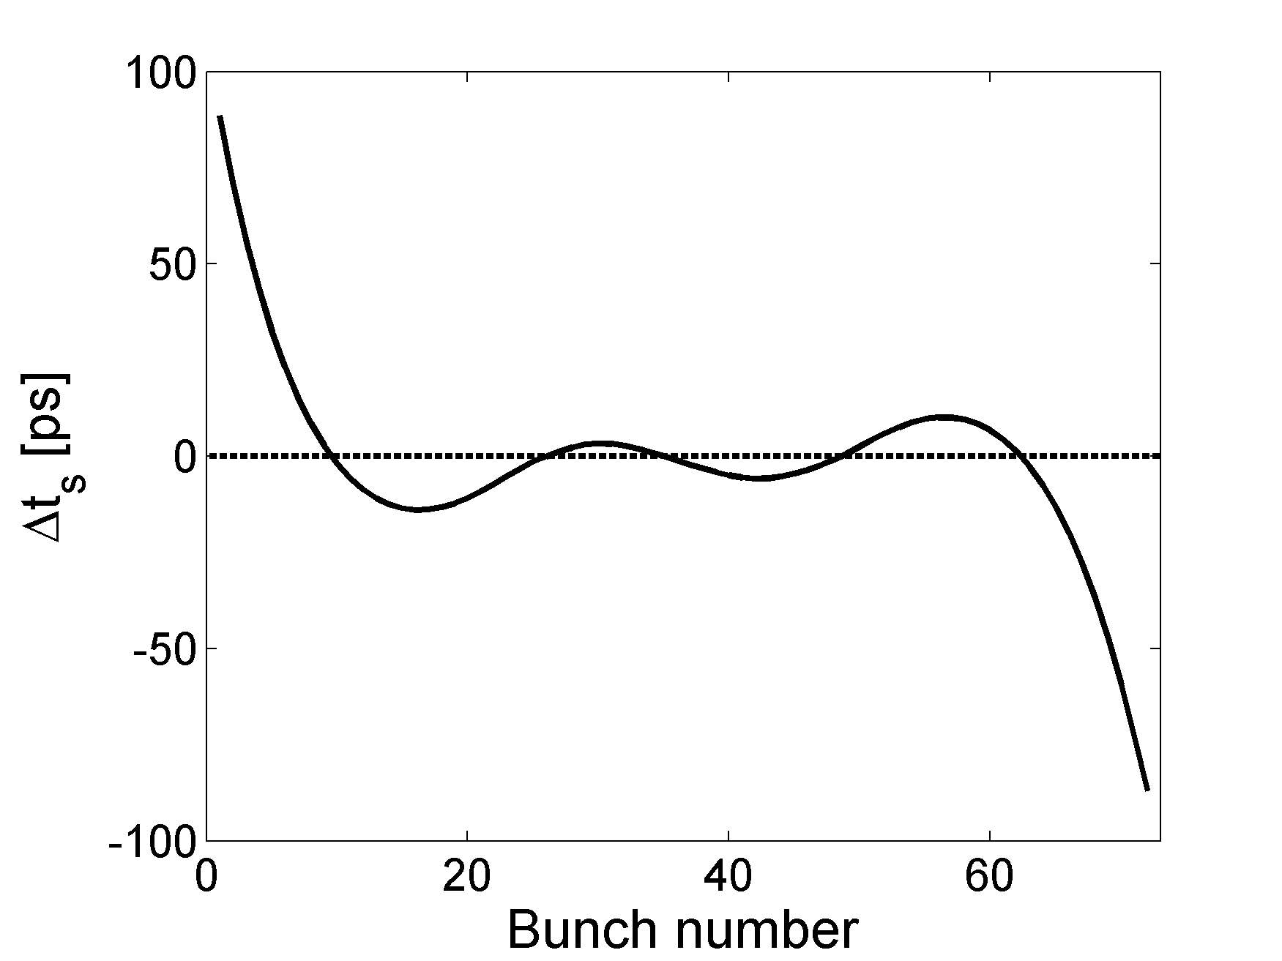
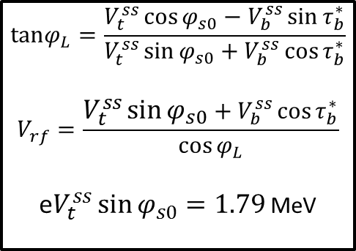
Beam loading in the SPS 200 MHz TWC
After beam loading compensation with feed-back (FB) & feed-forward (FF) systems
$Z_{bc}=\frac{Z_{b}−H_{FF}Z_{rf}}{1−H_{FB}Z_{rf}}$
Δt_{s} again from the same vector diagram but
$φ_{L}$ and $V_{rf}$ should by calculated first, assuming the steady state for the bunches in the middle of the batch
$Z_{rf}=\frac{V_{rf}}{I_{g}}=L\sqrt{\frac{Z_{0}R_{2}}{2}}\left(\frac{\sin{τ_{b}/2}}{τ_{b}/2}\right)$ the forward impedance
$I_{g}$: generator current
$H_{FF}$: FF gain
$H_{FB}$: FB gain
$$tanφ_{L}{=\frac{V_{t}^{ss}\cos{φ_{s0}−V_{b}^{ss}\sin{τ_{b}^{∗}}}}{V_{t}^{ss}\sin{φ_{s0}}+V_{b}^{ss}\cos{τ_{b}^{∗}}}}$$
$$V_{rf}=\frac{V_{t}^{ss}\sin{φ_{s0}}+V_{b}^{ss}\cos{τ_{b}^{∗}}}{\cos{φ_{L}}}$$
e$V_{t}^{ss}\sin{φ_{s0}}=1.79$ MeV

Slide 5
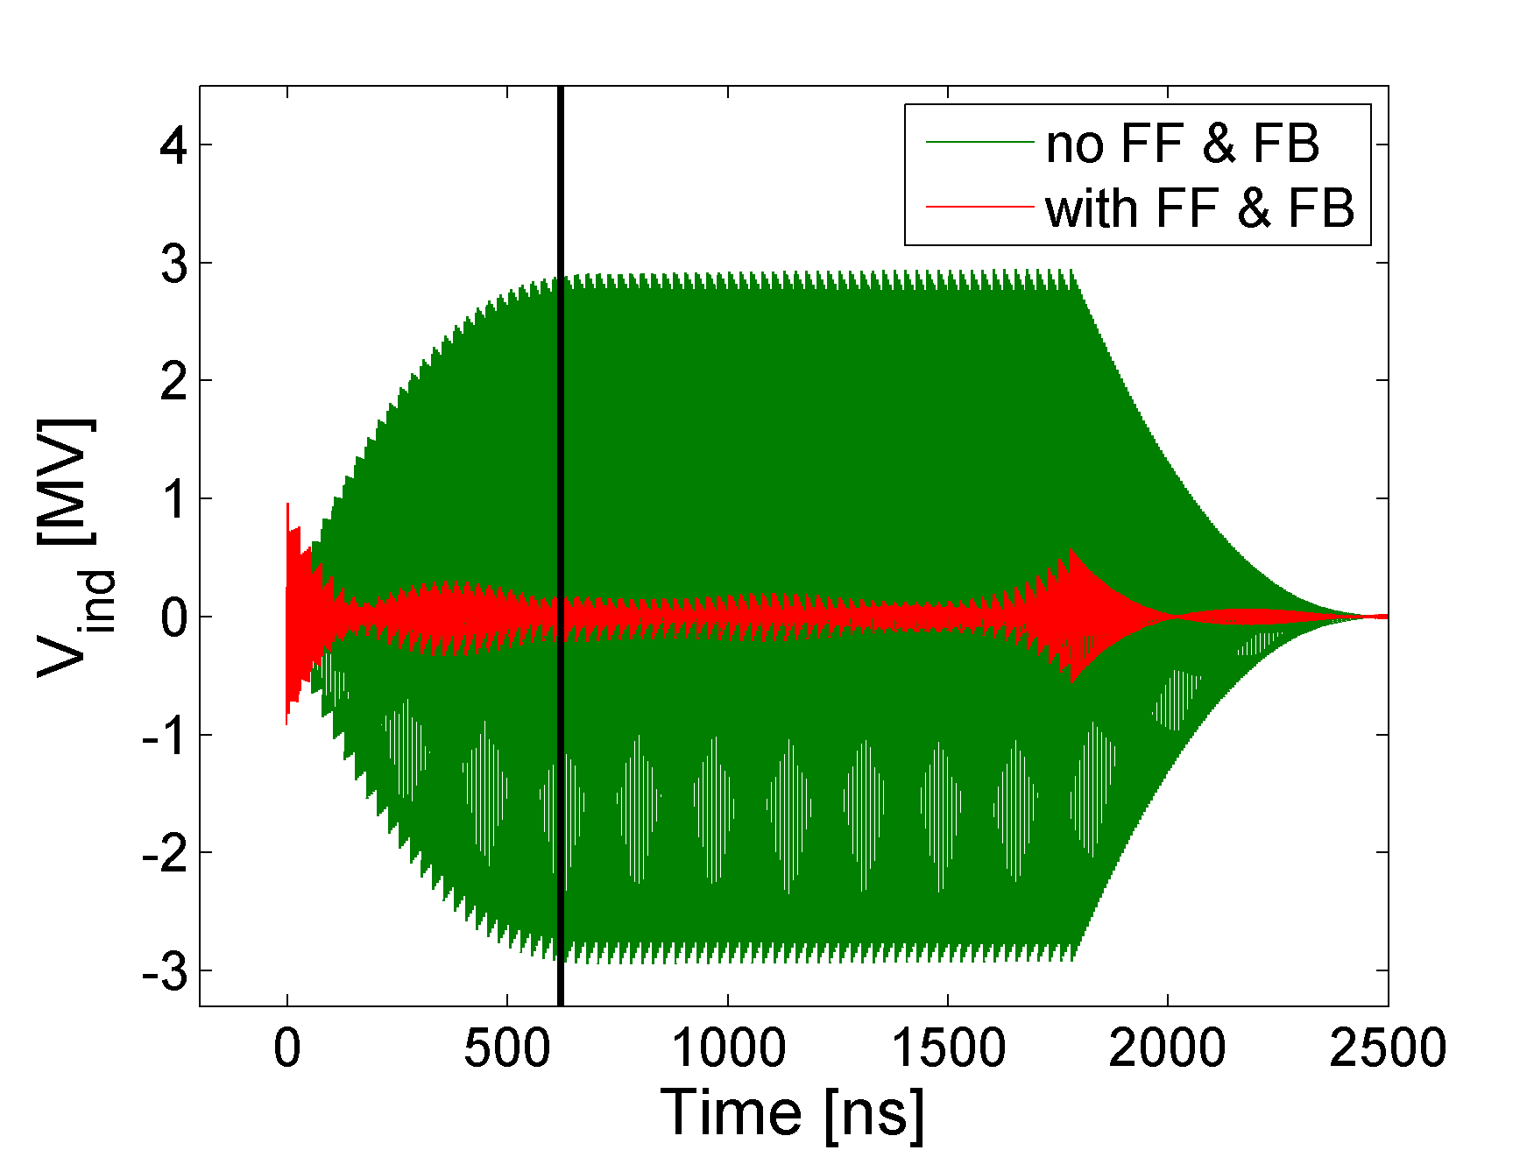
Effect of FF and FB on induced voltage
Induced voltage in the SPS 200 MHz RF system. 1 batch with same beam parameters as described before.

Slide 6
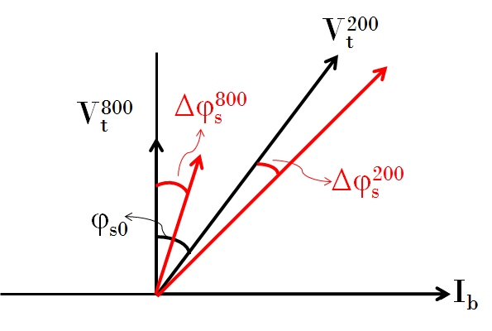
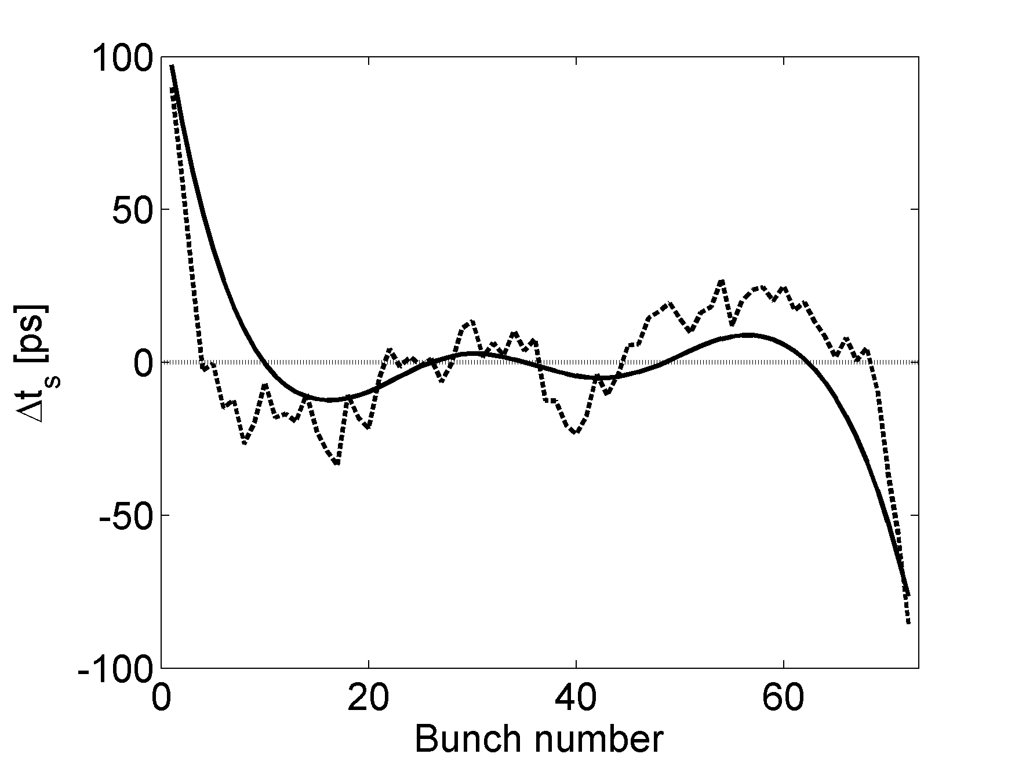
Beam loading in both SPS RF systems
Combining with effect of beam loading in the 800 MHz RF system (no FB & FF) considering that $V_{t}^{800}$ is aligned with $V_{t}^{200}$
$$tanΦ_{s}{=\frac{V_{t}^{200}\sin{Φ^{200}}+V_{t}^{800}\sin{{Δφ}^{800}}}{V_{t}^{200}\cos{Φ^{200}}+V_{t}^{800}{Δφ}^{800}}}$$
$Φ_{s}=φ_{s}+Δφ_{s}$, $φ_{s}$ is the total synchronous phase
$$Φ^{200}=φ_{s0}+Δφ_{s}^{200}$$
calculation
measurements
Very good agreement with measurements
Bunch position variation along the batch due to the effect of beam loading
Differences due to other impedances e.g. kicker

Slide 7
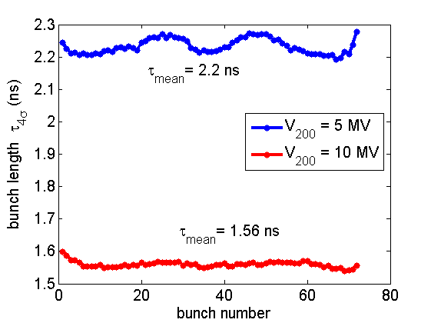
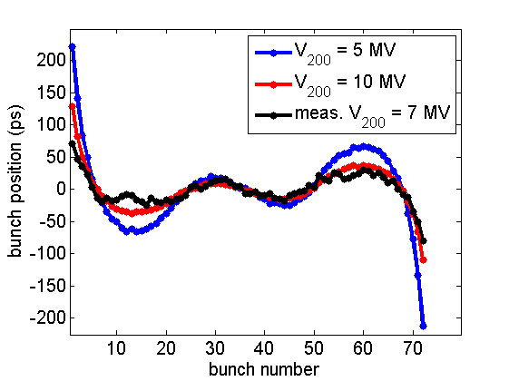
Application: Bunch rotation at flat top
(Chamonix 2014)
Starting rotation from V₂₀₀ = 5 MV and assuming V₂₀₀ = 10 MV available at flat top (2.3x10¹¹ p/b and Q20 optics)
Simulations with the SPS impedance + FF and FB in the 200 MHz RF → bunch position variation along the batch agrees very well with measurements
Bunch position variation along the batch
Measurements with half intensity
N = 1.3x10¹¹ p/b
Bunch rotation for LHC beam can be tested in the SPS with limited 200 MHz RF voltage

Slide 8
Conclusion
Simplified FB\FF model of the 200 MHz RF system shows a good agreement with the measurements.
It can be used in simulations to estimate the effect on the instability thresholds at Flat Bottom and Flat Top.
Compare with data and try to calibrate the FB and FF gains.
Improve to a more realistic model will be possibly needed for simulations through the ramp.

