Slide 1
Synchrotron frequency shift measurements and simulations in Q26 s LIU-SPS Beam Dynamics Working Group 28/10/2015
A. Lasheen, T. Bohl, S. Hancock, E. Shaposhnikova, MD coordination team and OP team

Slide 2
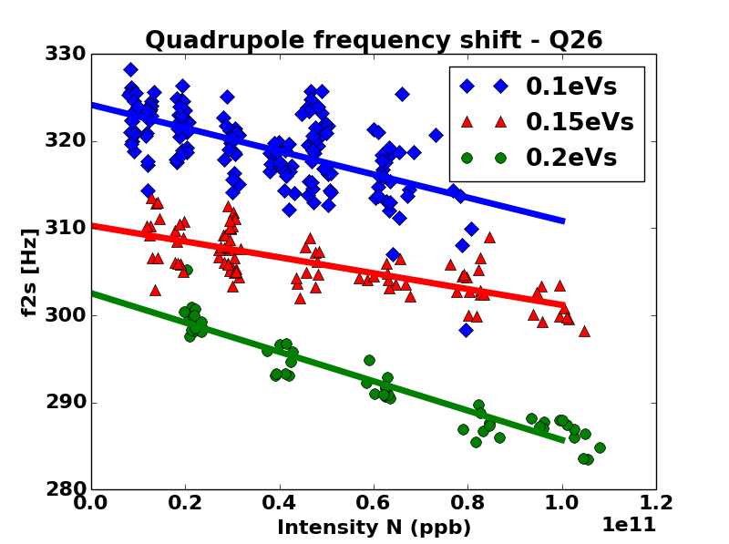
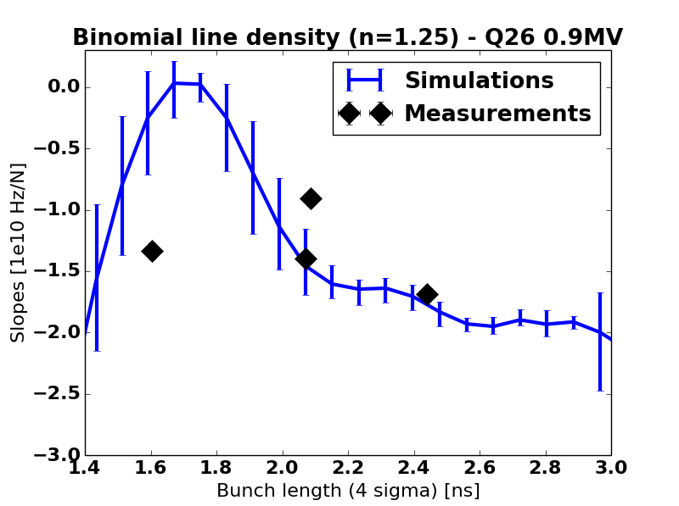
Introduction and motivation
The synchrotron frequency shift was studied in 2014 as as probe of the reactive impedance and to test the impedance model (LIU-SPS Beam Dynamics WG 06/11/2014 and HB2014)
An unexpected dependence with bunch length was observed in simulations and more measurements were planned to fill the gaps.

Slide 3
Outlook
Measurement setup
Measurement results
Impedance and space charge
Simulations
Conclusions and future work

Slide 4
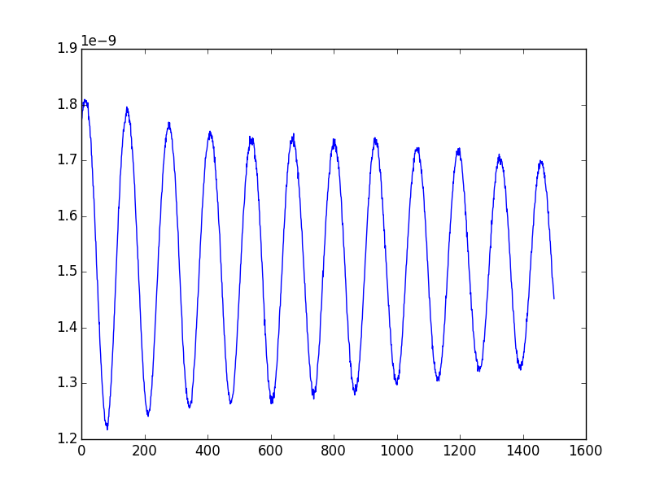
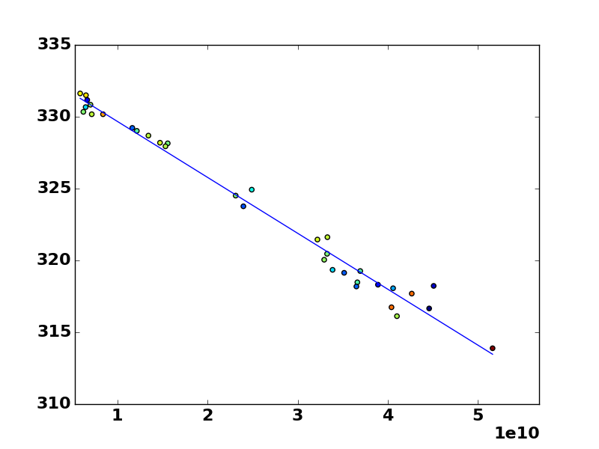
Measurement method
A mismatch bunch is injected in the SPS and its quadrupole oscillations are measured and analyzed
Bunch length is defined as $τ=4σ_{RMS}$ (from fitted profile)
Scanning intensities ($1⋅{10}^{10} to 8⋅{10}^{10}$) and emittances (0.1eVs to 0.2 eVs)
Bunch length [s]
Frequency [Hz]
Turns
Intensity

Slide 5
Incoherent frequency shift
This shift is due to the stationary spectrum of the bunch
$$f_{s}\left(N\right)≈f_{s}^{\left(0\right)}\left(1+\frac{αNZ_{1}}{2}\right) \\ Z_{1}= \int_{−∞}^{+∞}{\frac{df}{f_{0}} σ_{0}\left(f\right) ℑ\left(Z\left(f\right)\right) \frac{J_{1}\left(f\hat{τ}\right)}{f_{0}{\hat{τ}}/2}}$$
Above transition, $α<0$, so inductive impedance give $Z_{1}>0$ so the slope is steeper (vice-versa for capacitive impedance)
$f_{s}^{\left(0\right)}$ : synchrotron frequency
$Z_{1}$ : effective impedance
$σ_{0}$ : stationary bunch spectrum
$\hat{τ}$ : single particle oscillations amplitude

Slide 6
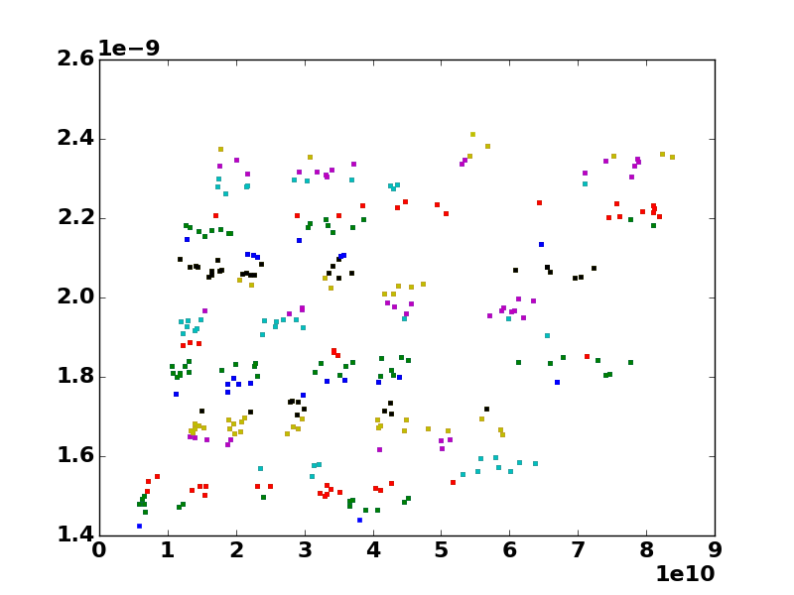
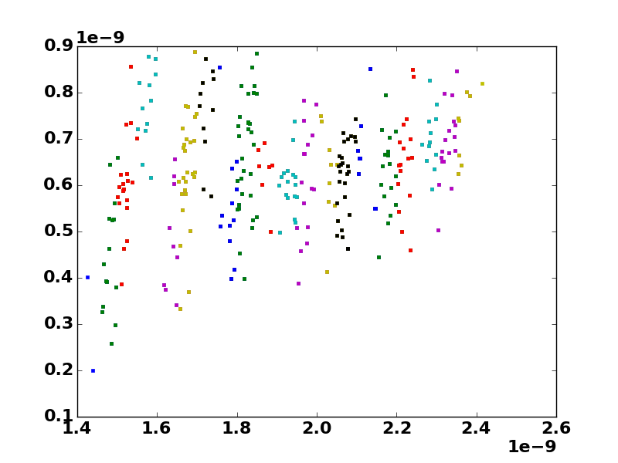
Scanning emittances and intensities in measurements
Average bunch length [s]
Peak to peak amplitude [s]
Intensity
Average bunch length [s]
Scanning emittances and intensities in the PSB
Some intensities not reachable due to unstable beam in the PS (some combinations of emittance and intensities are in the “grey zones” of the FB loops)

Slide 7
Scanning emittances and intensities in measurements
Average bunch length [s]
Peak to peak amplitude [s]
Intensity
Average bunch length [s]
In the SPS : Q26 optics, single RF V=0.7 MV, all LLRF feedback off except synchronization loop and phase loop (to damp dipole oscillations)

Slide 8
Scanning emittances and intensities in measurements
Average bunch length [s]
Peak to peak amplitude [s]
Intensity
Average bunch length [s]
In data analysis:
The frequency of the quadrupole oscillations are computed from the FFT
“Strips” of 100ps in average bunch length are selected to compute the slopes

Slide 9
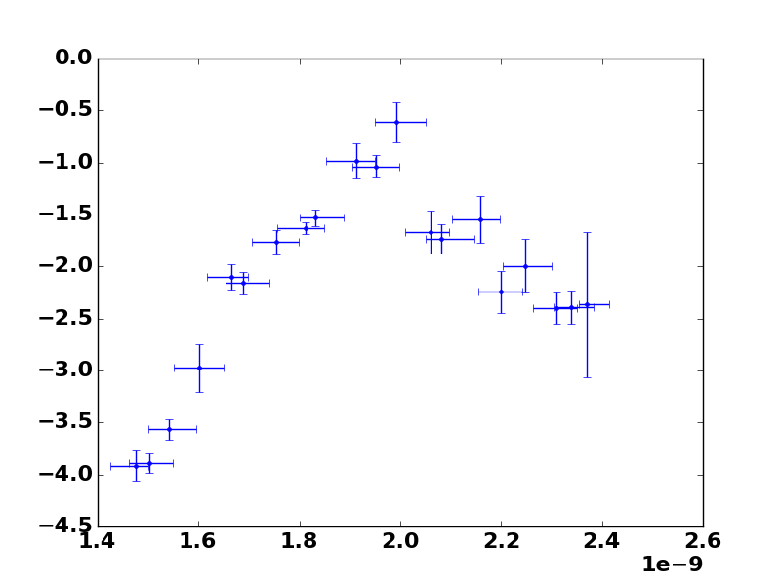
Slopes as a function of bunch length in measurements
$$τ_{average}=1.5 ns$$
Frequency [Hz]
Sloeps [1e-10 Hz]
Intensity
Average bunch length [s]
The synchrotron frequency shift as a function of bunch length is now covered in measurements for the full range in bunch length
The effective voltage appears to be around 900kV instead of 700kV ($2 f_{s,0}=344$ Hz for 900kV w.r.t. 304 Hz for 700kV)

Slide 10
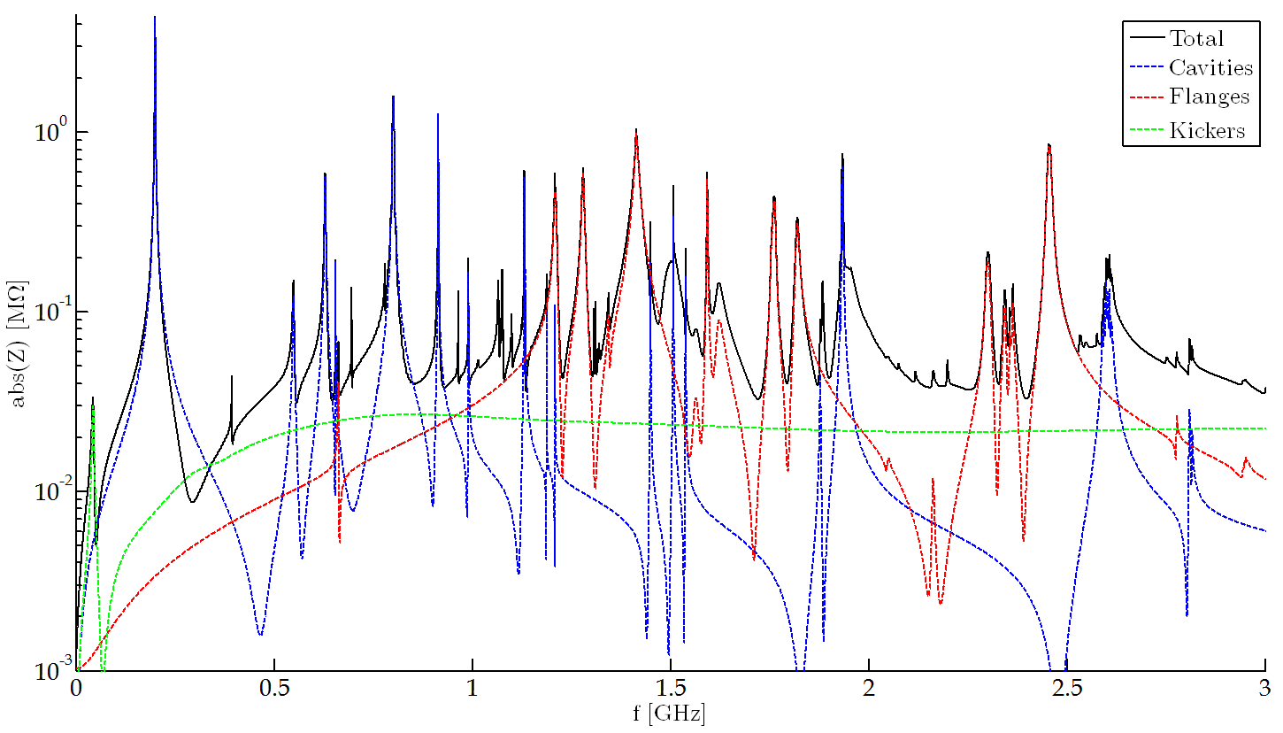
SPS Impedance model
Latest impedance model (J. Varela, B. Salvant, C. Zannini, D. Bazyl, P. Kramer):
Travelling wave cavities and HOMs
Kickers
Vacuum flanges
Unshielded pumping ports
BPMs
Y chambers
Beam scrapers
Resistive wall
Space charge (flat bottom)
(ZS/MSE)

Slide 11
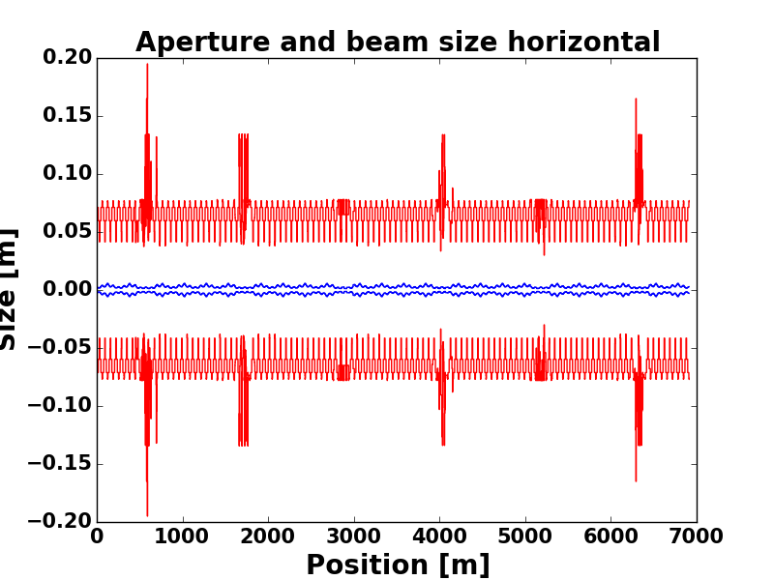
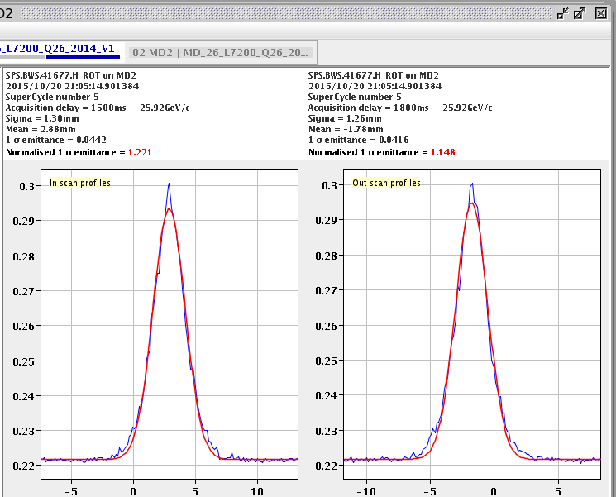
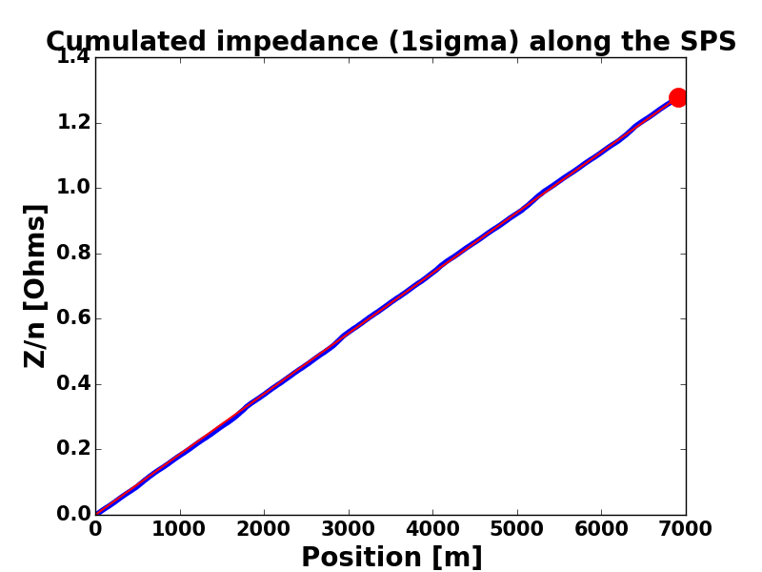
Longitudinal space charge
Measured transverse emittance:
$ε_{x} \sim 1.25 μm ε_{y}\sim 1.18 μm$
Momentum spread:
$dp/p\sim 6.6×{10}^{−4}$
Longitudinal space charge impedance (LSC code from SLAC):
$Z/n\sim −1.28 Ω$

Slide 12
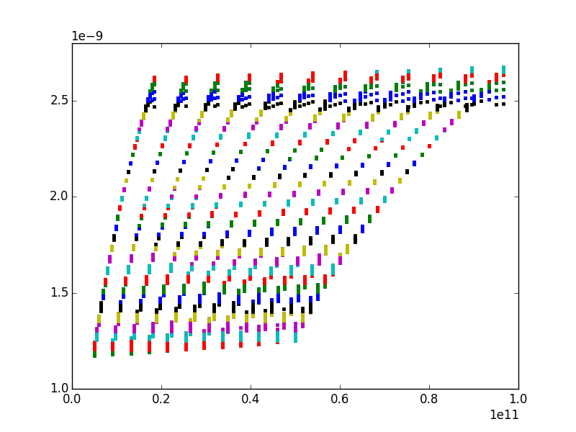
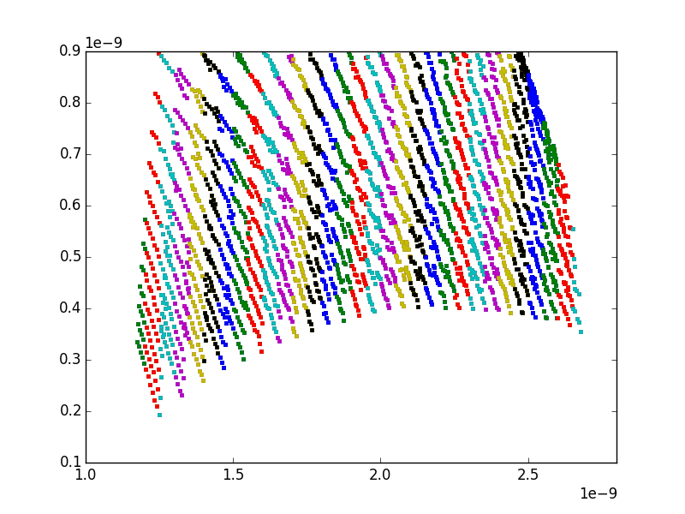
Parameters scanned in simulations
Average bunch length [s]
Peak to peak amplitude [s]
Intensity
Average bunch length [s]
The parameters are scanned in simulations to cover the same range as in measurements
The bunch is generated with the binomial function $F\left(H\right)=F_{0}{\left(1−\frac{H}{H_{0}}\right)}^{μ}$ (scanning $H_{0}$ and for different $μ$)
The bunch is generated in a different voltage to initiate the mismatch

Slide 13
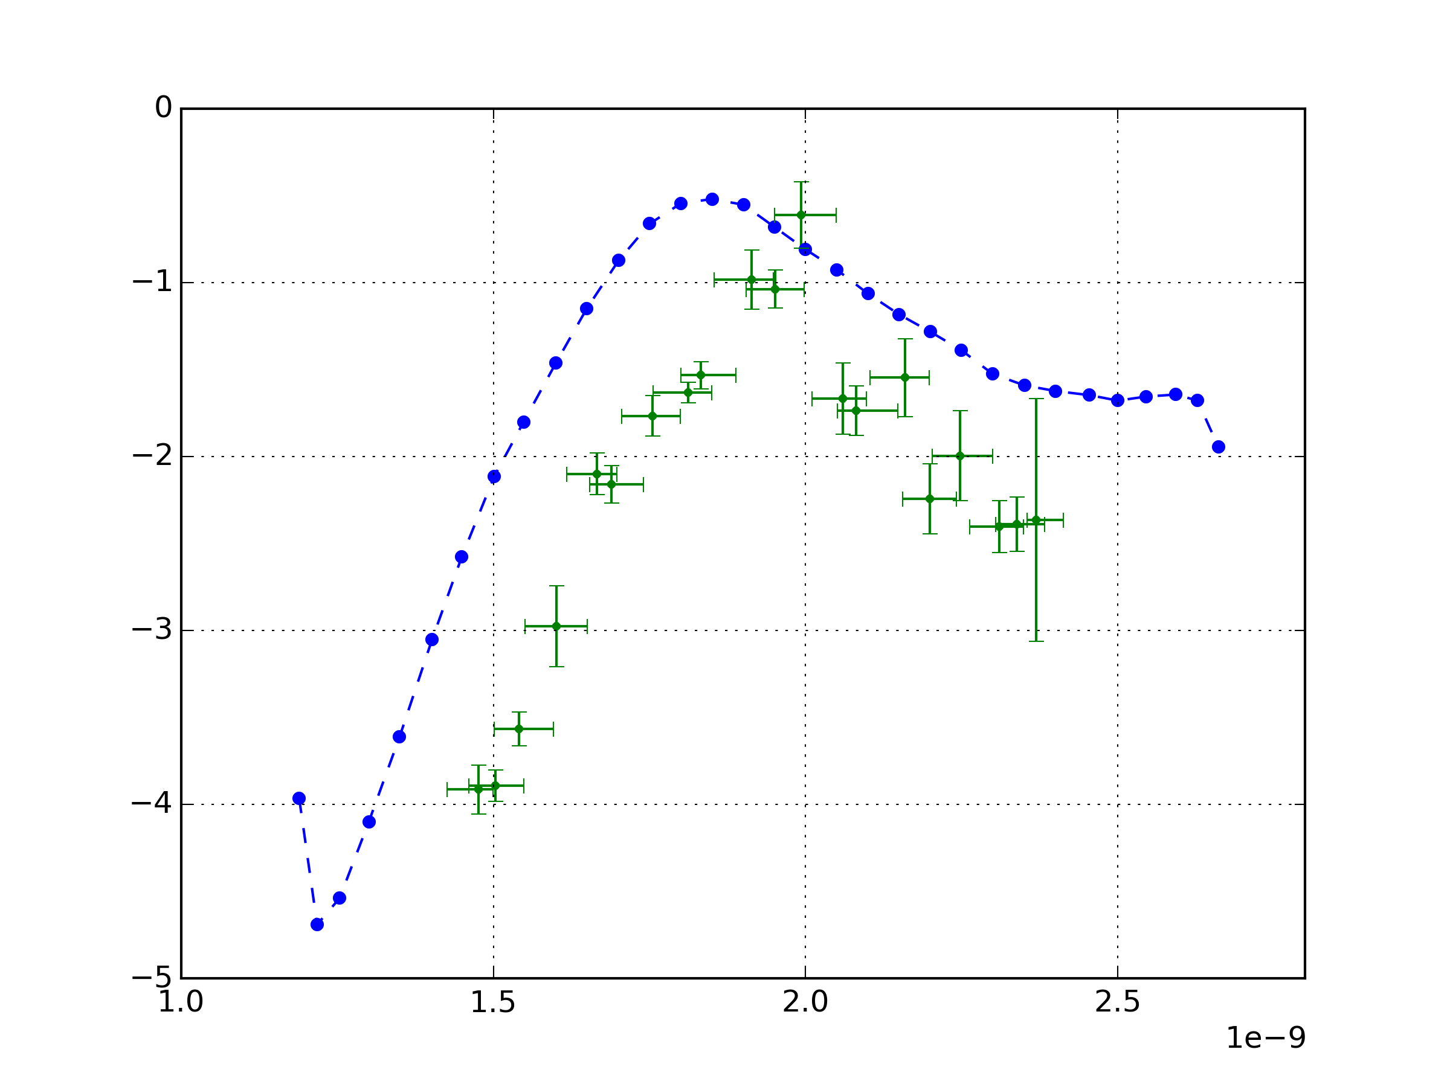
Comparing measurements and simulations
Missing impedance ?
Sloeps [1e-10 Hz]
~100ps discrepancy in average bunch length ?
Average bunch length [s]

Slide 14
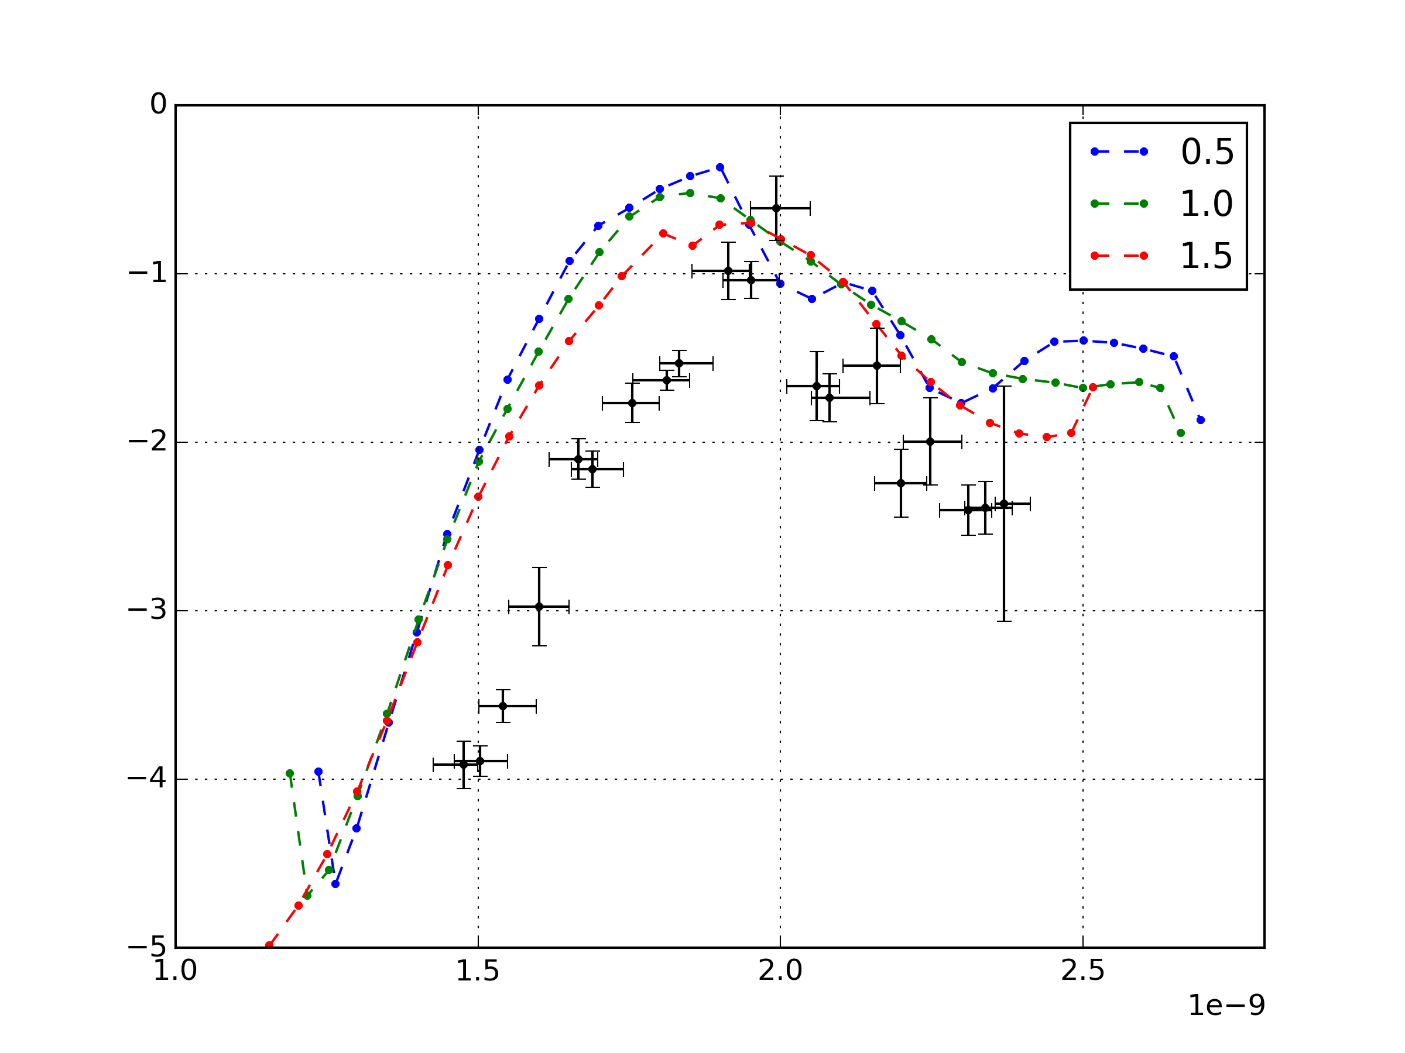
Effect of the distribution
Changing
$μ$ in the binomial distribution function
Sloeps [1e-10 Hz]
For bigger bunch length:
filamentation
Average bunch length [s]

Slide 15
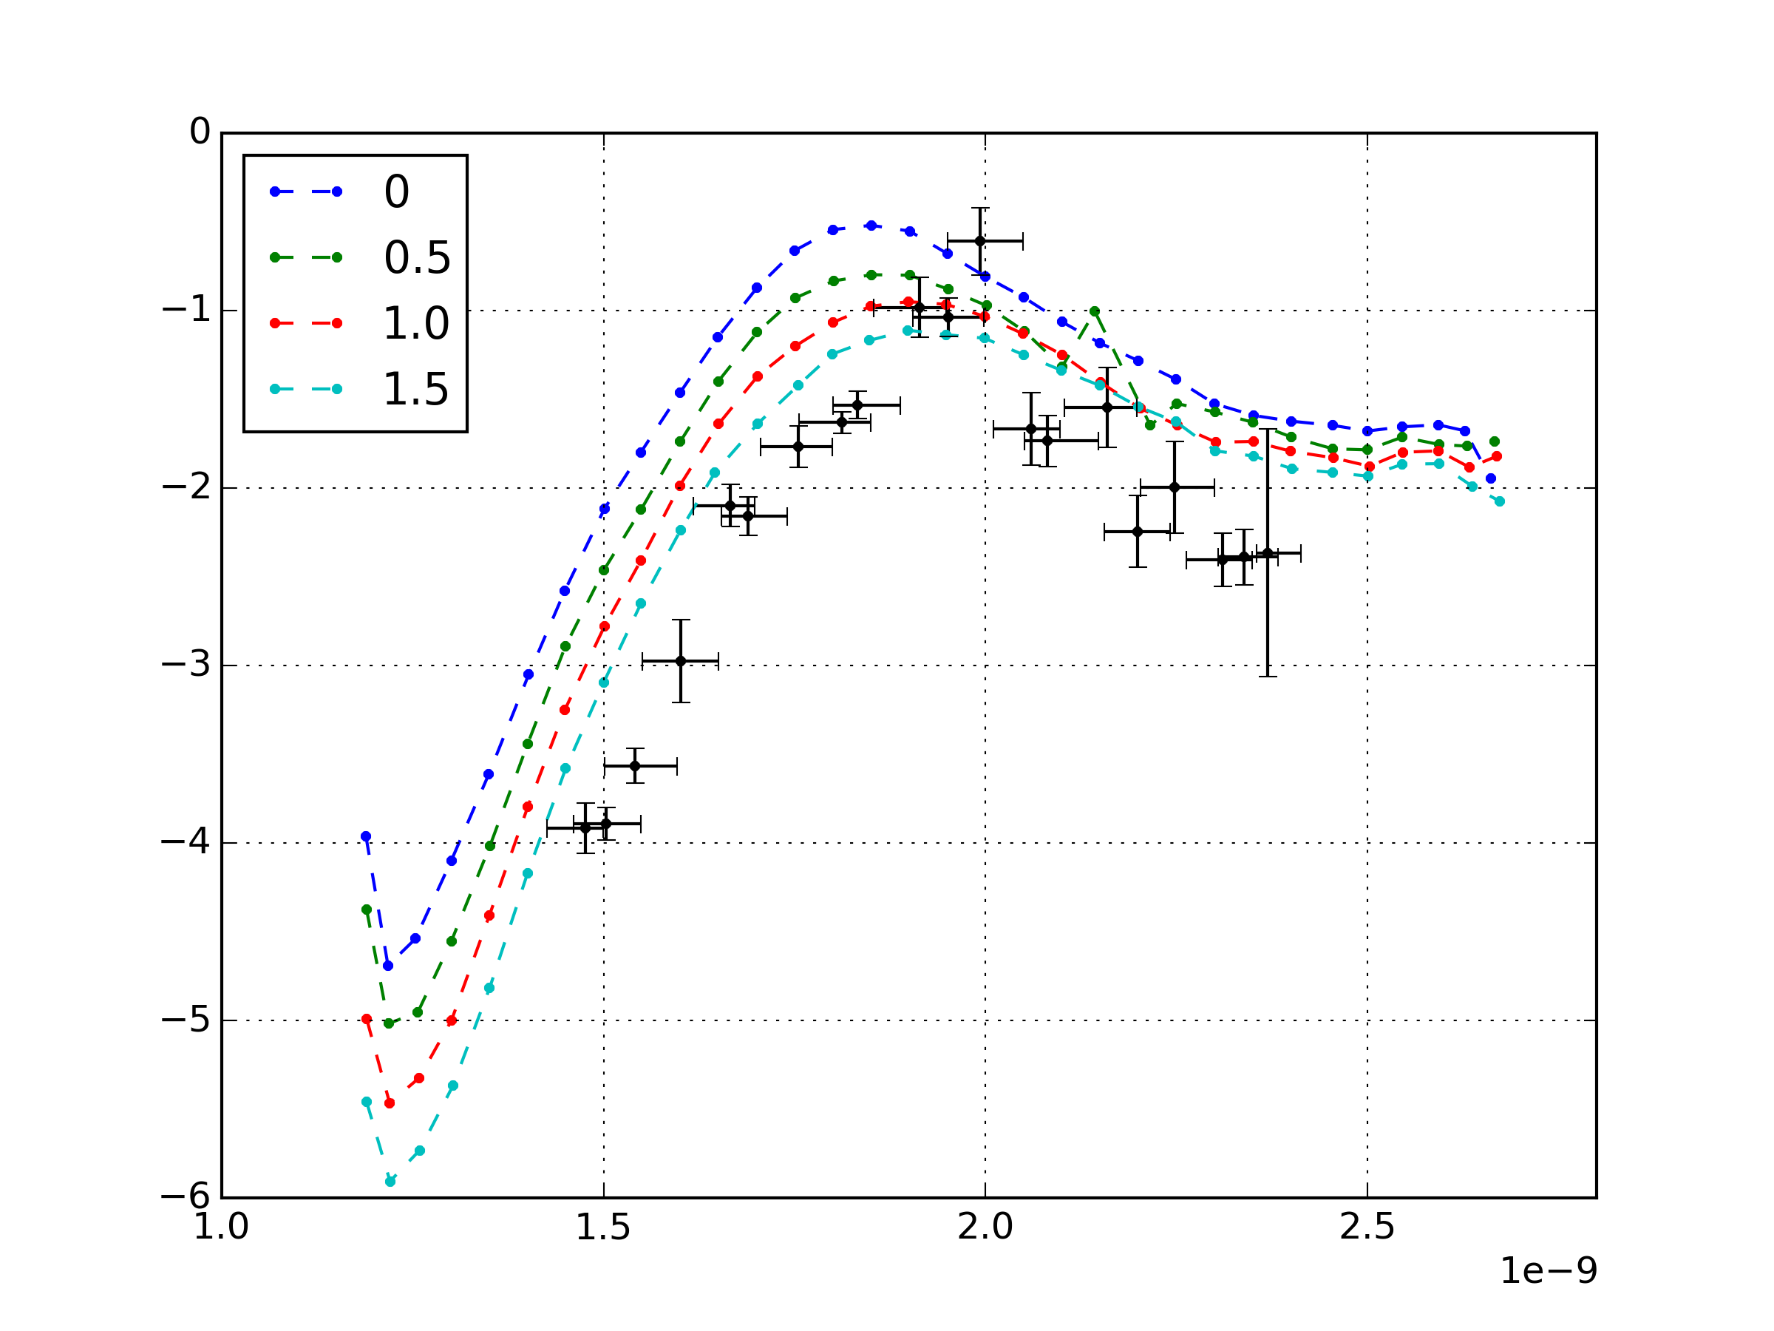
Adding extra impedance
Adding extra constant Z/n
Sloeps [1e-10 Hz]
Average bunch length [s]

Slide 16
Conclusions and future work
The dependence of the synchrotron frequency shift as a function of bunch length was measured for the whole range in bunch length.
Some discrepancy appear between measurements and simulations, implying that the measured bunch length is too long w.r.t. reality (~ +100ps), or that some impedance is missing (> 1.5 Ohm)
The source of this discrepancy will be investigated.
The bunch distribution has an important effect. More realistic distributions coming from the PS will be simulated.
Phase loop is not included in the simulations, its effect will be estimated.
A comparison with the 2012 measurements with the same data analysis method will be done

