Slide 1
Effect of the HOMs damping s LIU-SPS Beam Dynamics Working Group 28/10/2015
A. Lasheen, E. Shaposhnikova, J. Varela

Slide 2
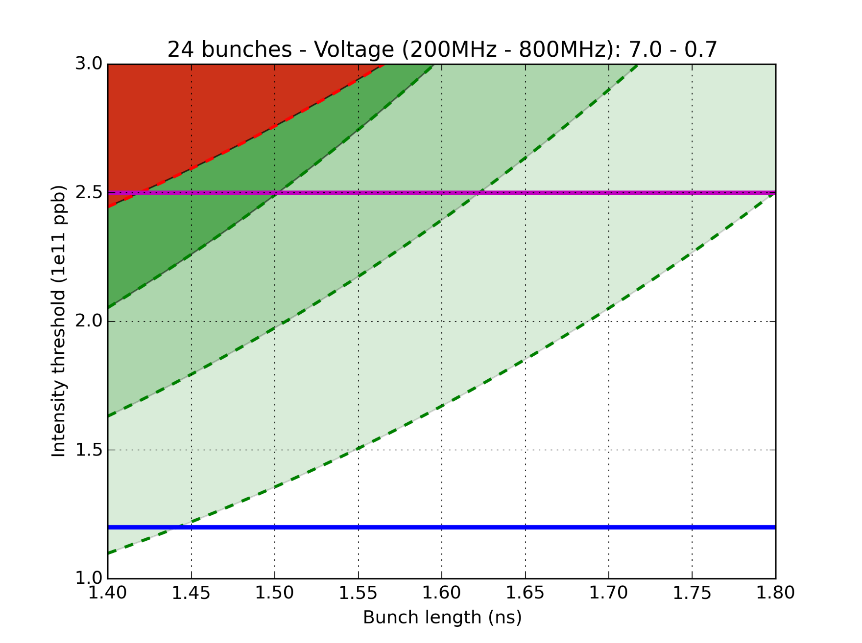
Double RF impedance reduction effect
Limit after LS2 without impedance reduction (reference point)
HL-LHC goal
36 bunches measured instability threshold (2015)
3
72 bunches measured instability threshold (2012)
2
Impedance reduction gain:
1: Flanges QF-type + HOM 630MHz
2: (1) + MKP
3: (2) + Flanges QD-type + other HOMs
1
Nominal LHC
1
2
3

Slide 3
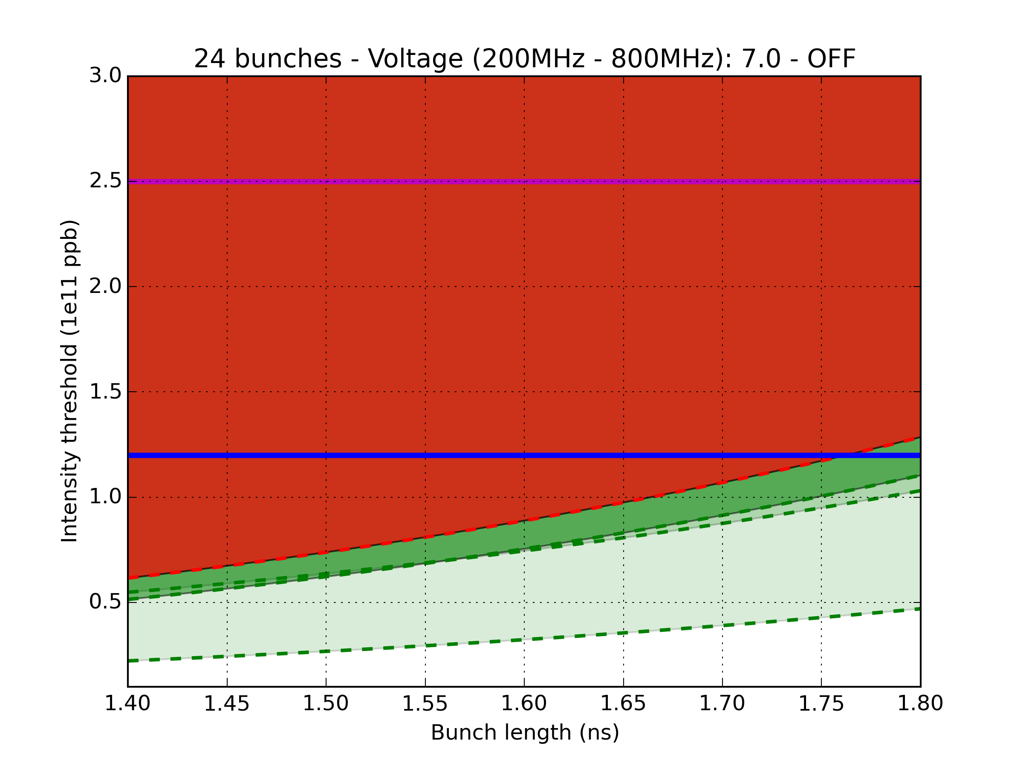
Single RF impedance reduction effect
Impedance reduction gain:
1: Flanges QF-type + HOM 630MHz
2: (1) + MKP
3: (2) + Flanges QD-type + other HOMs
HL-LHC goal
1
2
3
Nominal LHC
3
2
1

Slide 4
Introduction and motivation
The HOMs of the 200MHz cavities are an important contribution to the instabilities
The most important contribution was identified to be the resonances around 630MHz (+- 100MHz)
Simulations were done to determine how much these HOMs should be damped to increase the intensity threshold as much as possible.

Slide 5
Impedance of the HOMs
Example for the 2 long TWC:
f [GHz] | Z [kΩ] | Q | R/Q [Ω]
0.6291 | 260 | 300 | 867
0.6299 | 140 | 500 | 280
0.9142 | 940 | 4500 | 209
0.9148 | 720 | 4500 | 160
J. Varela – LIU-SPS Beam Dynamics Working Group 06/08/2015

Slide 6
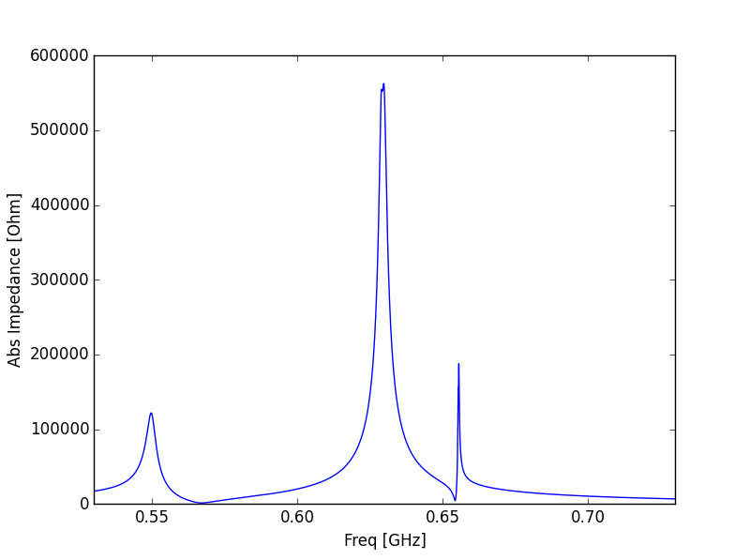
HOMs – Around 630MHz
Short cavities
f [GHz] | Z [kΩ] | Q | R/Q [Ω]
0.6289 | 80 | 700 | 114
0.6299 | 220 | 250 | 880
629MHz: High R/Q
(Coupling ~46 bunches with 25ns spacing)
Long cavities
f [GHz] | Z [kΩ] | Q | R/Q [Ω]
0.6291 | 260 | 300 | 867
0.6299 | 140 | 500 | 280
Short cavities
f [GHz] | Z [kΩ] | Q | R/Q [Ω]
0.6554 | 108 | 2500 | 43
Long cavities
f [GHz] | Z [kΩ] | Q | R/Q [Ω]
0.6556 | 136 | 2500 | 54
Short cavities
f [GHz] | Z [kΩ] | Q | R/Q [Ω]
0.5499 | 55.2 | 200 | 276
655MHz: High Q
(Coupling ~223 bunches with 25ns spacing)
Long cavities
f [GHz] | Z [kΩ] | Q | R/Q [Ω]
0.5498 | 66 | 150 | 440

Slide 7
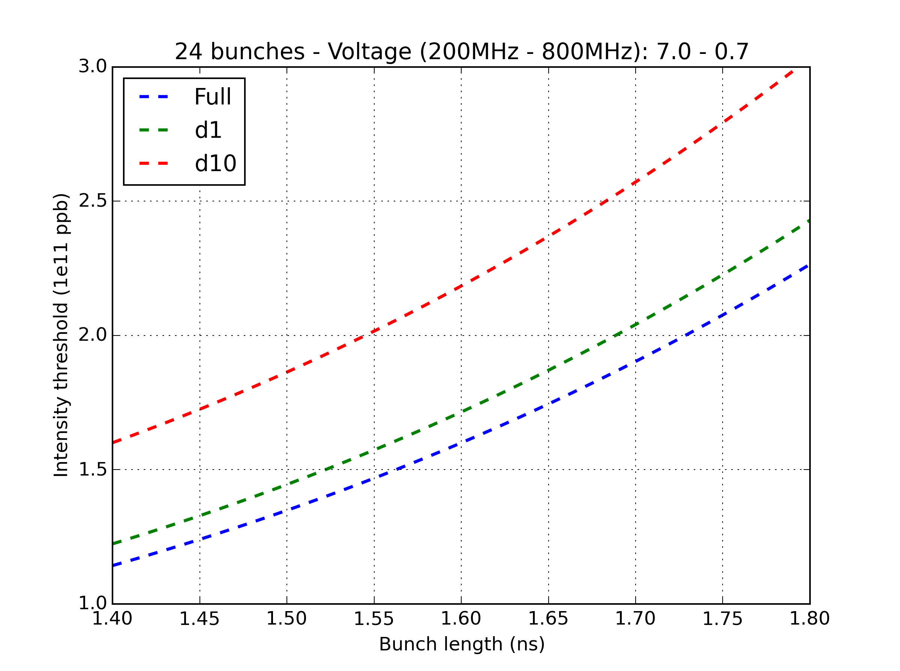
Reduction of the 630MHz HOMs
QF-type flanges + HOMs R and Q divided by 10
Shielding QF-type flanges only

Slide 8
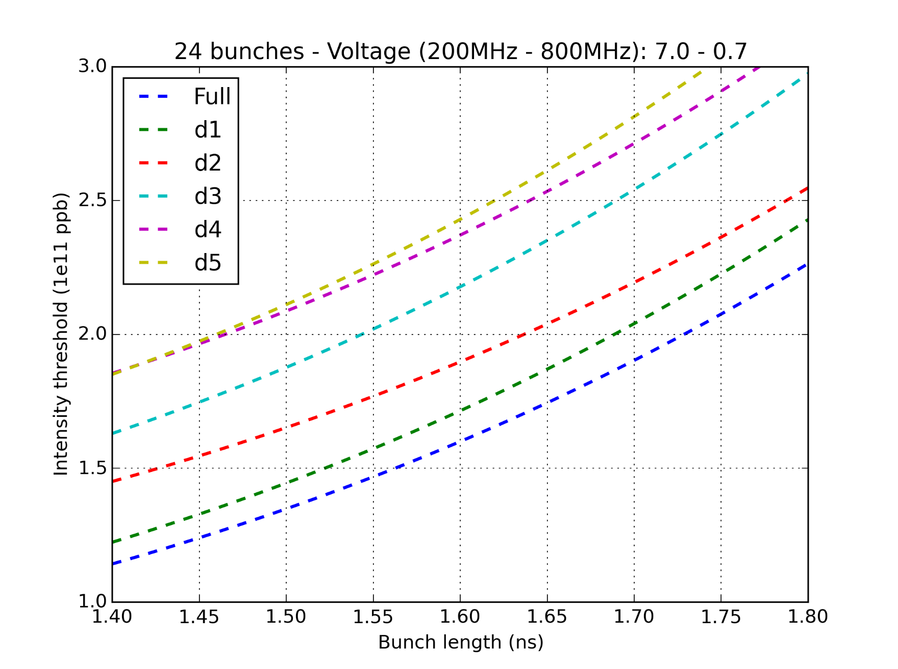
Reduction of the 630MHz HOMs
QF-type flanges + HOMs R and Q divided by ~4 is the best scenario

Slide 9
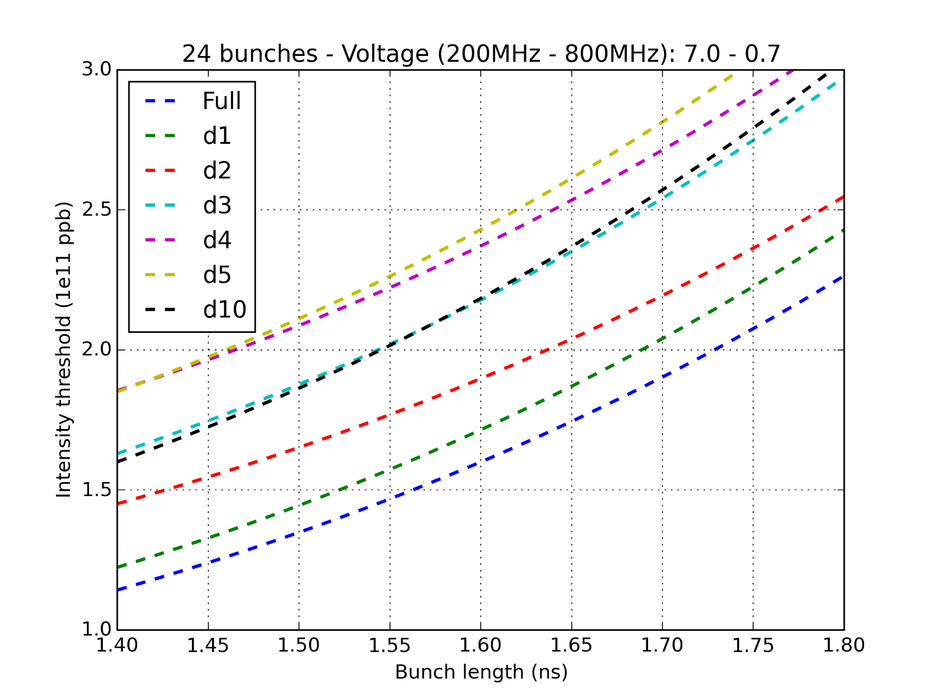
Reduction of the 630MHz HOMs
Dividing R and Q further is reducing the threshold:
Narrow-band -> Broad-band regime of instability ?

Slide 10
Conclusions and future work
The maximum intensity gain by damping the HOMs around 630MHz (+-100MHz) is obtained by reducing R and Q of the resonances by a factor 4.
Further reduction gives no improvement (or even seems to reduce the intensity threshold…).
These HOMs are already damped, it may be difficult to further damp the 629MHz resonance (Q~500), but it may be possible for the 655MHz resonance (Q~2500).
Further simulations will be done to determine which of the 629MHz (high R/Q) or the 655MHz (high Q) resonances is the most dominant in terms of beam instabilities.

