Slide 1
Space charge studies at the SPS
H. Bartosik, A. Oeftiger, F. Schmidt, M. Titze
LIU SPS-BD meeting, 29th October 2015

Slide 2
Experimental studies in 2015 (1)
Measurement and correction of machine non-linearities in Q20 and Q26
  Natural amplitude detuning without octupole correction
  Correction of amplitude detuning
  Non-linear chromaticity
  Impact of octupole settings on non-linear chromaticity (second order)

Slide 3
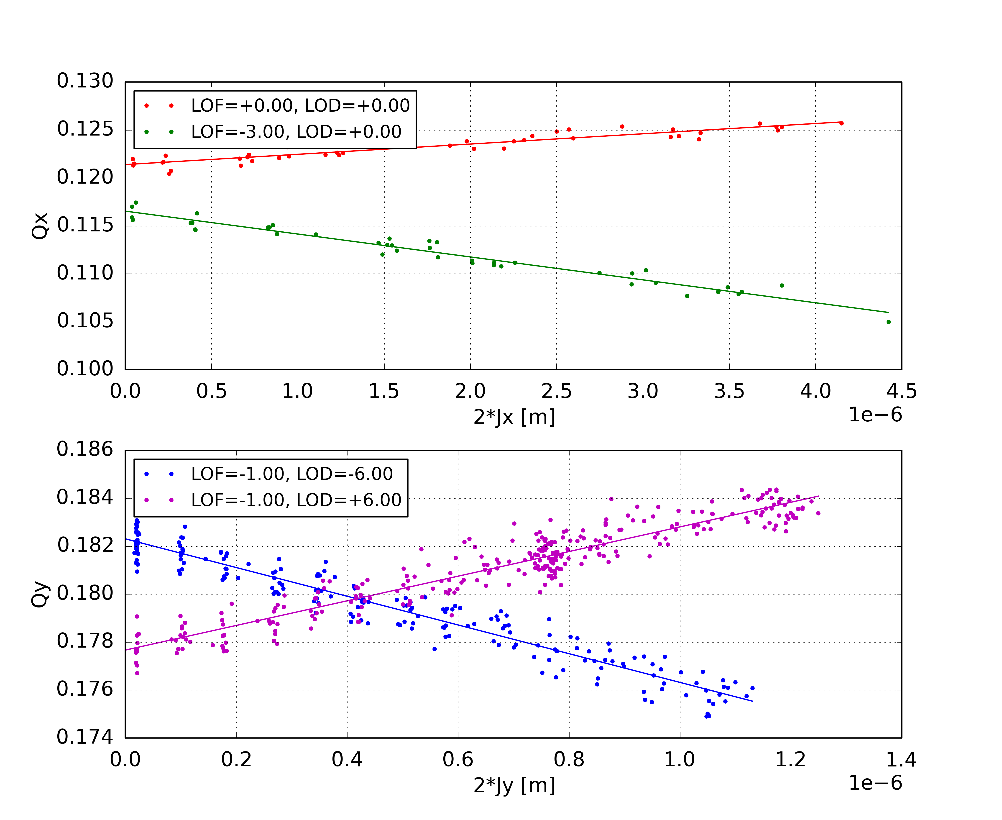
Measurement of non-linearities
In preparation of experimental studies and for non-linear optics model
Amplitude detuning
Q20 optics
horizontal detuning corrected for LOF=-1
Response of octupole knobs consistent with MADX model
Needed to use strong octupoles for vertical measurements due to limited aperture
vertical detuning corrected for LOD=0.5

Slide 4
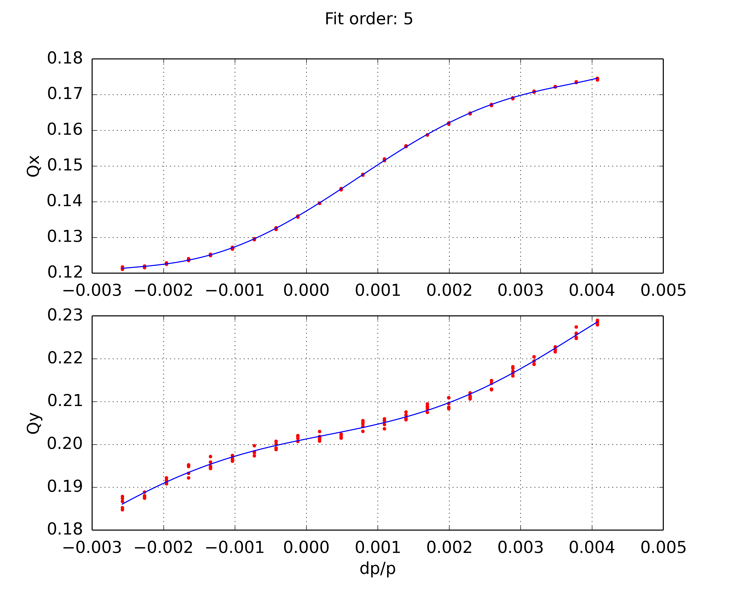
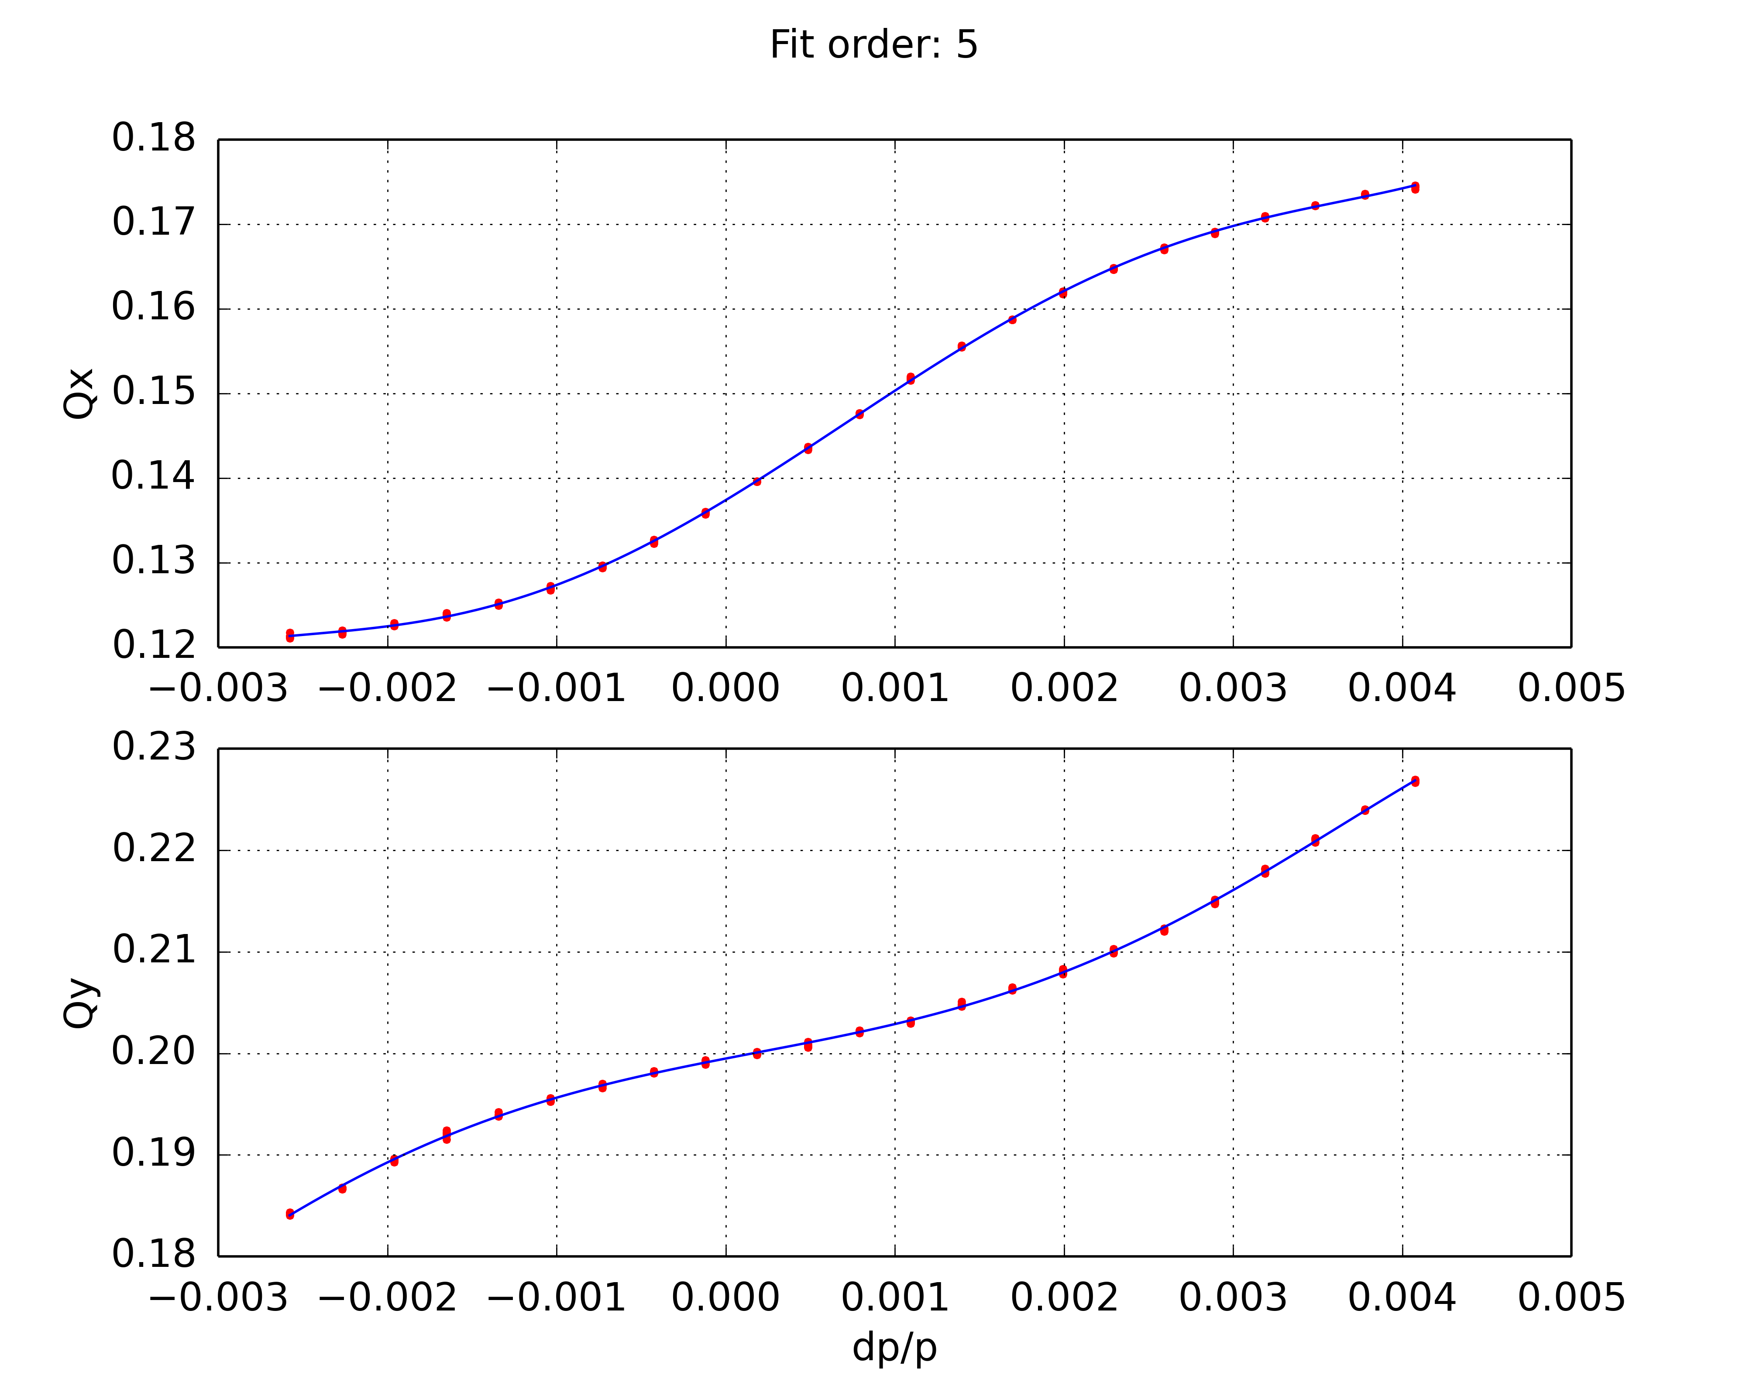
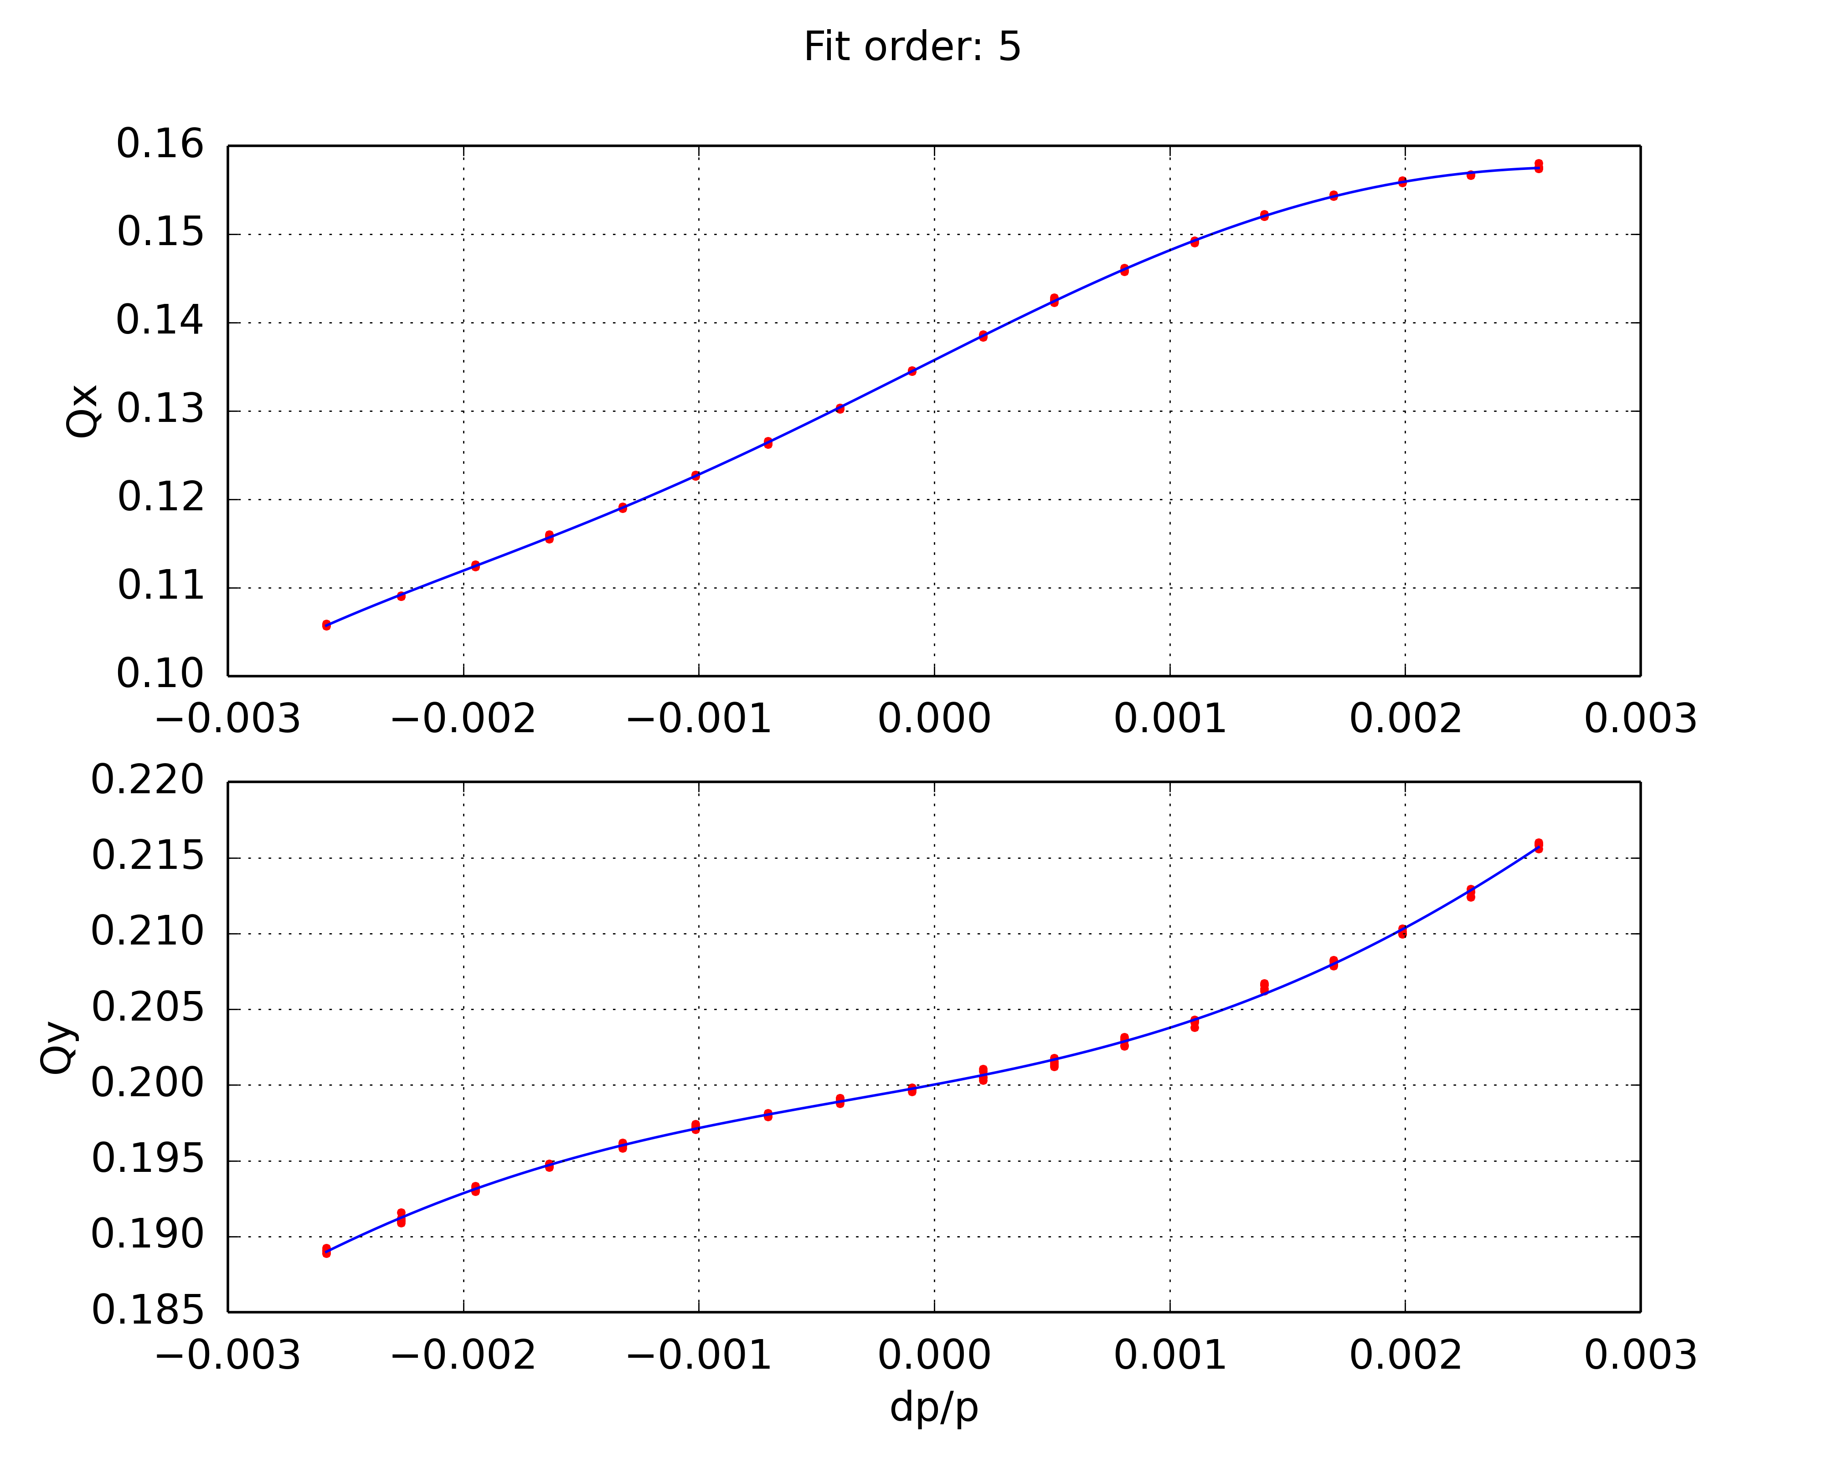
Measurement of non-linearities
In preparation of experimental studies and for non-linear optics model
Amplitude detuning
Non-linear chromaticity
Q20 optics
Using BBQ pickup with chirp excitation to measure tune
Spread in vertical due to intensity variation
Very clean results also in vertical when correcting for detuning with intensity → fit up to 5th order
Horizontal Q’’ reduced by correcting amplitude detuning as expected from MADX model
Q’’ reduced with LOF=-1
corrected for detuning due to impedance
spread due to intensity variations

Slide 5
Experimental studies in 2015 (2)
Measurement and correction of machine non-linearities in Q20 and Q26
  Natural amplitude detuning without octupole correction
  Correction of amplitude detuning
  Non-linear chromaticity
  Impact of octupole settings on non-linear chromaticity (second order)
Tune scans with single bunch high brightness beams in Q20
  Shot-to-shot reproducibility of single bunch beams significantly improved after LS1 due to new beam production scheme in PSB (intensity control with C16 blow-up)
  Can use linear wire scanners in SPS (better resolution compared to rotational scanners)
  Detailed scan with ~10 wire scanner measurements per working point
  Explored tune diagram above Qy = 20.25

Slide 6
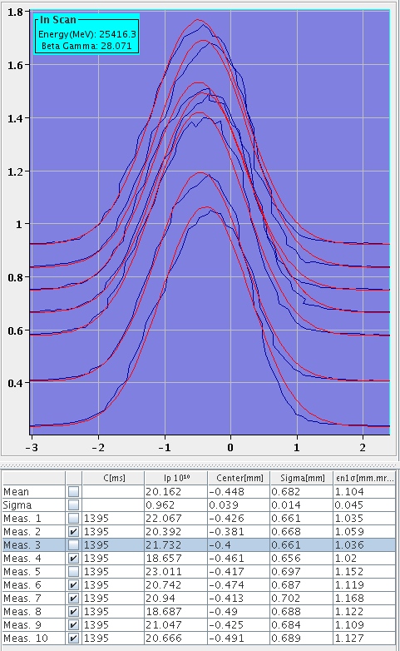
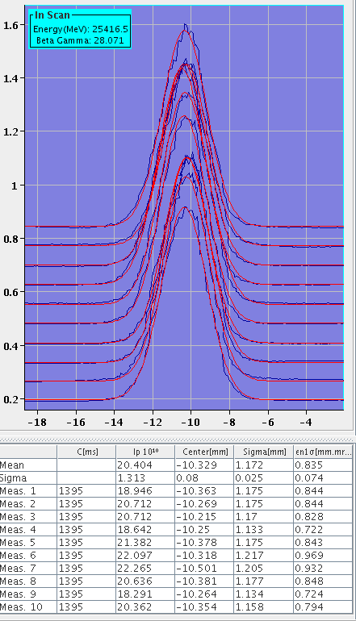
Single bunch tune scan
Beam production PSB
  1.8 turns injected
  Horizontal and vertical shaving
  Longitudinal blow-up (C16) to control intensity
  Emittance: H/V ~ 0.9 um (±10%)/1.0 um (±5%)
Beam parameters in PS
  Intensity ~2e11 p/b (±10%)
  Emittance: H/V ~ 0.84 um (±10%)/1.10 um (±5%)
SPS parameters
  Flat bottom cycle (3.3s)
  Q20 optics
  Small chromaticity
  Horizontal amplitude detuning corrected (LOF -1)
  RF voltage 4.5 MV at 200 MHz (single harmonic)
  Bunch length after filamentation ~3.3 ns
  space charge tune spread: (H, V) ~ (0.10, ~0.19)
85.V
65.H

Slide 7
For each working point …

Slide 8
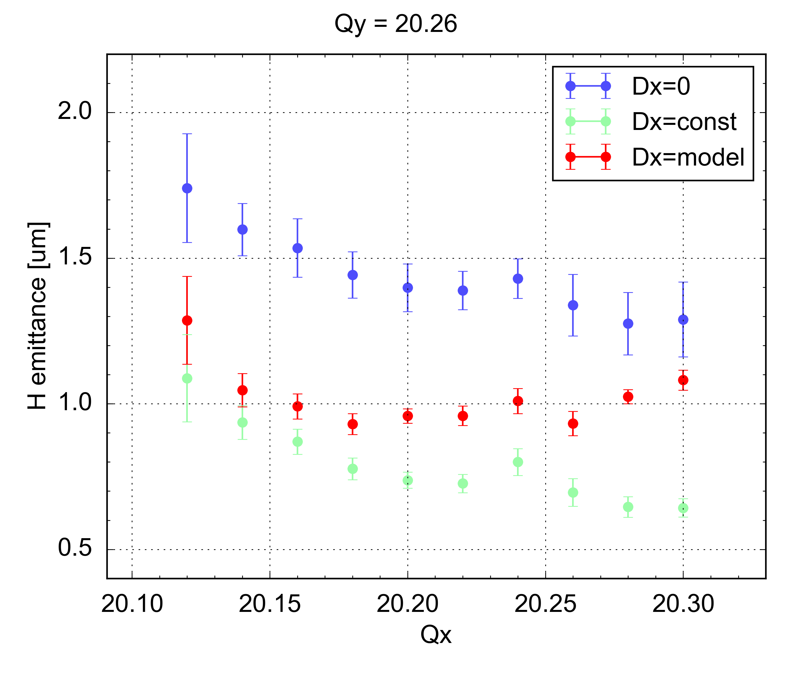
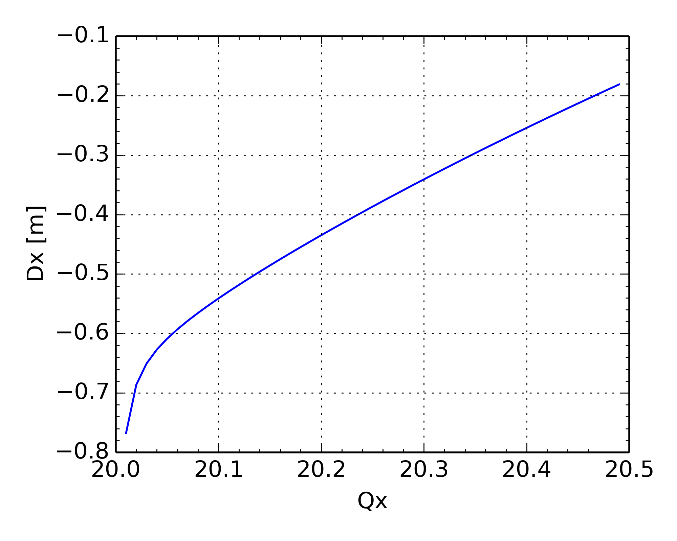
Impact of dispersion on horizontal emittance
Linear wire scanner 51731H
  Location with large dispersion and low beta-function
  Dispersion changes significantly along the scanned horizontal tunes
Dispersion at wire scanner location

Slide 9
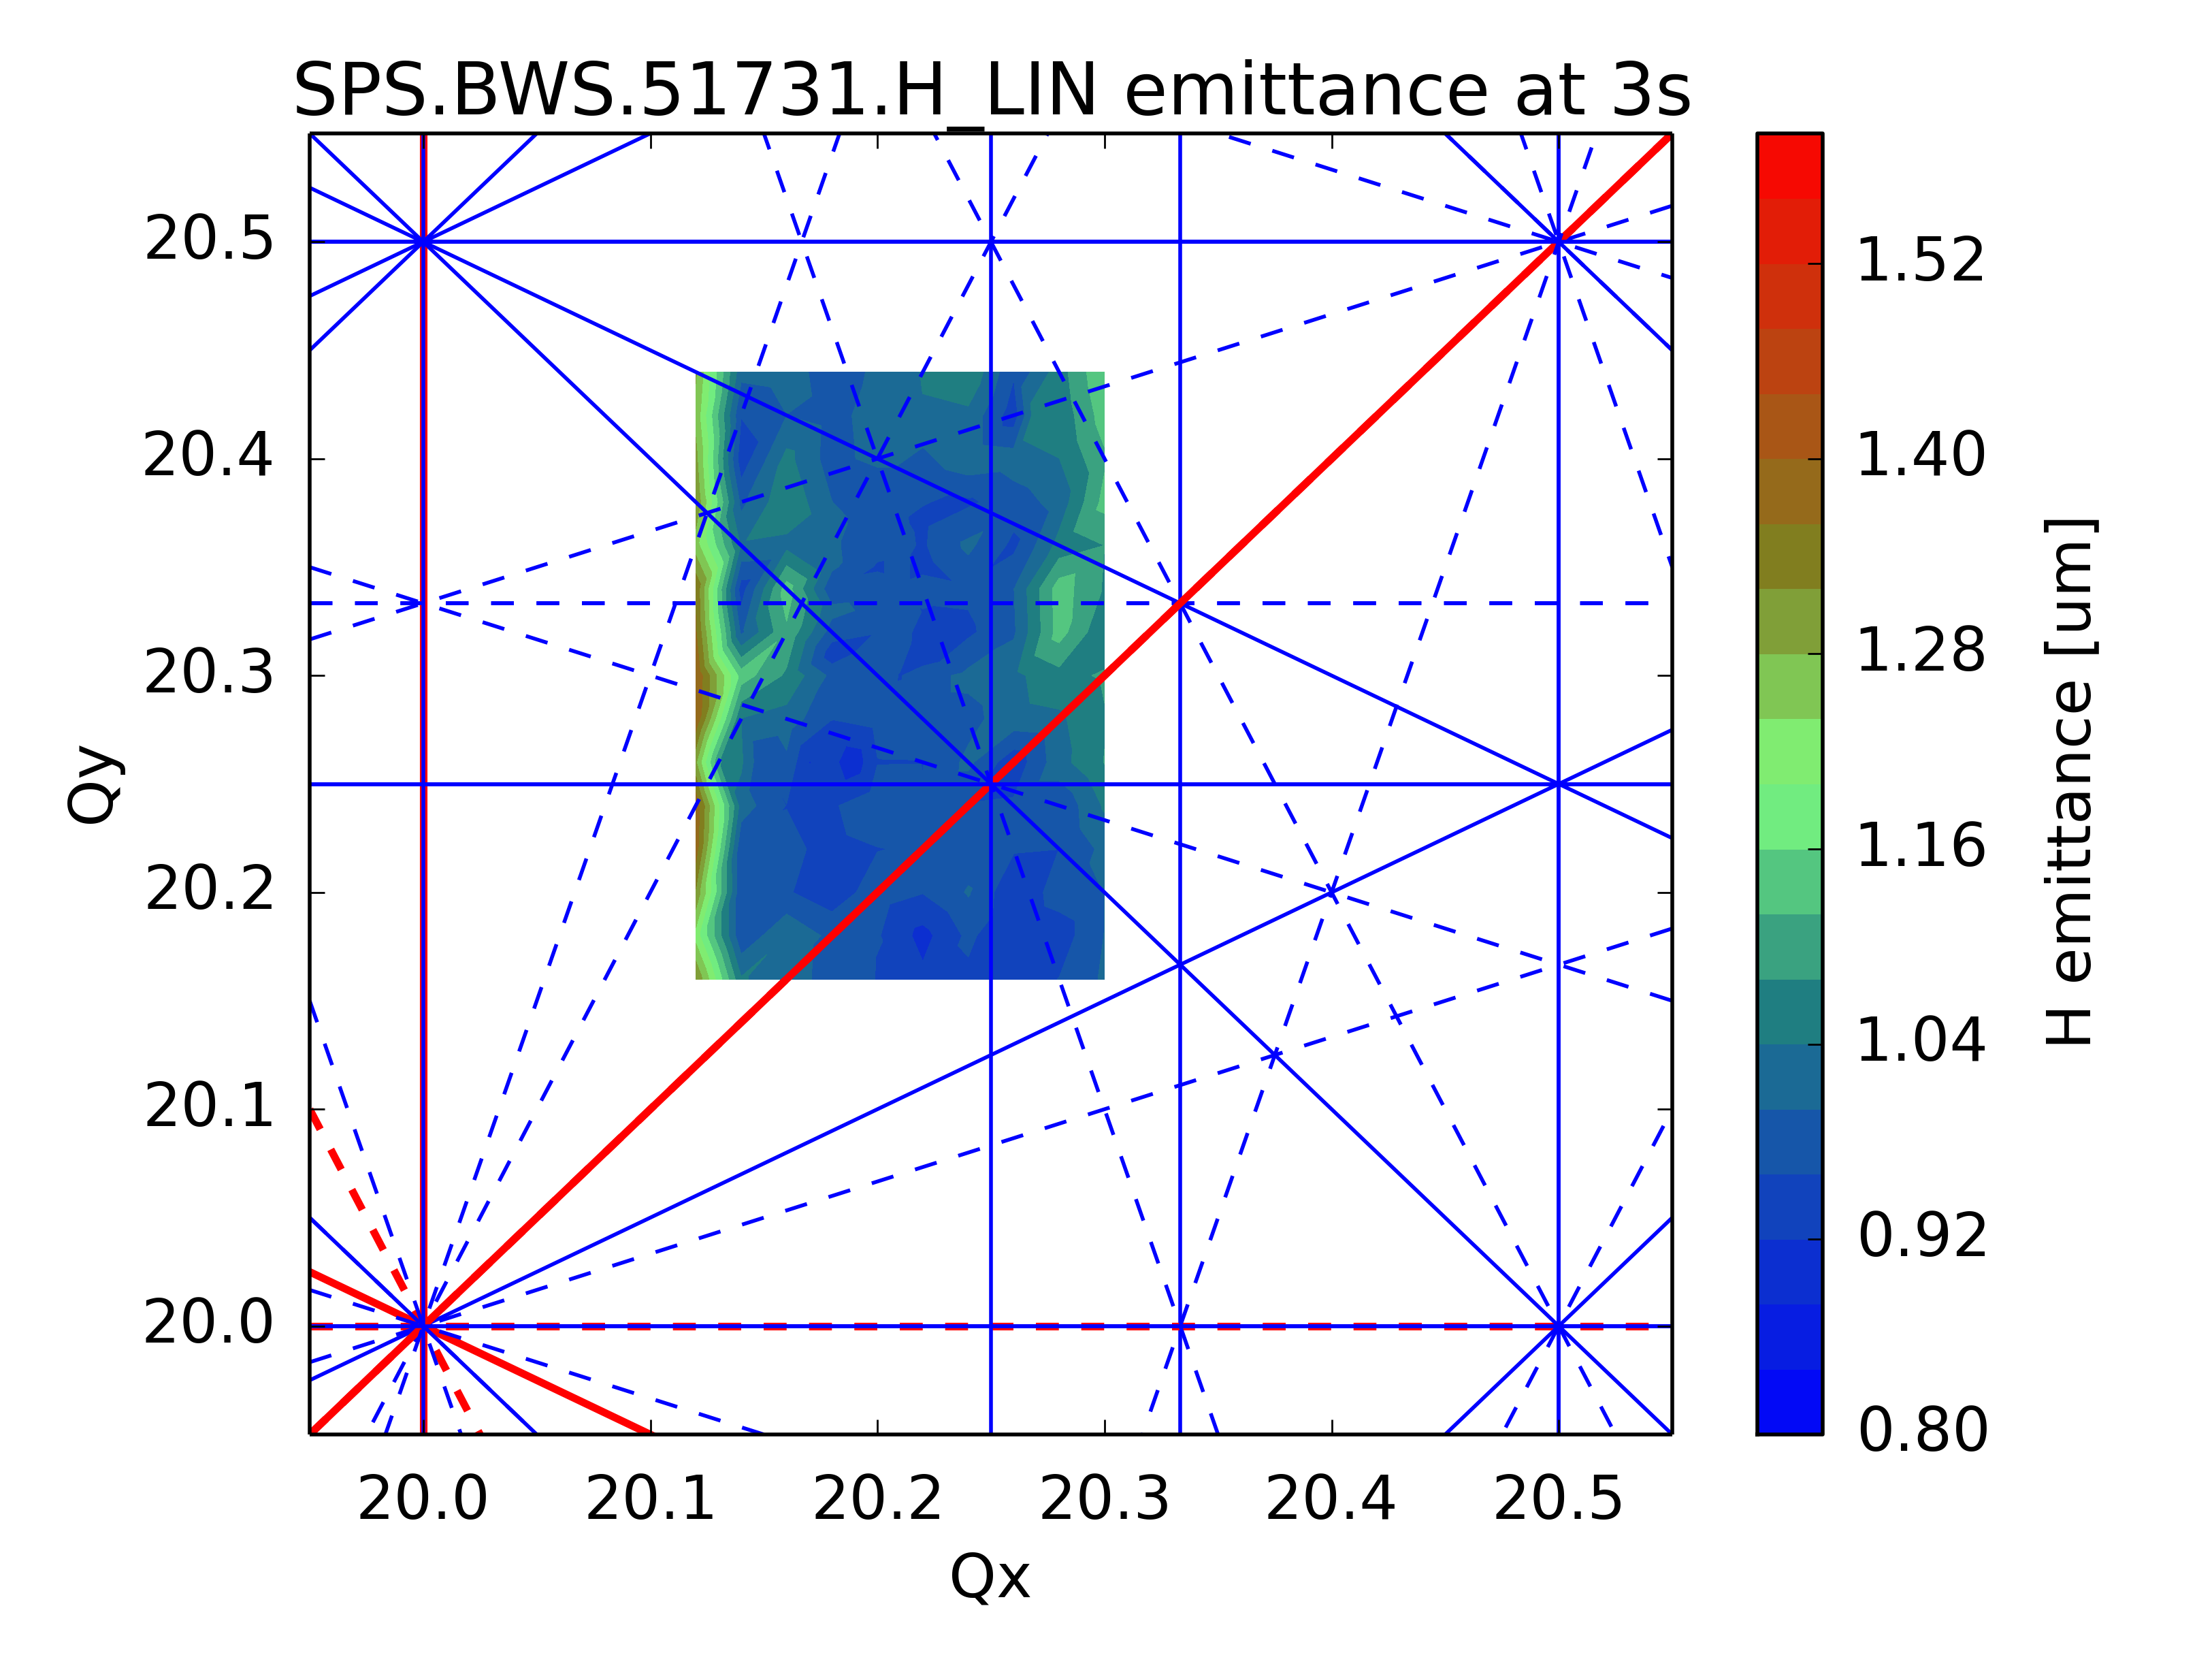
Tune scan results
Blow-up due to integer resonance

Slide 10
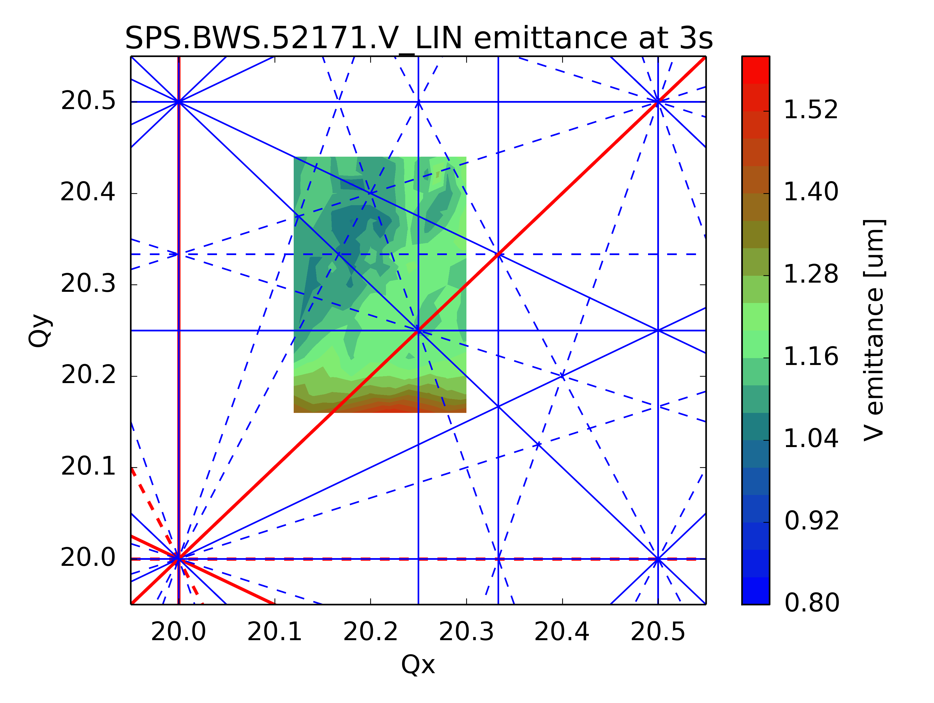
Tune scan results
Blow-up due to integer resonance

Slide 11
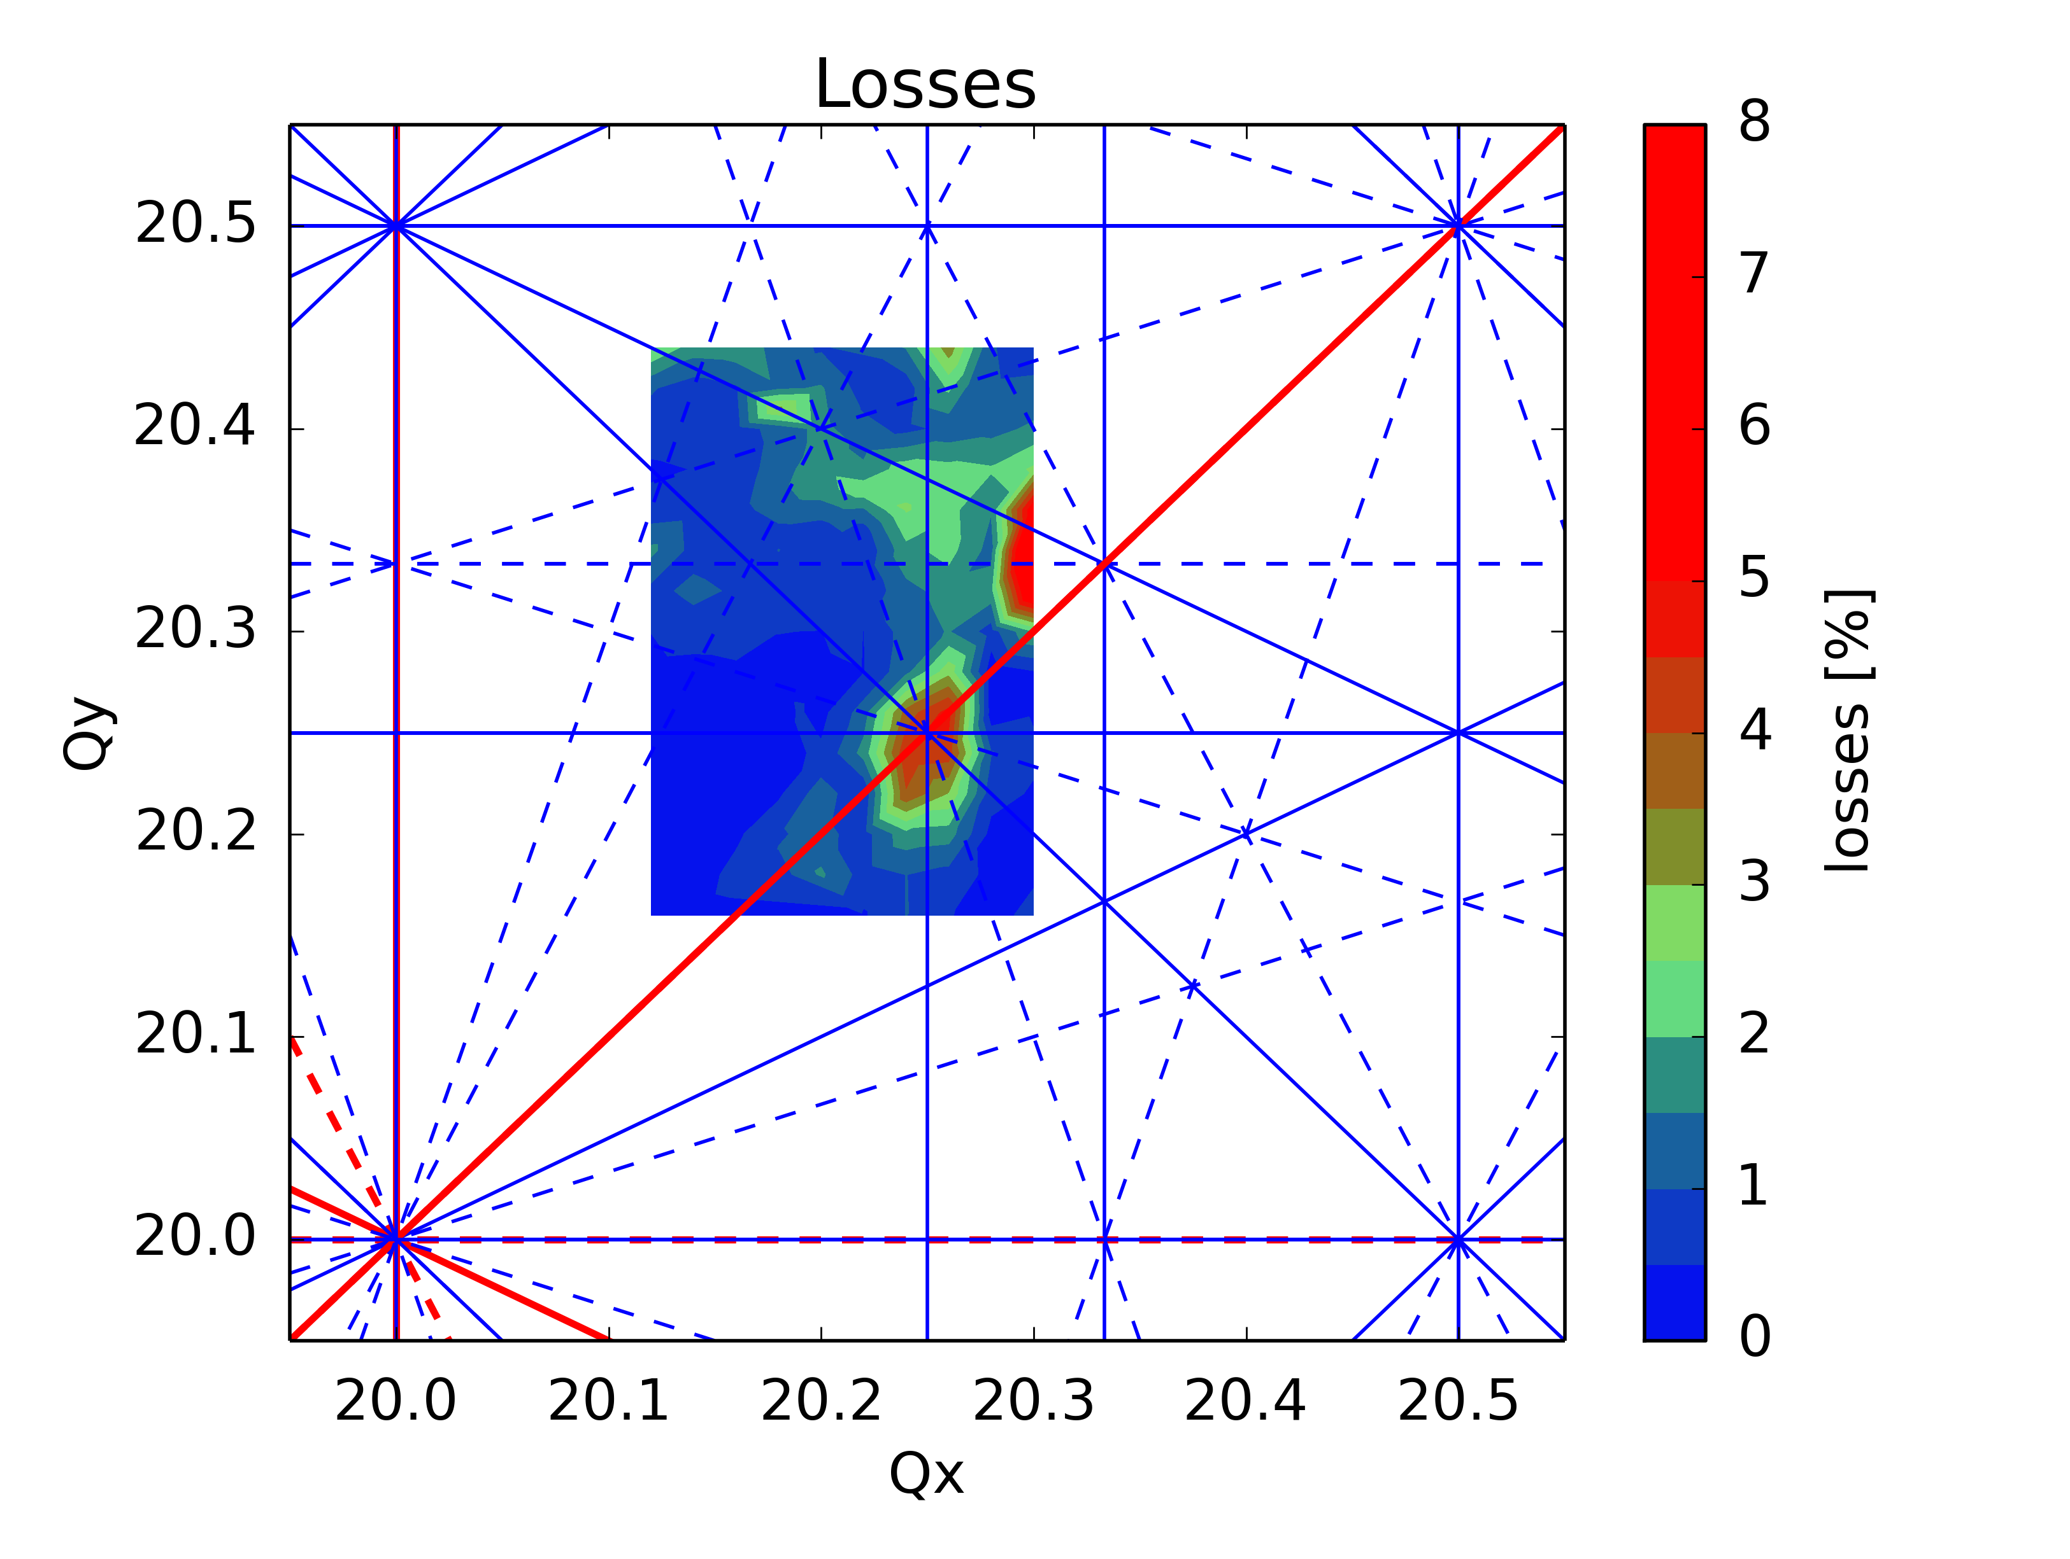
Tune scan results
Dynamic tune scan low brightness
Qx + 2Qy = 61
4Qx = 81

Slide 12
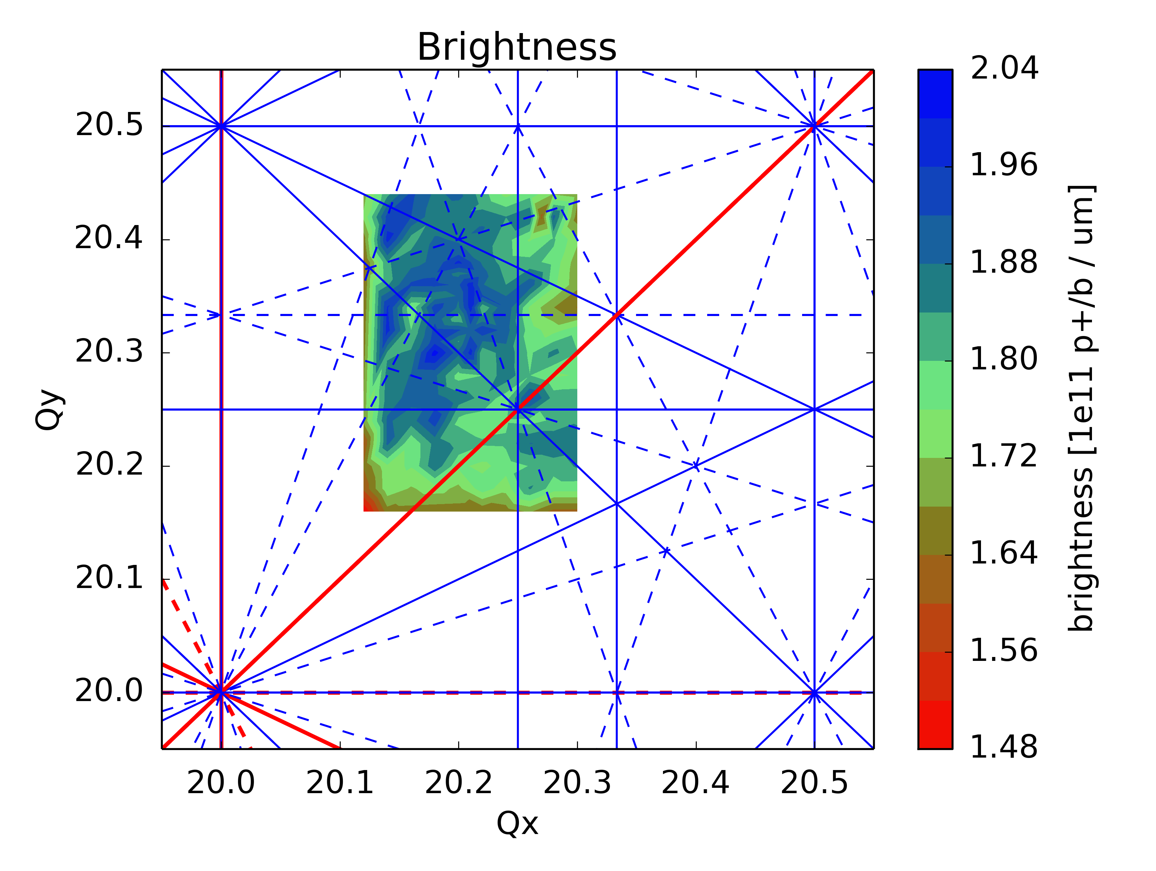
Tune scan results
operational working point

Slide 13
Tune scan results
Limiting resonances
  Blow-up at integer resonances
  Losses for working point close to the Qx + 2Qy normal sextupole resonance (studied in Fix-line experiment with Q26)
  Losses also around the 4Qx = 81 normal octupole resonance
Identified optimum working point area for vertical tune spread of 0.2
  20.16 < Qx < 20.23
  20.24 < Qy < 20.33
  Losses around 0.5% for 3 s storage time on flat bottom
Space charge tune spreads of up to ΔQy = 0.3 may be acceptable
  No strong limitation from Qy = 20.25
Some room for working point optimization with high brightness and e-cloud
  Could even consider compensating the Qx + 2Qy resonance in case of large e-cloud tune spread

Slide 14
Next steps
Characterize the transverse tail development as function of the working point
Study the identified optimum working point region with even higher brightness
  PSB can deliver similar transverse emittances for up to 2.7e11 p/b
Study the scaling of losses with single bunch
  As function of transverse emittance for constant brightness
  As function of beam brightness for constant transverse emittances
Characterize the Qx + 2Qy = 61 resonance
  Dynamic tune scans
  Resonance driving terms
Build SPS effective machine model
  Based on the measurements of non-linearities (combine measurement sets with different settings) and magnet alignment data from survey

Slide 15
Thank you for your attention!

