Slide 1
- Damping Resistors Survey - Longitudinal Impedance Model Update
Jose E. Varela

Slide 2
Outline
SPS Flanges - Longitudinal Impedance Model
2014
2015
The SPS Longitudinal Impedance Model
2015

Slide 3
Damping Resistor Survey Results
QF – QF closed flange with short Bellows (after visual inspection by J.A. Ferreira):
2014: 24 with DR, 2 without DR ( 8% )
2015: 23 with DR, 3 without DR ( 12% )
Non-shielded BPH-QF enamelled flange with long bellows:
2014: 39 with DR
2015: 25 with DR, 12 without DR ( 32% )
MBA – QF enamelled flange with short bellows:
2014: 75 with DR, 8 without DR ( 10% )
2015: 78 with DR, 2 without DR ( 3% )
QF – QF enamelled flange with short bellows:
2014: 13 with DR, 1 without DR ( 7% )
2015: 12 with DR, 2 without DR ( 14% )
Missing DR 2014 (assumed):
7 % (9% without BPHs)
Missing DR 2015 (surveyed):
12% (6% without BPHs)

Slide 4
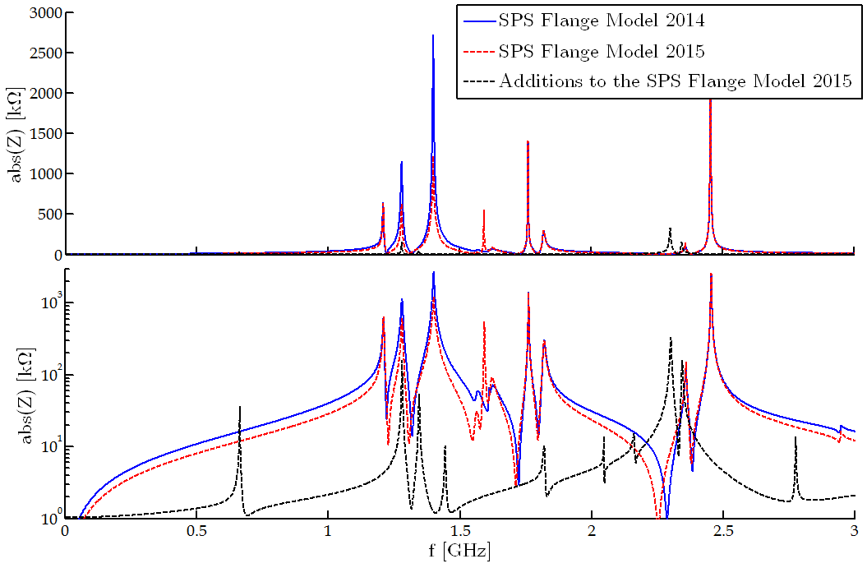
The Flange Impedance Model Comparison
Please Note:
No Resonance Scattering !

Slide 5
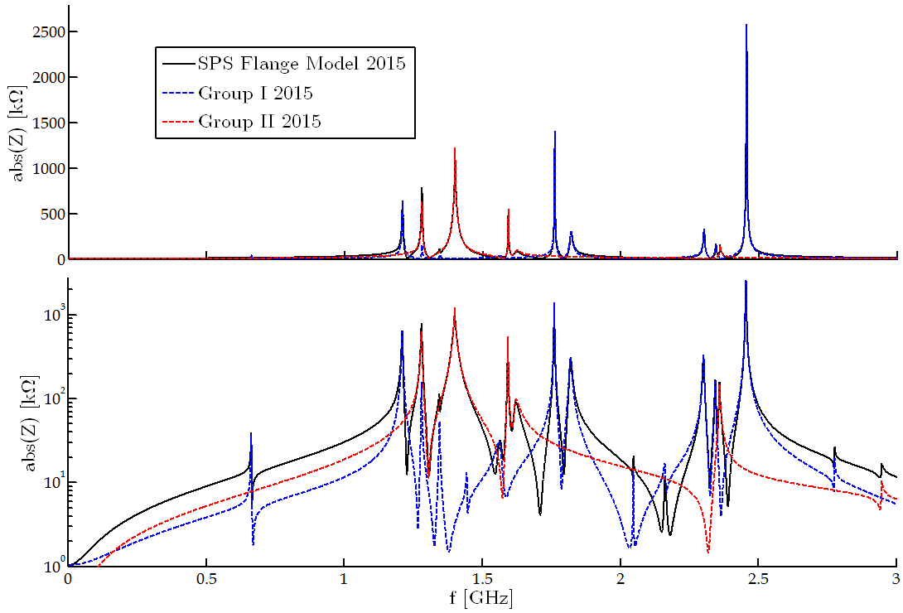
The 2015 Flange Impedance Model
QD short and long bellows!
Please Note:
No Resonance Scattering !

Slide 6
Outline
SPS Flanges - Longitudinal Impedance Model
2014
2015
The SPS Longitudinal Impedance Model
2015

Slide 7
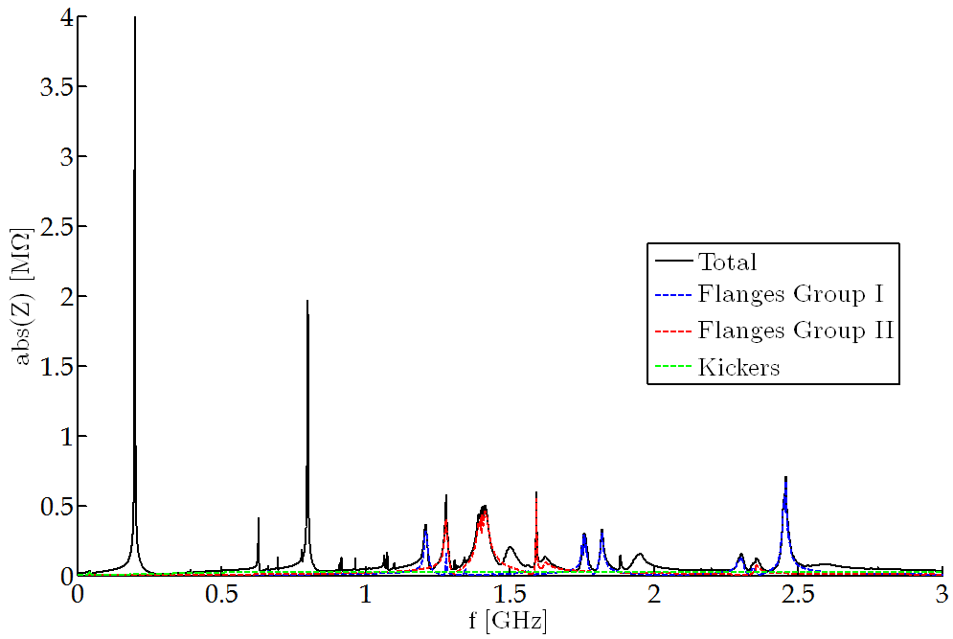
Longitudinal Impedance Model
To note:
0% Non-conform PP Shields
Resonances Scattered 2.5%

Slide 8
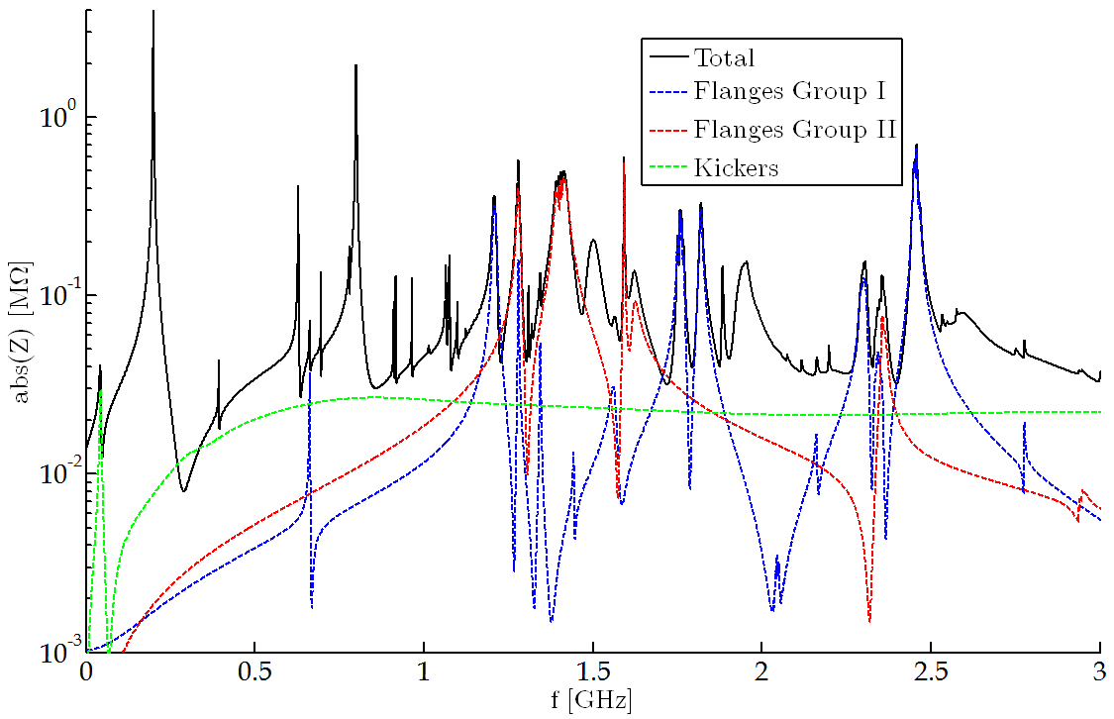
Longitudinal Impedance Model

Slide 9
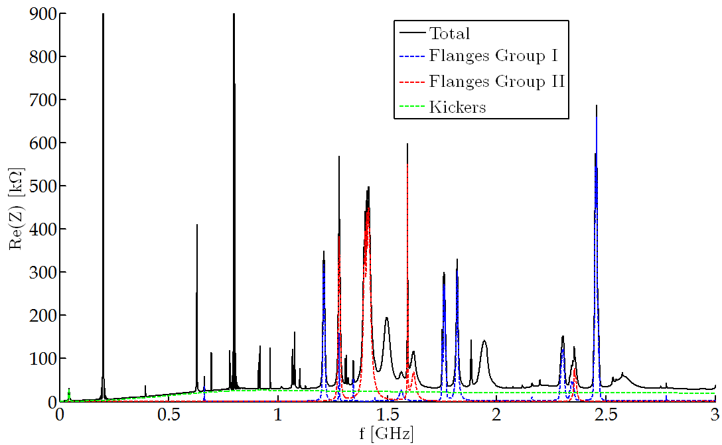
Longitudinal Impedance Model

