Slide 1
Planning of the SPS MDs for 2015
H. Bartosik, G. Rumolo

Slide 2
Injector schedule 2015 v1.0
Setup of doublet
beam (2d/week)
Setup of doublet beam (2d/week)
Setup of doublet beam (2d/week)
Start parallel MDs

Slide 3
Injector schedule 2015 v1.0

Slide 4
Setup of doublet scrubbing beam for LHC
LMC requested the setup of the doublet scrubbing beam for the LHC scrubbing (> 1.6e11 p/doublet) in parallel to physics during two days per week
The experts (RF longitudinal, transverse damper, transverse machine settings, BI, BQM, …) will be asked to optimize their equipment in a systematic way – each day will be devoted to the setup of a single system
The goal is to commission this new beam thoroughly, like it was done for the Ar-ion beams in 2014, in order to be ready for the LHC scrubbing run for 25 ns beams in the middle of the year
This will also help the SPS scrubbing runs, which will profit from the doublet beam

Slide 5
Dedicated MDs
Dedicated MDs will be performed on Wednesdays in blocks of 10 hours
Presently about 30 blocks scheduled, practically each week
Main focus of the activities will be
  Performance optimization and performance reach of the 25 ns operational LHC beam
  Electron cloud (in view of LIU scrubbing vs. coating decision, including instabilities and beam quality)
  Longitudinal beam dynamics studies (in view of impedance identification and understanding of intensity limitations)
  Coasting beam studies (emittance growth in view of crab cavities experiments, collimator studies)
  Space charge (study the maximum acceptable space charge tune spread)
  Qualification of new LIU beam types (e.g. 80 bunch scheme, 8b+4e, …)
  800 MHz LL RF
  COLDEX (request of 5 dedicated blocks)
  …

Slide 6
Parallel MDs
Up to 4 days of parallel MD per week
Maybe this year it would be good to have again each week devoted to a single subject …
  This could be more efficient rather than having different days assigned to different studies
Main activities
  Impedance measurements in transverse and longitudinal planes
  Instability studies on short cycles (flat bottom or fast ramp) in transverse and longitudinal plane
  Electron cloud instability on short flat bottom cycle with 2 injections
  SPS machine modeling (linear and non-linear optics)
  Space charge, transverse with high brightness beams (Pure batch compression) and longitudinal (with different energies)
  BI (BGI, BSRT, wire scanner calibration, matching monitor, …)

Slide 7
How to submit MD requests?
New online tool is available to collect, organize and manage MD requests
  The tool is brand-new and there are still features being added
  Scheduling and beam requests to pre-injectors will be done with the same tool
http://md-coord.web.cern.ch

Slide 8
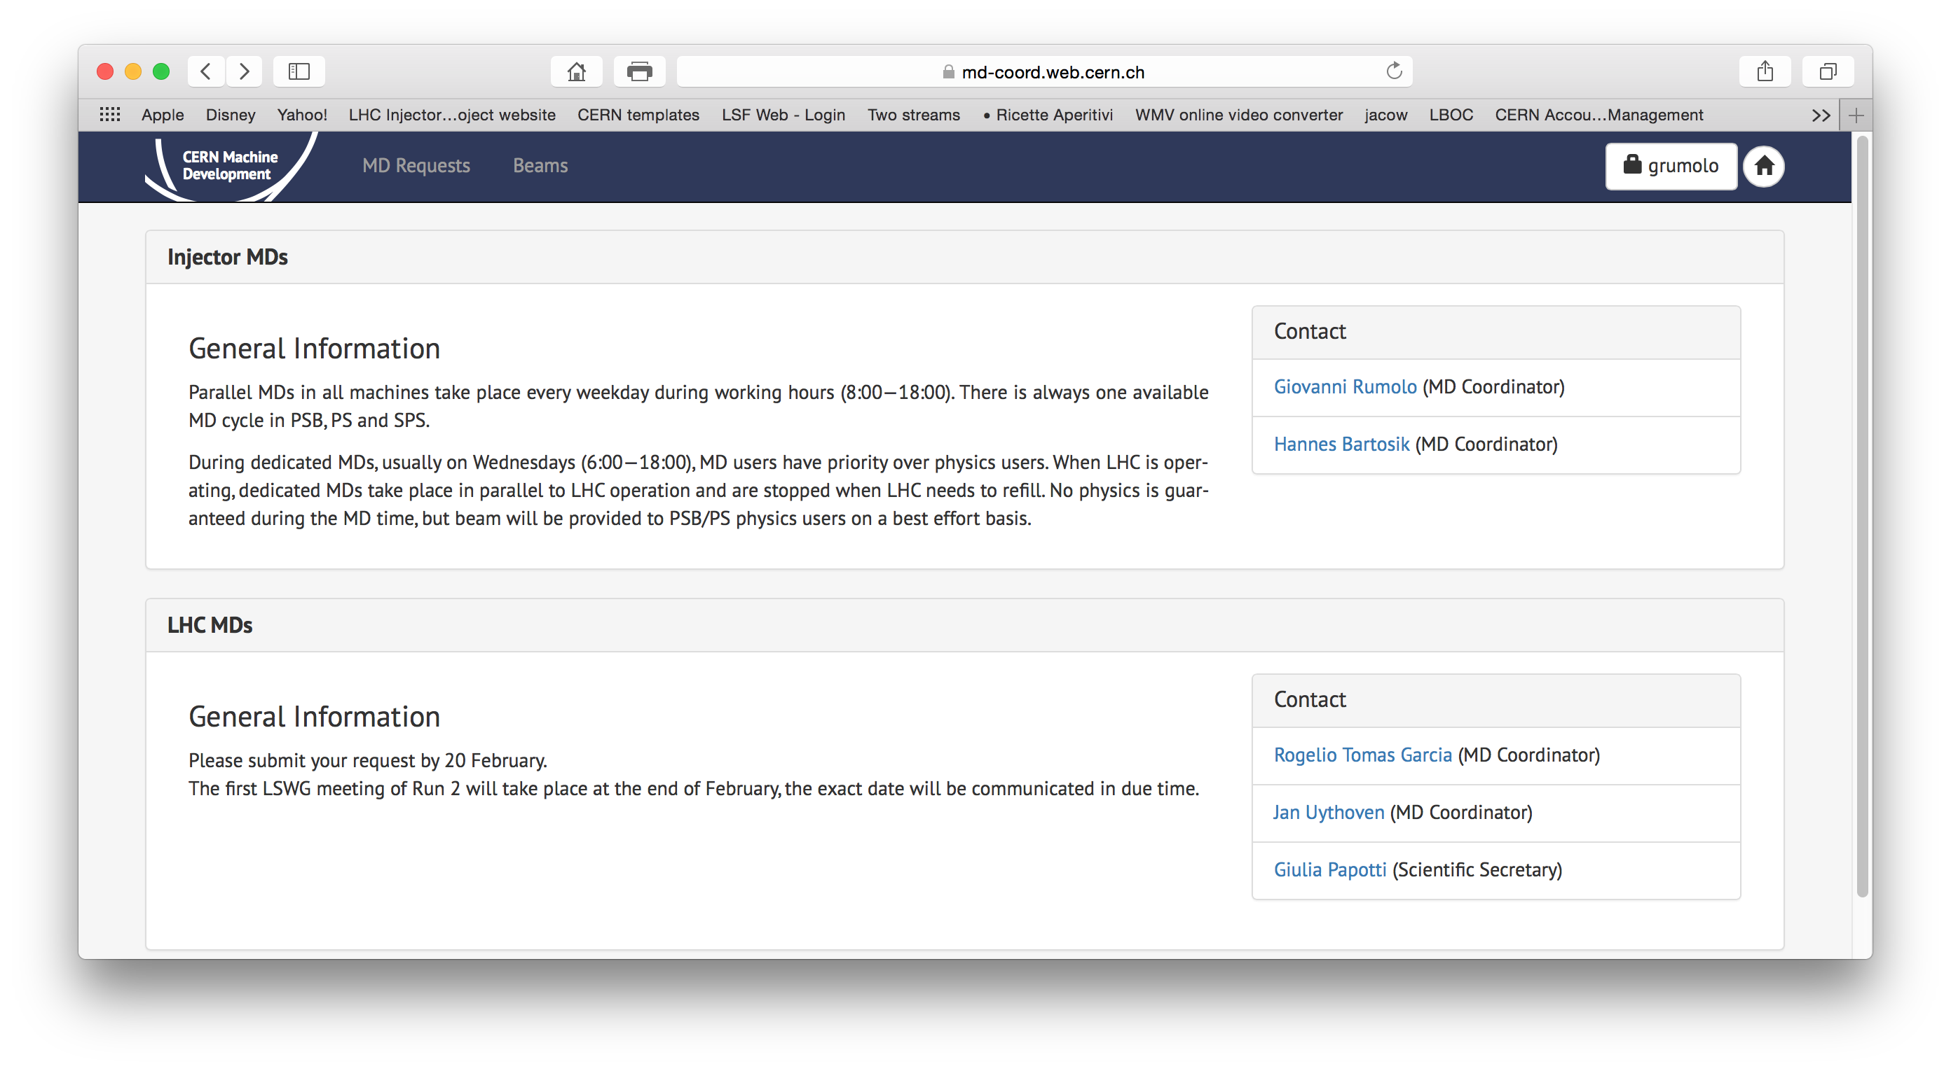
How to submit MD requests?
New online tool is available to collect, organize and manage MD requests
  The tool is brand-new and there are still features being added
  Scheduling and beam requests to pre-injectors will be done with the same tool

Slide 9
Thank you for your attention!

