Slide 1
2015 SPS Scrubbing Run week 16 and 17
H. Bartosik, G. Iadarola, K. Li, L. Mether, A. Romano, G. Rumolo, M. Schenk
Transverse damper: W. Höfle, G. Kotzian
RF team: T. Argyropoulos, T. Bohl, J. Esteban, Müller, A. Lasheen, E. Shaposhnikova
SPS OP: K. Cornelis, V. Kain, SPS operation crew
Vacuum: M. Taborelli
Thanks to: G. Arduini, E. Carlier, H. Damerau, L. Ducimetiere, A. Findlay, S. Gilardoni, B. Goddard, A. Guerrero, S. Hancock, M. Meddahi, E. Métral, B. Mikulec, G. Papotti, E. Piselli, B. Salvant
… and thanks to the PS complex for the preparation of the challenging beams!!
LIU-SPS Coordination Meeting, May 13, 2015

Slide 2
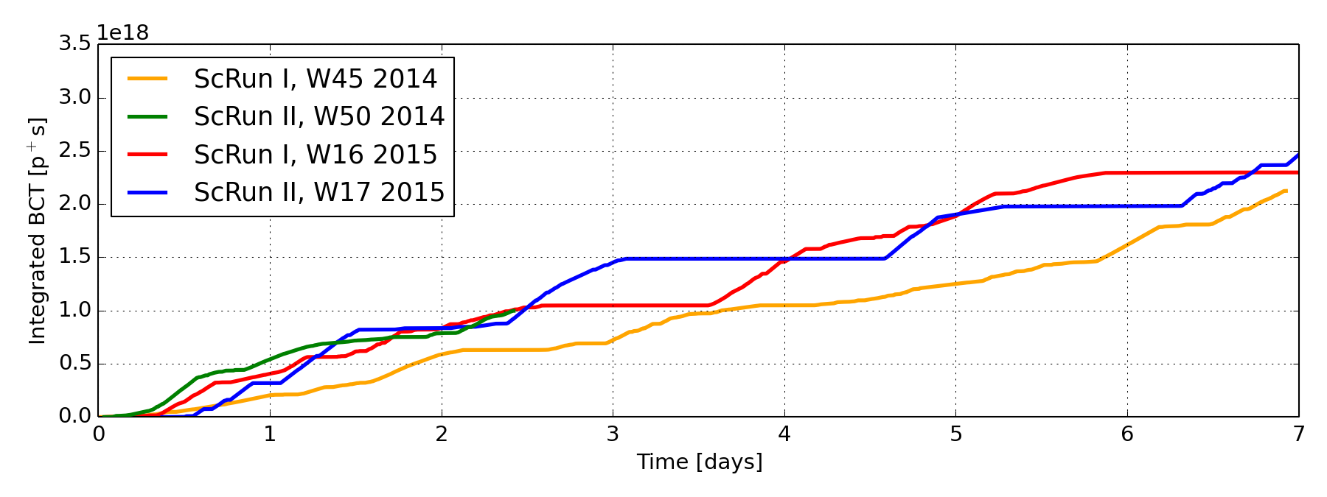
Scrubbing run weeks 16 & 17
PSB BLMs + COLDEX access
Linac2 fault
Set up of fixed target beam
PS POPS + water leak
Stop for cool-down
Linac2 fault
Overview
  Total accumulated beam current from Monday 13 April, 8:00 to Monday 27 April, 8:00.
  Beam availability
    Few longer stops (PSB BLMs + COLDEX intervention, Linac2 fault, set up of NA)
    Slope slowdown usually due to vacuum interlock on MKP
  Comparison with previous (2014) scrubbing runs

Slide 3
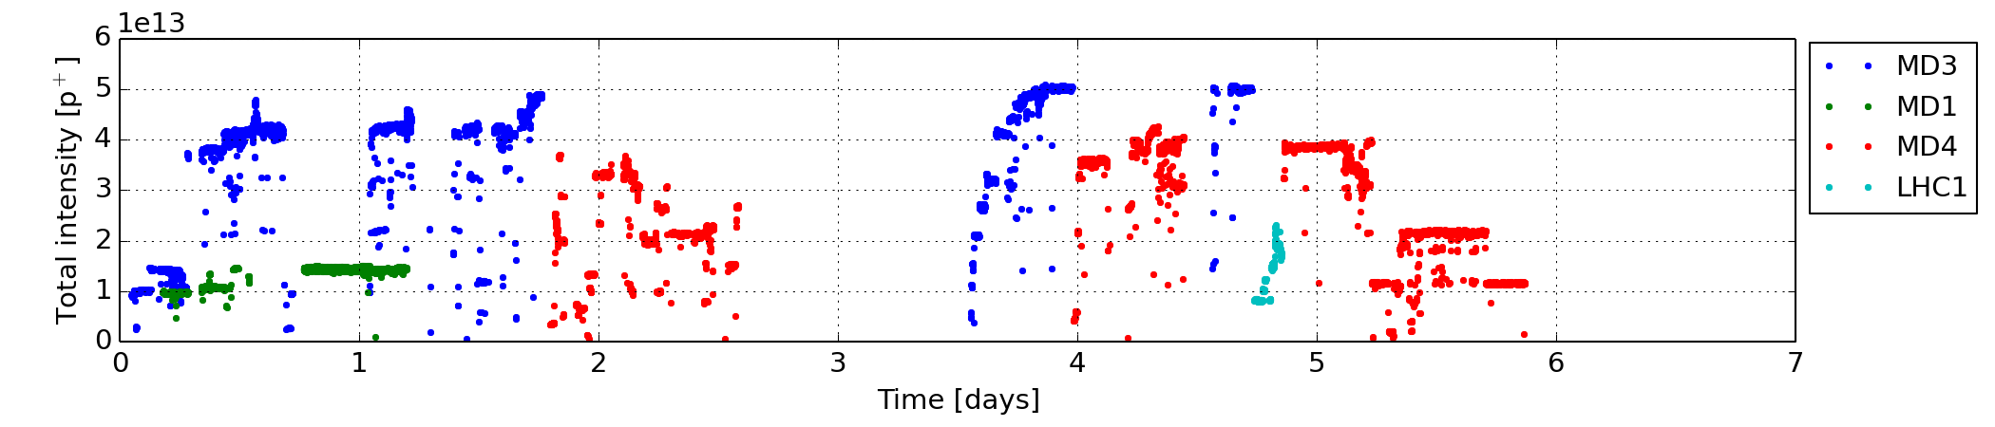
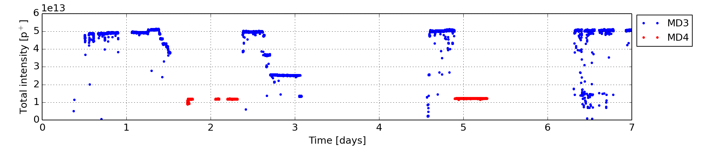
Scrubbing run weeks 16 & 17: detailed overview
Week 16
MD3: 26.4 s, 25 ns beam, 26 GeV
MD4: 26.4 s, doublet beam, 26 GeV
MD1: 7.2 s, doublet beam, 26 GeV
LHC1: 22.8 s, doublet beam, 450 GeV
Week 17
MD3: 26.4 s, 25 ns beam, 26 GeV
MD4: 26.4 s, doublet beam, 26 GeV

Slide 4
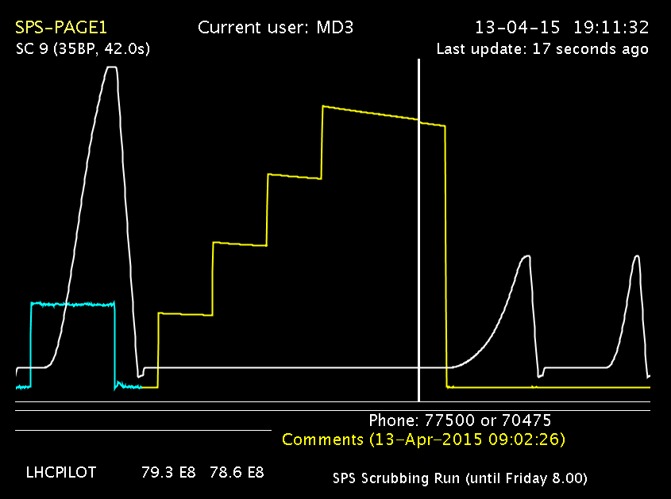
Scrubbing run week 16: detailed overview
MD3: 26.4 s, 25 ns beam, 26 GeV
MD4: 26.4 s, doublet beam, 26 GeV
MD1: 7.2 s, doublet beam, 26 GeV
LHC1: 22.8 s, doublet beam, 450 GeV

Slide 5
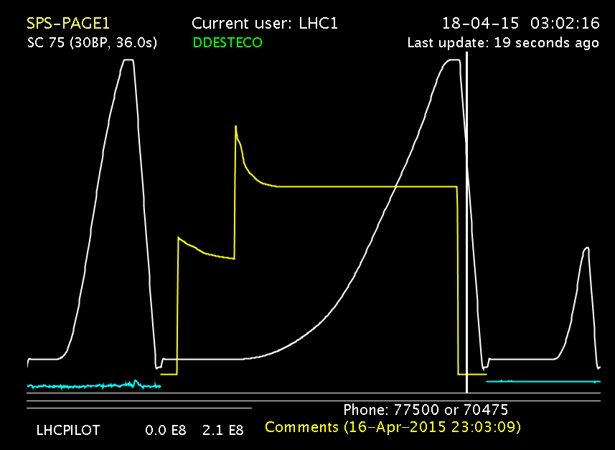
Scrubbing run week 16: detailed overview
MD3: 26.4 s, 25 ns beam, 26 GeV
MD4: 26.4 s, doublet beam, 26 GeV
MD1: 7.2 s, doublet beam, 26 GeV
LHC1: 22.8 s, doublet beam, 450 GeV

Slide 6
Scrubbing run week 16: highlights
Main highlights
  Up to four batches of standard 25 ns beam with up to 2.0e11 p/b injected into the SPS and stored for several seconds, efficient for scrubbing!
  Beam stabilized in the SPS with transverse feedback, chromaticity and octupoles, above 1.4e11 p/b.
    Clear signature of electron cloud (bunch-by-bunch lifetime degrading at tails of batches)
    Beam stabilisation achieved only within a small window of LOF current settings
  Scrubbing with high intensity limited by MKP outgassing (vacuum interlock raised to 4e-7 mbar at beginning of scrubbing run, then to 6e-7 mbar)
  First successful runs of sweep scrubbing with doublets based on 1) radial steering, or 2) creating orbit bumps over entire SPS arcs.

Slide 7
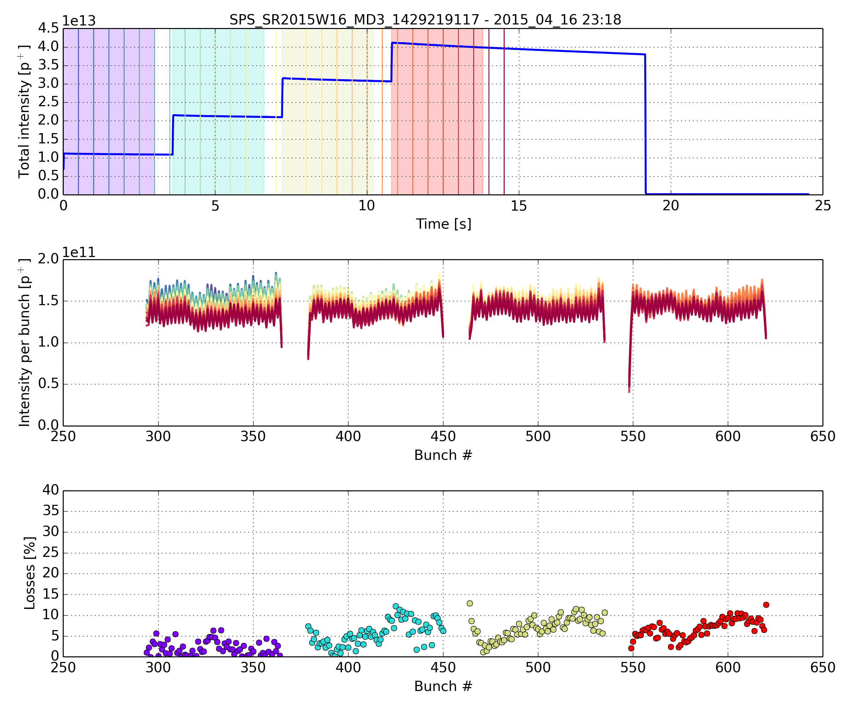
Scrubbing run week 16: highlights
1.6e11 p/b injected, eventually stable, good lifetime, faint electron cloud signature

Slide 8
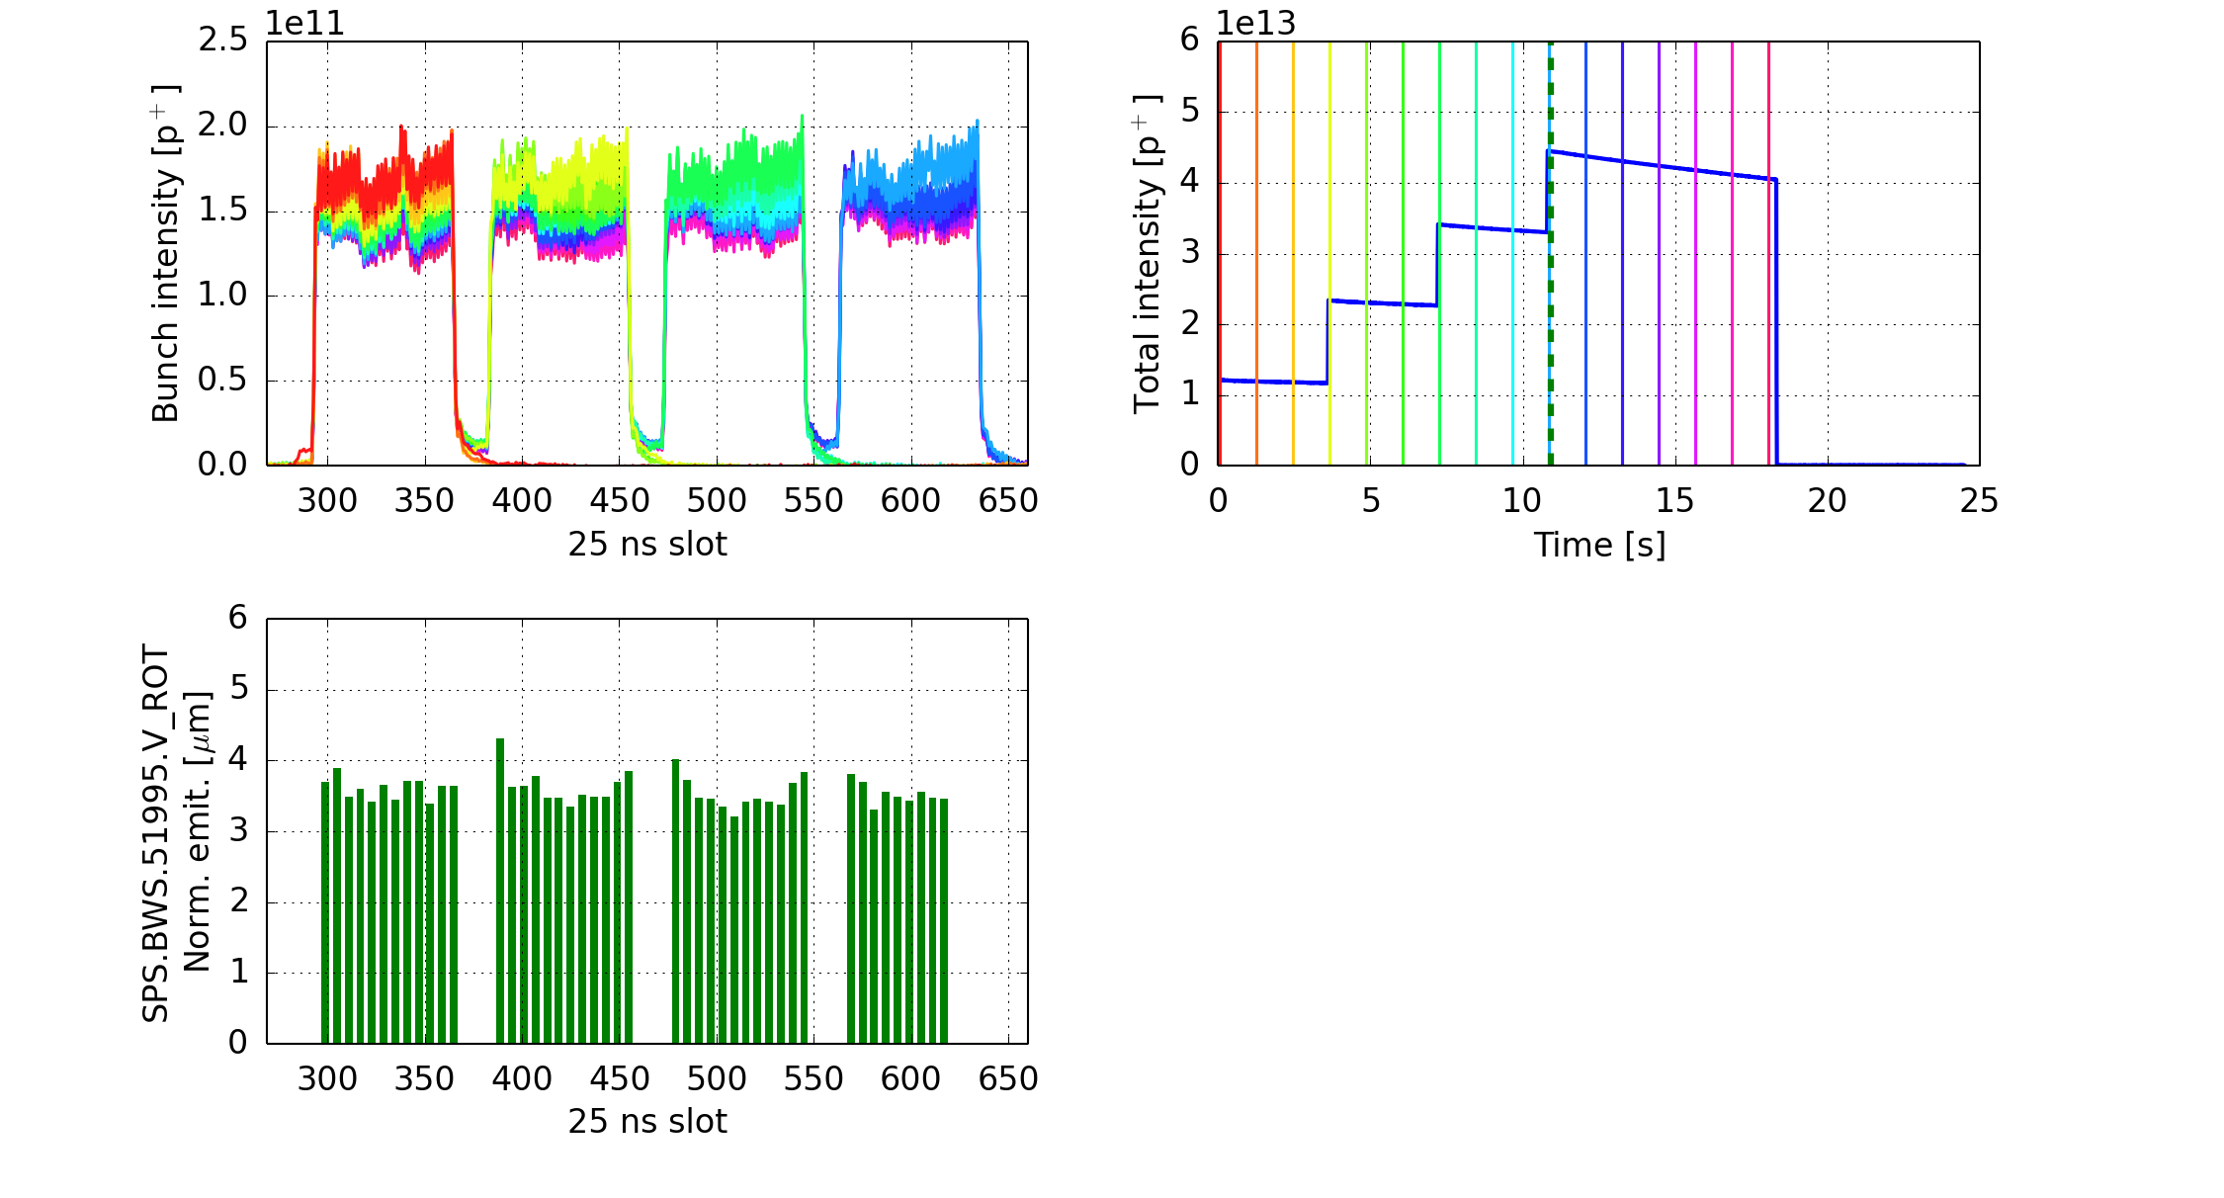
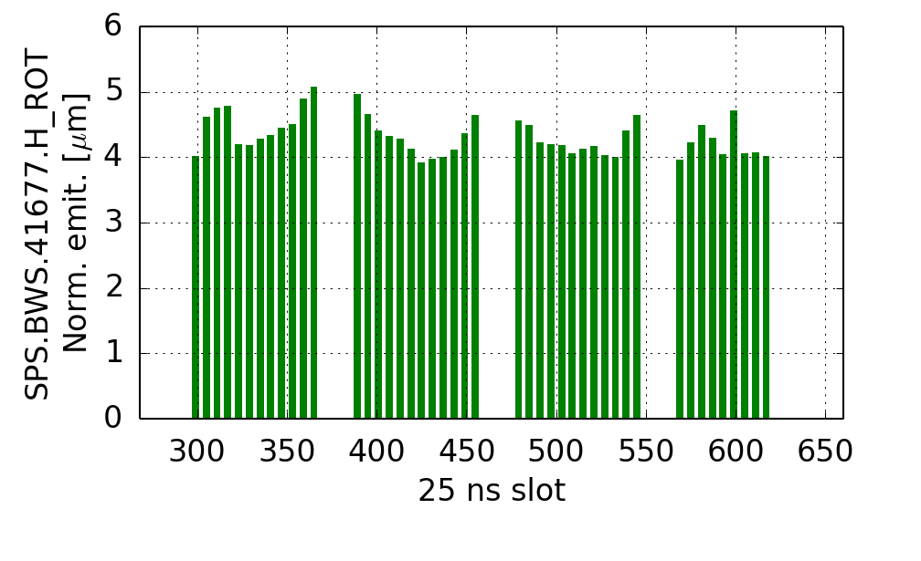
Scrubbing run week 16: highlights
1.6e11 p/b injected, stable, good lifetime, faint electron cloud signature
Emittance measurements

Slide 9
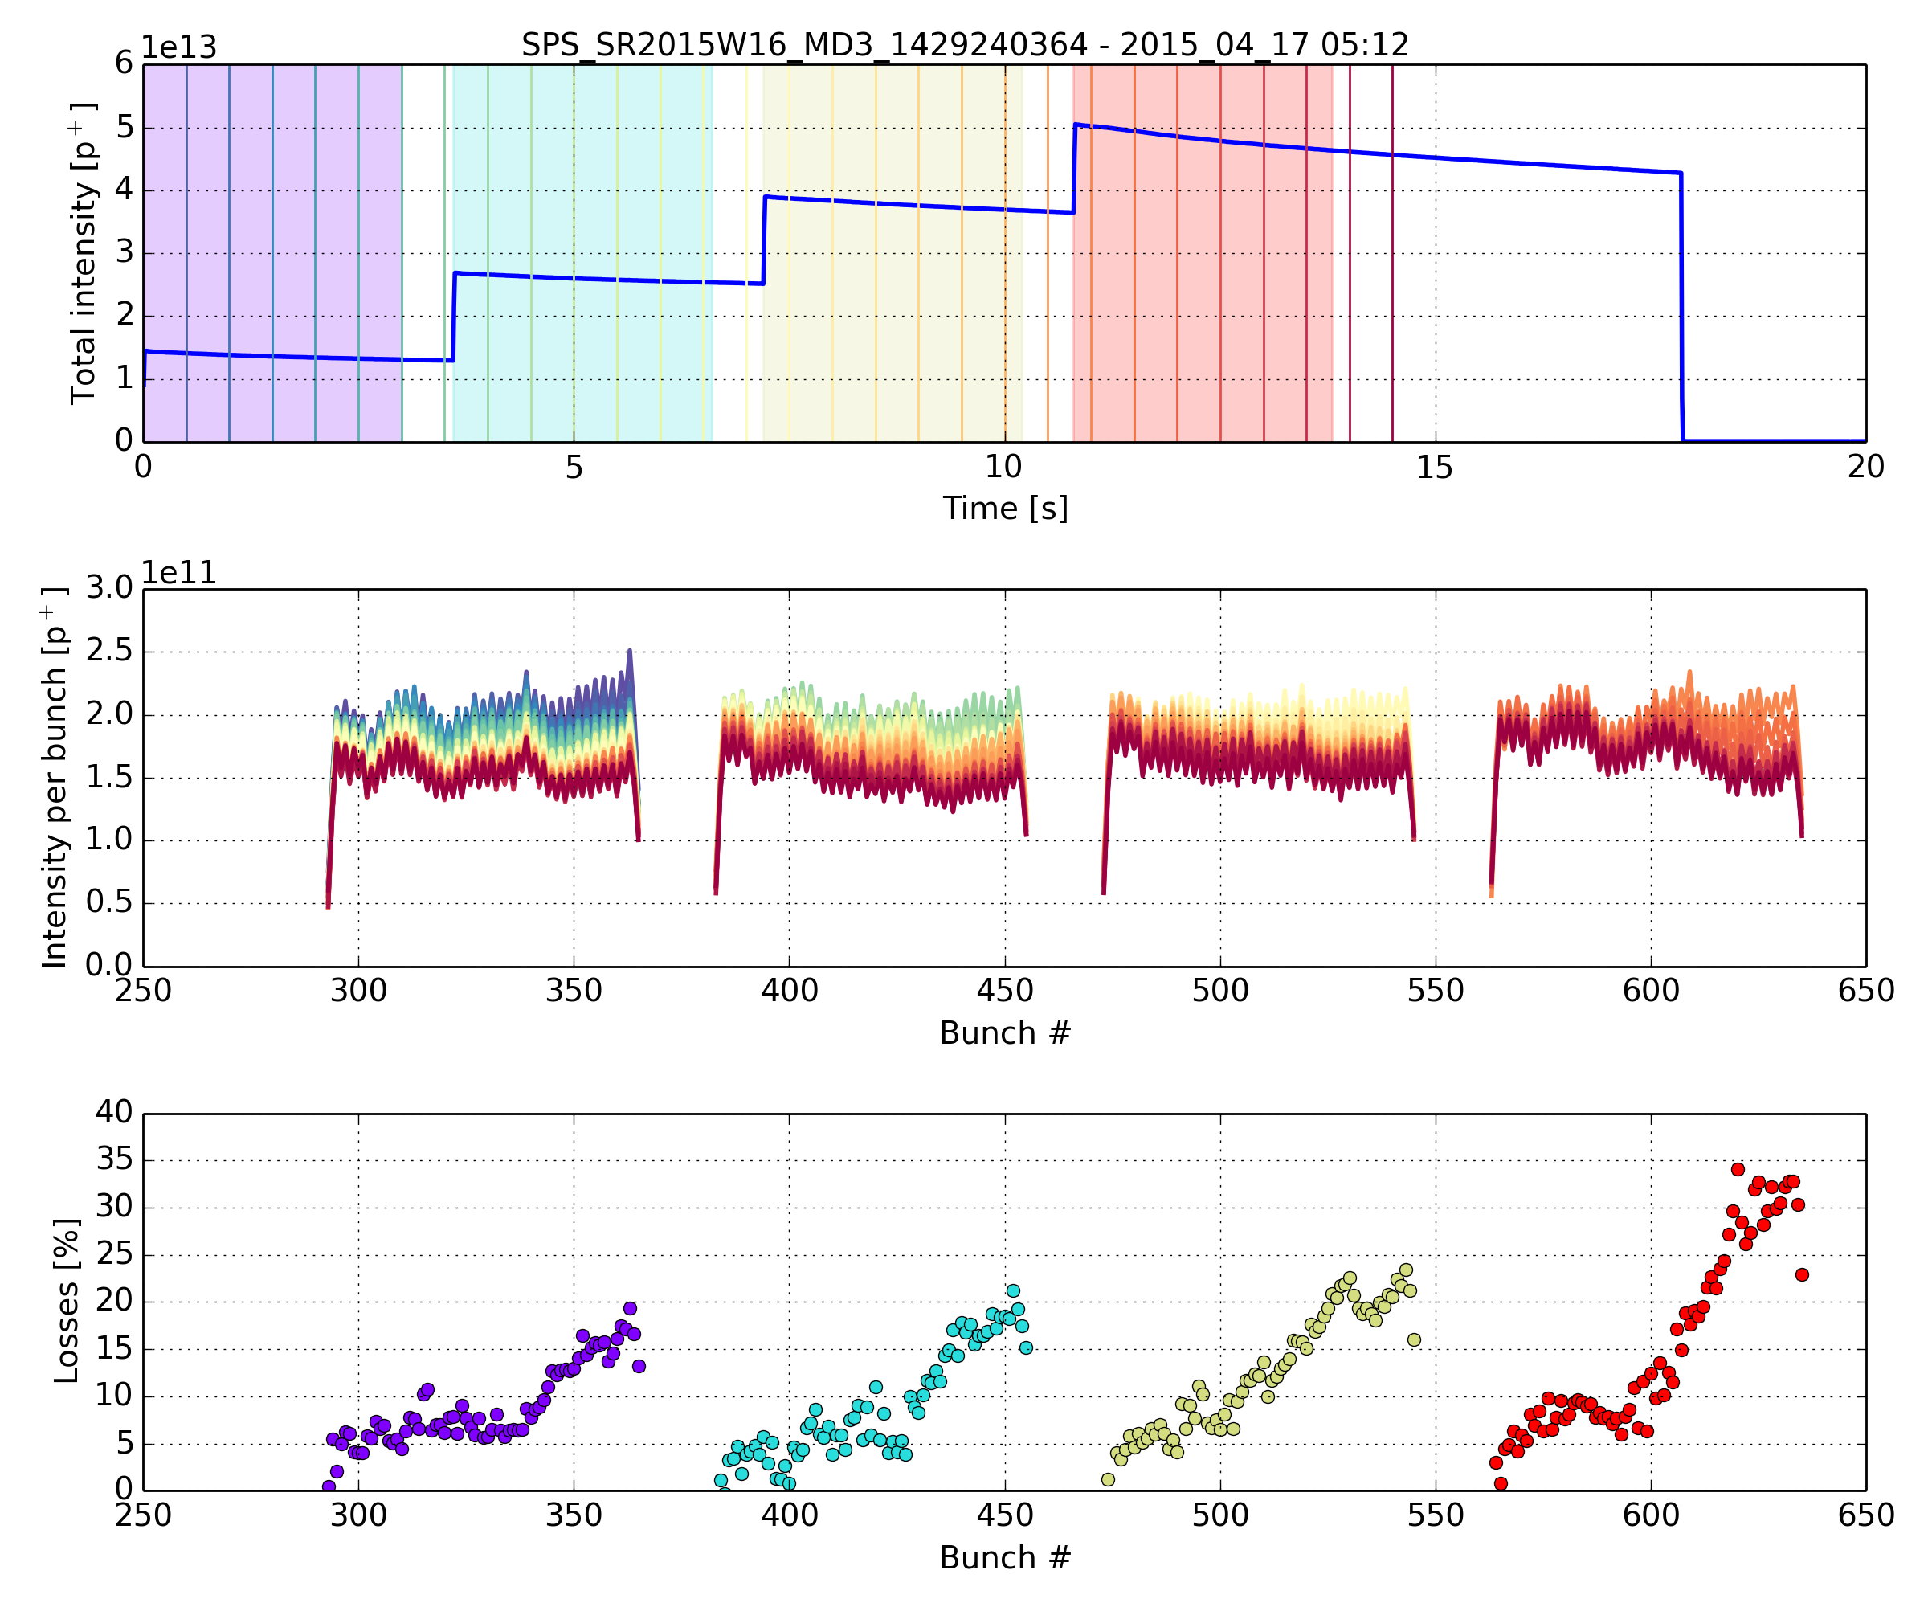
Scrubbing run week 16: highlights
2.0e11 p/b injected, at the limit of stability, significant electron cloud signature on loss pattern.
How much can we improve over the next scrubbing runs?
There are already indications of improvement….

Slide 10
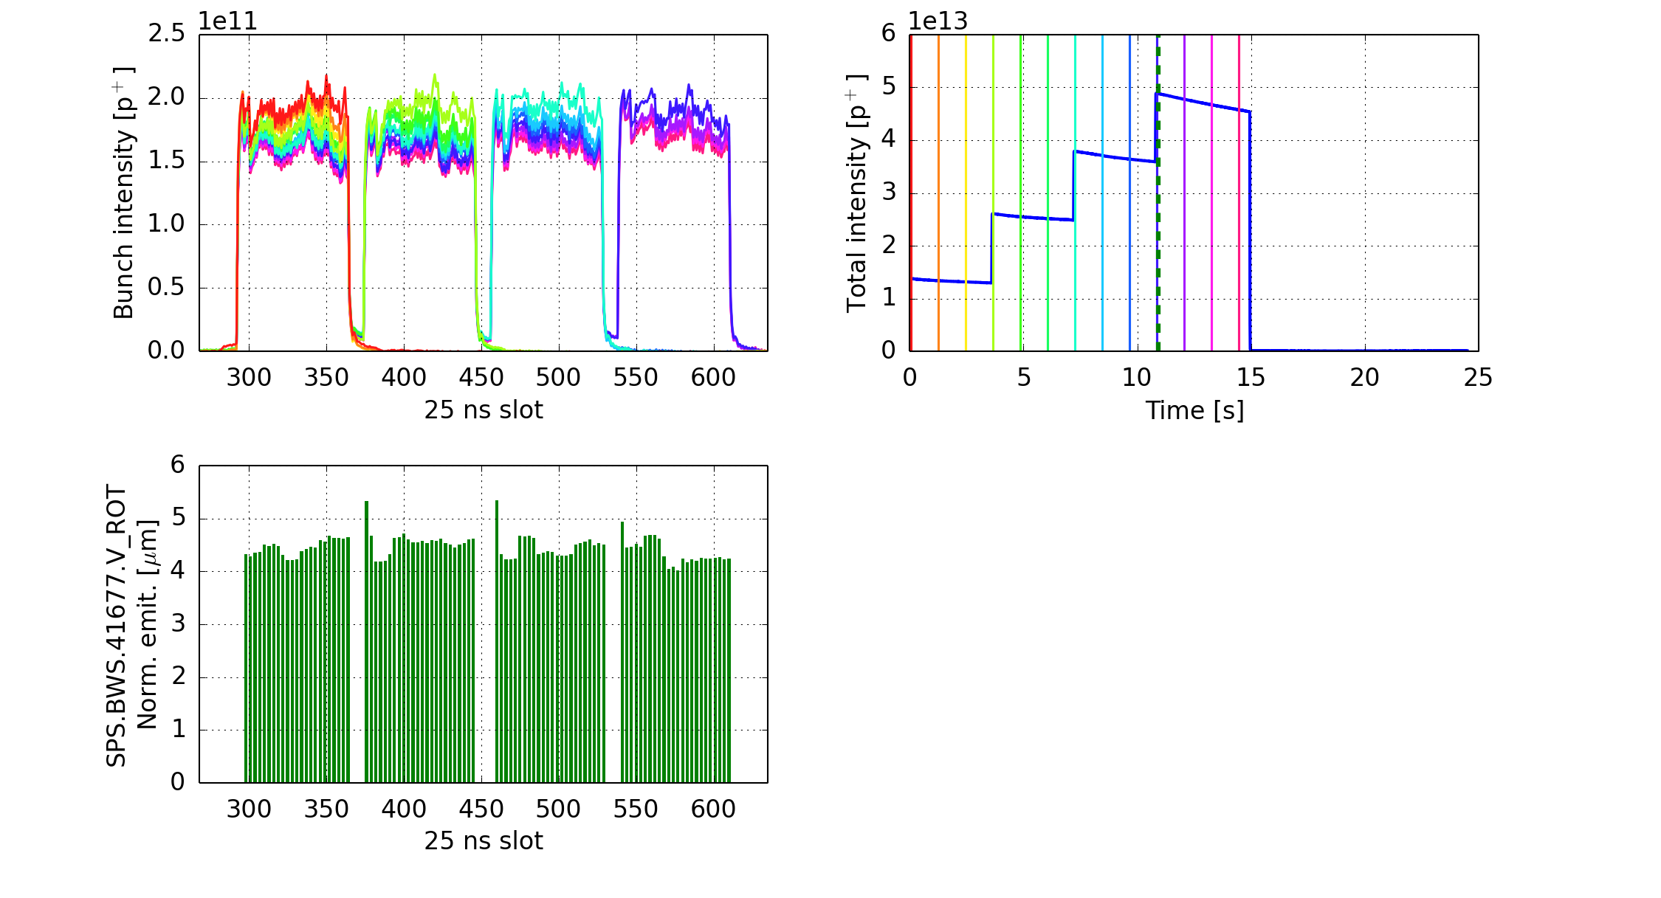
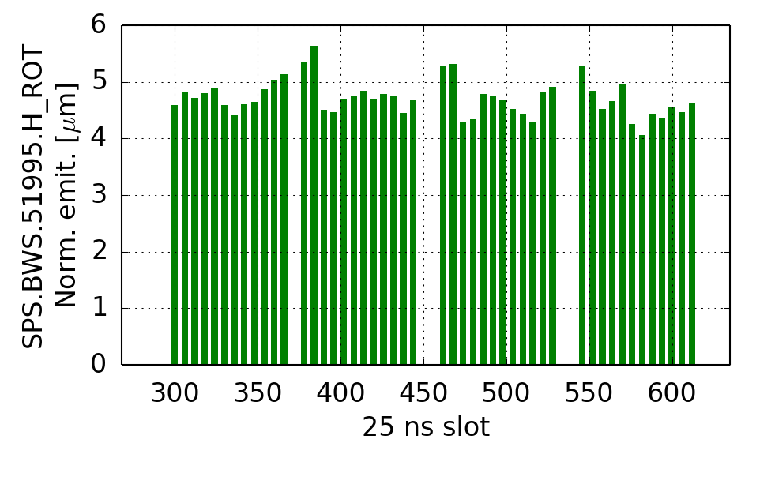
Scrubbing run week 16: highlights
2.0e11 p/b injected, at the limit of stability, significant electron cloud signature on loss pattern.
Emittance measurements at high intensity

Slide 11
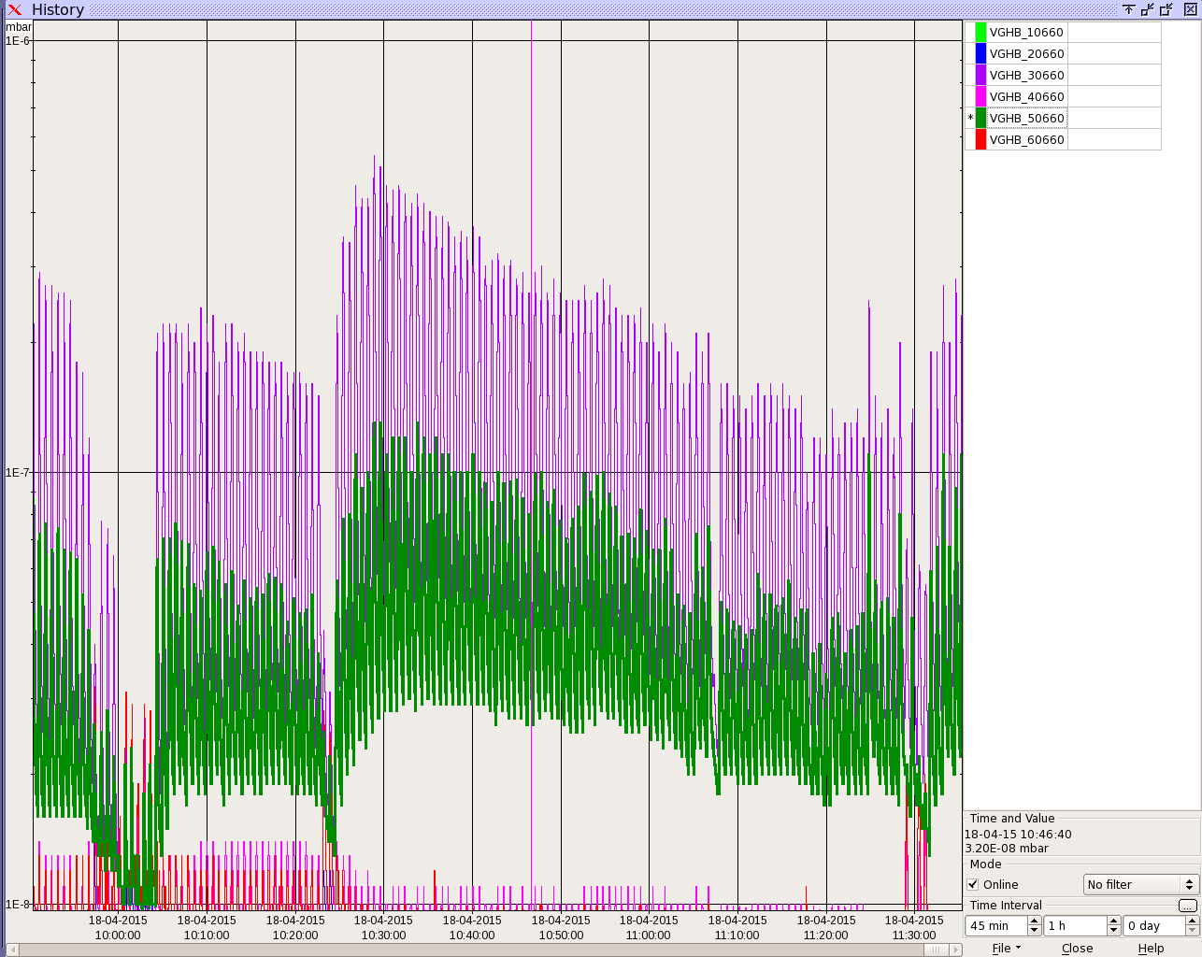
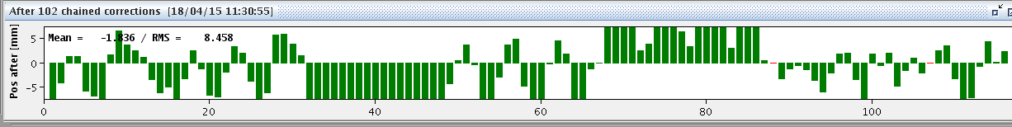
Scrubbing run week 16: highlights
Sweep scrubbing with several batches of doublet beam.
Beam horizontally displaced either by radial steering or by orbit bumps over full arcs.
Large pressure rises observed in ‘swept’ arcs

Slide 12
Scrubbing run week 17: highlights
Main highlights
  Gradual improvement observed on beam with up to 2.0e11 p/b → Observation over long time spans without trims (same machine conditions), lower losses, better lifetime
    Combined effect of optimization and scrubbing?
  Vacuum interlock on MKP4 raised to 7e-7 mbar
    Gives more margin (few hours run with 2e11 p/b beam),
    When limit reached, it was attempted to keep running just below, temperatures @MKP4 above 50º C
  Intensity scan with beam characterization
    Tests of beam stability with different chroma and octupole settings.
  Chroma calibration with single bunch
  Continuation of sweep scrubbing with both doublets and high intensity beam again based on 1) radial steering, or 2) creating orbit bumps over entire SPS arcs.
  Voltage ramp to 7 MV to shorten bunches and enhance the electron cloud

Slide 13
Scrubbing run week 17: highlights
Main highlights
  Gradual improvement observed on beam with up to 2.0e11 p/b → Observation over long time spans without trims (same machine conditions), lower losses, better lifetime
    Combined effect of optimization and scrubbing?
  Vacuum interlock on MKP4 raised to 7e-7 mbar
    Gives more margin (few hours run with 2e11 p/b beam),
    When limit reached, it was attempted to keep running just below, temperatures @MKP4 above 50º C
  Intensity scan with beam characterization
    Tests of beam stability with different chroma and octupole settings.
  Chroma calibration with single bunch
  Continuation of sweep scrubbing with both doublets and high intensity beam again based on 1) radial steering, or 2) creating orbit bumps over entire SPS arcs.
  Voltage ramp to 7 MV to shorten bunches and enhance the electron cloud

Slide 14
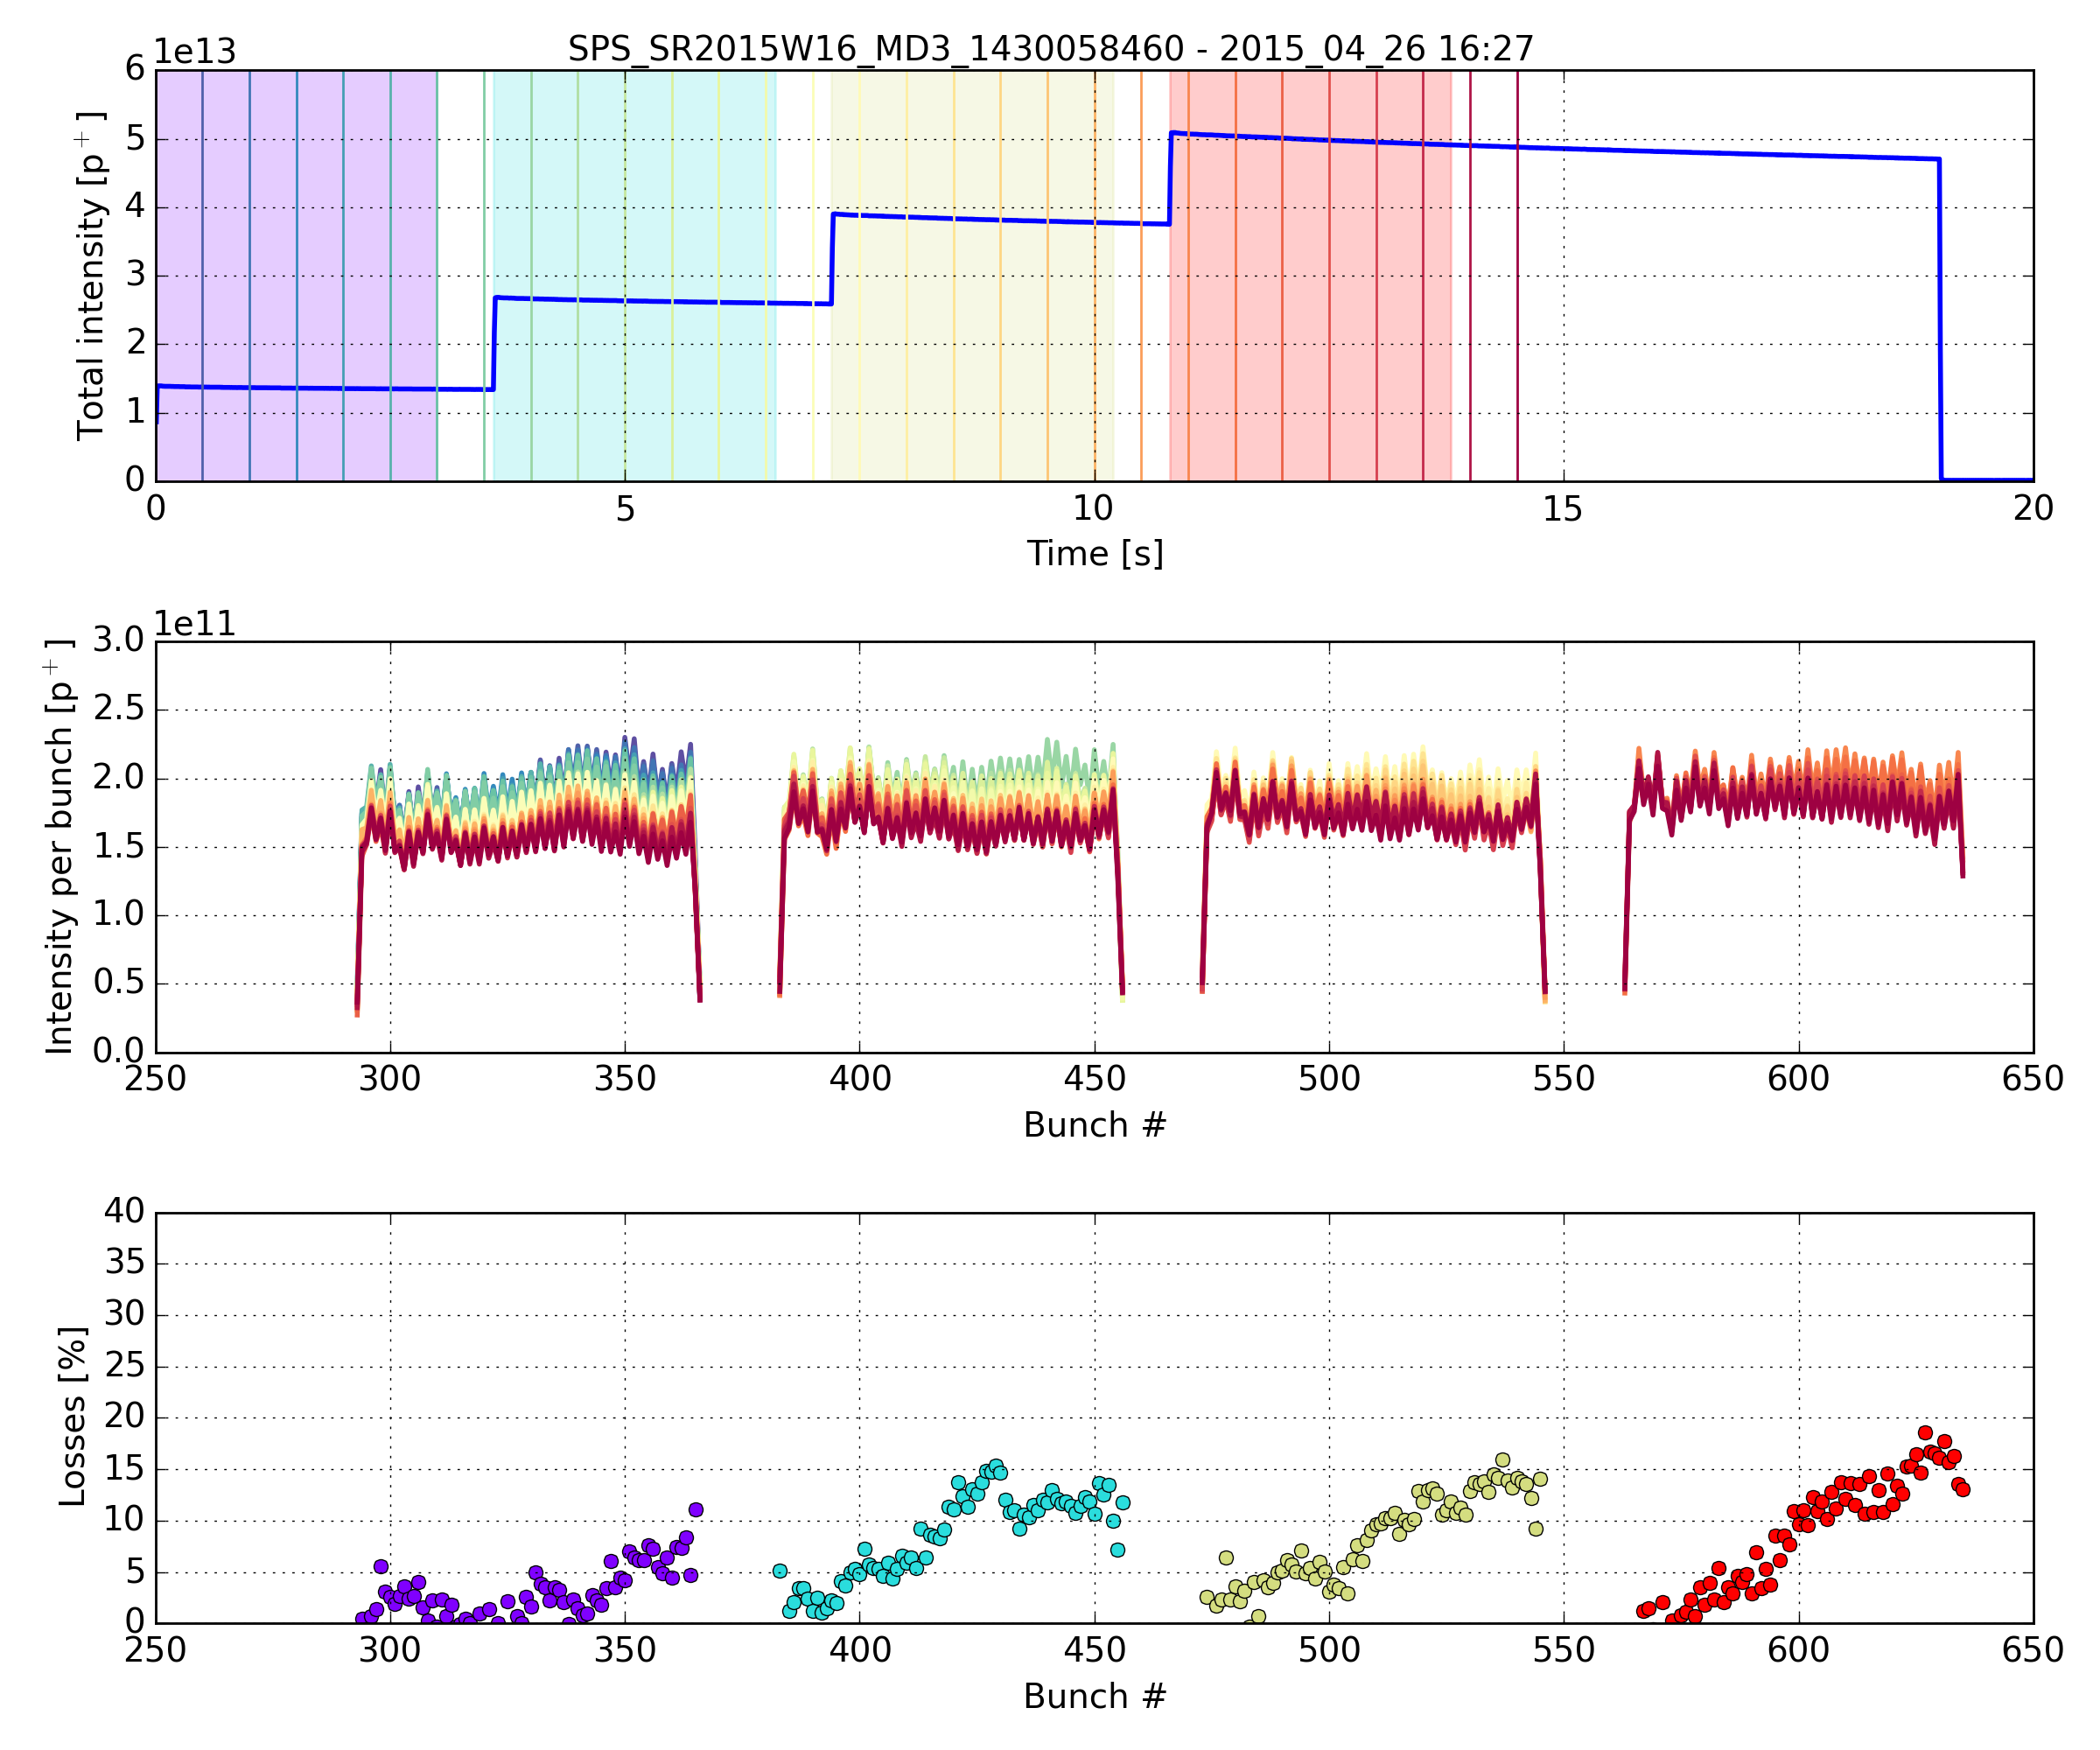
Scrubbing run week 17: highlights
  Losses reduced to below 20% at the end of scrubbing period
  Rolling back to the same machine settings when 35% losses was measured in Week 16 did not reproduce the same losses

Slide 15
Scrubbing run week 17: highlights
Main highlights
  Gradual improvement observed on beam with up to 2.0e11 p/b → Observation over long time spans without trims (same machine conditions), lower losses, better lifetime
    Combined effect of optimization and scrubbing?
  Vacuum interlock on MKP4 raised to 7e-7 mbar
    Gives more margin (few hours run with 2e11 p/b beam),
    When limit reached, it was attempted to keep running just below, temperatures @MKP4 above 50º C
  Intensity scan with beam characterization
    Tests of beam stability with different chroma and octupole settings.
  Chroma calibration with single bunch
  Continuation of sweep scrubbing with both doublets and high intensity beam again based on 1) radial steering, or 2) creating orbit bumps over entire SPS arcs.
  Voltage ramp to 7 MV to shorten bunches and enhance the electron cloud

Slide 16

Scrubbing run week 17: highlights

Slide 17
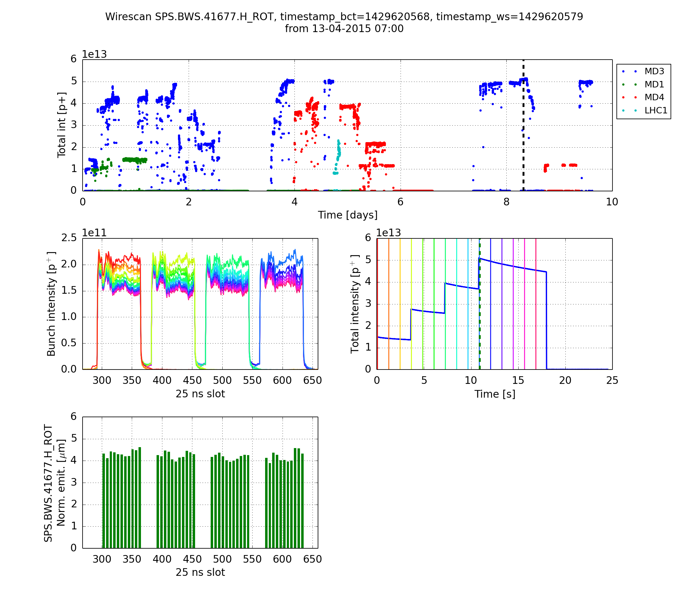
Scrubbing run week 17: highlights

Slide 18
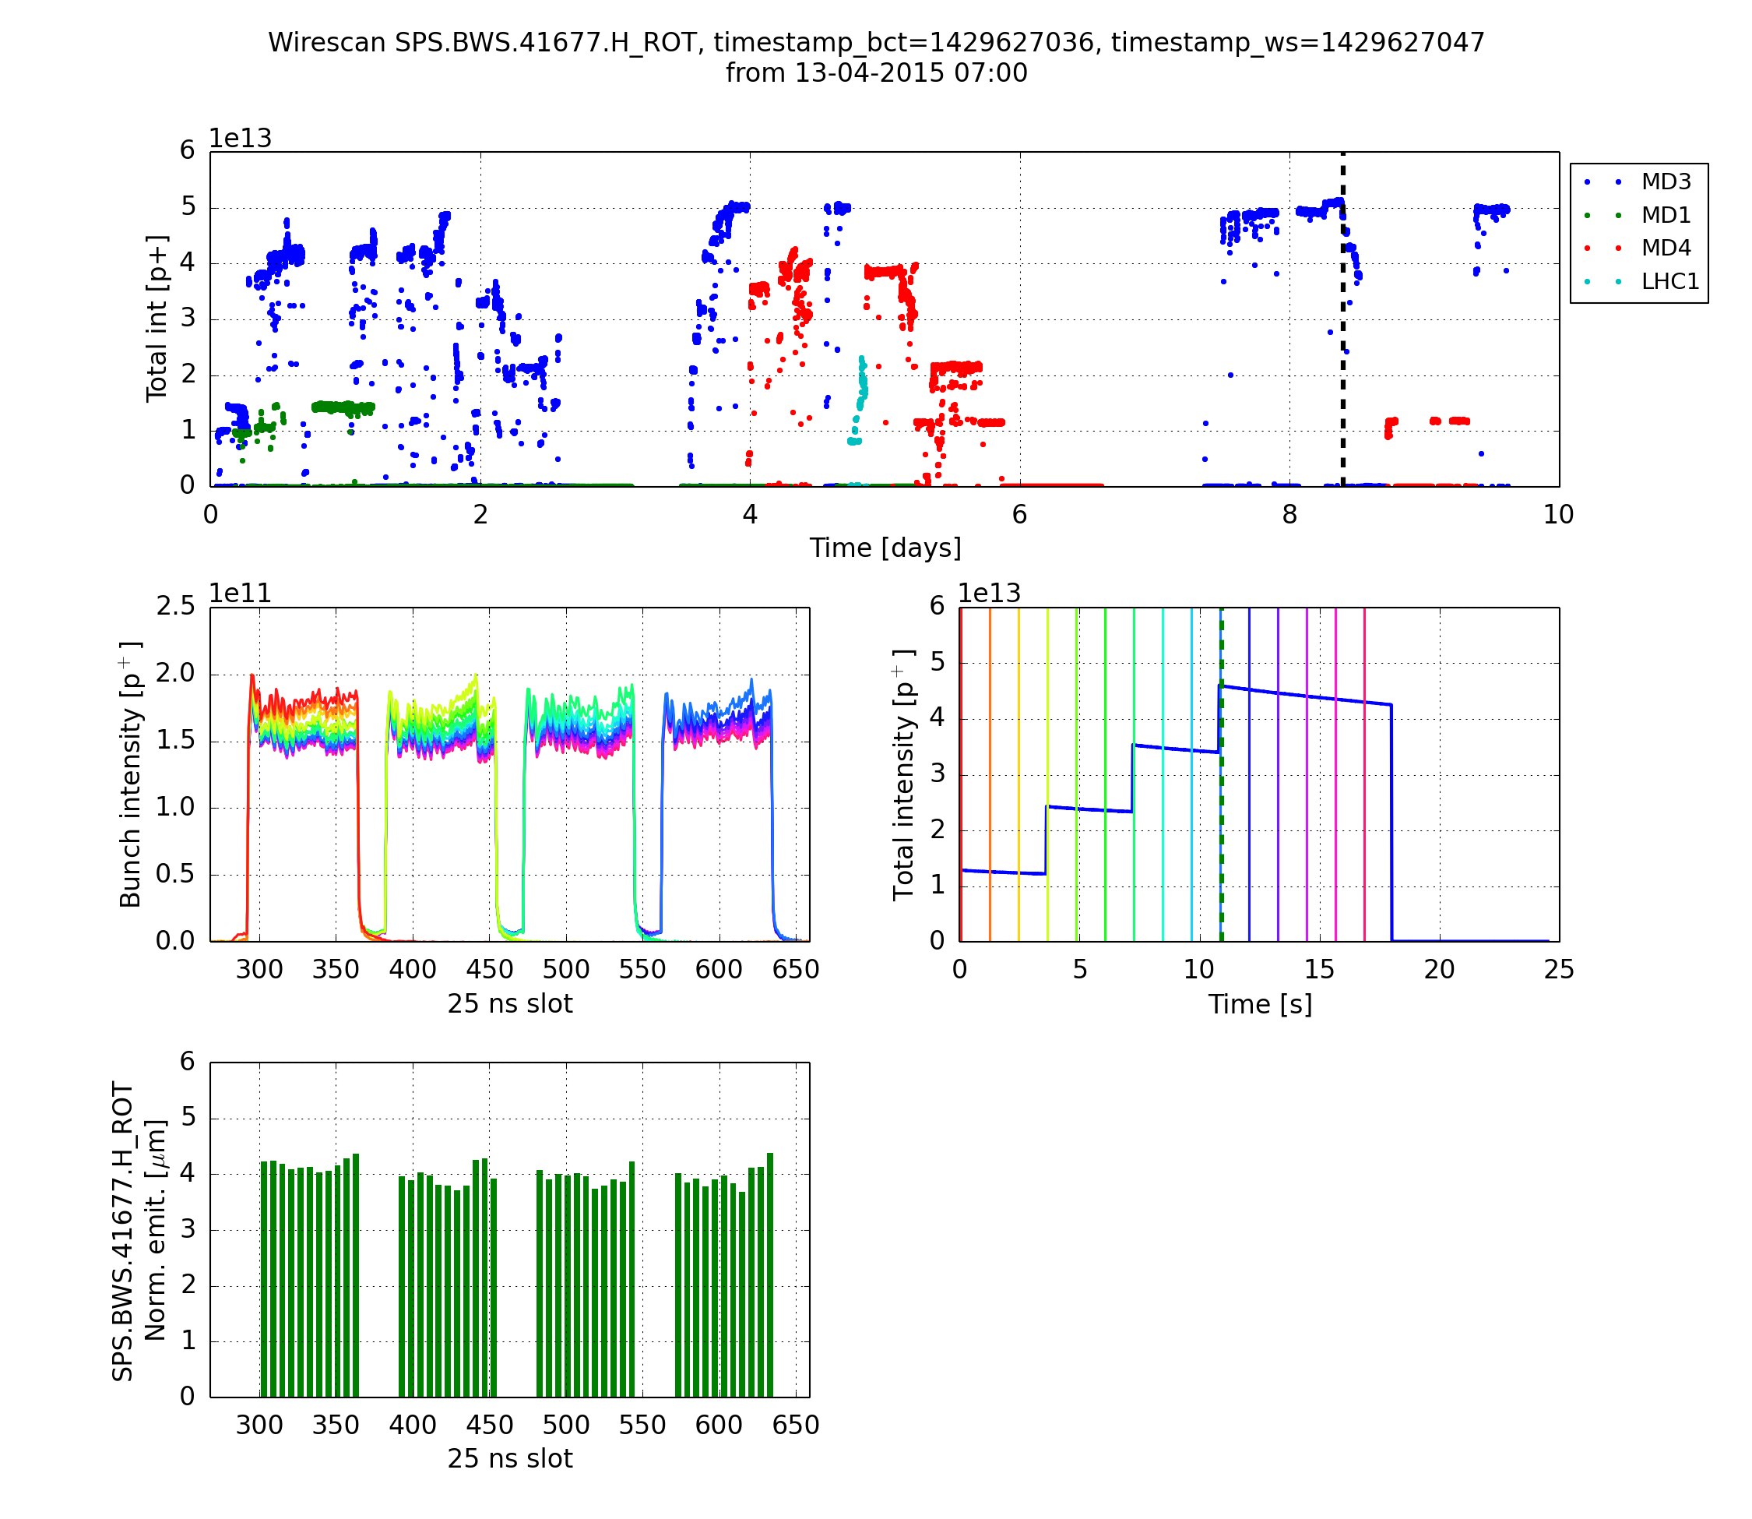
Scrubbing run week 17: highlights

Slide 19
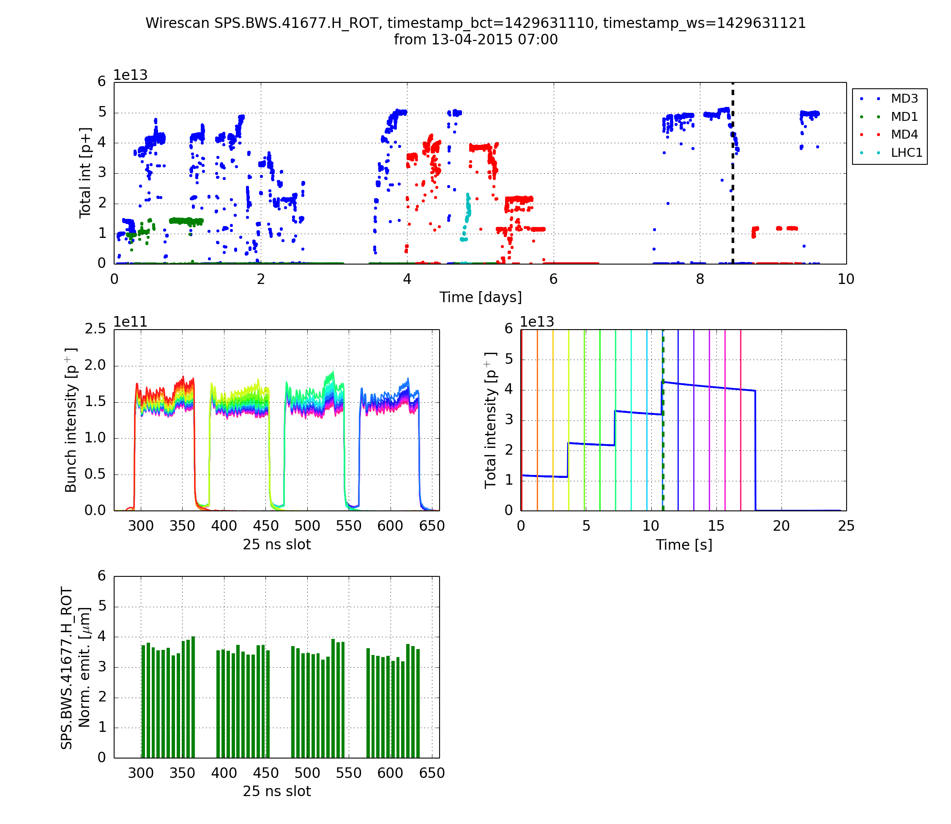
Scrubbing run week 17: highlights

Slide 20
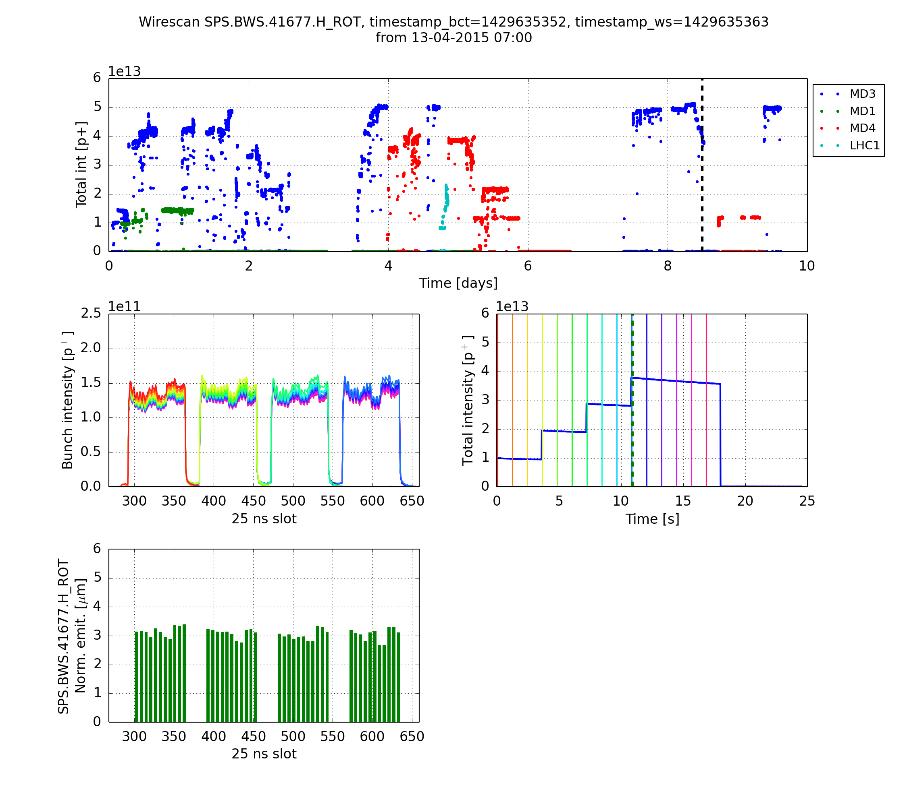
Scrubbing run week 17: highlights

Slide 21
Scrubbing run week 17: highlights

Slide 22
What next?
Continue scrubbing exercise
  With highest beam intensity achievable to clean machine and condition sensitive elements.
    Is it possible to go beyond 2.0e11 p/b at the PS extraction thanks to the new longitudinal feedback? This has been requested but looks to be hard as the current performance seems to be at the limit.
  Apply sweep scrubbing with doublet beam when needed (i.e. during periods of MKP cool-down)
Studies:
  Test RF power limitations by attempting acceleration of high intensity beams
  Try to disentangle lifetime effects due to electron cloud and dynamic aperture (need BCMS at 2.0e11 p/b to compare directly behaviour of batches of 48 bunches with same intensity and different transverse emittances – current best performance is 1.2e11 p/b and pushing this limit will also be hard.)

Slide 23
Thank you for your attention!

