Slide 1
Summary of discussion on isolating flanges
E. Shaposhnikova
With input from LIU-SPS BD WG (in particular H. Bartosik, F. Caspers and J. Varela), K. Cornelis, B. Goddard , BI colleagues (C. Boccard, …)
LIU-SPS BD WG meeting
21.05.2015

Slide 2
Outline
SPS impedance model (reminder)
What do we understand
What do we need to study

Slide 3
Present SPS longitudinal impedance model
Model includes:
200 MHz cavities (2+2)
628 MHz HOM
800 MHz cavities (2)
Kicker magnets (8 MKEs,
4 MKPs, 5 MKDs, 2 MKQs)
Vacuum flanges (~500) + DR
BPMs: BPH&BPV (~200)
Unshielded pumping ports (~ 16 similar + 24 various)
- non-conformal assumed 0
Y–chambers (2 COLDEX + 1)
Beam scrappers (3 S + 4 UA9)
Resistive wall
AEPs (RF phase PUs, 2) ~ 0
Model doesn’t include:
6 ZSs + PMs
25 MSE/MST + PMs
HOMs 200 MHz & 800 MHz
RF
RF
VF
HOM
Scrap.
VF
BPM
Y-c
EM simulations of J. Varela & C. Zannini
+ Lab measurements for 200 MHz, PPs, VFs (J. Varela et al.)

Slide 4
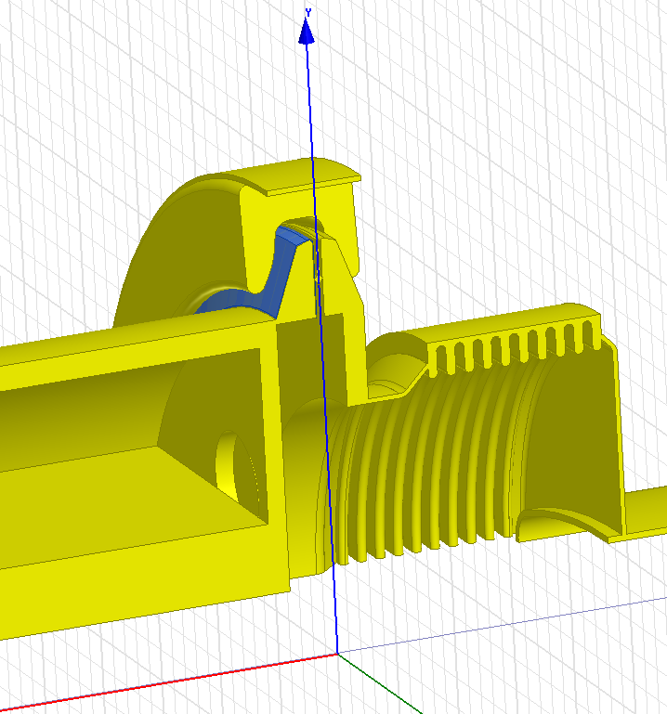
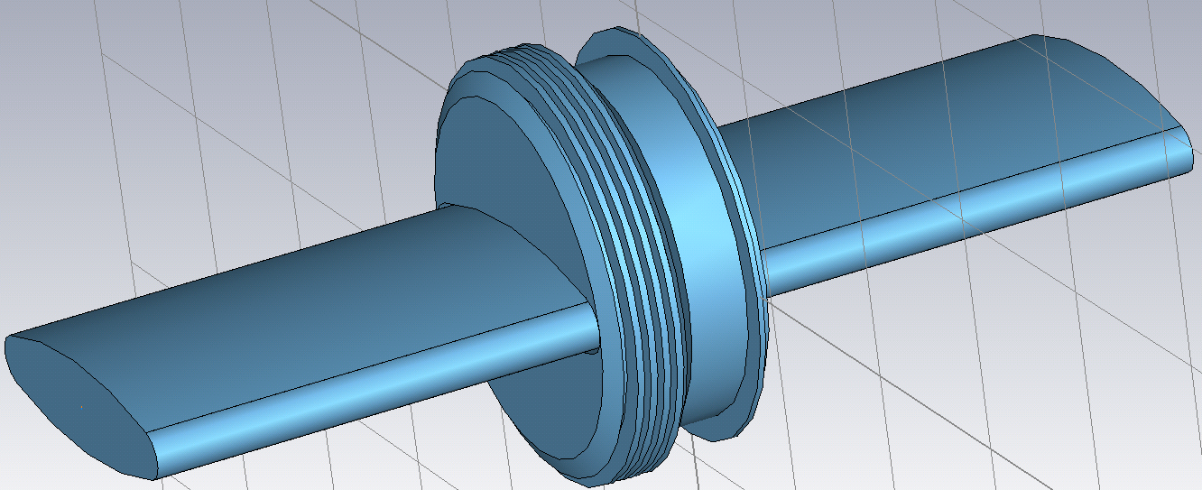
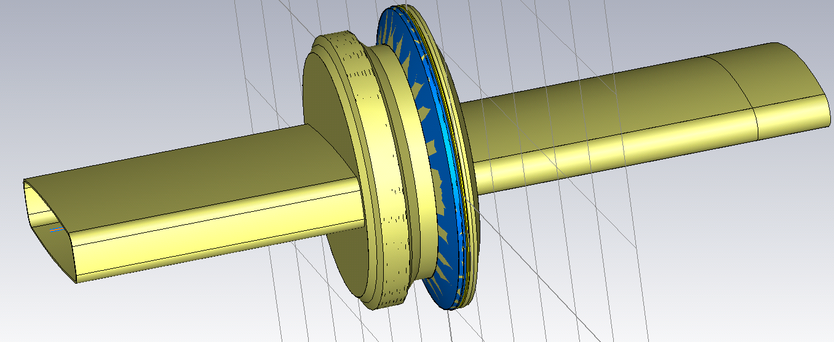
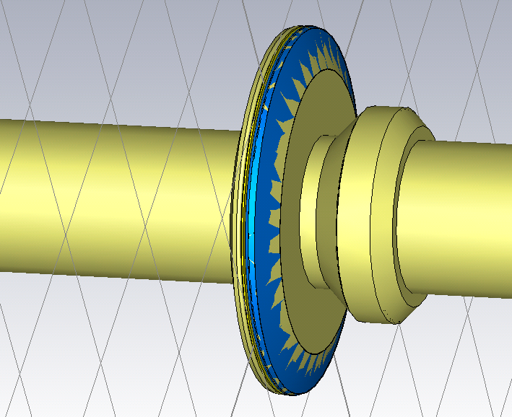
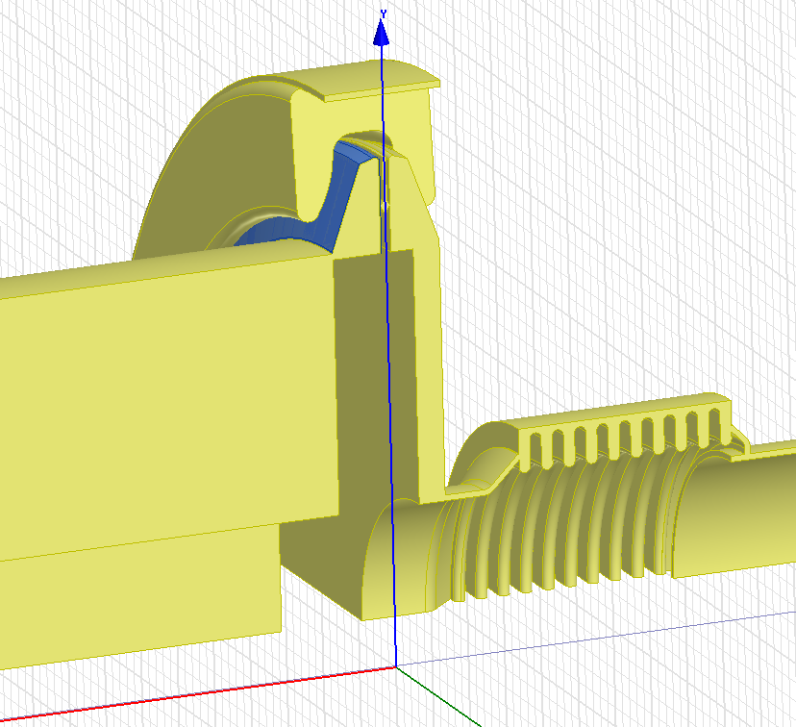
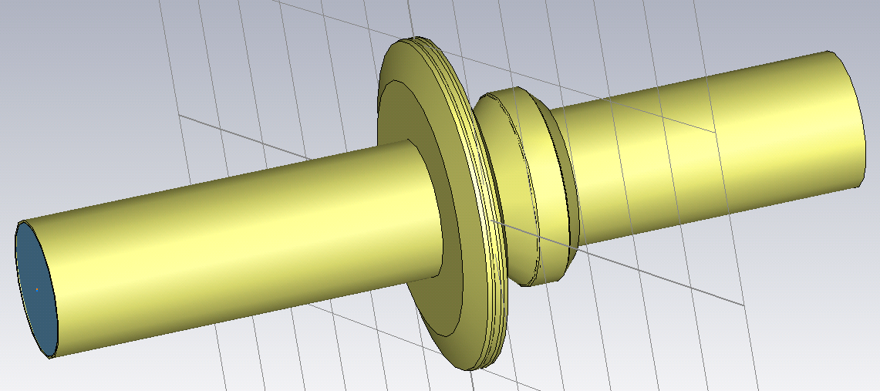
The SPS vacuum flanges
Group I – 1.4 GHz
Non-enamelled QF - QF ≈ 26
Enamelled QF - MBA ≈ 97
Non-shielded, enamelled BPH - QF ≈ 39
+ 64 shielded
Group II
Non-enamelled QD - QD ≈ 75
Enamelled QD - QD ≈ 99
Enamelled BPV - Q ≈ 90

Slide 5
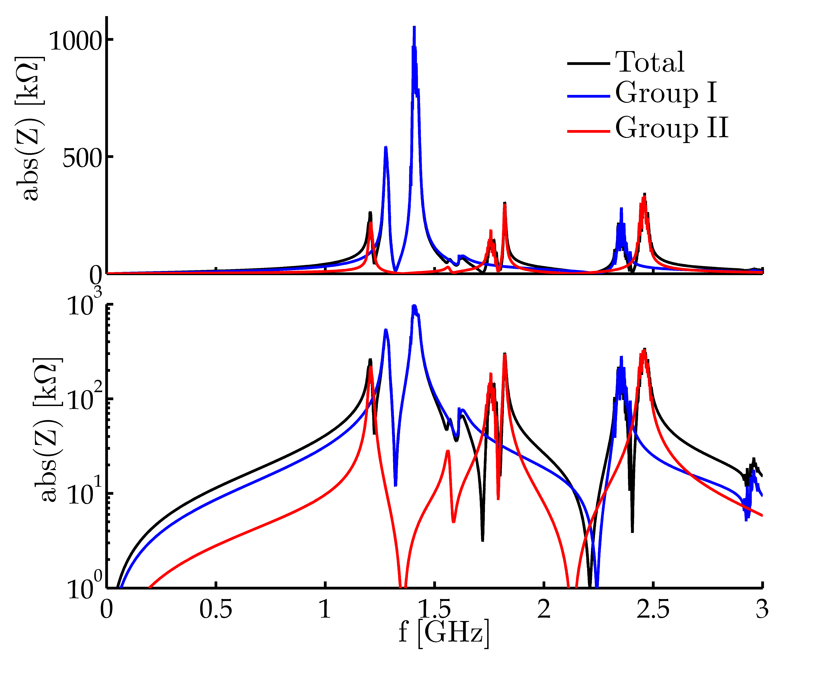
The SPS vacuum flanges
Scattered resonances, J. Varela

Slide 6
Insulating (Enamel) flanges in the SPS: motivation
The impact of eddy currents on the beam is seen in chromaticity variation along the ramp and its decay at the injection plateau. However it is not clear if this effect is mainly connected to eddy currents in beam pipes or in grounding loops
Insulating flanges were installed to avoid eddy-current in the loops formed by grounding cables (one at each last dipole in ½ cell)
If existing insulated flanges are short-circuited, the dynamic effect of eddy currents could be enhanced due to grounding loops
Checks during LS1 (OP, VAC, RF) show that new layouts often don’t have information about isolation flanges and groundings (as well as for damping resistors) and don’t correspond to reality
Isolating flange together with grounding loop forms a resonator (PS: f_{res}≈ 1.5 MHz, Q ≈ 1, n ≈ 200 - a huge source of PS impedance cured by RF by-pass). Preliminary measurements were also done in the SPS (F. Caspers, 2013): f_{res} ~ 25 MHz (?), impedance not known

Slide 7
Isolating flanges around BPMs
VF
BPM
grounding cable

Slide 8
Insulating (Enamel) flanges in the SPS
~389 enamelled PUs around each BPM
64 from them are short-circuited due to impedance shielding (similar to pumping ports); 39 of the same type are not shielded
BI didn’t see any negative effects of short-circuits
future BPM MOPOS system will use transformers (&optic link)
~23 RF PUs with enamelled flanges on both sides. These PUs are grounded via coaxial cables going to BA3 (FC). A few of them had isolation problems (T. Bohl)
6 PUs used for transverse damper (W. Hofle) – insulation is under investigation
There are others devices, mainly in LSSs (individual equipment) – not in the list for impedance reduction

Slide 9
Possible actions/studies
An experimental check of the effect of ground loops on the new MOPOS electronics could be done with the BPMs used for the transverse damper, which are already equipped with the new electronics, by short-circuiting the adjacent Enamel flanges
The eddy currents in ground loops induced by the variation of the magnetic field and the resulting multipole components seen by the beam could be simulated (?)
A test could be done by short-circuiting a large number of Enamel flanges (?).
One can question present SPS groundings and study their improvements (F. Caspers) –> ideas for different tests in lab and tunnel

Slide 10
Summary
Isolated flanges should be preserved where they are already installed unless another equivalent solution is implemented via grounding cables (as for new MOPOS system or transverse damper - tbc)
Existing shielding of isolating flanges is not necessary should be removed if another isolating flange is kept and then grounding loop is avoided by other means
Type of shielding of existing isolating flanges near BPM could be decided after some additional tests
“Cleaning” of the SPS ring (layouts, grounding loops, isolation) could help for future operation and diagnostics

Slide 11
Impedance of vacuum flanges
Element | Enam | Res. * | Num. | f [GHz] | Z [kΩ] | Q | R/Q [Ω]
Flanges [ Simulation Table ] * Damping Resistors have not been included in Simulations. This column states whether or not the flange SHOULD have a damping resistor inside (and its type). ** The enamelled QF-MBA case is assumed to be identical to the measured enamelled MBA-MBA flange. Should be very close in reality. *** Survey by Jose A. Ferreira (18/26 flanges surveyed). ! Damping resistor presence percentage is assumed to be identical to the *** case. !! The effect of the LONG damping resistors has not been estimated. In this table, it is assumed to be identical to a SHORT damping resistor. m Indicated entries that have been measured in the lab. | Yes | No | 90 | 1.210 | 633 | 315 | 2010
 | Yes | Long | 39 | 1.280 | 499 | 200 !! | 2495
 | Yes | Short | 90% of 83 ! | 1.415** | 364 | 75 ** | 4856** ± 5%
 | Yes | No | 10% of 83 ! | 1.415** | 177 | 270 ** | 656** ± 5%
 | Yes | Short | 90% of 14 ! | 1.415m | 61.4 | 75 | 819 ± 5%
 | Yes | No | 10% of 14 ! | 1.415m | 29.9 | 270 | 110 ± 5%
 | No | Short | 90% of 26 *** | 1.395m | 379 | 200 | 1895 ± 2.5%
 | No | No | 10% of 26 *** | 1.401m | 243 | 1100 | 221 ± 2.5%
 | Yes | No | 99 | 1.570 | 17.4 | 55 | 316
 | No | No | 20 | 1.610 | 588 | 980 | 600
 | Yes | Long | 39 | 1.620 | 61 | 60 !! | 1016
 | No | Yes | 75 | 1.861 | 771 | 810 | 952
 | Yes | No | 99 | 1.890 | 187 | 175 | 1070
 | No | Yes | 75 | 2.495 | 814 | 1190 | 685
data from J. Varela

