Slide 1
Multi-bunch measurements
T. Argyropoulos, T. Bohl, A. Lasheen, J. E. Muller, E. Shaposhnikova,
LIU-SPS BD WG 21/05/2015

Slide 2
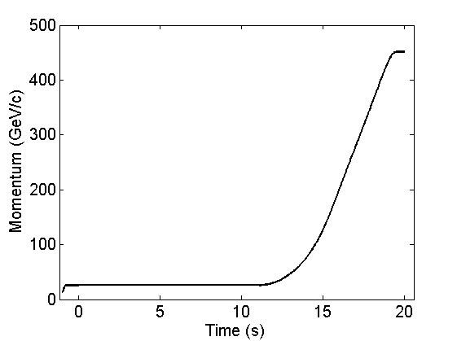
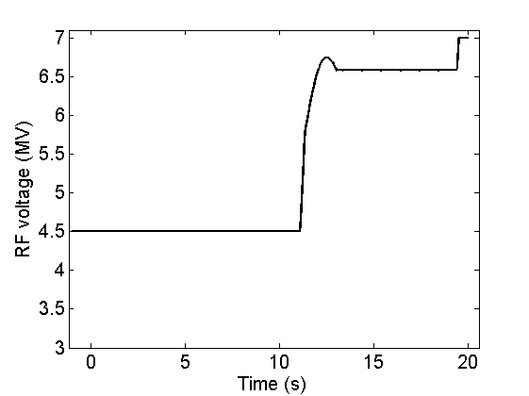
Measurements
4 dedicated MDs: MD1:08/10/2014, MD2:29/04/2015, MD3:06/05/2015, MD4: 13/05/2015
Aim:
instability threshold in a single RF system with 12 bunches
Instability threshold in a single RF system with different number of bunches and different batch schemes (12b (gap) 12b)
Instability threshold in a double RF system with different number of bunches not systematic measurements (high intensity is needed)
Beam parameters: nominal longitudinal emittance and varying intensity
For most of the measurements PL, FB, FFW, LD were ON (except the first MD)
New LHC cycle was used: LHCMD_25ns_SLOW_Q20_2014_V1

Slide 3
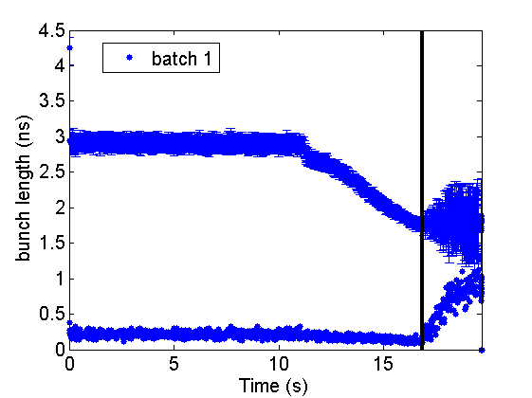
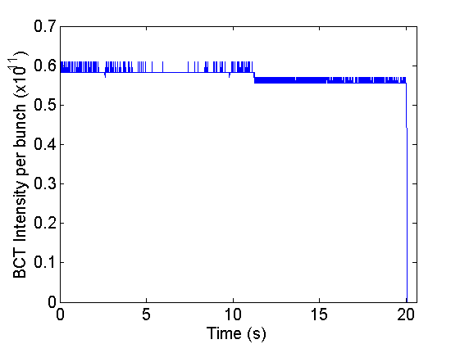
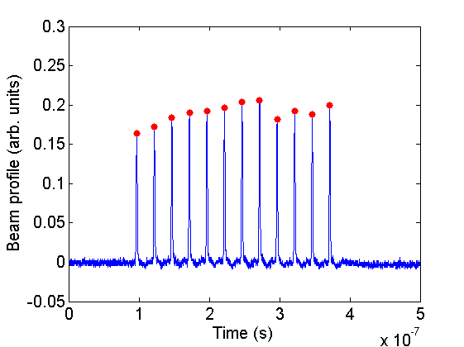
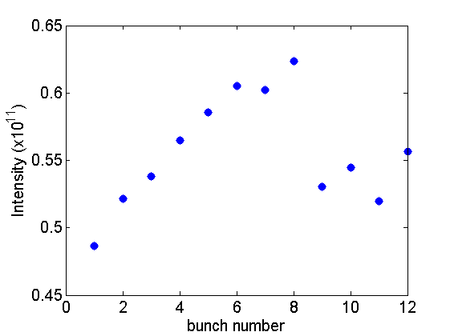
Example of measurements
Example from MD1 (only 12 bunches that day)
265 GeV/c
Normalized
Intensity

Slide 4
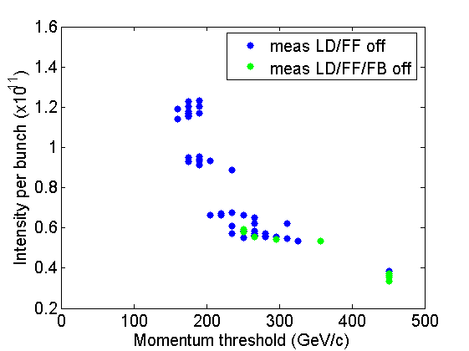
Summary of measurements in MD1
Instability threshold in energy versus the bunch intensity
Scatter due to variation in beam parameters:
bunch length, emittance, intensity per bunch
Intensity threshold for
stable beam at flat top
0.38x10¹¹ p/b < N_{p} < 0.53x10¹¹ p/b
Simulations using the SPS longitudinal impedance model to reproduce these results (work in progress)

Slide 5
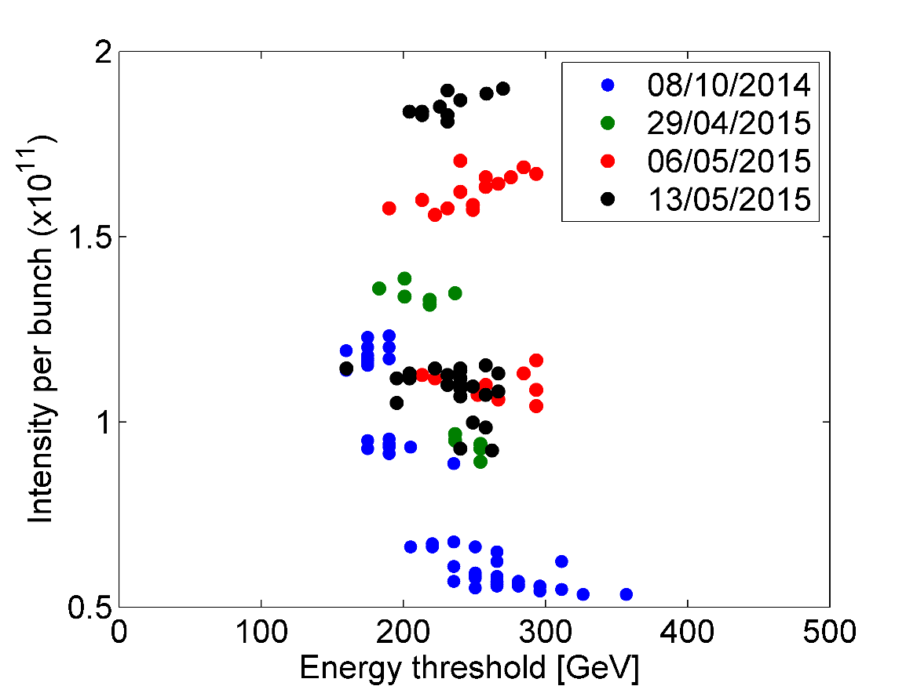
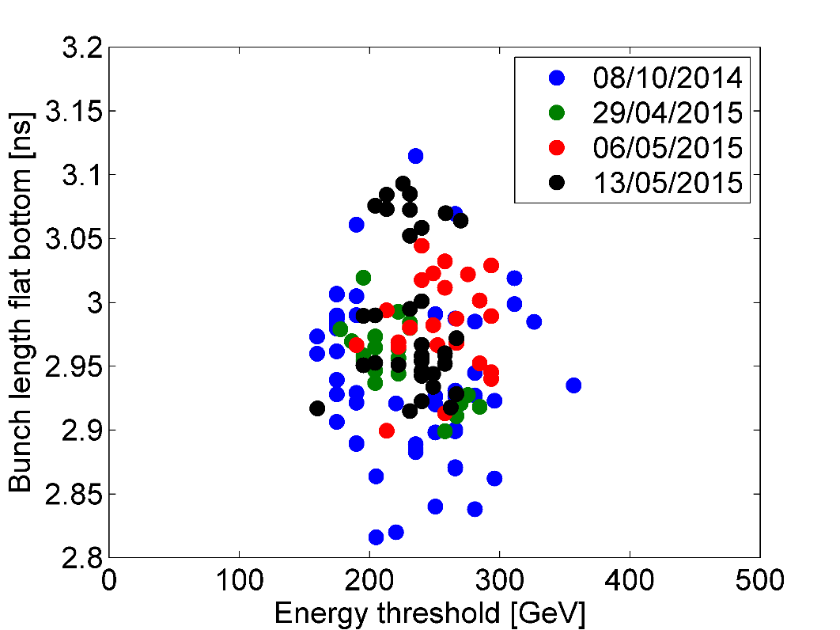
Instability threshold with 12 bunches
Sharp energy threshold with respect to bunch intensity
~6% scatter in bunch length

Slide 6
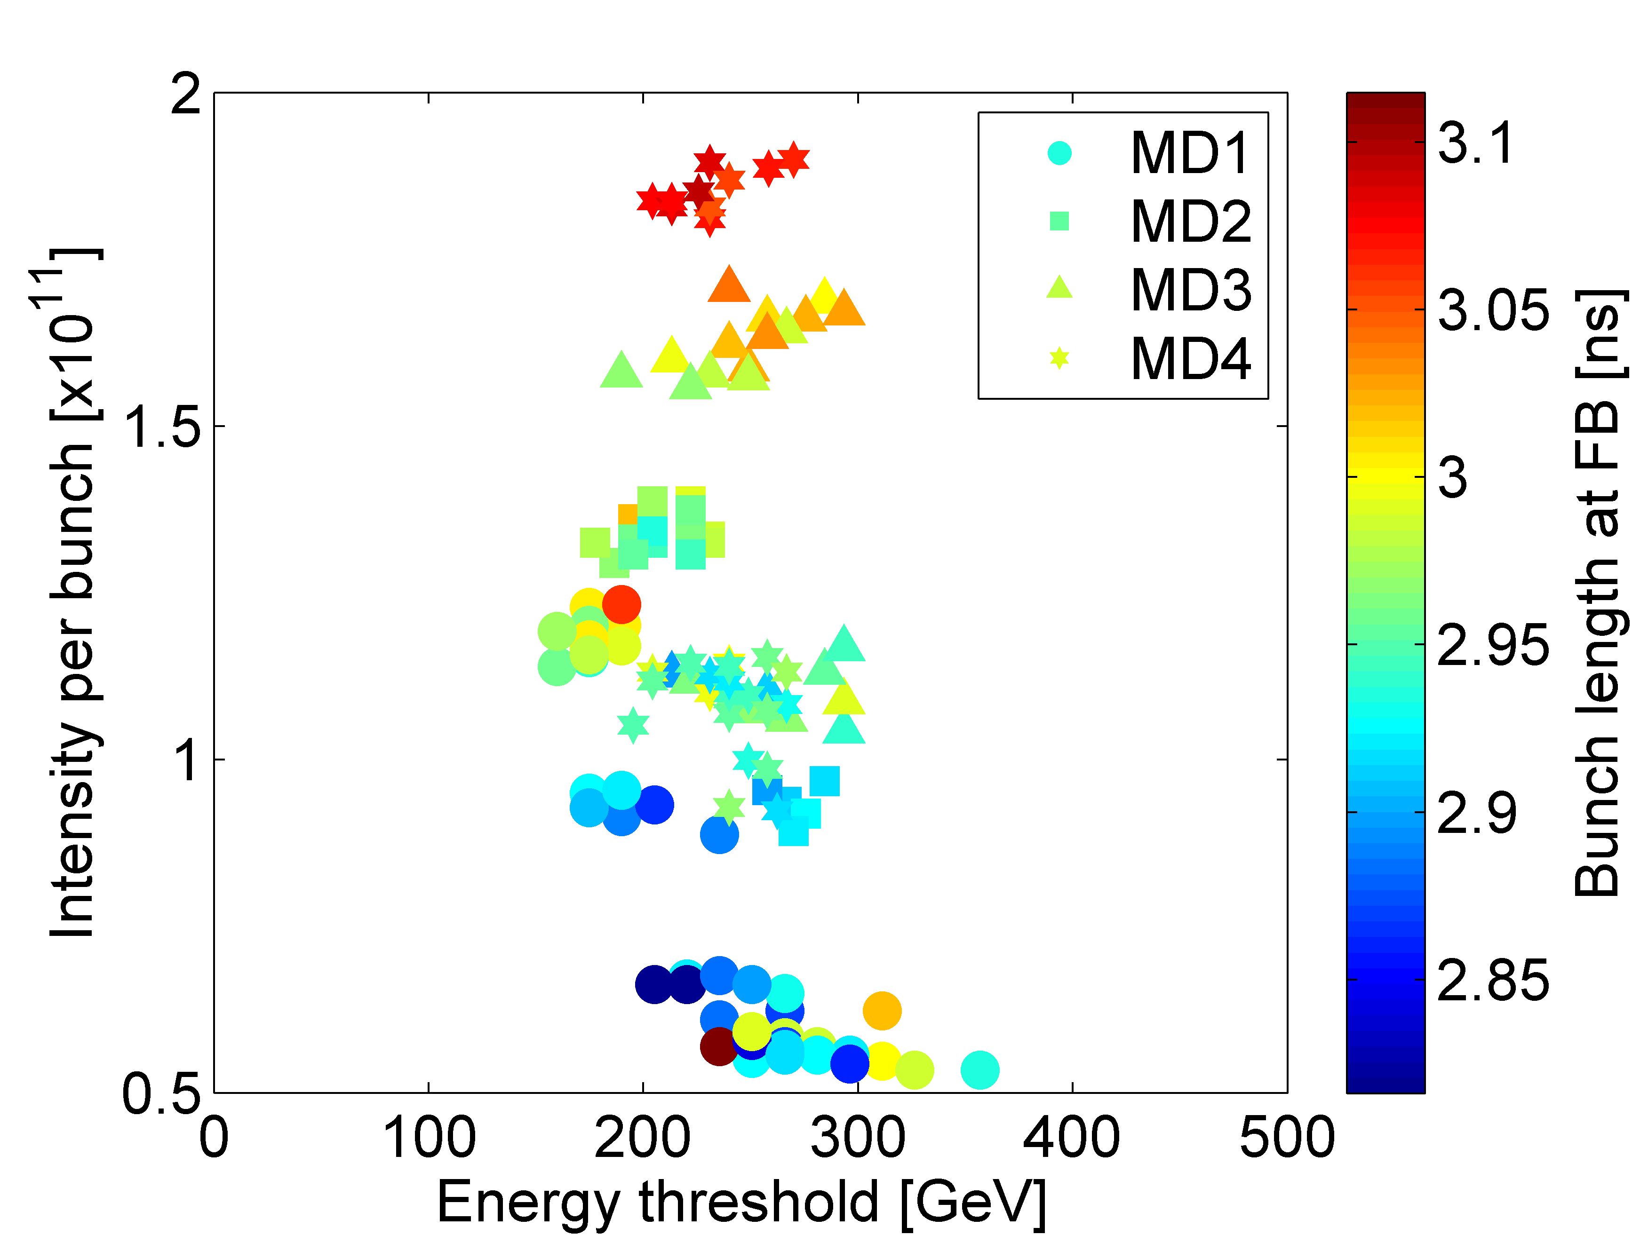
Instability threshold with 12 bunches

Slide 7
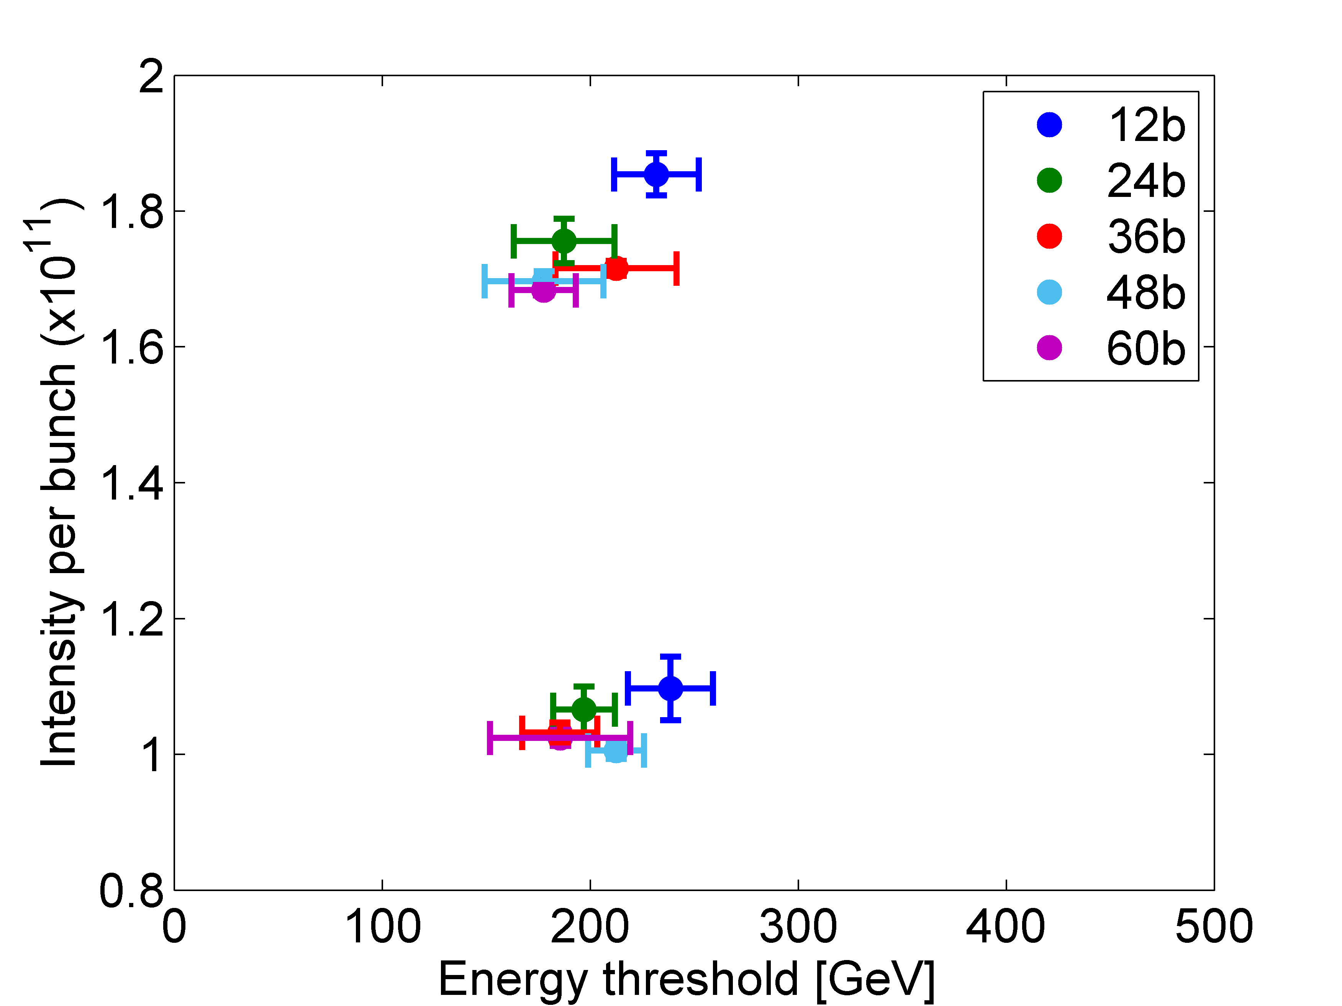
Instability threshold for different number of bunches
Investigate which are the characteristics of the impedance that is driving the multi-bunch instability → identify this in the impedance model → confirm from simulations
Measurements from MD4
It seams that 12 bunches are separated from the rest
If true the responsible impedance has a damping time > 12b but < 36b
Difference in intensity between the different number of bunches

Slide 8
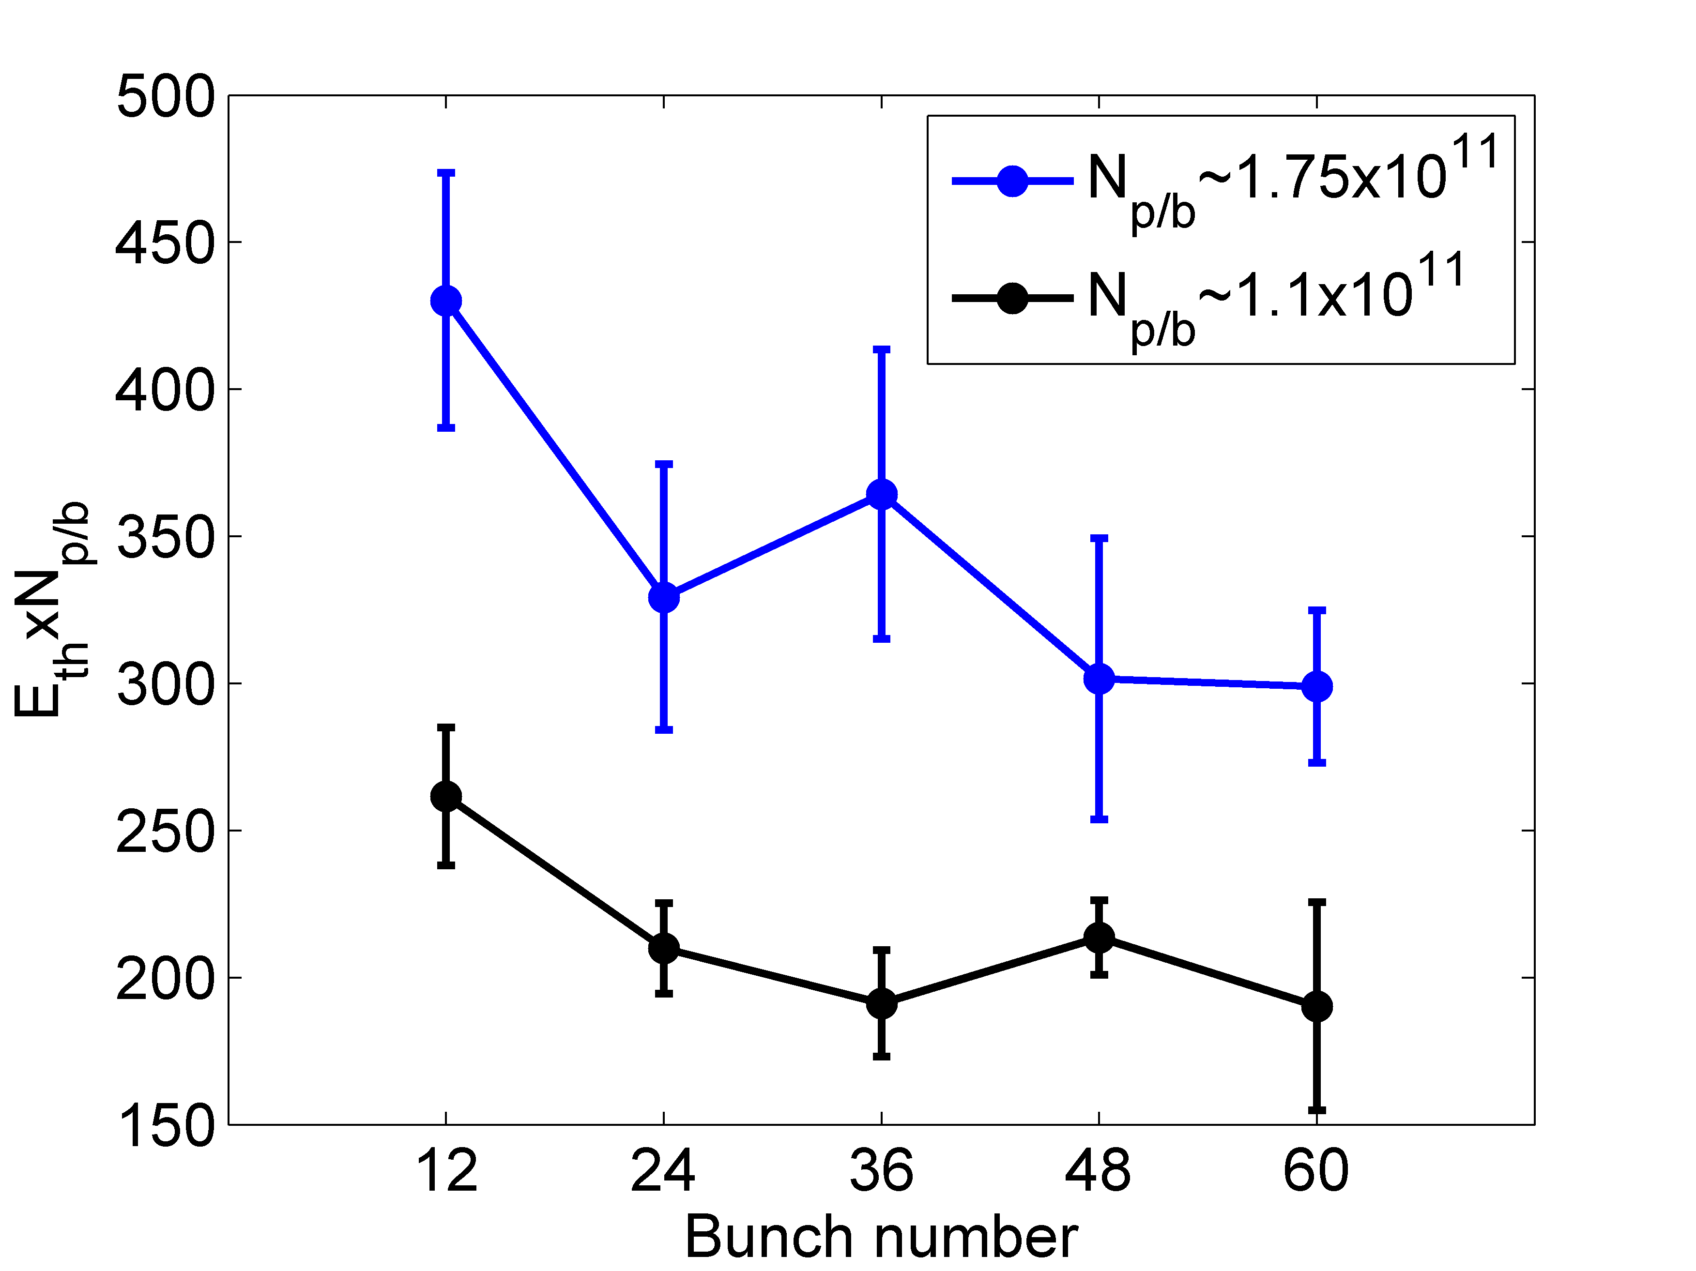
Instability threshold for different number of bunches
Since energy threshold follows the scaling: E_{th}~1/N we can plot E_{th}*N
Measurements from MD4
12 bunches are separated
Certain pattern between the different bunch number (?)

Slide 9
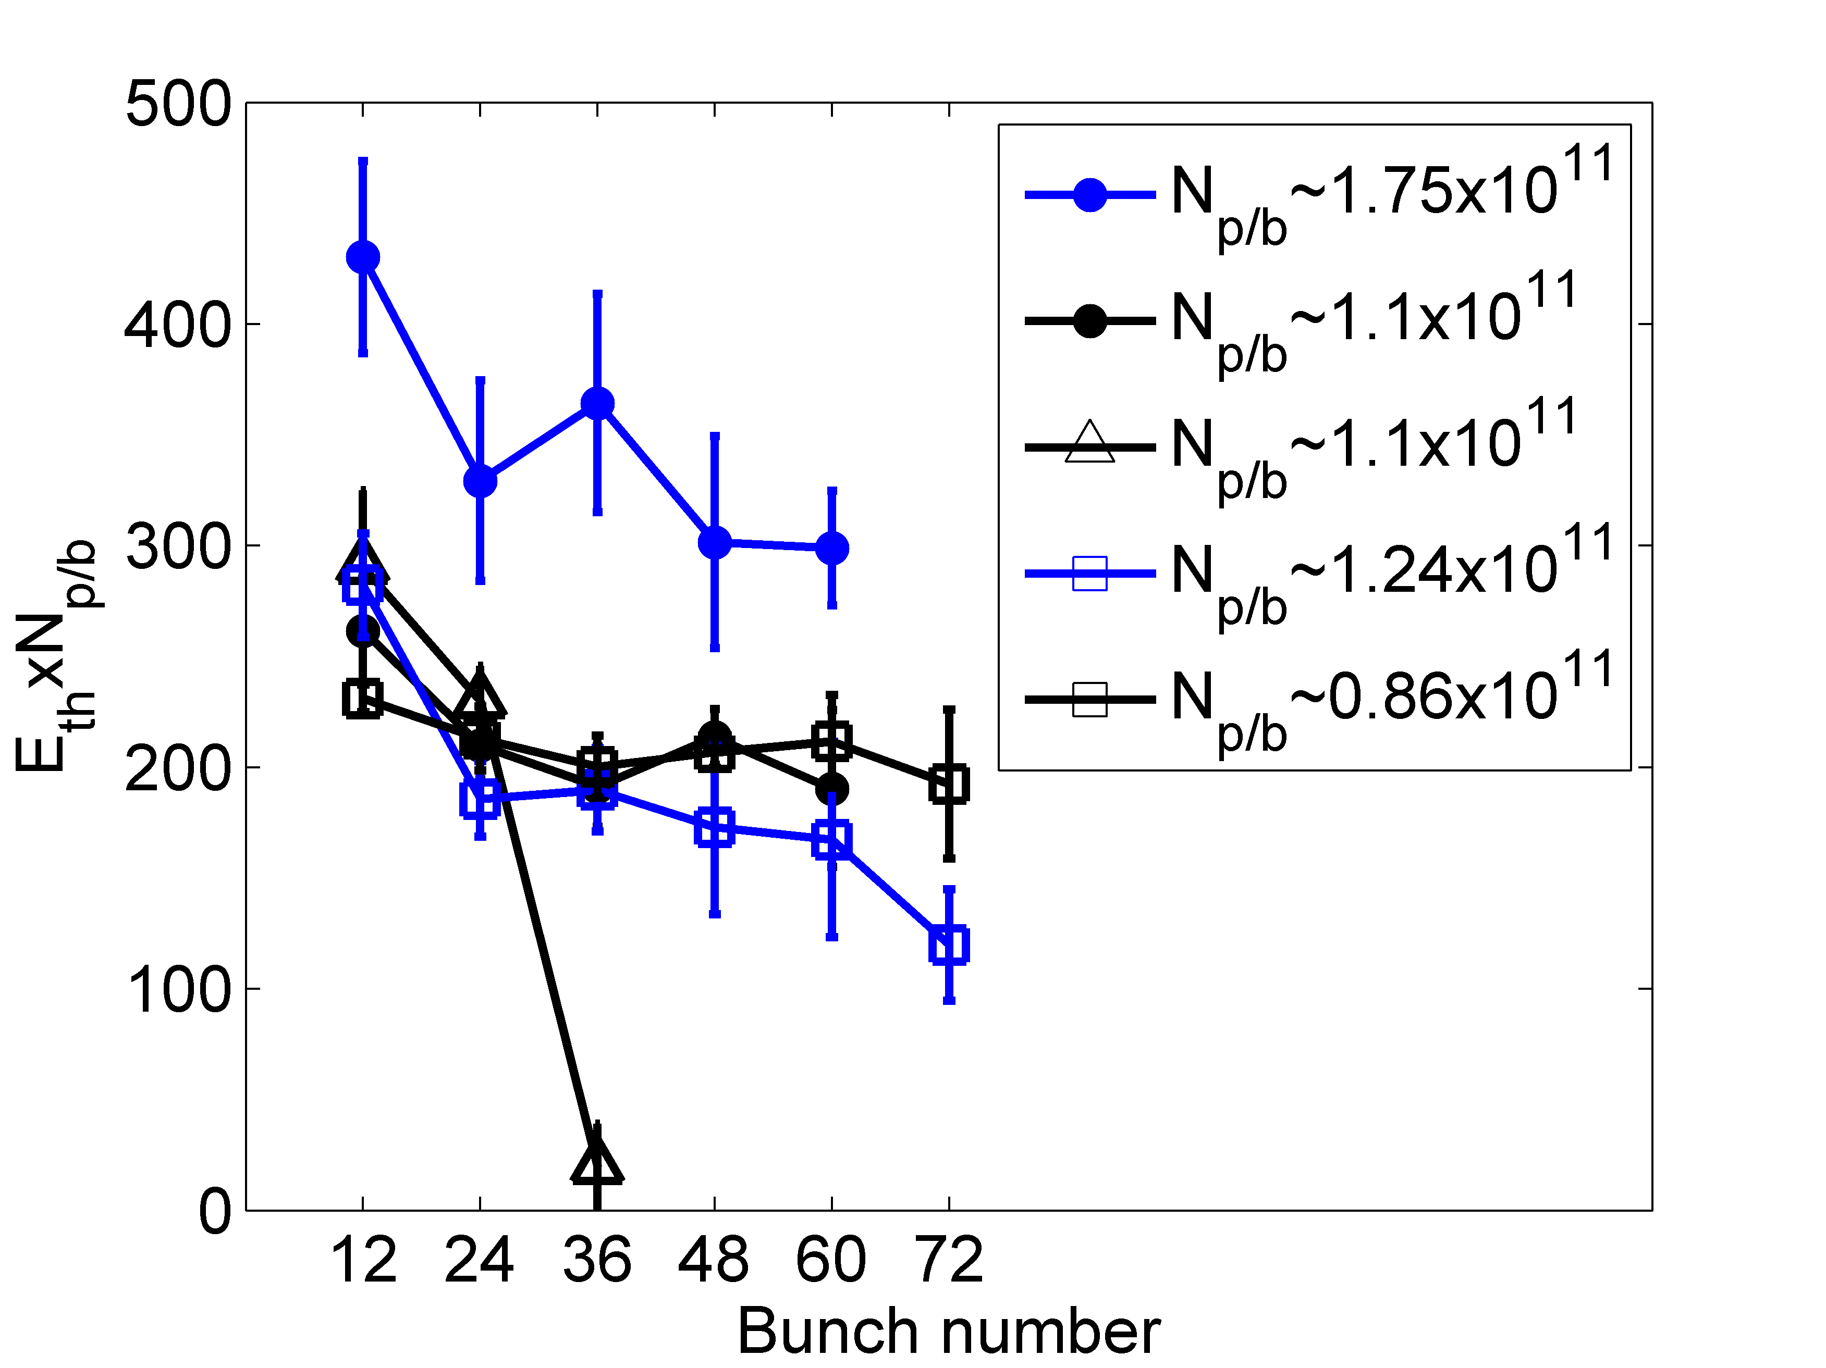
Instability threshold for different number of bunches
Since energy threshold follows the scaling: E_{th}~1/N we can plot E_{th}*N
Measurements from MD2,MD3,MD4
Sensitivity in differences of beam parameters (intensity emittance) → more measurements to increase statistics necessary for conclusive results
Kicker problem

Slide 10
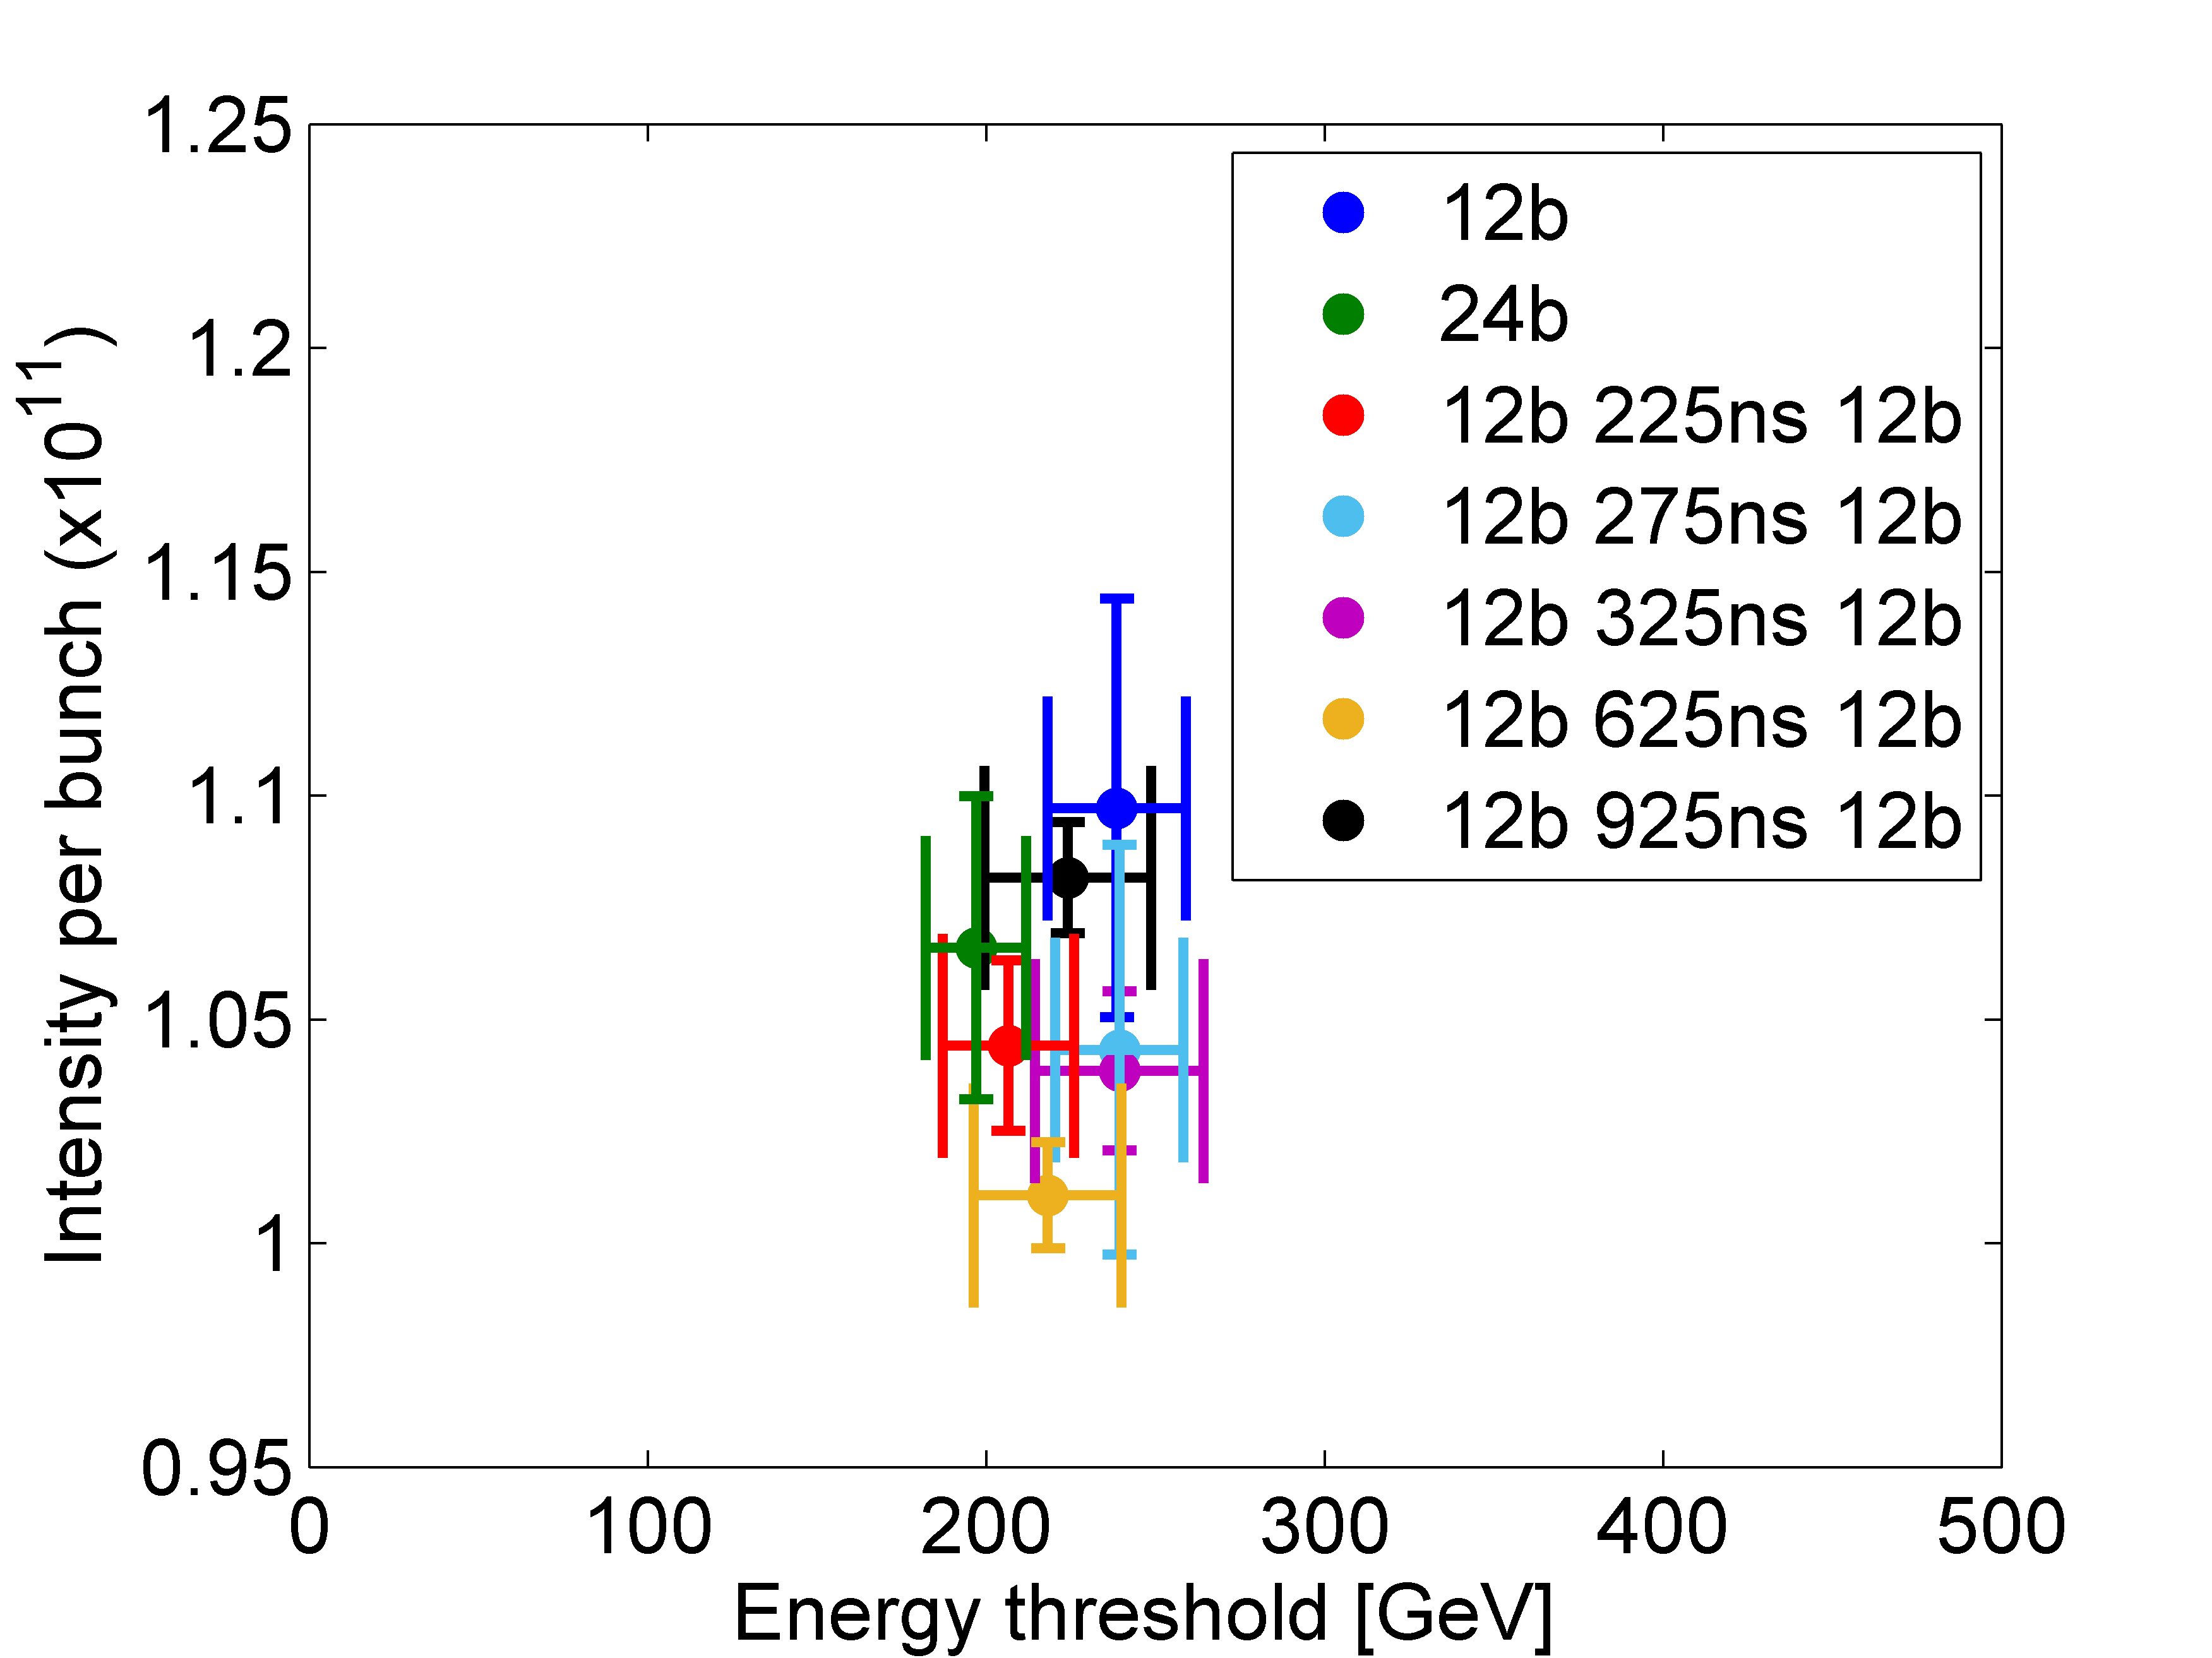
Instability threshold for different number batch configuration
Investigate which are the characteristics of the impedance that is driving the multi-bunch instability → identify this in the impedance model → confirm from simulations → see difference between 12 and 24 bunches
Measurements from MD4
24b threshold is lower with respect to 12b
With a gap of 225ns threshold in between 12b and 24 b
275ns seams that two batches are decoupled

Slide 11
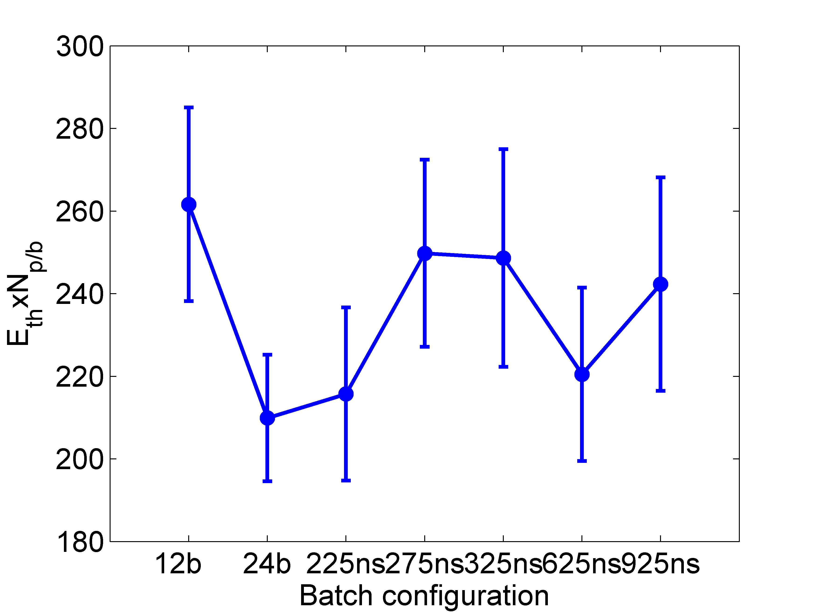
Instability threshold for different number batch configuration
Measurements from MD4
24b threshold is lower with respect to 12b
With a gap of 225ns threshold in between 12b and 24 b
275ns seams that two batches are decoupled
Sensitivity in differences of beam parameters (intensity emittance) → more measurements to increase statistics necessary for conclusive results

Slide 12
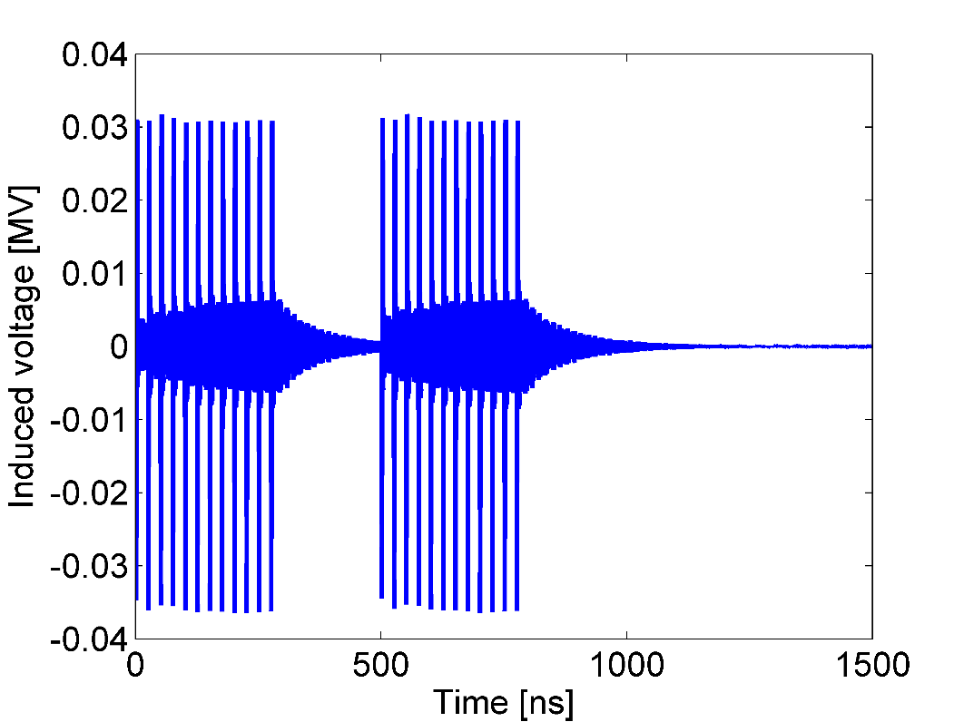
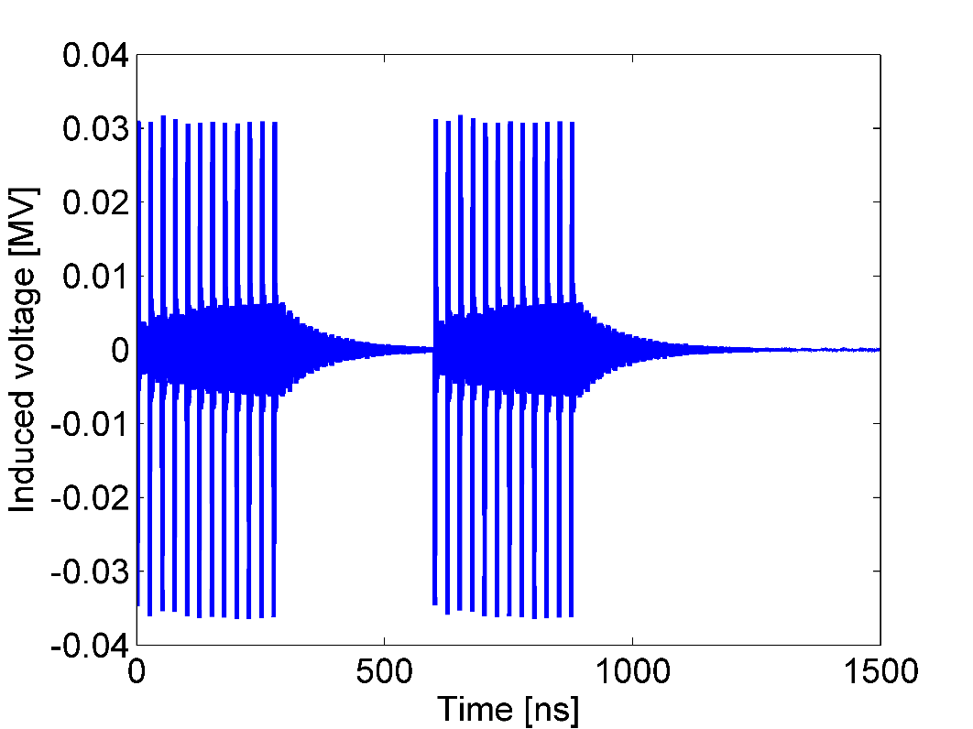
Beam simulations
Looking for impedance that has the characteristics indicated by these measurements: for a gap of 225ns still batches are coupled but with 275ns gap are decoupled.
Simulations of 12 bunches started in the past but still work is on-going:
Investigate what is the responsible impedance source that drives the instability
Similar analysis of the results as in measurements to be done
Many simulations are pending
Simulate also 24 bunches
gap of 225 ns
gap of 225 ns

Slide 13
Next steps
Simulations (mentioned before)
Similar measurements in a double RF:
Investigate the behaviour of the instability threshold with respect to different number of bunches
Higher intensities are needed

