Slide 1
Shielding of the SPS Vacuum Flanges - Design Studies – Update
Jose E. Varela and Jaime Perez
21 May 2015

Slide 2
Outline
Introduction
Vacuum Flange Shielding Studies
New Reference
Tube & Double Tube
Pumping Port Fingers
Gap Filling
Shield Comparison – R/Q Reduction
Next Steps

Slide 3
Introduction
Today we report on the progress made in the design of suitable shields for vacuum flanges belonging to group II.
This presentation will not cover the redesign of the bellows belonging to group II (production of elliptical bellows) nor the impedance reduction measures for flanges belonging to group I (QD flanges).
More information can be found in previous presentations [LIU-SPS BD WG meetings on 09-10-2014, 04-09-2014 and 12-03-2015]

Slide 4
Introduction
Last time, four different shield implementations (without gap filling) were analysed and compared to the ‘reference’ (closed MBA-MBA vacuum flange without damping resistor) case.
Vacuum Flange Shield Comparison of the ‘1.4GHz Resonance’ and Low Frequency Contribution.
 | f [GHz] | Z [kΩ] | Q | R/Q [Ω] | ≈Im( Z )/n
Ref | 1.40 | 145 | 1850 | 78 | 3.53mΩ
Shield I | 1.55 | 14.3 | 550 | 26 | 1.19mΩ
Shield II | 1.33 | 4.6 | 350 | 13 | 0.95mΩ
Shield IV | 1.53 | 29.8 | 880 | 34 | 1.31mΩ
Overestimated Q values.
NOT COMPARABLE
Relevant parameters for comparison
Three main points were stated as ‘next steps’:
A more detailed analysis of the structure (realistic convolutions).
The analysis of a tube-like shield (similar to the current pumping port shields) in one or both sides.
Mitigation of the consequences of the potential gap between shield and vacuum chamber.

Slide 5
Outline
Introduction
Vacuum Flange Shielding Studies
New Reference
Tube & Double Tube
Pumping Port Fingers
Gap Filling
Shield Comparison – R/Q Reduction
Next Steps

Slide 6
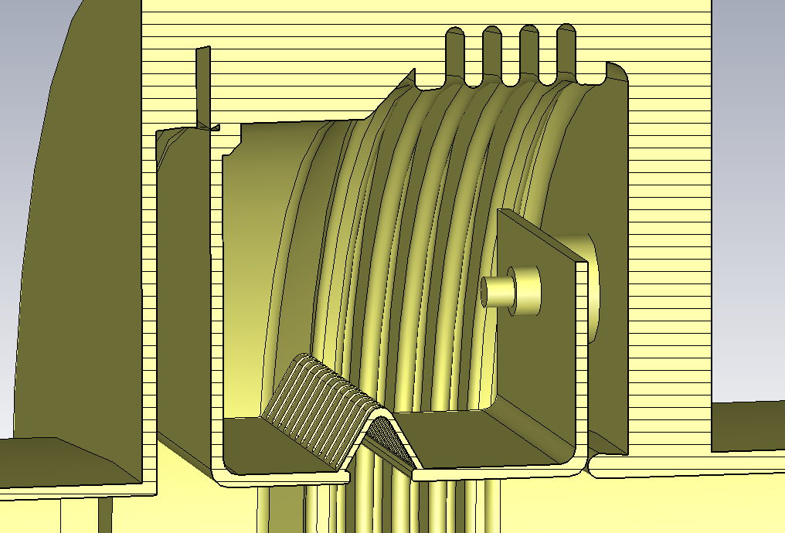
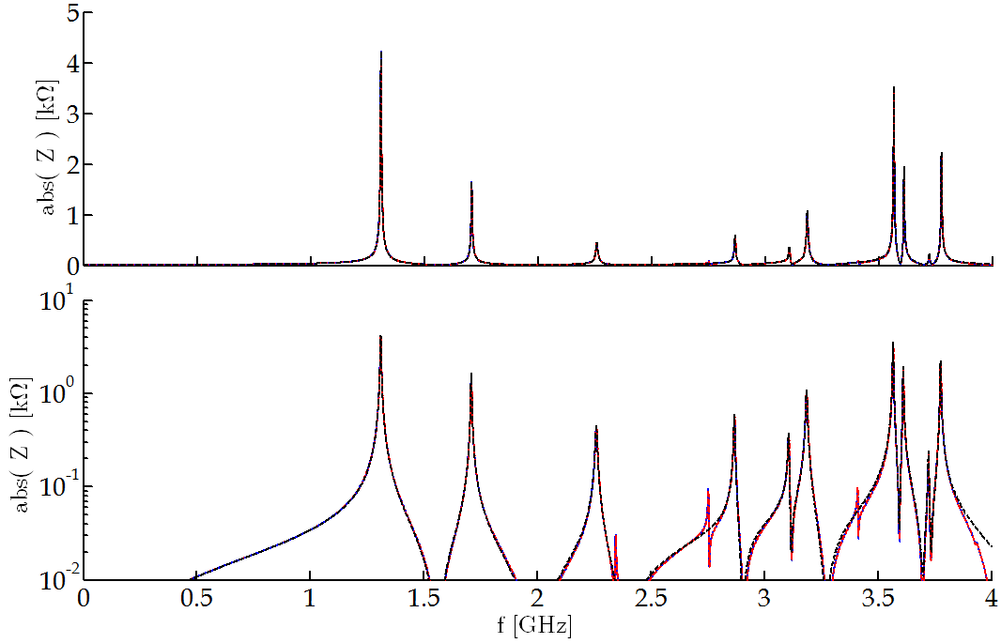
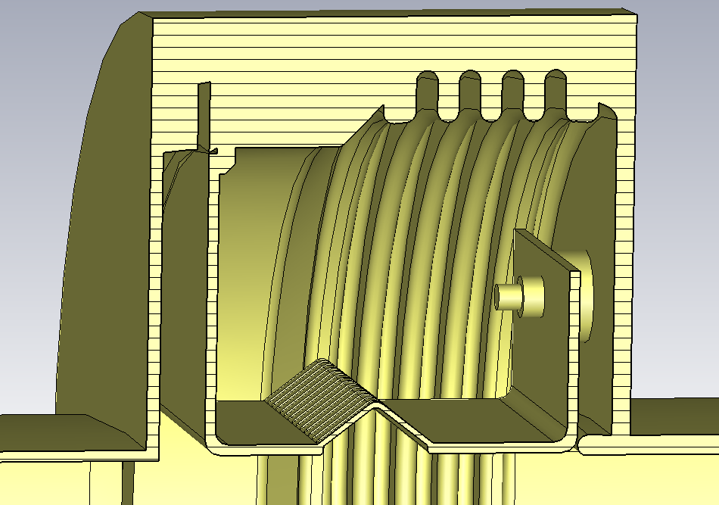
Previously…
Initial (simplified) analysis showed that this implementation gives the highest impedance reduction.
 | f [GHz] | Z [kΩ] | Q | R/Q [Ω] | ≈Im( Z )/n
Nominal | 1.33 | 4.6 | 350 | 13 | 0.95 mΩ
Plus 10 | 1.31 | 4.2 | 350 | 12 | 0.94 mΩ
Minus 10 | 1.35 | 5.0 | 350 | 14 | 0.80 mΩ
Impedance of the ‘Plus 10mm’ case

Slide 7
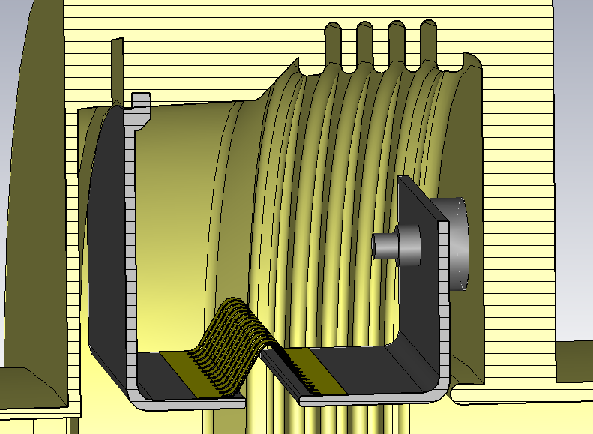
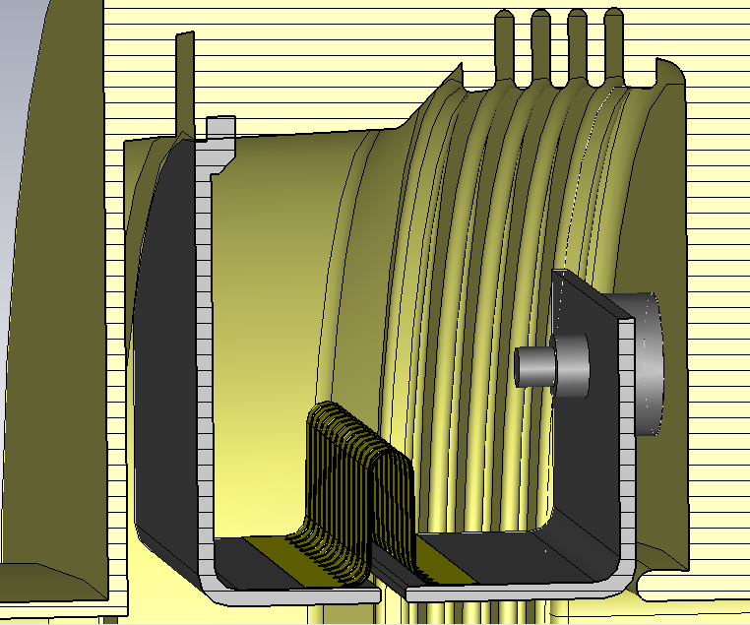
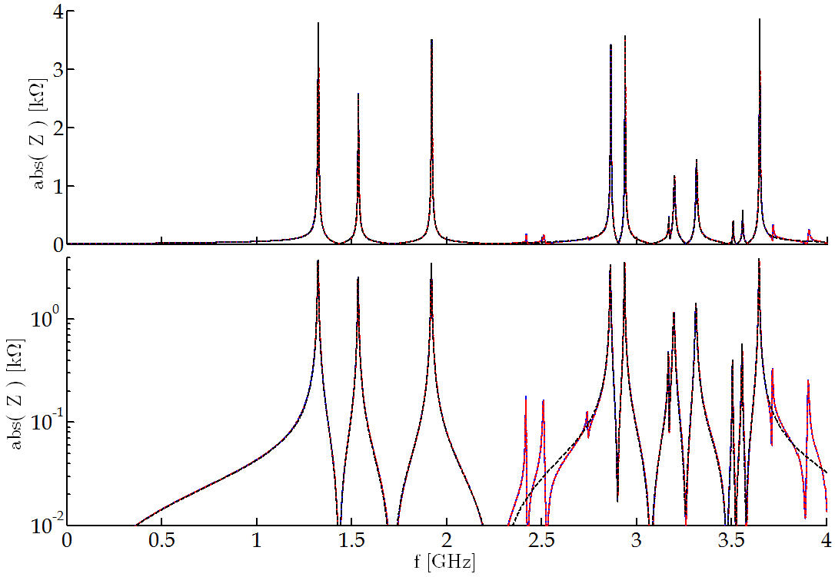
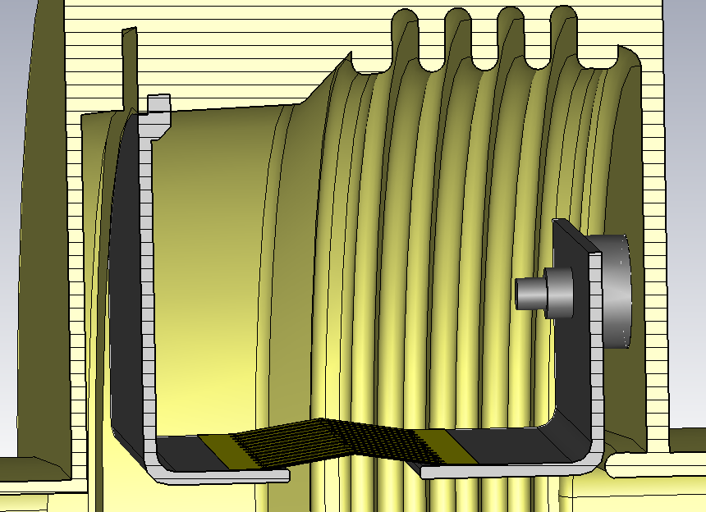
More Realistic Analysis
 | f [GHz] | Z [kΩ] | Q | R/Q [Ω] | ≈Im( Z )/n
Nominal | 1.32 | 4.0 | 325 | 12 | 1.25 mΩ
Plus 10 | 1.31 | 4.2 | 325 | 13 | 1.11 mΩ
Minus 7 | 1.32 | 3.8 | 320 | 12 | 1.24 mΩ
+ 25%
Impedance of the ‘Minus 7mm’ case

Slide 8
Outline
Introduction
Vacuum Flange Shielding Studies
New Reference
Tube & Double Tube
Pumping Port Fingers
Gap Filling
Shield Comparison – R/Q Reduction
Next Steps

Slide 9
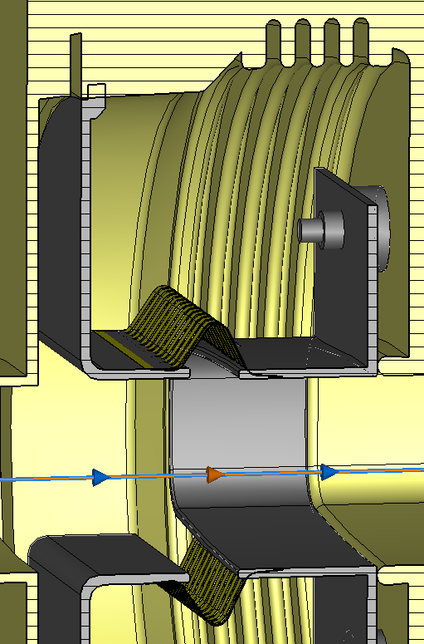
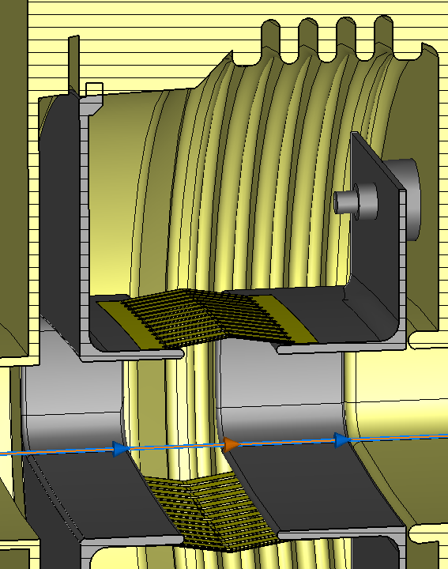
Tube & Double Tube
Tube-like and double tube-like shields are also under consideration.

Slide 10
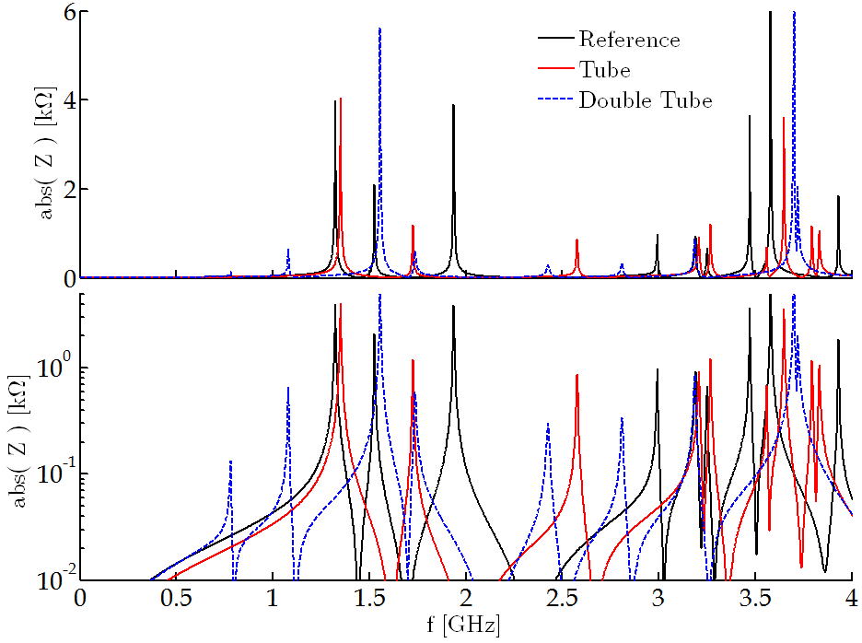
Tube & Double Tube
Longitudinal impedance comparison at the nominal position for the reference, tube and double tube shields.
Im( Z )/n = 1.26
Im( Z )/n = 0.97
Im( Z )/n = 1.27
The single tube solution improves the reference shield.
The double tube solution creates two small (but relevant) low frequency resonances that increase the Im(Z)/n.

Slide 11
Outline
Introduction
Vacuum Flange Shielding Studies
New Reference
Tube & Double Tube
Pumping Port Fingers
Gap Filling
Shield Comparison – R/Q Reduction
Next Steps

Slide 12
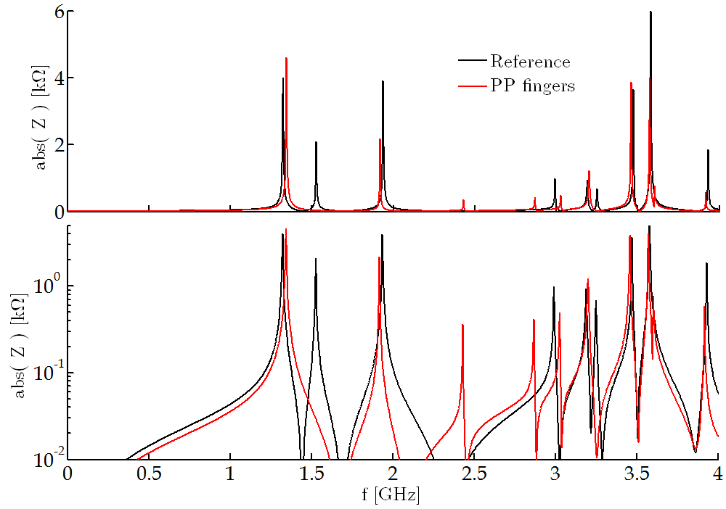
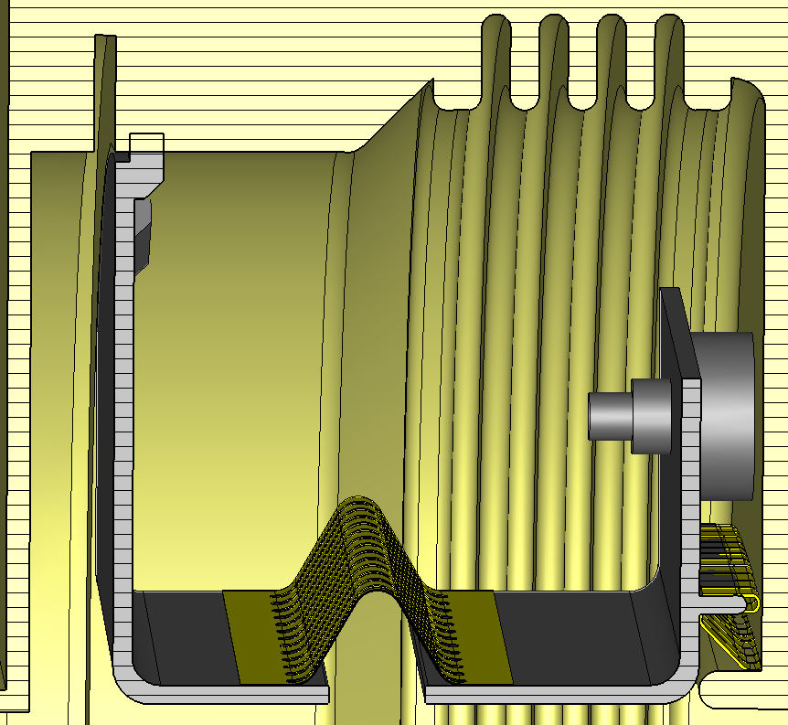
Pumping Port Fingers
As anticipated, using RF fingers in the gap between the shield and the bellows wall reduces the impedance contribution of HOMs.
 | f [GHz] | Z [kΩ] | Q | R/Q [Ω] | ≈Im( Z )/n
Reference | 1.32 | 4.3 | 340 | 12.5 | 1.26 mΩ
Fingers | 1.34 | 4.6 | 340 | 13.7 | 1.03 mΩ

Slide 13
Outline
Introduction
Vacuum Flange Shielding Studies
New Reference
Tube & Double Tube
Pumping Port Fingers
Gap Filling
Shield Comparison – R/Q Reduction
Next Steps

Slide 14
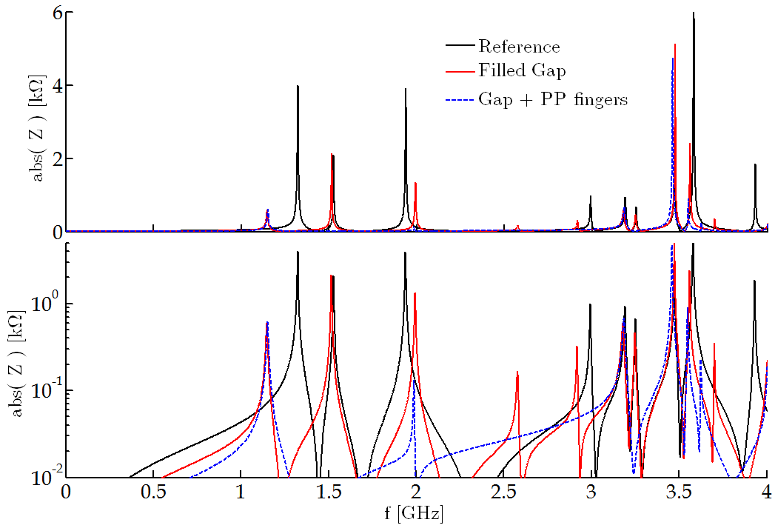
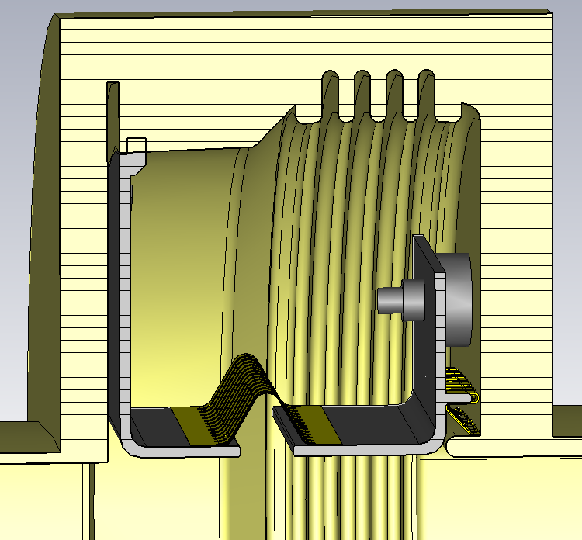
Gap Filling
As shown in the past, filling the left gap further reduces the impedance.
 | f [GHz] | Z [kΩ] | Q | R/Q [Ω] | ≈Im( Z )/n
Reference | 1.32 | 4.3 | 340 | 12.5 | 1.26 mΩ
Gap | 1.15 | 0.7 | 150 | 4 | 0.77 mΩ
Gap + fing | 1.15 | 0.6 | 145 | 4.3 | 0.54 mΩ

Slide 15
Outline
Introduction
Vacuum Flange Shielding Studies
New Reference
Tube & Double Tube
Pumping Port Fingers
Gap Filling
Shield Comparison – R/Q Reduction
Next Steps

Slide 16
Shield Comparison - R/Q Reduction
Vacuum Flange Shield Comparison of the ‘1.4GHz Resonance’ and Low Frequency Contribution
 | f [GHz] | Z [kΩ] | Q | R/Q [Ω] | ≈Im( Z )/n
Original | 1.40 | 145 | 1850 | 78 | 3.53mΩ
Ref. | 1.32 | 4.3 | 340 | 12.5 | 1.26mΩ
Best | 1.15 | 0.62 | 145 | 4.3 | 0.54mΩ
Overestimated Q values.
NOT COMPARABLE
Relevant parameters for comparison
Best solution so far gives a factor ≈20 reduction in R/Q and a ≈ 85% reduction in Im(Z)/n.

Slide 17
Outline
Introduction
Vacuum Flange Shielding Studies
New Reference
Tube & Double Tube
Pumping Port Fingers
Gap Filling
Shield Comparison – R/Q Reduction
Next Steps

Slide 18
Next Steps
From the design point of view, once more, there are three main points of interest:
The study of the ‘single tube’ + ‘PP fingers’ + ‘gap filling’ case.
Extrusion/compression analysis for the best solution.
The prototype was delayed, but we expect to have it soon available for measurements.
+

