Slide 1
2015 SPS Scrubbing Run weeks 23 and 25
H. Bartosik, G. Iadarola, K. Li, L. Mether, A. Romano, G. Rumolo, M. Schenk
RF team: T. Argyropoulos, T. Bohl, E. Shaposhnikova,
SPS OP: K. Cornelis, V. Kain, SPS operation crew
Vacuum: M. Taborelli
Thanks to: SPS OP crew, G. Arduini, E. Carlier, K. Cornelis, H. Damerau, J. Esteban Muller, A. Findlay, S. Gilardoni, B. Goddard, A. Guerrero, S. Hancock, W. Höfle, V. Kain, G. Kotzian, A. Lasheen, M. Meddahi, E. Métral, B. Mikulec, G. Papotti, E. Piselli, R. Salemme, B. Salvant, M.Taborelli
… and thanks to the PS complex for the preparation of the challenging beams!!
LIU-SPS-BD Meeting 18 June 2015

Slide 2
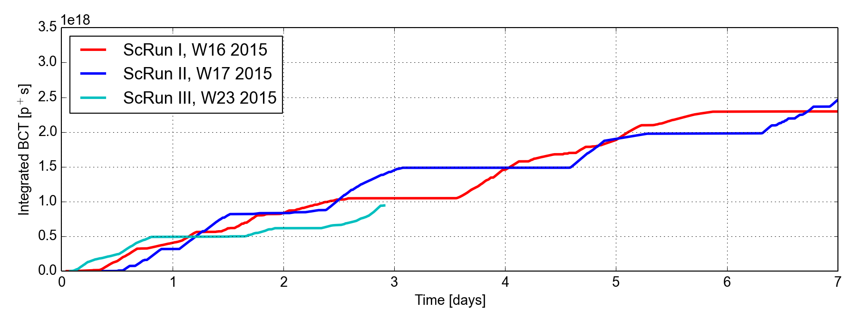
Scrubbing run week 23: integrated beam dose

Slide 3
Scrubbing run week 23: overview
25 ns beam, 26 GeV
25 ns beam, 450 GeV

Slide 4
Scrubbing run week 23: overview
25 ns beam, 26 GeV
25 ns beam, 450 GeV
MONDAY
High intensity LHC beam (4 batches 72b) at 26 GeV/c
Recovered beam performance from previous scrubbing: it took about half a day
BCMS vs 25 ns beam
To try to disentangle lifetime effects due to electron cloud and dynamic aperture
Compared trains of 48 bunches of standard beam with BCMS beam

Slide 5
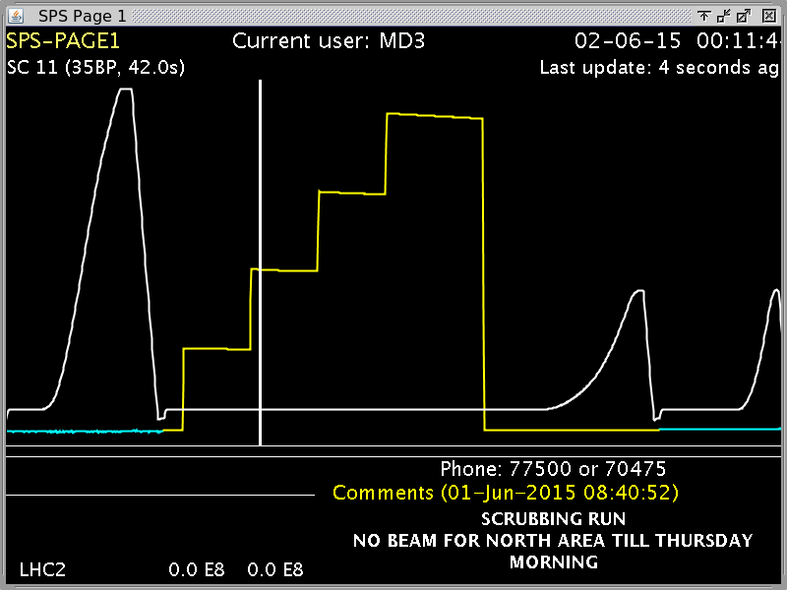
BCMS beam (1.7e11 p/b)

Slide 6
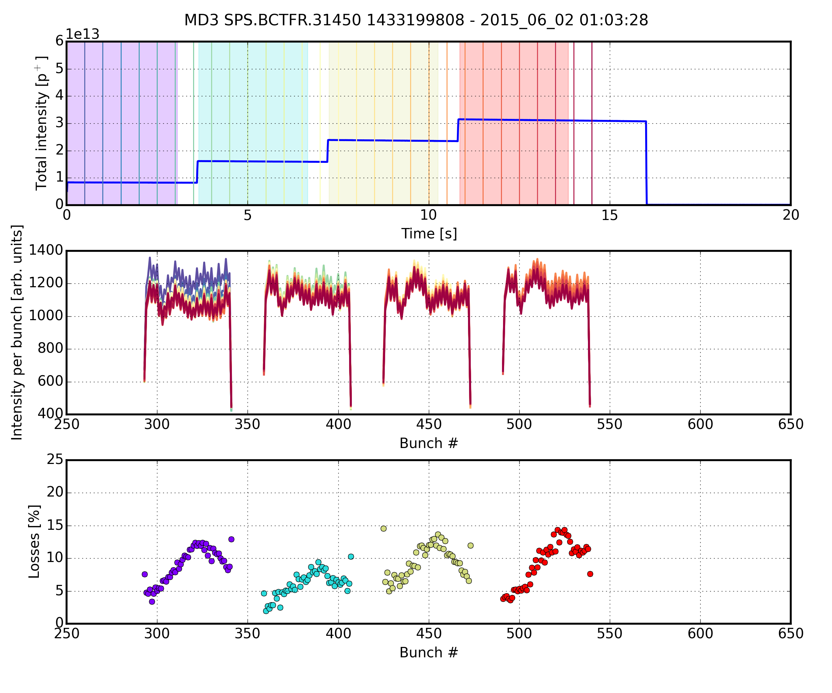
BCMS vs 25 ns beam (1.7e11 p/b)
Standard 25 ns beam
Significant uncaptured beam
E-cloud pattern in incoherent losses

Slide 7
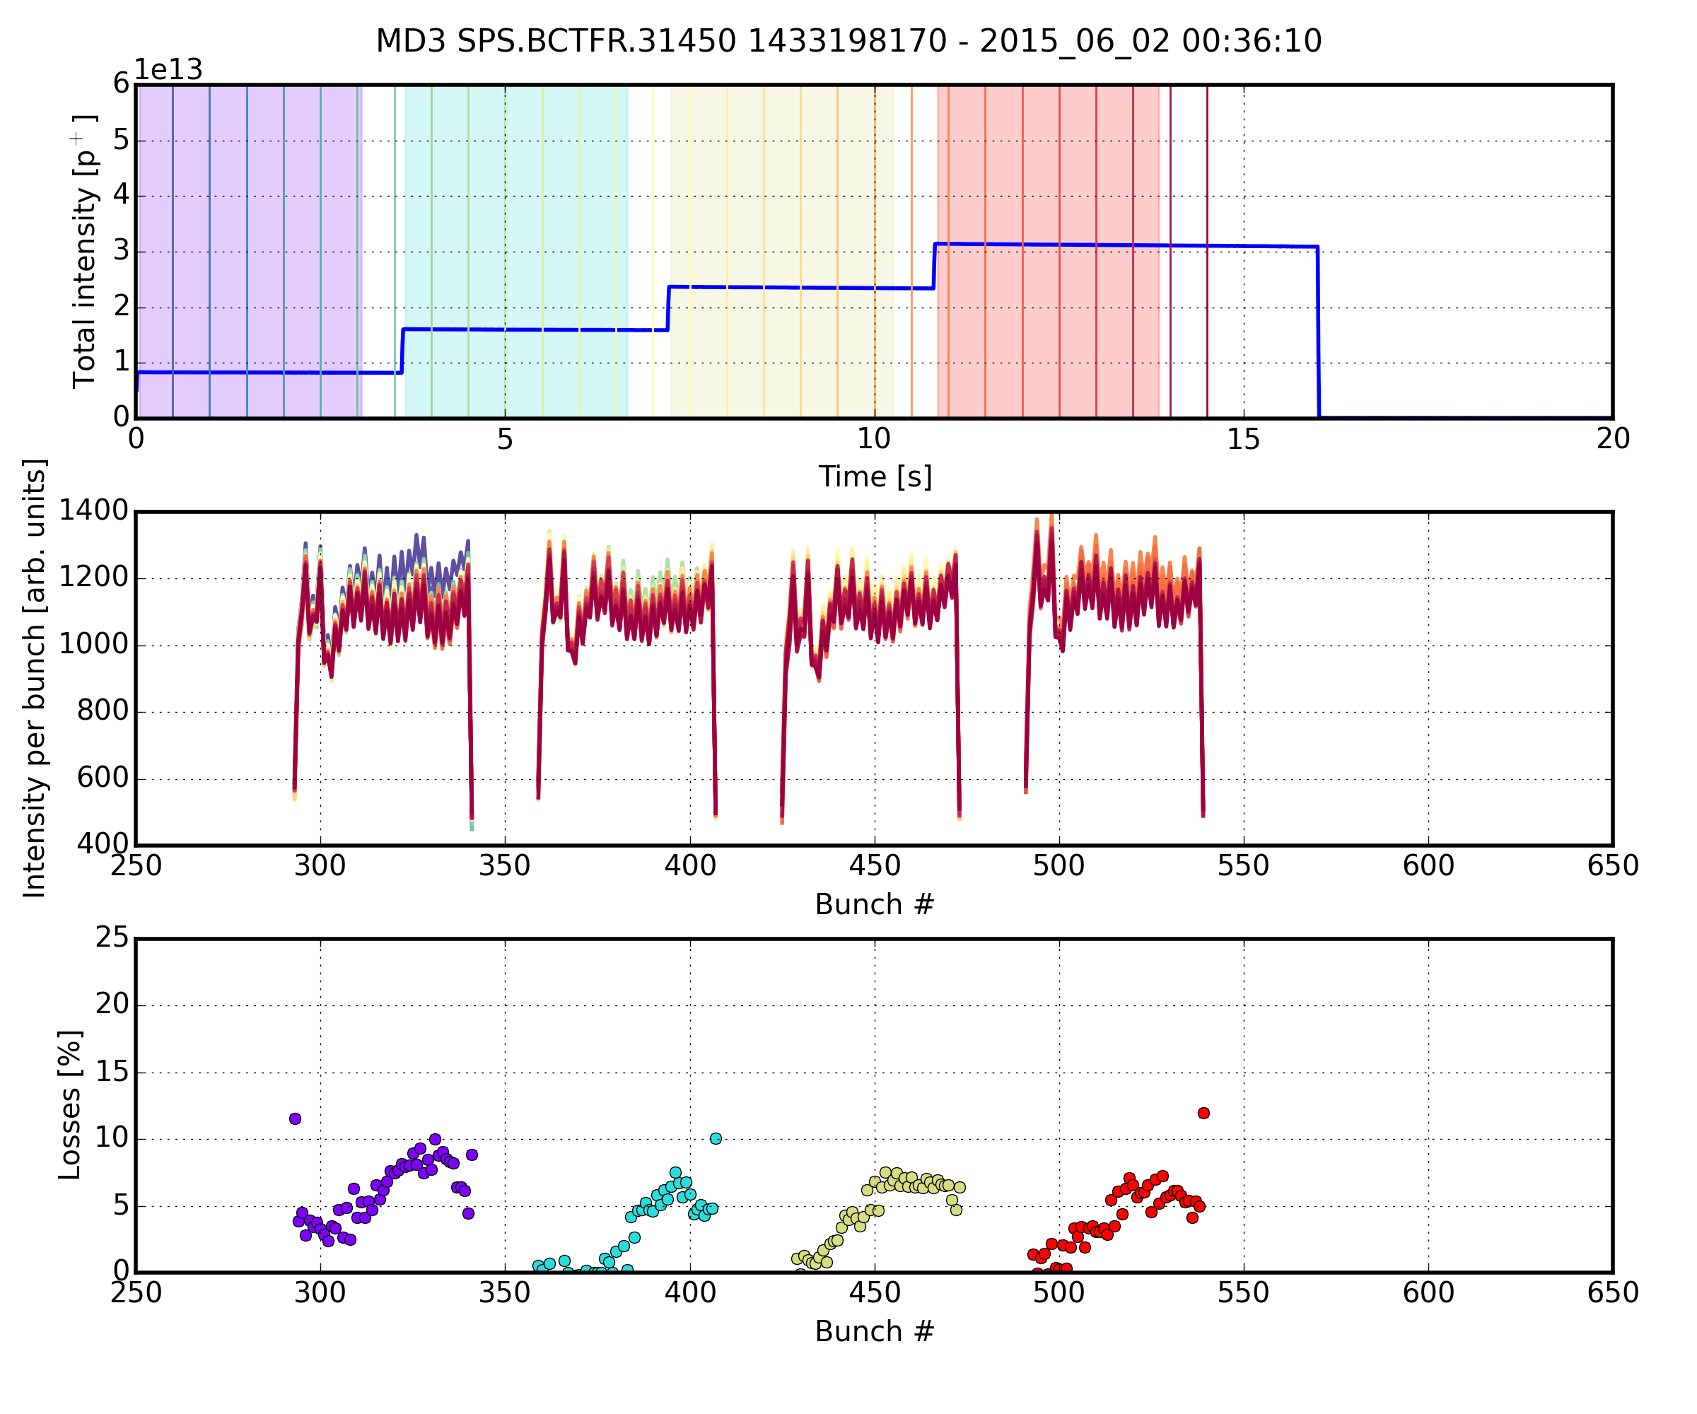
BCMS vs 25 ns beam (1.7e11 p/b)
BCMS
Better capture
Lower losses
No sign of enhanced e-cloud pattern

Slide 8
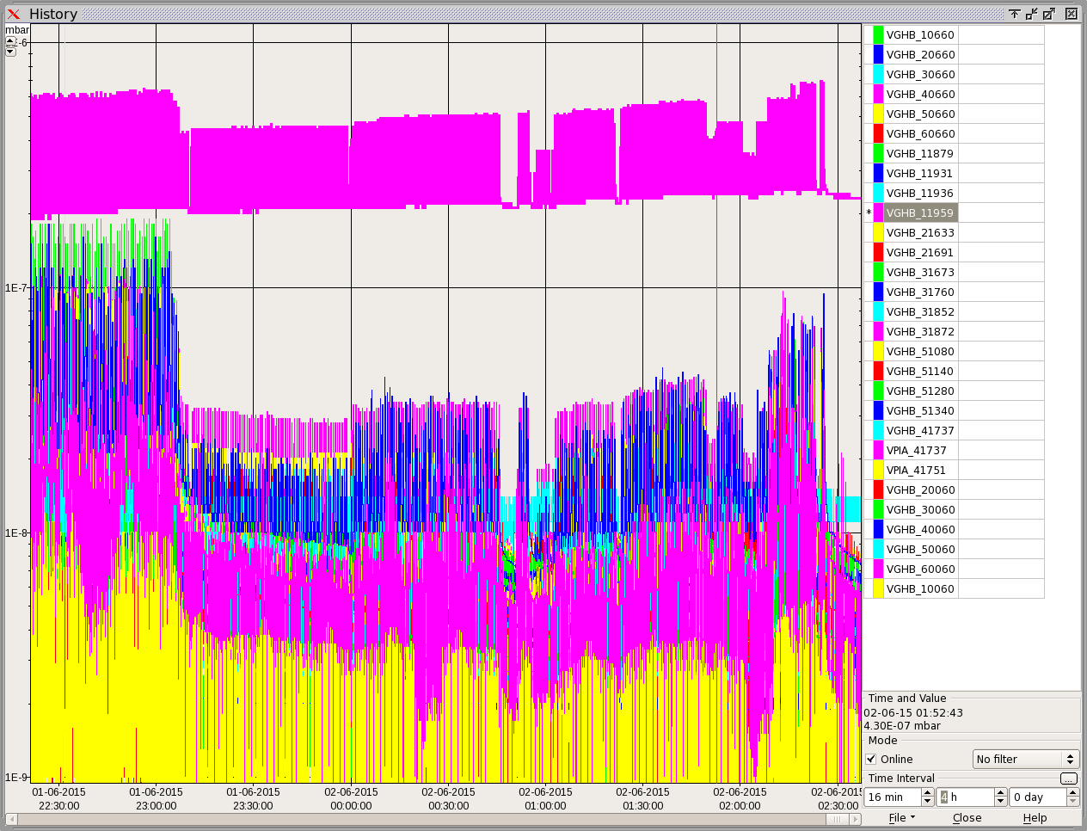
Monday studies
Extended vacuum interlock threshold reached
4e-7 mbar

Slide 9
Scrubbing run week 23: overview
25 ns beam, 26 GeV
25 ns beam, 450 GeV
TUESDAY
Cooldown of MKP4
Characterization of the limiting instability (mainly with three batches)
Low vertical chromaticity and zero LOF setting → Vertical instability, single bunch type
High (enough) vertical chromaticity and zero LOF setting → Horizontal instability, coupled bunch
High (enough) vertical chromaticity and LOF setting to [0.6, 1.0] → Beam stable

Slide 10
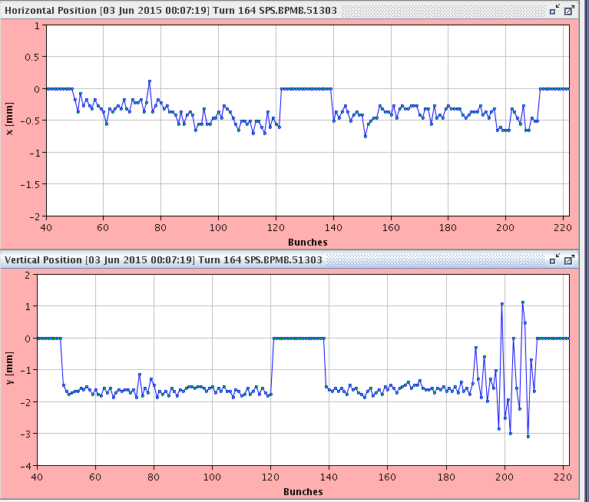
Instability characterization
Low V chroma → Vertical instability at tail of batch, single bunch

Slide 11
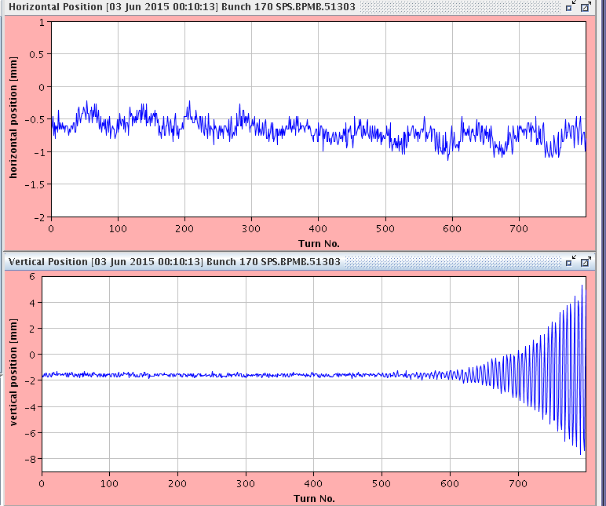
Instability characterization
Low V chroma → Vertical instability at tail of batch, single bunch

Slide 12
Instability characterization
Low V chroma → Vertical instability at tail of batch, single bunch

Slide 13
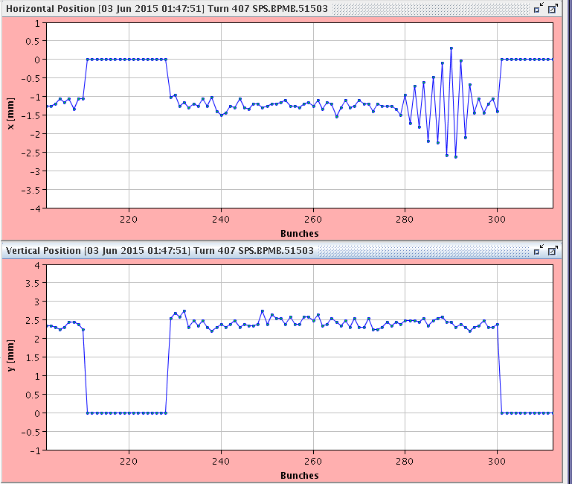
Instability characterization
High V chroma, zero LOF → Horizontal instability at tail of batch, multi-bunch

Slide 14
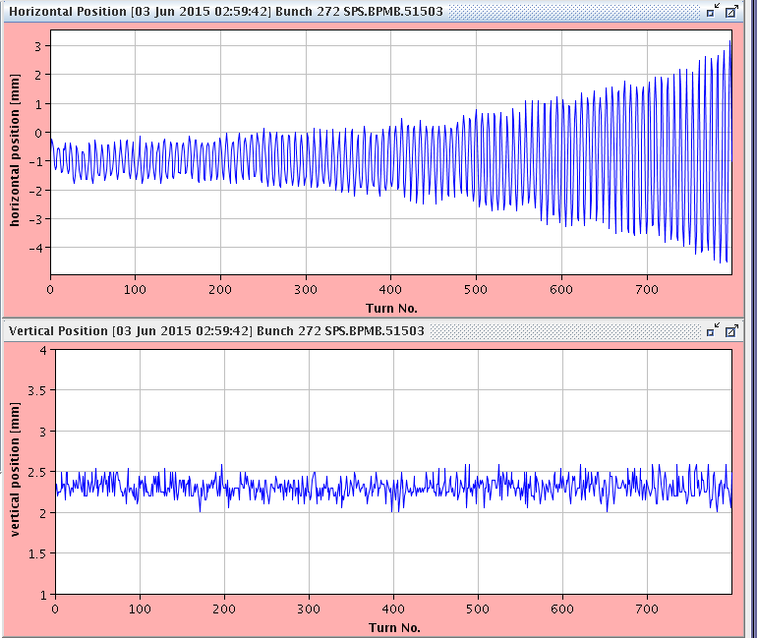
Instability characterization
High V chroma, zero LOF → Horizontal instability at tail of batch, multi-bunch

Slide 15
Instability characterization
High V chroma, zero LOF → Horizontal instability at tail of batch, multi-bunch

Slide 16
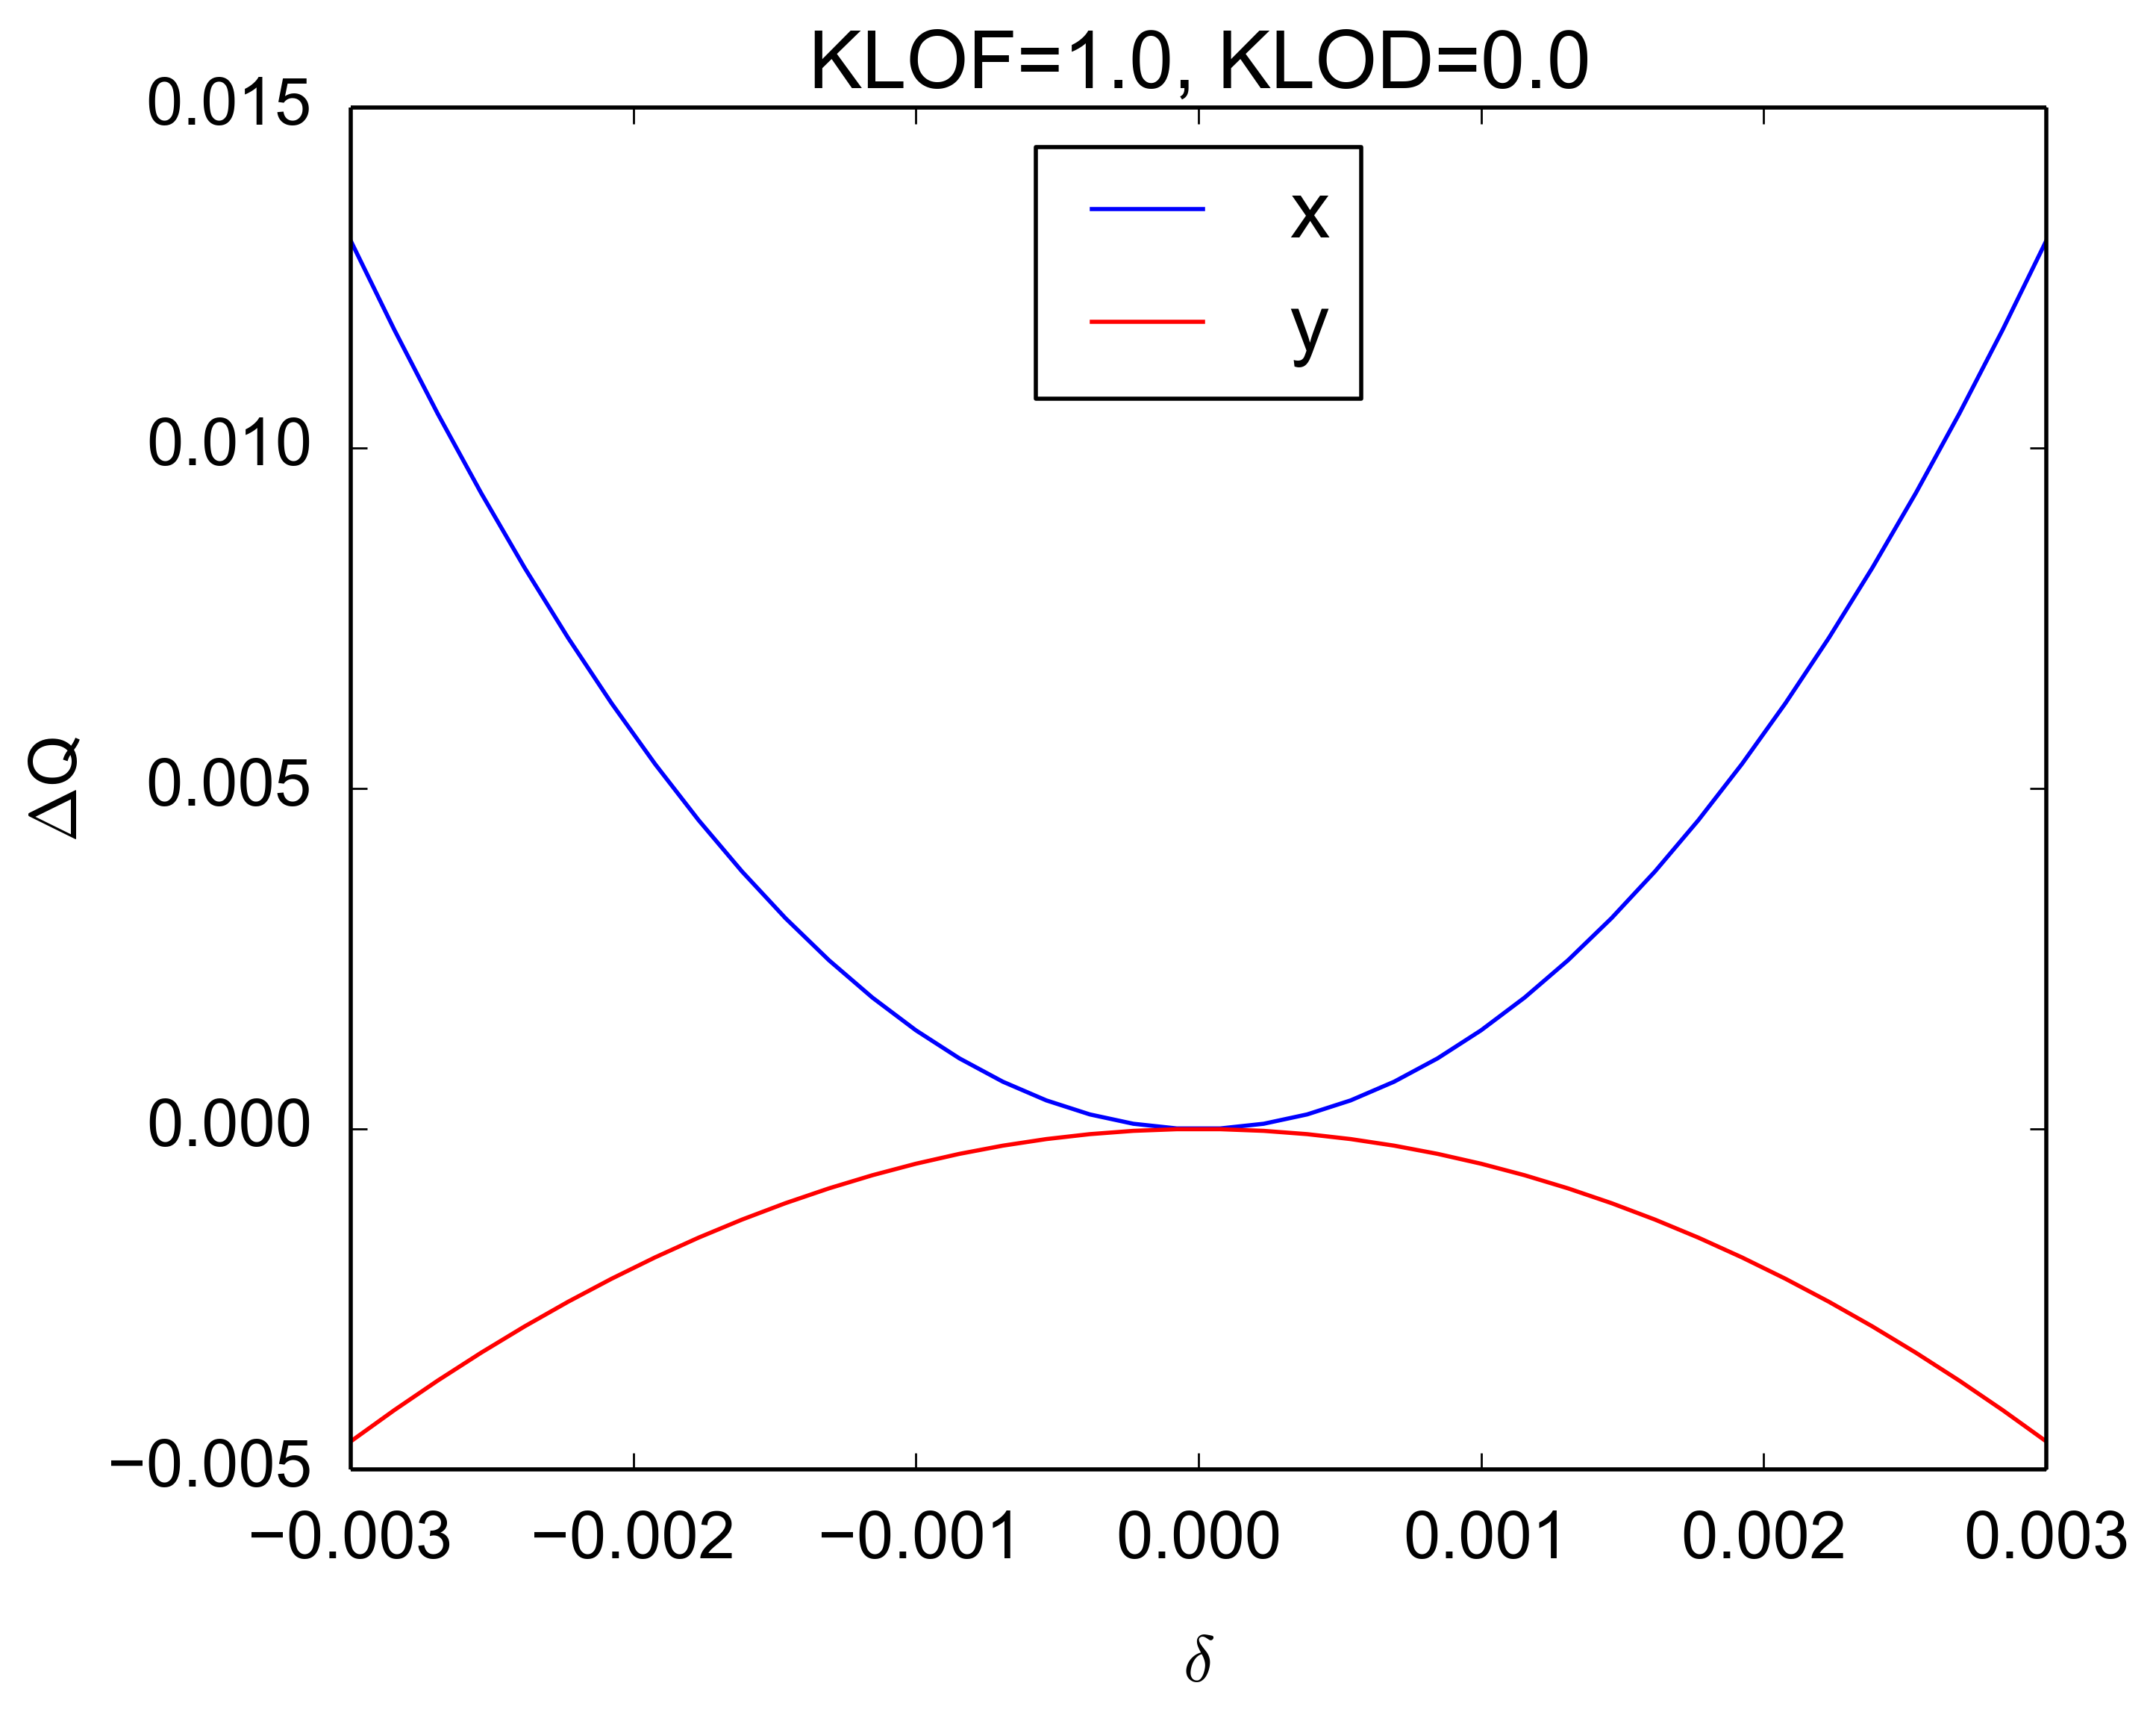
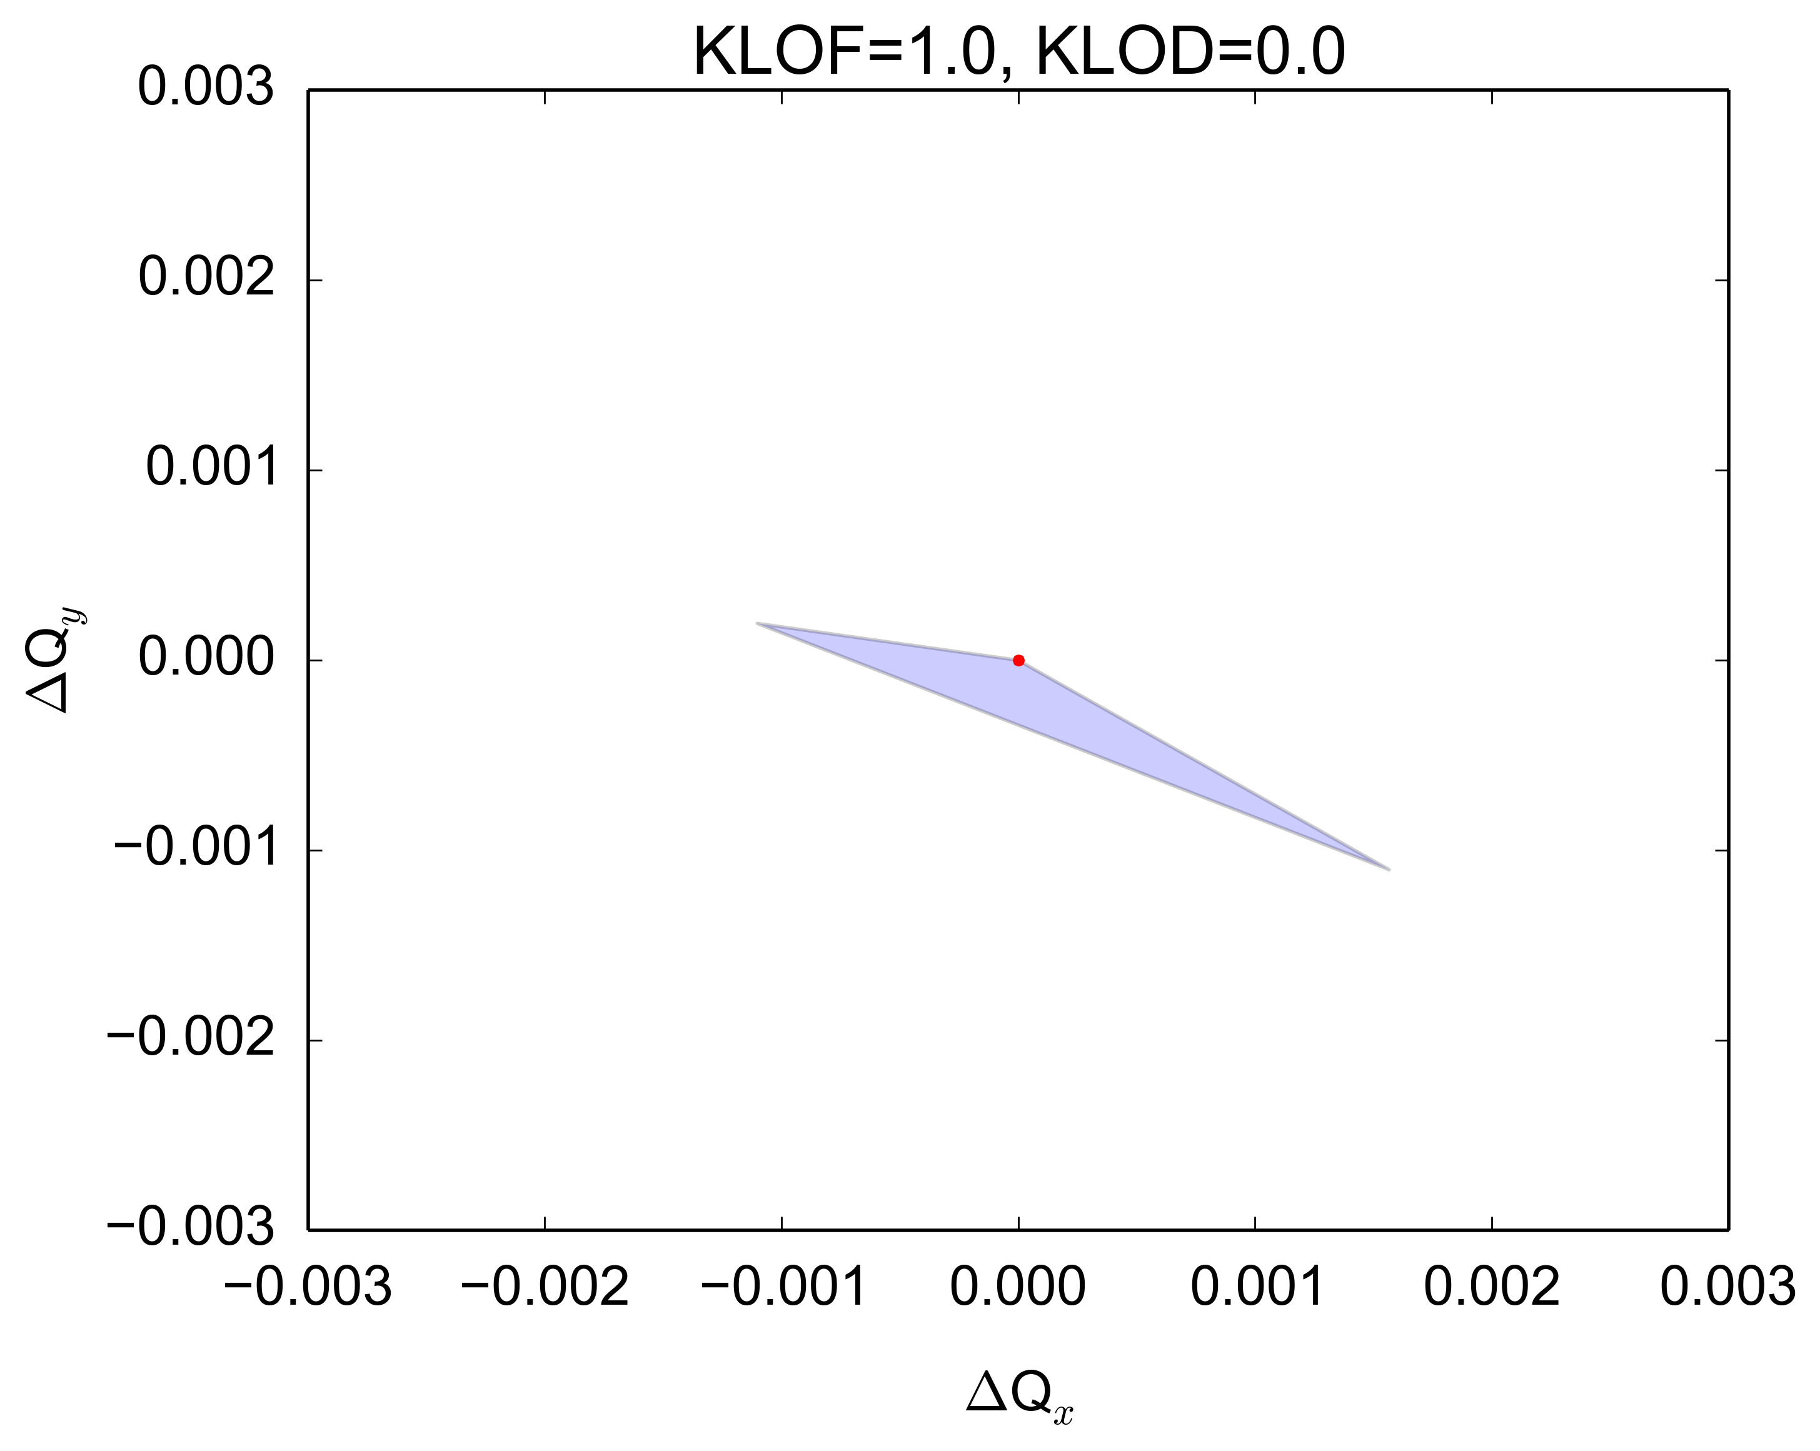
Instability characterization
Effect of LOF as expected from the SPS optics model
Tune spread
Effect on nonlinear chromaticity
With particles up to 3σ
±1σ

Slide 17
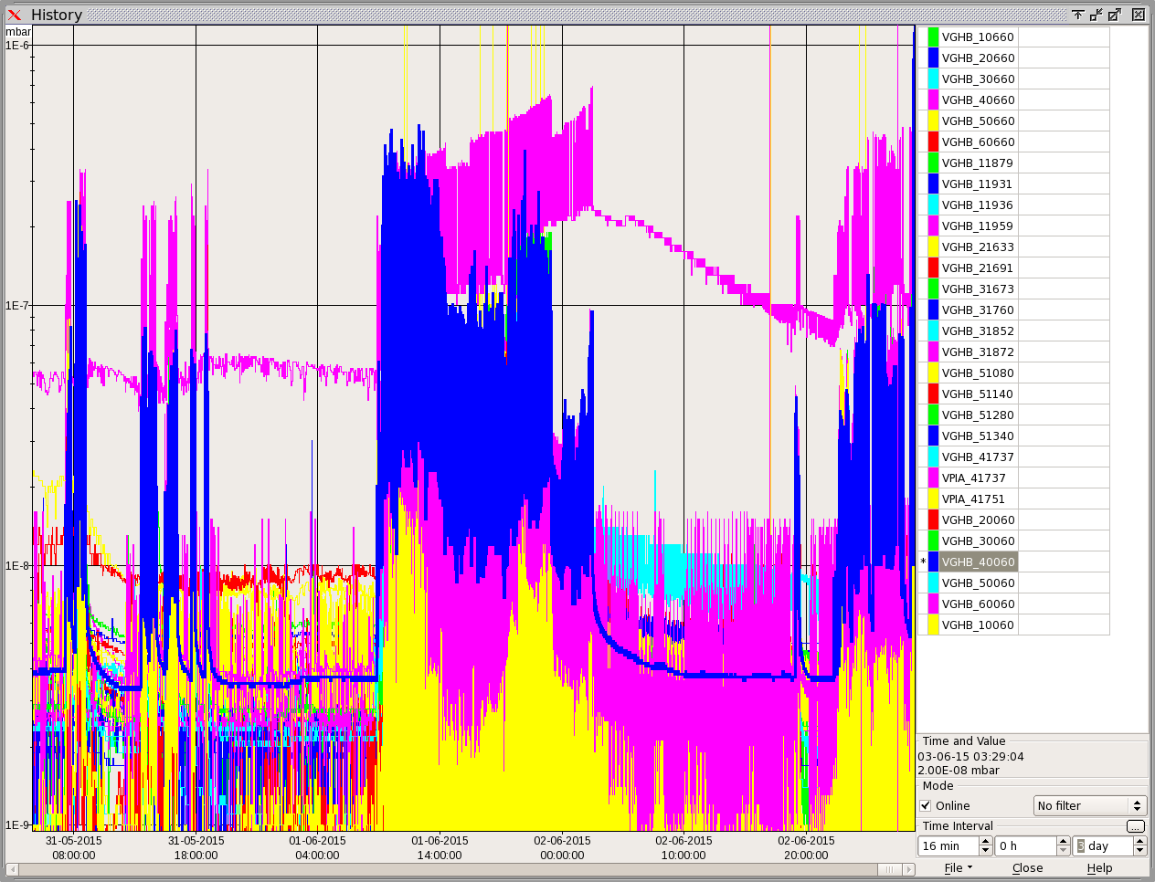
Tuesday studies
Extended vacuum interlock threshold not again reached, but cooldown needed to move to acceleration on next day
4e-7 mbar

Slide 18
Scrubbing run week 23: overview
25 ns beam, 26 GeV
25 ns beam, 450 GeV
WEDNESDAY
Cooldown of MKP4
High intensity beam acceleration
Up to 1.6e11 p/b at 450 GeV (in one batch), when injecting 2.0e11 p/b
Scan in number of bunches (from 12 to 72) to check longitudinal behaviour
Longitudinal instabilities observed at several stages along the cycle (T. Argyropoulos, E. Shaposhnikova)
More transverse stability studies
Used high brightness version with new PSB working point (E. Benedetto)
Transverse damper set up vs. octupole settings

Slide 19
Tests of acceleration of high intensity 25 ns
Acceleration of one batch with 2e11 p/b: studies by RF team

Slide 20
Scrubbing run week 25: overview

Slide 21
Scrubbing run week 25: overview
25 ns beam, 26 GeV
TUESDAY
High intensity LHC beam (4 batches 72b) at 26 GeV/c
Recovered beam performance from previous scrubbing
COLDEX moved in to take data in parallel
Transverse damper set up after software updates
Heating of the MKP4 kicker
Mini flash-over on MKP4 during the night

Slide 22
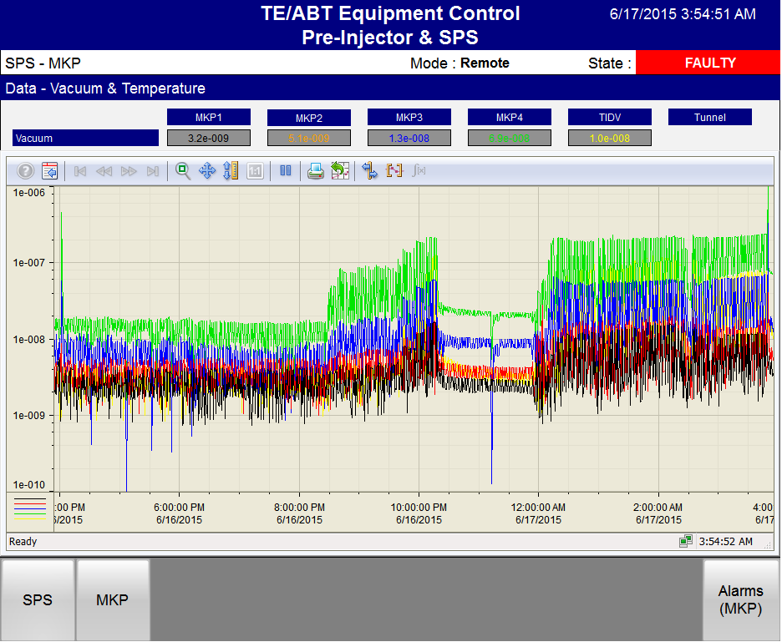
MKP4 mini flash-over
Scrubbing software interlock

Slide 23
Scrubbing run week 25: overview
25 ns beam, 26 GeV
WEDNESDAY
Cooldown of MKP4
Dedicated MDs in Linac2, PSB
Preparation of single bunch beams for HiRadMat experiment
Dedicated MD on SPS matching monitor with single bunch
High intensity LHC beam (4 batches 72b) at 26 GeV/c in the night
Enhanced ecloud with increased RF voltage
Measurements of ecloud monitors for different magnetic field settings

Slide 24
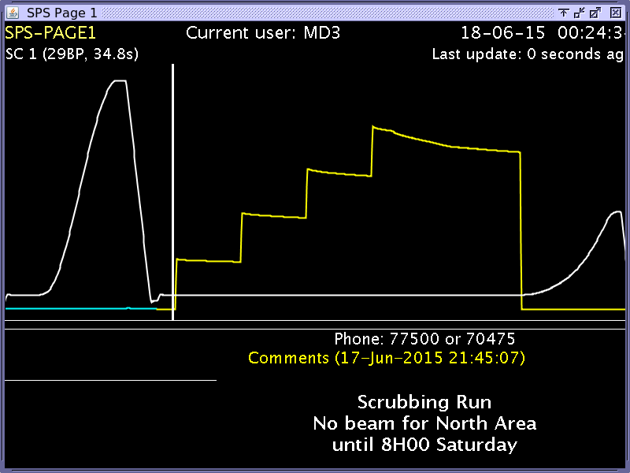
Enhanced ecloud by increased RF voltage

Slide 25
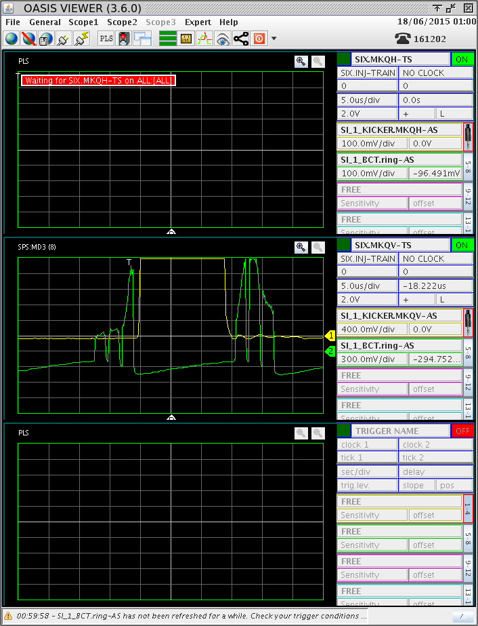
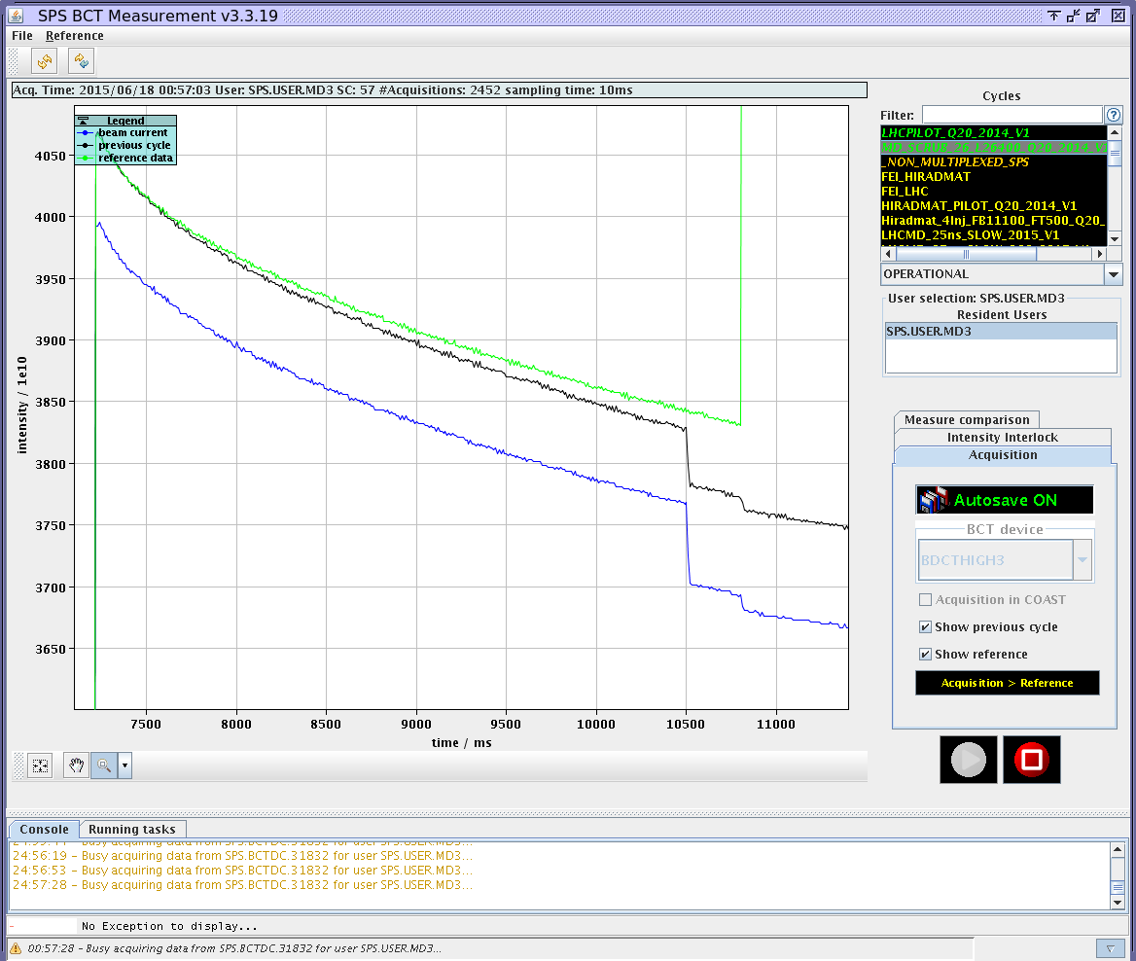
Try to determine amount of un-captured beam

Slide 26
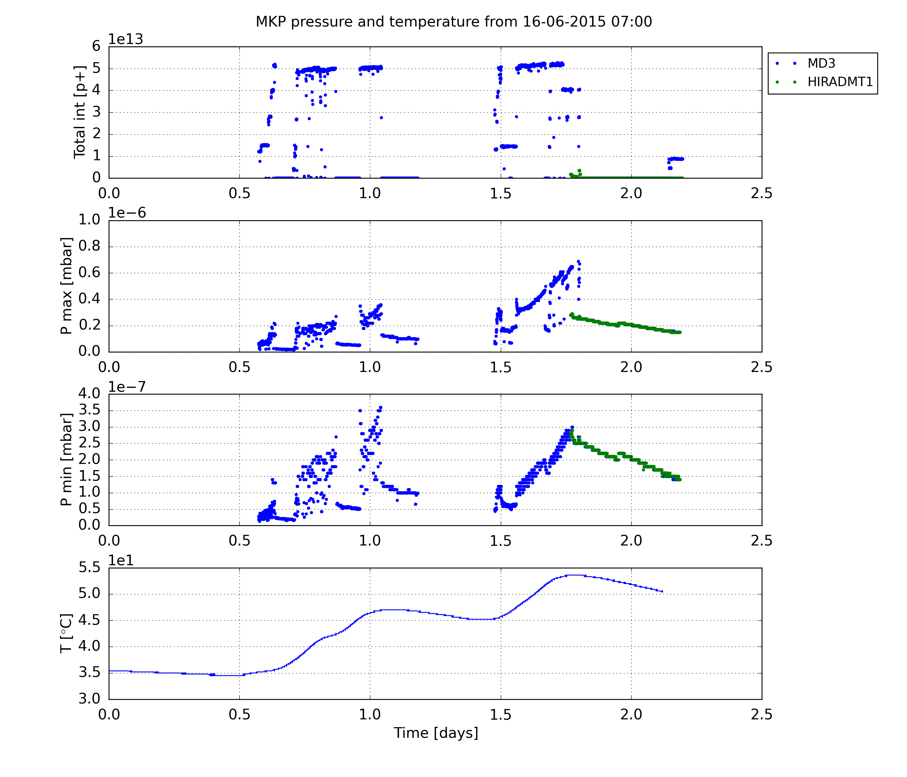
MKP4 heating

Slide 27
Scrubbing run week 25: overview
25 ns beam, 26 GeV
THURSDAY
Cooldown of MKP4
Setup of 200 MHz Feed-forward with 25ns nominal beam dumped at 100 ms
Coast at 270 GeV with single bunch to test UA9 equipment
HiRadMat with single bunches in the pipeline

Slide 28
Summary
Scrubbing Run in Week 23 carried out mainly with high intensity beams for miscellaneous studies (~2e11 p/b)
Recovery of beam quality from previous scrubbing run achieved (but lifetime still quite poor)
BCMS beams (~1.7e11 ppb) were tested -> better beam quality preservation wrt standard beam with same bunch pattern
Horizontal higher order mode coupled bunch instability appearing to be the main limiting factor
Could be stabilized using octupoles
Tests of acceleration of high intensity 25 ns beam and longitudinal stability checks
Scrubbing Run in Week 25 ongoing mainly with high intensity beams (~2e11 p/b)
COLDEX moved in and taking data in parallel
Performing beam qualification studies with high intensity beam
Quickly reached extended MKP4 interlock level
Using the MKP4 cool-down time to perform dedicated MDs and HiRadMat preparation with single bunches
Up next: optimization of high intensity beam to qualify presently reachable performance

Slide 29
Thank you for your attention!

