Slide 1
Update on longitudinal instability studies s LIU-SPS Beam Dynamics Working Group 17/09/2015
A. Lasheen, T. Argyropoulos, T. Bohl, T. Roggen, E. Shaposhnikova, J. Varela

Slide 2
Introduction and motivation
The presentation on the 06/08/2015 was dedicated the comparison of simulations using the latest impedance model, with measurements of instabilities during the ramp (single bunch, fast ramp)
This benchmark showed a good agreement in single RF.
In Double RF, the agreement between simulations and measurements relies on assumptions on the effective phase and voltage of the 800MHz system (further studies are ongoing with T. Roggen).
For this study, simulations were used to determine which impedances are the most harmful for the beam stability and for various cases.

Slide 3
Outlook
Main impedances
Single bunch instabilities
Instability thresholds with full impedance for different cycles and voltage programs
Impedance reduction of the flanges
Multi-bunch instabilities
At flat top
12 bunches
Impedance reduction for several cases

Slide 4
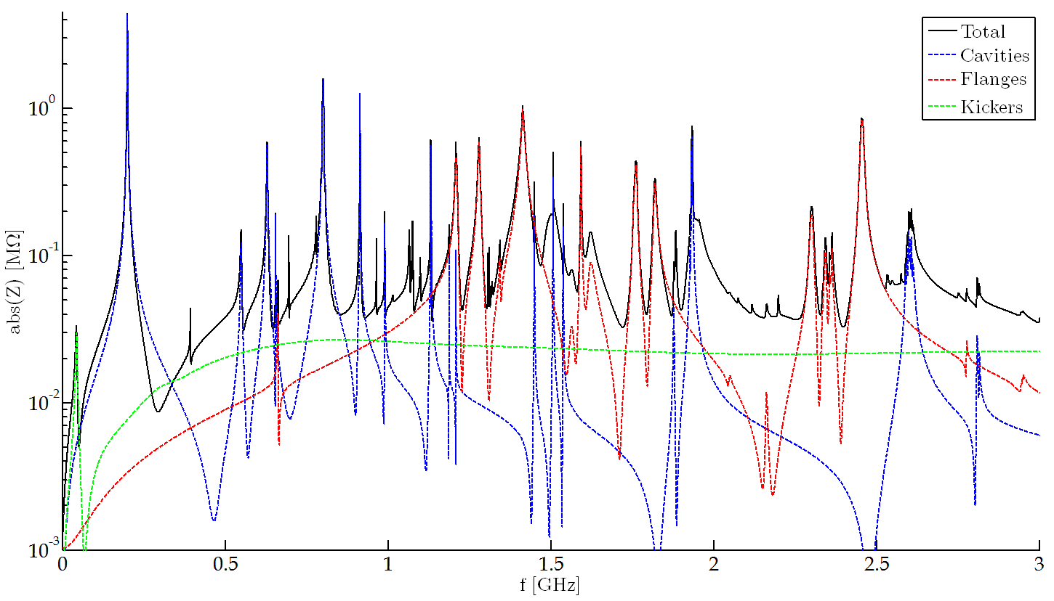
SPS Impedance model
Latest impedance model (J. Varela, B. Salvant, C. Zannini, D. Bazyl, P. Kramer):
Travelling wave cavities and HOMs
Kickers
Vacuum flanges
Unshielded pumping ports
BPMs
Y chambers
Beam scrapers
Resistive wall
Space charge (flat bottom)
(ZS/MSE)

Slide 5
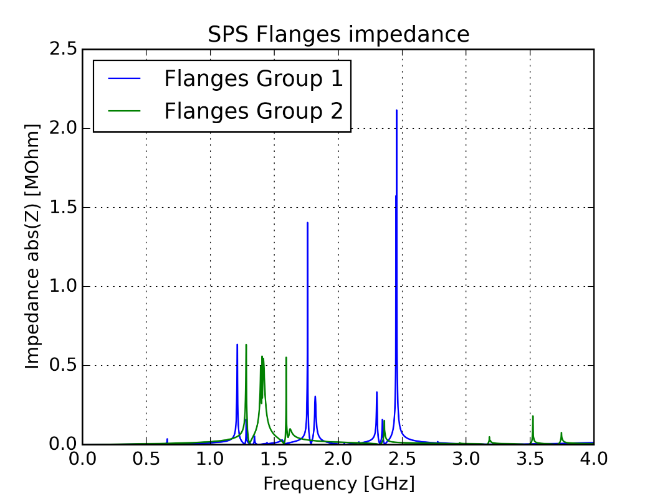
Vacuum flanges groups
Vacuum Flanges Group 1:
QD-QD enameled flanges (99)
QD-QD closed flanges (75)
Shielded pumping ports – Long QD Bellows (71)
Shielded pumping ports VVSA – Long QD Bellows (17)
BPV – QD flanges
Vacuum Flanges Group 2:
QF – QF closed flange no bellows (18+2)
QF – QF closed flange (22+1+3)
BPH – QF flanges (25+12)
MBA – MBA flanges (12+2)
QF – MBA flanges (78+2)

Slide 6
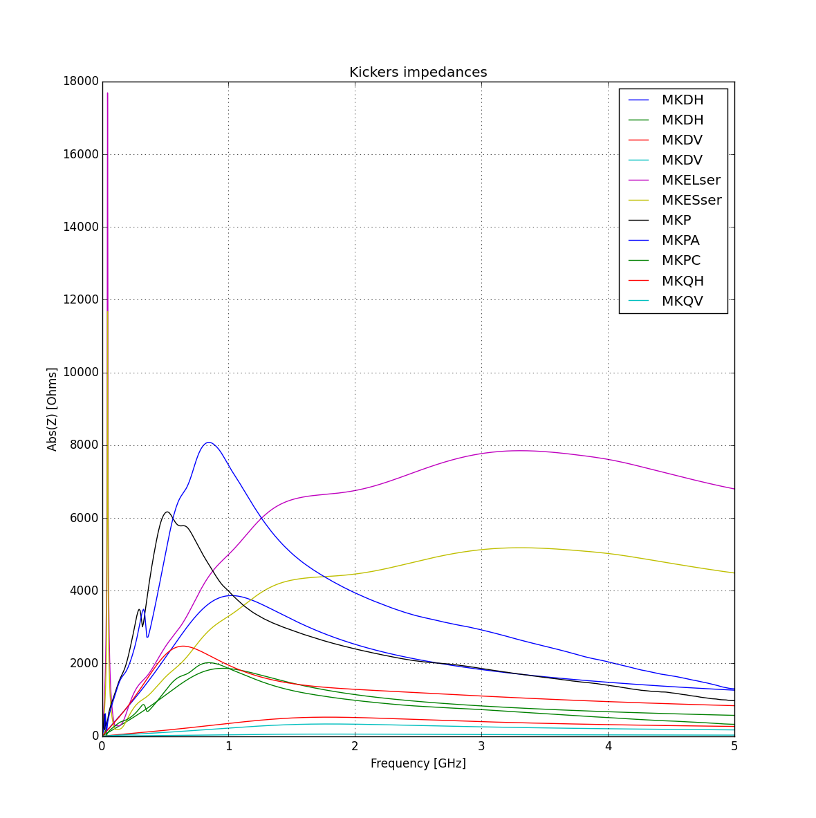
Kickers
Kickers :
MKDH (x3)
MKDV (x2)
MKEL (x5) (serigraphed)
MKES (x3) (serigraphed)
MKP (x1)
MKPA (x2)
MKPC (x1)
MKQH (x1)
MKQV (x1)

Slide 7
HOMs
Example for the 2 long TWC:
f [GHz] | Z [kΩ] | Q | R/Q [Ω]
0.6291 | 260 | 300 | 867
0.6299 | 140 | 500 | 280
0.9142 | 940 | 4500 | 209
0.9148 | 720 | 4500 | 160
J. Varela – LIU-SPS Beam Dynamics Working Group 06/08/2015

Slide 8
Impedance reduction simulations: single bunch

Slide 9
Studied parameters space
Different parameters to scan:
Intensity
Emittance
Different RF programs (single and double RF)
Different cycles (fast and long ramp)
Different distributions (binomial)
Impedance tested:
Flanges (group 1)
Flanges (group 2)
Bunch distribution: $$F\left(H\right)=F_{0}{\left(1−\frac{H}{H_{0}}\right)}^{μ}$$

Slide 10
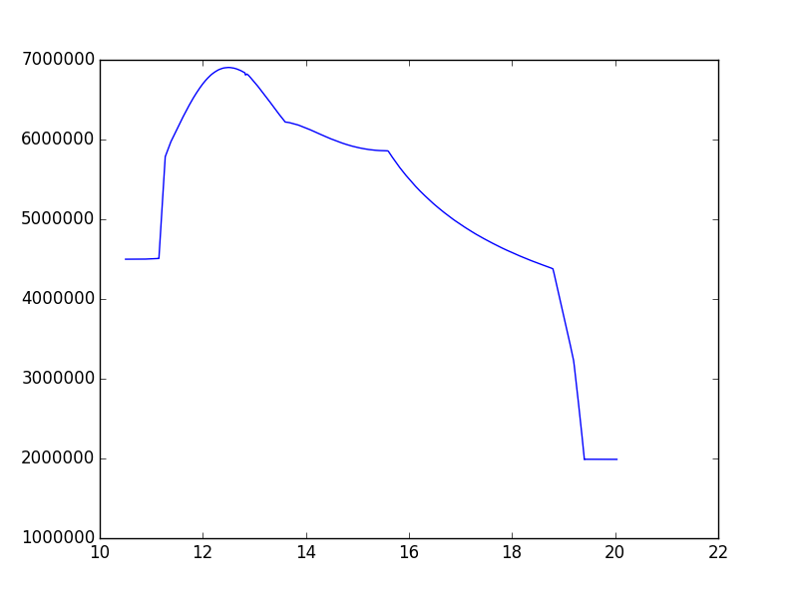
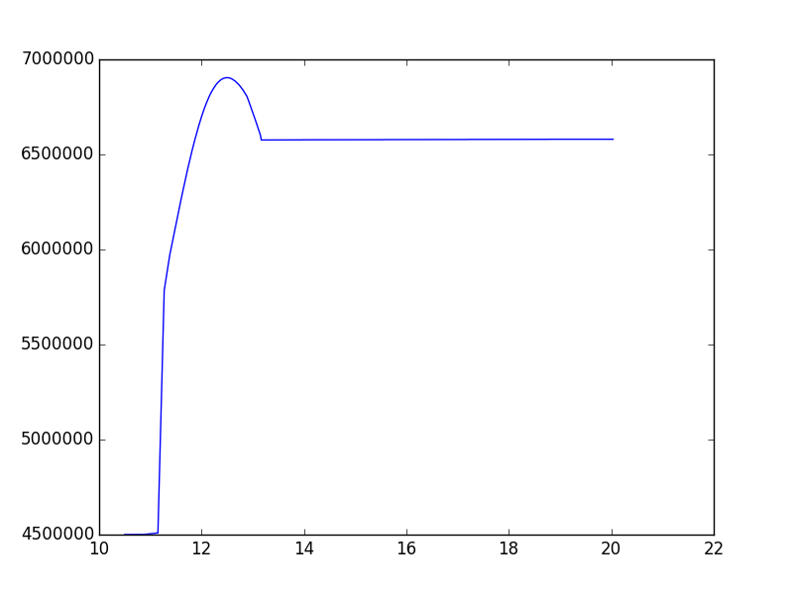
Slow ramp parameters
Slow ramp (8.6s nominal LHC cycle)
Two RF voltage settings
Constant bucket area CBA (acceptance 0.6eVs)
High voltage HV (~6.6MV)
Second RF voltage set to 10% of the main RF
CBA
HV
Voltage (V)
Voltage (V)
Time (s)
Time (s)

Slide 11
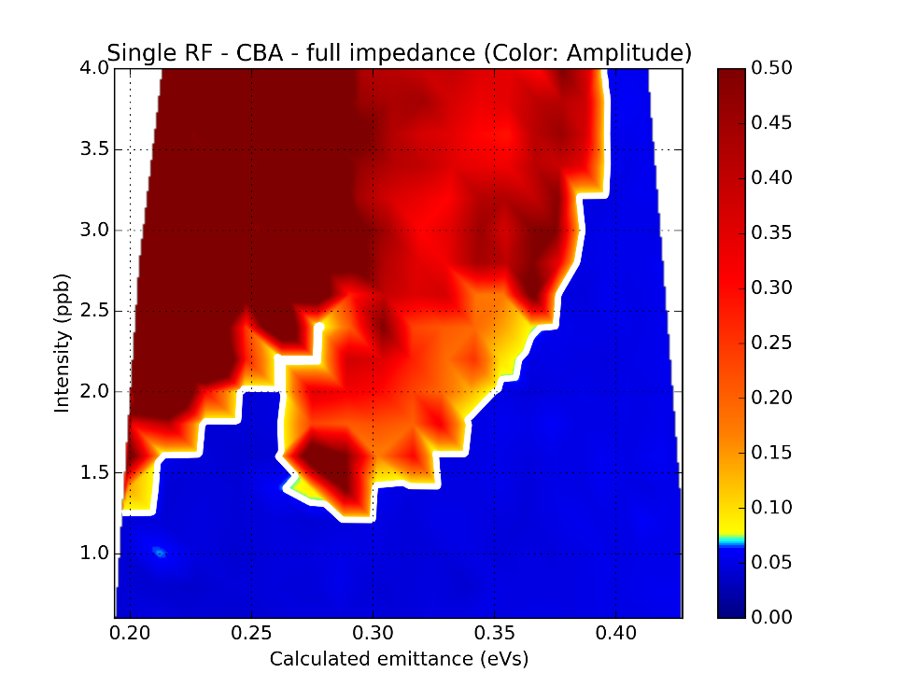
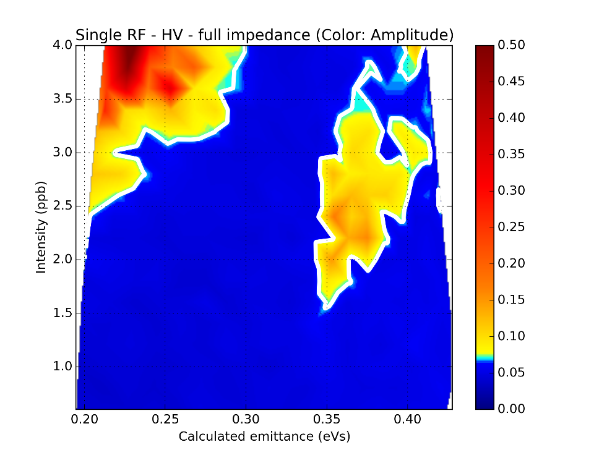
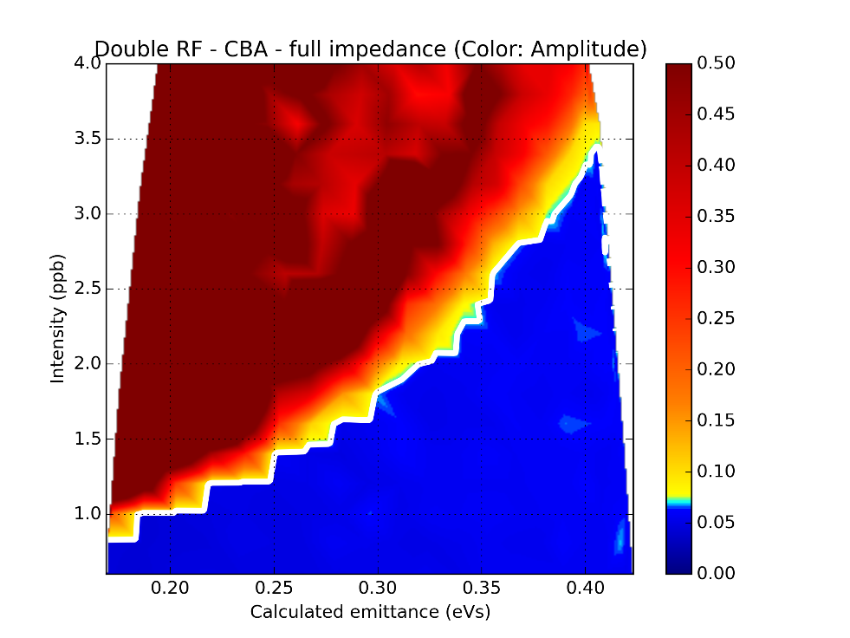
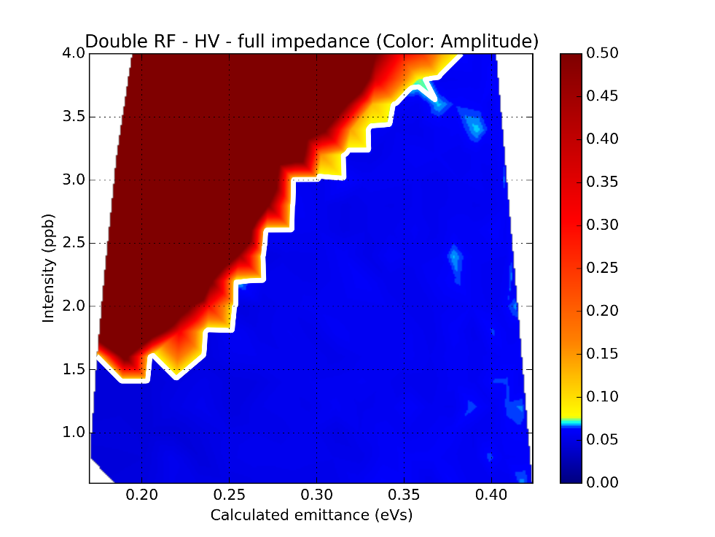
Max bunch length oscillations ($N$ vs. $ε$)
CBA
HV
1RF
2RF

Slide 12
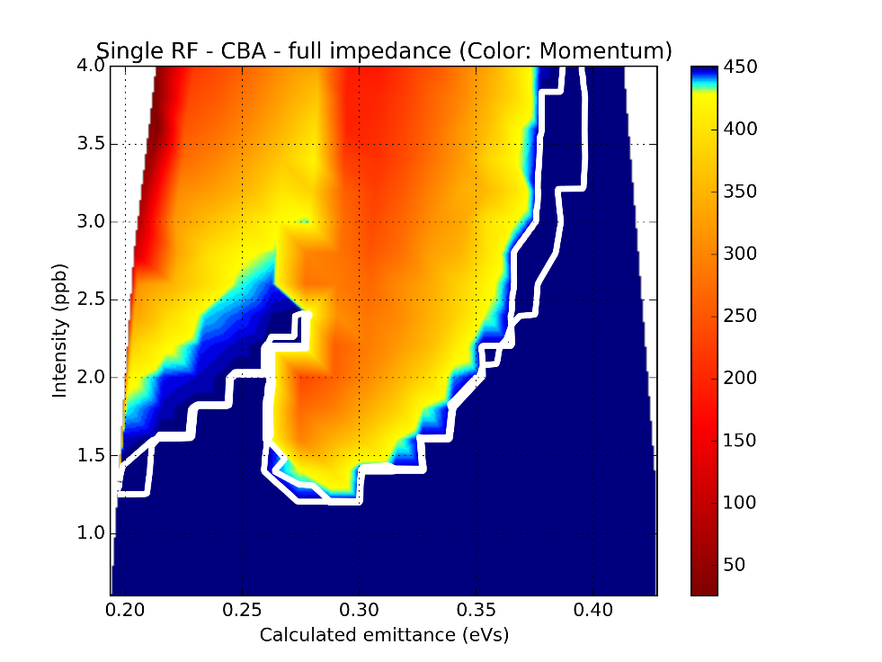
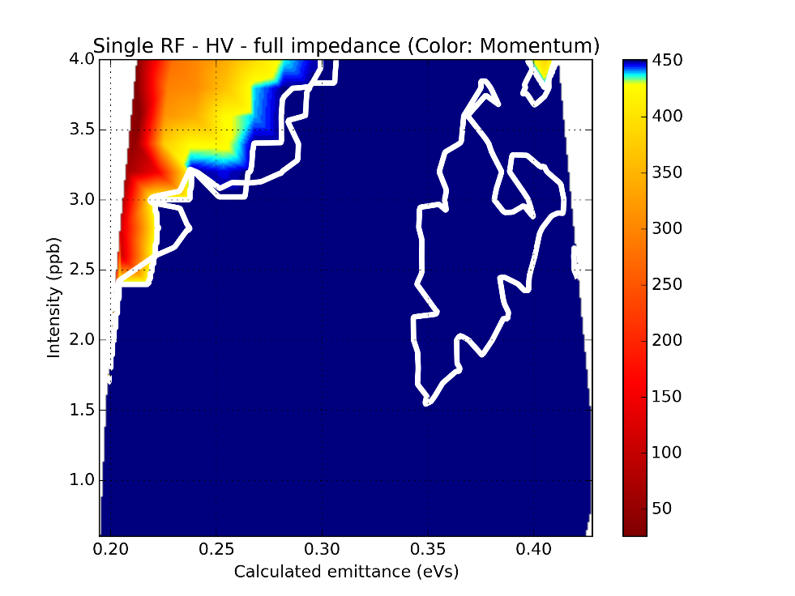
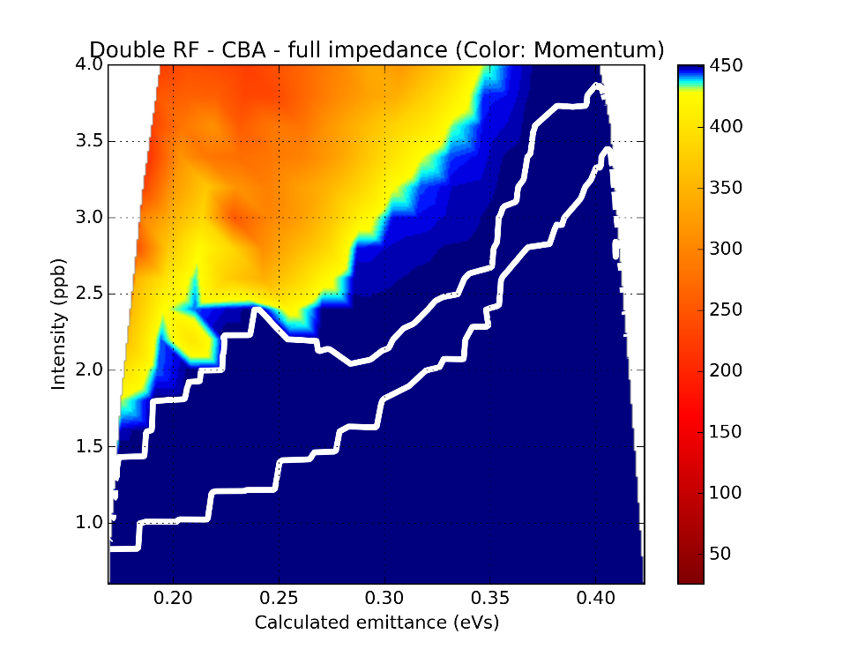
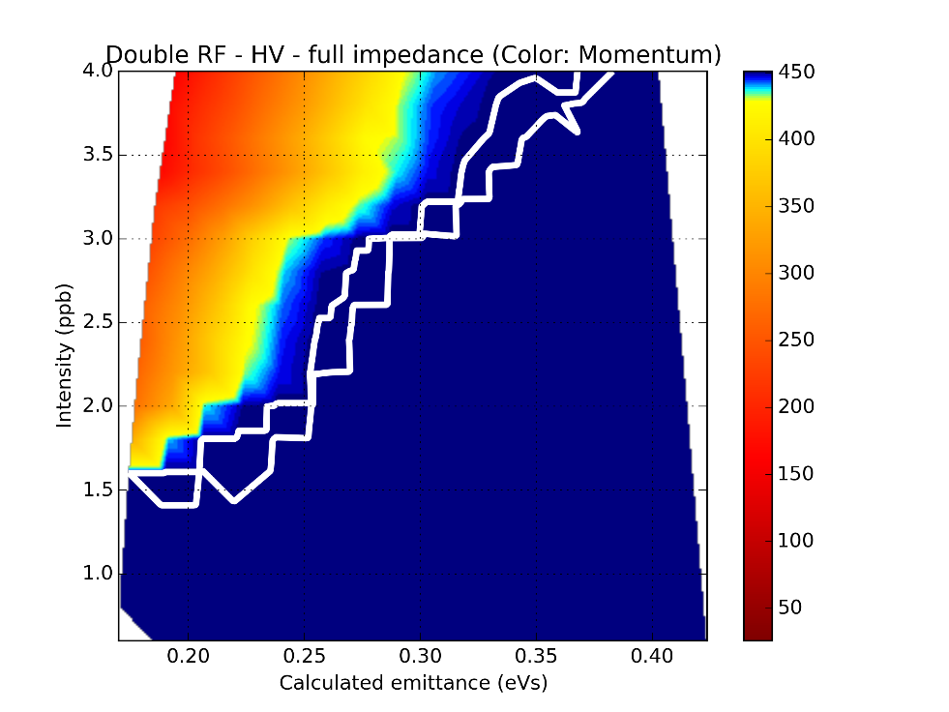
Momentum at start of instability ($N$ vs. $ε$)
CBA
HV
Instability at flat top
1RF
2RF

Slide 13
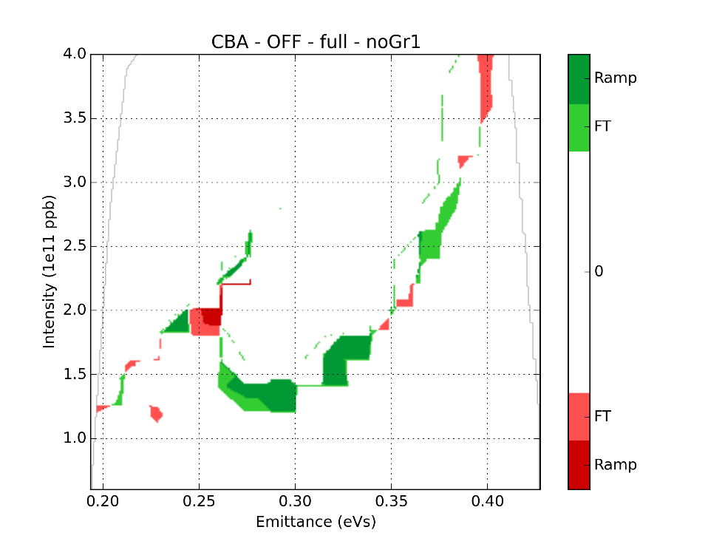
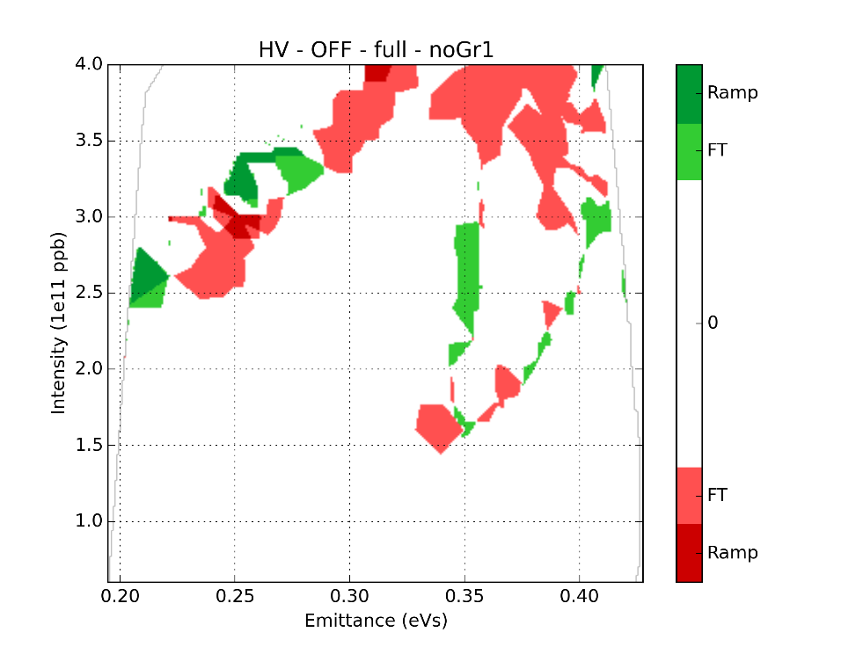
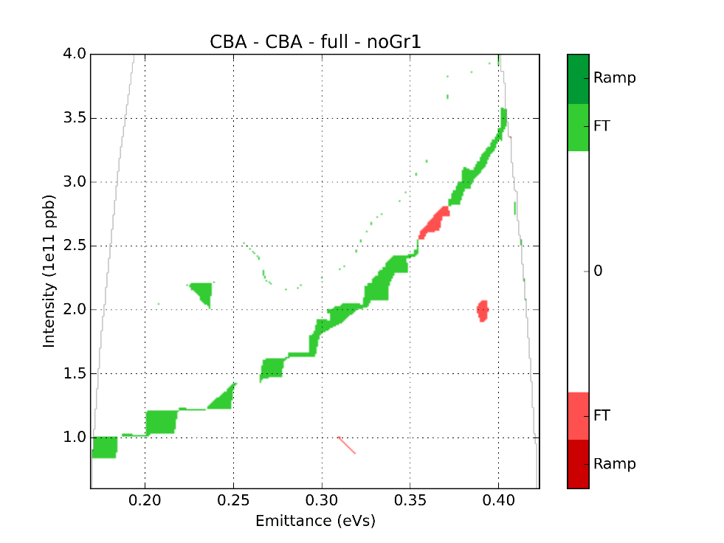
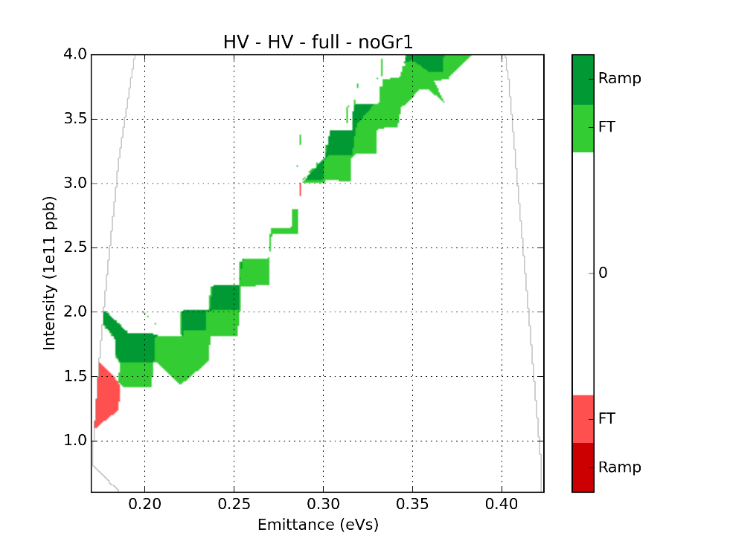
Gain of removing flanges Group 1 ($N$ vs. $ε$)
CBA
HV
1RF
2RF

Slide 14
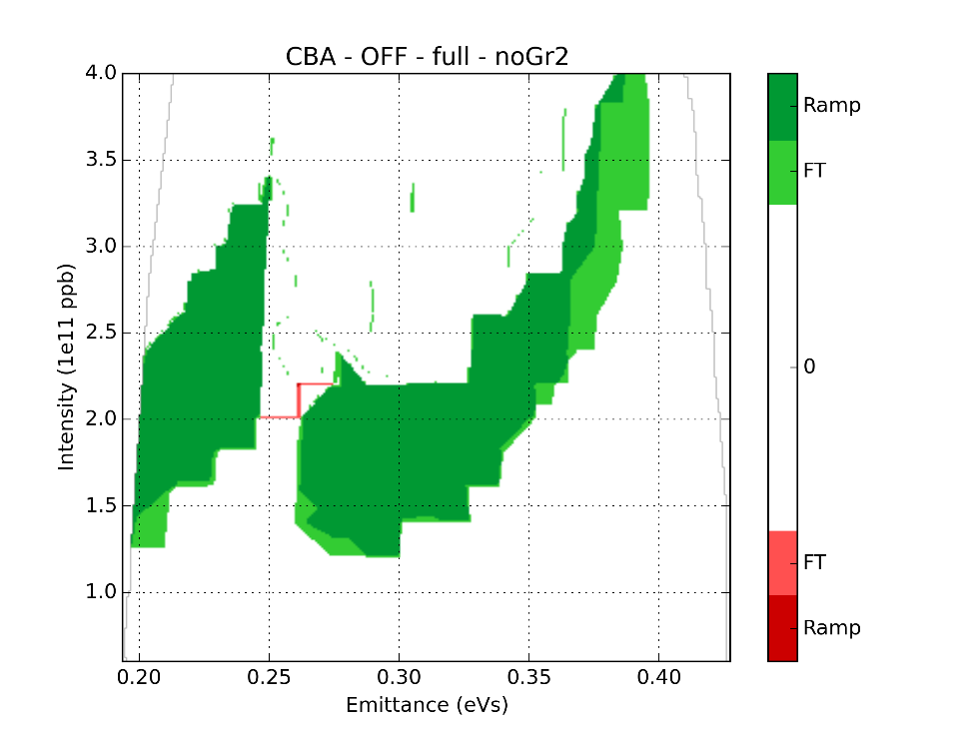
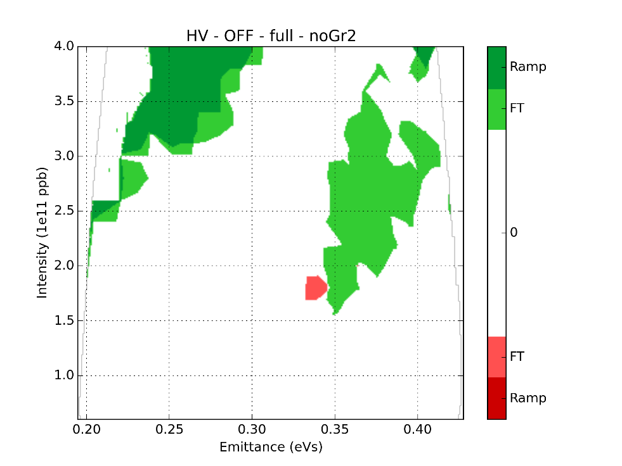
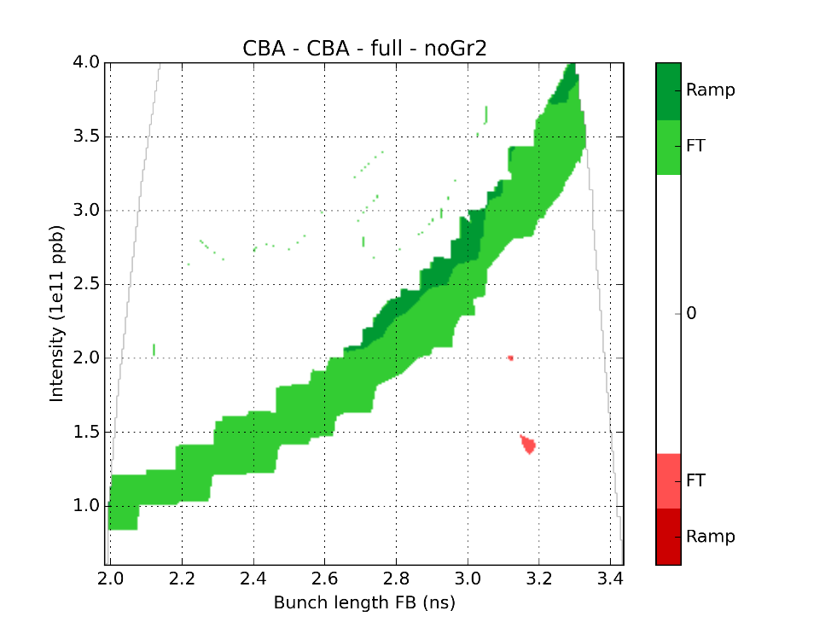
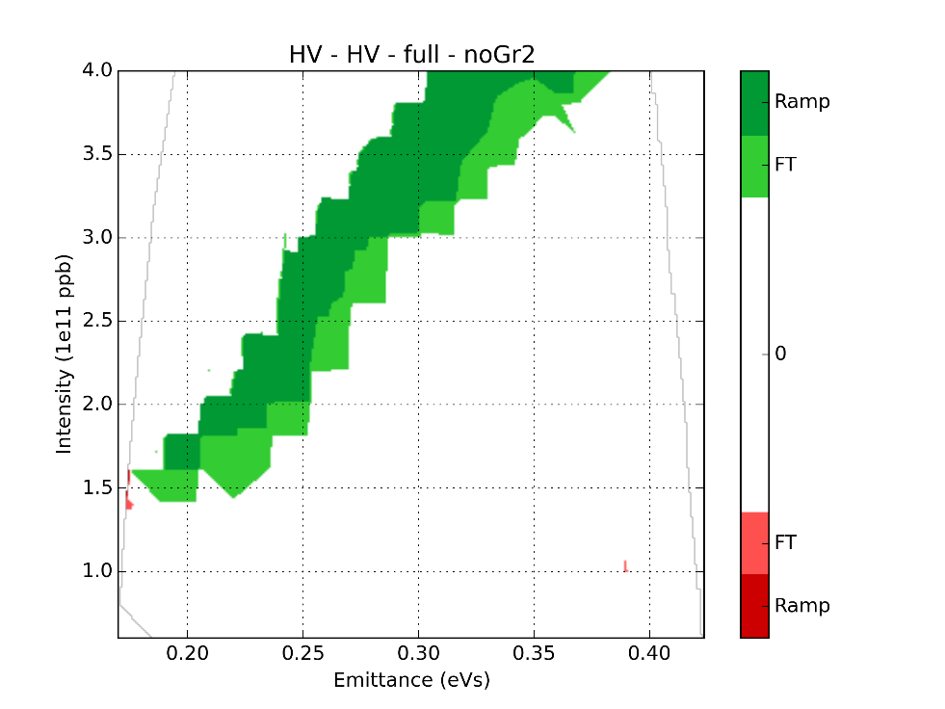
Gain of removing flanges Group 2 ($N$ vs. $ε$)
CBA
HV
1RF
2RF

Slide 15
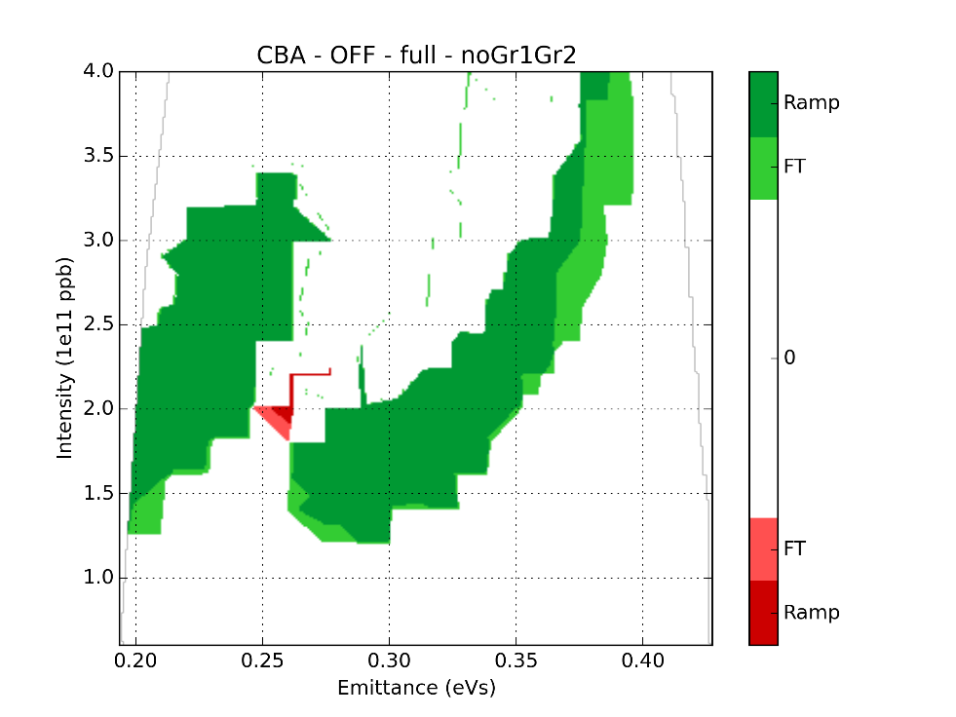
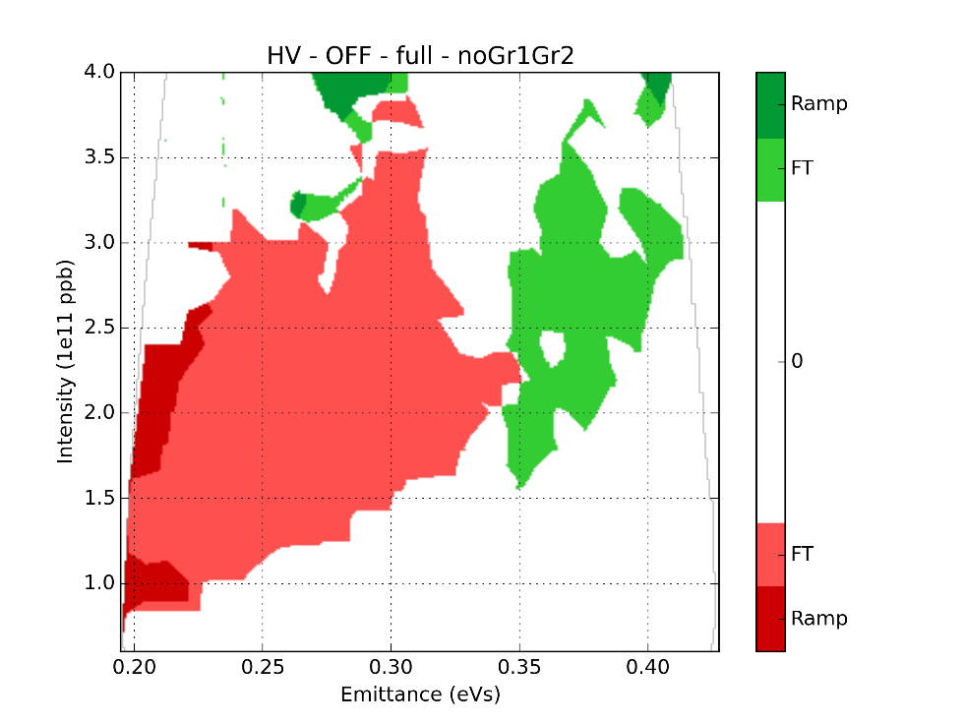
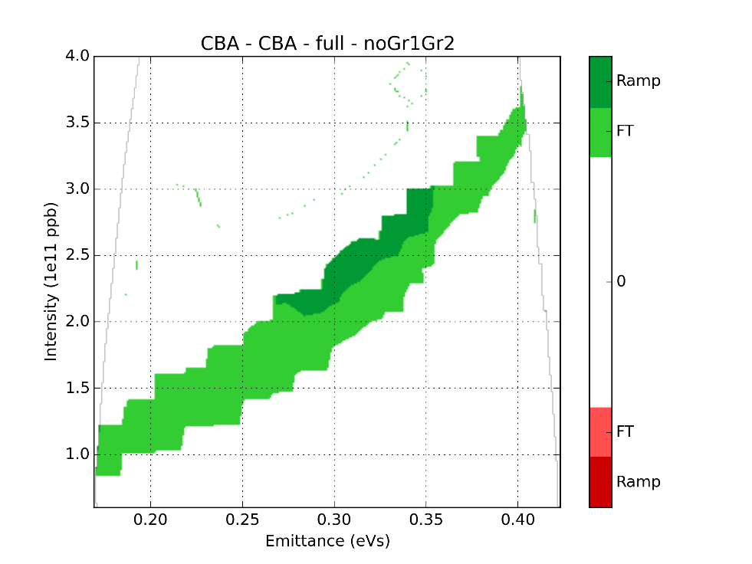
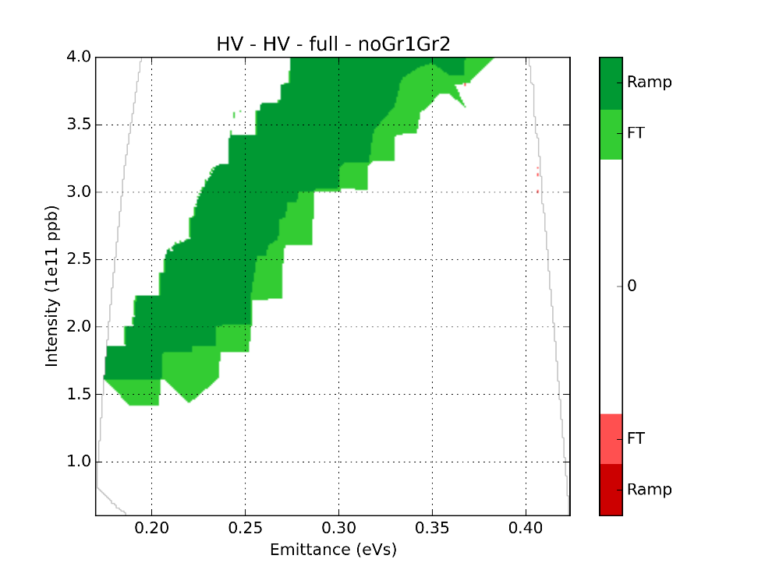
Gain of removing all flanges ($N$ vs. $ε$)
CBA
HV
1RF
2RF

Slide 16
Conclusions for single bunch
The impedance reduction study for single bunch showed that:
Removing the group 1 of the flanges has low effect
Removing the group 2 of the flanges has a significant effect (intensity gain > $0.5×10^{11}$)
Removing both groups usually sums the effect of removing group 1 and 2 independently, except in single RF and high voltage where it gets more unstable at flat top for small emittances
Conclusions are the same for the slow and the fast ramp (-> extra slides).

Slide 17
Impedance reduction simulations: 12 bunches

Slide 18
Studied parameters space
Different parameters to scan:
Intensity
Emittance
Fixed parameters:
Flat top energy
$V_{200}=7 MV$
One distribution $μ=1.5$
12 bunches, 25ns spacing
TWC200 main harmonic reduced by 20dB (feedback)
Impedance tested in this study:
Flanges (group 1)
Flanges (group 2)
Kickers
TWC200 and TWC800 HOMs
Bunch distribution: $$F\left(H\right)=F_{0}{\left(1−\frac{H}{H_{0}}\right)}^{μ}$$

Slide 19
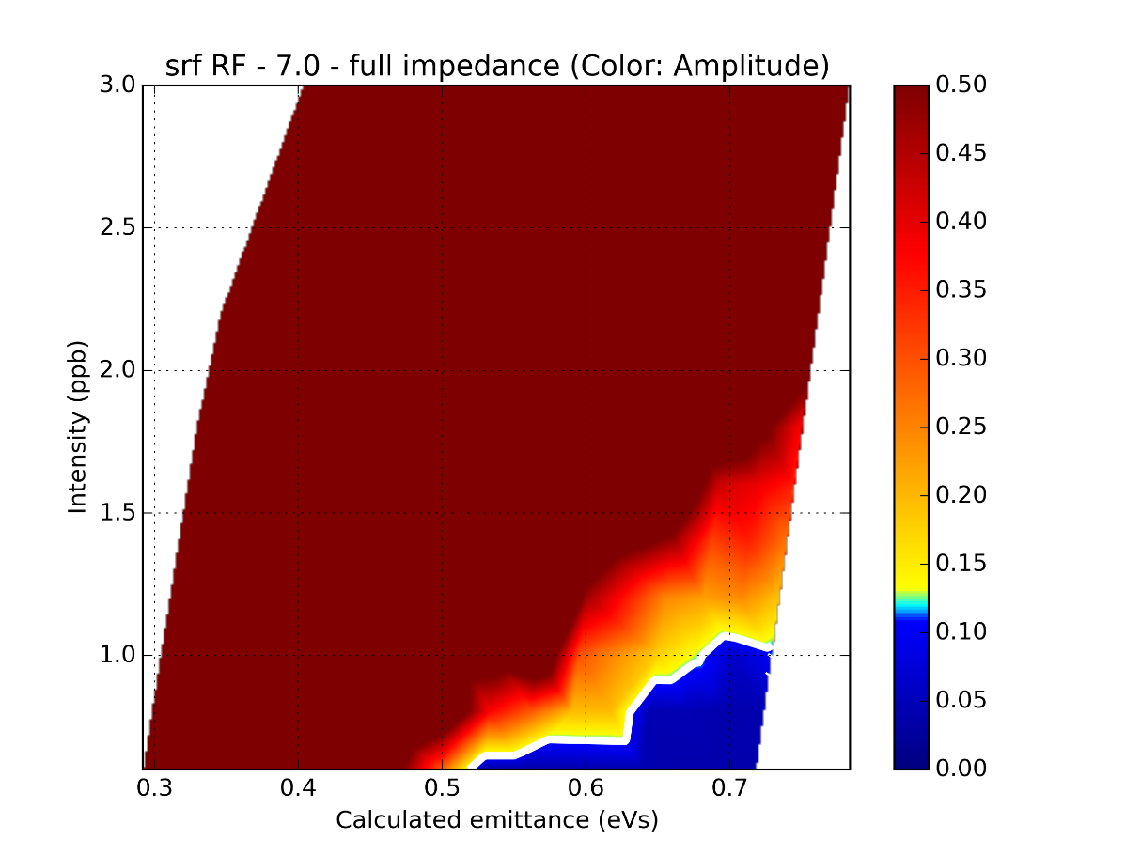
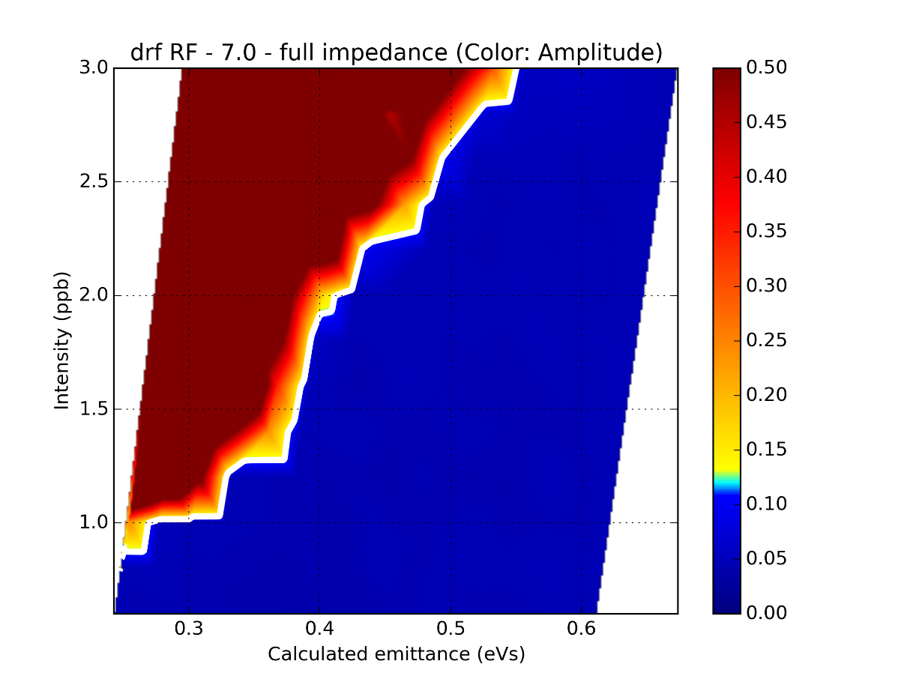
Max bunch length oscillations ($N$ vs. $ε$)
1RF
2RF
According to simulations, HL-LHC parameters can already be reached in double RF for 12 bunches…
To be taken into account:
12 bunches
No ramp
Simple feedback model
Effective phase and voltage of 800MHz study ongoing

Slide 20
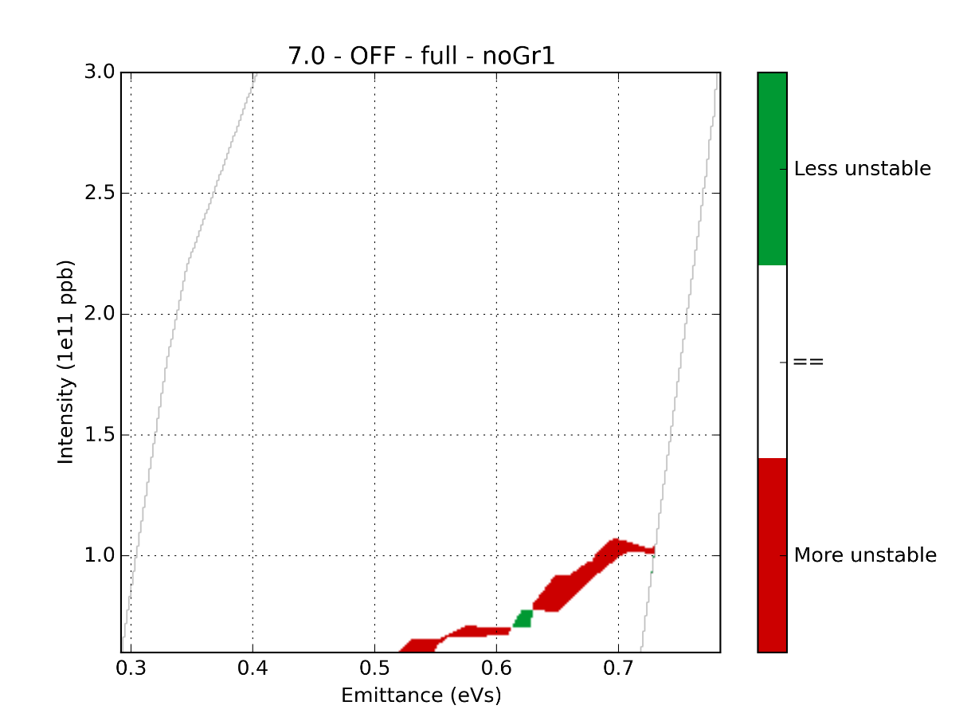
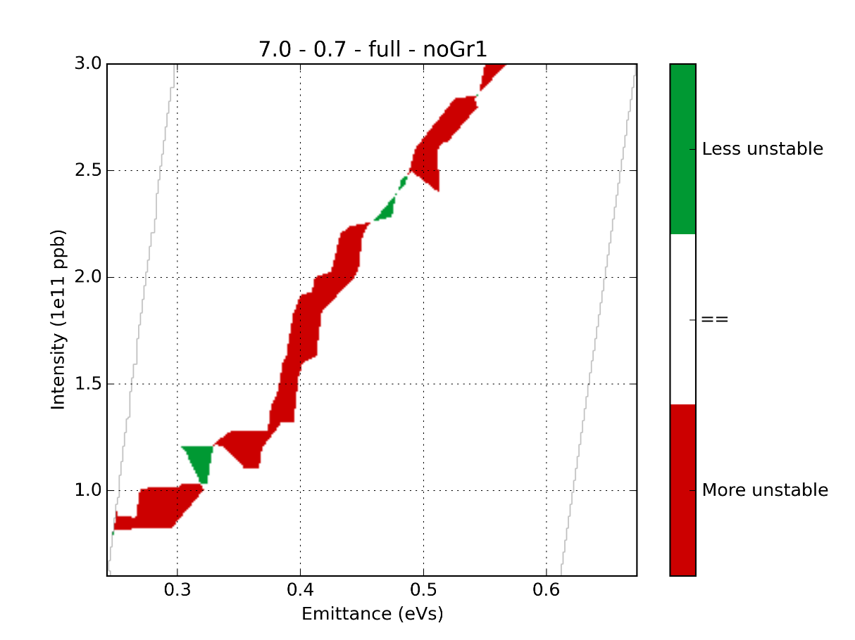
Removing the flanges (Gr1)
1RF
2RF
More stable
More stable
More unstable
More unstable
Barely no effect

Slide 21
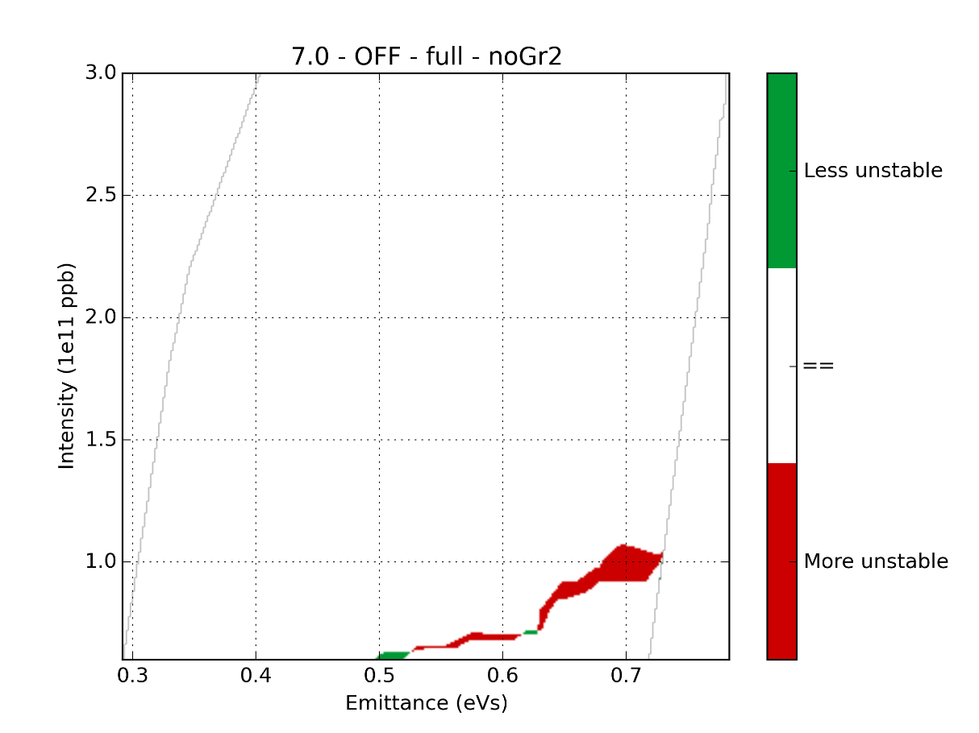
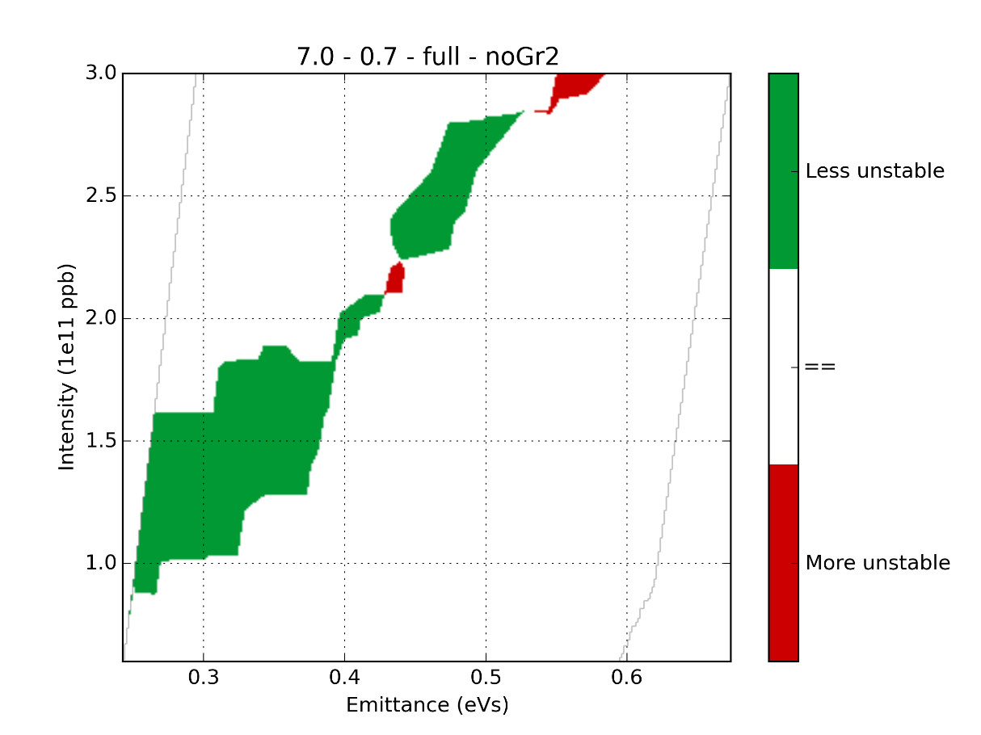
Removing the flanges (Gr2)
1RF
2RF
More stable
More stable
More unstable
More unstable
Effect for low emittances in double RF

Slide 22
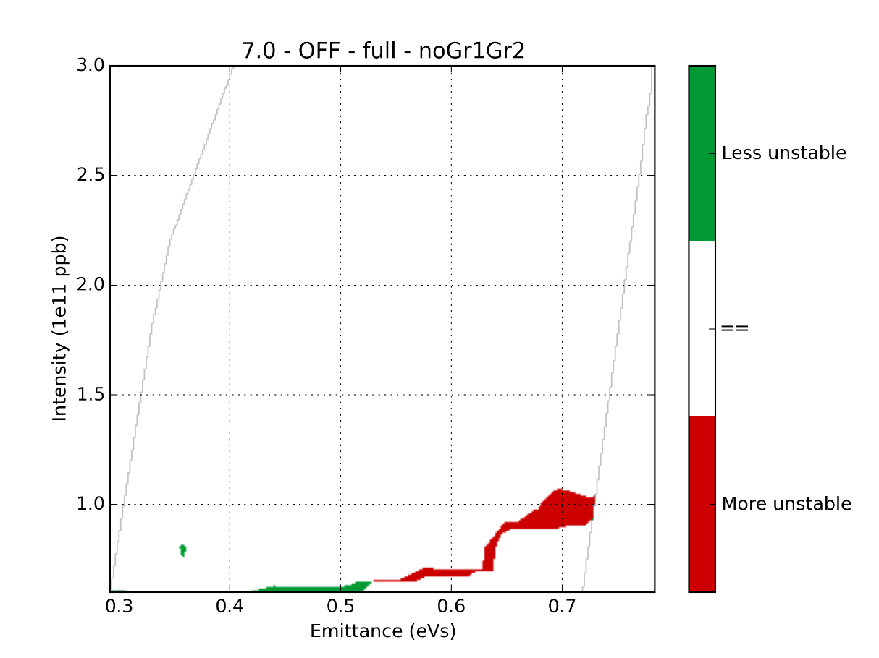
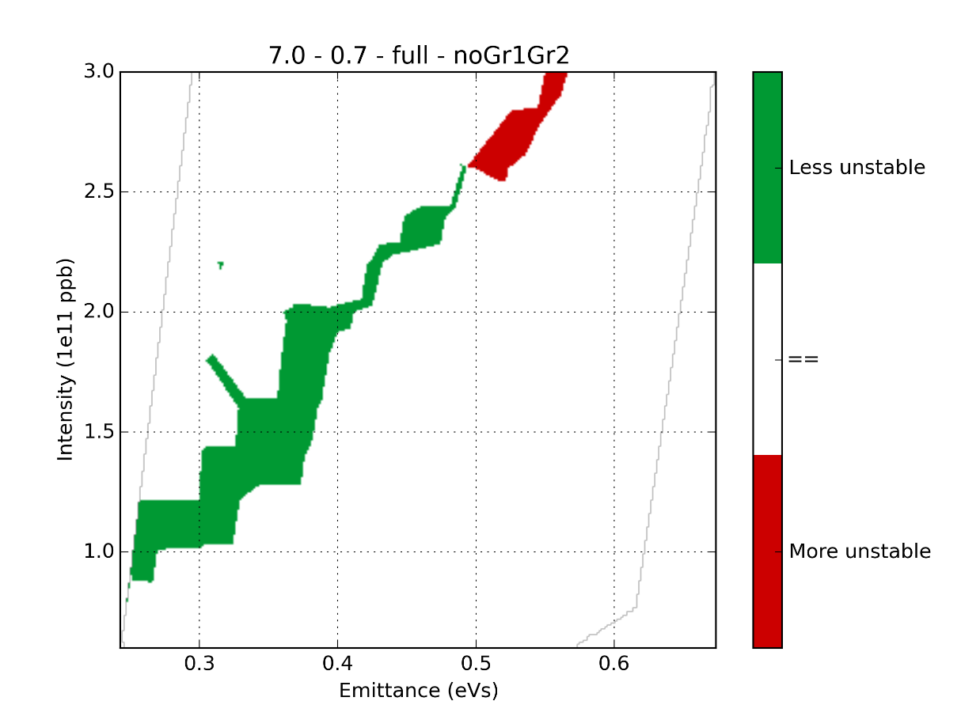
Removing the flanges (all)
1RF
2RF
More stable
More stable
More unstable
More unstable
Small effect for low emittances in double RF

Slide 23
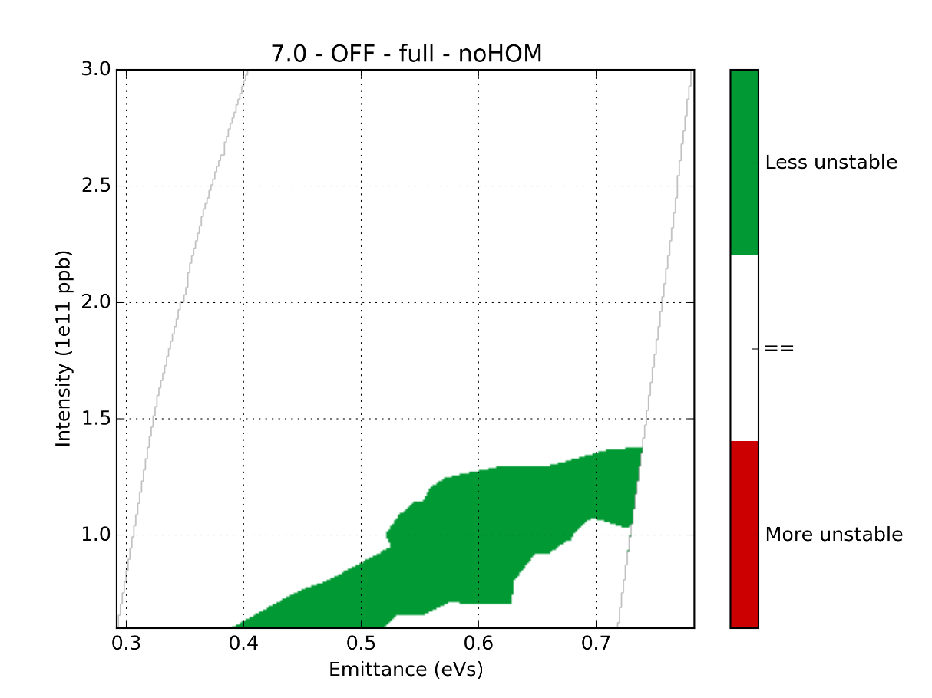
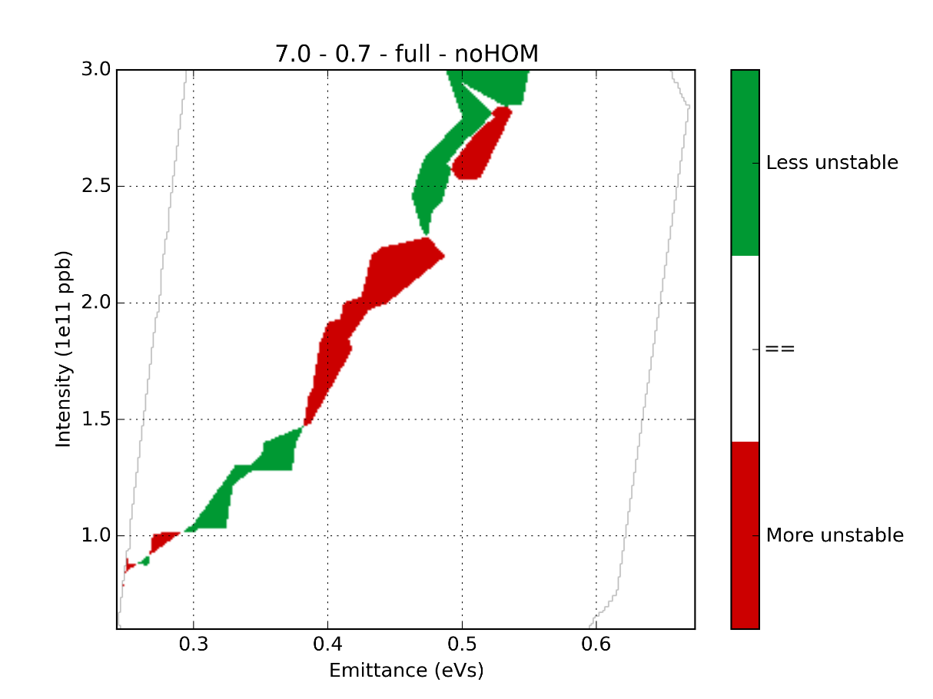
Removing the HOMs
1RF
2RF
More stable
More stable
More unstable
More unstable
Effect for low emittances in single RF

Slide 24
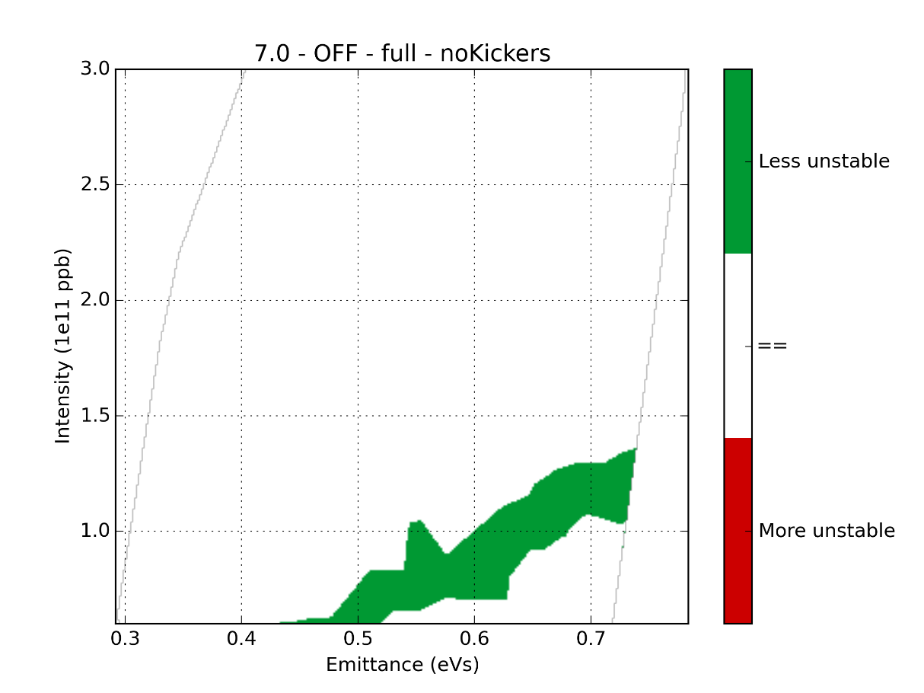
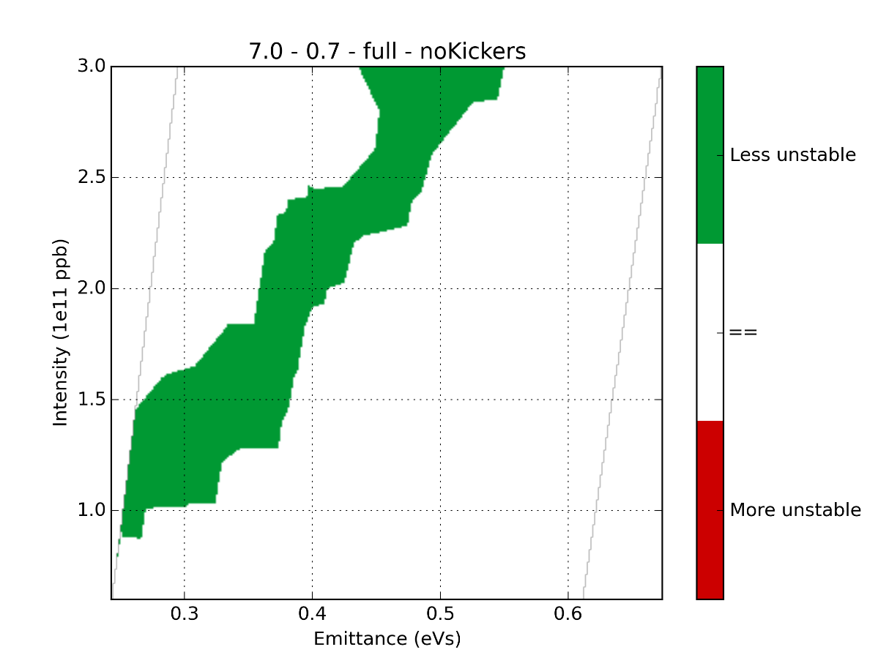
Removing the kickers
1RF
2RF
More stable
More stable
More unstable
More unstable
Effect for both single and double RF
Kickers seem to have an effect for multi-bunch, even as a broadband impedance

Slide 25
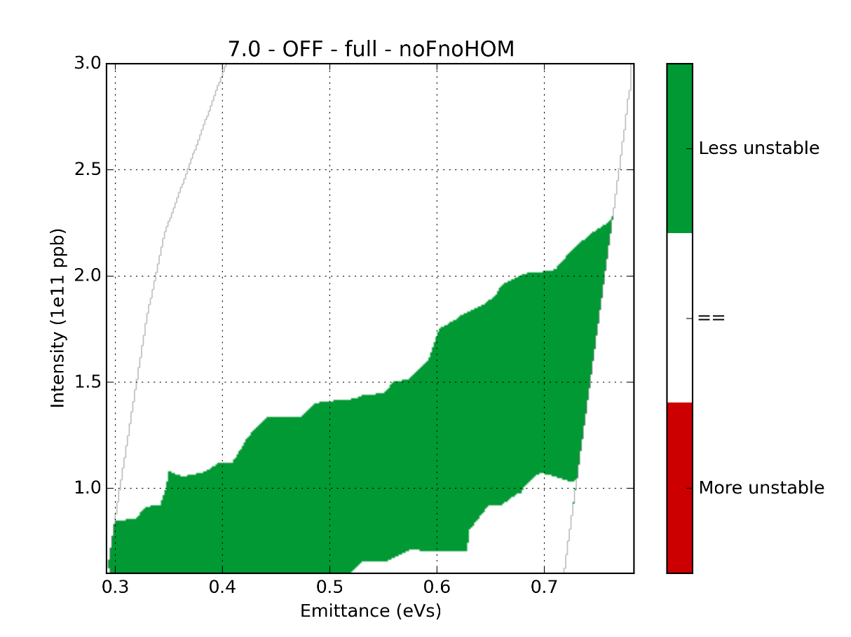
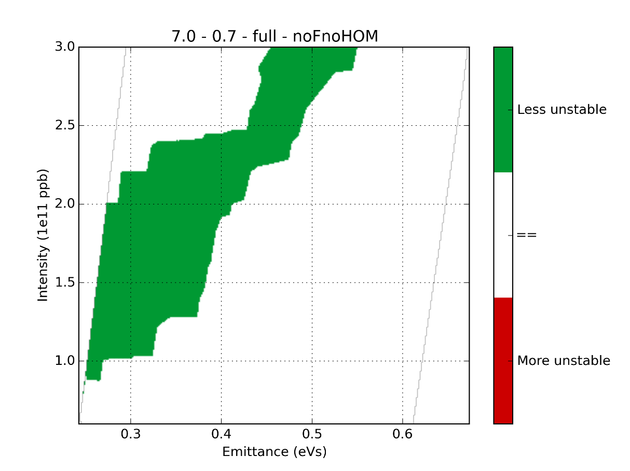
Removing the flanges and HOMs
1RF
2RF
More stable
More stable
More unstable
More unstable
Important effect by removing 2 impedance sources

Slide 26
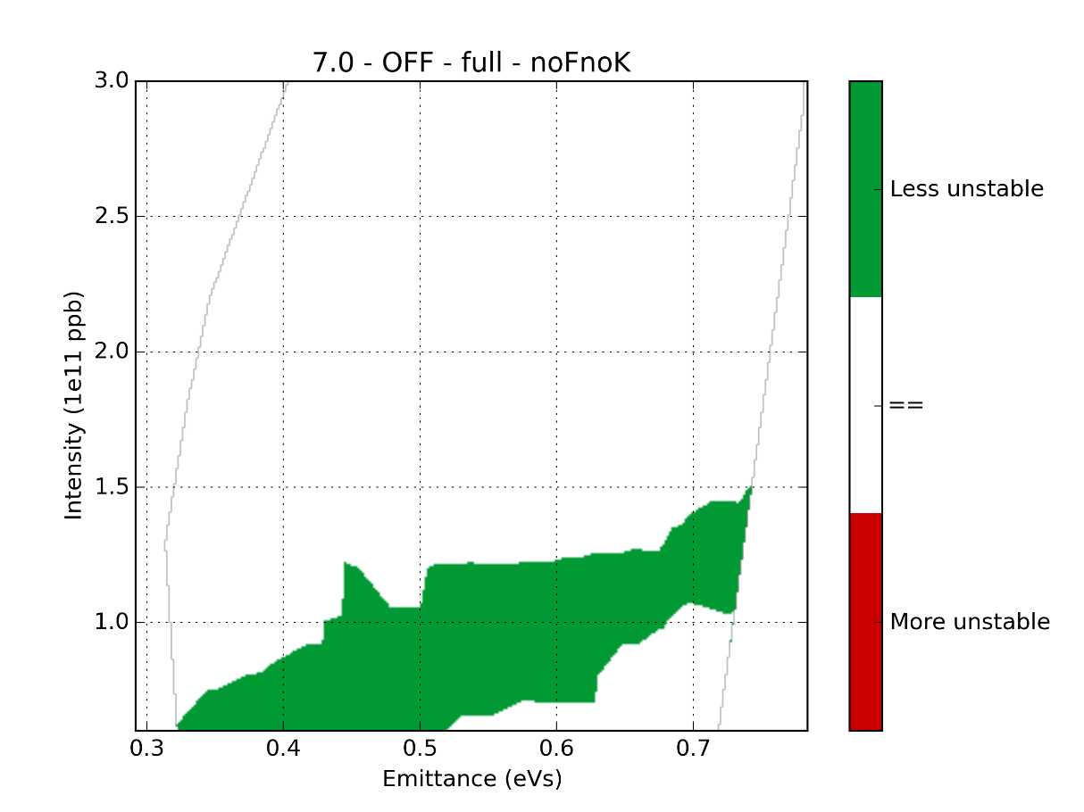
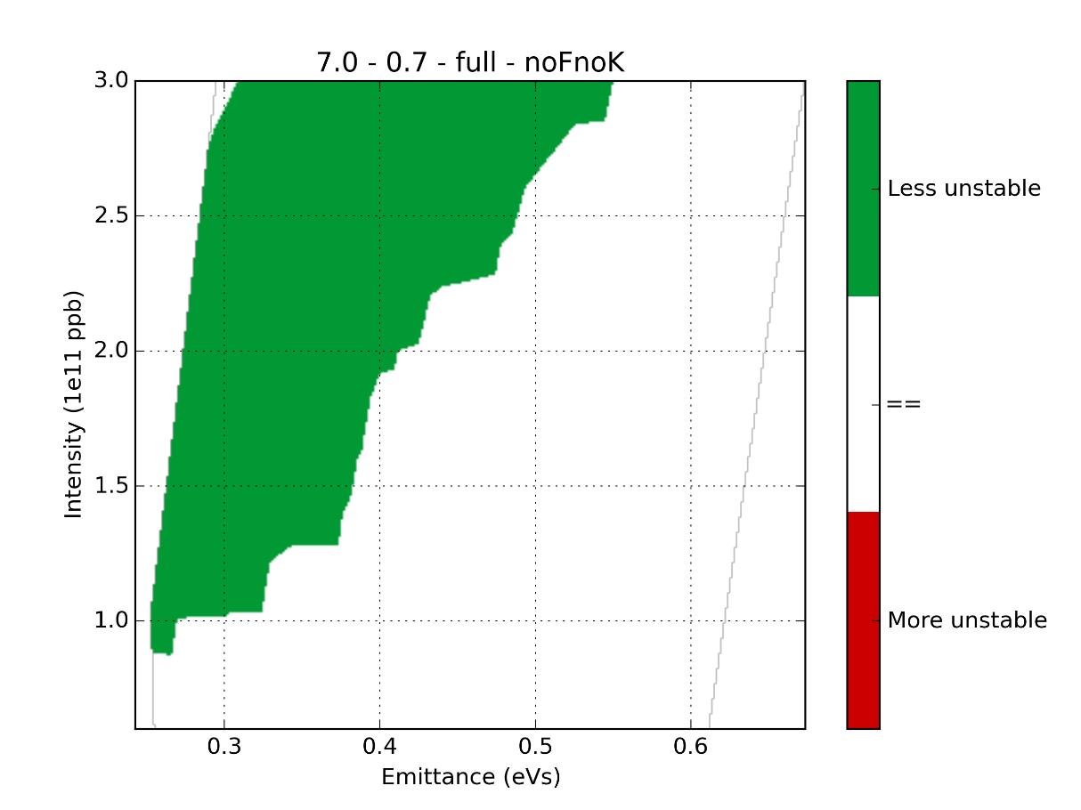
Removing the flanges and kickers
1RF
2RF
More stable
More stable
More unstable
More unstable
Single RF: small gain (not more than removing HOMs alone)
Double RF: important gain (all stable)

Slide 27
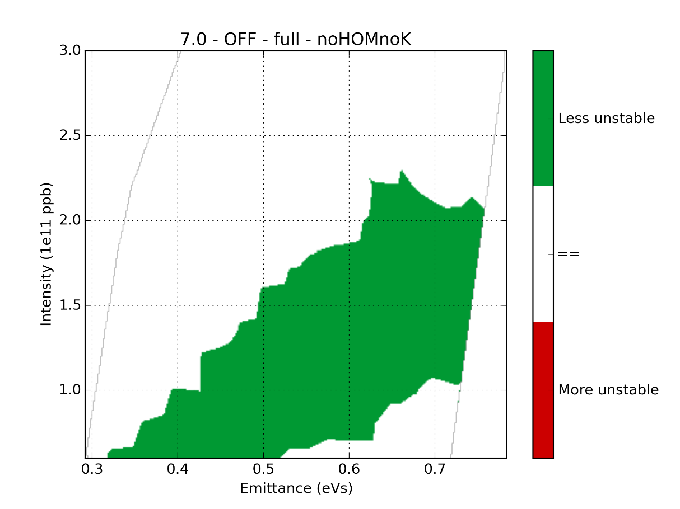
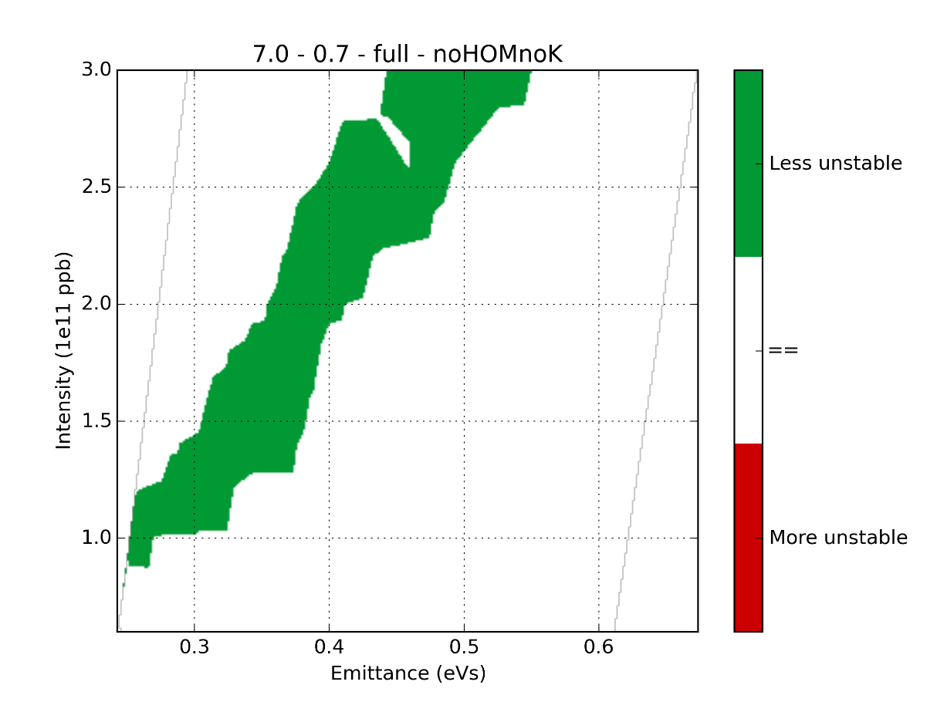
Removing the HOMs and kickers
1RF
2RF
More stable
More stable
More unstable
More unstable
Single RF: more intensity gain than removing flanges/kickers
Double RF: no more gain than removing kickers alone

Slide 28
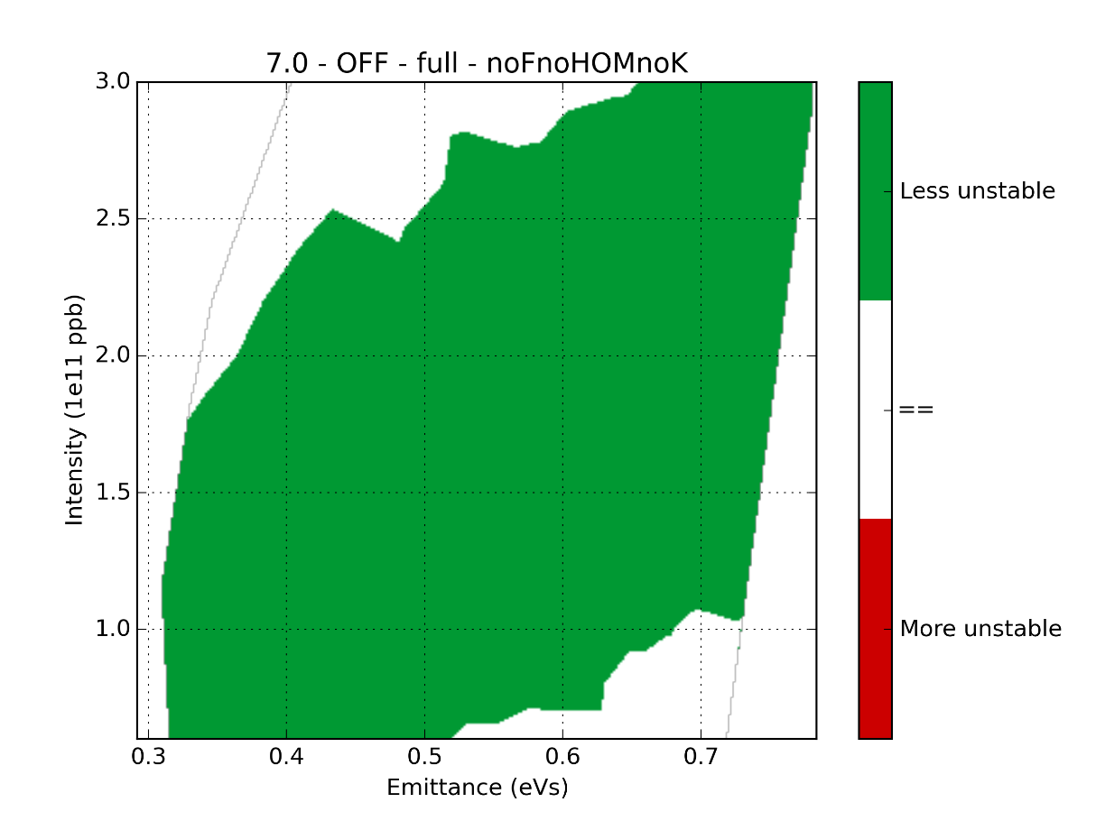
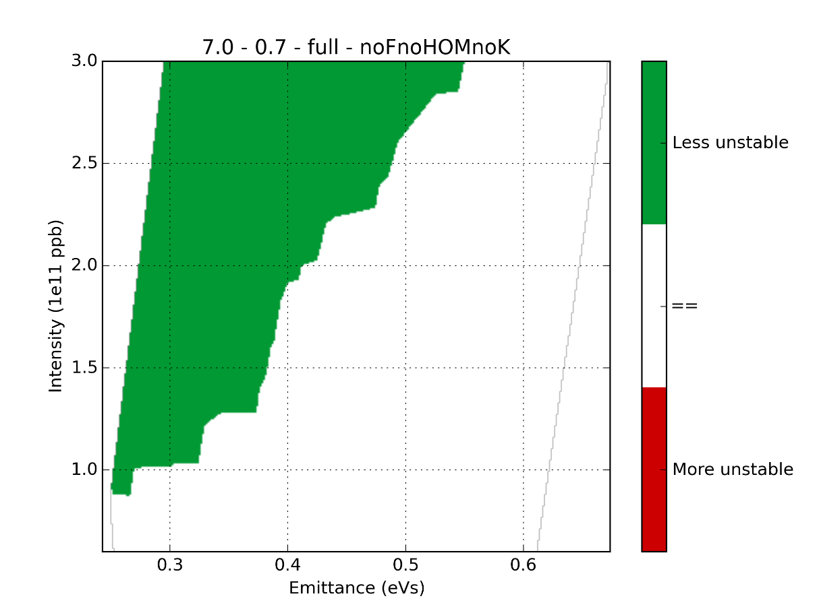
Removing the flanges, HOMs and kickers
1RF
2RF
More stable
More stable
More unstable
More unstable
The flanges, HOMs, kickers are the main impedances driving instabilities.
It is to notice that in single RF, the remaining impedances can still lead to instabilities at high intensities.

Slide 29
Conclusions for multi bunch
The impedance reduction study for single bunch showed that:
Removing a single impedance (flanges or HOMs or kickers) has a limited effect
Removing two impedances has an important effect for all the combinations (up to $1×{10}^{11}$ ppb).
Flanges seems more limiting in double RF, HOMs seems more limiting in single RF. As in single RF, the group 2 of the flanges seems to have more effect than the group 1.
This shows that for multi-bunch cases (with feedback on the TWC 200MHz), the instabilities are not dominated by a single source of impedance.
As the impedances cannot be completely removed, simulations for more realistic cases of impedance reduction need to be done.

Slide 30
Further steps and ideas
Simulations of more realistic cases for impedance reduction:
Reduction of the number of kickers (8 MKEs now, simulations planned with 6 and 4 MKEs, serigraphy of the MKP)
Impedance reduction of the vacuum flanges (shielding model for the group 2, MBA-MBA type)
Impedance reduction of the HOMs (estimation of the reduction in Q from HOM couplers)
Increase of the maximum RF voltage (needs an impedance evaluation of the reorganized cavities)
Increase in the number of bunches
Influence of the ramp

Slide 31
Extra slides

Slide 32
Impedance reduction simulations: single bunch

Slide 33
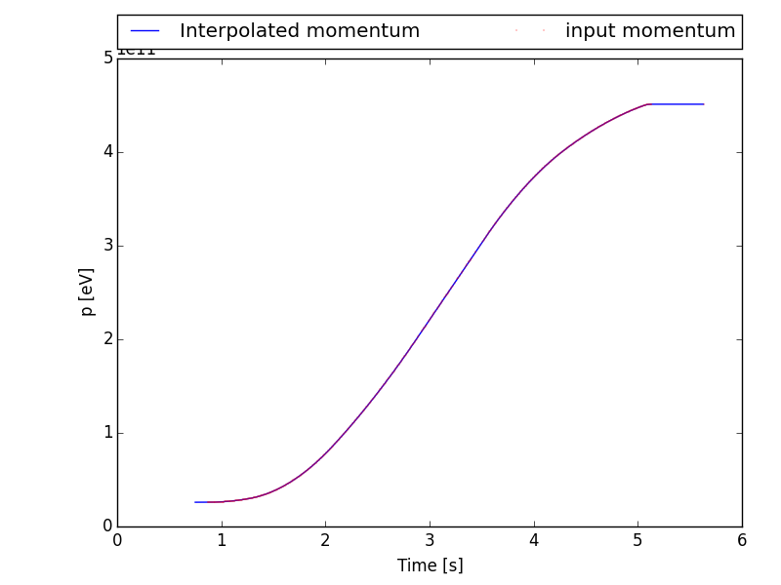
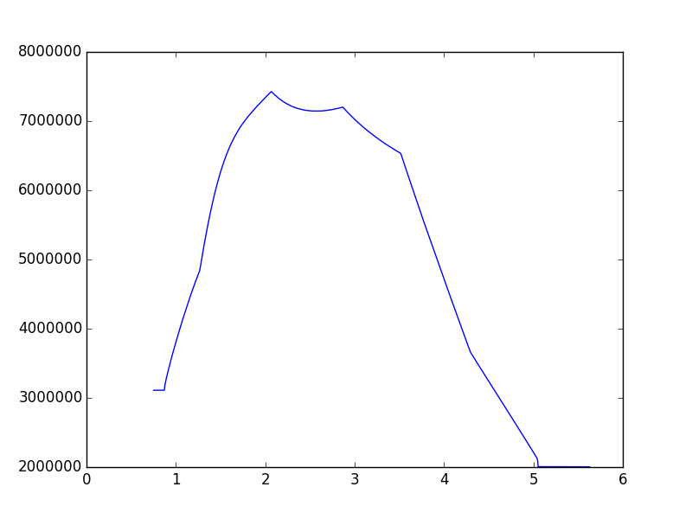
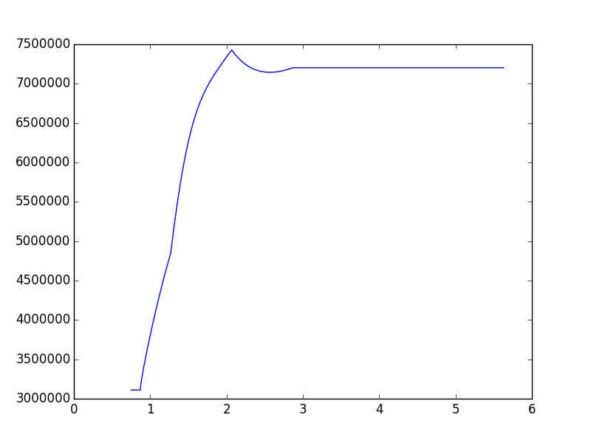
Fast ramp programs
Fast ramp (LHC pilot cycle)
Two RF voltage settings
Constant bucket area CBA (acceptance 0.5eVs)
High voltage HV (~7.2MV)
800MHz voltage set to 10% of the main RF
Momentum (eV)
CBA
HV
Voltage (V)
Voltage (V)
Time (s)
Time (s)

Slide 34
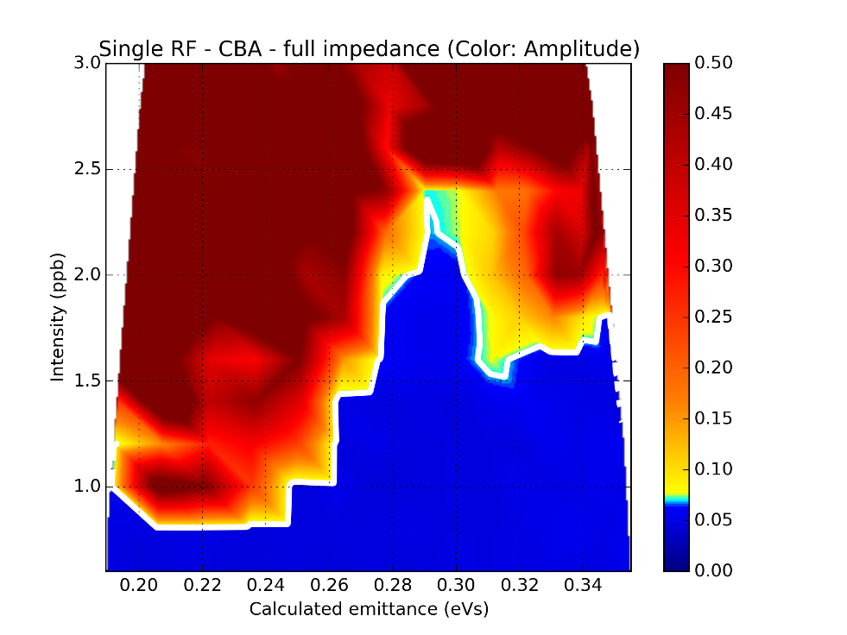
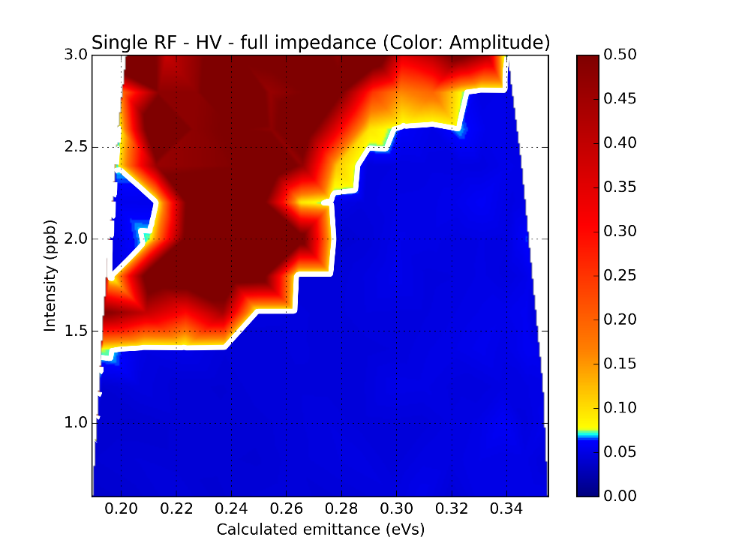
Max bunch length oscillations ($N$ vs. $ε$)
CBA
HV
1RF
2RF

Slide 35
Momentum at start of instability ($N$ vs. $ε$)
CBA
HV
Instability at flat top
1RF
2RF

Slide 36
Gain of removing flanges Group 1 ($N$ vs. $ε$)
CBA
HV
1RF
2RF

Slide 37
Gain of removing flanges Group 2 ($N$ vs. $ε$)
CBA
HV
1RF
2RF

Slide 38
Gain of removing all flanges ($N$ vs. $ε$)
CBA
HV
1RF
2RF

Slide 39
Conclusions for the fast ramp cycle
RF voltage:
Beam is more stable with high voltage than constant bucket area
Influence of double RF:
Beam is more stable with double RF than single RF during ramp
Beam is more stable with double RF than single RF after reaching flat top (except for constant bucket area, where there is a stability island around $ε\sim 0.29$eVs)
Effect of removing the flanges:
Group 1 : low effect
Group 2 : important effect (gain > $0.5×{10}^{11}$)
Group 1 and 2 : comparable to removing group 2 only (except in single RF and high voltage for low emittance)

Slide 40
Conclusions for the slow ramp cycle
RF voltage:
High voltage is more stable that constant bucket area
Instability island for the high voltage case around $ε\sim 0.35−0.40$eVs
Double RF:
Double RF is more stable than Single RF (except for constant bucket area, where there is a stability island around $ε\sim 0.29$eVs)
Effect of removing the flanges:
Group 1 : low effect
Group 2 : important effect (gain > $0.5×{10}^{11}$)
Group 1 and 2 : comparable to removing group 2 only (except in single RF and high voltage for low emittance)

