Slide 1
Analysis of un-captured beam loss on flat bottom
H. Bartosik, M. Schenk for the SPS scrubbing team
LIU SPS BD meeting, 17 September 2015

Slide 2
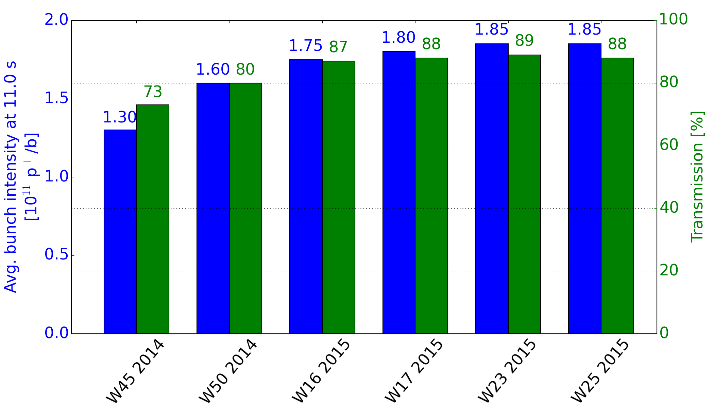
Introduction
The aim is to quantify the amount of beam that is not contained in RF buckets
Motivated by analysis of transmission on flat bottom with high intensity 25 ns beams of the SPS scrubbing runs (see SPS review “scrubbing vs. coating” Sep. 8) …
How much of the losses are due to un-captured beam?

Slide 3
Introduction
The aim is to quantify the amount of beam that is not contained in RF buckets
Motivated by analysis of transmission on flat bottom with high intensity 25 ns beams of the SPS scrubbing runs (see SPS review “scrubbing vs. coating” Sep. 8)
How much of the losses are due to un-captured beam?
The amount of un-captured beam is assessed with the three different methods
Dedicated experiment using the tune kicker. Set up a pulse within the window of empty RF buckets and measure the losses caused by the kick.
By comparing PS extraction with SPS injection intensities, the amount of losses caused by the injection kick pulse can be measured (assuming that the BCTs in the PS and SPS are cross-calibrated). It gives a rough estimate on the un-captured beam in the machine.
Un-captured beam causes losses at the beginning of the acceleration ramp. Use 2012 SPS data (taken during the LHC scrubbing run) where the nominal beam was ramped to 450 GeV/c.

Slide 4
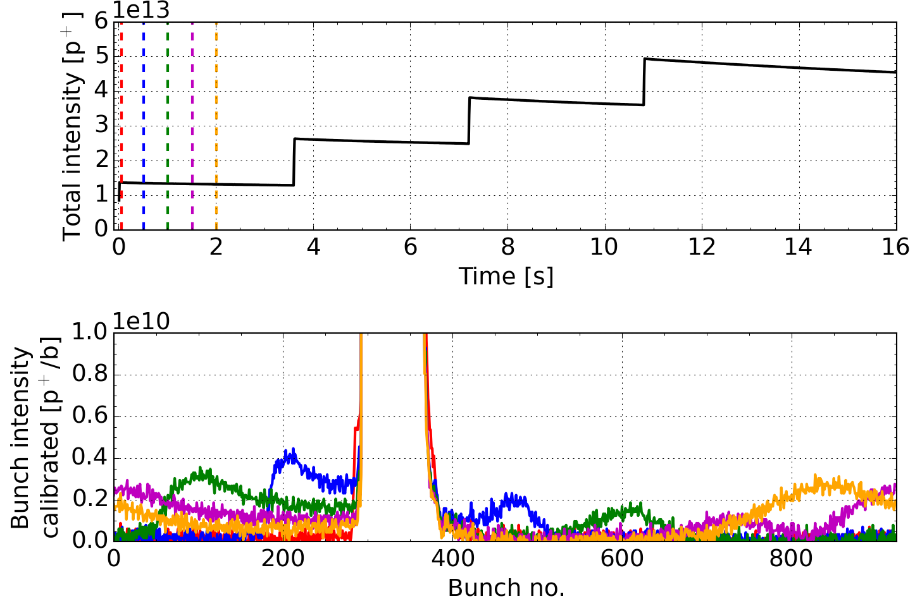
Un-captured beam
FBCT

Slide 5
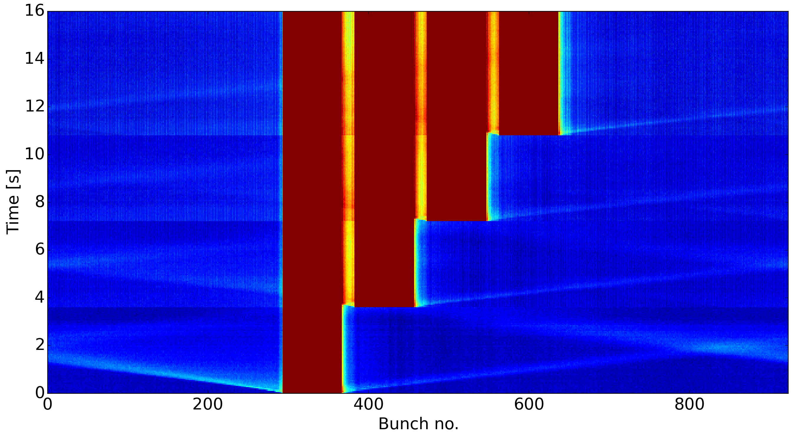
Un-captured beam
FBCT

Slide 6
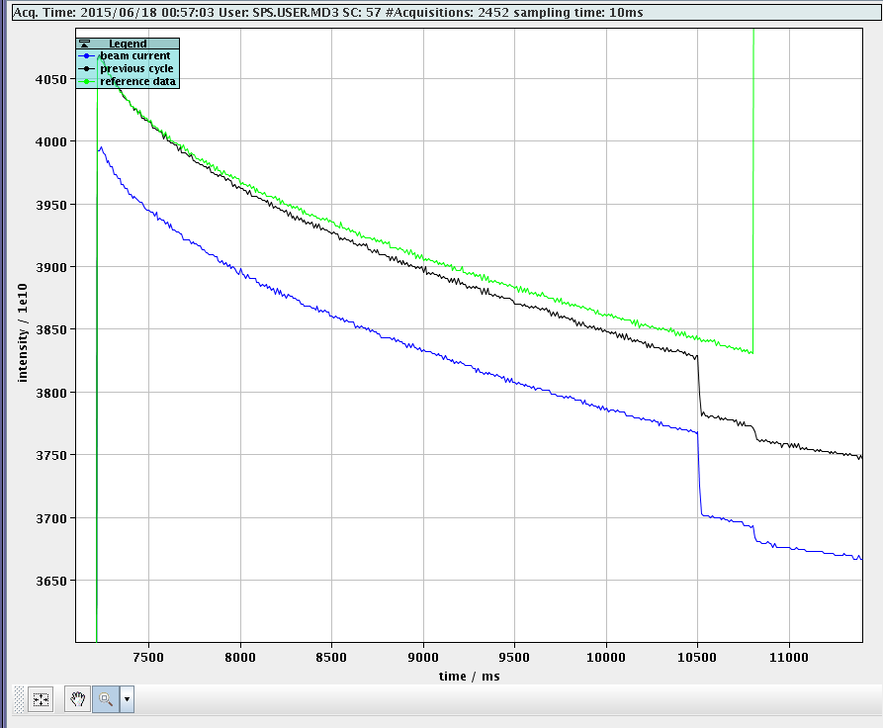
I. Experiment with tune kicker, W25 2015
After 3rd injection, 7·10¹¹ p⁺ un-captured/lost particles in kicker pulse window.
(5 % of inj. value)
Tune kicker
Injection kicker
Tune measurement kicker pulse to clean up un-captured particles

Slide 7
II. Losses caused by injection kicker
Intensity
Kicker pulse,
2nd injection
Intensity
ΔI_{SPS}
Batch 1
I_{PS}
Particles in kicker pulse region
Un-captured particles
Pos. along the ring
Time

Slide 8
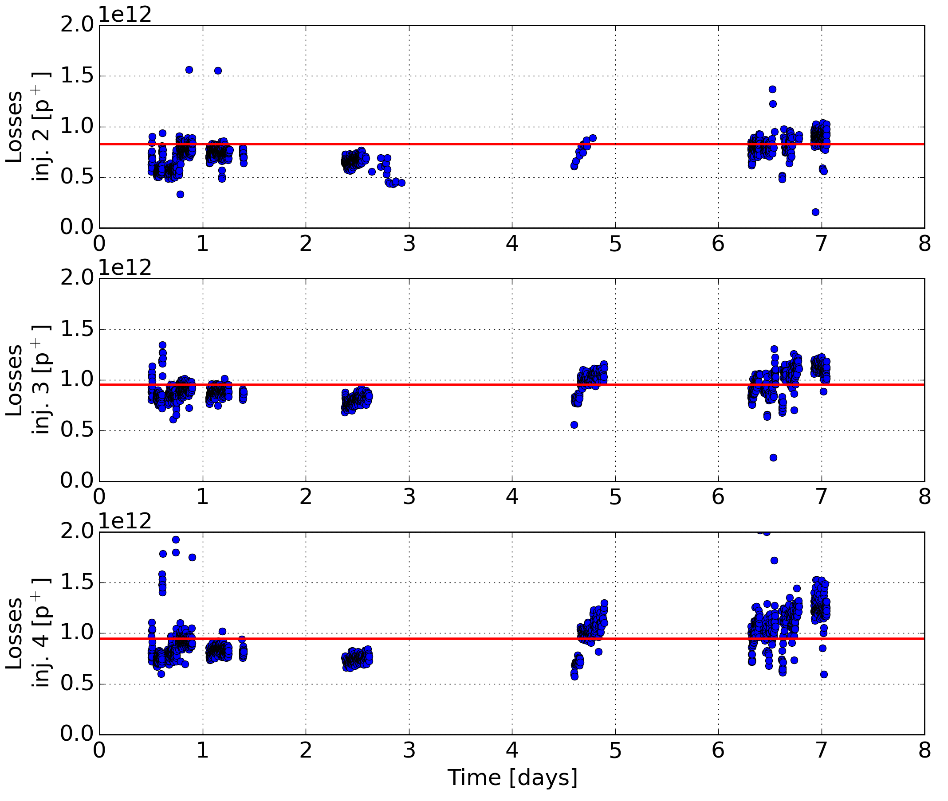
II. Losses caused by injection kicker, W17 2015
Percentage of PS
extracted intensity
8.3·10¹¹ p⁺ (5.9 %)
9.5·10¹¹ p⁺ (6.8 %)
9.5·10¹¹ p⁺ (6.7 %)
Summing up the losses of the three first injections and comparing that to the sum of the three first PS extractions gives a ratio of (6.5 ± 1.0) %.

Slide 9
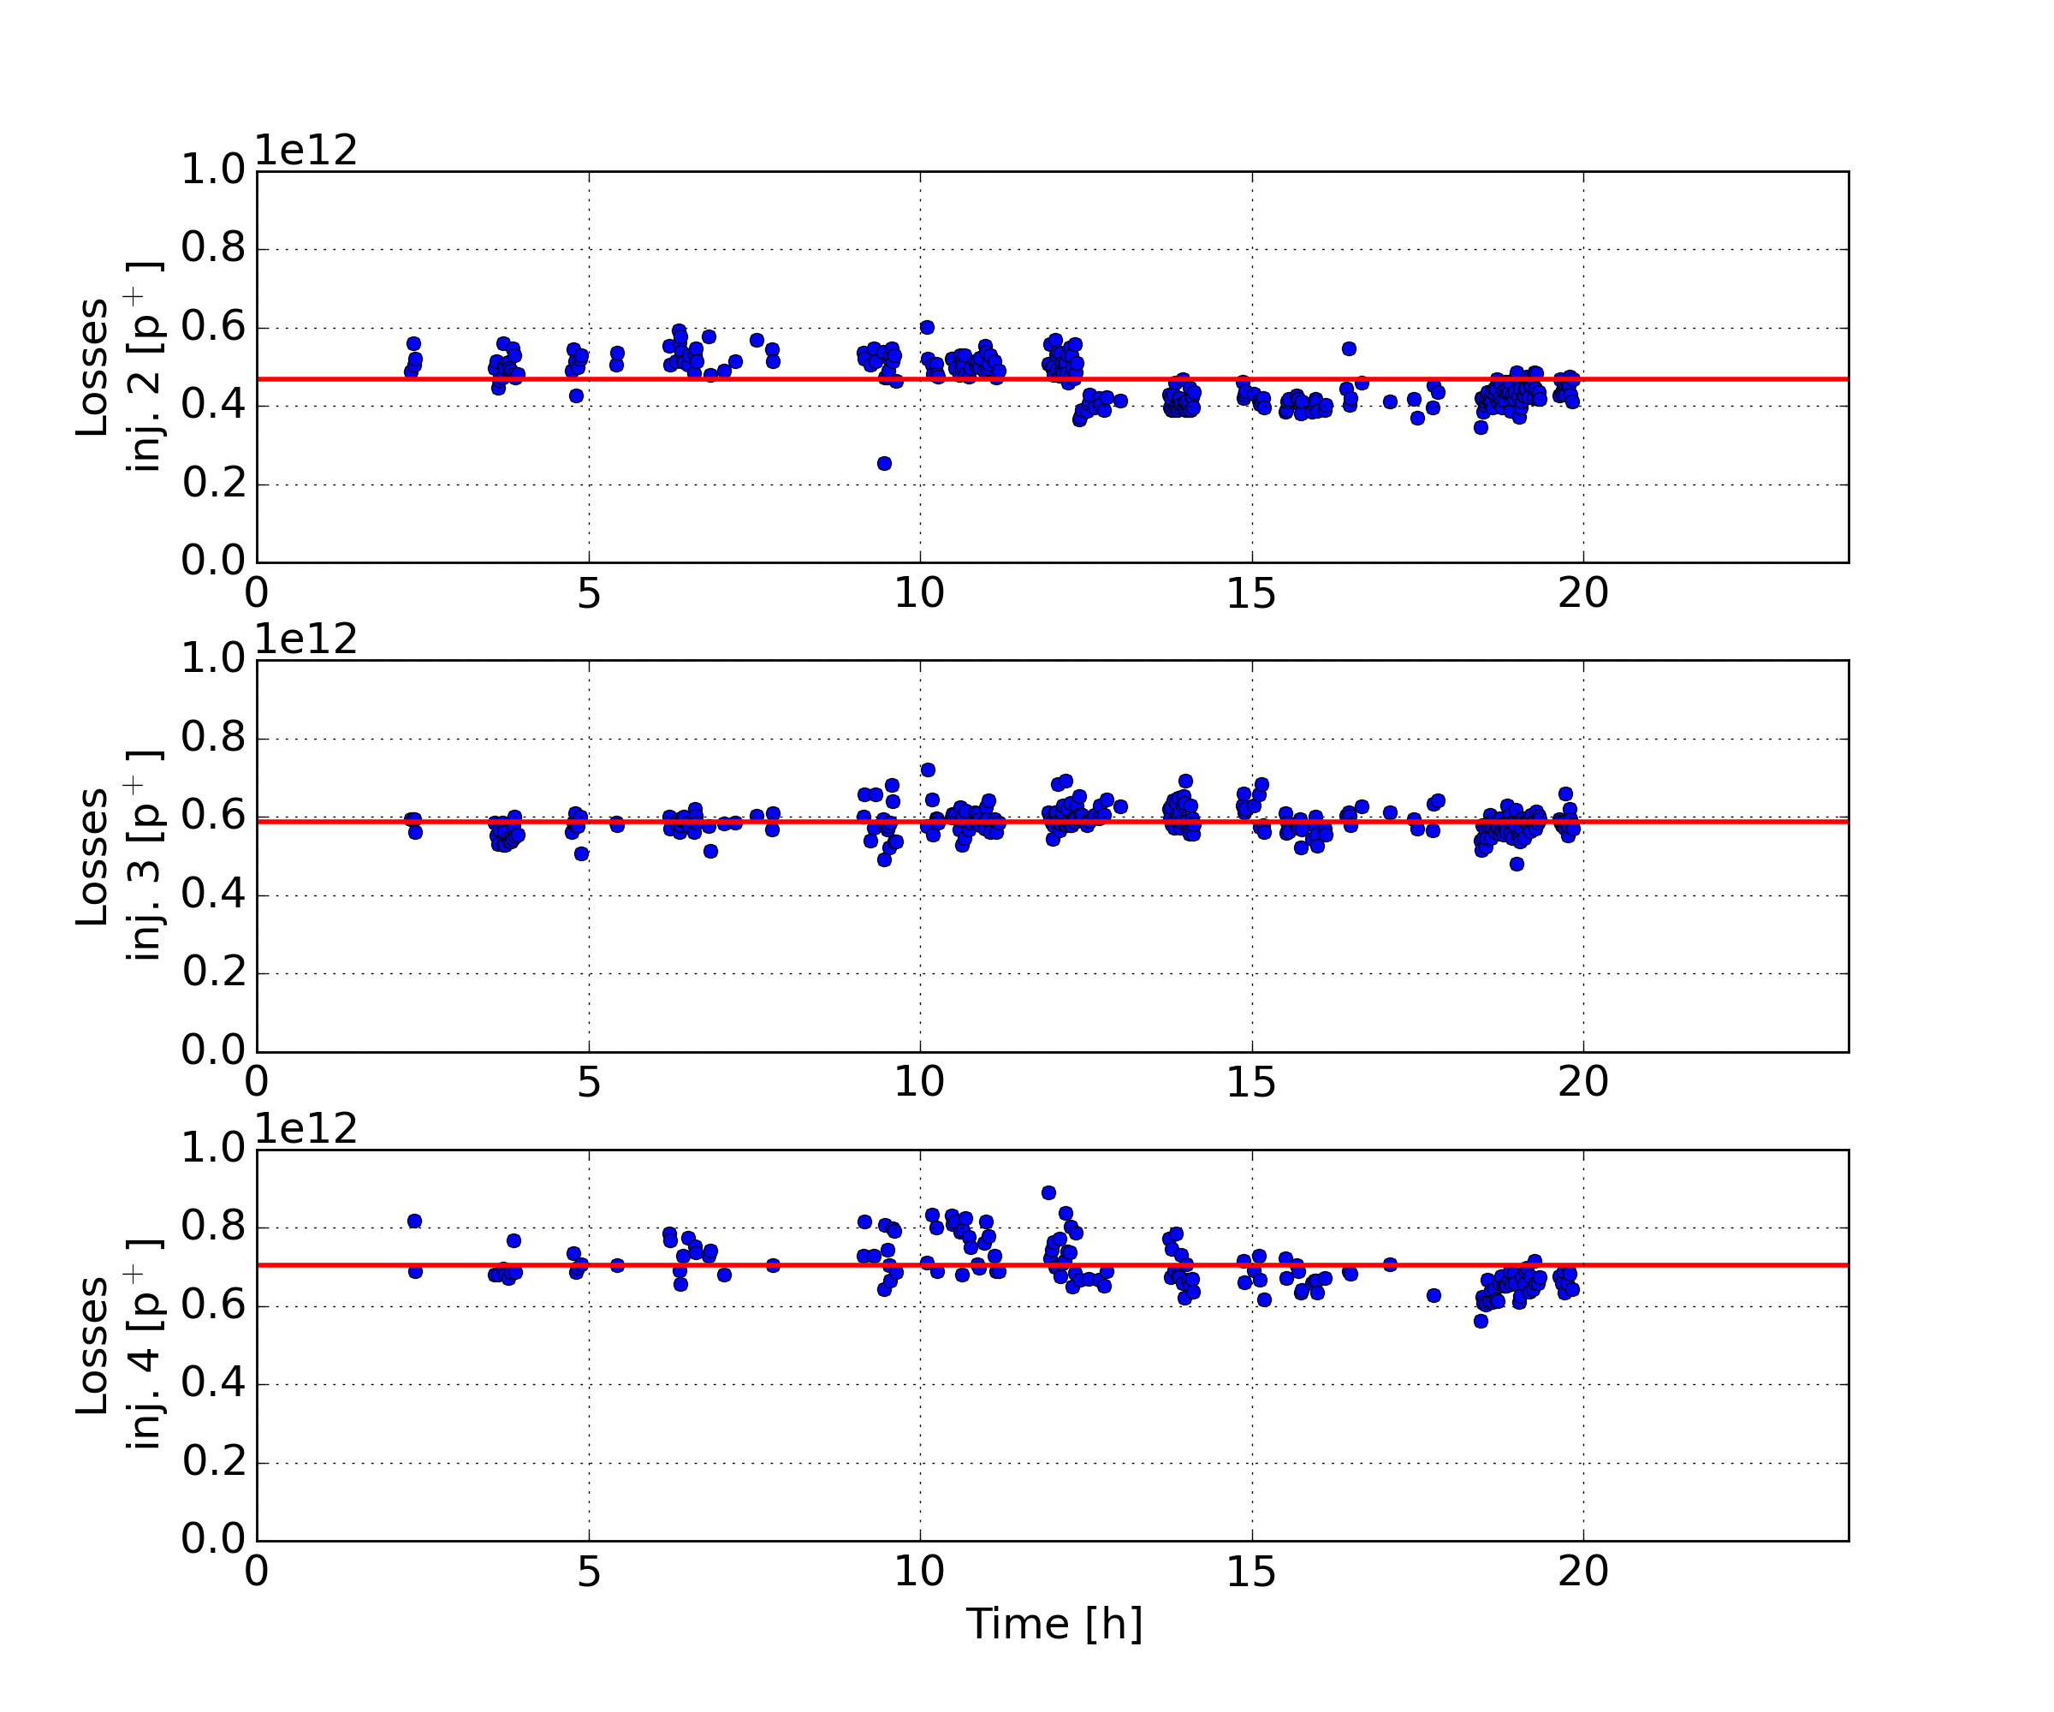
II. Losses caused by injection kicker, W49 2012
Percentage of PS
extracted intensity
4.7·10¹¹ p⁺ (5.2 %)
5.9·10¹¹ p⁺ (6.5 %)
7.1·10¹¹ p⁺ (7.8 %)
Summing up the losses of the three first injections and comparing that to the sum of the three first PS extractions gives a ratio of (6.5 ± 0.5) %.

Slide 10
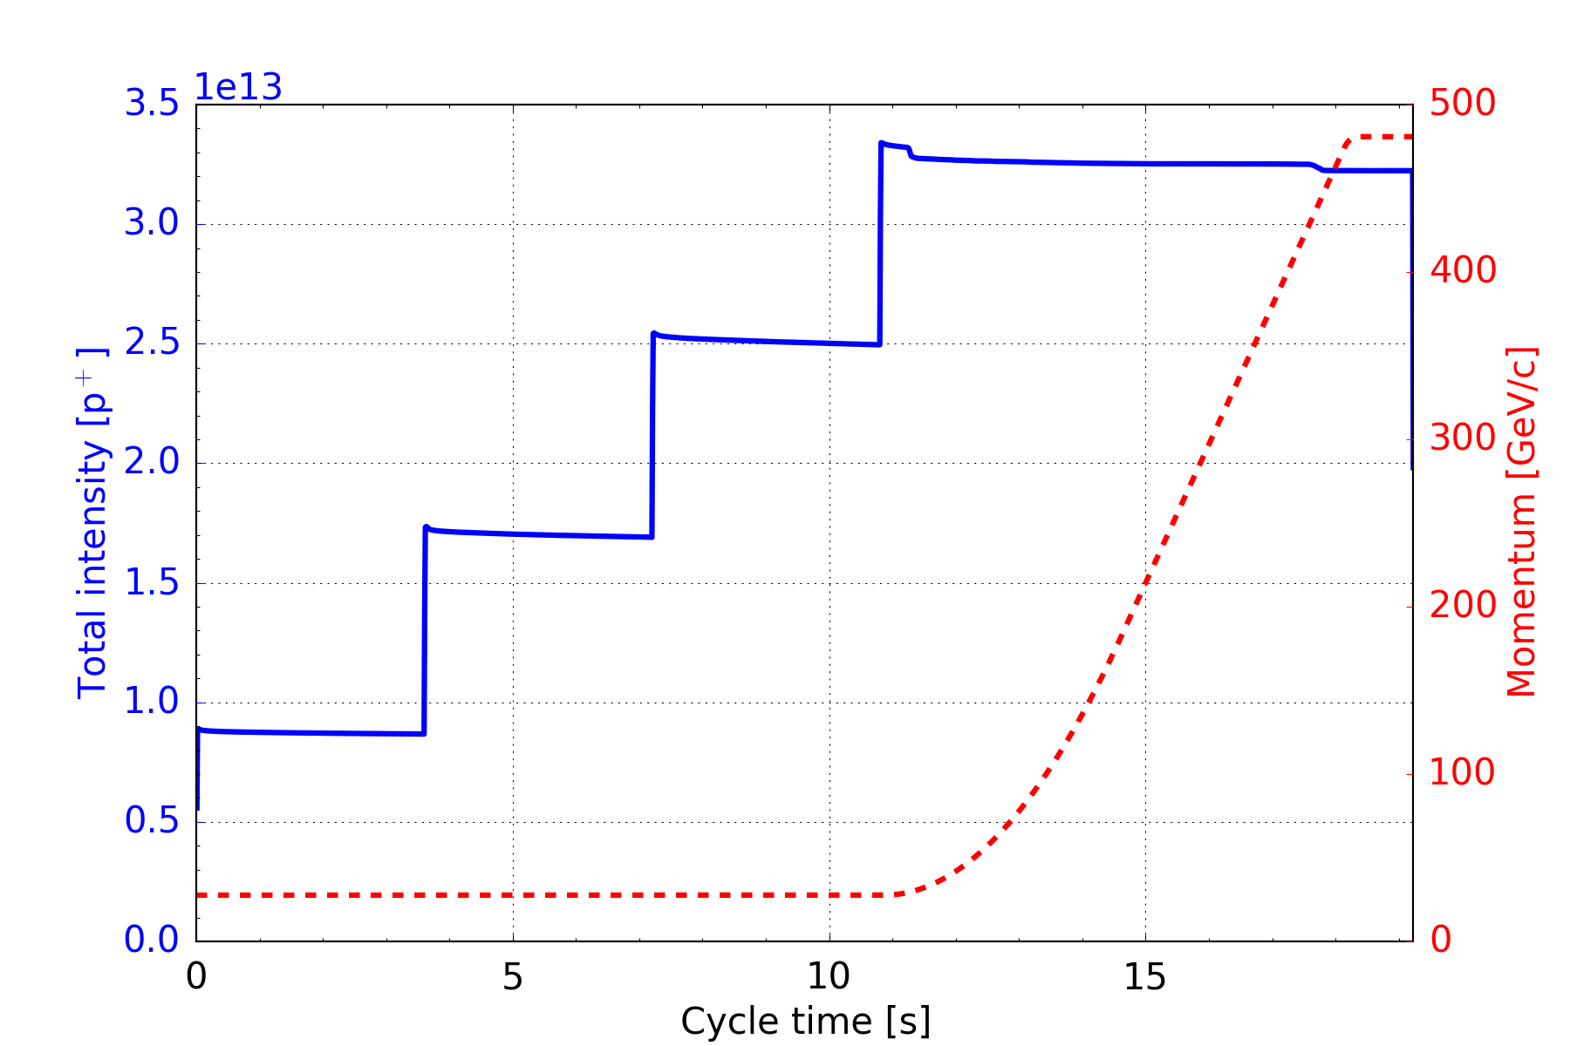
III. Losses at beginning of the ramp, W49 2012
Ramp from 26 GeV/c to 450 GeV/c.
Losses at beginning of the ramp

Slide 11
III. Losses at beginning of the ramp, W49 2012
Percentage of PS
extracted intensity
4.7·10¹¹ p⁺ (5.2 %)
5.9·10¹¹ p⁺ (6.5 %)
7.1·10¹¹ p⁺ (7.8 %)
5.5·10¹¹ p⁺ (6.1 %)

Slide 12
Summary and conclusions
Amount of un-captured beam assessed with three different methods
Tune kicker cleaning empty part of machine circumference
Comparison of PS extracted intensity with SPS intensity step on BCT
Losses at beginning of acceleration
About 5-6% of injected beam is not captured in SPS RF buckets
Similar in 2012 with 25ns beam nominal intensity (1.1e11 p/b) and in 2015 with 2e11 p/p injected during scrubbing runs → mostly caused by particle distribution resulting from bunch rotation?
Losses at each injection (method II) are similar to losses at beginning of acceleration (6% of one batch correspond to ~2% of total intensity) → corresponds mostly to un-captured beam
Worth to study again the usage of additional cavity for PS bunch rotation!

Slide 13
Thank you for your attention!

Slide 14
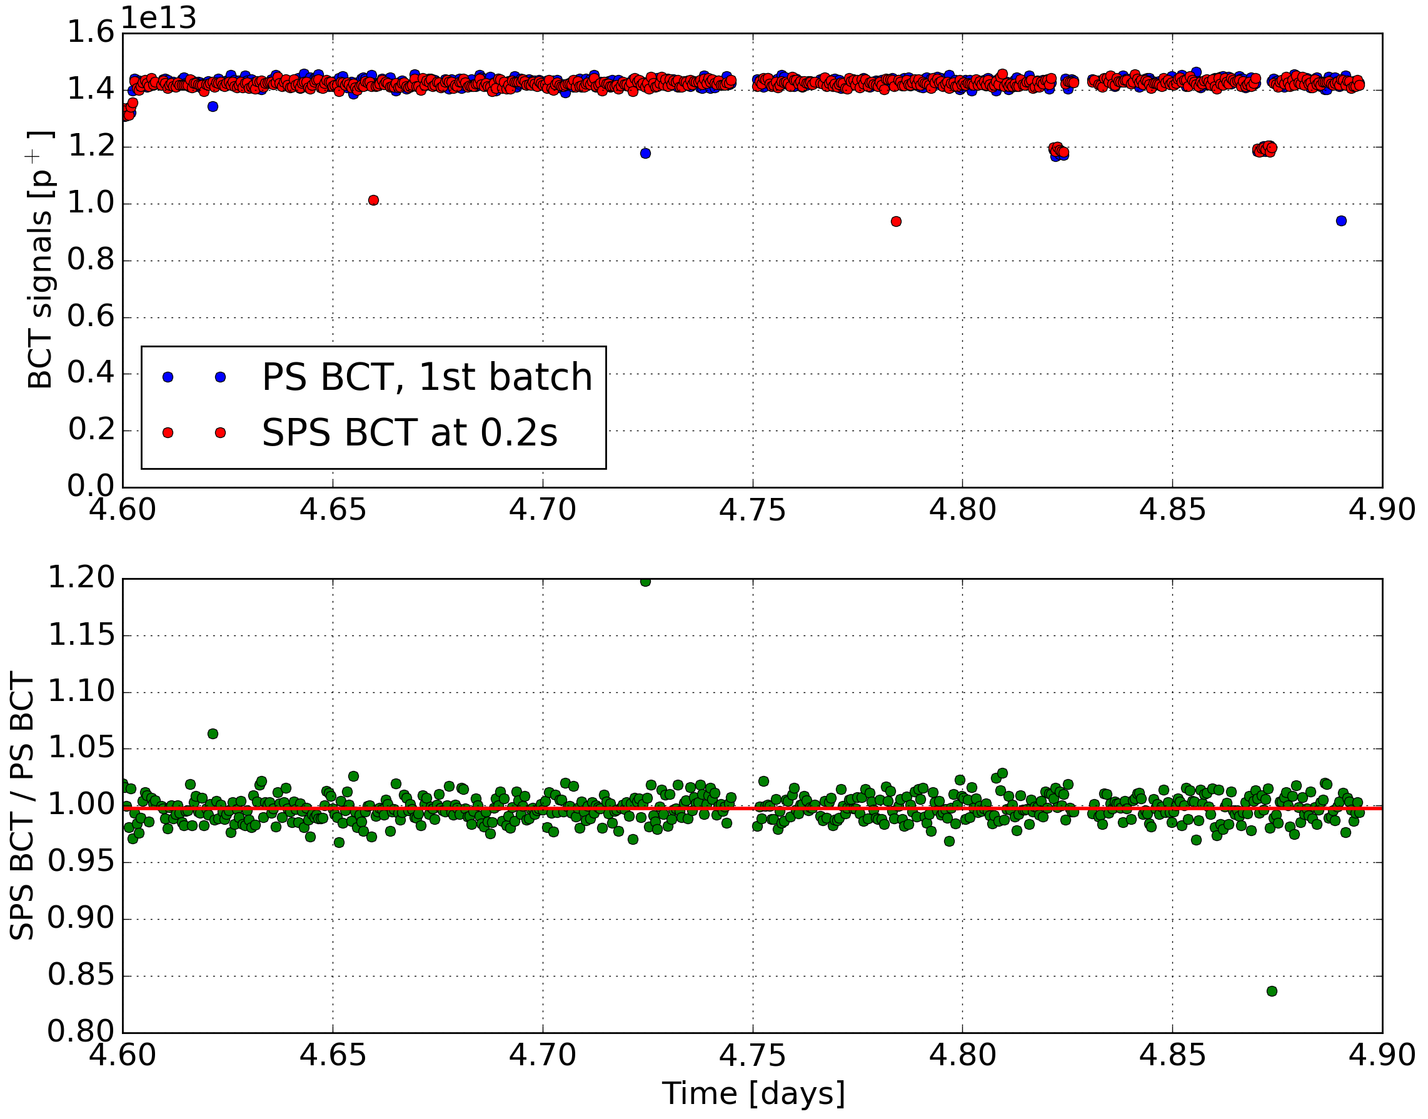
SPS and PS BCT calibration check
(99.7 ± 3.3) %

