Slide 1
Update on BLonD development s LIU-SPS Beam Dynamics Working Group 16/04/2015
A. Lasheen, T. Argyropoulos, J. Esteban Müller, D. Quartullo, E. Shaposhnikova, H. Timko

Slide 2
Introduction
The BLonD code is now able to simulate most of the features we wanted to include
This includes:
Longitudinal beam dynamics with multiple RF, acceleration ramp, RF manipulations
Intensity effects (impedances, space charge)
Feedbacks (phase loop, synchro loop)
Multibunch
It also have some “utilities”:
Matched beam generation (by inputing the line density or the distribution density)
Synchrotron frequency distribution study
Plots
The current version can now be considered as a prototype.

Slide 3
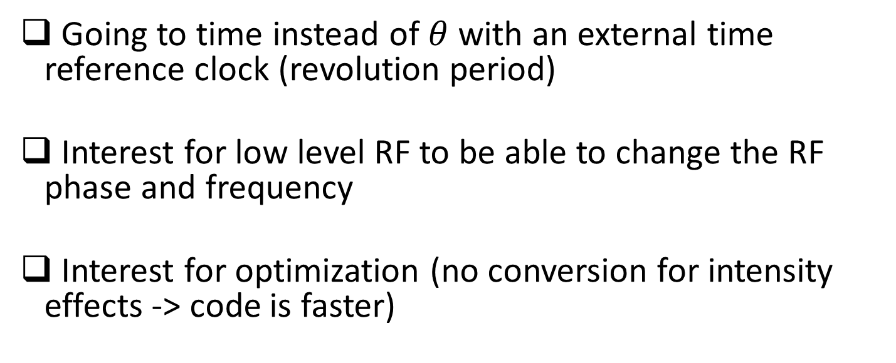
Longitudinal beam dynamics
Going to time instead of $θ$ with an external time reference clock (revolution period)
Interest for low level RF to be able to change the RF phase and frequency
Interest for optimization (no conversion for intensity effects -> code is faster)

Slide 4
Low level RF
Phase loop and synchro loop for the LHC and PSB were implemented by Helga Timko.
These should be applicable for the SPS as well and will be tested soon.
Longitudinal emittance blow-up by applying noise from the phase loop in the LHC is also implemented

Slide 5
Intensity effects
The beam generation, matched with intensity effects was extended to multibunch
The tracking of with intensity effects was also extended to multibunch, and first simulations were run for testing.
To be implemented:
Method to skip the induced voltage calculation for empty buckets
Multi turn induced voltage

Slide 6
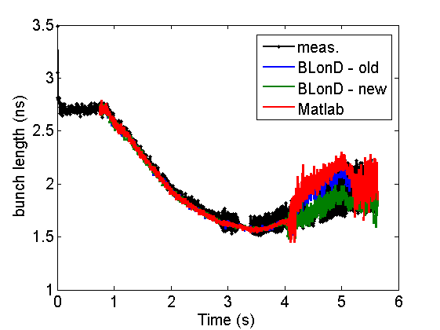
Benchmarking
Code to measurement benchmarking (MDs planned, LLRF, double RF, intensity thresholds)
Code to theory benchmarking (scalings, intensity thresholds, potential well distortion, growth rates)
Code to code benchmarking (done with PyORBIT for SC workshop), with Theodoros Argyropoulos code in MATLAB to consolidate results
Comparison between codes and measurements

Slide 7
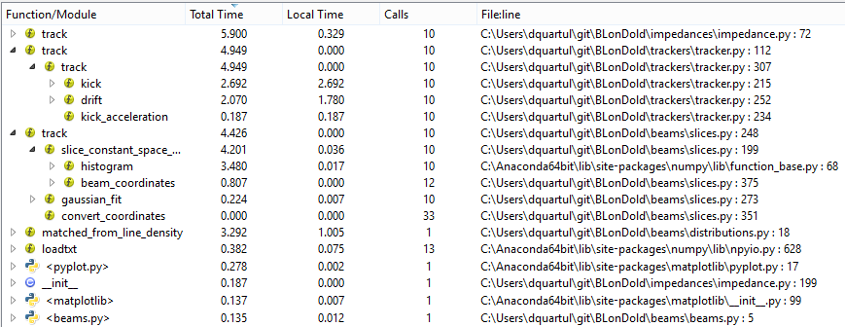
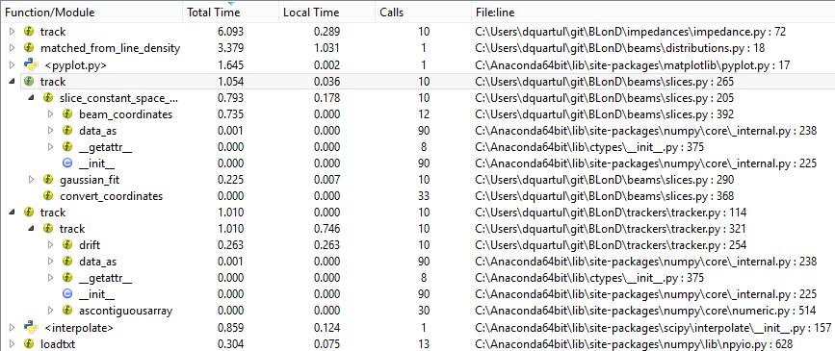
Optimization
The histogram and tracking functions were already optimized in the past (C)
The np.interp function was also optimized
It is used in the intensity effects kick
It divided the simulation time by 3 for our first test (4e5 macroparticles, single bunch, full ramp)
We aim to simulate the full ramp, 12 bunches with 4e5 macroparticles in less than one day (to be able to do scans in lxplus)

Slide 8
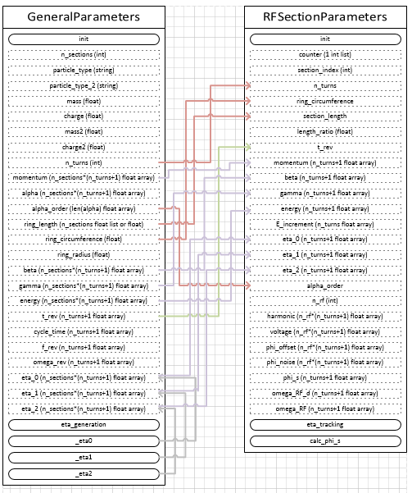
Code structure
The present code structure is the result of many months of developments
Some parts needs to be refreshed, for optimization

Slide 9
Future developments
New numerical methods to be tested (spline interpolations, derivatives)
Code structure will be refreshed to identify bottlenecks and simplification that can be made
Python compilation, vectorization, GPU and parallelization are under study to further optimize the code

Slide 10
Future developments
Next version of BLonD v1.11 will be used as a prototype version
Future version of BLonD v2.0 will be developed to be an optimized version of v1, with a “refreshed” code structure

