Slide 1
Impact of the flanges redesign on the transverse impedance
C. Zannini
Thanks to: J. Varela

Slide 2
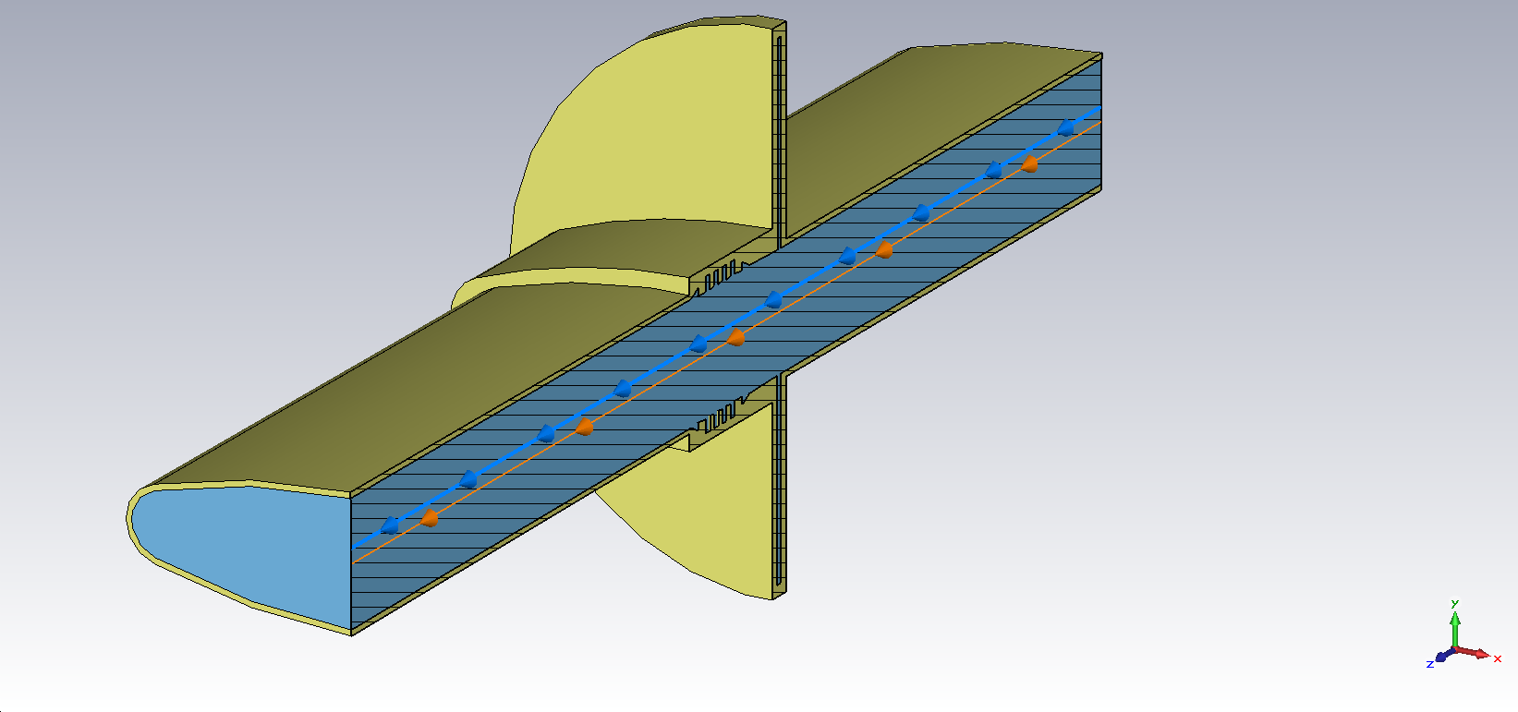
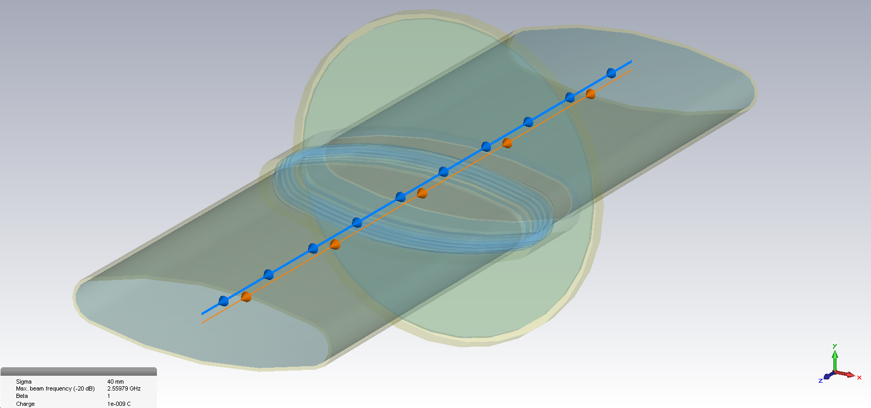
Drawing from J. Varela: QF-QF flange redesign
Notes:
Spiegarla meglio

Slide 3
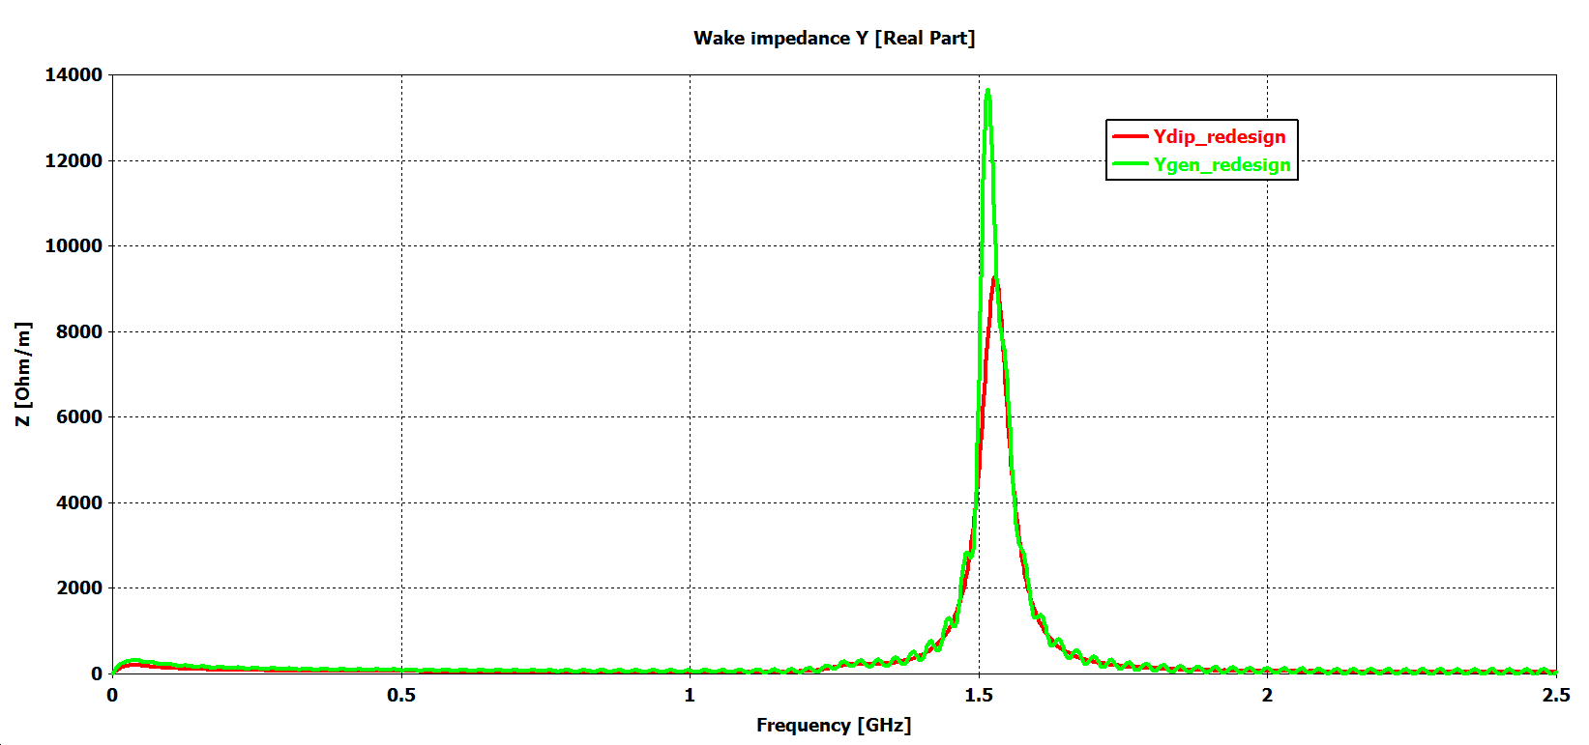
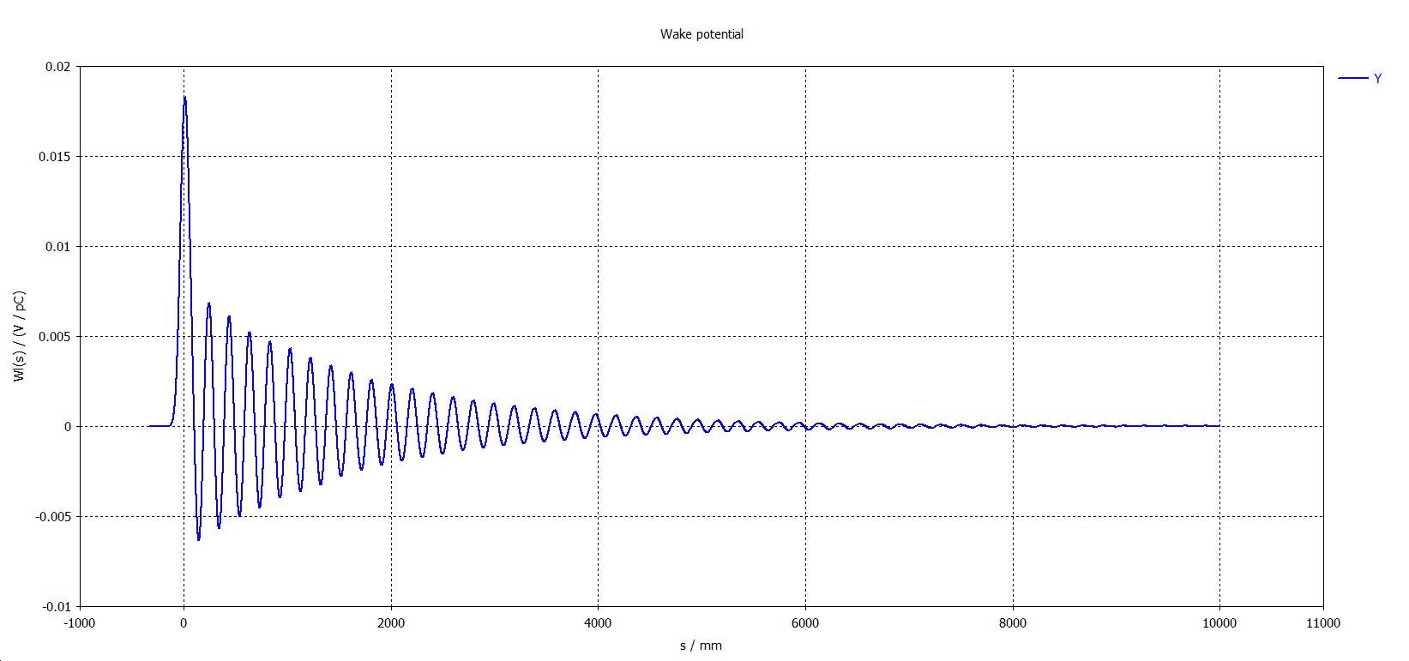
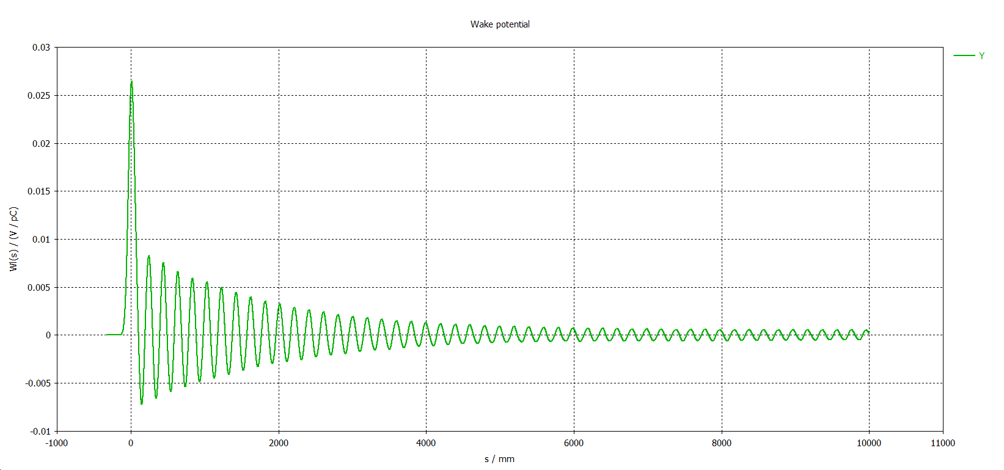
Vertical impedance
Wake almost vanished
Dipolar wake
Generalized wake
Broadband resonance at about 1.5 GHz
Notes:
Spiegarla meglio

Slide 4
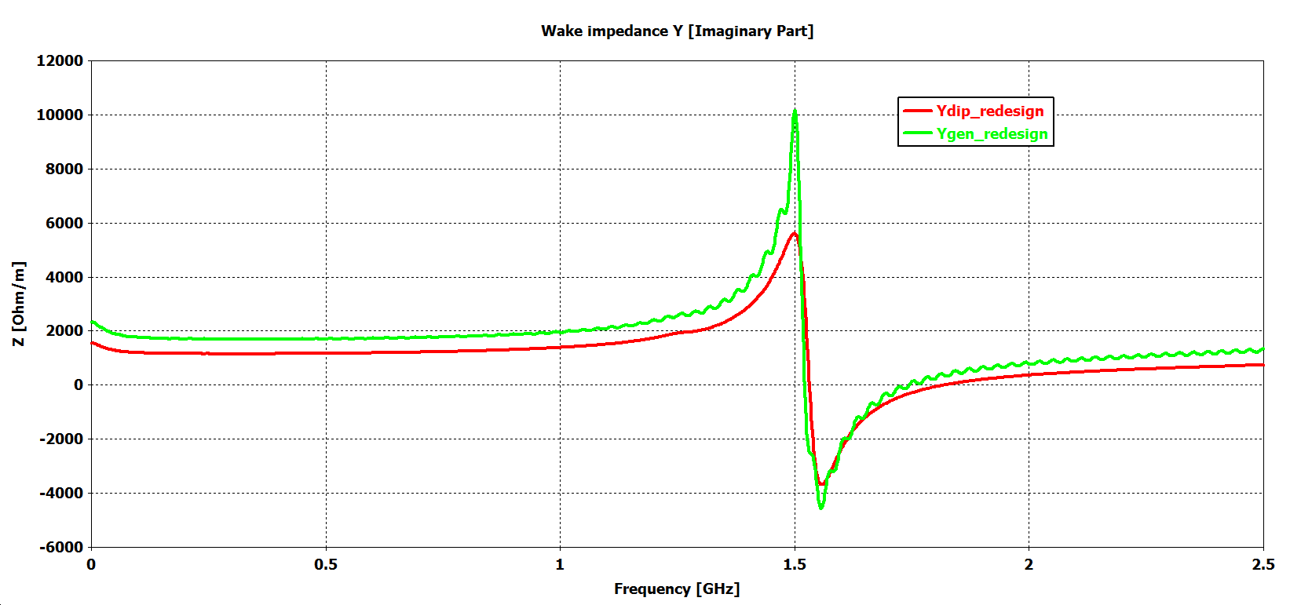
Vertical impedance
Generalized broadband impedance of about 2 kΩ/m
Notes:
Spiegarla meglio

Slide 5
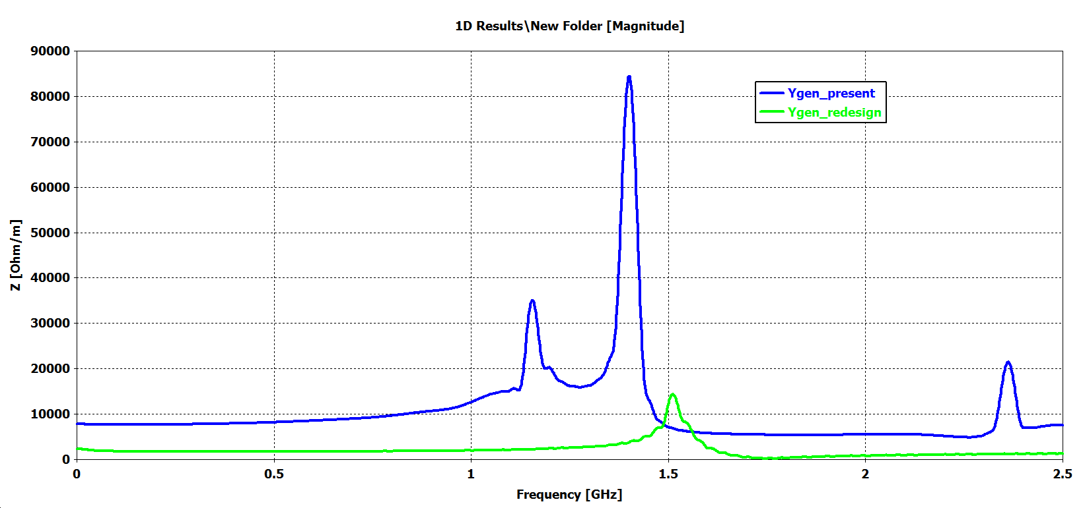
Vertical impedance
Very slow decay of the wake (the peak values could be significantly higher
Present
Wake almost vanished
The broadband impedance is reduced of about a factor 4
Impedance increases around 1.5 GHz
Improvement at all the other frequencies up to 2.5 GHz
Notes:
Spiegarla meglio

Slide 6
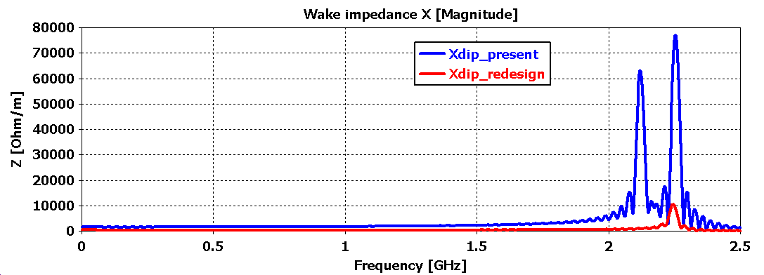
Horizontal impedance
Improvement at all frequencies up to 2.5 GHz
Notes:
Spiegarla meglio

Slide 7
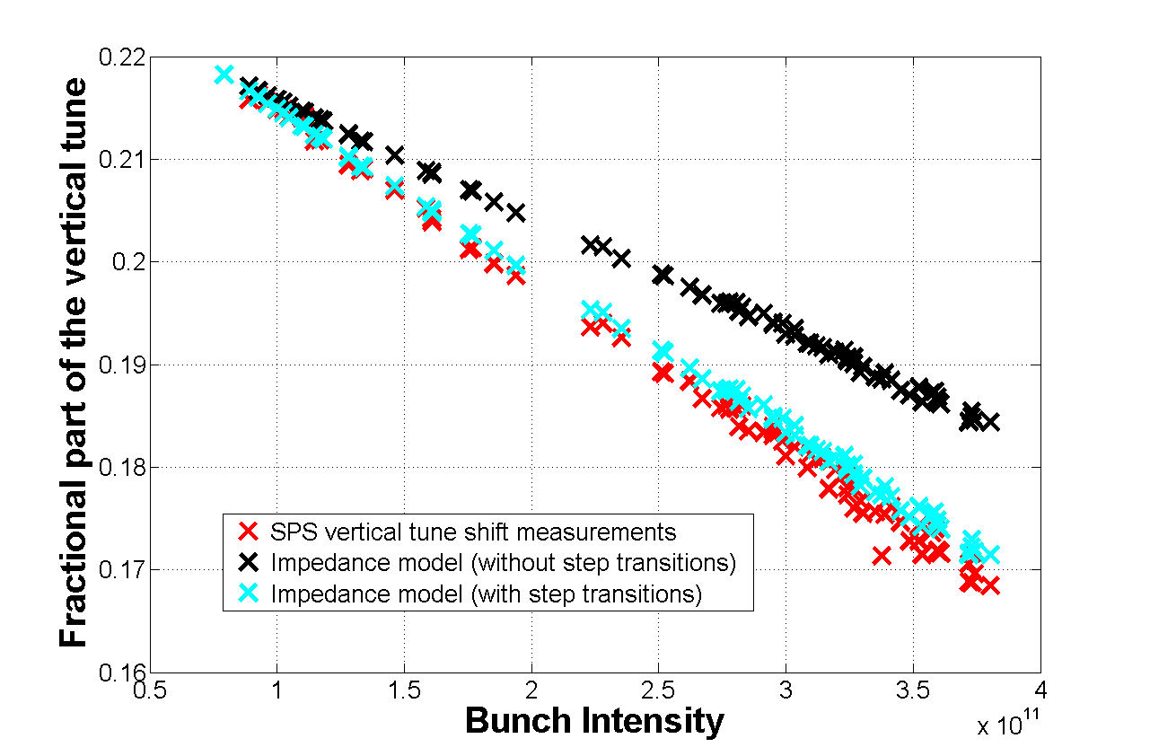
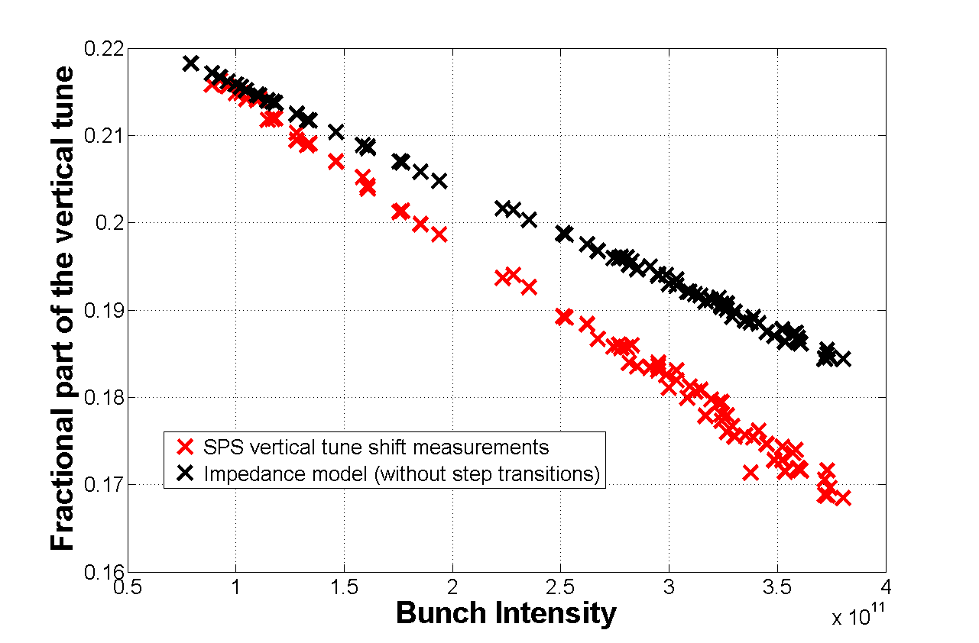
Impact on the SPS impedance budget
Coherent tune shift
20 %
40 %
60 %
80 %
100 %
Redesign of the QF-QF flanges is expected to reduce the global SPS tune shift of about 6%

Slide 8
Summary
The impact of the flange redesign on the transverse impedance is expected to be beneficial
No dangerous resonances
6% reduction in the tune shift from QF-QF flanges redesign

Slide 9
Thank you very much for your attention

