Slide 1
Impedance simulations of the SPS TPST
S. Persichelli, B. Salvant
SPS-LIU meeting
11-03-2015

Slide 2
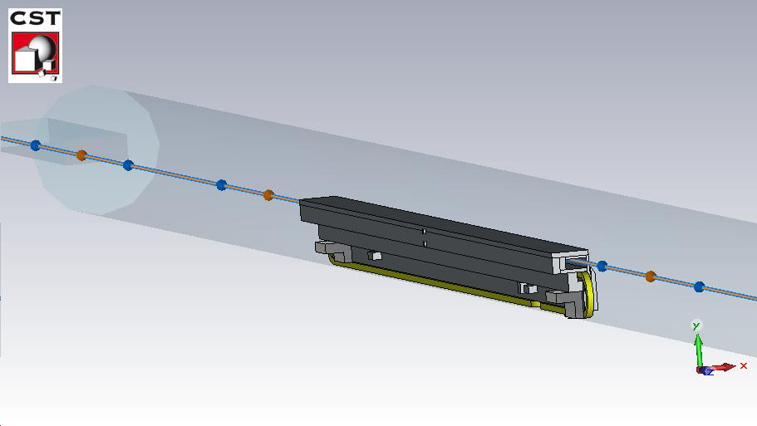
Model for simulations
Total length 6.7 m
Blade length 2.16 m
Blade: 10 sections
8 Stainless steel (1,35 e+06 S/m)
2 Copper

Slide 3
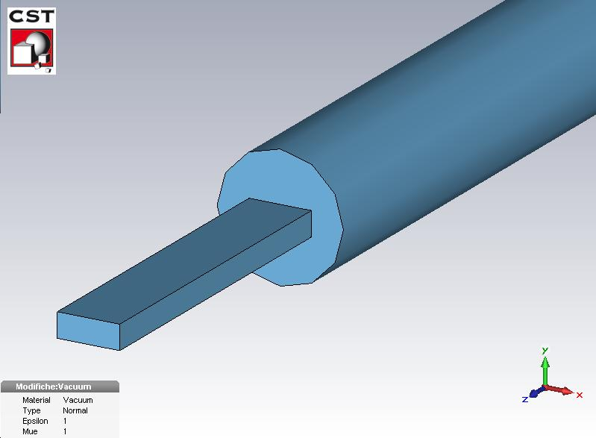
Model for simulations: frequencies
Tank
Radius 133.6 mm
Cut-off TE₁₁ 660 MHz
Pipes:
Vertical aperture 26 mm
Horizontal aperture 66 mm
Cut-off TM₁₁ 6.2 GHz

Slide 4
Modification of the design
OLD (installed)
NEW (to be installed)

Slide 5
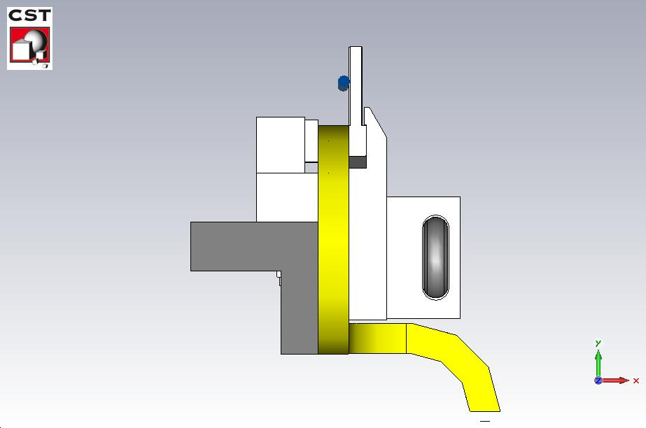
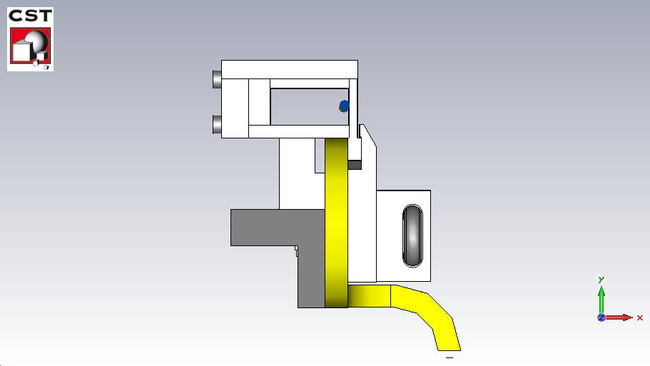
Modification of the design
OLD (installed)
NEW (to be installed)

Slide 6
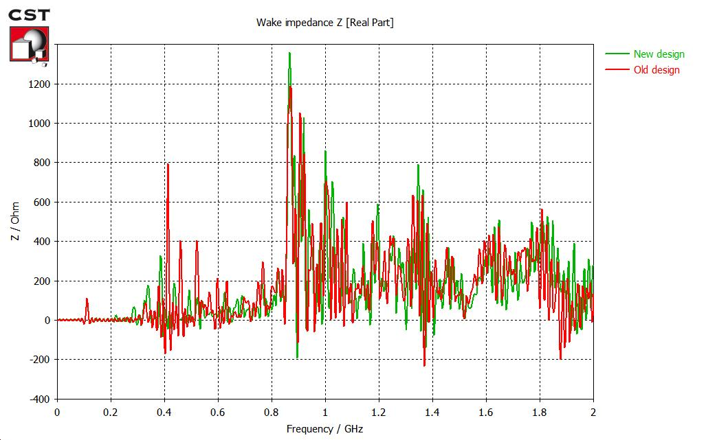

Longitudinal impedance (nominal beam)
Comparison new/old design
Effective impedance
(low freq):
$$\frac{Z}{n}=0.0143 Ω$$
$$\frac{Z}{n}=0.0176 Ω$$

Slide 7
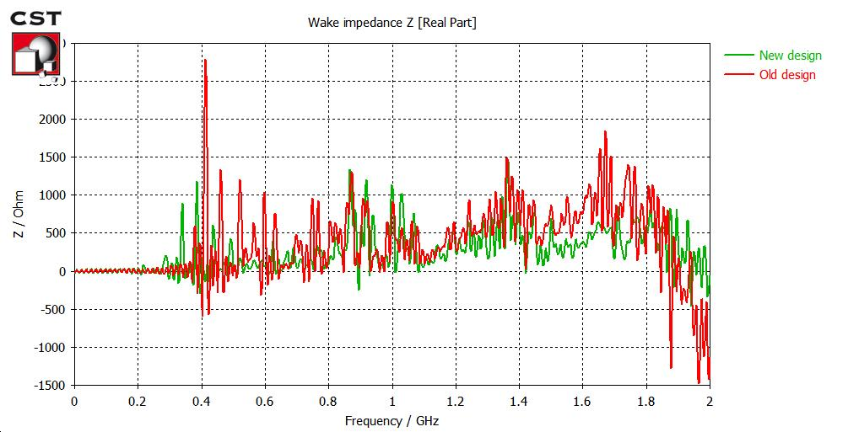
Longitudinal impedance (extraction beam)
Comparison new/old design
Effective impedance (low freq): $\frac{ Z}{n}=0.0237 Ω$
$\frac{Z}{n}=0.0299 Ω$

Slide 8
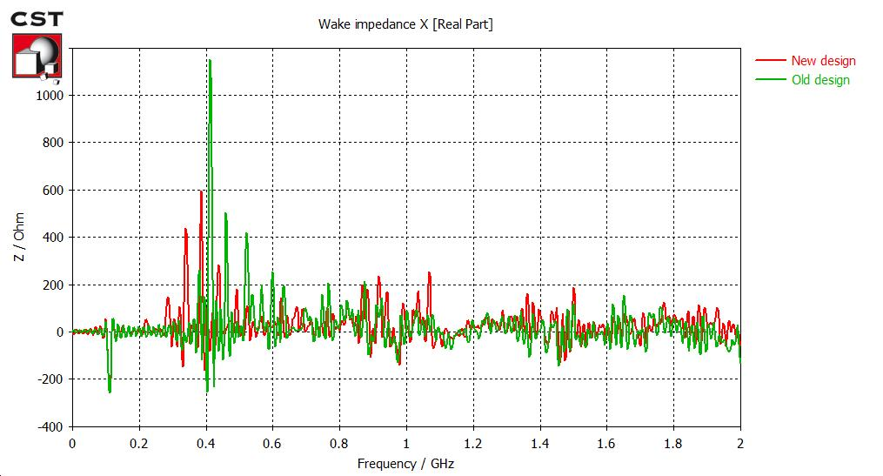
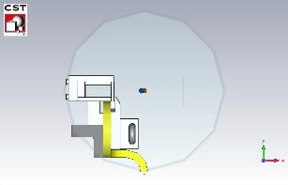
Dipolar horizontal impedance (nominal beam)
Comparison new/old design
Effective impedance (low freq): $Z_{x}^{dip}=19 kΩ/m$

Slide 9
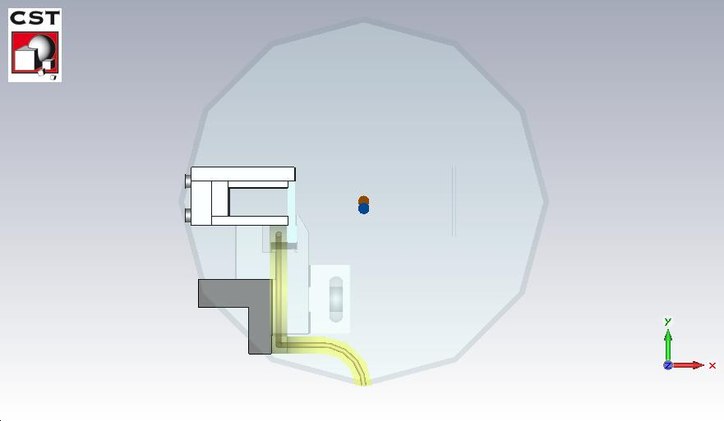
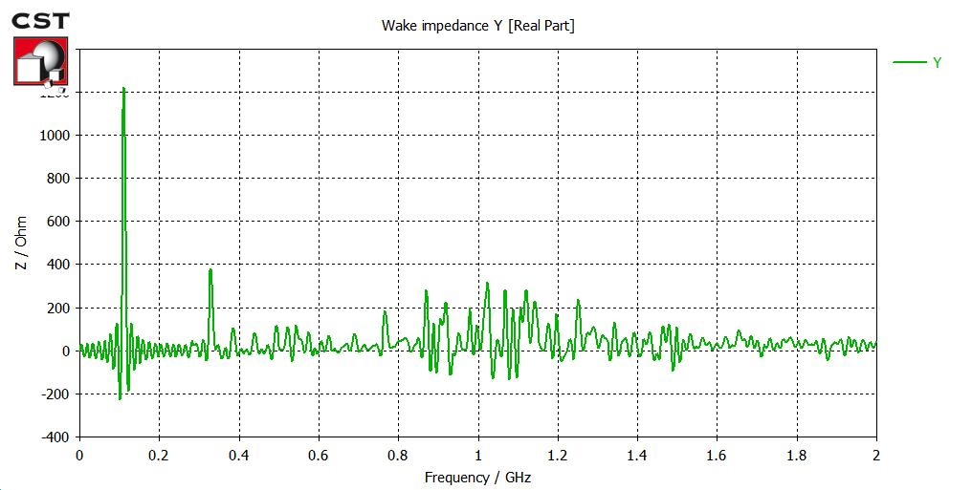
Dipolar vertical impedance (nominal beam)
New design
Effective impedance (low freq): $Z_{Y}^{dip}=45 kΩ/m$

Slide 10
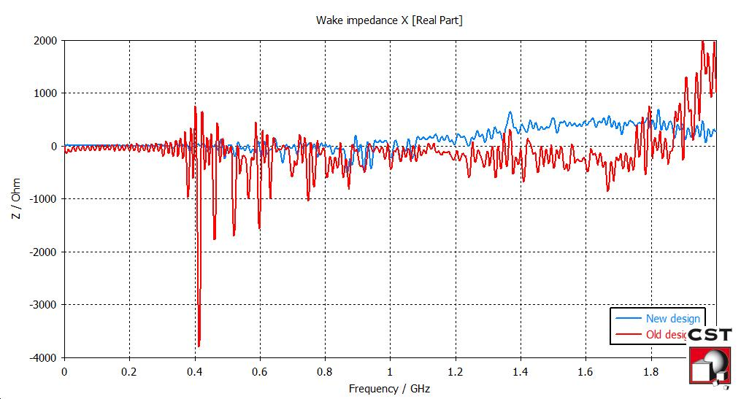
Dipolar horizontal impedance (extraction beam)
Comparison new/old design
New: Effective impedance (low freq): $Z_{x}^{dip}=104\frac{kΩ}{m}$

Slide 11
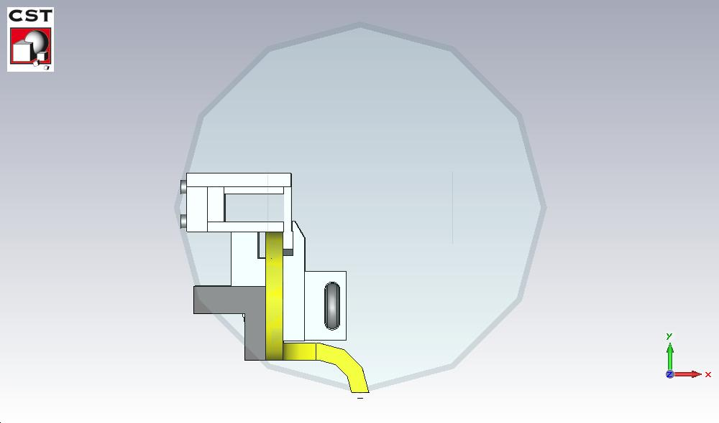
Nominal beam: Eigenmode (new design)
NB: Microwave Studio (Linac convention) definition:
$$R_{s}=\frac{V_{0}^{2}}{P}=\frac{4kQ}{ω_{0}}$$
 | Freq [MHz] | Rs [Ω] | Q
1 | 72.97 | 52.01 | 348.92
2 | 84.31 | 31.15 | 495.87
3 | 106.22 | 672.73 | 1122.96
4 | 106.37 | 1057.32 | 1133.86
5 | 147.33 | 240.25 | 522.65
6 | 168.76 | 78.59 | 587.31
7 | 186.96 | 1335.39 | 1627.92
8 | 187.08 | 263.78 | 1633.63
9 | 219.44 | 725.08 | 793.30
10 | 253.03 | 130.95 | 577.63
 | Freq [MHz] | Rs [Ω] | Q
11 | 283.52 | 3507.64 | 1125.70
12 | 315.54 | 52.15 | 996.08
13 | 317.54 | 85.64 | 1667.21
14 | 317.80 | 483.42 | 1088.86
15 | 335.12 | 23070 | 2437.48
16 | 355.19 | 7.06 | 596.35
17 | 379.68 | 13823.15 | 2343.22
18 | 383.00 | 4075.81 | 2404.87
19 | 385.34 | 5518.97 | 2343.70
20 | 433.42 | 2091.73 | 765.42

Slide 12
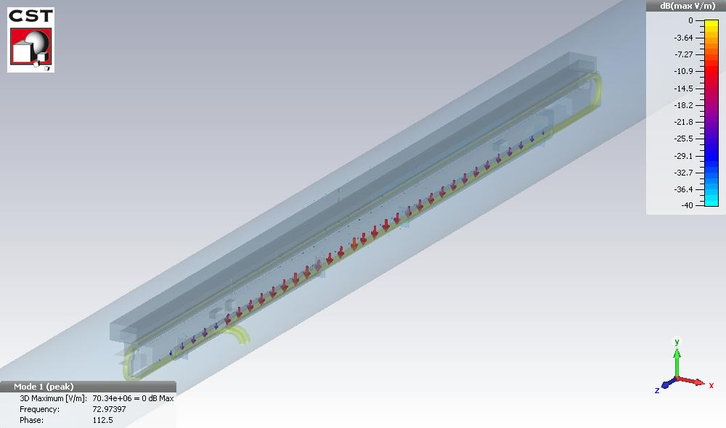
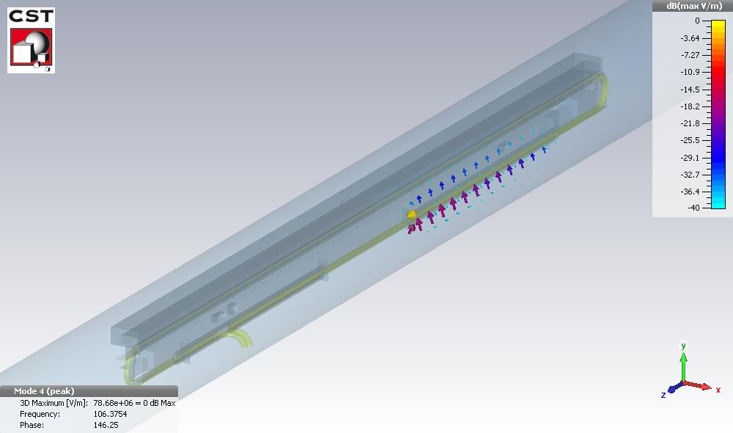
Nominal beam: Eigenmode (new design)
Mode 1 72 MHz
Mode 2 84 MHz
Mode 3 106 MHz
Mode 4 106 MHz

Slide 13
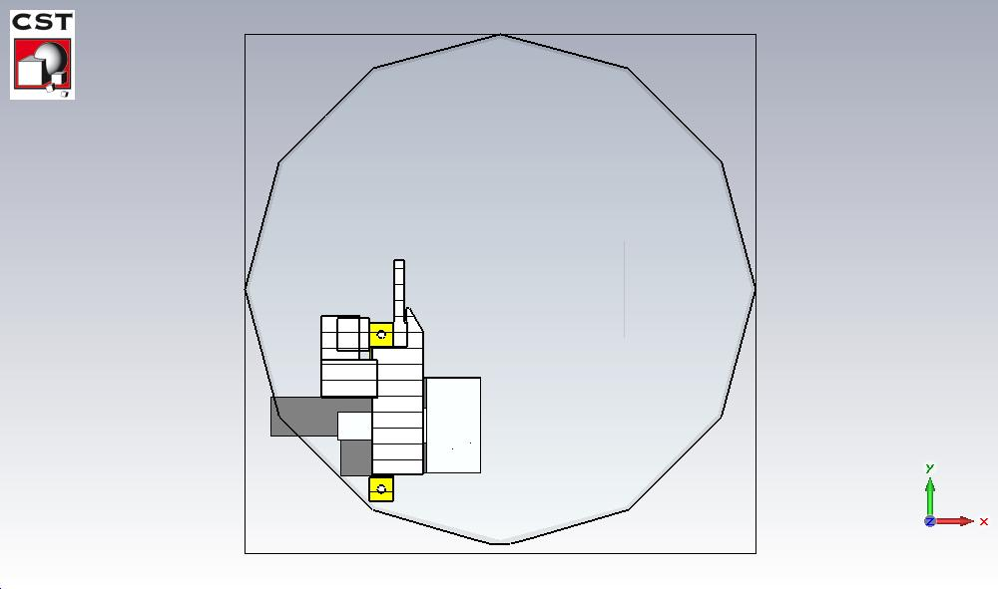
Nominal beam: Eigenmode (old design)
NB: Microwave Studio (Linac convention) definition:
$$R_{s}=\frac{V_{0}^{2}}{P}=\frac{4kQ}{ω_{0}}$$
 | Freq [MHz] | Rs [Ω] | Q
1 | 74.58 | 5.84 | 131.33
2 | 86.74 | 34.61 | 620.13
3 | 106.25 | 720.69 | 488.89
4 | 106.26 | 419.28 | 485.11
5 | 152.91 | 20.99 | 183.18
6 | 172.93 | 100.31 | 640.18
7 | 186.28 | 417.15 | 693.40
8 | 186.50 | 464.10 | 699.15
9 | 230.85 | 38.65 | 245.60
10 | 258.66 | 90.80 | 549.91
 | Freq [MHz] | Rs [Ω] | Q
11 | 300.45 | 119.28 | 301.98
12 | 316.64 | 190.50 | 852.93
13 | 317.40 | 178.02 | 840.53
14 | 333.89 | 263.85 | 917.56
15 | 354.77 | 43.47 | 288.82
16 | 372.96 | 3772.30 | 1126.01
17 | 380.87 | 1510.51 | 991.06
18 | 386.16 | 761.84 | 1070.31
19 | 409.69 | 43763.06 | 2476.04
20 | 439.44 | 85.61 | 284.19

Slide 14
Conclusions
The low frequency mode frequencies (below 100 MHz) are not changing when the beam is in nominal position because are due to the trapping around the cooling system.
The inductive longitudinal impedance at nominal and extraction position is not changing with respect to the old TPST design.
The low frequency dipolar effective impedance at nominal and extraction position of the new TPST design is very small.
The modifications of the design are not predicted to be a problem from the impedance point of you.
RF Measurements to confirm results from simulations?

