Slide 1
Preliminary Results on the Impedance Characterization of the 200MHz TWCs
Jose E. Varela
12 March 2015

Slide 2
Outline
Introduction
The 200MHz Accelerating Wave
One Tank Analysis
RF Characteristics
Longitudinal Impedance
Next Steps

Slide 3
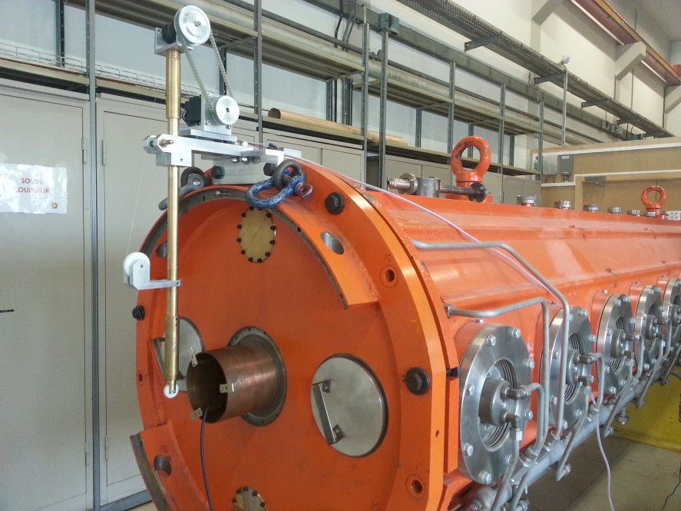
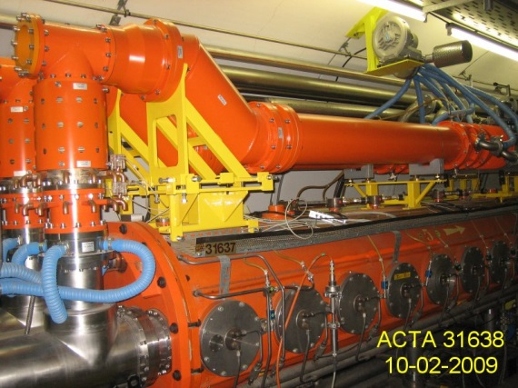
Introduction
There are currently four 200MHz traveling wave cavities in the SPS. Two of these have four sections and the other two five (44 and 55 cells respectively).
During LS2 the cavities will be rearranged (four cavities with three sections and two four section cavities) to maximize the available voltage and reduce the impedance.
There are several important points to be addressed before/during the rearrangement.
Tank available for measurements
Cavity in the tunnel (detail of the loads)

Slide 4
Outline
Introduction
The 200MHz Accelerating Wave
One Tank Analysis
RF Characteristics
Longitudinal Impedance
One Tank Standing Wave Measurements
Next Steps

Slide 5
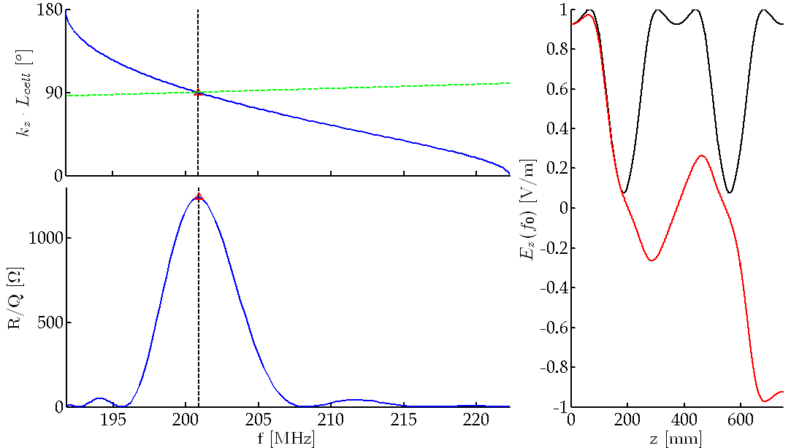
The 200MHz Accelerating Wave (I)
Analysis of a single cell assuming infinite periodicity yields,
Dispersion Diagram
R/Q of the fundamental passband for 11 cells
Ez at center frequency along two cells

Slide 6
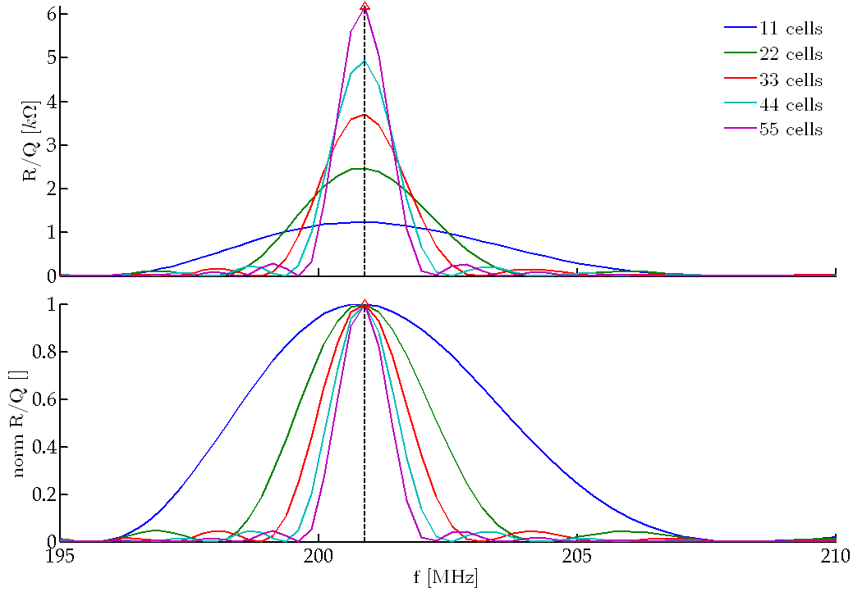
The 200MHz Accelerating Wave (II)
R/Q of the fundamental passband of 11, 22, 33, 44 and 55.
R/Q of the fundamental passband of 1, 2, 3, 4 and 5 tanks and perfect matching.

Slide 7
The 200MHz Accelerating Wave (III)

Slide 8
The 200MHz Accelerating Wave (IV)

Slide 9
Outline
Introduction
The 200MHz Accelerating Wave
One Tank Analysis
RF Characteristics
Longitudinal Impedance
One Tank Standing Wave Measurements
Next Steps

Slide 10
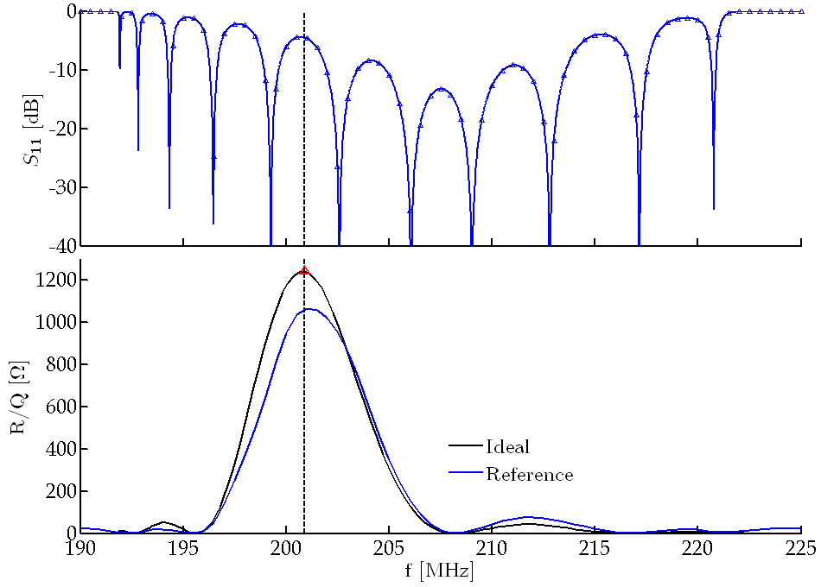
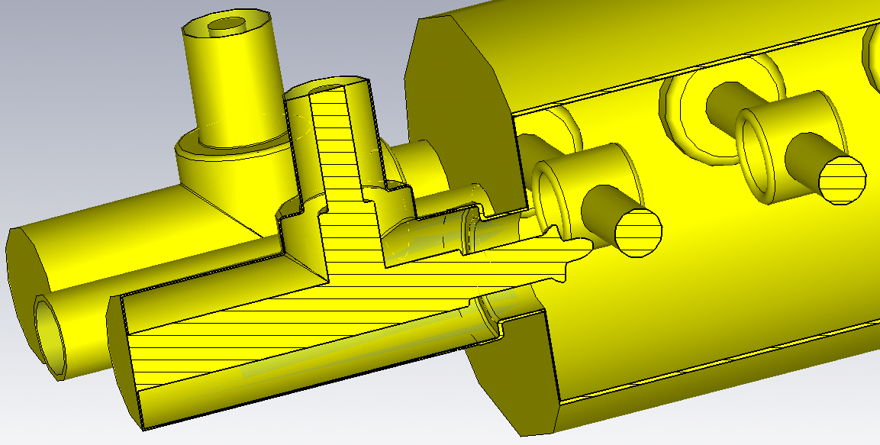
One Tank Analysis
Modelling the main couplers of the cavities from official layouts we get,
Since some details are missing here, this will be referred to as the ‘Reference’ model.

Slide 11
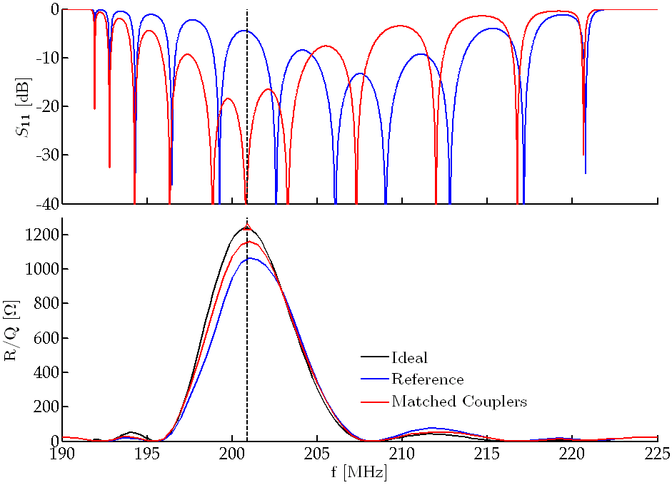
One Tank Analysis
We compare now the reference situation to that that we would have with good matching,
Compared to the ideal case, R/Q is smaller,
a 15% with the reference couplers
a 7% with the matched ones
Difference between the reference and matched cases is around 8.5%

Slide 12
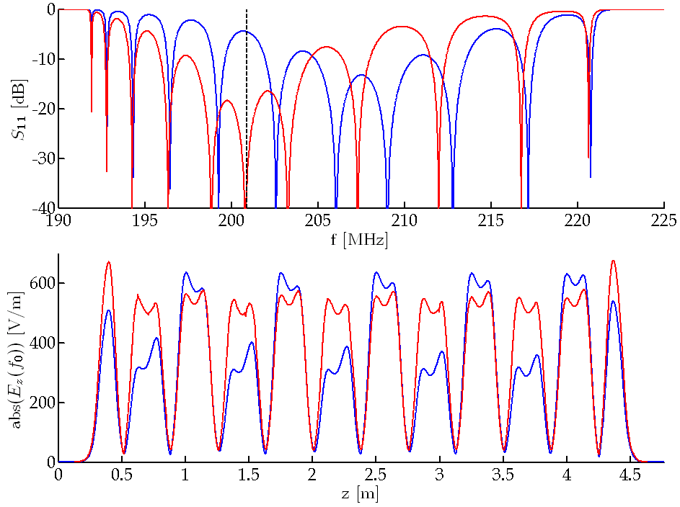
One Tank Analysis - Field Profile
If we check the longitudinal electric field inside the cavity at center frequency,
In both cases, the field profile shows some standing wave component.
Field flatness is typically one of the most important parameters of a TW cavity as it has a direct impact on available voltage.

Slide 13
Outline
Introduction
The 200MHz Accelerating Wave
One Tank Analysis
RF Characteristics
Longitudinal Impedance
Next Steps

Slide 14
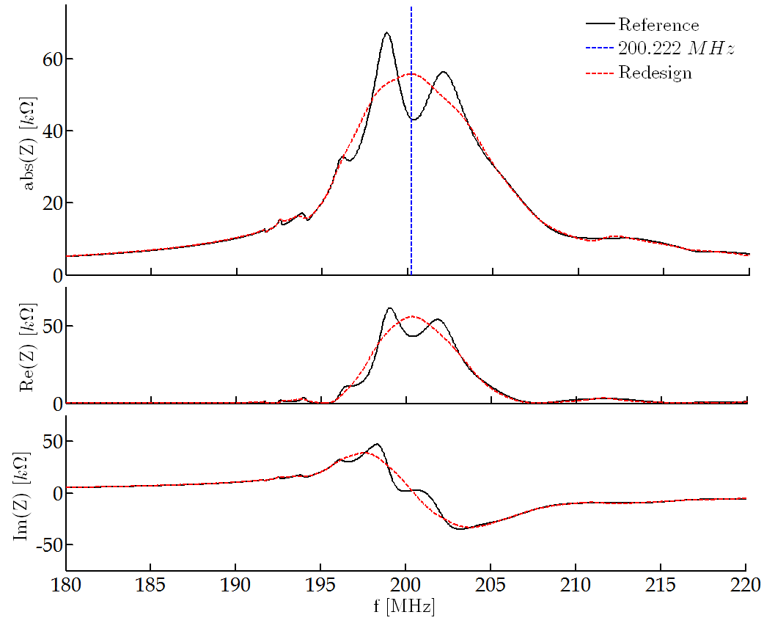
Longitudinal Impedance Comparison
Computing the longitudinal impedance of the fundamental passband we get,
Reminder!
I am NOT saying that this is the case right now in the machine

Slide 15
Outline
Introduction
The 200MHz Accelerating Wave
One Tank Analysis
RF Characteristics
Longitudinal Impedance
Next Steps

Slide 16
Next Steps
The results presented today show the importance of the main couplers in a travelling wave cavity.
There are two clearly defined goals:
Characterize the real current situation in the machine.
Create a realistic full model of the cavities (including the different HOM couplers and voltage loops)
Calculate the impedance of the fundamental passband for the 4 and 5 section cavities
Characterize the impedance of the HOMs (both damped and untouched).
Evaluate the impact of the HOM couplers in the cavity performance (accelerating mode)
Study the way to optimize performance ( LS2 )
Ensure good matching of the main couplers
Ensure the correct tunning of the cavity sections (center frequency, field flatness…)
Ensure that the most important HOMs are damped as much as possible

