Slide 1
Simulations of single-bunch instability on the SPS flat top
Edgaras Radvilas
Supervisor – Alexandre Lasheen

Slide 2
Introduction
Simulations start at flat top (no ramp) with number of turns extended to 100 000 (2.304s) to detect slow growing instabilities
Initial bunch distribution is matched for given intensity and bunch length using the SPS impedance model
Two cases for impedance model :
Full SPS impedance model
SPS impedance model with all vacuum flanges removed
Simulations were run using Blond code (http://blond.web.cern.ch/) and SPS impedance model (J. Varela et al.)

Slide 3
Scan for instabilities
 | Single RF | Double RF
Distribution density exponent µ | 1, 1.5 and 2.5
RF voltage $V_{200MHz}$, MV | 2, 7 | 2 | and | 7
RF voltage $V_{800MHz}$, MV | – | 0.2 |  | 0.7
Intensity N, p | (0.5 – 2.6$)×{10}^{11}$ | (0.5 – 4.0) $×{10}^{11}$
Input emittance $ε_{0}$, eVs | 0.2 – 0.95
Calculated emittance${ ε}_{calc}$, eVs | 0.2 – 0.6
$F(H)= {F_{0}\left(1−\frac{H}{H_{0}}\right)}^{μ}$– distribution density
Notes:
calcEmittance = 2 / (hRF*omegao) * A * np.trapz(np.sqrt(H0 - potBunch), dx = phaseBunch[1] - phaseBunch[0])

Slide 4
V = 7.0 MV, N = $2.6×{10}^{11}$ p, $ε_{0}$ = 0.45 eVs, Single RF
Criteria to determine the instability: RMS
If bunch length oscilating amplitude goes above 1.5% of its average at the first 500 turns.
If $τ_{f}/τ_{0}$ > 2.5%, where:
$τ_{f}$ - bunch length average of the last 500 turns
$τ_{0}$ - bunch length average of the first 500 turns
, [s]
Bunch length obtained using RMS – unstable case

Slide 5
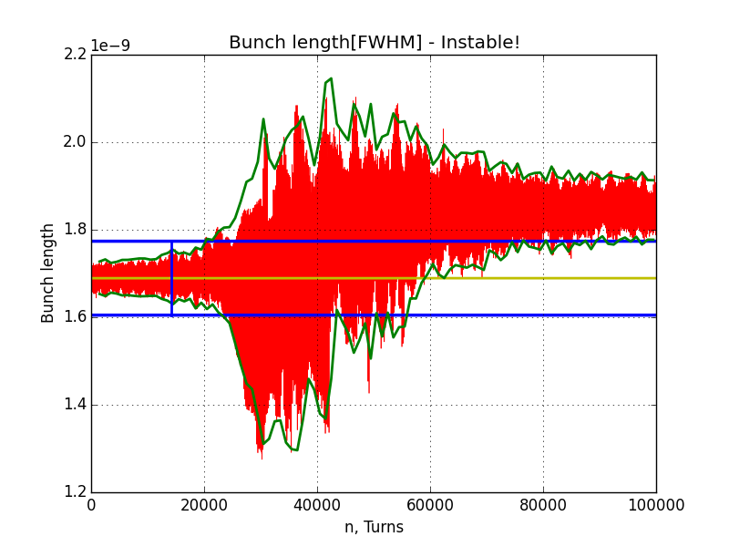
V = 7.0 MV, N = $2.6×{10}^{11}$ p, $ε_{0}$ = 0.45 eVs, Single RF
Criteria to determine the instability: FWHM
If bunch length oscilating amplitude goes above 5% of its mean at the first 500 turns.
If $∆τ/τ_{0}$ > 0.07 in any point of the simulation, where:
$∆τ$- bunch length peak to peak oscilating amplitude
, [s]
Bunch length obtained using FWHM– unstable case

Slide 6
Single RF stability maps, $μ=$ 1.5, V = 7 MV
Bunch length defined by RMS
Bunch length defined by FWHM
$$N [p]$$
$$N [p]$$
$$ε_{calc} [eVs]$$
$$τ_{f}/τ_{0}$$
$$ε_{calc} [eVs]$$
$$∆τ/τ_{0}$$
Slightly different results depending on bunch length definition used
For RMS we use $τ_{f}/τ_{0}$ and $∆τ/τ_{0}$ for FWHM
Stability islands are clearly present for lower emittances
Stability islands appear only in single RF case
Note: Ramp should be taken into account for stability islands

Slide 7
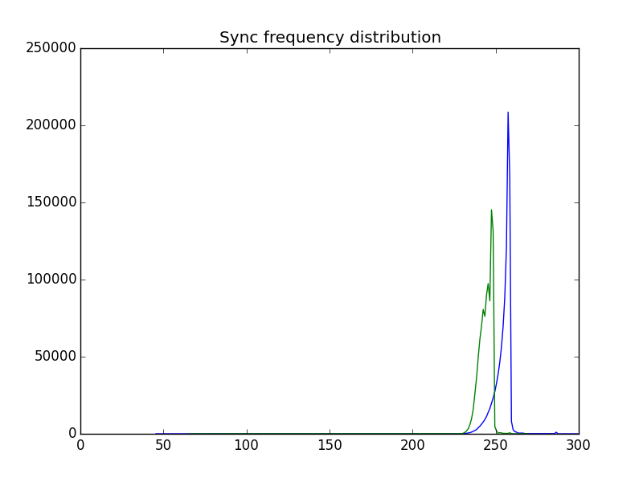
Single RF synchrotron frequency distribution
V = 7.0 MV ; N $=1.8×{10}^{11}$p; $μ=$ 1.5
$ε_{0}=$0.35 eVs – stability island
$ε_{0}=$ 0.50 eVs – unstable case
$ε_{0}=$ 0.70 eVs
$$f [Hz]$$
$$f [Hz]$$
$$f [Hz]$$
Blue line in these plots represent synchrotron frequency distribution without intensity effects, green line – with intensity effects.
For the unstable case ($ε_{0}=$0.50 eVs) we see that synchrotron frequency distribution is very small – most of the particles have similar synchrotron frequency.
For the input emittance of stability island ($ε_{0}=$0.35 eVs) synchrotron frequency distribution is increased due induced voltage.

Slide 8
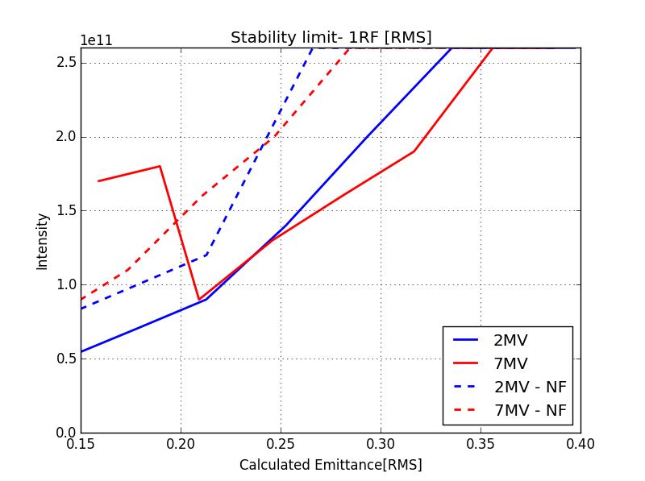
Single RF stability thresholds for different bunch distributions
$μ=$ 1.0
$μ=$ 1.5
$μ=$ 2.5
$$N [p]$$
$$N [p]$$
$$N [p]$$
$$ε_{calc} [eVs]$$
$$ε_{calc} [eVs]$$
$$ε_{calc} [eVs]$$
Different bunch distributions give similar results with small discrepancies
The bunch is more unstable for higher μ
$μ=$ 1.5 will be used in following slides as an example, since this value is closest to one found in meassurements

Slide 9
The effect of vacuum flanges on beam stability in single RF
With vacuum flanges = 2 MV
Without vacuum flanges, V = 2 MV
Stability thresholds, V = 2, 7 MV
$$N [p]$$
$$N [p]$$
$$N [p]$$
$$ε_{calc} [eVs]$$
$$∆τ/τ_{0}$$
$$ε_{calc} [eVs]$$
$$∆τ/τ_{0}$$
$$ε_{calc} [eVs]$$
Removing vacuum flanges improves stability in 2MV voltage:
stability islands are bigger.
Instabilities shift to lower emittances
Increase of voltage does not improve stability in higher emittances ($ε_{calc}$ > 0.35 eVs)

Slide 10
Effect of vacuum flanges on beam stability in double RF
With vacuum flanges removed , V = 2 MV
Stability thresholds, V = 2, 7 MV
$$N [p]$$
$$N [p]$$
$$ε_{calc} [eVs]$$
$$∆τ/τ_{0}$$
$${ε }_{calc} [eVs]$$
Significant reduction of stability islands where observed
Stability threshold dependencies are more monotonic
Removing vacuum flanges improves stability for all emittances
Removing vacuum flanges has more effect for 7 MV cases
High voltage is always better for stability

Slide 11
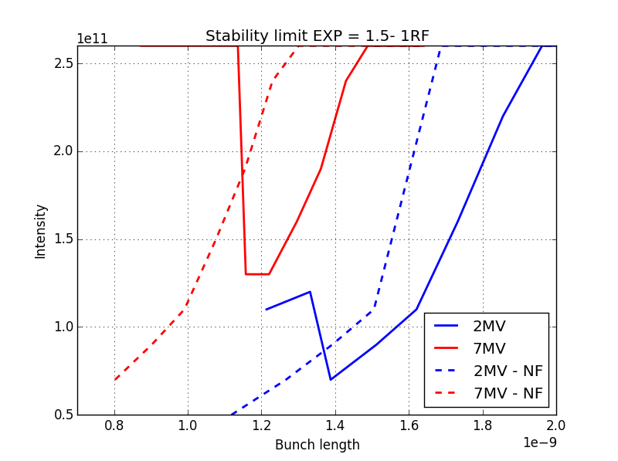
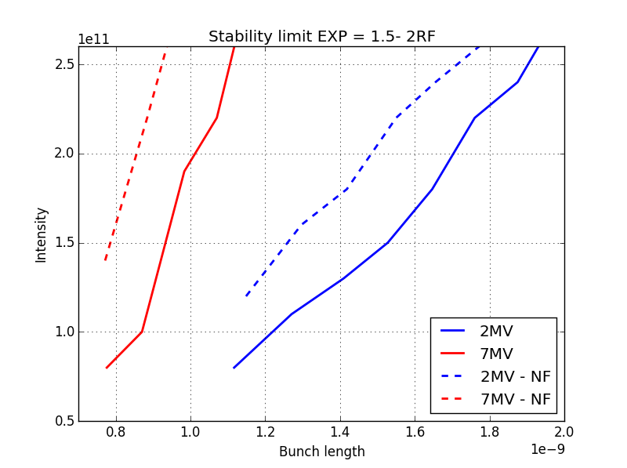
Stability thresholds in bunch lengths, $μ=$ 1.5
Single RF
Double RF
$$N [p]$$
$$N [p]$$
$$[s]$$
$$[s]$$

Slide 12
Stability maps for 2 MV and 7 MV w/o vacuum flanges, $μ=$1.5
V = 2 MV
V = 7 MV
Stability islands disappear
Does not improve stability much overall
Single RF
$$N [p]$$
$$N [p]$$
$$ε_{calc} [eVs]$$
$$∆τ/τ_{0}$$
$$ε_{calc} [eVs]$$
$$∆τ/τ_{0}$$
Increases instability threshold for specified emittance ($ε_{calc}$)
Double RF
$$N [p]$$
$$N [p]$$
$$ε_{calc} [eVs]$$
$$∆τ/τ_{0}$$
$$ε_{calc} [eVs]$$
$$∆τ/τ_{0}$$

Slide 13
Summary
For single RF instability threshold dependencies are not always monotonic
Stability islands are present due to effect of induced voltage on synchrotron frequency distribution
Removing vacuum flanges:
In a double RF case increases instability threshold for 7 MV and less for 2 MV
For single RF system stability islands are more pronounced in 2 MV
For single RF system stability islands disappear for 7 MV case
Some stability islands might not even get through the ramp, that is why our next step is to do full ramp simulations

