Slide 1
Single bunch instabilities during ramp s LIU-SPS Beam Dynamics Working Group 06/08/2015
A. Lasheen, T. Argyropoulos, T. Bohl, S. Hancock, E. Radvilas, E. Shaposhnikova, J. Varela, MD coordination team, operation team

Slide 2
Introduction and motivation
The SPS impedance was probed with special beam measurements (synchrotron frequency shift, long bunches…), and compared with simulations using the impedance model => reasonable agreement
The next step was to compare measurements and simulations with an accelerating ramp and for different configurations, using the latest impedance model.
The measurements were done during parallel MDs in order to have enough statistics.
Starting with single bunch for fast simulations and measurements, to start with the simplest case.

Slide 3
Outlook
Setup
Measurement setup
Simulation setup
Instability criterion
Single RF measurements
Two voltages
Simulations
Double RF measurements
Two voltages
Simulations
Second harmonic effective phase and voltage
Simulations with second harmonic assumptions

Slide 4
Setup

Slide 5
Measurement setup
Fast ramp (LHCMD_PILOT_Q20_V1)
LLRF
Synchronization loop and phase loop ON
Feedback, feedforward, longitudinal damper, emittance blowup OFF
Bunch length calculated as $τ=4 {τ_{FWHM}}/{\left(2\sqrt{2\ln\left(2\right)}\right)}$ (rescaling of $τ_{FWHM}$ for a Gaussian profile)
Emittance and intensity adjusted in the PSB
Emittance ($ε_{l}\sim 0.24$ eVs, calculated from $τ$)
Scanning intensity ($N_{ppb}=0.5×{10}^{11}$ to $2.8×{10}^{11}$)
Four configuration for RF voltage
Single RF (constant bucket area CBA and high voltage HV)
Double RF CBA and HV ($V_{800 MHz}=0.1 V_{200 MHz}$, bunch shortening mode)

Slide 6
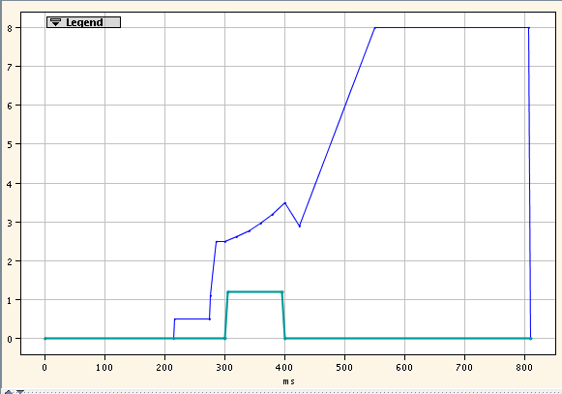
PSB configuration
C02 RF voltage
Adjusting emittance
C16 RF voltage
Adjusting intensity

Slide 7
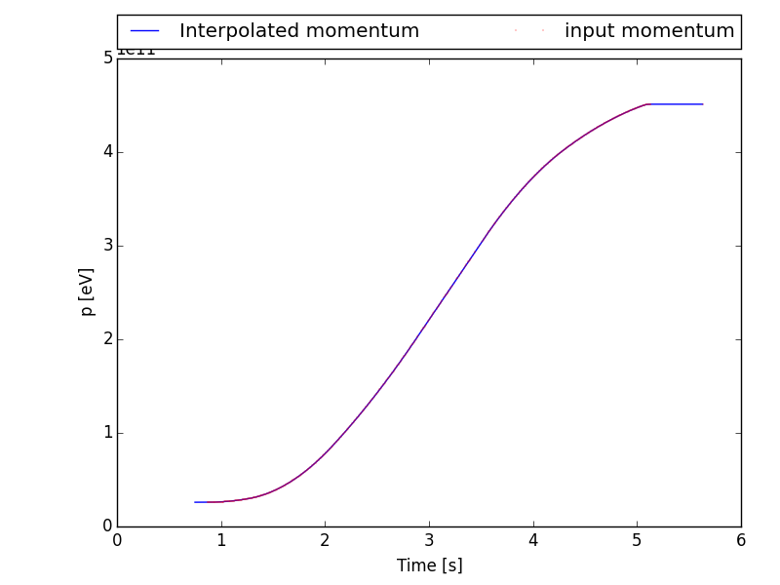
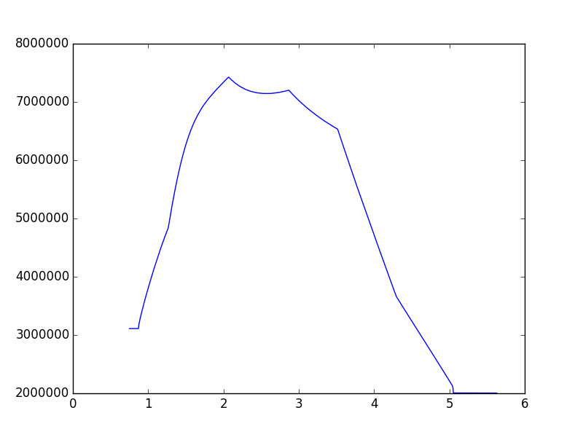
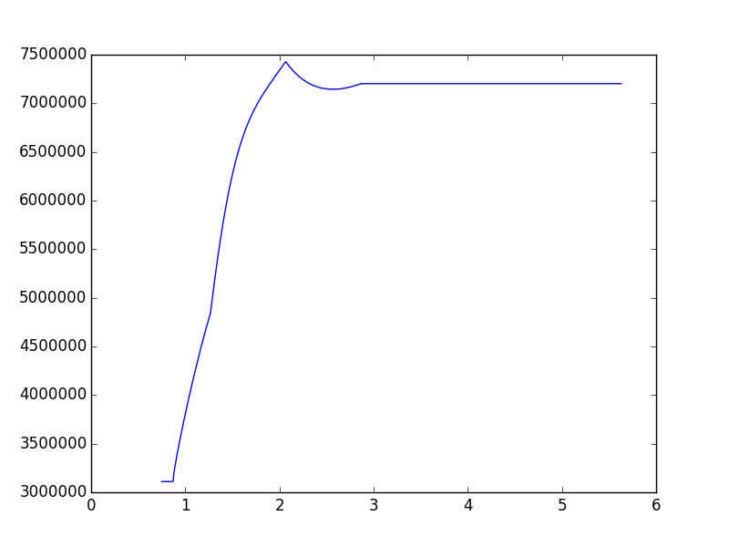
Measurement setup
Ramp from the LHC pilot cycle
Two RF voltage settings
Constant bucket area CBA (acceptance 0.5eVs)
High voltage HV (~7.2MV)
Momentum (eV)
CBA
HV
Voltage (V)
Voltage (V)
Time (s)
Time (s)

Slide 8
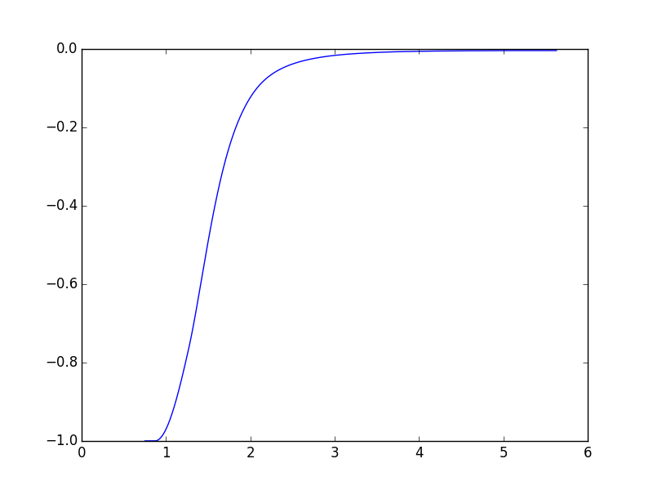
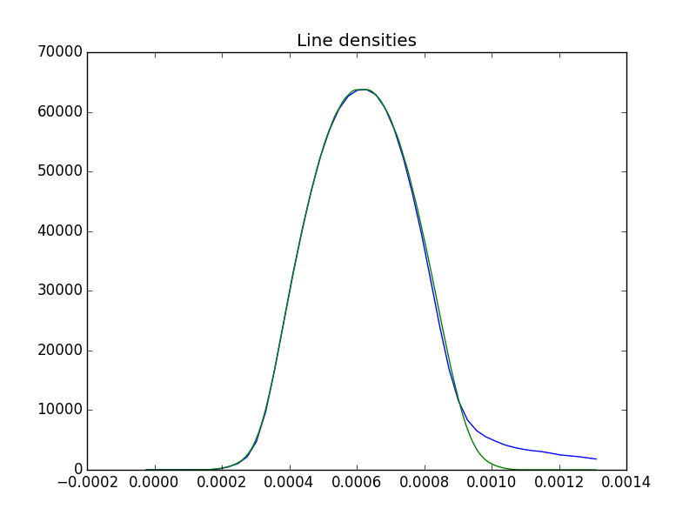
Simulation setup
Input line density
Measurement
Simulation
Space charge impedance (Ohm)
Time (s)
Simulations done with BLonD
Full impedance model (updated model with the new HOM model for the 200MHz cavity)
Including space charge during ramp (scaling with the energy and the transverse beam size evolution)
Bunch generated from the Abel transform of the measured profiles, matched with intensity effects

Slide 9
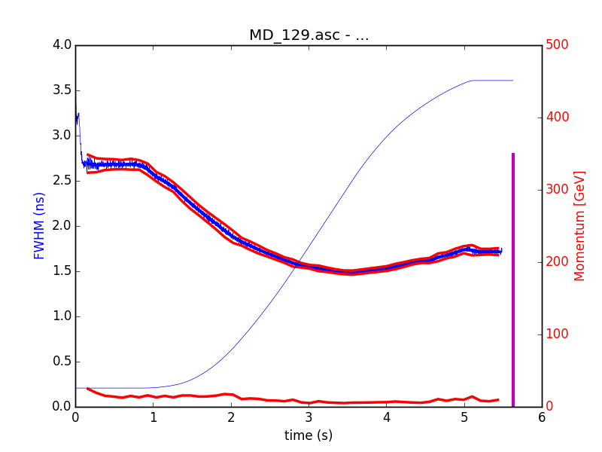
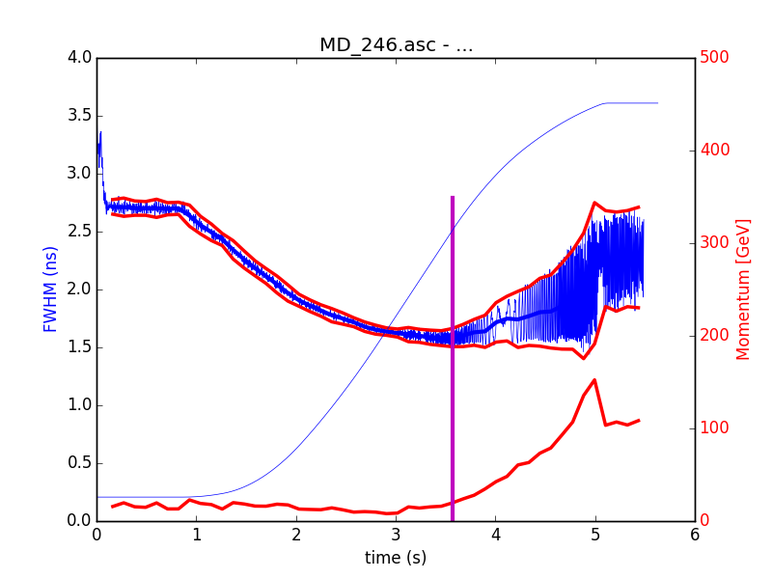
Instability criterion
Peak-to-peak amplitude $dτ_{pp}$ of the bunch length oscillations sampled over several turns
Instability threshold set to:
$${dτ_{pp}}/τ>0.1$$

Slide 10
Single RF

Slide 11
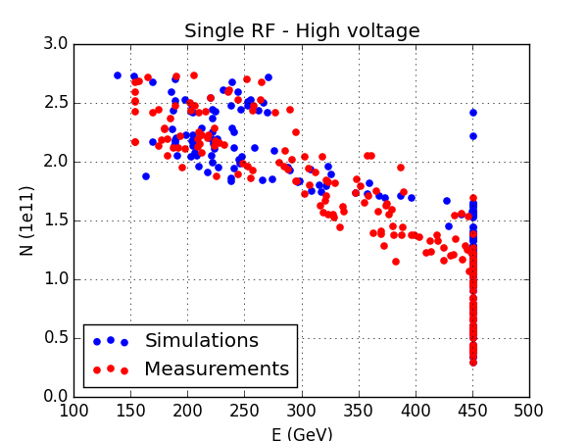
Single RF instability vs. energy
In CBA : good agreement
In HV : good agreement after $N_{b}\sim 1.6×{10}^{11}$, but the instability threshold is lower in measurements

Slide 12
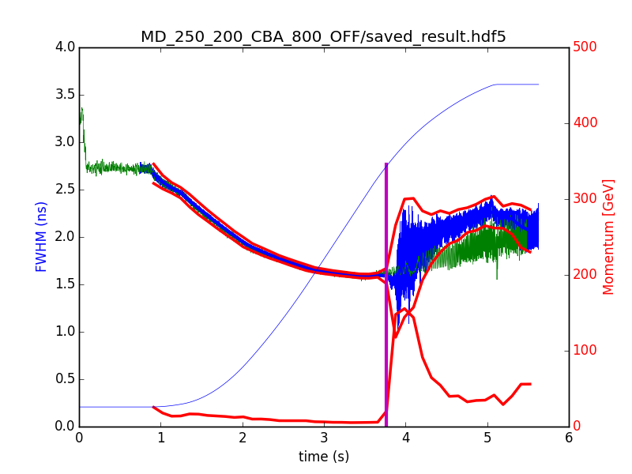
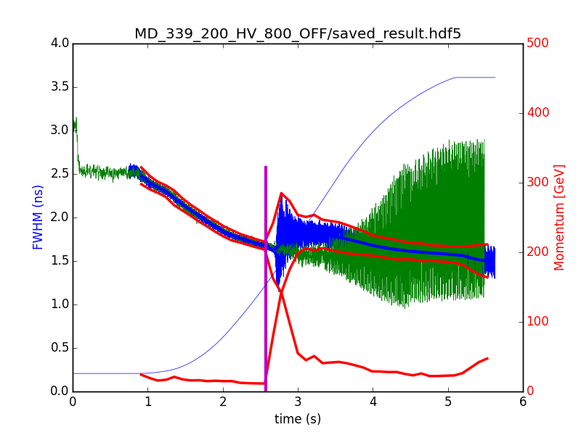
Measured instability pattern
CBA
HV
Measurement
Simulation
Measurement
Simulation
Bunch length (ns)
Bunch length (ns)
Slow instability in measurements (in green)
Instability grows faster in simulations (in blue)
Effect of the phase loop ?
Different kind of instabilities ?

Slide 13
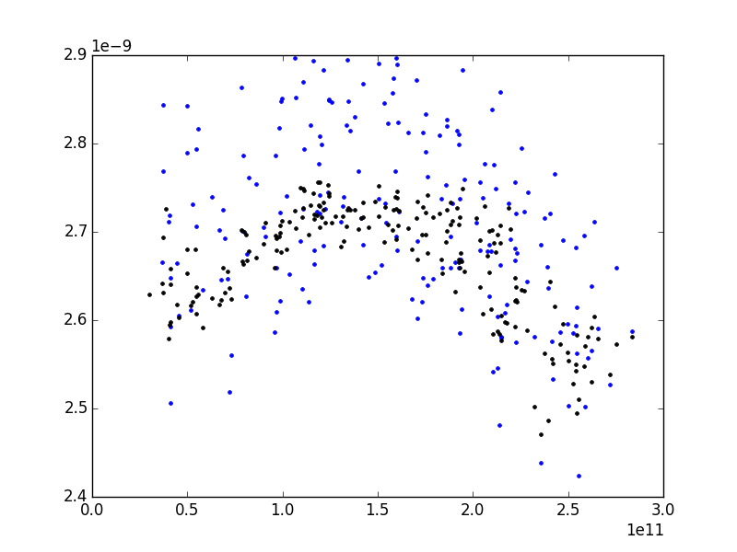
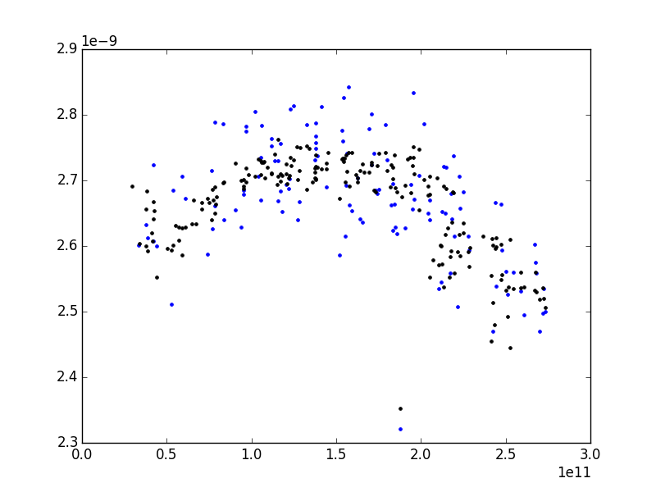
Input bunch length
CBA
HV
Bunch length (ns)
Bunch length (ns)
Measurement
Simulation
Measurement
Simulation
Intensity (ppb)
Intensity (ppb)
The injected bunch length is lower for low and high intensities (distribution is slightly different)
The difference between injected bunch length in measurements/simulations is within 10% (<200ps)

Slide 14
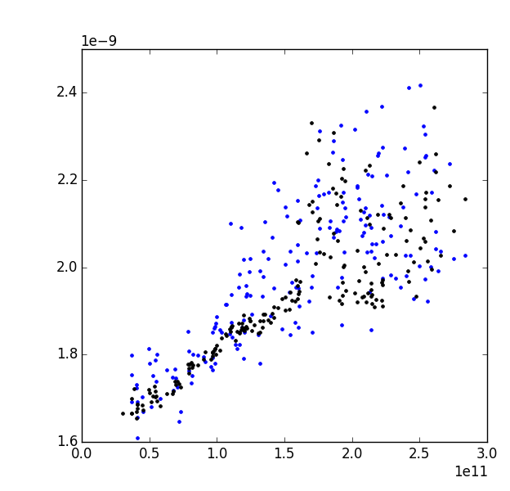
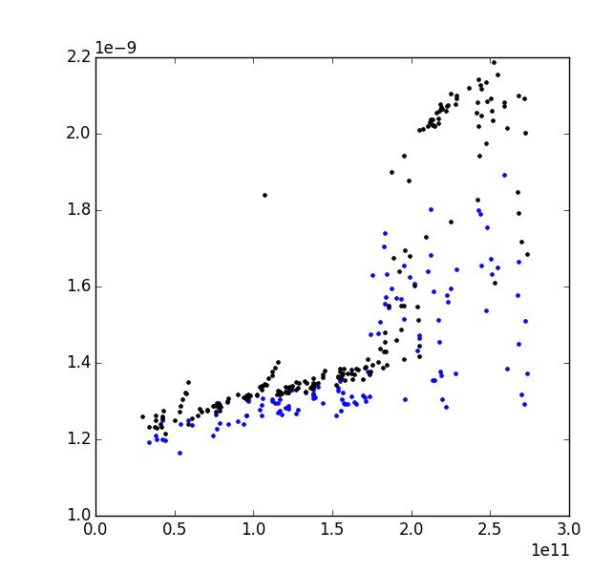
Output bunch length
CBA
HV
Bunch length (ns)
Bunch length (ns)
Measurement
Simulation
Measurement
Simulation
Intensity (ppb)
Intensity (ppb)
CBA : the extracted bunch length is in good agreement
HV : The extracted bunch length is systematically higher in measurements

Slide 15
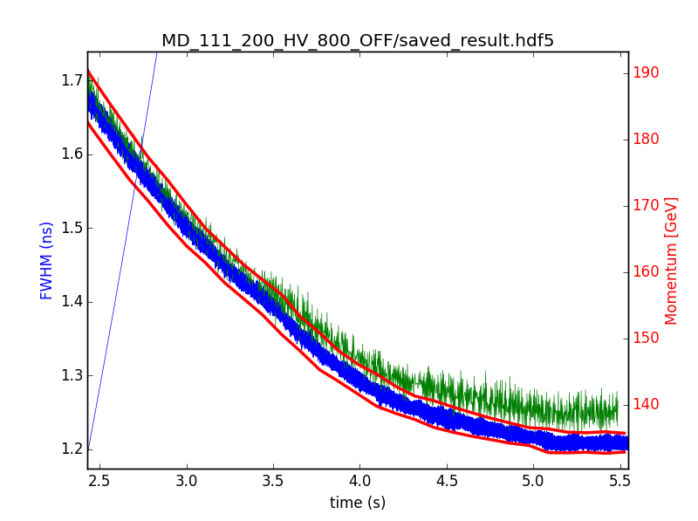
Emittance blow-up in high voltage
HV
Measurement
Simulation
Bunch length (ns)
Bunch length (ns)
Measurement
Simulation
Intensity (ppb)
The bunch length is systematically higher in HV, even for low intensities
Bunch length is increasing in measurements around $t=3.3 ns$

Slide 16
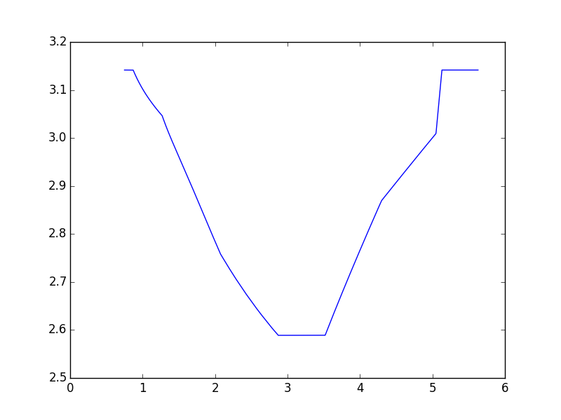
Emittance blow-up in high voltage
HV
Measurement
Simulation
Bunch length (ns)
$$φ_{s}$$
Blow-up
Time (s)
It corresponds to the time where $φ_{s}=constant$
In CBA: there is no flat portion for $φ_{s}$

Slide 17
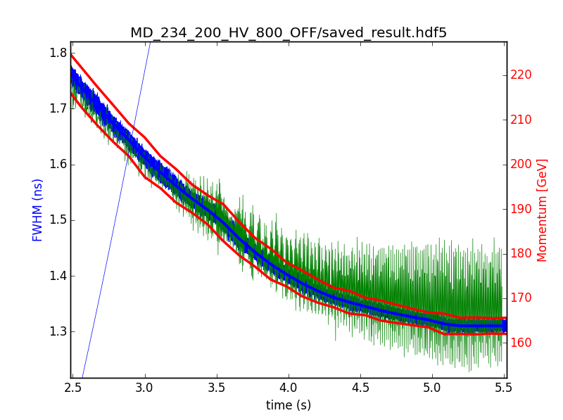
Amplitude of oscillations in high voltage
Bunch length (ns)
Around the instability threshold ($N_{b}\sim 1.4×{10}^{11}$), the amplitude of oscillations are very small
The instability thresholds in energy for intensities above $N_{b}\sim 1.6×{10}^{11}$ corresponds to the time where $φ_{s}$ is not constant anymore

Slide 18
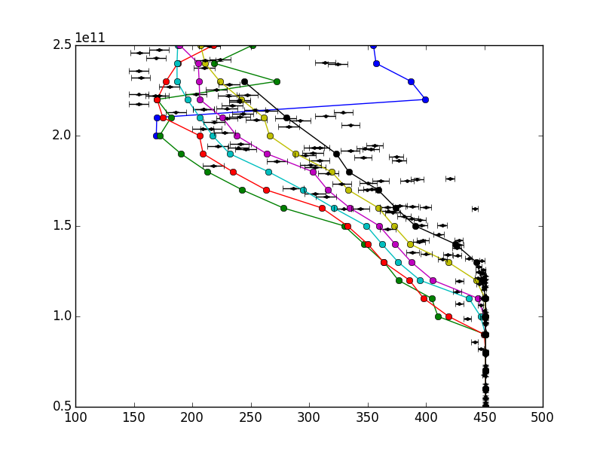
Stability islands
…
For lower emittances, some intensities seem to be more stable
This is observed in measurement and simulations
See talk of E. Radvilas for instabilities at flat top

Slide 19
Double RF

Slide 20
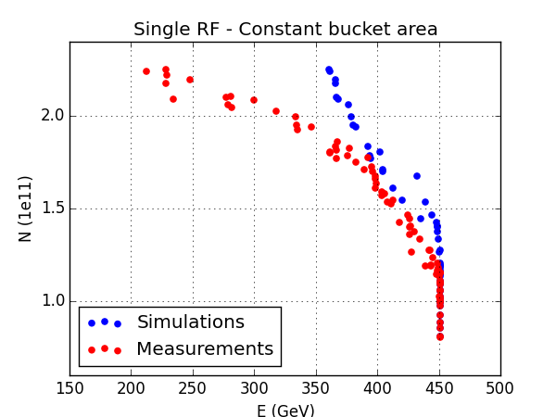
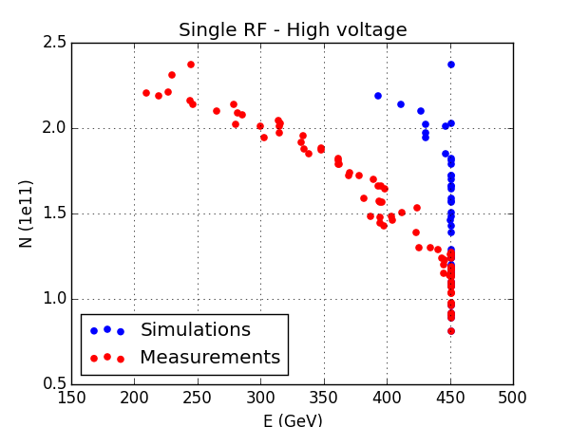
Double RF simulations
CBA
HV
In CBA : instability threshold is close, but at higher intensities the energy threshold is not reproduced…
In HV : the instability threshold is way higher in simulations than in measurements

Slide 21
Second harmonic effective voltage and phase

Slide 22
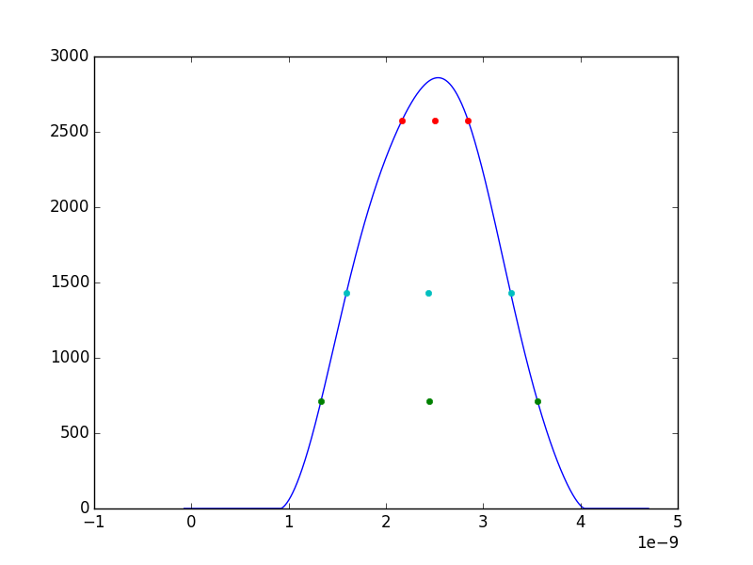
Double RF calibration
Tilt: $tilt=t_{low}−t_{high}$
Flattening: $flattening=\frac{τ_{low}}{τ_{high}}$

Slide 23
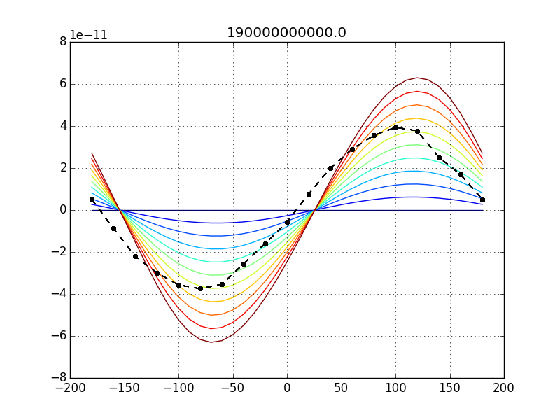
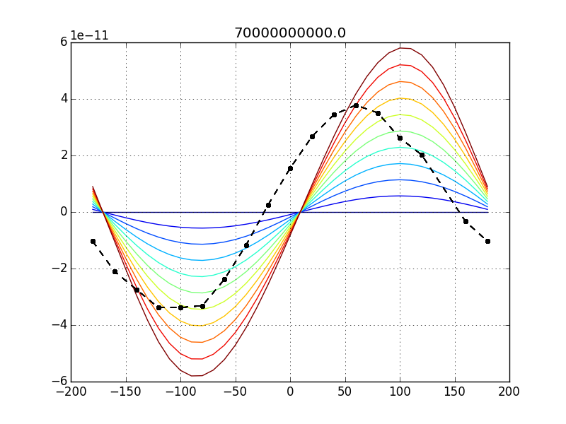
Double RF phase scan (flat bottom)
2015-06-23
2015-07-22
Tilt (s)
Tilt (s)
Phase offset ($φ_{800}$)
Phase offset ($φ_{800}$)
Calibration is done using CBA
In measurements, we set $V_{800 MHz}=0.1 V_{200 MHz}$
In simulations, we scan from $V_{800 MHz}=a V_{200 MHz}$ ( with a from 0 (blue) to 0.1 (red))

Slide 24
Double RF phase scan (flat bottom)
2015-06-23
2015-07-22
Tilt (s)
Tilt (s)
Phase offset ($φ_{800}$)
Phase offset ($φ_{800}$)
Results for two different dates (different settings in the phase shifter)
The effective voltage in measurements wrt simulations is ~6% instead of 10%
The phase offset between measurements and simulations is 16° for 06-23 and 31° for 07-22

Slide 25
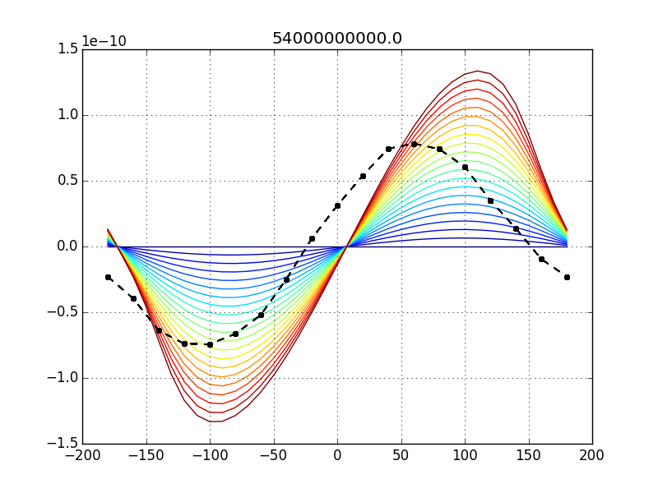
Double RF phase scan (flat bottom)
2015-07-27
Tilt (s)
Phase offset ($φ_{800}$)
We now set $V_{800 MHz}=0.2 V_{200 MHz}$ (scan in simulations)
The effective voltage in measurements wrt simulations is ~12% instead of 20%
The phase offset between measurements and simulations is 32° for 07-27 (same settings as 07-22)

Slide 26
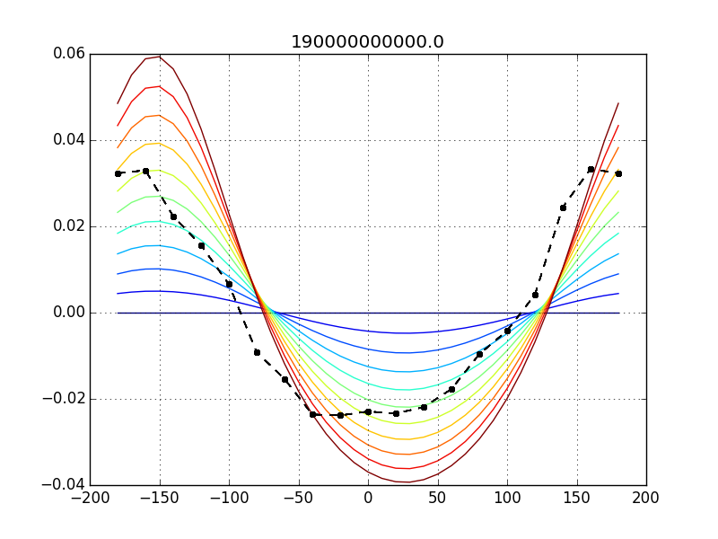
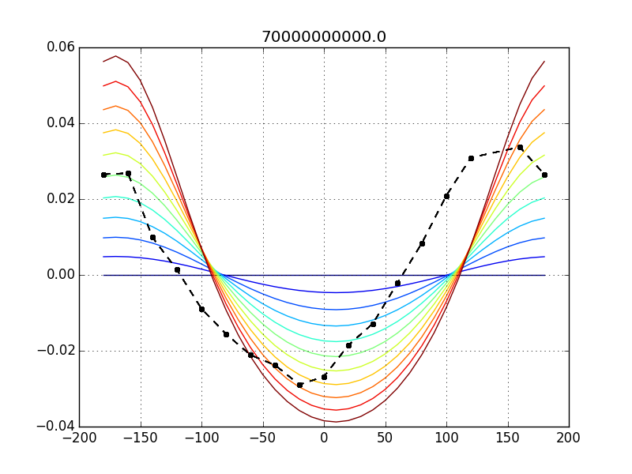
Double RF phase scan (flat bottom)
…
2015-06-23
2015-07-22
Tilt (s)
Tilt (s)
Phase offset ($φ_{800}$)
Phase offset ($φ_{800}$)
Same conclusions as for the tilt

Slide 27
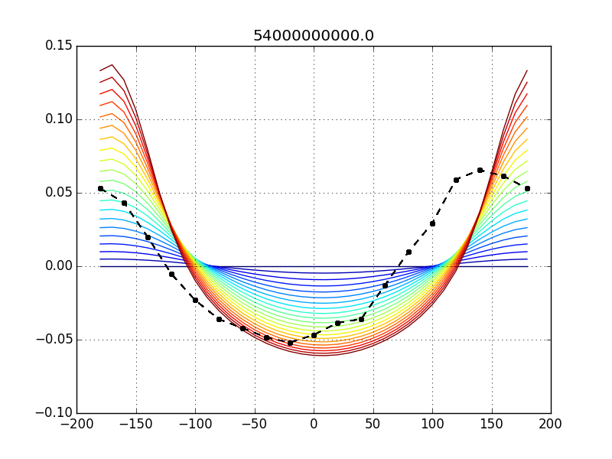
Double RF phase scan (flat bottom)
2015-07-27
Tilt (s)
Phase offset ($φ_{800}$)
Same conclusion as for the tilt

Slide 28
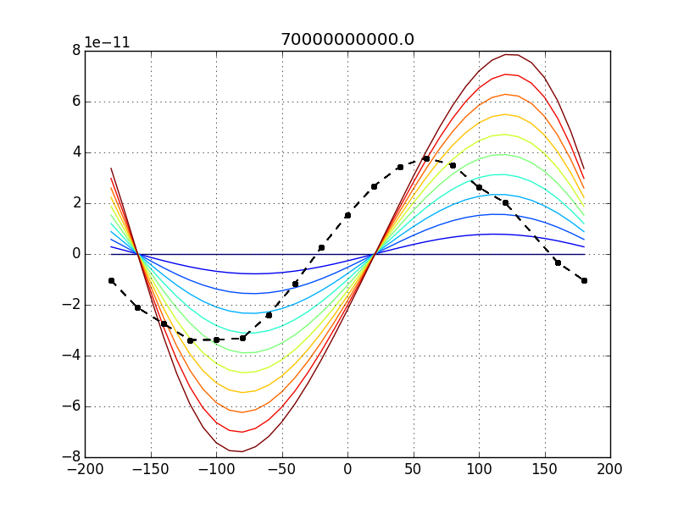
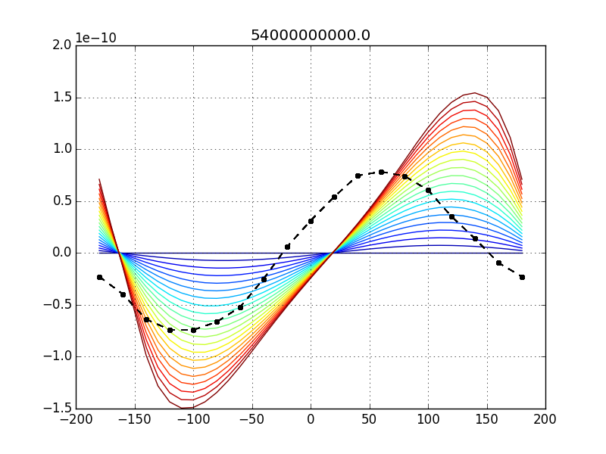
Double RF phase scan (flat top)
2015-06-23
2015-07-22
Tilt (s)
Tilt (s)
Phase offset ($φ_{800}$)
Phase offset ($φ_{800}$)
At flat top, the ratio effective voltage ratio is still 6%
The phase offset is changed to ~42° (~31° at flat bottom)

Slide 29
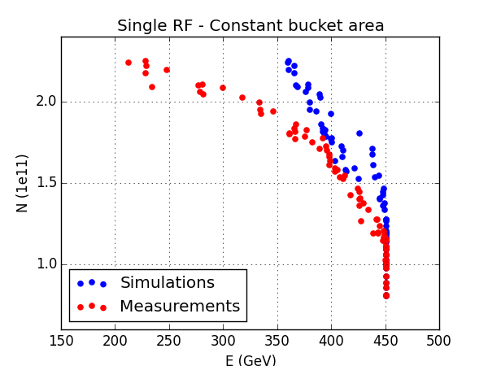
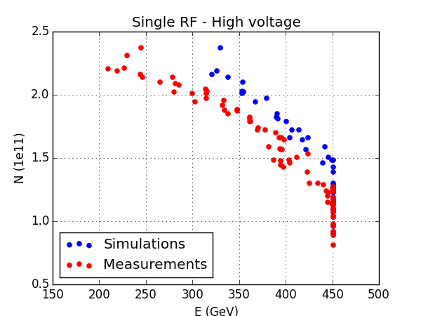
Double RF simulations
CBA
HV
Now making the assumption that the effective voltage and phase offset is the one that we got from the previous slides.
In CBA : the picture didn’t change much
In HV : the instabilities are now closer to measurements, but still slightly more stable

Slide 30
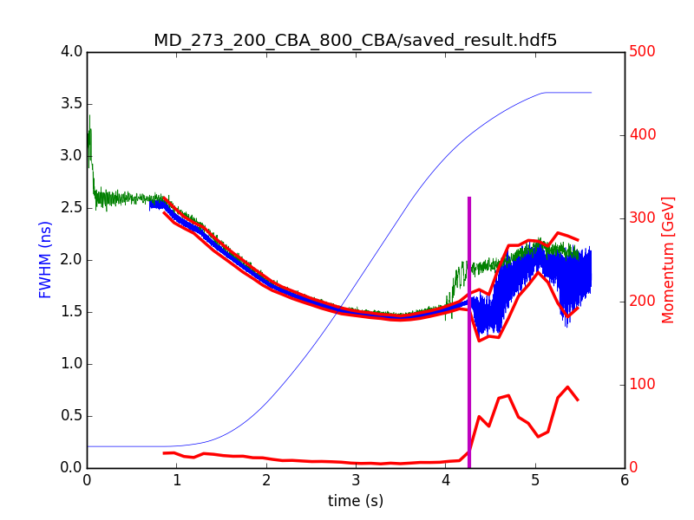
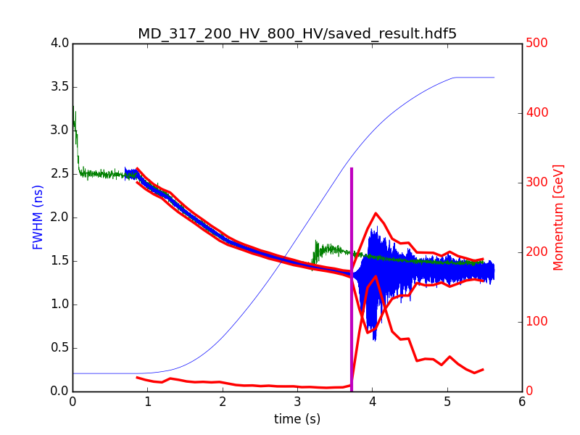
Measured instability pattern
CBA
HV
Measurement
Simulation
Measurement
Simulation
Bunch length (ns)
Bunch length (ns)
Fast instability in measurements (green) and simulations (blue)
The instabilities are damped faster in measurements than in simulations

Slide 31
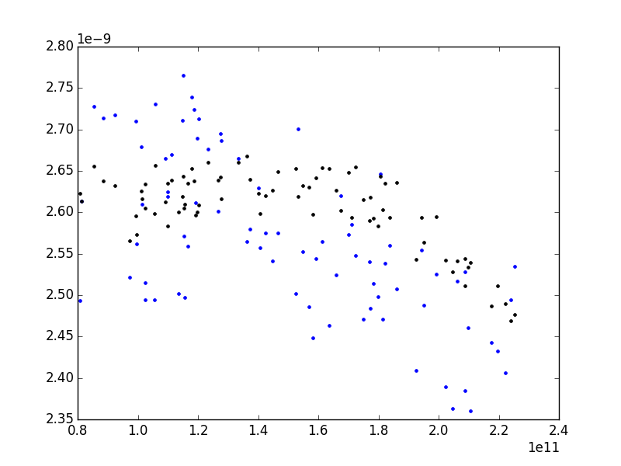
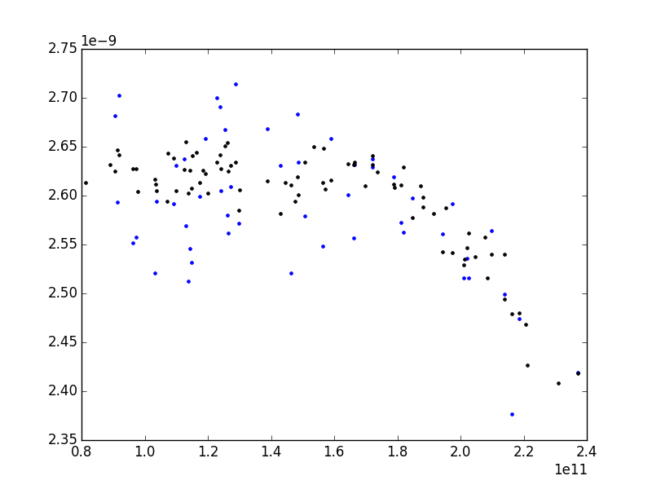
Input bunch length
CBA
HV
Bunch length (ns)
Bunch length (ns)
Measurement
Simulation
Measurement
Simulation
Intensity (ppb)
Intensity (ppb)
The injected bunch length is lower for low and high intensities (distribution is slightly different)
The difference between injected bunch length in measurements/simulations is within 10% (<200ps)

Slide 32
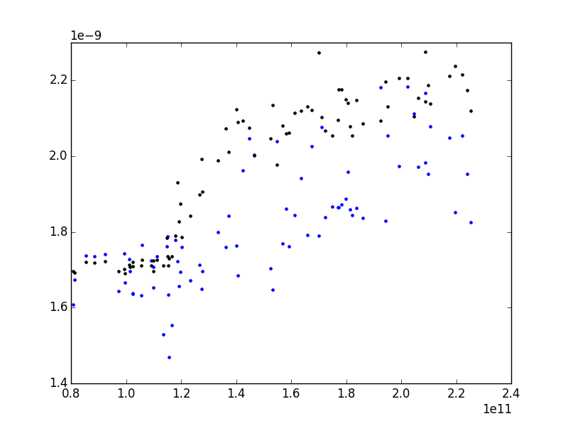
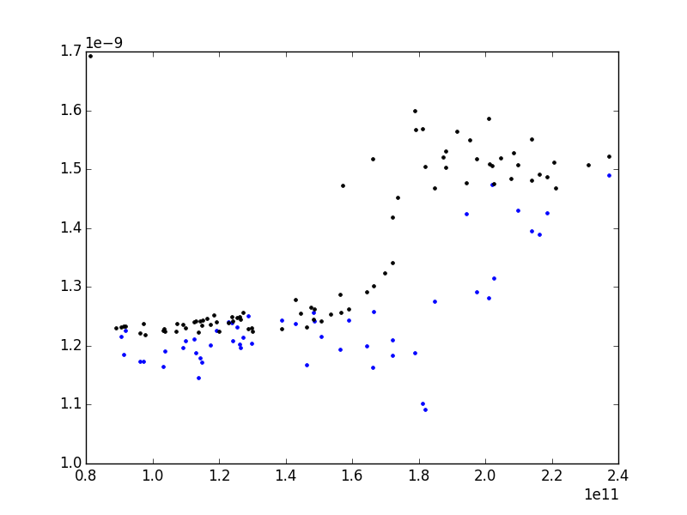
Output bunch length
CBA
HV
Bunch length (ns)
Bunch length (ns)
Measurement
Simulation
Measurement
Simulation
Intensity (ppb)
Intensity (ppb)
CBA : Good agreement between simulations and measurements
HV : As in single RF, the extracted bunch length is slightly higher

Slide 33
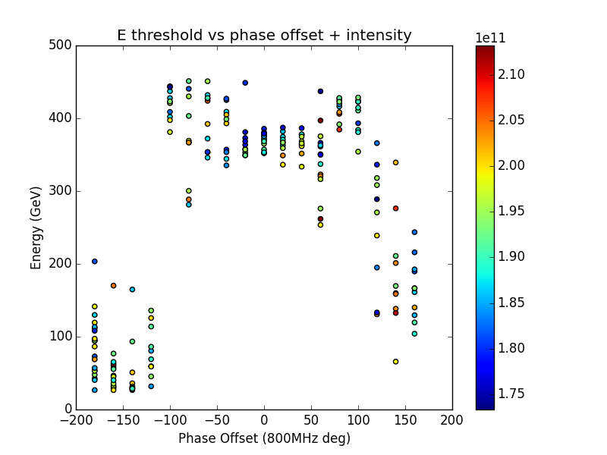
Instability threshold vs. phase offset
The instability threshold for different phase offset was measured.
Bunch shortening mode (0°) is more stable than bunch lengthening mode (180°)

Slide 34
Conclusions
Single RF
CBA => good agreement
HV => good agreement except close to the instability threshold
Double RF (no assumptions on the effective voltage and phase)
CBA => fair agreement for intensities $N_{ppb}<1.8×{10}^{11}$
HV => instabilities not reproduced
Double RF (with assumptions on the effective voltage and phase)
CBA => fair agreement for intensities $N_{ppb}<1.8×{10}^{11}$
HV => better agreement for all intensities

Slide 35
Further steps and ideas
Multibunch (possible in this cycle ?)
Missing impedance assumptions
Impedance reduction simulations
Including 800MHz HOM
Comparison with the long LHC cycle
Scanning different emittances
Implementing phase loop
Correct the injected profiles with the pick-up transfer function

