Slide 1
Longitudinal Impedance Model of the SPS Travelling Wave Cavities
Dmitry Bazyl, Patrick Kraemer and Jose E. Varela
06 August 2015

Slide 2
Outline
Introduction
200 MHz TWC
4 Tank Cavities
5 Tank Cavities
Updated SPS Longitudinal Impedance Model
Conclusions

Slide 3
Introduction
The current best longitudinal impedance estimation for the two types of 200 MHz TWCs will be briefly presented.
Current cavity models account for the longitudinal HOM couplers but NOT for the transverse ones.
Finally, the current impedance model of all the SPS cavities will be put together and compared to the other contributions.

Slide 4
Outline
Introduction
200 MHz TWC
4 Tank Cavities
5 Tank Cavities
Updated SPS Longitudinal Impedance Model
Conclusions

Slide 5
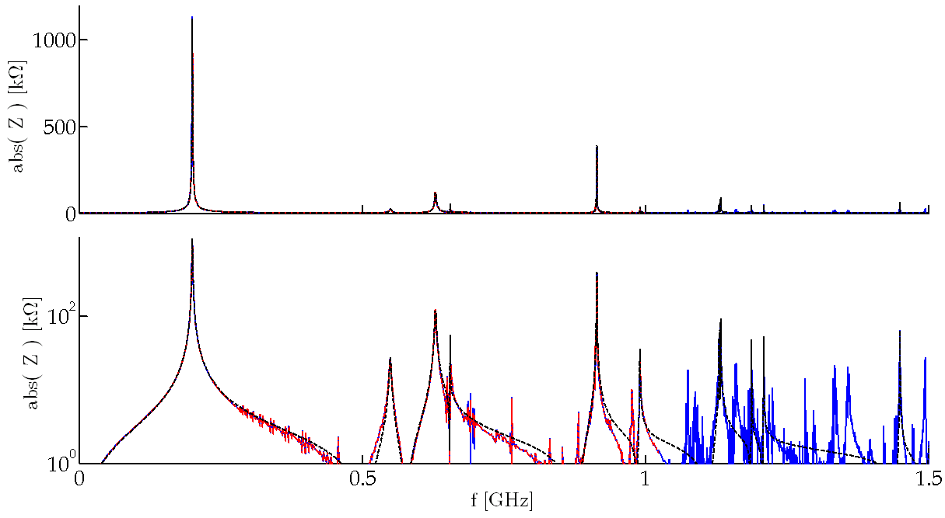
200 MHz TWC – 4 Tanks
Wakefield simulation of a 4 tank 200 MHz TWC with longitudinal HOM couplers.
915 MHz HOMs
Damped HOM
630 MHz

Slide 6
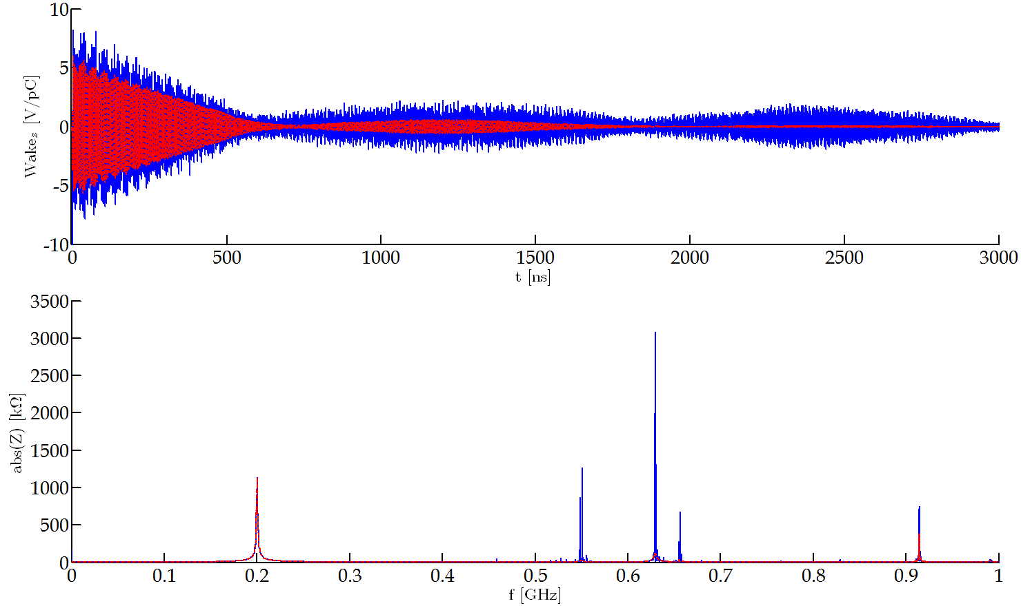
200 MHz TWC – 4 Tanks
Effect of the HOM couplers - Comparison.
Without long. HOM couplers
With long. HOM couplers
Fundamental passband unaffected
Huge HOM damping

Slide 7
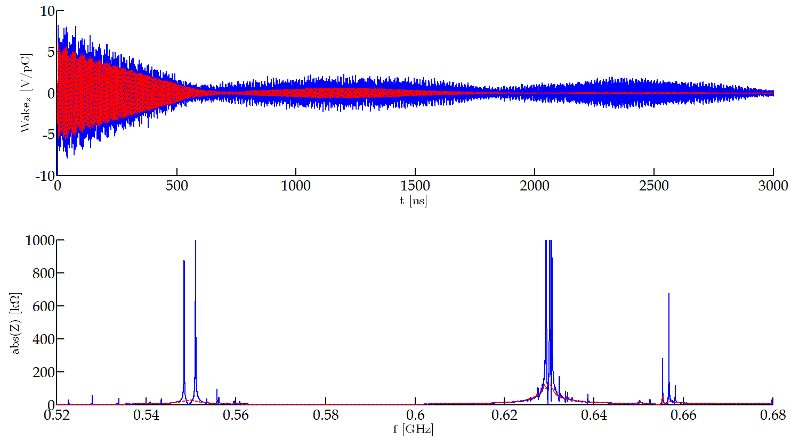
200 MHz TWC – 4 Tanks
Effect of the HOM couplers.
Without long. HOM couplers
With long. HOM couplers
HOM couplers designed for 630 MHz.
Also damps other longitudinal HOMs.

Slide 8
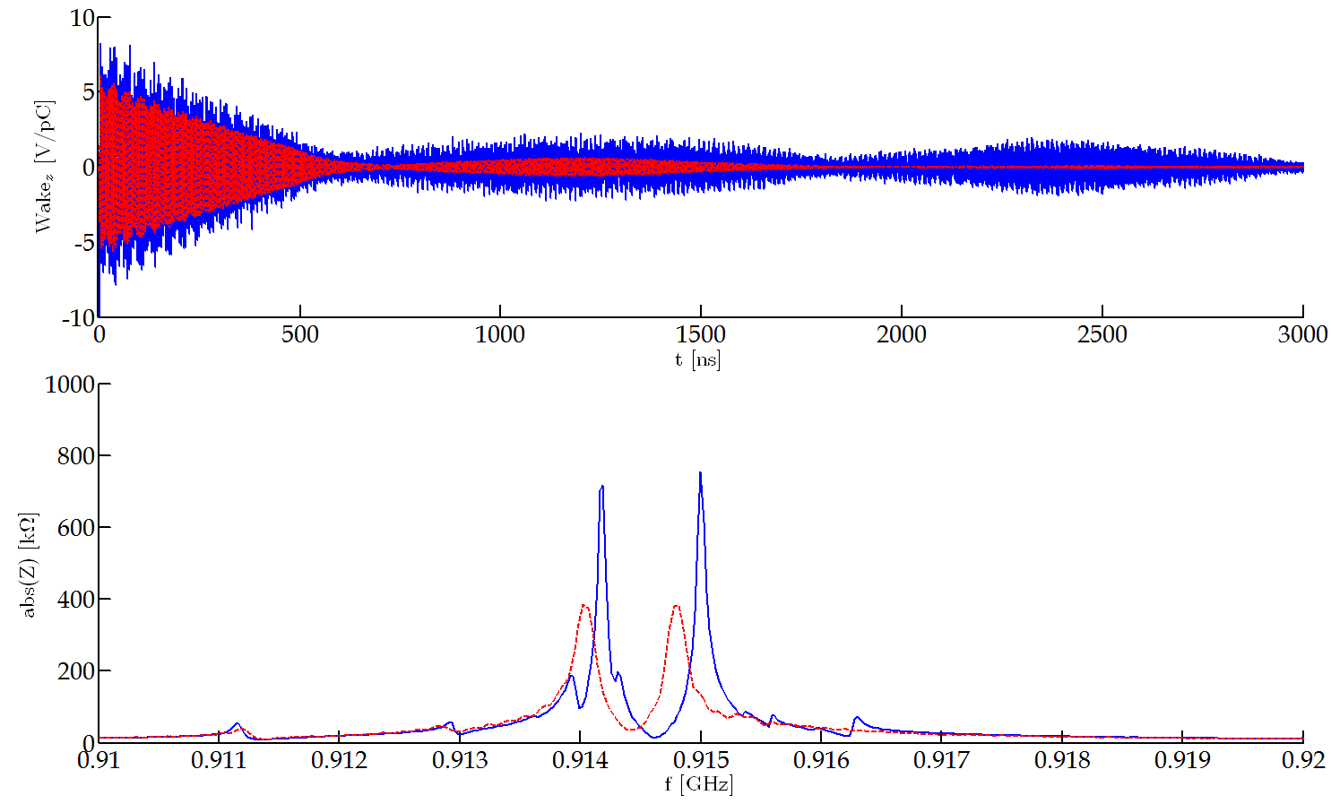
200 MHz TWC – 4 Tanks
Effect of the HOM couplers.
Without long. HOM couplers
With long. HOM couplers
HOM couplers designed for 630 MHz
Also damps other longitudinal HOMs
Less efficient at 915 MHz

Slide 9
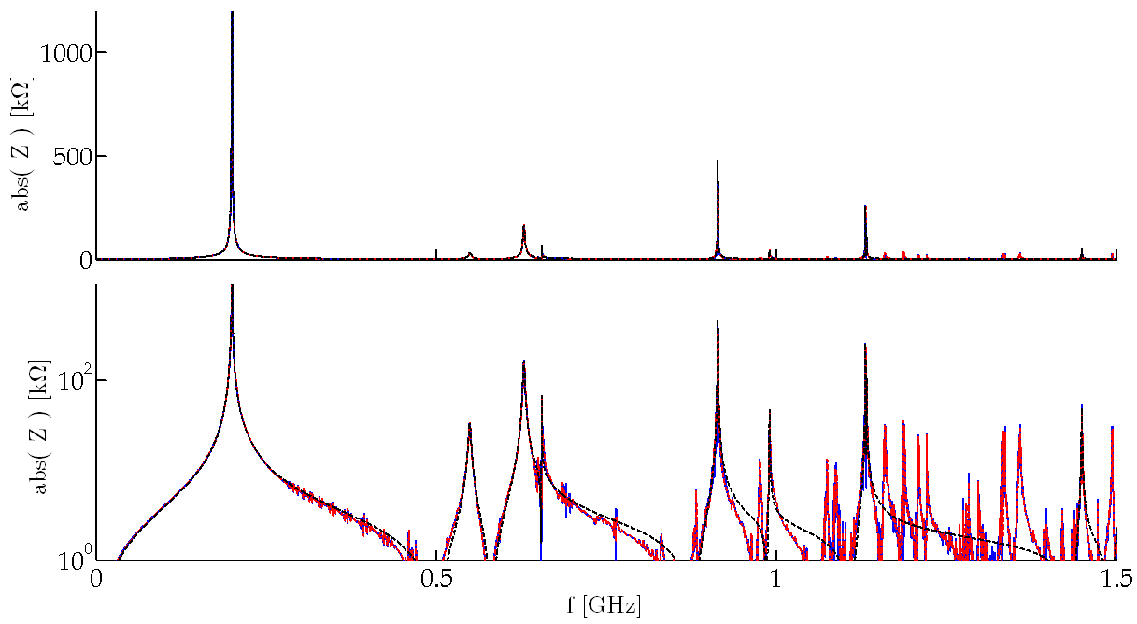
200 MHz TWC – 5 Tanks
Wakefield simulation of a 5 tank 200 MHz TWC with longitudinal HOM couplers.
915 MHz HOMs
Impedance is not linear with cavity length
Damped HOM
630 MHz

Slide 10
Outline
Introduction
200 MHz TWC
4 Tank Cavities
5 Tank Cavities
Updated SPS Longitudinal Impedance Model
Conclusions

Slide 11
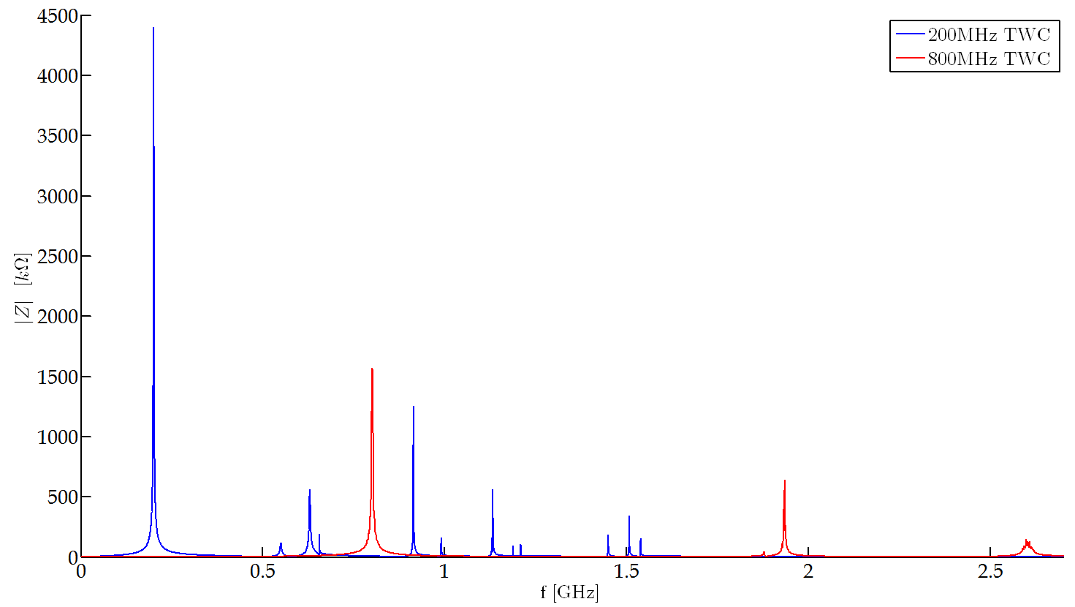
SPS cavities – Total Impedance
Total longitudinal impedance of the SPS cavities
A modification of the current HOM coupler filters should be enough to damp any other longitudinal HOM in the 200MHz cavities.
The 630MHz HOM could be further damped if needed.
HOM couplers for the 800MHz cavities are to be designed if needed.

Slide 12
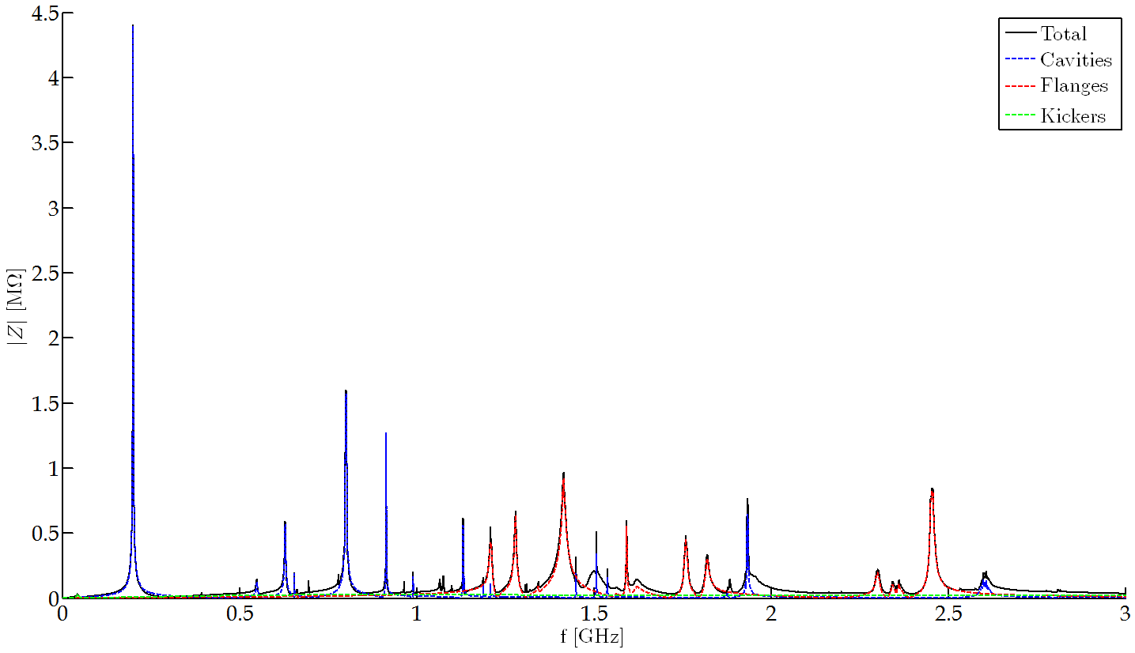
SPS - Longitudinal Impedance
Complete longitudinal impedance model of the SPS.
To note:
0% Non-conform PP Shields
Resonances Scattered 2.5%

Slide 13
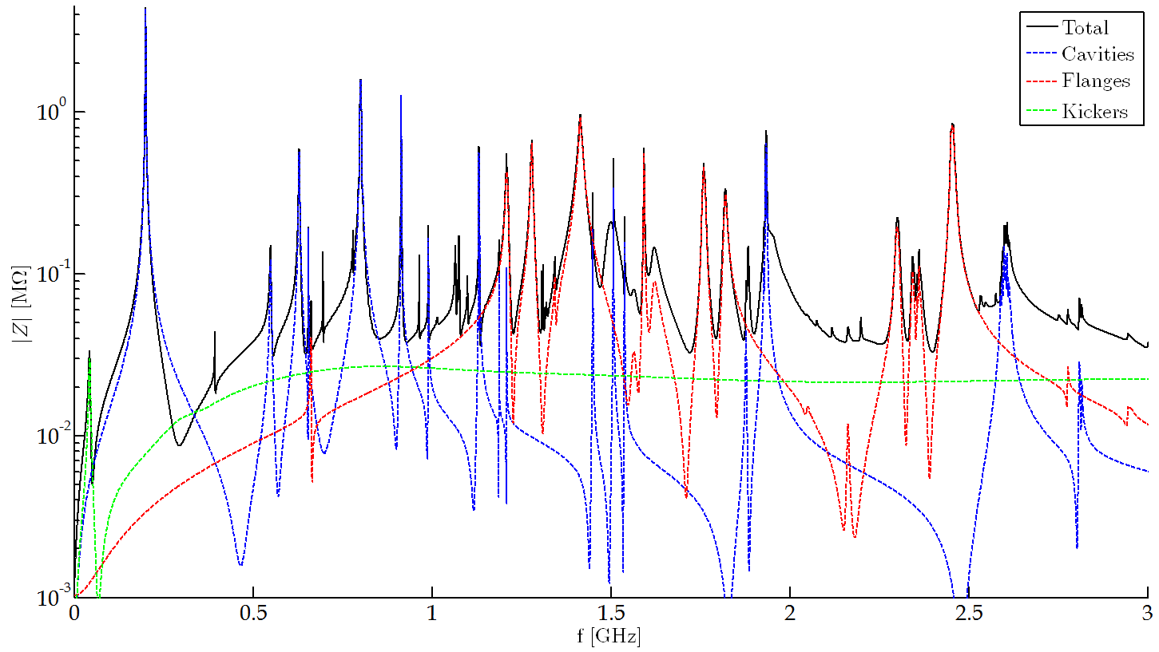
SPS - Longitudinal Impedance
Complete longitudinal impedance model of the SPS.

Slide 14
Outline
Introduction
200 MHz TWC
4 Tank Cavities
5 Tank Cavities
Updated SPS Longitudinal Impedance Model
Conclusions

Slide 15
Conclusions
The longitudinal impedance model of the SPS has been updated with the current best estimation of the impedance of the cavities ( 200 and 800 MHz).
The longitudinal HOM couplers in the 200MHz cavities are very effective, not only for the 630MHz HOMs, but also for other resonances.
A high-impedance HOM has been identified in the 200MHz cavities (915 MHz). Current HOM couplers could be modified to damp it.
The longitudinal impedance model of the 800 MHz cavities was discussed in the previous presentation. When compared to the rest of the impedance model, only the 1.93 GHz HOM seems relevant.

