Slide 1
Impedance of the 800 MHz cavity.
Summer student: Bazyl Dmitry, NRNU “MEPhI”
Supervisors: Elena Shaposhnikova,
José Enrique Varela Campelo,
CERN, BE-RF department.
06 August, LIU-SPS BD WG

Slide 2
Content:
Introduction
Characterization of the fundamental mode
Periodic cell - Dispersion diagram
Simulations
Full model - Frequency domain
Simulations
Measurements
Characterization of the higher order modes
Wakefields
Simulations
Eigenmode – R/Q
Simulations
Measurements
Conclusion

Slide 3
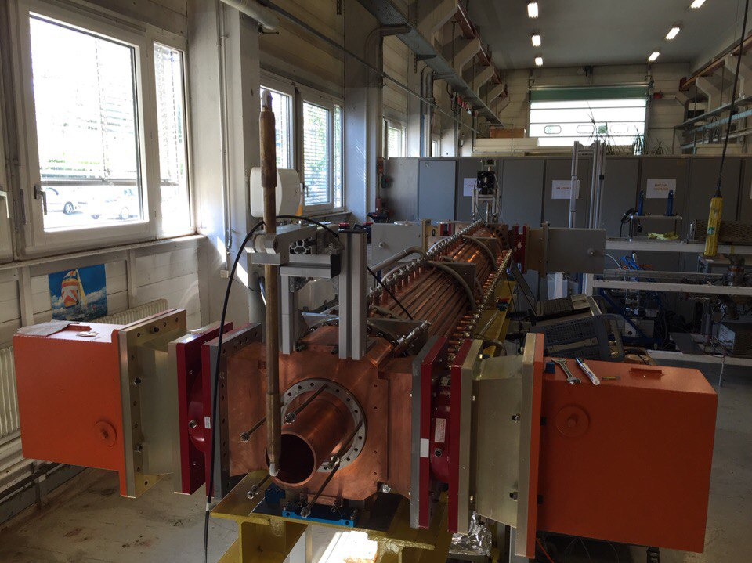
Characterization of the 800 MHz TWC:
Introduction:
Computation of the dispersion diagram for longitudinal modes using CST MWS software.
Measurements and computations of the acceleration voltage for the fundamental passband.
Computation of impedance of the longitudinal higher order modes.
Computation and measurements of the R/Q of the longitudinal higher order modes.

Slide 4
Several reasons to do it:
No detailed information about the cavity. No information about the fundamental passband (central frequency, operating mode, acceleration voltage , and so on).
There is longitudinal beam instabilities in the SPS. No studies were done in a past for the longitudinal HOMs for the 800 MHz TWC. It is well known that HOMs have a negative impact on the beam quality. So it’s kind of necessary to check if there are any potentially dangerous HOMs.
Complete impedance model of the 800 MHz TWC is needed for beam dynamics studies.

Slide 5
Content:
Introduction
Characterization of the fundamental mode
Dispersion diagram
Simulations – single cell
Accelerating voltage
Simulations
Measurements
Characterization of the Higher Order Modes
Wakefields
Simulations
Eigenmode – R/Q
Simulations
Measurements
Conclusion

Slide 6
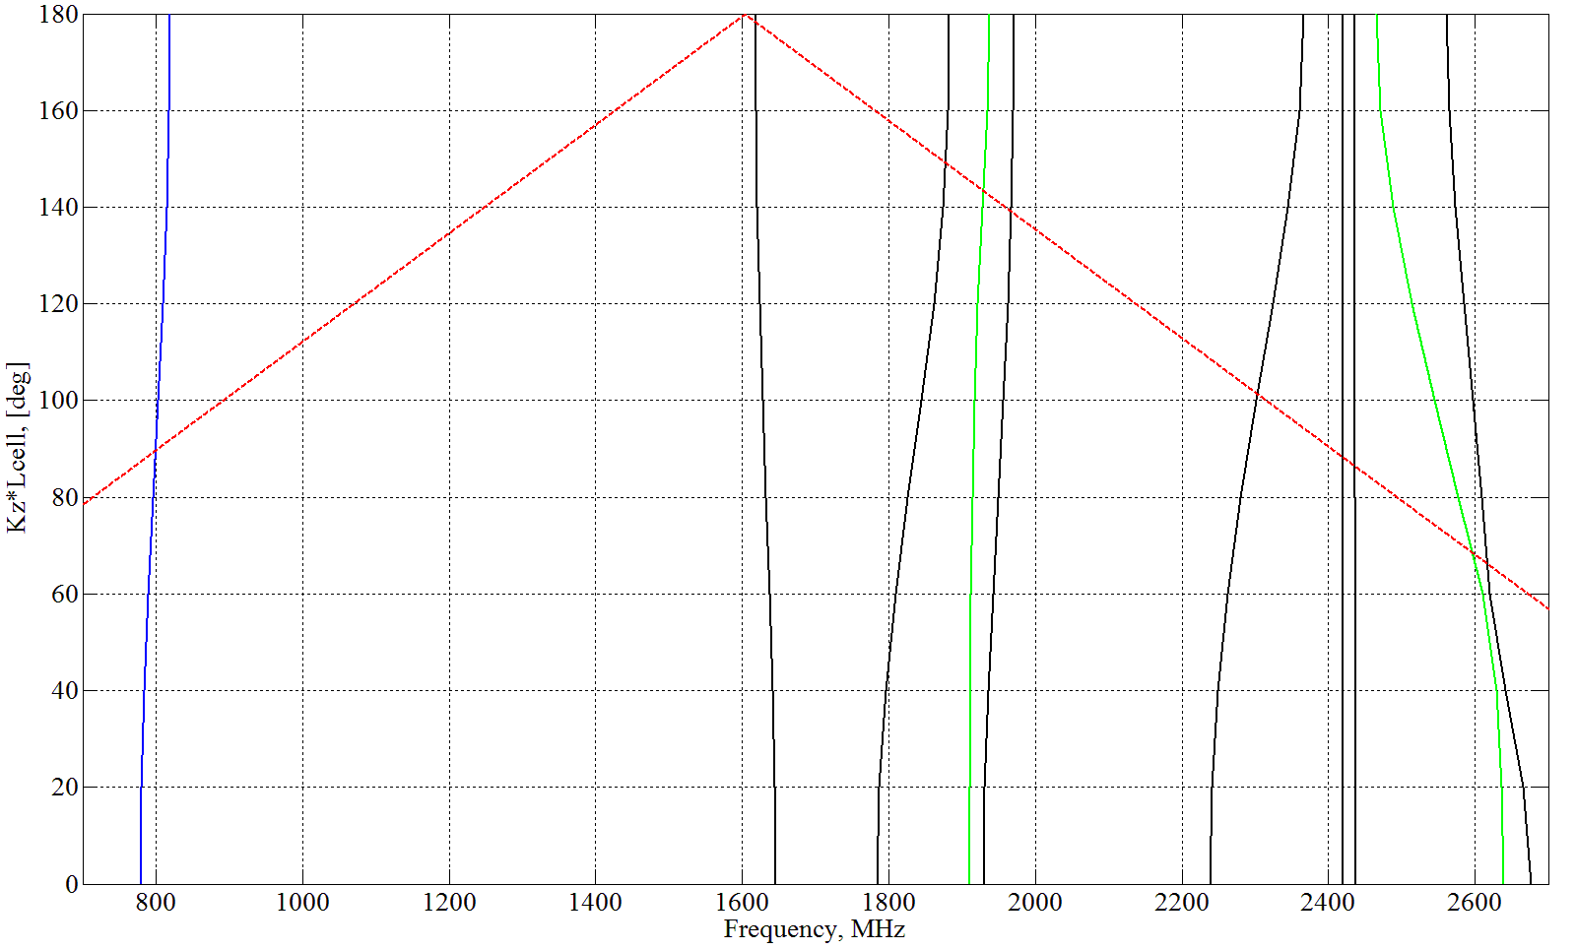
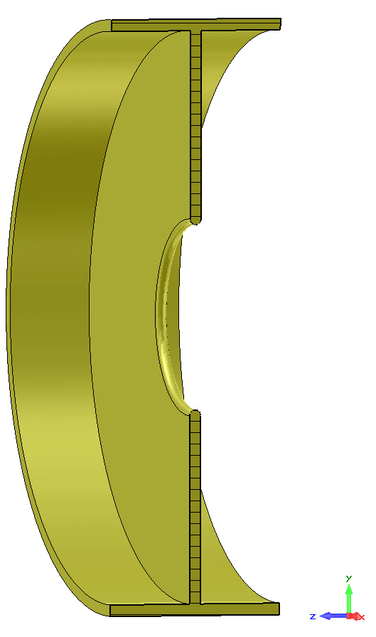
Dispersion diagram for longitudinal modes:
Potentially high impedance regions
$$light line$$
Fundamental passband
Forward wave
$\frac{π}{2}$ accelerating mode
Central frequency of the
passband
One cell model (x-cut plane)

Slide 7
Acceleration Voltage
Longitudinal effective acceleration voltage V is an important quantity for the design of RF cavities. By knowing V one can calculate the longitudinal shunt impedance Rsh. eff. . The shunt impedance of an RF cavity determines how effectively this cavity can convert supplied RF power to accelerating gradient.
Simulations
vs
Measurements

Slide 8
Acceleration Voltage - Simulations
Frequency domain simulations in CST MWS were done for the fundamental passband.
Results of the simulations were post-processed using MATLAB. As the result, the effective longitudinal acceleration voltage was computed for 150 frequencies in the fundamental passband.
Full model (x-cut plane)

Slide 9
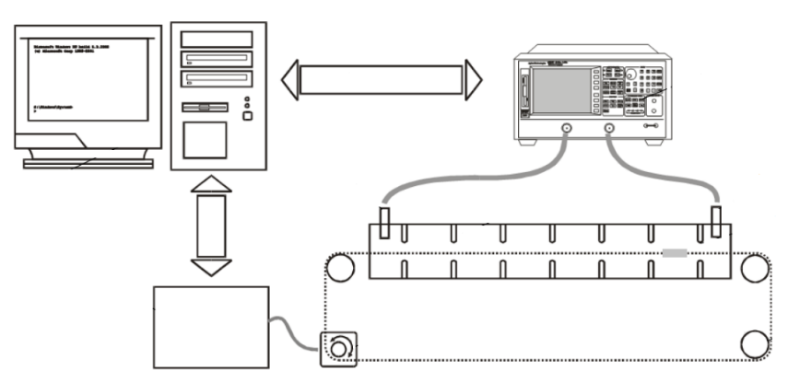
Acceleration Voltage - Measurements
Cavity
PC
Vector Network Analyzer
Bead-pull
Nonresonant perturbation theory
Post-process measurements -> get the fields using mathematical approach from [1]
Calculate accelerating voltage
Motor controller
Needle
[1] A Nonresonant Perturbation Theory // Steele, C.W., Microwave Theory and Techniques, IEEE Transactions (Volume: 14, Issue: 2), 1966.

Slide 10
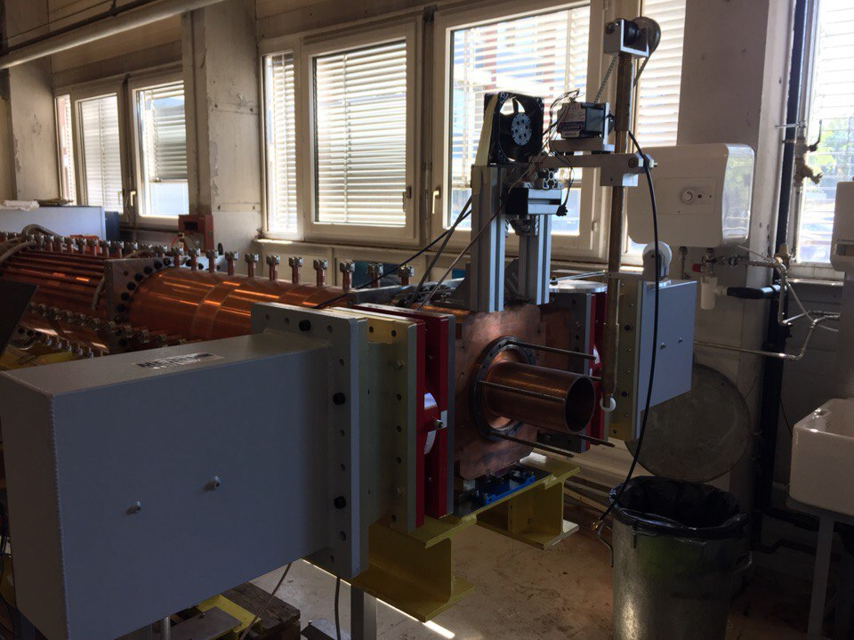
Acceleration Voltage - Measurements

Slide 11
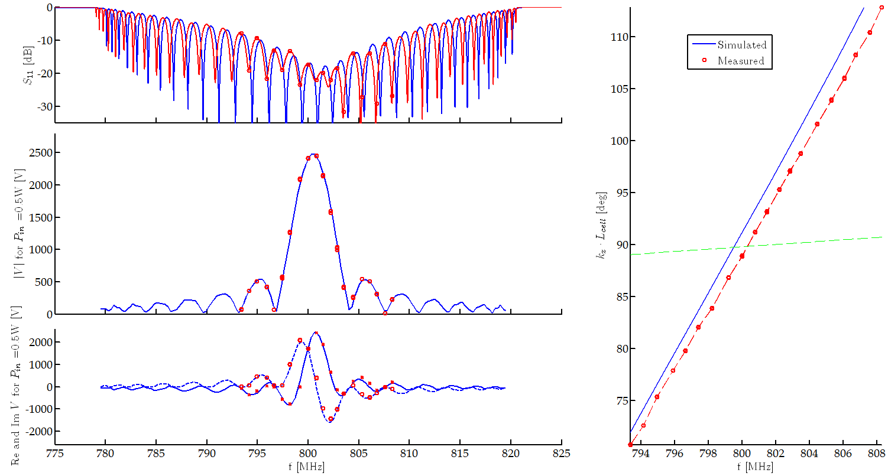
Acceleration Voltage – Measurements vs Simulations
Measured broadband matching of -19.5 dB
Maximum voltage for 0.5W input power 2.48 kV
pA at 800.8MHz is 91.2deg

Slide 12
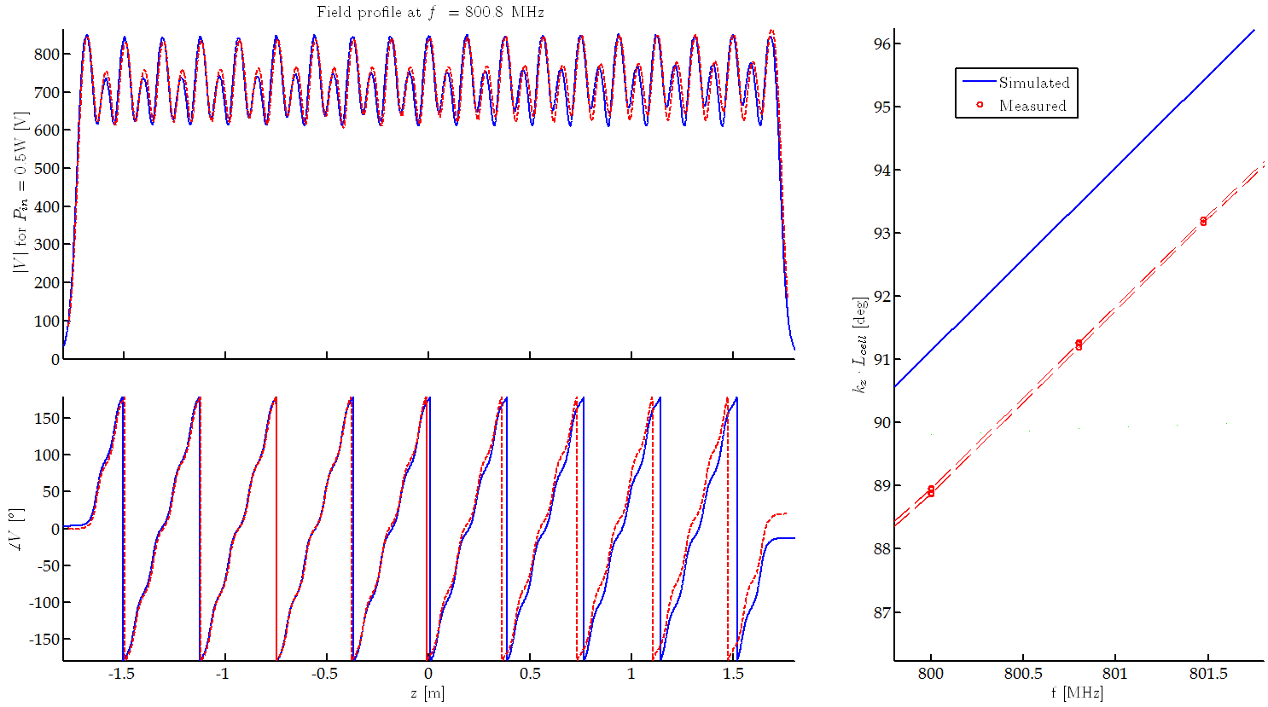
Acceleration Voltage – Measurements vs Simulations
Amplitude difference = 9%
pA at 800.8MHz is 91.2 deg

Slide 13
Content:
Introduction
Characterize the 800 MHz TWC
Describe the cavity
Several reasons
There is no detailed info on the cavity
Impedance of the HOMs
Characterization of the fundamental mode
Periodic cell - Dispersion diagram
Simulations
Full model - Frequency domain
Simulations
Measurements
Characterization of the Higher Order Modes
Full model - Wakefields
Simulations
Full model - Eigenmode – R/Q
Simulations
Measurements
Conclusion

Slide 14
Characterization of the Higher Order Modes
Computation of Impedance of the longitudinal higher order modes using CST Wakefield solver.
Computation and measurements of the R/Q for the longitudinal higher order modes.
Simulations | Measurements
Wakefield | -
R/Q | R/Q

Slide 15
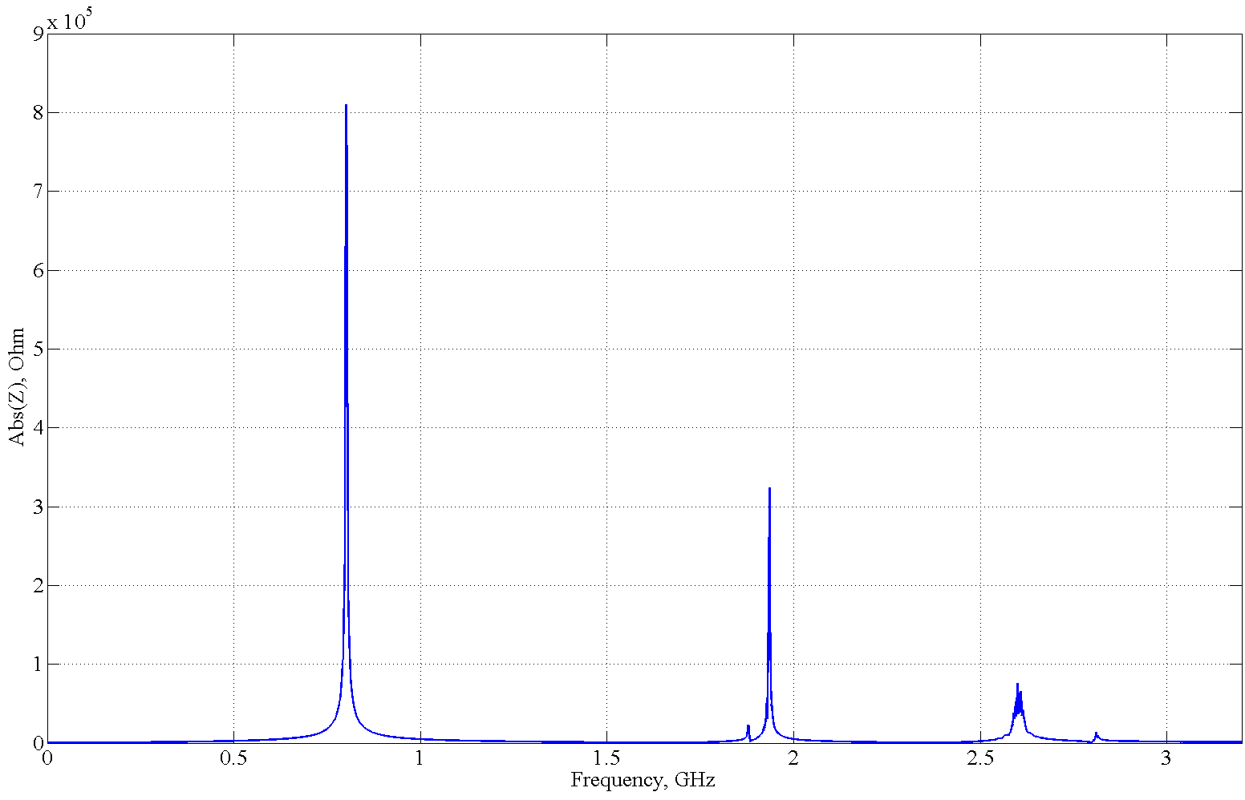
Wakefield simulation
Fundamental mode;
F = 800.8 MHz
Abs(Z) = 809 kOhm
HOM#1
F1 = 1.935 GHz
Abs(Z) = 319 kOhm
HOM#2
F1 = 2.59 GHz
Abs(Z)= 73 kOhm

Slide 16
R/Q simulations
Using the information about the location of longitudinal higher order modes that we’ve got from the wakefield simulation we have computed R/Q values for two modes with frequencies F = 1.9 GHz and F = 2.59 GHz respectively.
All simulations were done in CST MWS using eigenmode solver.

Slide 17
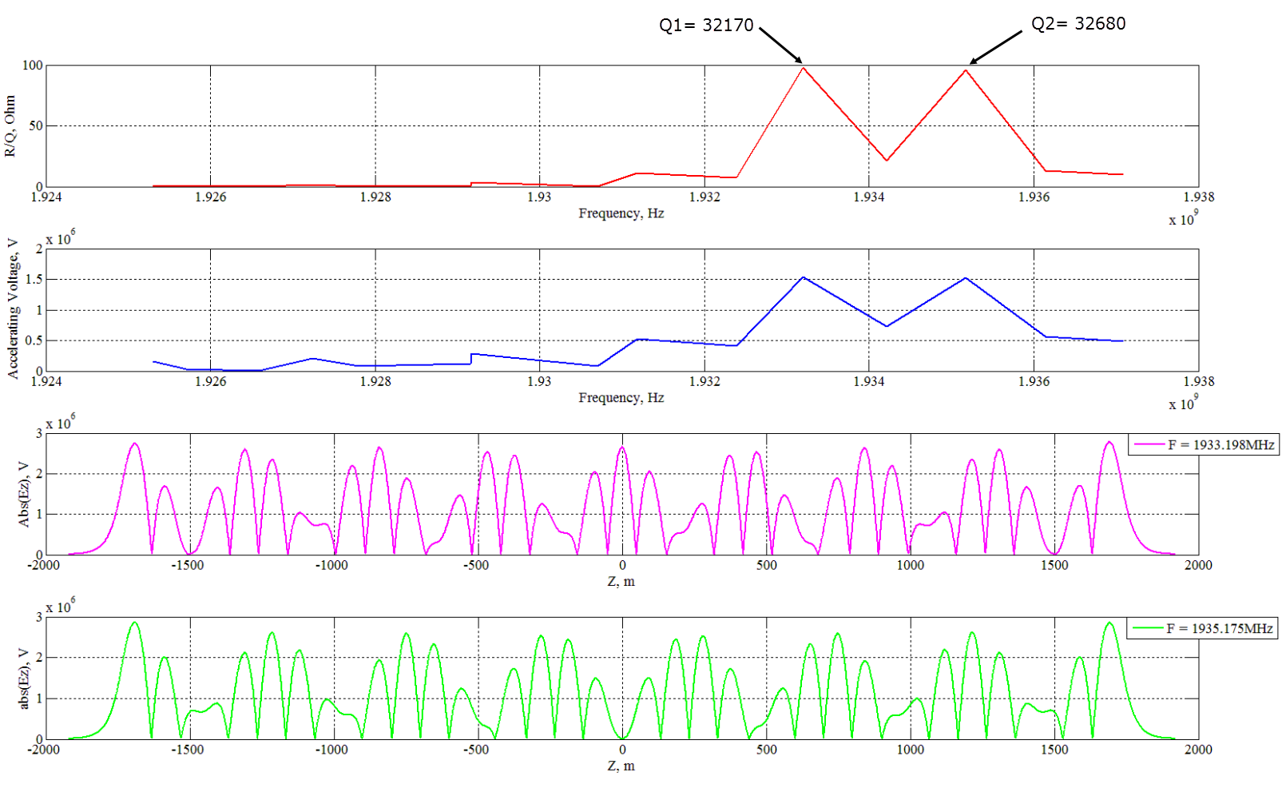
R/Q Simulations – F = 1.9 GHz

Slide 18
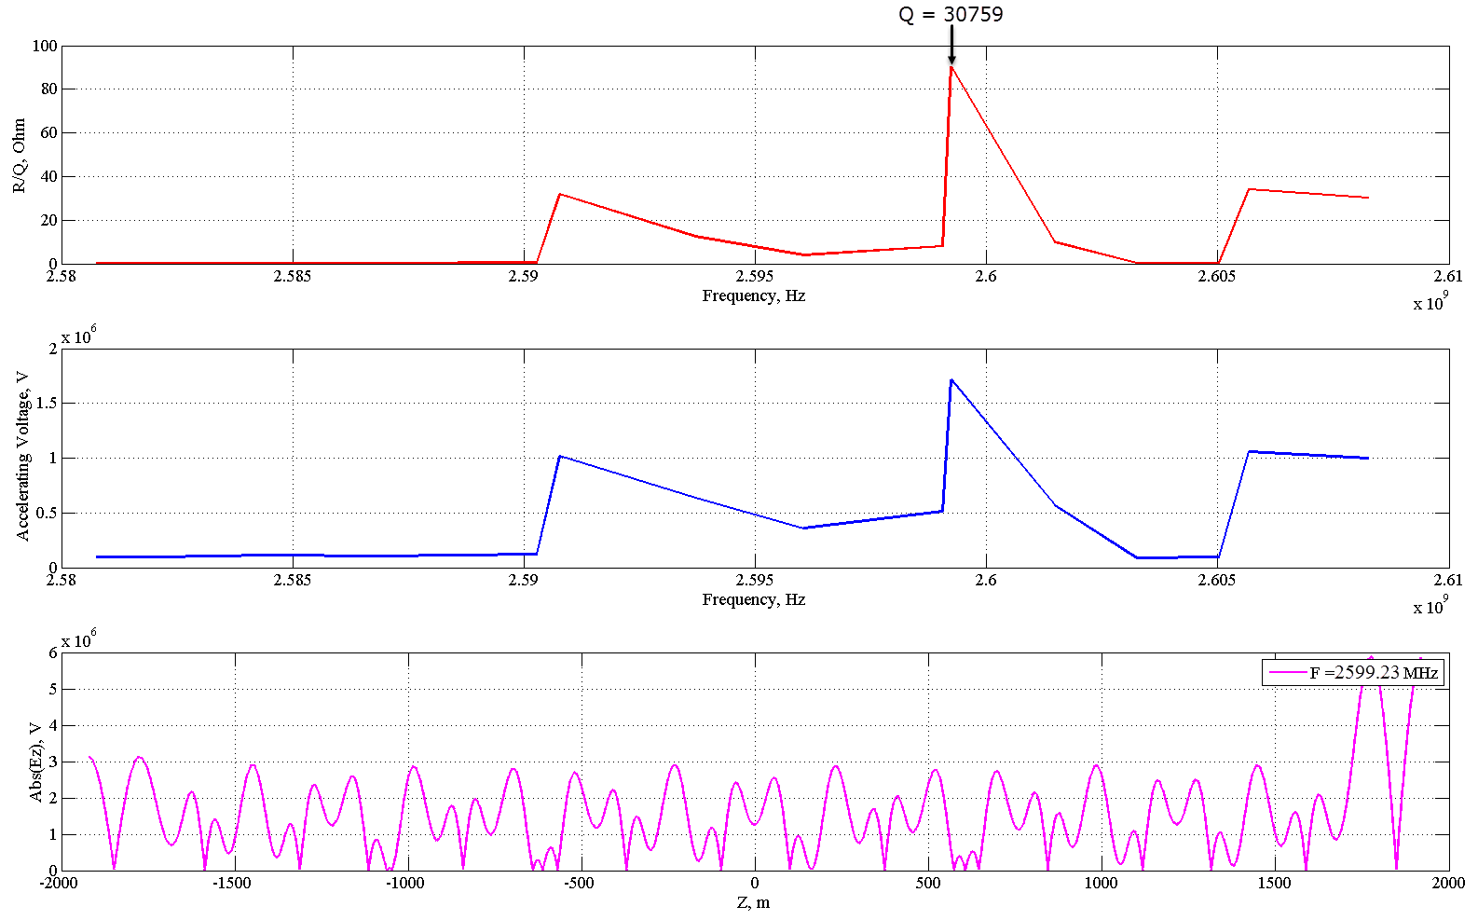
R/Q Simulations – F = 2.59GHz

Slide 19
R/Q - Simulations vs measurements – F = 1.9 GHz
№ | F, GHz | Measured R/Q||, Ohm | Simulated R/Q||, Ohm
1 | 1.9219 | 0.19 | 0.51
2 | 1.9230 | 0.21 | 0.49
3 | 1.9307 | 11.9 | 11.3
4 | 1.9347 | 90.4 | 96.1
5 | 1.9367 | 16.4 | 13.1

Slide 20
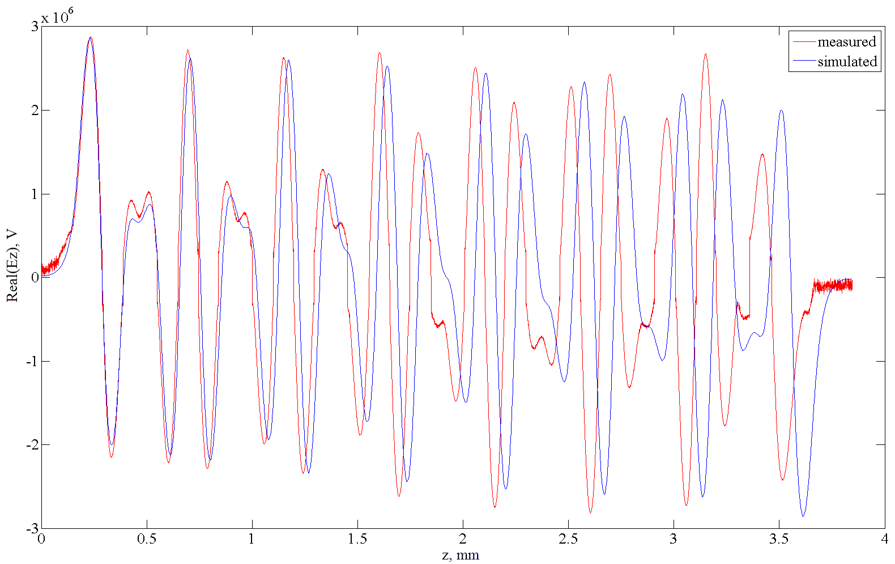
R/Q – simulations vs measurements – 1.9 GHz
F = 1.935 GHz
R/Q sim. = 96.1 Ohm
R/Q meas. = 90.4 Ohm

Slide 21
Conclusion and further work:
Acceleration voltage was computed and measured. The results showed that computed values is in a good agreement with experimental data.
Wakefield simulation show that there is two potentially dangerous longitudinal higher order modes.
Measured and computed values of R/Q are in a good agreement but there is still noise in the measured field profiles. Also the measured field doesn’t completely fit to the simulated one.
Further measurements of HOMs needed (improve signal excitation, etc)
Carry out the measurements of the R/Q for F = 2.59 GHz mode and compare it to computed values.

