Slide 1
Plans for space charge studies
H. Bartosik, G. Rumolo, F. Schmidt

Slide 2
Outline
Studies and conclusions from 2012
Open questions
Measurements 2015 – ongoing studies and plans

Slide 3
Space charge tune scan - horizontal
Machine setup for high brightness 50ns BCMS beam (1 batch of 24 bunches)
  N = 1.95x10¹¹ p/b (at injection)
  ε ~ 1.15μm
  Transmission up to flat top around 94% without scraping (very small losses on flat bottom)
  Combined emittance measurement of 5 shots at the end of flat bottom
  Error bars contain only fit uncertainty
  ΔQ_{x}/ΔQ_{y} ~ 0.10/0.18 (from Laslett formula)
Lossless blow-up of beam core
“no blow-up”
for Q_{x}>20.14

Slide 4
Space charge tune scan - vertical
Machine setup for high brightness 50ns BCMS beam (1 batch of 24 bunches)
  N = 1.95x10¹¹ p/b (at injection)
  ε ~ 1.15μm
  Transmission up to flat top around 94% without scraping (very small losses on flat bottom)
  Combined emittance measurement of 5 shots at the end of flat bottom
  Error bars contain only fit uncertainty
  ΔQ_{x}/ΔQ_{y} ~ 0.10/0.18 (from Laslett formula)
Lossless blow-up of beam core
”no blow-up”
for Q_{y}>20.20

Slide 5
Conclusions from 2012
Due to the long injection plateaus in the production of LHC beams, space charge poses a potential brightness limitation in both the PS and SPS
  The measurements in 2012/13 have shown that injecting a beam with an estimated ΔQ=0.21 can be tolerated on the SPS flat bottom within <10% emittance growth and losses (i.e. the SPS budget) up to flat top
  The present performance limits underlying the LIU parameter tables are based on machine experience (achieved values in operation and MDs)
50 ns beam

Slide 6
Open questions
Can we achieve and preserve the same brightness with 25 ns beams?
  Interplay between space charge and electron cloud effects in particular if we go for scrubbing as e-cloud mitigation
Can we reproduce the experimental observations in simulations?
What is the loss mechanism on the flat bottom
  Is it due to space charge in combination with resonances or is there another mechanism involved
  How do the losses scale with brightness and with intensity
What is the optimal working point for high brightness beams?
  Present operation with Qx=20.13/Qy=20.18 is good for operational beam parameters
Can we cope with even higher beam brightness?
  Maximum tune spread with acceptable losses and emittance growth
  Further explore the maximum tolerable space charge tune spread at 26 GeV/c
  Explore the tune diagram for Q_{y} ≥ 20.25 → are there limiting resonances?
What is the interplay between space charge and coherent effects (TMCI)?

Slide 7
Space charge studies 2015 – ongoing
Measurements of the linear and non-linear machine optics in Q20 (and Q26)
  Natural amplitude detuning without octupole correction
  Correction of amplitude detuning
  Non-linear chromaticity
  Impact of octupole settings on non-linear chromaticity (second order)
Development of simulation tools
  Non-linear optics model of the SPS in MADX-PTC
  Frozen-SC and frozen PIC modules in PTC-pyOrbit
  Space charge modules for pyHEADTAIL (A. Oeftiger)

Slide 8
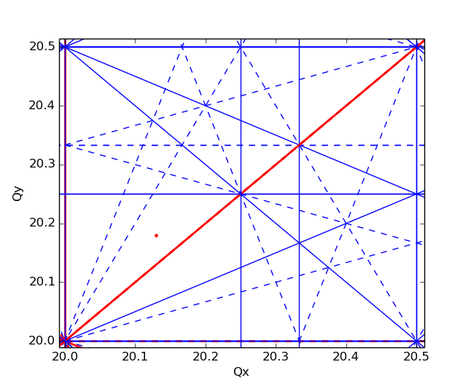
Measurements 2015 - plans
Explore the tune diagram above Qy=20.25
  Is the Qy=20.25 a limitation (e.g. losses)?
  Measure potential emittance growth and losses for a high brightness beam on flat bottom cycle
  Study impact of beam brightness (i.e. similar intensity but different transverse emittance & similar transverse emittance but different intensity) on flat bottom losses and on losses at ramp start
  Use single bunch beams and linear wirescanner (for better transverse profile measurements)

Slide 9
Thank you for your attention!

