Slide 1
Higher order modes in 200 MHz TWC for SPS
Ya. Shashkov

Slide 2
Content
Initial structure
Couplers checking
What was tried

Slide 3
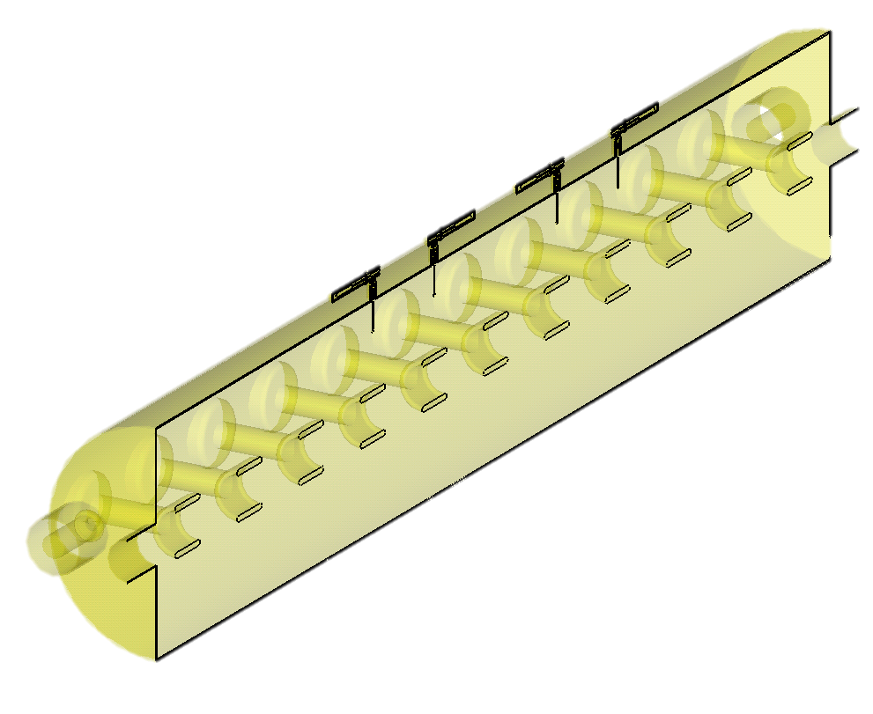
Initial structure

Slide 4
CST parameters that I used
In most of the cases Ht=0 symmetry plane was used
In most of the cases tetrahedral mesh with 300k-400k mesh cells was used. But results have a good convergence already at 100k

Slide 5
Longitudinal R/Q in 11 cells

Slide 6
Qext in initial structure

Slide 7
Modes
628.0 MHz
630.22 MHz

Slide 9
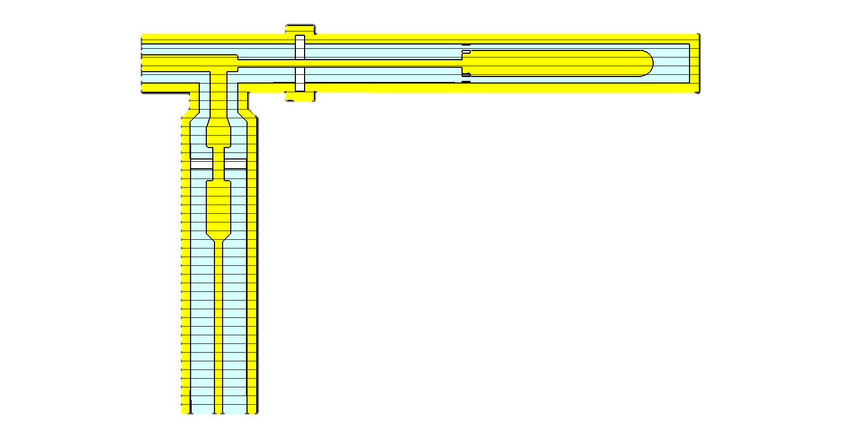
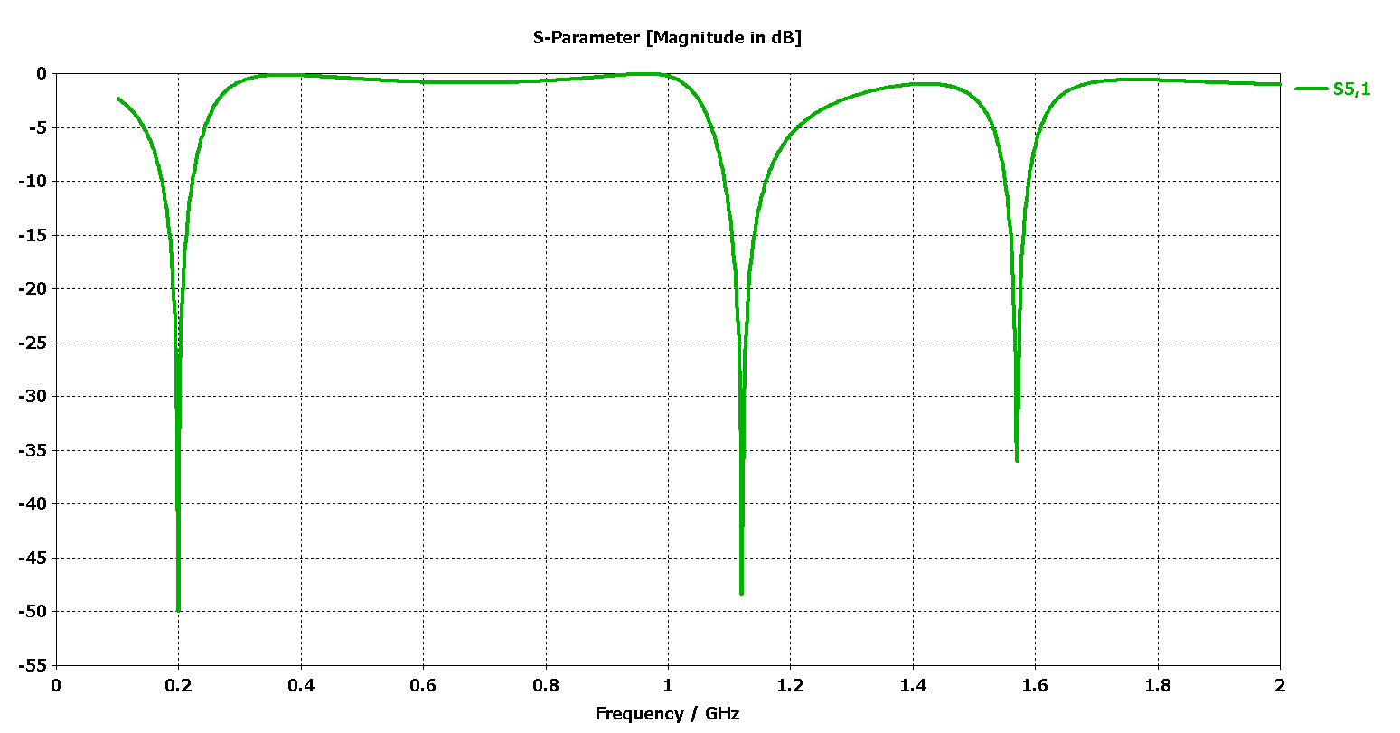

Slide 10
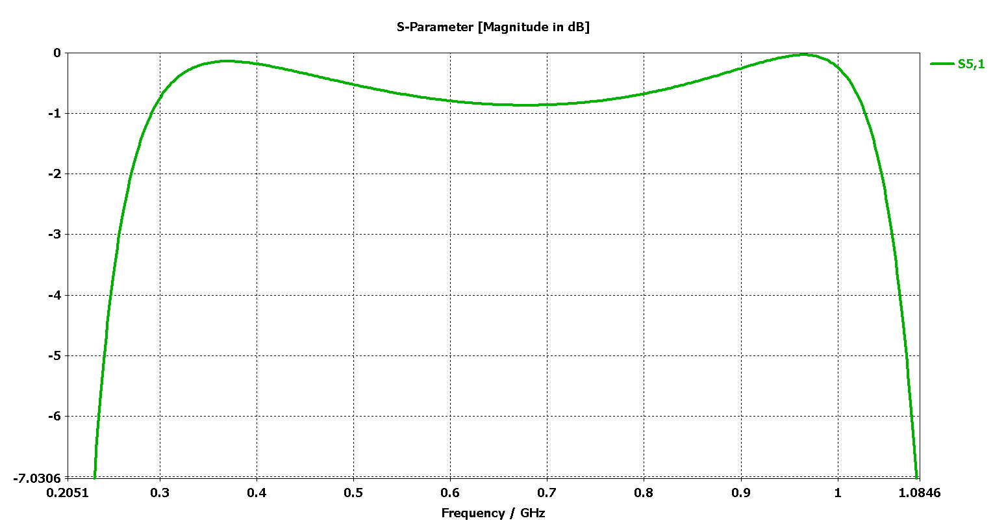
-1 dB means that we have only 10% reflection

Slide 11
Model without couplers

Slide 12
Qext with and without couplers

Slide 13
More couplers

Slide 15
FPC as a damping device

Slide 16
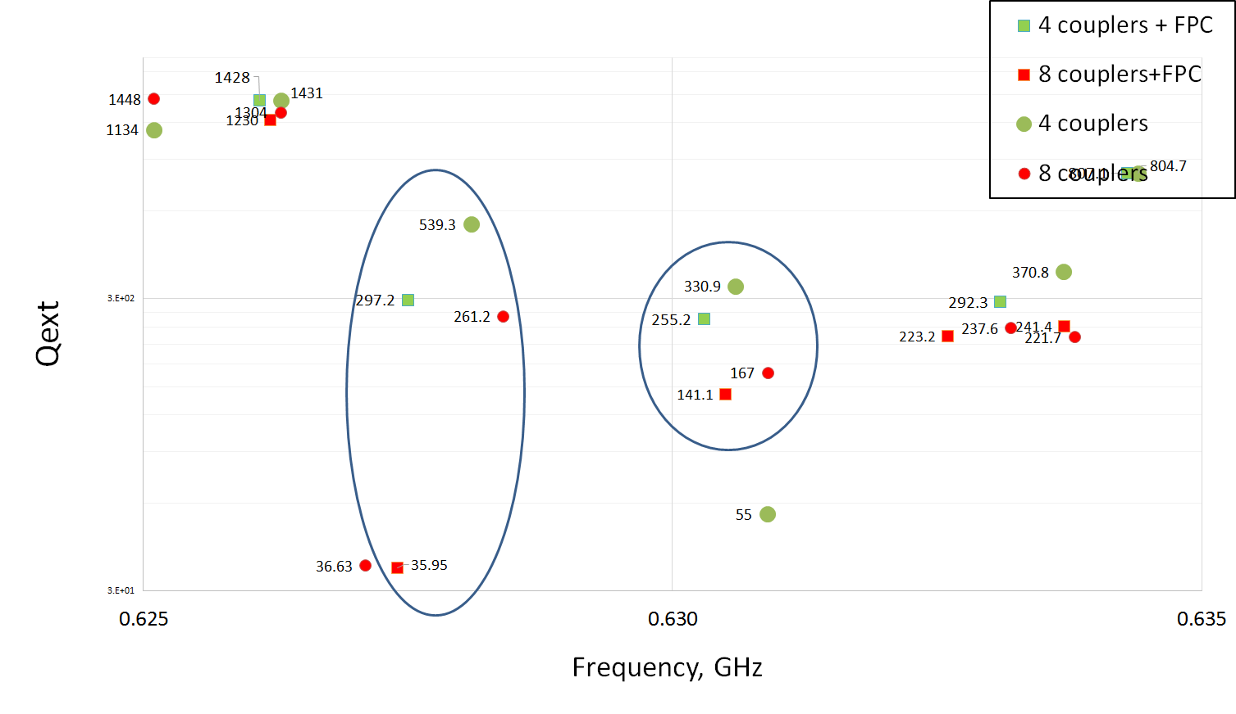

Slide 17
Conclusion
Changing the couplers would not help to reduce Qext
Adding more couplers and using FPC as a damping device can reduce Qext of HOM near 630 MHz about 2.5 times
Further reduction can be challenging

