Slide 1
The SPS Transverse Damper
Status 2015 / Plans 2016
Acknowledgements: BE-RF-FB,
BE-RF-CS,
BE-RF-PM,
BE-OP,
BE-ABP
G. Kotzian for the SPS Damper Team
BE-RF-FB, 03. December 2015 LIU-SPS BD WG
http://paf-spsu.web.cern.ch/paf-spsu/

Slide 2
Outline
Objective:
Have a look at the upgraded SPS Damper,
illustrate few components which have been evaluated in 2015,
and how the damper could be used e.g. for MDs in 2016.
Structure:
Design of the upgraded SPS Damper
Status 2015
Outlook for 2016 (briefly)

Slide 3
Transverse Damper in General
The transverse damper is a feedback system: it measures the bunch-by-bunch oscillations and damps them by fast electrostatic kickers.
BPM
Kicker
5ns Bunches
Active closed loop feedback
Analog
Front
End
Signal
Processing
BBQ
SUM
ADC
DAC
Power Amp
transverse
position
pre-processed
sampled
position
calculated
correction data
correction
signal
drive signal

Slide 4
SPS Damper Loops
pLHC
RF Frontend
200 MHz
ADC1
BeamPos1
DSPU1
DAC1
Switch M1
Damper Signal Selector
pLHC
BeamPos2
DSPU2
Switch M2
ADC2
DAC2
pLHC
cfv-ba2-alltrdamp[hv]1
SPS Damper Loops
pFT
Baseband Frontend
ADC1
BeamPos1
DSPU1
DAC1
pFT
ADC2
BeamPos2
DSPU2
DAC2
pFT
from BBQ
SPS Damper Loops
Ions
RF Frontend
200 MHz FSK
ADC1
BeamPos1
DSPU1
DAC1
Ions
ADC2
BeamPos2
DSPU2
DAC2
Ions
cfv-ba2-alltrdamp[hv]2
from VNA
SPS Damper Loops
Scrub
Baseband Frontend
(40 MHz)
ADC1
BeamPos1
DSPU1
DAC1
Scrub
from VNA
ADC2
BeamPos2
DSPU2
DAC2
Scrub
Stripline pickup
processing
BPM
Proc.
BPM
Proc.
pLHC,
Scrub
Ions
PLC1
PLC2
200 W
Driver
200 W
Driver
LLRF MODULES:
6 commissioned
2 Experimental
2 Ions (to do)
SURFACE BA2
TUNNEL LSS2
pFT
Damper Power System
Electrostatic PU processing
BW ~100MHz
BPM
Proc.
BPM
Proc.
Final
Stage
Final
Stage
POWER:
Excellent availability during 2015!
BEAM
PU1
PU2
KICKER1
KICKER2

Slide 5
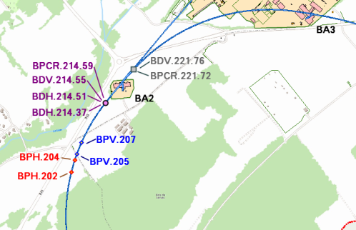
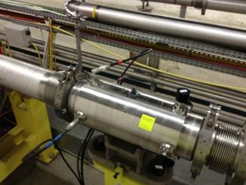
6x Beam Position Monitors installed in LS1
2 BPCR (H/V) for LHC type beams
(couplers maximum Z_{T} @ 200 MHz)
2 BPH electrostatic PU (pFT)
2 BPV electrostatic PU (pFT)
RF Faraday cage
SPS Transverse FB
BPCR.221
all BPMs re-cabled with 7/8-inch smooth wall coaxial cables during LS1; [length ~250..700m]
BPH/BPV: electronics and amplifiers in the tunnel tested and verified; "hot-spares" readily checked and kept in the tunnel
BDH / BDV kickers unchanged
BPH/BPV electronics
(in pits right below the BPMS)
are extremely robust.
Very reliable also during operation 2015.

Slide 6
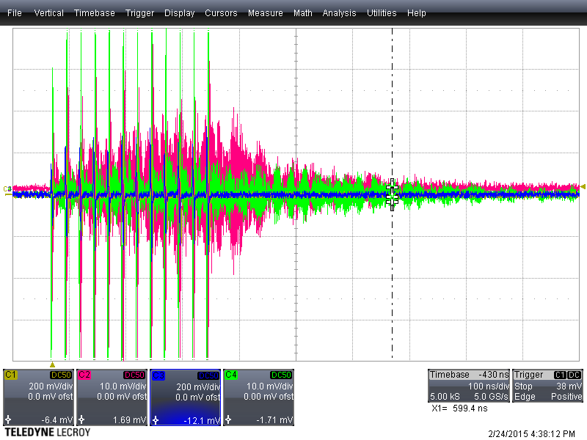
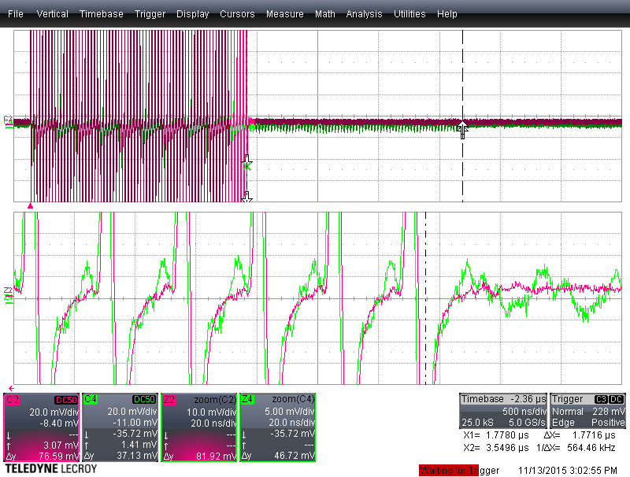
BPCR Stripline Pickups
Build-up during beam passage
(A) BPCR.214 at FT, 12 bunches.
Raw DELTA signal reveals frequencies > 1 GHz being picked up.
Decay ~ 100 ns
BPCR.221
CH1: SUM-H
CH2: DELTA-H
CH3: SUM-V
CH4: DELTA-V
“ECHO”
≈1.77 µs
CH2: SUM
CH4: DELTA
(B) BPCR.221.V shows “echo”
after beam passage.
Lasts for ~1.77 us
Appears to not depend on transverse position
discovered 2014/11/08 (origin unclear, tunnel inspection foreseen)

Slide 7
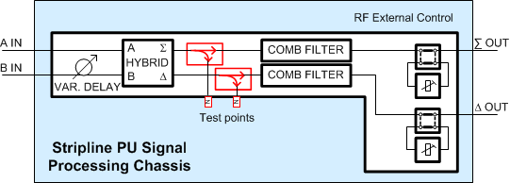
Analog Frontend Control / External Control
Two analog frontend types:
  RF frontend, used for pLHC and Ions,
  LO = 200 MHz, I/Q components
  Baseband frontend (BB),
  used for pFT and Scrub, only I-component
External control:
  Input termination / attenuation / amplifier
  Hardware missing for Ions (foreseen 2016)
Input gain control: RF frontend
  RF: switching attenuators + amp, delay matched
  Large dynamic range: -39 dB to + 20 dB = 59 dB
Input gain control: BB frontend
  BB: variable gain amplifier (VGA)
  Large dynamic range: -27.4 dB to + 26 dB = 53.4 dB
  Signal levels between VGA and ADC not inline
  Patching of signal levels required → saturation+noise
LO 200 MHz
120 MHz
120 MHz
RF frontend schematic

Slide 8
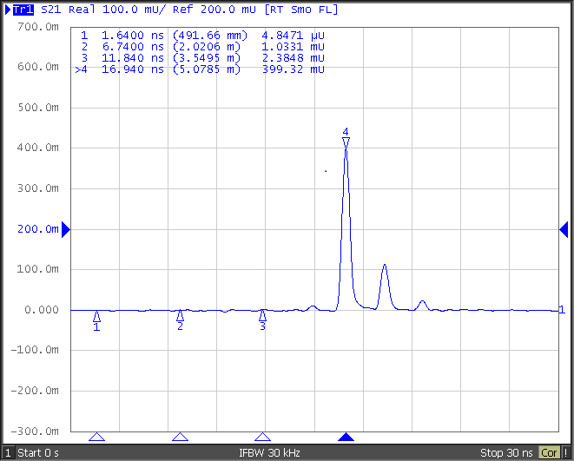
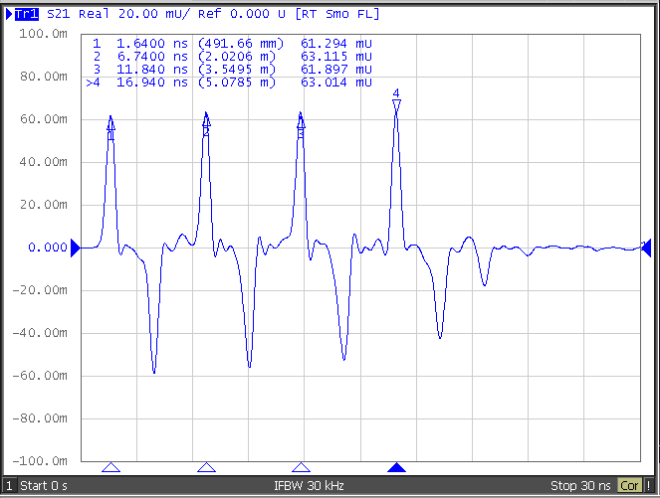
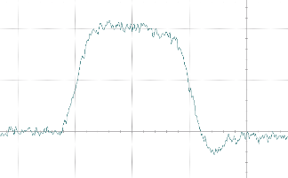
200 MHz Comb Filter
THRU line of stripline coupler picks up “ECHOs”
Affecting SCRUB Frontend
Spoiling pLHC response (200 MHz)
5 ns
Response not flat
➔ Baseband pulse distorted
25 ns
Undershoot (cross-talk)

Slide 9
Beam Position Block (BeamPos)
2 BeamPos Blocks per damper loops module
= one per pick-up input
I/Q inputs of SUM and DELTA signals
  in ADC sampling clock domain,
  hence subject to delay adjustment
CoRe – Conditioning and Resampling
  I/Q phase rotation
  Down sampling: 120 MSPS → 40 MSPS (25ns bunch sync)
  Combining 3 samples for one position signal
  → sampling delay problematic already at 200 MHz
Normalization
  position calculation (in-phase)
  “quadrature position” indicating head-tail activity
  bypass mode in case of DELTA processing (pFT)

Slide 10
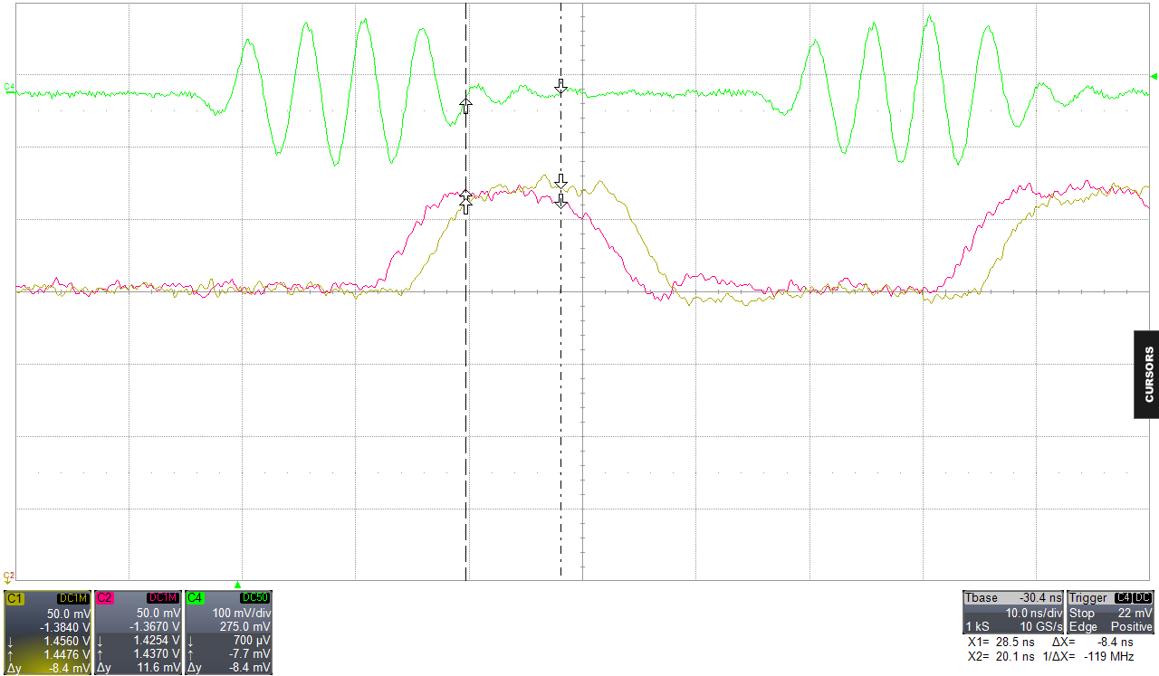
Analog I/Q inputs of SUM and DELTA
Bunch n-1
Bunch n
Bunch n+1
SAMPLING POINTS
Skew between I and Q signals
Time lag beween I/Q up to 3.5 ns
Depending on phase of LO phase

Slide 11
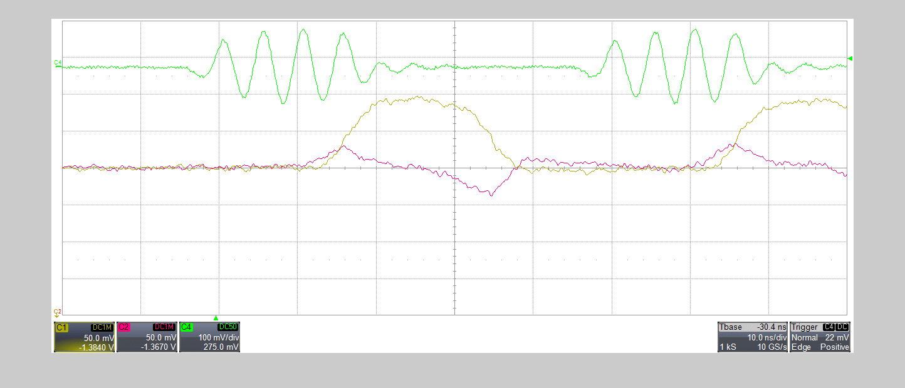
Analog I/Q inputs of SUM and DELTA
Skew between I and Q signals
Time lag beween I/Q up to 3.5 ns
Depending on phase of LO phase

Slide 12
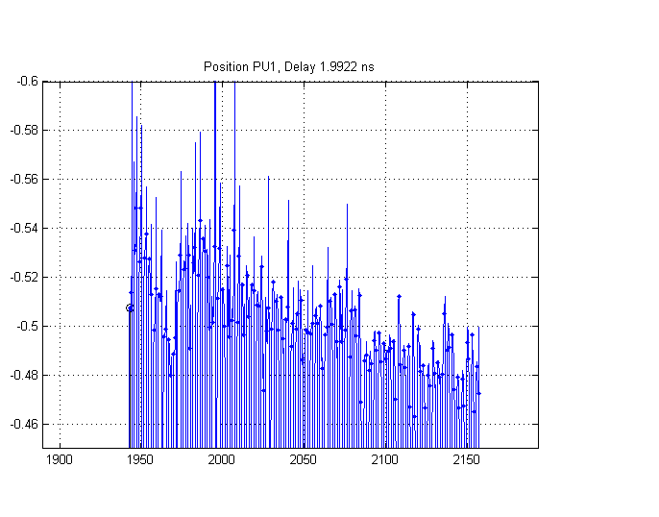
Transverse Position
pLHC module (200 MHz analog frontend)
batch of 72 bunches, nominal intensity
Aquired after decay of injection oscillations → bare orbit = transverse offset (DC)
Slope → bunches towards the end of a batch appear on ‘different orbit’
Implications on damping?
Potential solution: use direct sampling, also for
200 MHz input – first tests with beam affirmative …

Slide 13
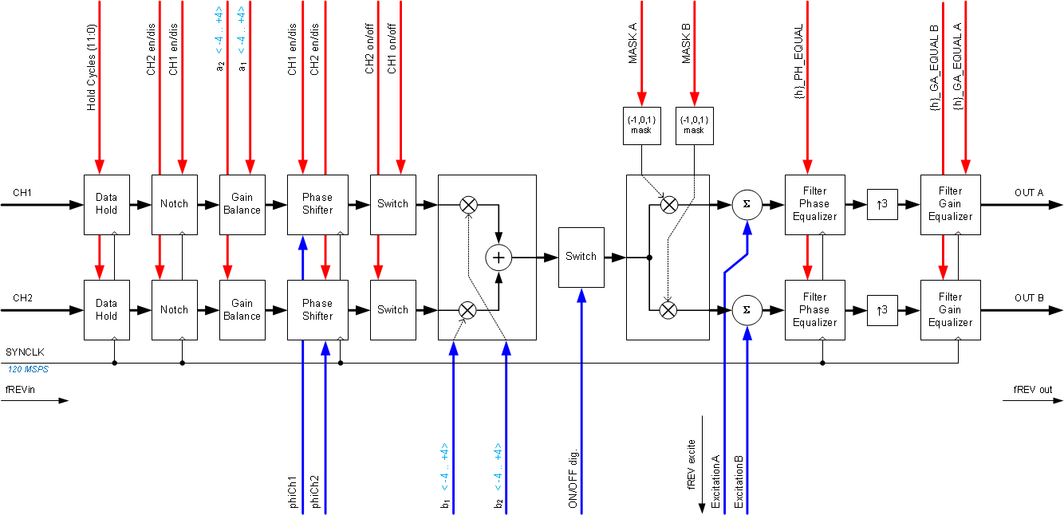
DSPU – Digital Signal Processing Unit
Control signals (FESA):
Functions (from RFFG)
Excitation input (DDS)

Slide 14
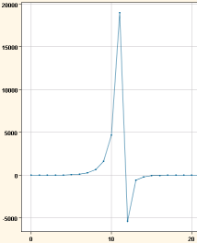
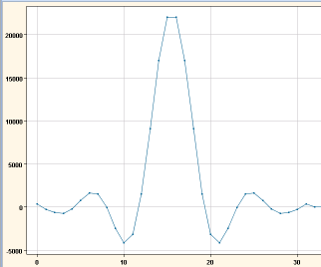
DSPU – Digital Signal Processing Unit
phase equalizer FIR, comp. 1st order 4.5 MHz
2 DSPUs per damper; one per module; two inputs
Signal processing
  phase equalizer FIR (up to 64 taps), linearize phase of power system
  ≈ low pass 1st order, cutoff freq. (-3dB) @ 4.5 MHz
  operated at 40 MSPS → better resolution at lower frequencies
  gain equalizer (up to 64 taps), digital low pass shaping output signal
  operated at 120 MSPS
Recently …
  Flat phase equalizer FIR and
  Flat gain equalizer FIR
digital low pass,
fc > 20 MHz

Slide 15
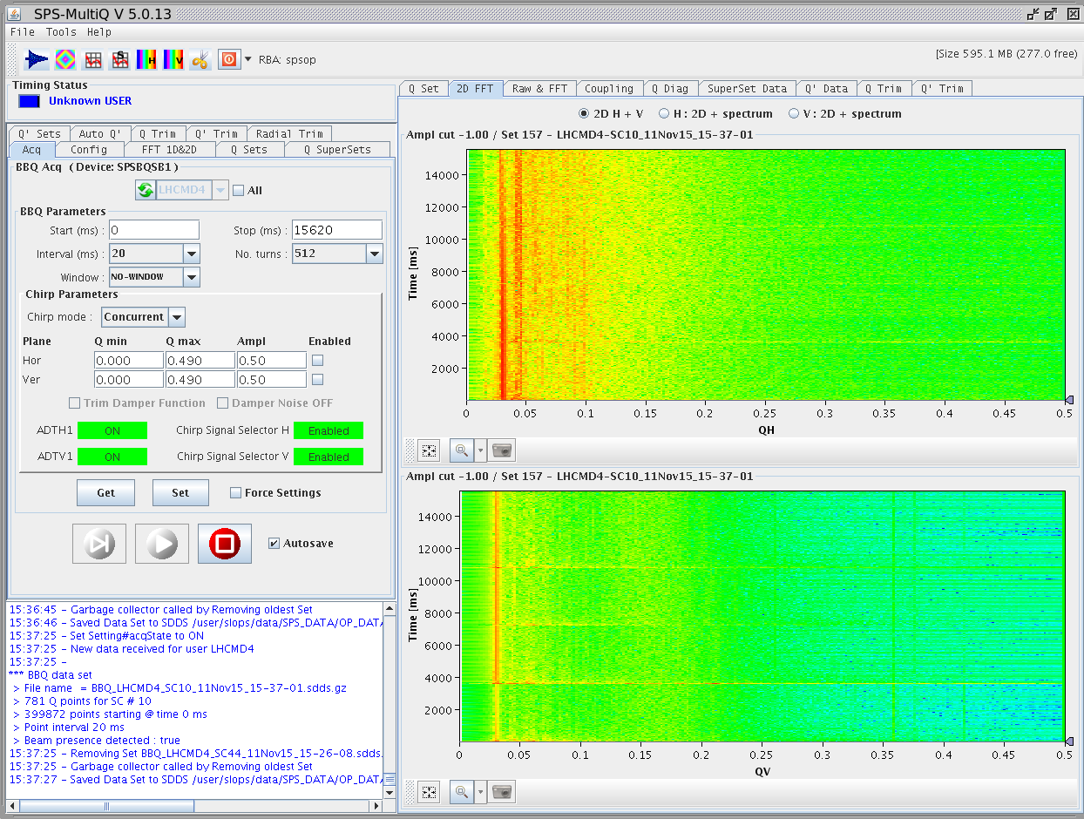
2015-11-11
http://elogbook.cern.ch/eLogbook/event_viewer.jsp?eventId=2039845
“Dampers are happily running at maximum bandwidth […].
Current modules: DamperLoop_H_pLHC and DamperLoop_V_pLHC”
NB: tunes are at
Qh = 0.13
Qv = 0.18
  For discussion:
  Flat phase equalizer FIR and
  Flat gain equalizer FIR

Slide 16
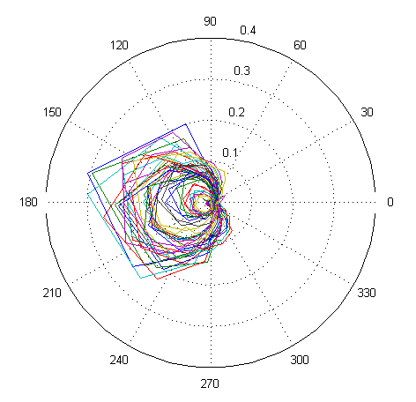
Semi-Auto Parameter Extraction
Open loop response (polar):
basis is the classical method with VNA(s)
  automation with scripts
  automatic data collection
Measure OL 1 MHz to 20 MHz
  (here: Meas39, BPCR.221.V → V2)
  20 sweeps x SC period … 15-30 min
Post-processing allows parameters to be extracted, e.g.
  Phase advance PU → Kicker
  Feedback COARSE + FINE delay
  Tune
  Loop phase response
PRELIMINARY
(Meas39 - 2015/11/04)

Slide 17
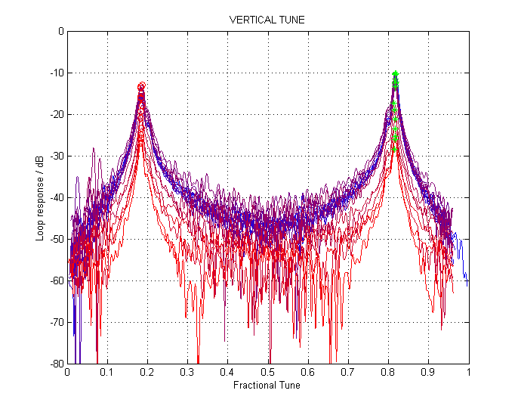
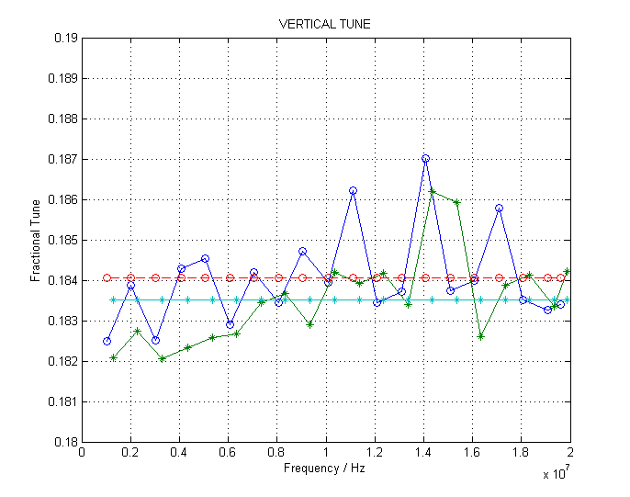
Fractional Tune
Open loop response (mag):
Open loop response (mag):
Overlay of 20 measurements:
from 1 MHz to 20 MHz
Feature extraction:
blue = q
green = (1-q)
PRELIMINARY
(Meas39 - 2015/11/04)

Slide 18
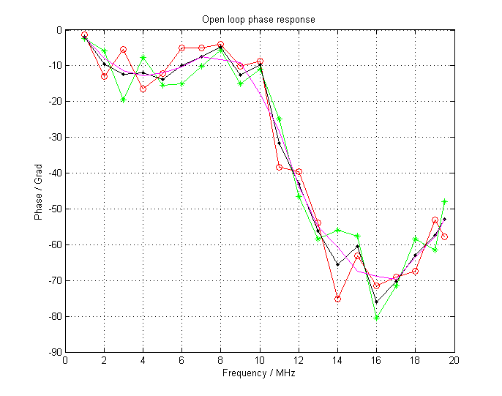
Loop Phase Response
NB:
The Power system is considered to have a
1st order low-pass characteristic,
with cutoff-frequency 4.5 MHz (=45 Grad)
… for discussion
4.5 MHz
PRELIMINARY

Slide 19
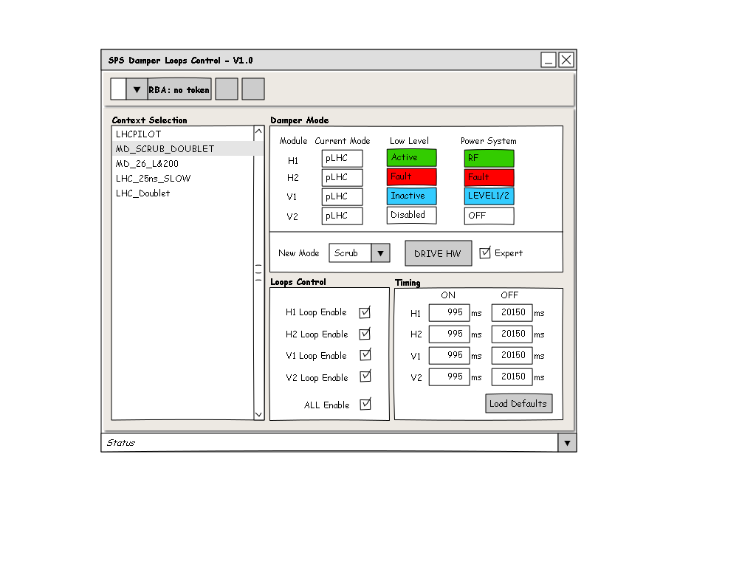
USER INTERFACE
GUI in JAVA
  talks to LSA (set parameters) and FESA (read back)
  loads settings to LSA for 1 active damper (sets others to “safe settings”)
  display status and monitoring
  trimming of feedback parameters (in LSA, with history)
  store/recall reference settings
  import/export damper settings to file (consistent snapshot, e.g. for/during MDs)
“RESTORE TO
DEFAULT SETTINGS”

Slide 20
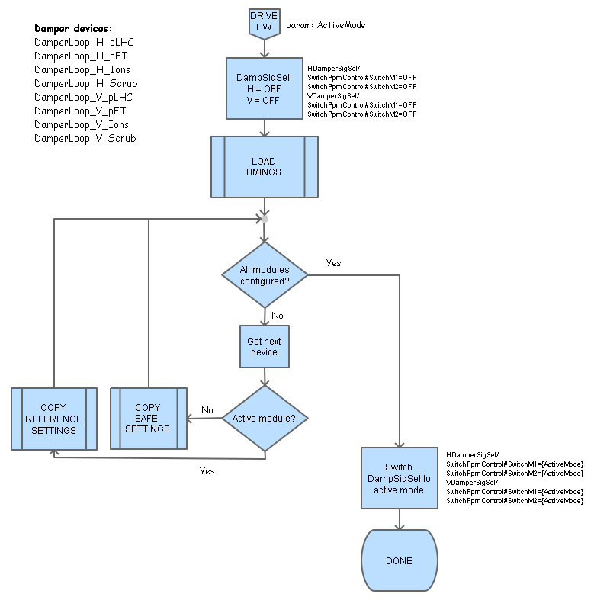
Drive Sequence
Copy REFERNCE settings
to active modules
Load SAVE settings
to inactive modules

Slide 21
Status 2015
  Signal processing Modules, aka. DamperLoops:
    6 commissioned
    2 Experimental
    2 Ions modules, in preparation for 2016
  Damper Power system
    Excellent availability during 2015
    Special thanks to colleagues from RF-PM!
  Pickup Signal processing
    Electronics in the tunnel extremely robust & very reliable
    Performance of analog signal processing chain under evaluation
  Observation Box
    Prototyping: server installed, signalling already running with test crate
  First MD studies on damper performance evaluation
  … running also for Ions (using pLHC temporarily)

Slide 22
Plans for 2016
  Evaluating concepts for improvements of the damping performance
    different implementations for phase shift filters
    adaptive feedback control
    test a novel damping algorithm
    bunch extrapolation (single bunches, ions), beam gap interpolation (in between batches)
  Develop methods to facilitate loop diagnostics
    loop information indispensable during commissioning and for setting-up
    easy-to-use repeatable measurements: allows re-qualification of settings/parameters → handy e.g. for cycle generation
    review potential for per-bunch head/tail activity monitoring
    (test with wideband feedback)
  exploitation of new features
    real bunch-by-bunch damper (in view of crab cavity tests)
    adding a DDS allows for built-in-network analysis
    controlled emittance blow-up, beam cleaning, and bunch shaping using transverse excitation signals

Slide 23
Feedback performance evaluation with different phase shift filters
Objective: study different implementations of phase shift filters
Goal: make feedback phase-insensitive to tune variations
Notch, 1T delay, phase rotation
Phase compensation for sidebands

Slide 24
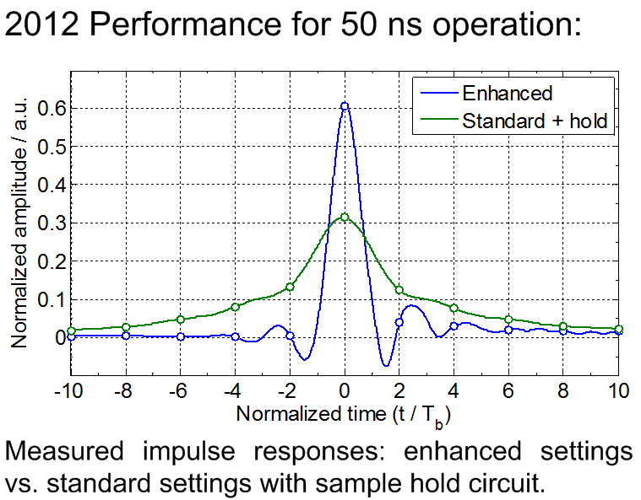
Real bunch-by-bunch damper based on feedback gain equalization
Objective: shaping the time-domain response to generate individual kicks per-bunch, requires feedback gain equalization/gain levelling
LHC case → see W. Hofle, “PERFORMANCE OF THE LHC TRANSVERSE DAMPER WITH BUNCH TRAINS,” WEPME043 - IPAC’13.
Useful for crab cavity tests
Individual bunch blow-up (in coast)
Fully linearized system
LHC ADT

Slide 25
THANK YOU
Questions?

