Slide 1
Momentum slip-stacking of the nominal I-LHC beam in the SPS Particle simulations (preliminary)
T. Argyropoulos, E. Shaposhnikova
LIU-SPS BD WG 30/01/2014

Slide 2
History
Previous studies in the SPS to increase bunch intensity:
Protons: D. Boussard and Y. Mizumachi. Production of beams with high line-density by azimuthal combination of bunches in a synchrotron. IEEE Trans. Nucl. Sci. Vol. NS-26 No. 3, 3623, June 1979.
Ions: T. Linnecar. Azimuthal combination - slip stacking. Slides, SLI Meeting 2001-10-11, CERN.
2013 proposal (R. Garoby): Interpose two super batches of the nominal I-LHC Beam (100 ns bunch spacing)→beam of 50 ns bunch spacing.
Same way of implementation

Slide 3
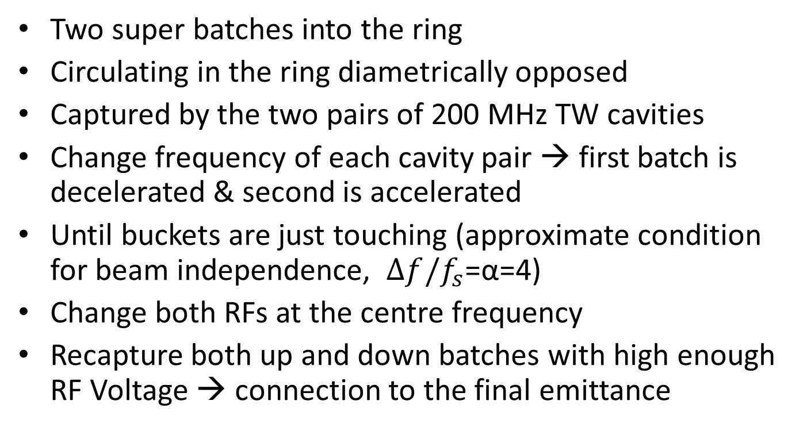
Slip-stacking procedure
Two super batches into the ring
Circulating in the ring diametrically opposed
Captured by the two pairs of 200 MHz TW cavities
Change frequency of each cavity pair → first batch is decelerated & second is accelerated
Until buckets are just touching (approximate condition for beam independence, $Δf/f_{s}$=α=4)
Change both RFs at the centre frequency
Recapture both up and down batches with high enough RF Voltage → connection to the final emittance

Slide 4
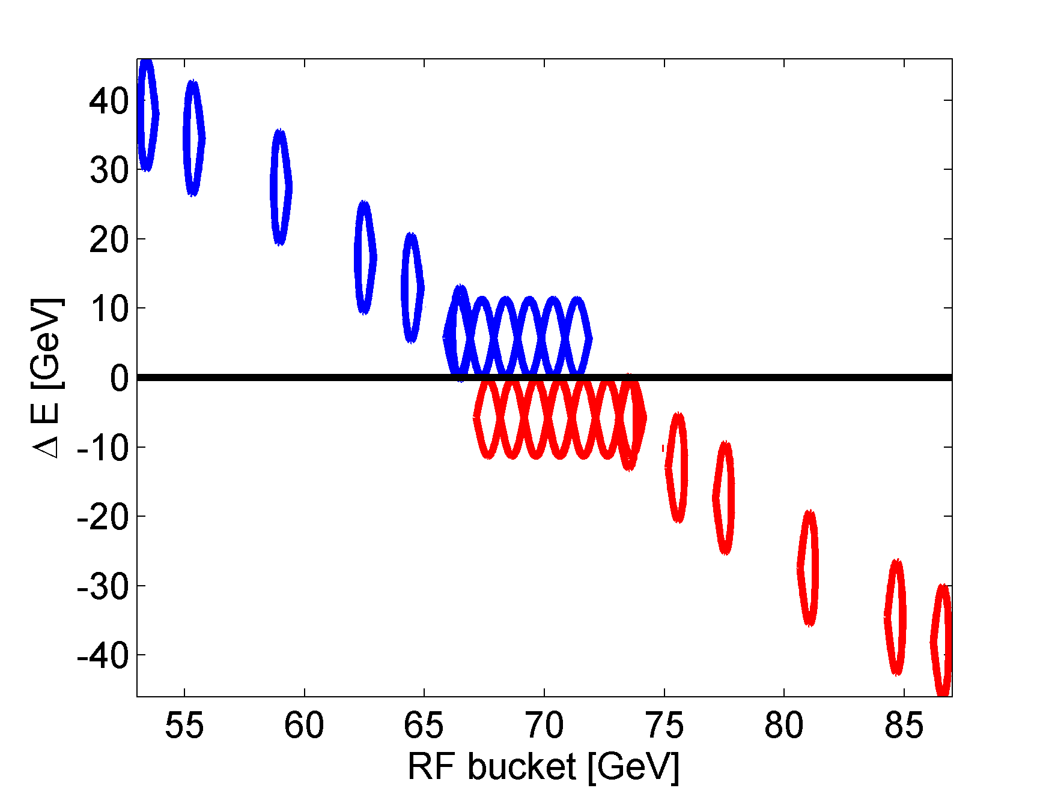
Slip-stacking procedure
Buckets do not interact in that case
In reality we need α>5 for both batches to slide without emittance blow-up
Simulations are focused on the last part –recapture of the batches

Slide 5
Slip-stacking parameters
Based on: T. Bohl, Note-2013-26
Flat bottom: not studied here
large recapture voltage needed
influence of RF noise, IBS and space charge (observed under present operational conditions)

Slide 6
Slip-stacking parameters
Flat top (450 GeV/c):
Longitudinal emittance: ε_{L} = 0.125 eVs/A
Initial RF Voltage: VRF = 0.225 MV (filling factor of 0.9)
momentum separation: dp/p=2x10⁻³
min. dist. of mean radial pos: ΔR = 6.8 mm
Simulations were performed for the last part→ bring the batches back starting from the maximum distance
from the central orbit

Slide 7
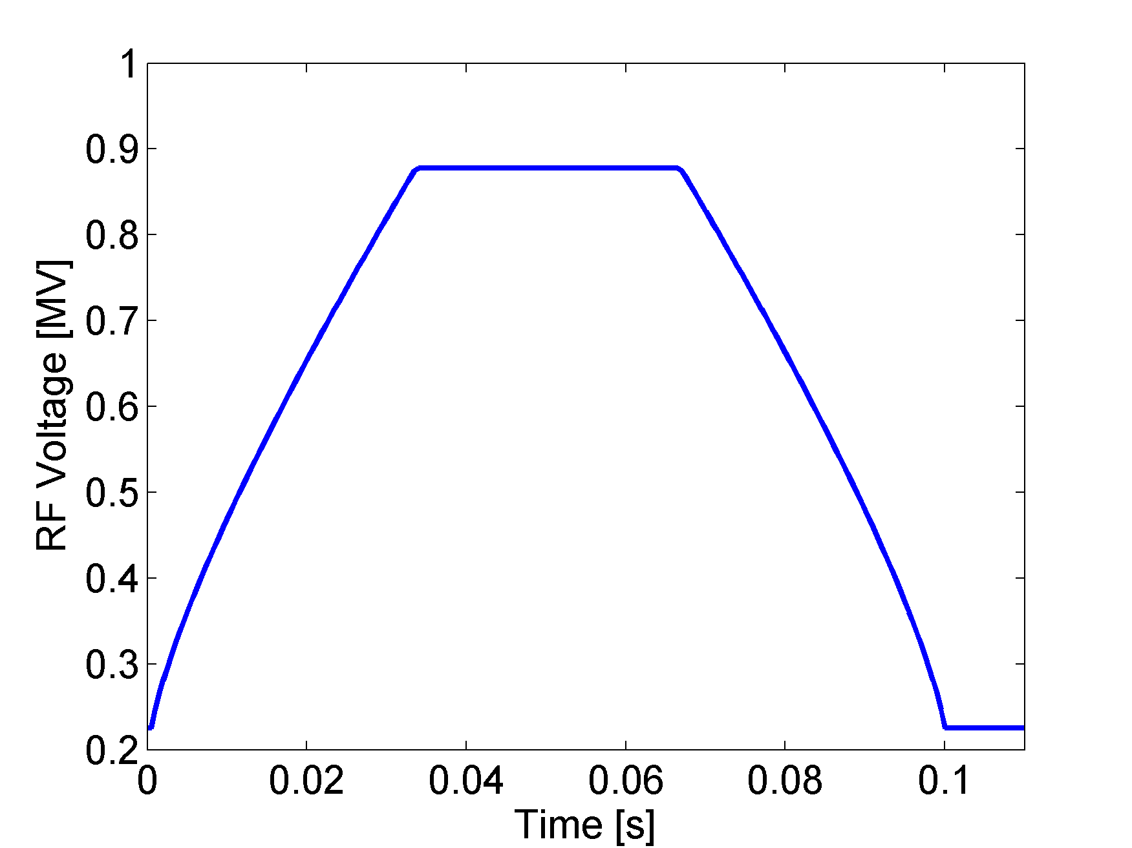
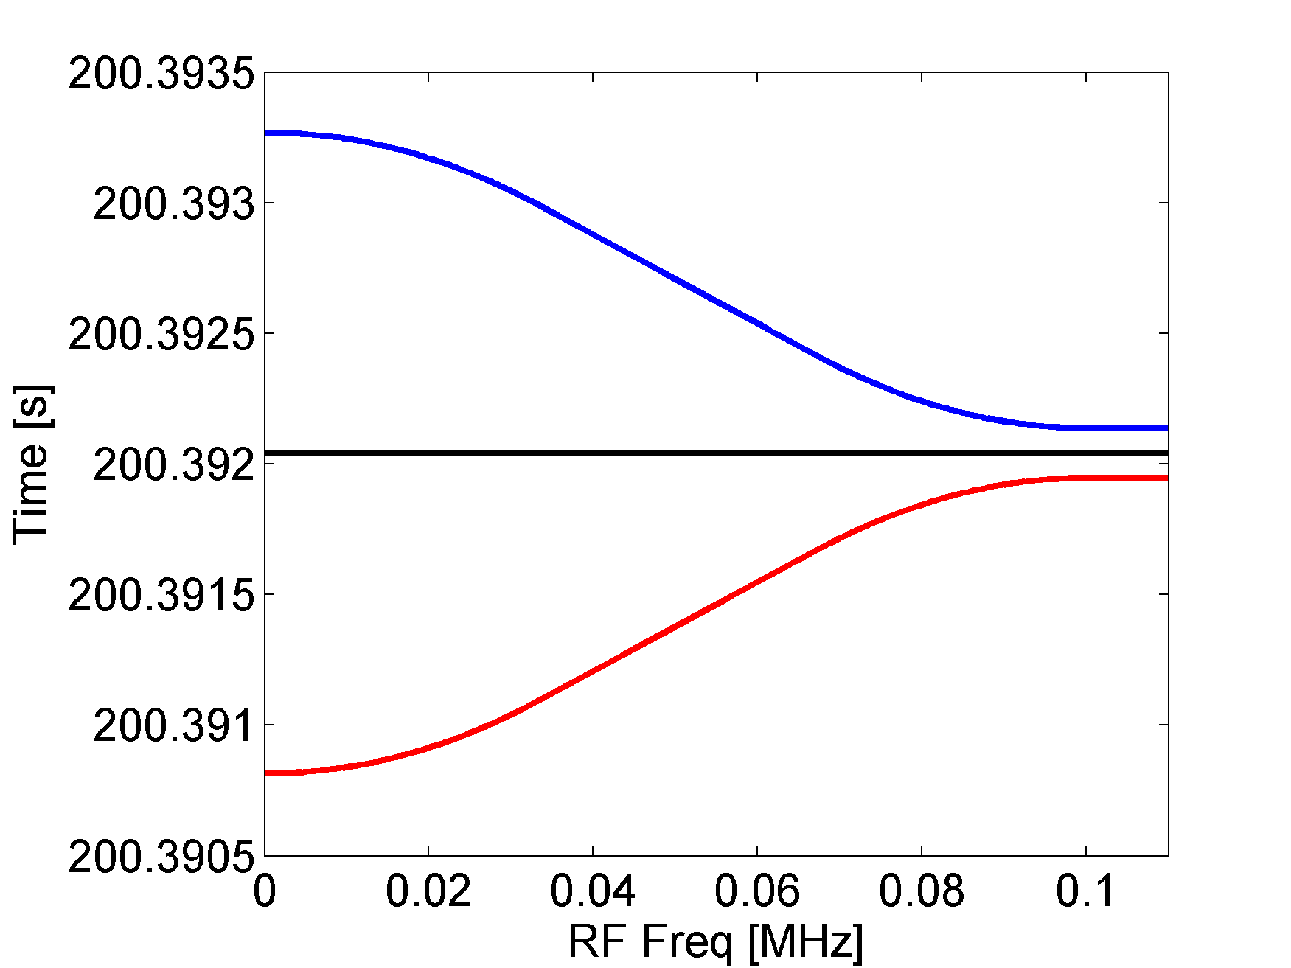
Designed RF programs
Programs calculated for a single RF for constant bucket area

Slide 8
Varying parameters
Δf_{RF}
Time of the cycle, T_{cycle}
Time of recapture
V_{RF} recapture
Δf_{RF}
T_{cycle}

Slide 9
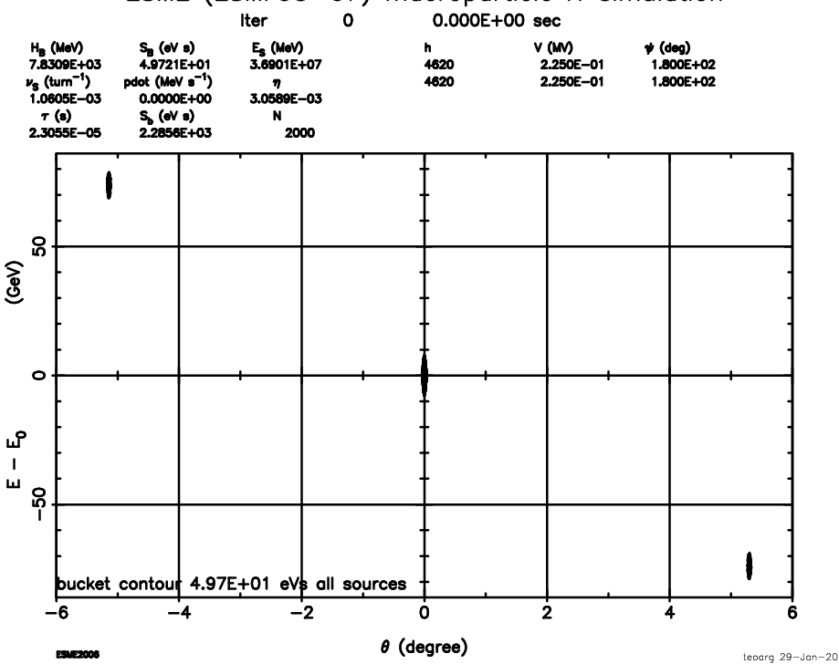
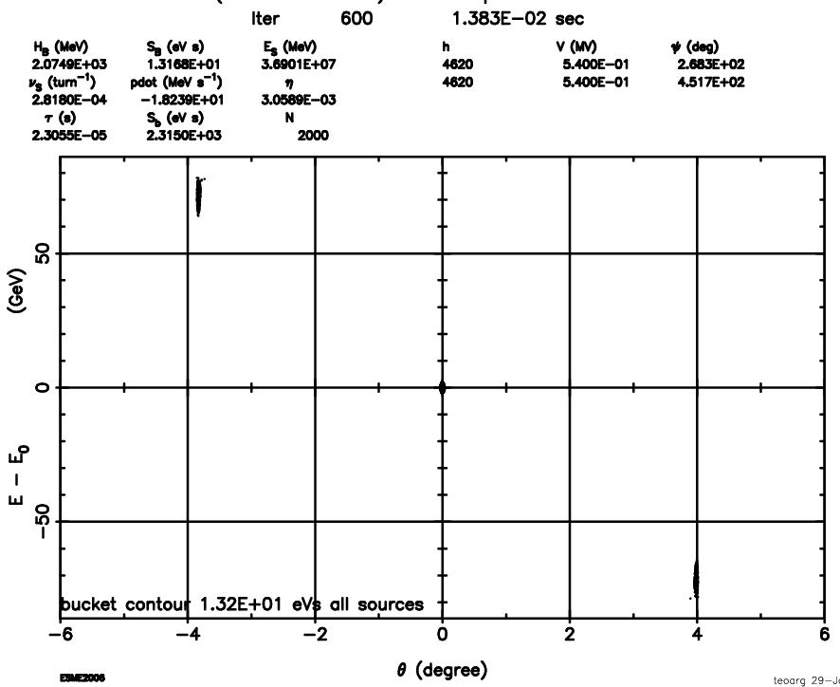
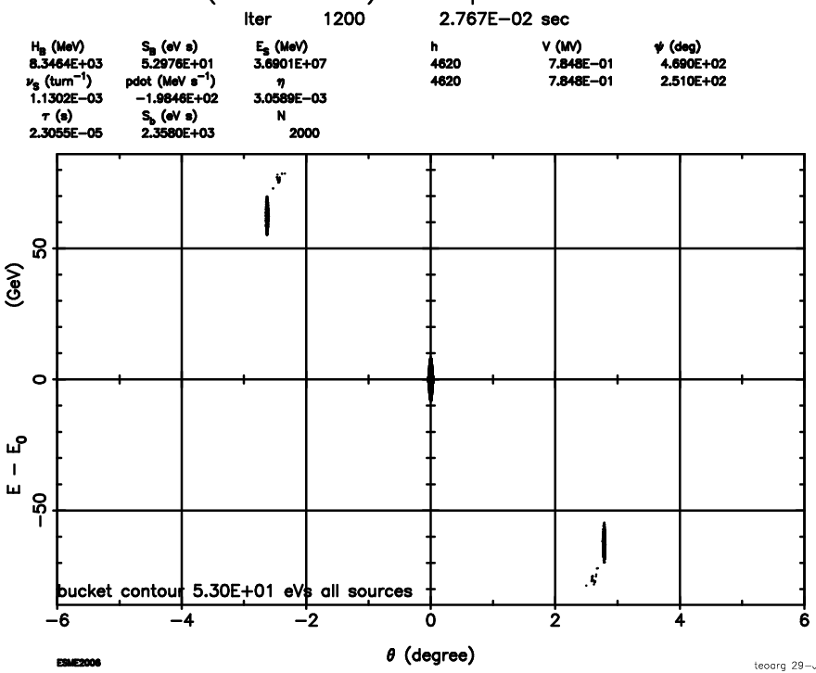
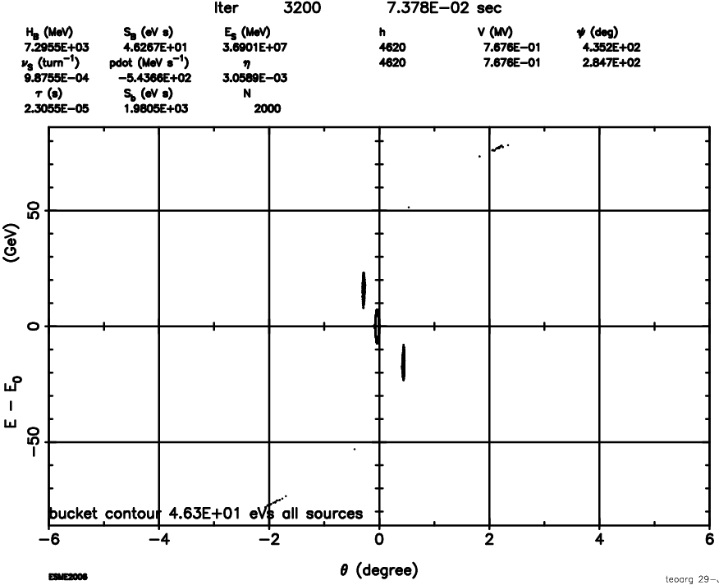
Example Δf_{RF} = 4f_{s}
Initial losses (~2 %) can be possibly eliminated

Slide 10
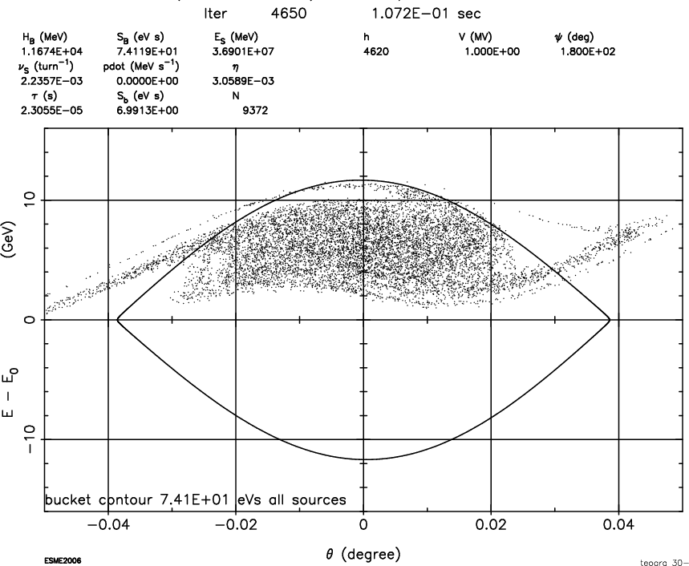
Example Δf_{RF} = 4f_{s}
ε_{L} = 0.3 eVs/A
Losses = 10 %
Decreasing VRF = 0.7 MV
ε_{L} = 0.29 eVs/A
Losses = 15 %

Slide 11
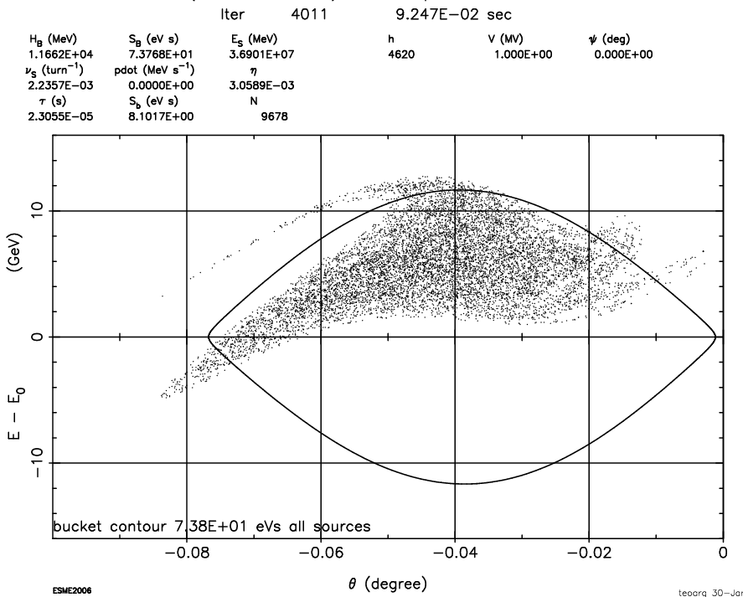
Δf_{RF} < 4f_{s}
ε_{L} = 0.3 eVs/A
Losses = 7 %
Decreasing VRF = 0.7 MV
ε_{L} = 0.28 eVs/A
Losses = 12-15 %
For Δf_{RF} > 4f_{s} we don’t gain in intensity but more emittance blow-up

Slide 12
Increasing Tcycle
Increasing the total time reduces the losses by ~ 20 %
And also the final ε_{L} can be reduced by a ~5%
More time is still needed for fine tuning

Slide 13
Summury
Time required for manipulations: ~ 1.0 s t_{tot} = 0.45 s (slipping) + 0.2 s (up-down) +0.35 s (filamentation)
(maybe more time will be needed, +0.2 s ?)
Beam parameters: losses >7%, emittance blow-up by ~ factor 2.5 => OK for extraction to LHC after 200 MHz upgrade in the SPS (or 200 MHz in LHC)
Further optimization is needed!

