Slide 1
Simulations of the synchrotron frequency shift
A. Lasheen
Acknowledgements : E. Shaposhnikova, T. Argyropoulos, H. Timko
LIU-SPS BD WG Meeting 27/03/2014

Slide 2
Outline
Introduction
Measurements
Simulations
Impedance model
Quadrupolar frequency shift as a function of bunch length
Estimation of the missing imaginary impedance
Conclusion

Slide 3
Introduction
Synchrotron frequency shift with intensity is used as a reference measurement of low frequency inductive impedance of the ring.
Measurements in the past were able to show impedance reduction (2001) and then increase (2007) due to installation of MKE kickers. Following reduction is due to serigraphy of these kickers which can be seen in the latest measurements.
These measurements are now used to verify the SPS impedance model and simulations are done to estimate the missing impedance. These measurements are complicated due to the strong dependance on the injected parameters which are not reproducible from one MD to another.

Slide 4
Method of measurement
We inject bunches into the SPS with a mismatched (900kV) voltage to allow bunch to oscillate
Bunch length is measured (Gaussian fit) during 10 oscillations (1500 turns)
Injected bunch length and emittance should ideally be the same for the different intensities (which is not true in reality)
The frequency of the oscillations depend on the intensity, and leads to a shift depending on the imaginary part of the impedance

Slide 5
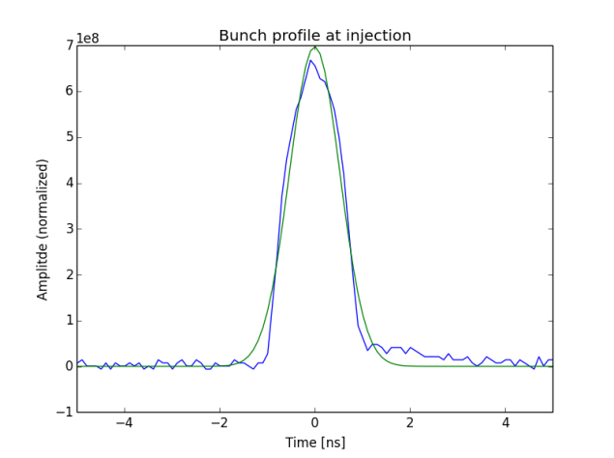

Measurements - Example of injected bunch profile and fit
Blue : measurement
Green : Fit (bunch length $4σ$)
Bunch profile

Slide 6
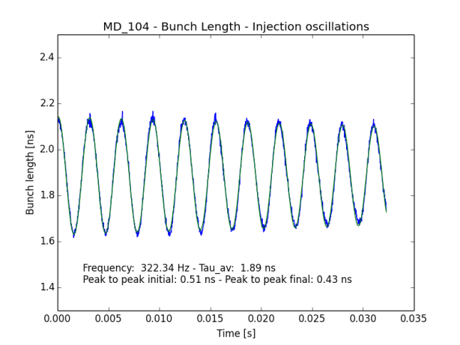
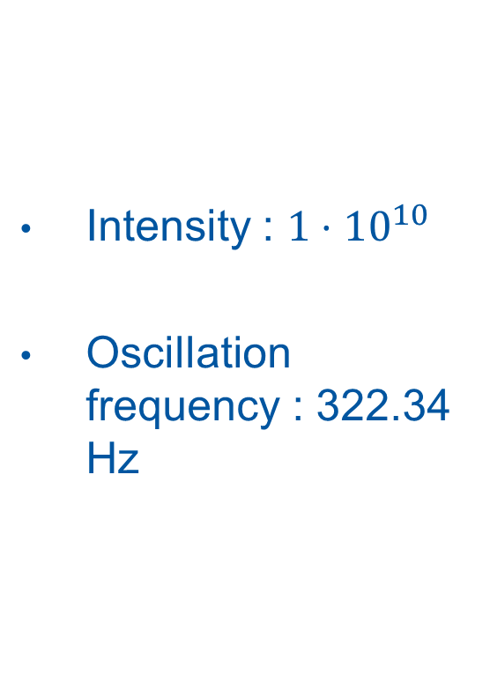
Measurements - Quadrupolar oscillations after injection for low intensity
Intensity : $1⋅{10}^{10}$
Oscillation frequency : 322.34 Hz

Slide 7
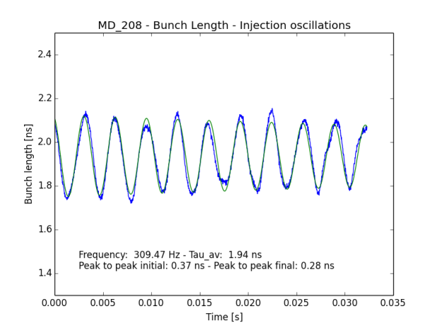
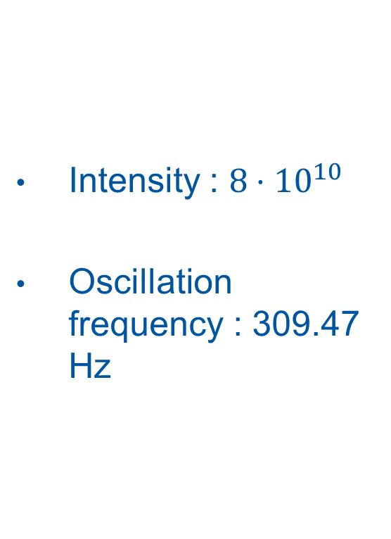
Measurements - Quadrupolar oscillations after injection for high intensity
Intensity : $8⋅{10}^{10}$
Oscillation frequency : 309.47 Hz

Slide 8
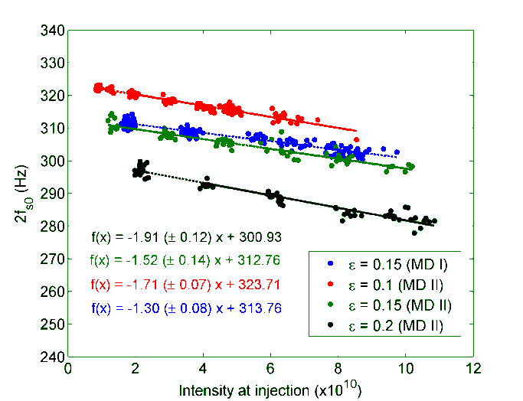
Summary of measurements for different injected emittances
Reference measurements from 02/04/2013 and 28/01/2013 (T. Argyropoulos - LIU-SPS BD WG meeting 07/02/2013)
Oscillation frequencies wrt intensity and slope values for different emittances

Slide 9
Impedance model used in simulations
Cavities
Flanges
BPMs
Kickers
f [GHz] | Z [kΩ] | Q
0,200222 | 2860 | 195
0,200222 | 1840 | 156
0,629 | 388 | 500
0,800888 | 1940 | 390
f [GHz] | Z [kΩ] | Q
1.210 | 633 | 315
1.280 | 499 | 200
1.410 | 722 | 134
1.410 | 160 | 268
1.410 | 133 | 143
1.410 | 30 | 285
1.410 | 449 | 242
1.410 | 377 | 1828
f [GHz] | Z [kΩ] | Q
0.885 | 14.6 | 482
0.892 | 19.8 | 493
1.052 | 159.7 | 773
1.062 | 190.3 | 773
1.069 | 45.4 | 654
1.092 | 57 | 667
1.185 | 11.6 | 610
1.215 | 1.2 | 624
1.598 | 42.6 | 672
1.613 | 597.5 | 686
1.859 | 295.1 | 896
1.960 | 72.1 | 1993
f [GHz] | Z [kΩ] | Q
0.044 | 26 | 10
0.150 | 1 | 1
0.310 | 2 | 5
0.346 | 1 | 10
0.550 | 5 | 1
0.810 | 20.5 | 1
1.500 | 12 | 1
3.000 | 14.5 | 1
Only resonators $Z\left(f\right)=\frac{R_{s}}{1+j Q \left(\frac{f}{f_{r}} −\frac{f_{r}}{f}\right)}$

Slide 10
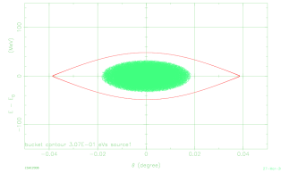
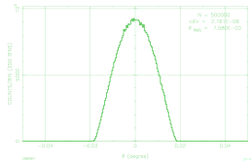
Simulations: input distribution
Generation of a parabolic or Gaussian bunch (ESME)
In SPS RF system with voltage mismatched in respect to 900 kV
emittance variation (~bunch length)
Example of parabolic bunch generation

Slide 11
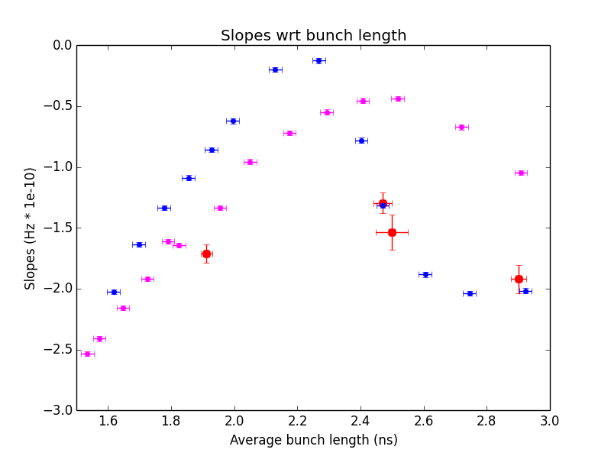
Slopes as a function of bunch length
Simulation code is HEADTAIL
Parabolic (blue) and gaussian (magenta) bunch profiles
We consider the average bunch length (after filamentation)
Strong dependance on the bunch distribution
Bunch length in measurement in different from real bunch length (++ for small bunches, up to 100ps in the LHC, information from T. Bohl)

Slide 12
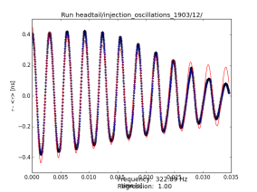
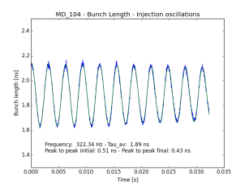
Simulations – input distribution (2)
Simulations of injection oscillations for low intensities with HEADTAIL
Trying to find the closest distribution to what is extracted from the PS
Comparison with the average of several measurements
Example of injection oscillations comparison
Simulation
Measurement

Slide 13
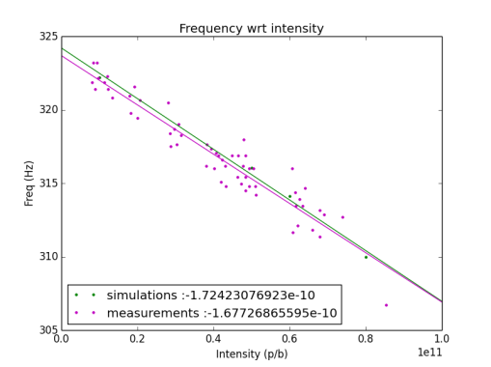
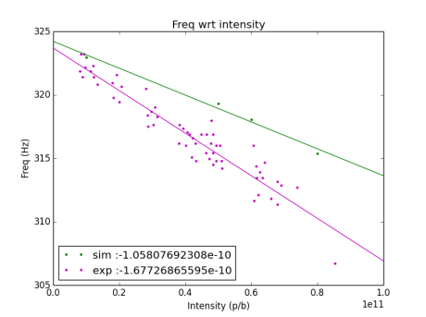
Simulations – missing impedance estimation
SPS impedance model
SPS impedance + single broadband resonator

Slide 14
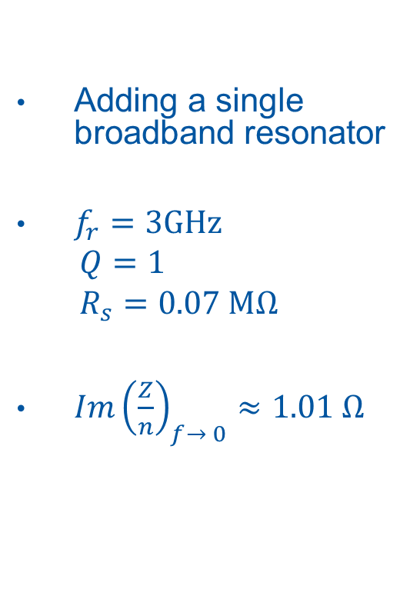
Simulations – missing impedance estimation
Adding a single broadband resonator
$f_{r}=3GHz$ $Q=1$ $R_{s}=0.07 MΩ$
$Im{\left(\frac{Z}{n}\right)}_{f→ 0}≈1.01 Ω$

Slide 15
Conclusion
Work in progress
Impedance contributions to be added or improved
Cavities : travelling wave cavity model
Steps
Space charge
Resistive walls
Higher emittances to be analyzed : oscillations are very dependent on the input distribution

