Slide 1
SPS Longitudinal Impedance Simulations & Measurements Update
Benoit Salvant, Carlo Zannini, Thomas Bohl, Helga Timko,
Fritz Caspers, Elena Shaposhnikova and Jose E. Varela
Acknowledgements: Jose A. Ferreira (TE-VSC_IVM),
Sebastien Calvo and Antoine Boucherie (BE-RF-PM)

Slide 2
Outline
Introduction
SPS Longitudinal Impedance Model 2013
SPS Longitudinal Impedance Model - Update
Flanges
Cavities
Next Steps
Conclusions

Slide 3
Introduction
The impedance model of the SPS is evolving with time as new elements are included in the model.
The complete SPS longitudinal impedance model, as used in beam stability simulations, will be presented today.
In addition, a preliminary version of small updates to the model will be shown as ‘work in progress’.

Slide 4
Outline
Introduction
SPS Longitudinal Impedance Model 2013
SPS Longitudinal Impedance Model- Update
Flanges
Cavities
Next Steps
Conclusions

Slide 5
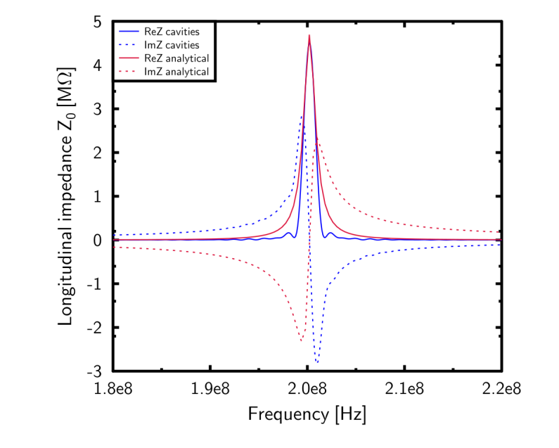
2013 SPS Longitudinal Impedance Model (I)
Updated in LIU-SPS BD WG meeting 19/09/2013. Talk of H. Timko.
Element | f [GHz] | a (μs) | Z [kΩ] | Q | R/Q [Ω]
200 TWS - 43 cell | 0.200 | 3.56 | 1752 | G. Dome SPS/ARF/77-11 | -
200 TWS - 54 cell | 0.200 | 4.47 | 2760 |  | -
800 TWS | 0.800 | 2.07 | 1938 |  | -
200 TWS HOM | 0.629 | - | 388 | 500 | 780
$$Z\left(f\right)=R \left\{{\left(\frac{sin\left(\frac{a(f−f_{r})}{2}\right)}{\frac{a(f−f_{r})}{2}}\right)}^{2}−2i\frac{a\left(f−f_{r}\right)−sin⁡(a\left(f−f_{r}\right))}{{(a(f−f_{r}))}^{2}}\right\}$$
$W\left(t\right)=\frac{2R}{\tilde{a}}\left(1−\frac{t}{\tilde{a}}\right)cos\left(ω_{r}t\right)$, where $\tilde{a}=\frac{a}{2π}$.

Slide 6
2013 SPS Longitudinal Impedance Model (II)
Element | Enamel | Resistor * | Num. | f [GHz] | Z [kΩ] | Q | R/Q [Ω]
Flanges [ Simulation Table ] * Damping Resistors have not been included in Simulations. This column states whether or not the flange SHOULD have a damping resistor inside (and its type). ** The damping resistors were estimated to halve the Q of enamelled flanges. Latest measurements showed a lower reduction, 1.26, on a different set-up. For non-enamelled flanges, the damping resistors are estimated to lower the Q by a factor of 10. *** Survey not completed. Waiting for final confirmation from vacuum group about these percentages. ! Damping resistor presence percentage is assumed to be identical to the *** case. !! The effect of the LONG damping resistors has not been estimated. In this table, it is assumed to be identical to a SHORT damping resistor. | Yes | No | 90 | 1.210 | 633 | 315 | 2010
 | Yes | Long | 39 | 1.280 | 499 | 200 !! | 2495
 | Yes | Short | 90% of 83 ! | 1.410 | 722 | 134 ** | 5388
 | Yes | No | 10% of 83 ! | 1.410 | 160 | 268 | 597
 | Yes | Short | 90% of 14 ! | 1.410 | 133 | 143 ** | 930
 | Yes | No | 10% of 14 ! | 1.410 | 30 | 285 | 105
 | No | Short | 90% of 26 *** | 1.410 | 449 | 242 ** | 1855
 | No | No | 10% of 26 *** | 1.410 | 377 | 1828 | 206
 | Yes | No | 99 | 1.570 | 17.4 | 55 | 316
 | No | No | 20 | 1.610 | 588 | 980 | 600
 | Yes | Long | 39 | 1.620 | 61 | 60 !! | 1016
 | No | No | 75 | 1.800 | 651 | 881 | 739
 | Yes | No | 99 | 1.890 | 187 | 175 | 1070

Slide 7
2013 SPS Longitudinal Impedance Model (III)
Element | Type | f [GHz] | Z [kΩ] | Q | R/Q [Ω]
BPMs Values calculated by B. Salvant: [LIU-SPS BD WG 08/06/2013] | BPH | 0.885 | 14.6 | 482 | 30
 | BPH | 0.892 | 19.8 | 493 | 40
 | BPH | 1.052 | 159.7 | 773 | 207
 | BPH | 1.062 | 190.3 | 773 | 246
 | BPV | 1.069 | 45.4 | 654 | 69
 | BPV | 1.092 | 57 | 667 | 85
 | BPV | 1.185 | 11.6 | 610 | 19
 | BPV | 1.215 | 1.2 | 624 | 2
 | BPH | 1.598 | 42.6 | 672 | 63
 | BPH | 1.613 | 597.5 | 686 | 871
 | BPH | 1.859 | 295.1 | 896 | 329
 | BPV | 1.960 | 72.1 | 1993 | 36

Slide 8
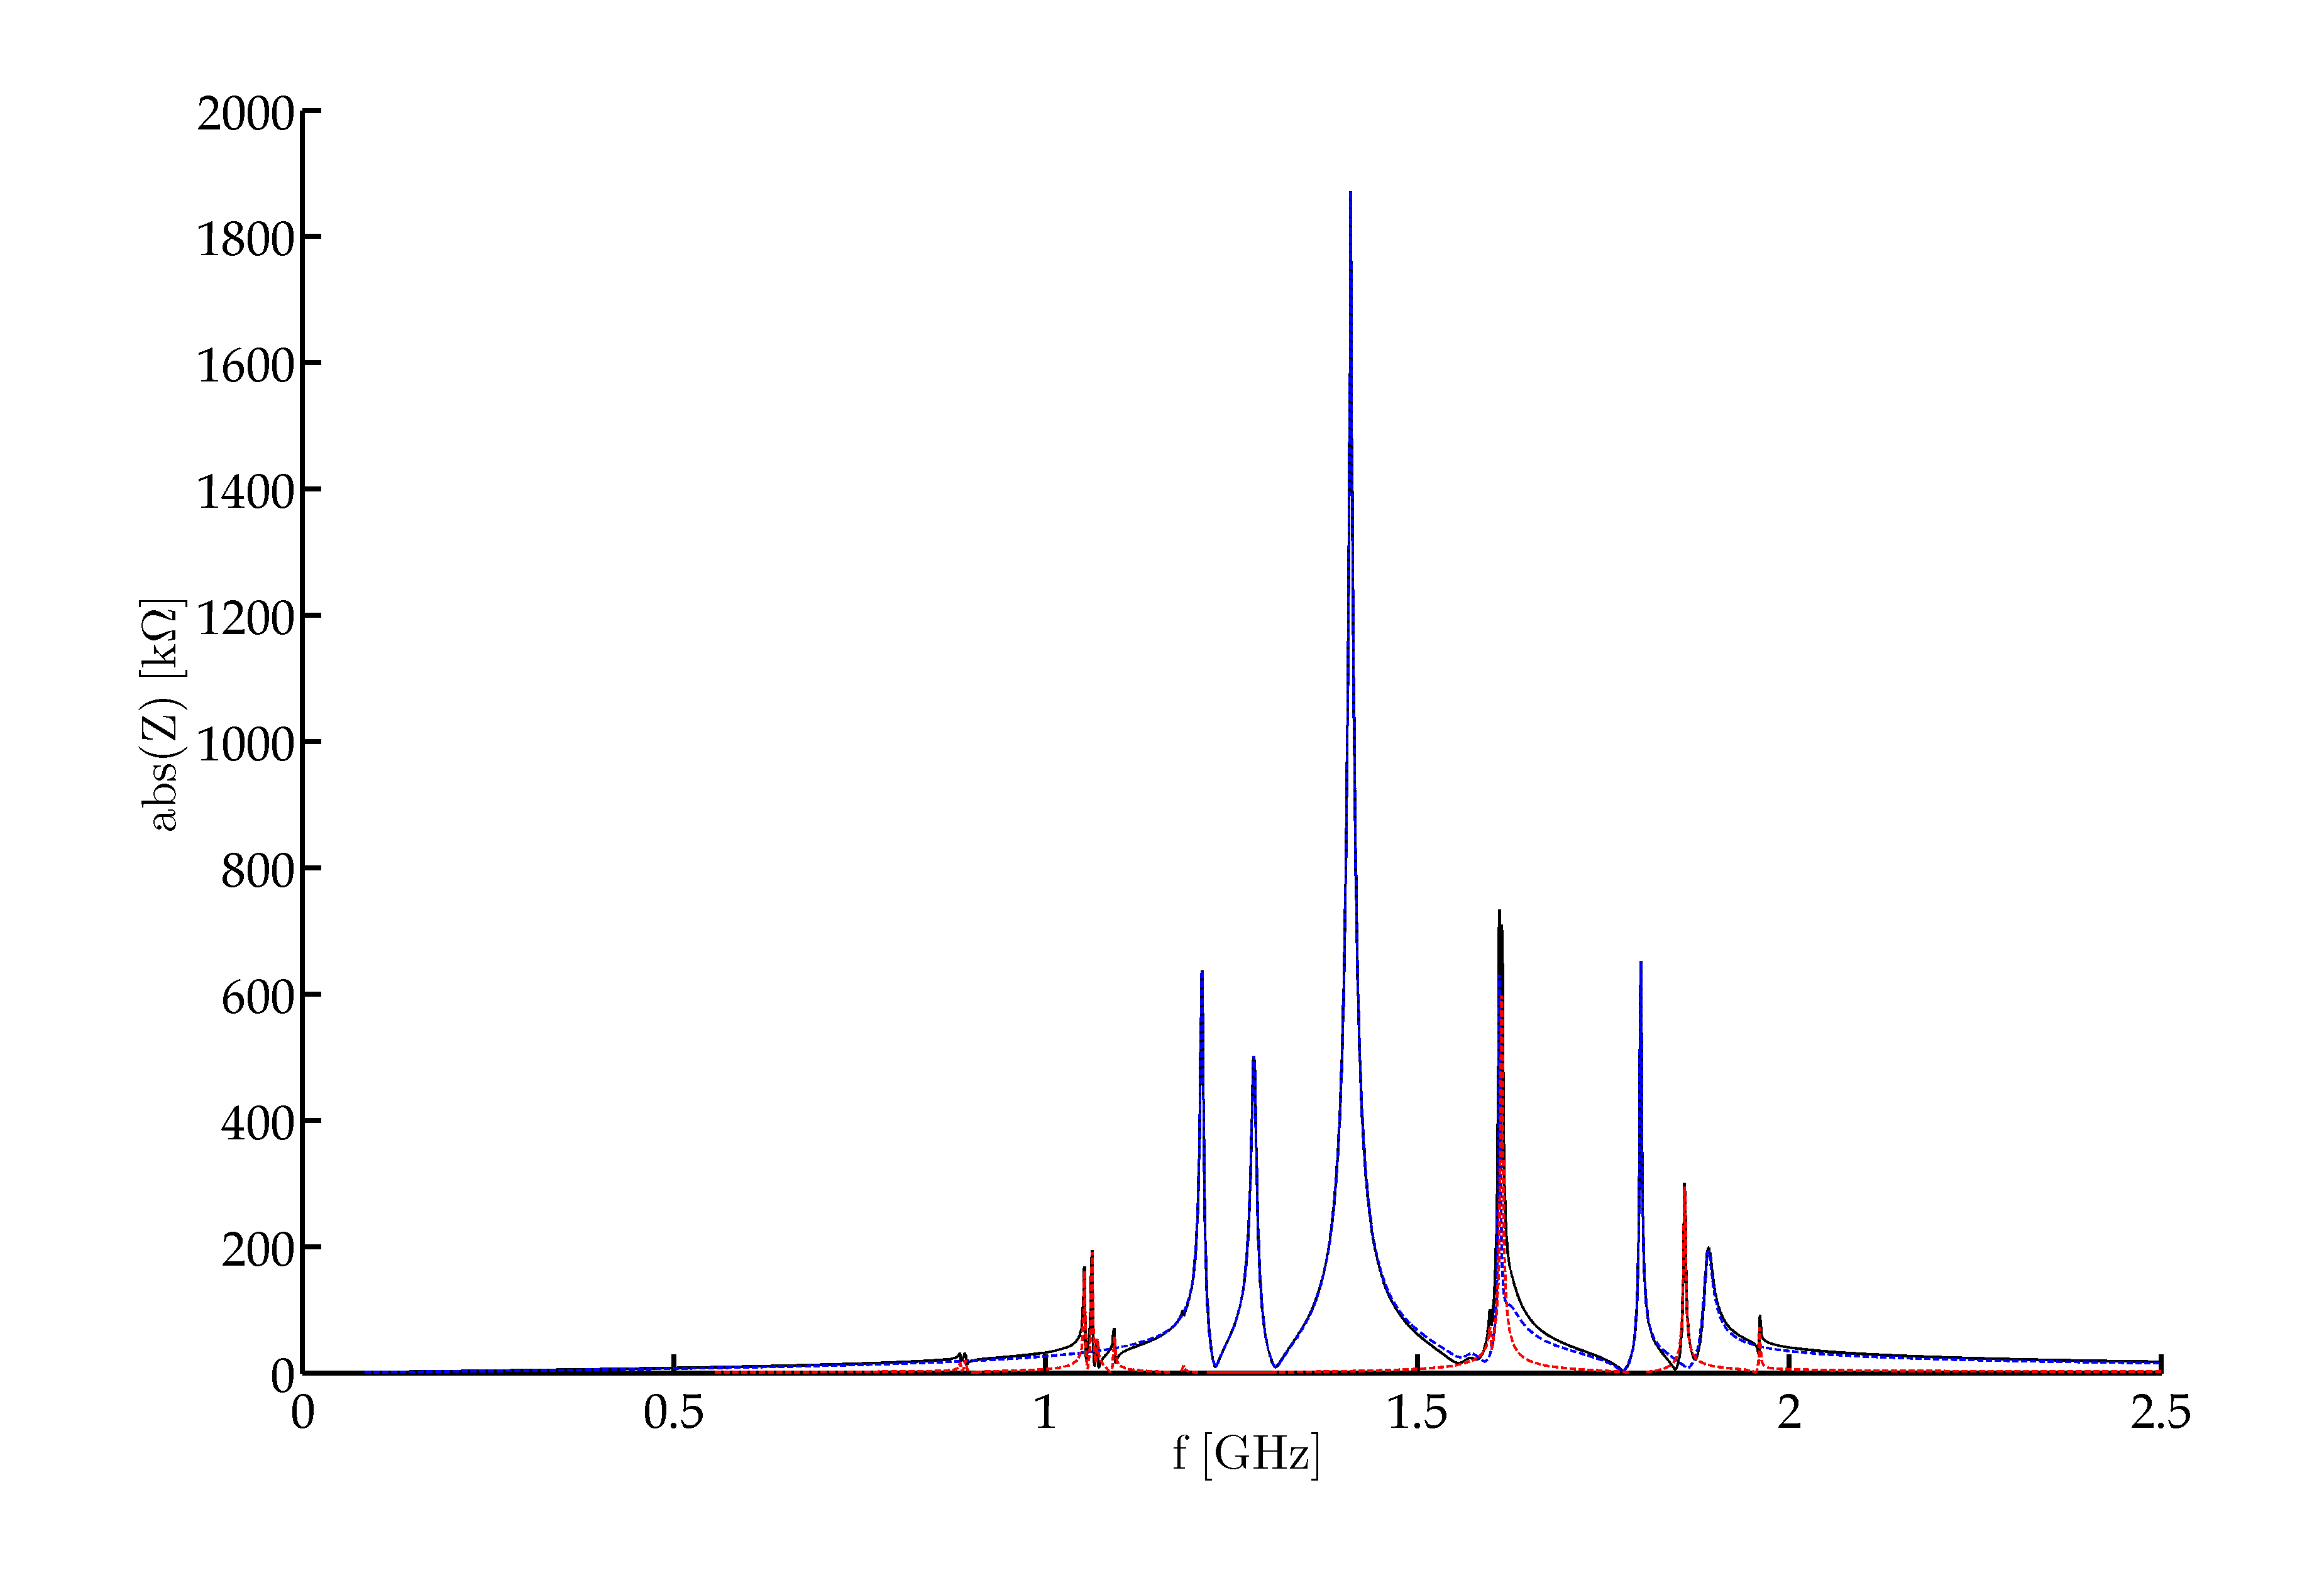
2013 SPS Longitudinal Impedance Model (IV)
1.4GHz Flanges
Blue – Flanges
Red – BPMs
Black – Flanges + BPMs
1.6GHz BPMs + Flanges
1.2GHz Flanges

Slide 9
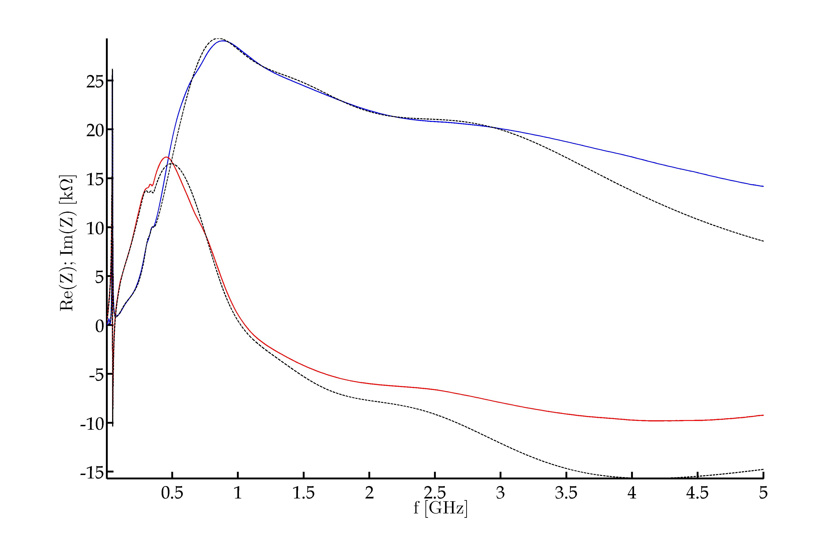
2013 SPS Longitudinal Impedance Model (V)
Element | f [GHz] | Z [kΩ] | Q | R/Q [Ω]
SPS Kickers Fit (8 resonator model) Impedance calculated by C. Zannini [LIU-SPS BD WG meeting 21/03/2013] Fit by H. Timko [LIU-SPS BD WG meeting 19/09/2013] | 0.044 | 26 | 10 | 2600
 | 0.150 | 1 | 1 | 1000
 | 0.310 | 2 | 5 | 400
 | 0.346 | 1 | 10 | 100
 | 0.550 | 5 | 1 | 5000
 | 0.810 | 20.5 | 1 | 20500
 | 1.500 | 12 | 1 | 12000
 | 3.000 | 14.5 | 1 | 14500
Blue – Re(Z)
Red – Im(Z)
Black - Fit

Slide 10
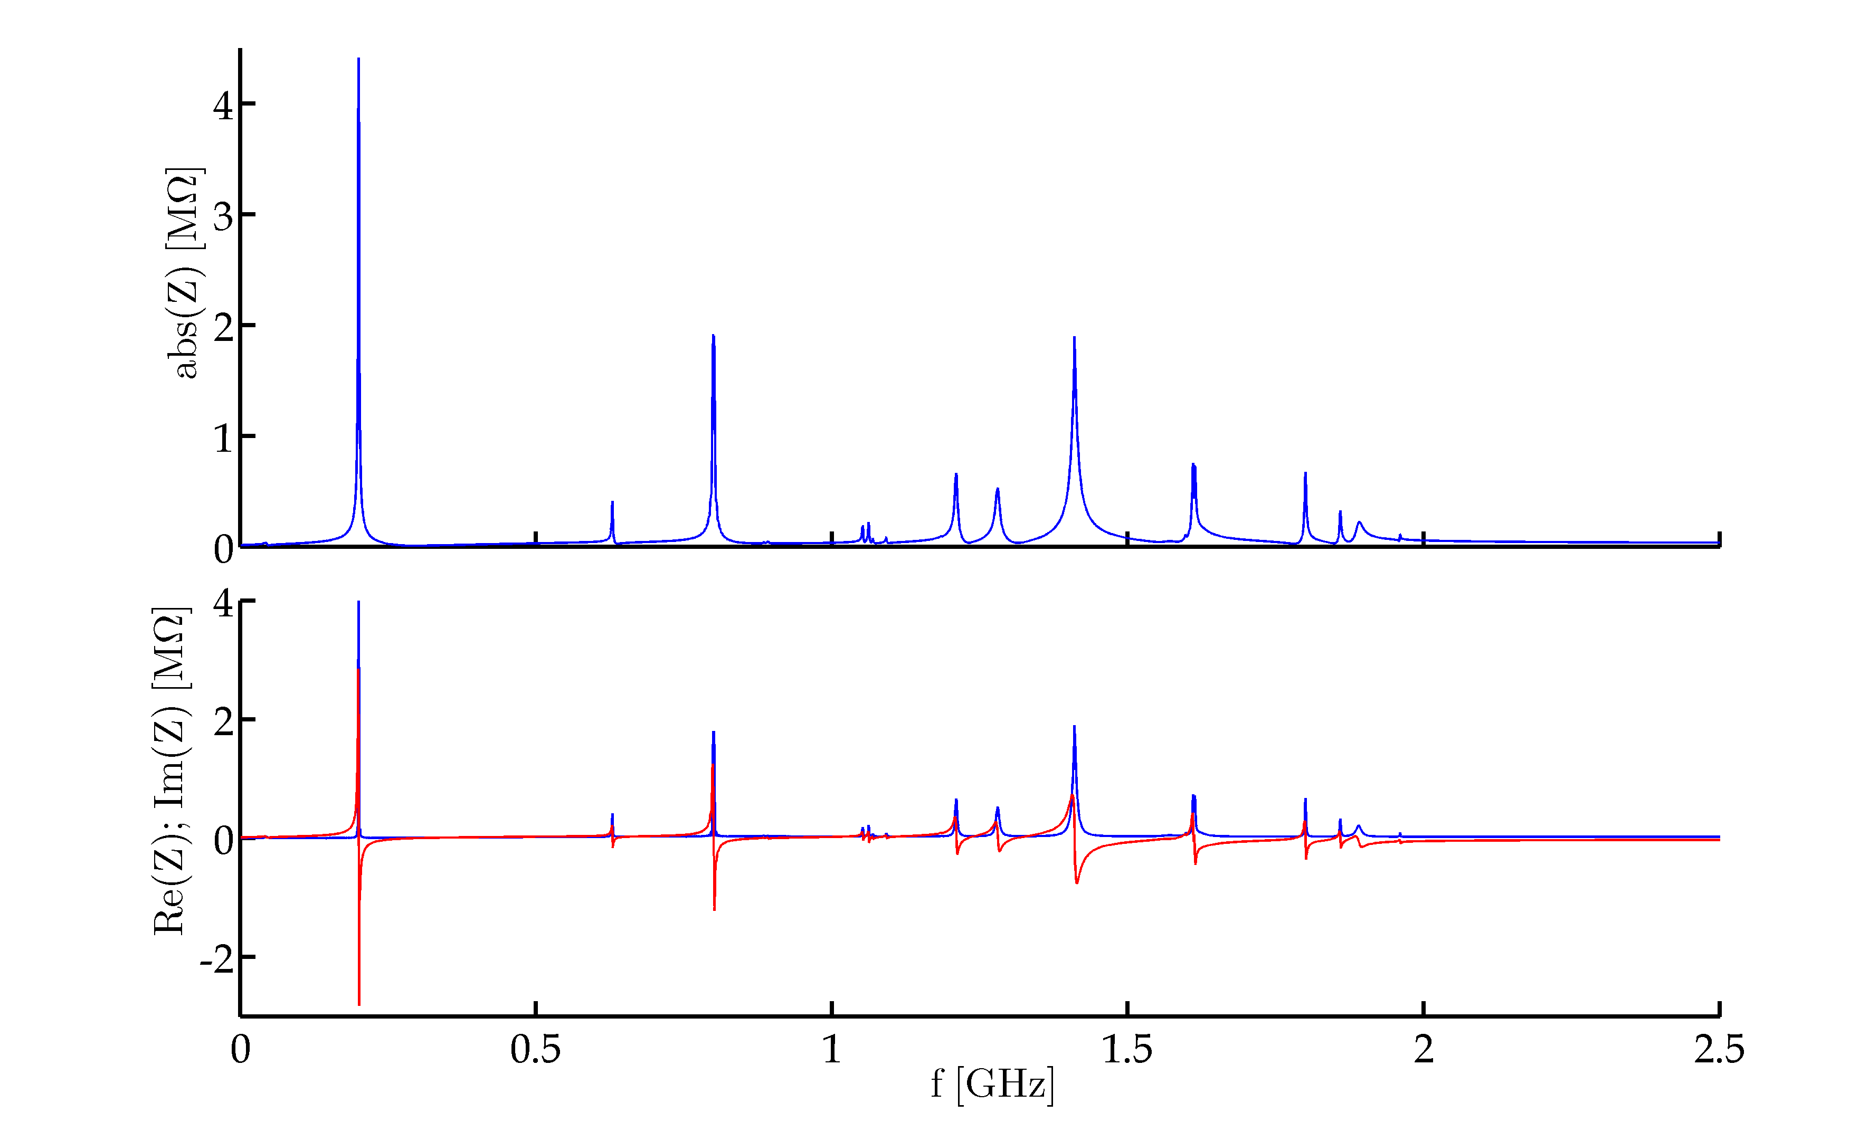
Total 2013 SPS Longitudinal Impedance Model (I)
200MHz TWC
800MHz TWC
Flanges
Blue – Re(Z)
Red – Im(Z)

Slide 11
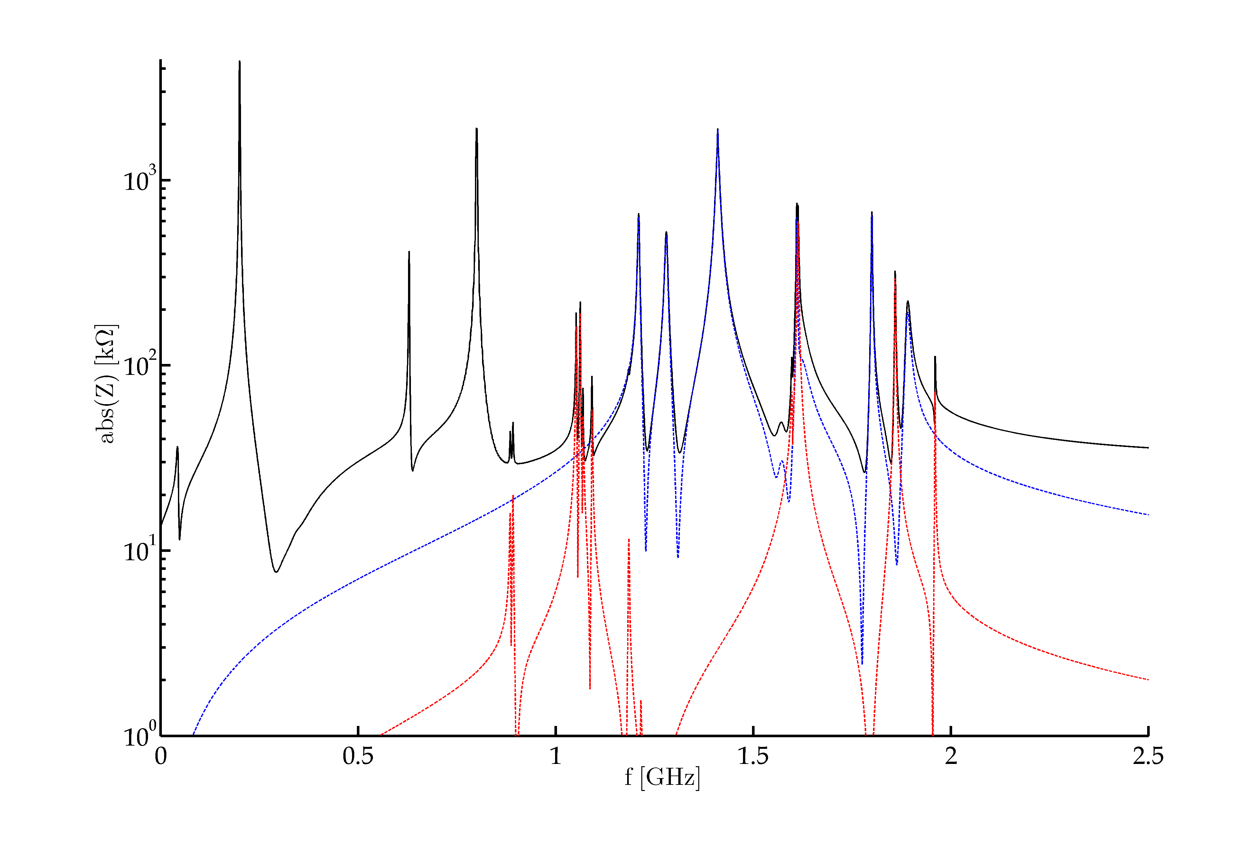
Total 2013 SPS Longitudinal Impedance Model (II)
200MHz TWC
Blue – Flanges
Red – BPMs
Black – Total
800MHz TWC
630MHz TWC HOM

Slide 12
2013 SPS Longitudinal Impedance Model Main Resonant Impedance Sources
Element | Number | f [MHz] | Z [kΩ] | Q | R/Q [Ω]
Serigraphy | 18 | 44 | 26 | 11 | 2400
200 TWC – 54 cell | 2 | 200 | 2760 | 150 | 18400
200 TWC – 43 cell | 2 | 200 | 1752 | 120 | 14600
200 TWC - HOM | 4 | 630 | 388 | 500 | 780
800 TWC | 2 | 800 | 1938 | 300 | 6460
Kickers | 18 | 810 | 20.5 | 1 | 20500
Vac. Flanges | 129 | 1200 | 630 + 500 | 250 | 4500
Vac. Flanges | 123 | 1400 | 1875 | 200 | 9300
Kickers | 18 | 1500 | 12 | 1 | 12000
Vac. Flanges | 59 | 1600 | 630 | 395 | 1600
BPM - H | 106 | 1600 | 597.5 | 686 | 871
Kickers | 18 | 3000 | 14.5 | 1 | 14500
Approximate values.
Highlighted in red biggest impedance contributors.

Slide 13
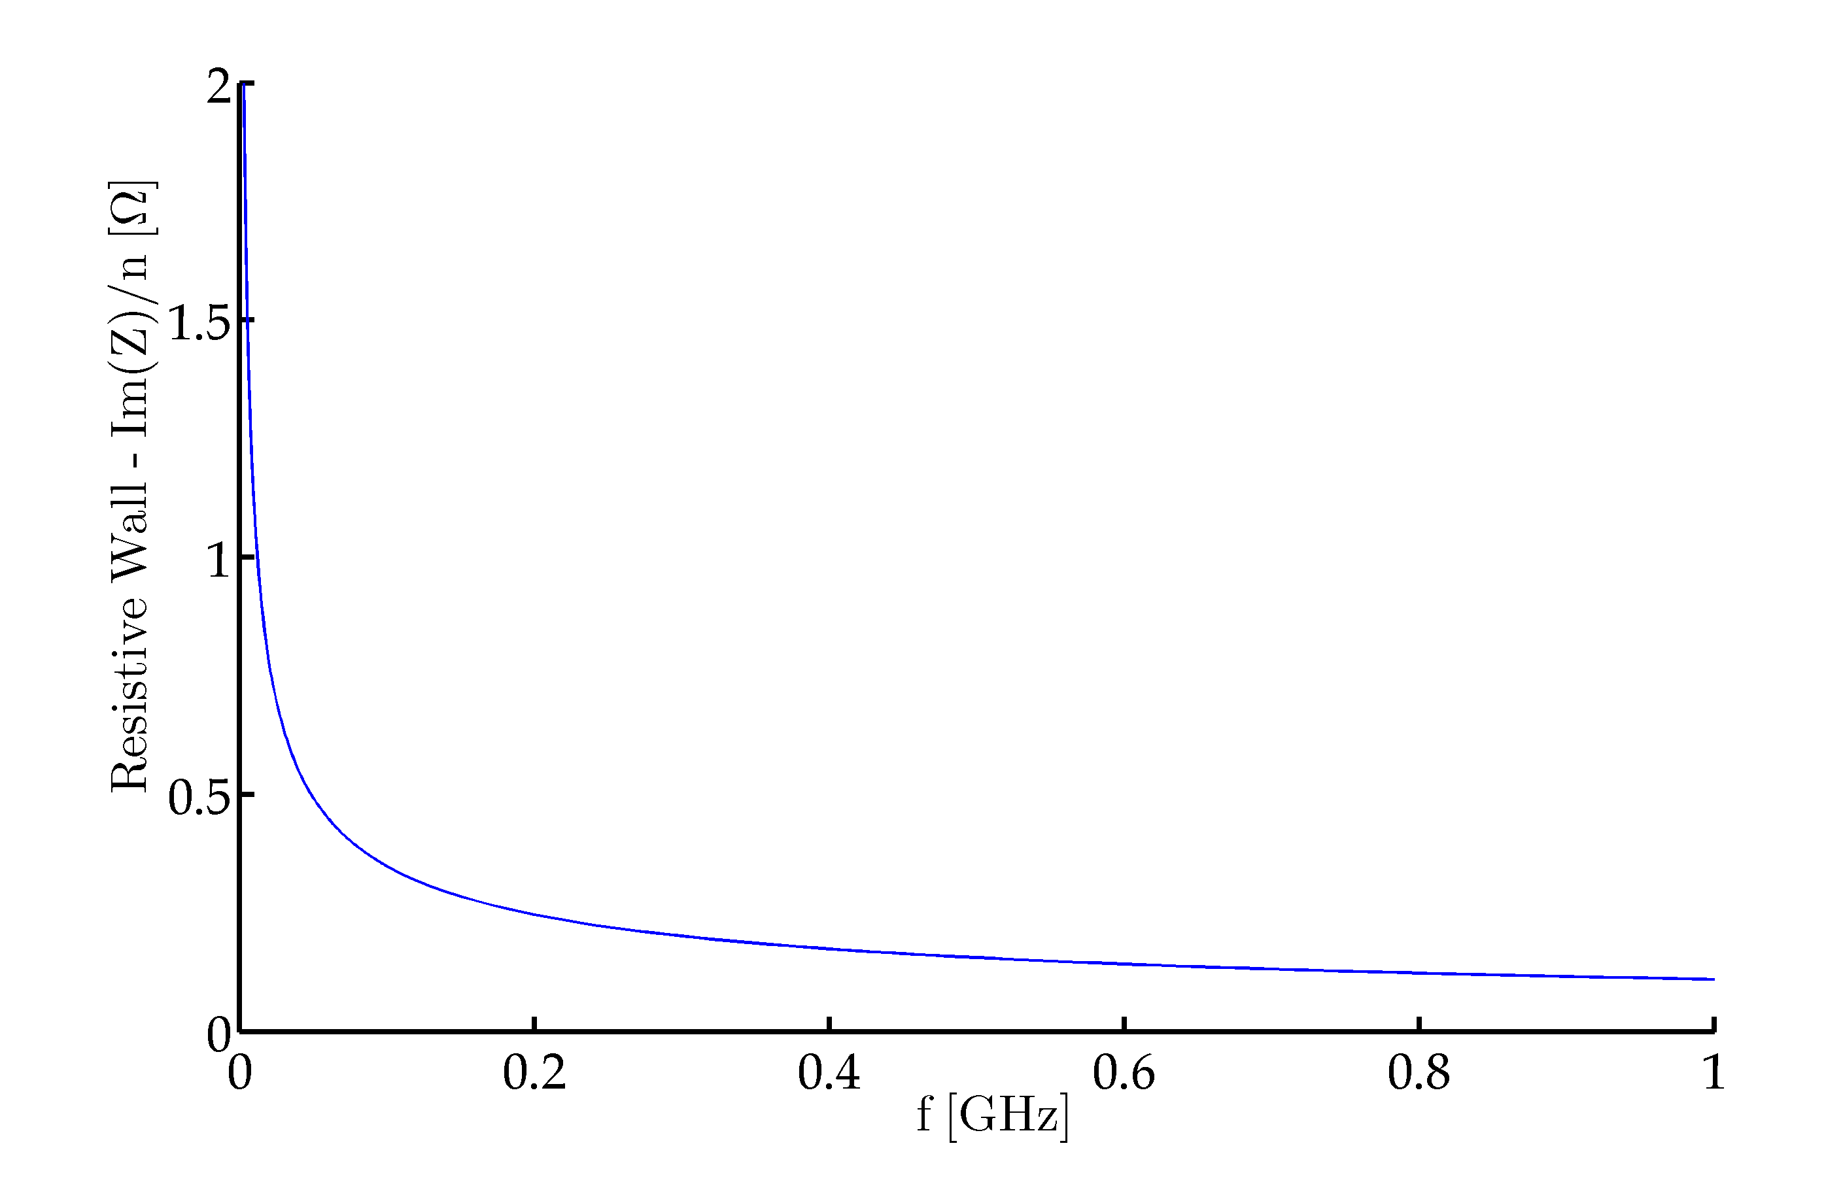
2013 SPS Longitudinal Impedance Model Included Im( Z )/n Contribution
Element | Number | Source | Im( Z )/n [Ω] | Fmax [MHz] | Im( Z )/n [Ω] Included in the Model
200 TWC – 54 cell | 2
200 TWC – 43 cell | 2
200 TWC - HOM | 4 |  |  | 200 ? | 0.055
800 TWC | 2
Kickers | 8
Vac. Flanges | 589 | Carlo | 0.954 | 300 – 400 ? | 0.532
BPM - H | 106 | Benoit | 0.106 | 300 – 400 ? | 0.063
BPM - V | 96 |  | 0.048
Im(Z)/n included in the model:
0.65 Ω + TWC cavities + Kickers
Non-included ‘known’ contributions:
0.5 + Resistive Wall – Space Charge
± Low Freq. Enamelled Flange Resonance
Calculated by Carlo

Slide 14
Outline
Introduction
SPS Longitudinal Impedance Model 2013
SPS Longitudinal Impedance Model- Update
Flanges
Cavities
Next Steps
Conclusions

Slide 15
Im(Z)/n Steps - Contribution
Step Type | Enamel | Num. of Steps | First Order Approx. | Im(Z)/n slope [Ω/GHz] |  | Total Slope [Ω/GHz] |  | Total Im(Z)/n | Slope Up to [MHz]
 |  |  | !! | Simulations by Carlo
QD - QD | No | 82 | 277 | 10.25 | 840 |  | 0.0365 |  | 400
 | Yes* | 101 |  |  | 1035 |  | 0.0449 |  | 400
BPV – QD | Yes* | 94 |  |  | 970 |  | 0.0418 |  | 400
VVSA - QD | No | 18 | - | - | - |  | - |  | -
156 - QD | No | 19 | 19 | 20.5 | 390 |  | 0.0169 |  | 500
QF - 156 | No | 42 | 128 | 40.5 | 1701 |  | 0.0738 |  | 500
 | Yes* | 86 |  |  | 3483 |  | 0.1511 |  | 500
MBA - 156 | No | 35 | 44 | 43 | 1505 |  | 0.0653 |  | 400
 | Yes* | 9 |  |  | 387 |  | 0.0168 |  | 400
156 – QF | No | 58 | 58 | 40.5 | 2349 |  | 0.1019 |  | 500
156 - MBA | No | 114 | 114 | 43 | 4902 |  | 0.2127 |  | 400
BPH - QF | Yes* | 37 | 37 | 88 | 3256 |  | 0.1413 |  | 500
No bellow | QF-QF | 17 | 17 | 21 | 357 |  | 0.0155 |  | 400
 | MBA-QF | 4 | - | - | - |  | - |  | -
268 - 156 | No | 21 | 21 | 17 | 357 |  | 0.0155 |  | 300
MBB – 156 | No | 22 | 22 | 32 | 704 |  | 0.0305 |  | 500
Steps Included Above |  | 759 |  | First Order Approx. |  |  | 0.9645
Total Step Count |  | 855 | Missing Steps in the Approx. = 118 (14%)
* We know that the enamelled flanges have low frequency resonances.
25MHz measured by Fritz in the tunnel (next slides).
5MHz measured on a QD-QD flange in the lab.
!! Several step types have been assumed to be identical.

Slide 16
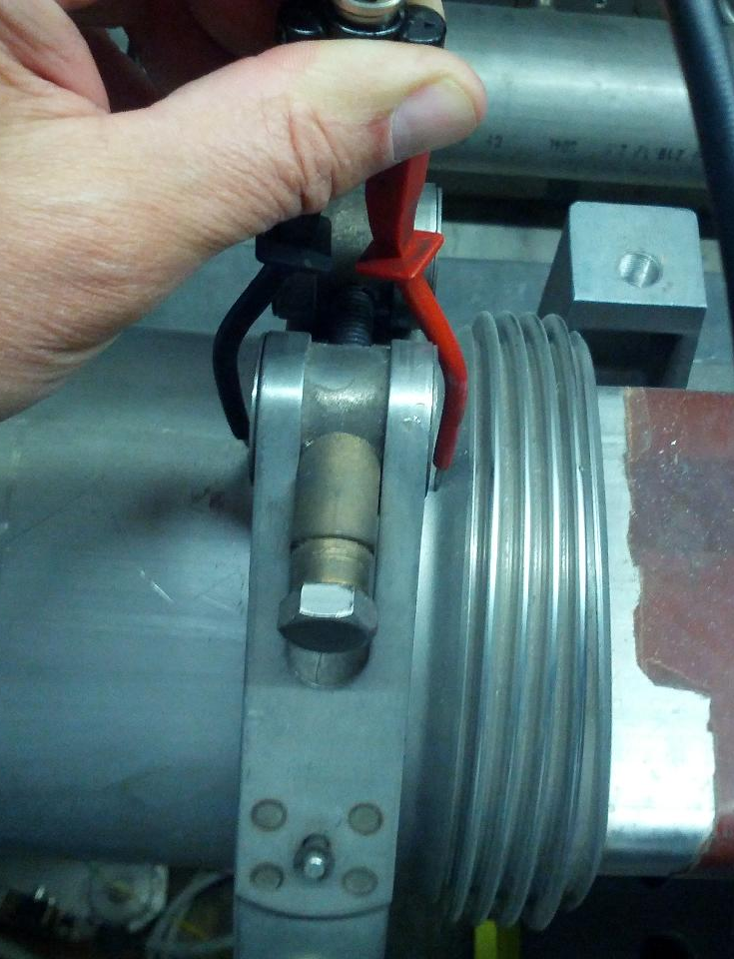
Im(Z)/n Steps - Fritz Measurements (I) LIU-SPS BD meeting 25-04-2013
Measurement on ENAMELLED flange BPH 31998
Imaginary Part of the reflection coefficient

Slide 17
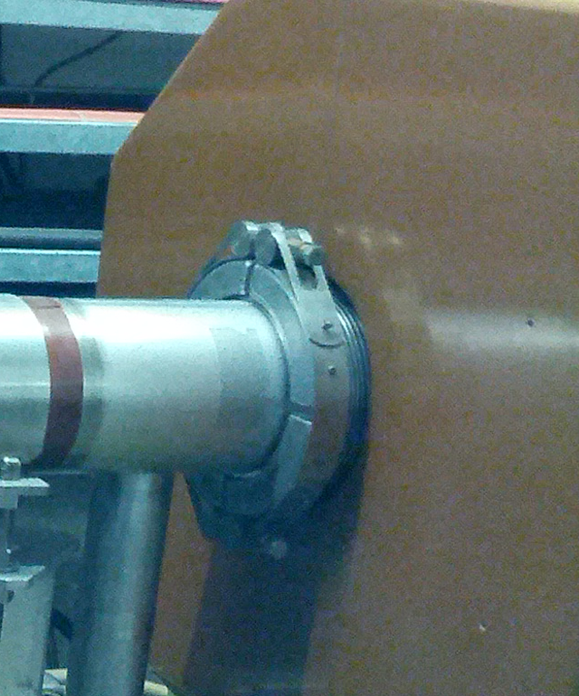
Im(Z)/n Steps - Fritz Measurements (II) LIU-SPS BD meeting 25-04-2013
Measurement on a NON-ENAMELLED flange LOE 32002
Imaginary Part of the reflection coefficient

Slide 18
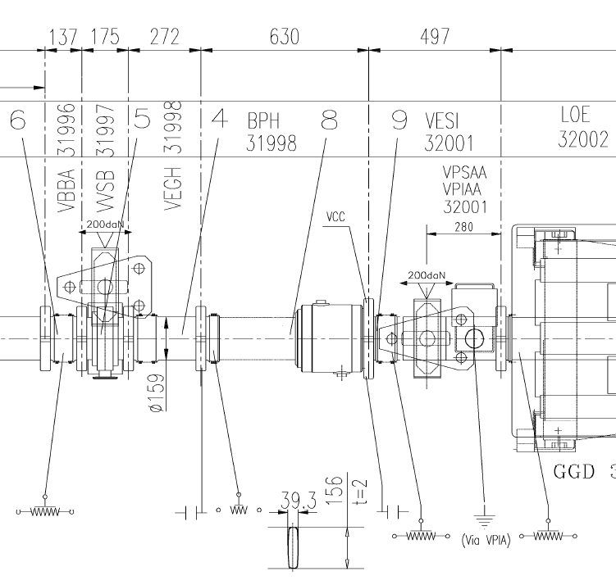
Im(Z)/n Steps - Fritz Measurements (and III)
Non-Enamelled Flange
v
Enamelled Flange
25MHz Resonance

Slide 19
Outline
Introduction
SPS Longitudinal Impedance Model 2013
SPS Longitudinal Impedance Model- Update
Flanges
Cavities
Next Steps
Conclusions

Slide 20
Travelling Wave Cavity Impedance Model (I)
Current TWC impedance model
Element | f [GHz] | a (μs) | Z [kΩ] | Q | R/Q [Ω]
200 TWS - 43 cell | 0.200 | 3.56 | 1752 | G. Dome SPS/ARF/77-11 | -
200 TWS - 54 cell | 0.200 | 4.47 | 2760 |  | -
800 TWS | 0.800 | 2.07 | 1938 |  | -
200 TWS HOM | 0.629 | - | 388 | 500 | 780
Problem with this is that the group velocity is frequency dependant and not symmetric (with respect to the cavity’s center frequency).
$$Z\left(f\right)=R \left\{{\left(\frac{sin\left(\frac{a(f−f_{r})}{2}\right)}{\frac{a(f−f_{r})}{2}}\right)}^{2}−2i\frac{a\left(f−f_{r}\right)−sin⁡(a\left(f−f_{r}\right))}{{(a(f−f_{r}))}^{2}}\right\}$$
$W\left(t\right)=\frac{2R}{\tilde{a}}\left(1−\frac{t}{\tilde{a}}\right)cos\left(ω_{r}t\right)$, where $\tilde{a}=\frac{a}{2π}$.
a = Lcav/vg(w)

Slide 21
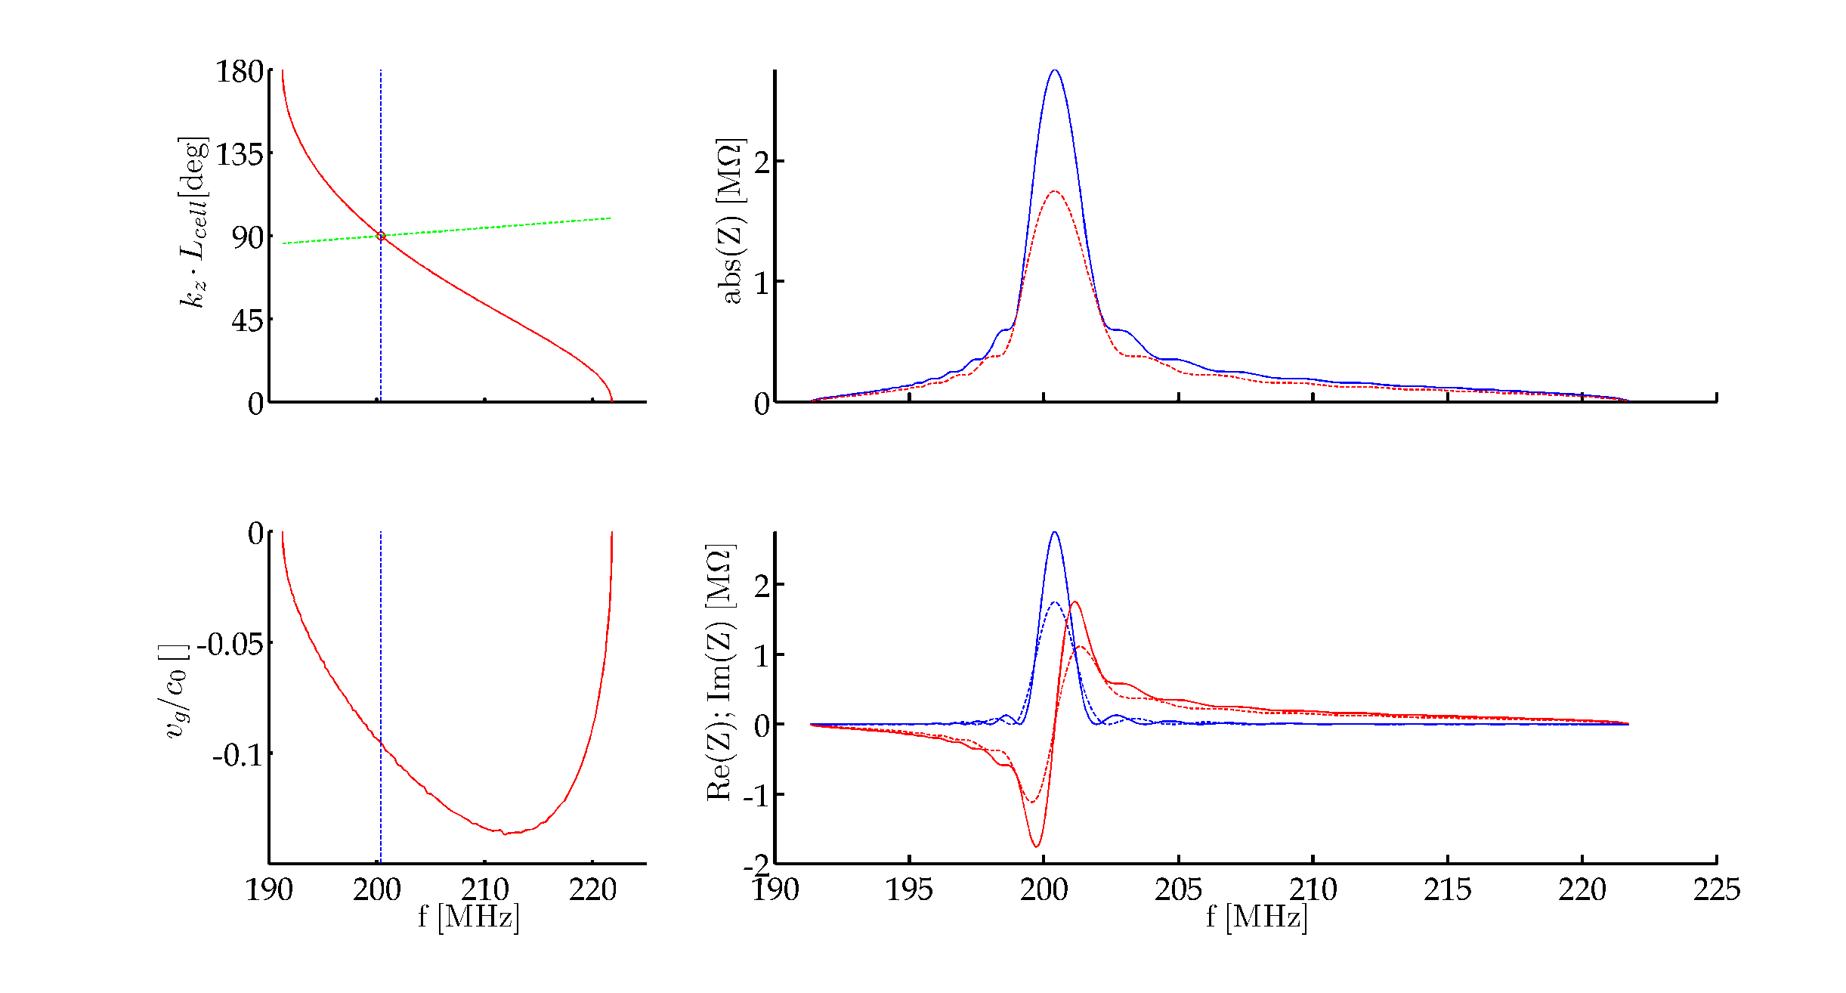
Travelling Wave Cavity Impedance Model (and II)
G. Dome’s equations when the frequency dependent group velocity is taken into account.

Slide 22
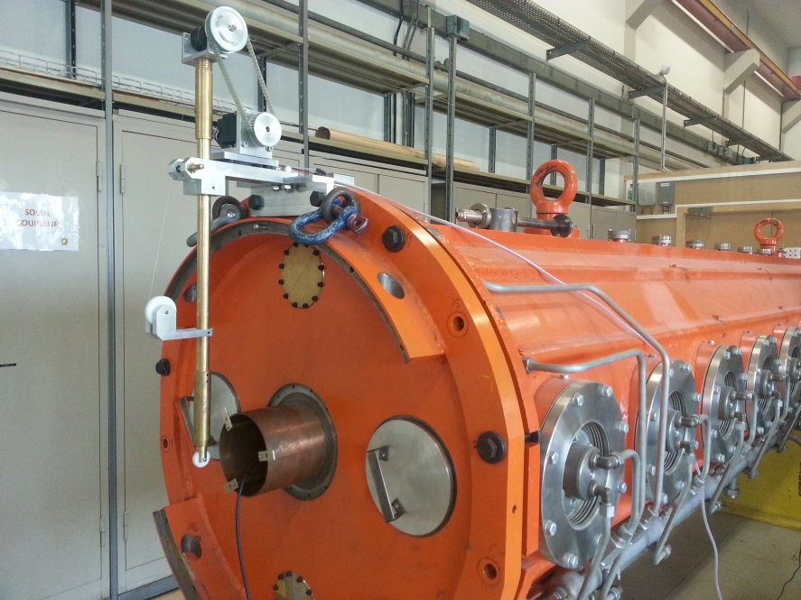
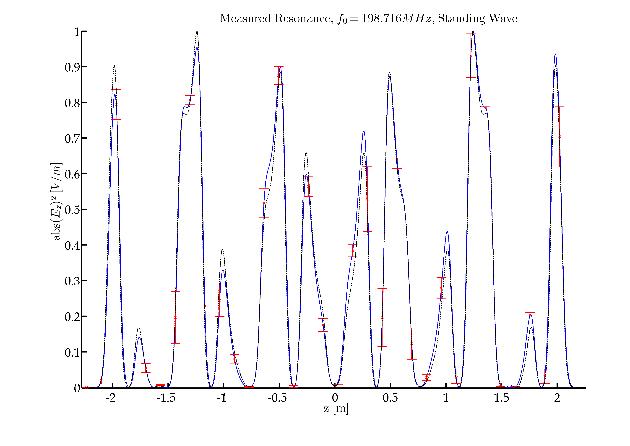
200MHz Cavity – Standing Wave (I)
A Bead-Pull measurement set-up has been built to characterize the SPS cavities.
 | Resonant freq. [MHz] | Q | R/Q
Simulation | 199.872 | Q0 = 20770 | 508
Measurement | 198.716 | QL = 14950 ± 0.1% | 542 ± 1%
PRELIMINARY RESULTS
Comparison between simulated and measured field profiles (Cavity in Standing Wave mode).
Blue – Mean field profile (10 traces)
Red – Error bars
Black - Simulation

Slide 23
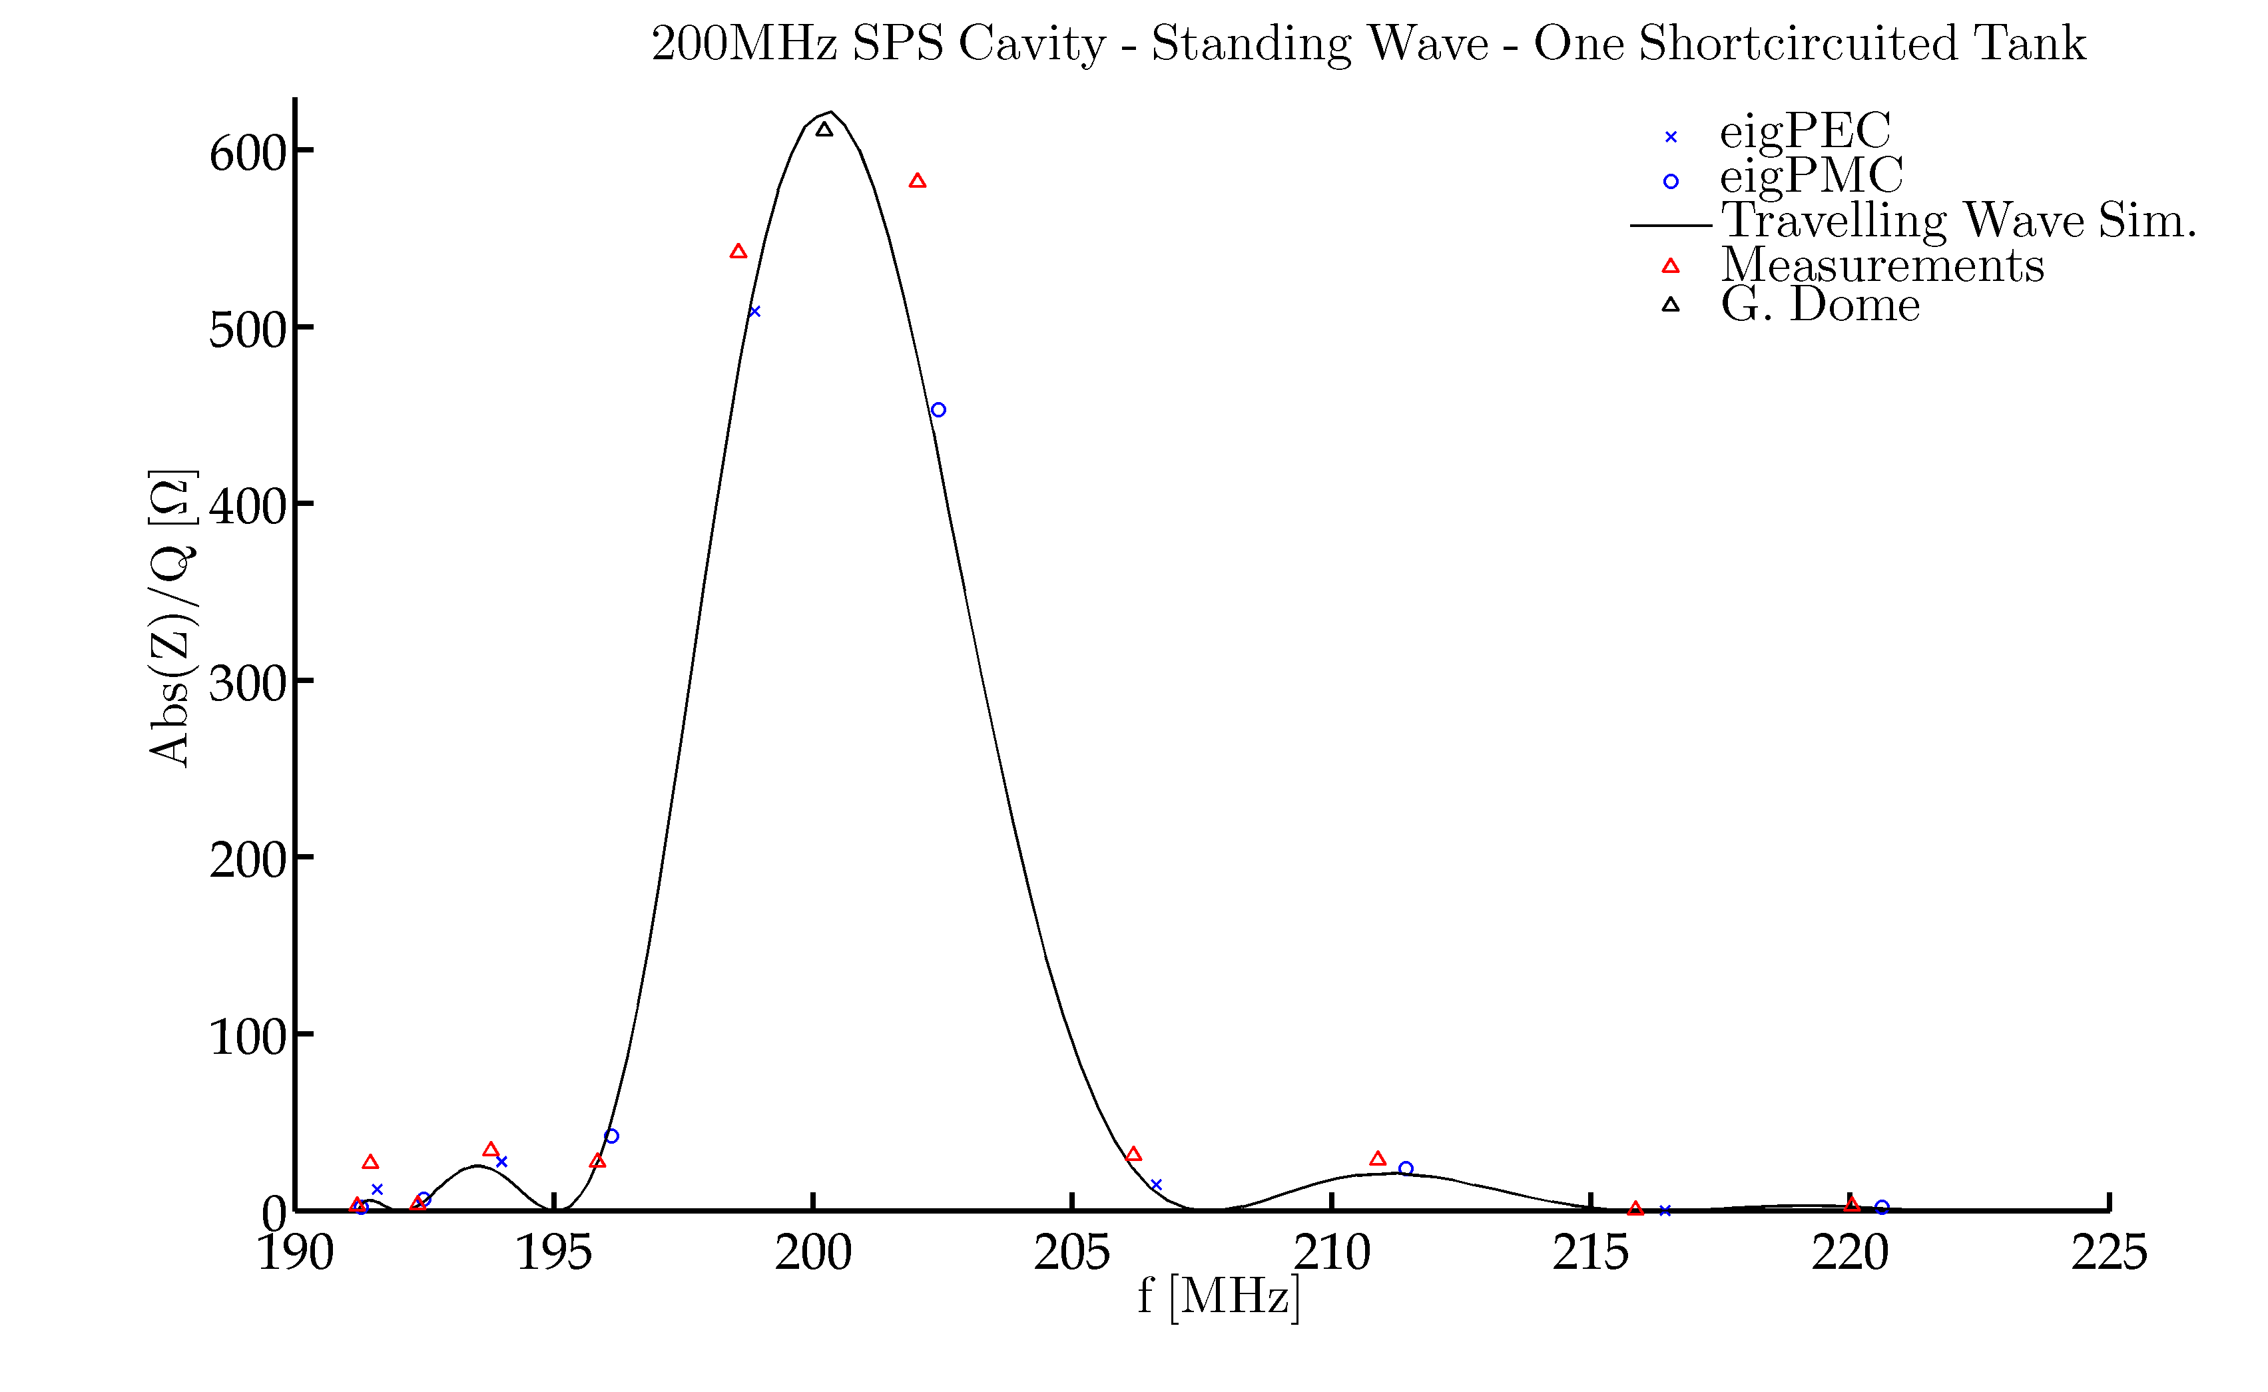
200MHz Cavity – Standing Wave (and II)
Fundamental pass-band R over Q comparison.
Simulation results have been displaced -1MHz.
PRELIMINARY RESULTS

Slide 24
Outline
Introduction
SPS Longitudinal Impedance Model 2013
SPS Longitudinal Impedance Model- Update
Flanges
Cavities
On-going efforts
Conclusions

Slide 25
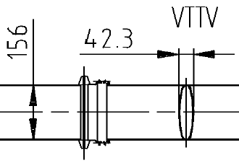
Damping Resistor Influence Assessment
All the SPS cavity-like transitions were filled with damping resistors by G. Dôme back in 1973.
Simulating the effect of the damping resistors is tricky. So far, their effect has not been simulated reliably.
First measurements show that damping resistors can reduce up to 10 times the unloaded Q of a cavity.
Additional measurements under preparation.
 | MBA-MBA Enamelled Flange * |  | Non-Enamelled Cavity **
 | NO Resistor | WITH Resistor | NO Resistor | WITH Resistor
f [GHz] | 1.49 | 1.49 | 1.417 | 1.411
Q₀ | 340 ± 5% | 270 ± 9% | 1930 ± 1% | 186 ± 1%
* The enamel coating makes the flanges OPEN resonators:
→ Low Q due to radiation losses
→ High scatter in measurements due to the impact of surrounding area.
** These measurements were made on a set-up that is not present in the SPS ring.

Slide 26
Preliminary Longitudinal Impedance Simulations
Element | Resistor* | Type | Num. | f [GHz] | Z [kΩ] | Q | R/Q [Ω]
Unshielded Pumping Ports ! Measurements under preparation. * Damping Resistors have not been included in Simulations. This column states whether or not the flange SHOULD have a damping resistor inside (and its type). ** Inappropriate way of simulating the structure. Values have some error. *** Inappropriate way of simulating the structure. Values may have a VERY LARGE error.
 | 2*Long | MBA-QF ! | 17 | 1.397 ** | 383 | 2107 | 182
 |  |  |  | 1.560 *** | 2686 | 2801 | 958
 |  |  |  | 1.987 *** | 381 | 3718 | 102
 |  |  |  | 2.000 *** | 1972 | 3045 | 648
 |  | Other | 25 | ?
Element | Resistor | Type | Num. | f [GHz] | Z [kΩ] | Q | R/Q [Ω]
Vacuum Valves ! The inner dimensions of the valves are unknown. Measurements under preparation. Won’t be soon. ^{1, 2} Two different simulations with ‘reasonable’ inner valve dimensions. * Minimum number of elements in the SPS. ONLY Short Straight Sections layouts considered.
 | No | VVSA¹ ! | 19 * | 1.214 | 390 | 450 | 866
 |  |  |  | 1.682 | 157 | 635 | 250
 | No | VVSA² ! | 19 * | 1.544 | 532 | 573 | 928
 | No | VVSB | 24 * | ?

Slide 27
Outline
Introduction
SPS Longitudinal Impedance Model 2013
SPS Longitudinal Impedance Model- Update
Flanges
Cavities
On-going efforts
Conclusions

Slide 28
Conclusions
The current SPS longitudinal impedance model has been presented.
An accurate model of the SPS TWC impedance is being built by means of measurements and simulations.
Several other elements are also under study and measurements under preparation.

