Slide 1
Update of the SPS transverse impedance model
C. Zannini, G. Rumolo, B. Salvant
Acknowledgments: H. Bartosik, O.Berrig, G. Iadarola, W. Hofle, E. Métral, N. Mounet, V.G. Vaccaro, Jose E. Varela

Slide 2
Overview
SPS transverse impedance model
Broadband impedance of step transitions
Future update of the model
Summary

Slide 3
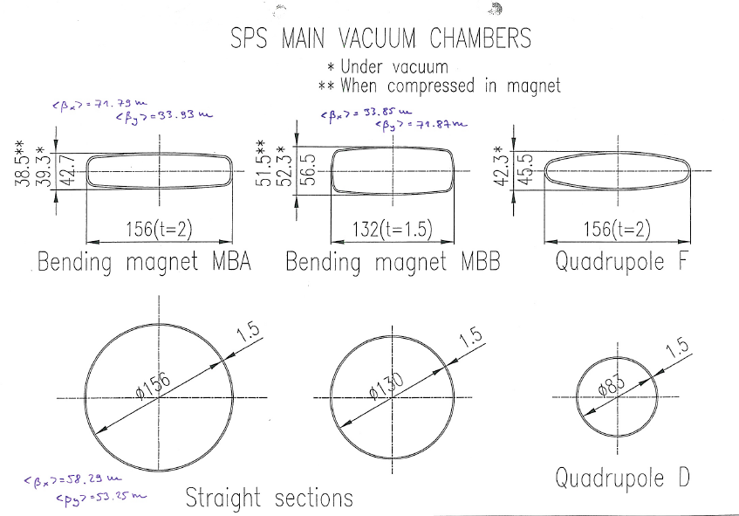
SPS transverse impedance model
Elements included in the database:
Realistic model that takes into account the different SPS vacuum chambers weighted by the respective length and beta function. Also the iron in the magnets is taken into account
Beam pipe
Notes:
Specificare che la cavita’ e’ quella a 200 MHz

Slide 4
SPS transverse impedance model: wall impedance
Horizontal SPS Wall impedance
Horizontal driving and detuning are opposite in sign

Slide 5
SPS transverse impedance model: wall impedance
Vertical SPS Wall impedance

Slide 6
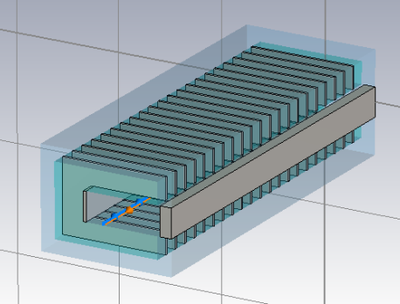
SPS transverse impedance model
Elements included in the database:
Realistic model that takes into account the different SPS vacuum chambers weighted by the respective length and beta function. Also the iron in the magnets is taken into account
19 kickers (CST 3D simulations)
Beam pipe
Kickers
Notes:
Specificare che la cavita’ e’ quella a 200 MHz

Slide 7
SPS transverse impedance model: kicker impedance
Horizontal SPS kicker impedance
Peak due to the serigraphy

Slide 8
SPS transverse impedance model: kicker impedance
Vertical SPS kicker impedance
Peak due to the serigraphy

Slide 9
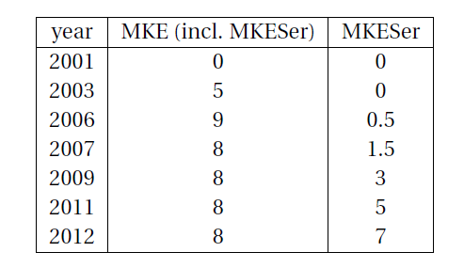
Evolution of the extraction kickers in the SPS
Post-LS1
2014 8 8
Notes:
Slide solo tabella storia

Slide 10
SPS transverse impedance model
Elements included in the database:
Realistic model that takes into account the different SPS vacuum chambers weighted by the respective length and beta function. Also the iron in the magnets is taken into account
19 kickers (CST 3D simulations)
106 BPHs (CST 3D simulations)
96 BPVs (CST 3D simulations)
BPH
BPV
Beam pipe
Kickers
Notes:
Specificare che la cavita’ e’ quella a 200 MHz

Slide 11
SPS transverse impedance model: BPMs impedance
Horizontal SPS BPMs impedance
Horizontal driving and detuning are about opposite in sign

Slide 12
SPS transverse impedance model: BPMs impedance
Vertical SPS BPMs impedance
Below 3% of the total SPS impedance

Slide 13
SPS transverse impedance model
Elements included in the database:
Realistic model that takes into account the different SPS vacuum chambers weighted by the respective length and beta function. Also the iron in the magnets is taken into account
19 kickers (CST 3D simulations)
106 BPHs (CST 3D simulations)
96 BPVs (CST 3D simulations)
200 MHz cavities without couplers (CST 3D simulations)
800 MHz cavities without couplers (CST 3D simulations)
Enamel flanges (CST 3D simulations)
Enamel flanges
BPH
BPV
Beam pipe
Kickers
TW 200MHz and 800MHz
Notes:
Specificare che la cavita’ e’ quella a 200 MHz

Slide 14
SPS transverse impedance model: cavities impedance
Horizontal SPS cavities impedance

Slide 15
SPS transverse impedance model: cavities impedance
Vertical SPS cavities impedance
Below 3% of the total SPS impedance

Slide 16
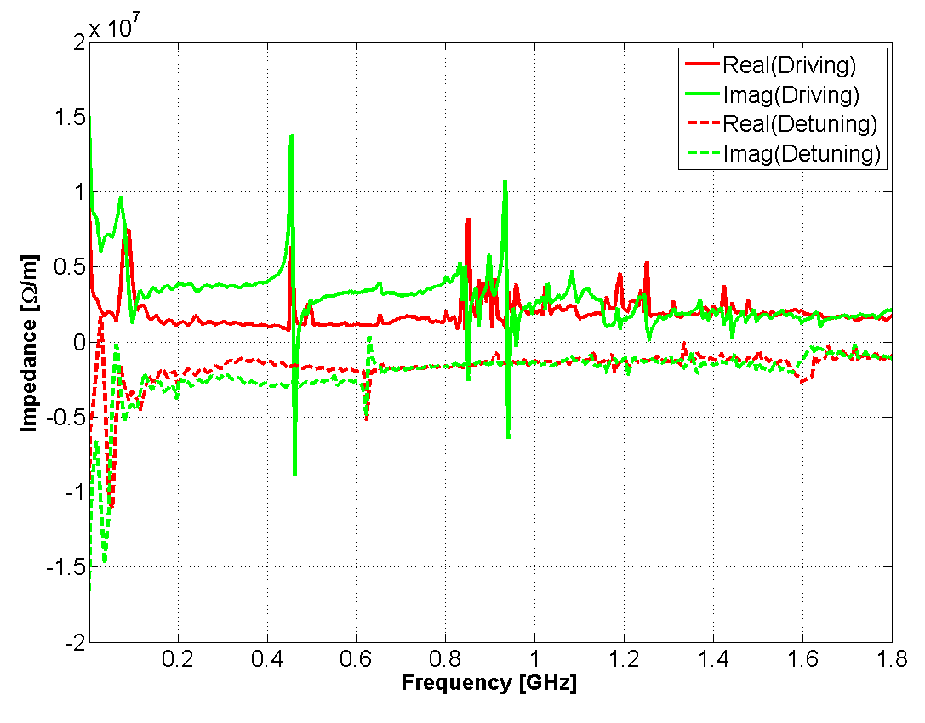
SPS horizontal impedance model

Slide 17
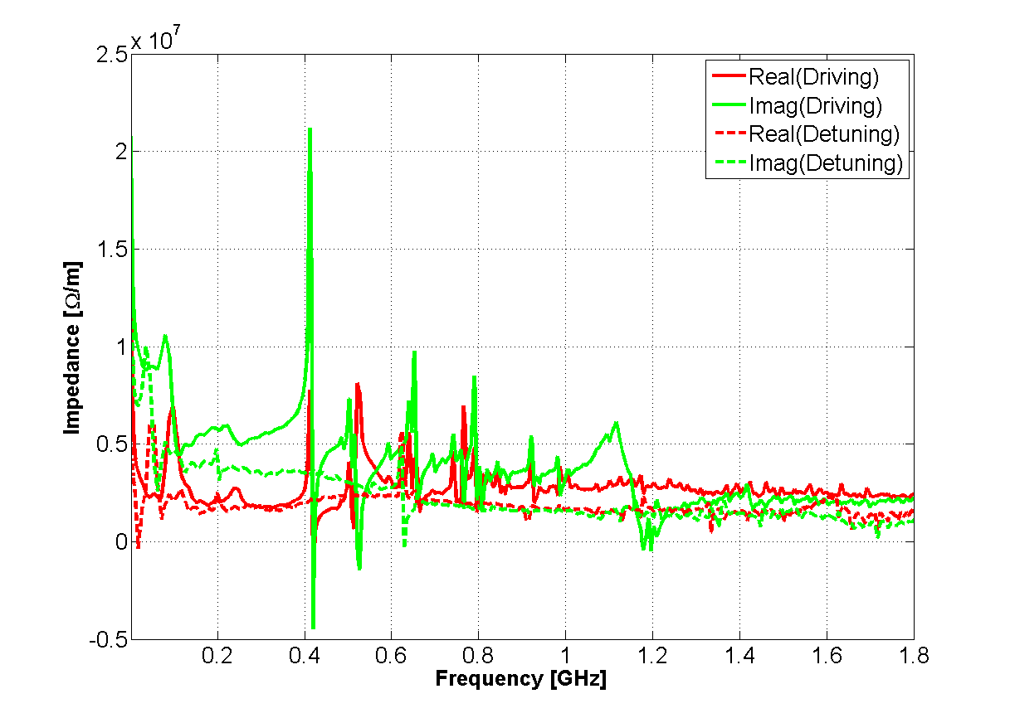
SPS vertical impedance model

Slide 18
Vertical coherent tune shift
20 %
40 %
60 %
Measurements performed in September 2012
80 %
100 %
Present SPS impedance model reproduces about 70% of the vertical tune measured in the Q20
Present impedance model reproduces the instability behavior (H. Bartosik, Talk at the SPSU, 12 December 2013)

Slide 19
Stability diagram: Q20
Two regimes of instability in measurements
Fast instability threshold with linear dependence on ε_{l}
Slow instability for intermediate intensity and low ε_{l}
Excellent qualitative agreement with HEADTAIL simulations
H. Bartosik
measurements
HEADTAIL simulations
nominal
Island of slow instability
4.5x10¹¹ p/b
@ 0.35 eVs

Slide 20
Intra-bunch motion:Q20
H. Bartosik
measurements
HEADTAIL simulations
Example for slow instability
Example for fast TMC instability
Excellent agreement between measurements and simulation

Slide 21
Horizontal coherent tune shift
Measurements performed in February 2013
The kicker impedance model predicts a slightly negative horizontal effective impedance (positive slope of the coherent tune shift) in agreement with the measurements

Slide 22
Overview
SPS transverse impedance model
Broadband impedance of step transitions
Future update of the model
Summary

Slide 23
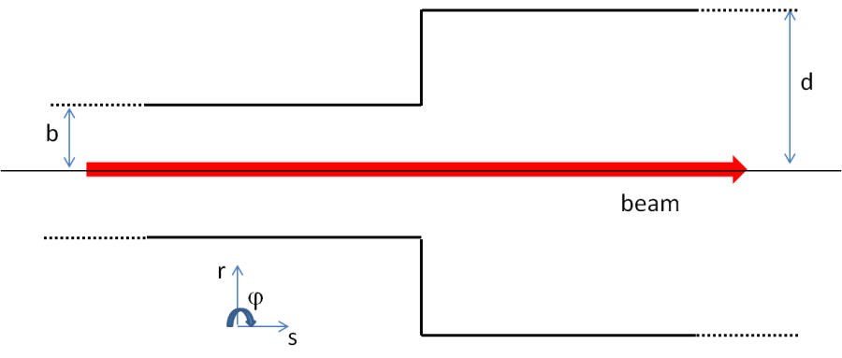
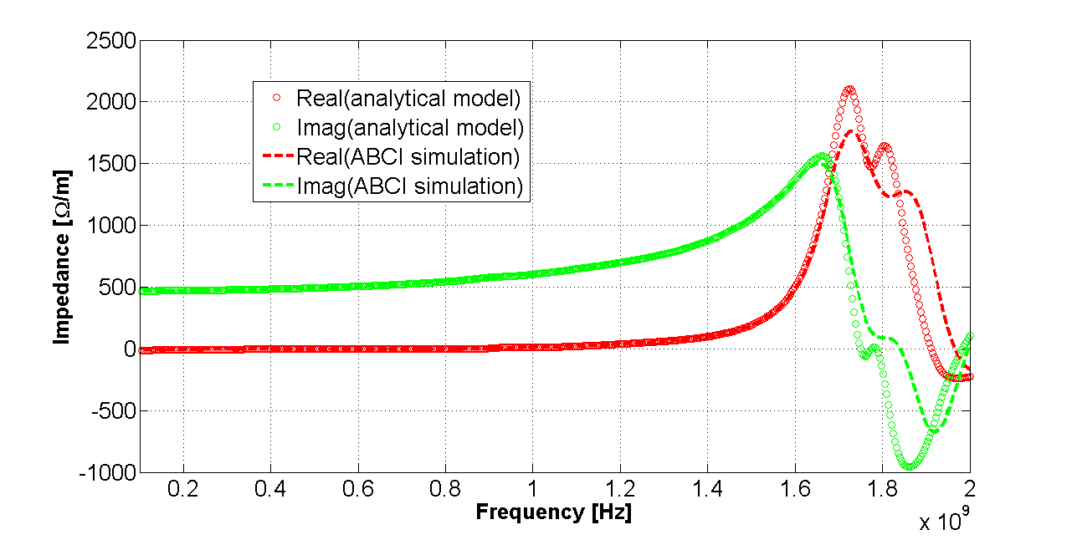
Broadband impedance of a step transition
Transverse Impedance
Based on the results of 3D EM simulations, the broadband impedance contribution due to an abrupt transition is independent of the relativistic beta. Therefore, based on the aperture model, the generalized broadband impedance of the PSB transitions has been calculated as:
C. Zannini, Electromagnetic simulations of CERN accelerator components and experimental applications. PhD thesis, Lausanne, EPFL, 2013. CERN-THESIS-2013-076.

Slide 24
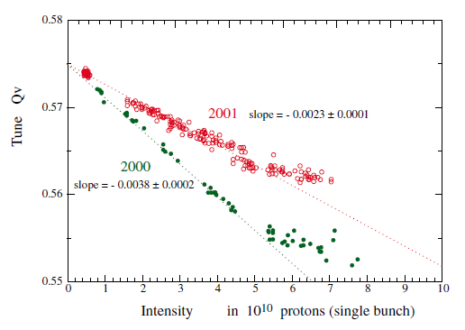
Pumping ports
Impedance reduction campaign: shielding of the pumping ports, lepton cavities etc.)
2000
Total number of shielded pumping ports
H. Burkhardt, G.Rumolo, F. Zimmermann: Measurements of SPS Single-Bunch coherent Tune Shifts and Head-Tail Growth Rates in the Year 2001
P. Collier et al.: Reducing the SPS Machine Impedance, 2002
The broadband impedance due to step transitions can give significant contribution to the coherent tune shift
Notes:
There are also other device that we are studying . Like……..

Slide 25
Pumping ports
Impedance reduction campaign: shielding of the pumping ports, lepton cavities etc.)
2000
SPS Pumping port
SPS Pumping port shielding
The picture does not include pumping holes
Notes:
There are also other device that we are studying . Like……..

Slide 26
Broadband impedance of step transitions
L
Weak dependence on L

Slide 27
Broadband impedance of step transitions
L2
Weak dependence on L2

Slide 28
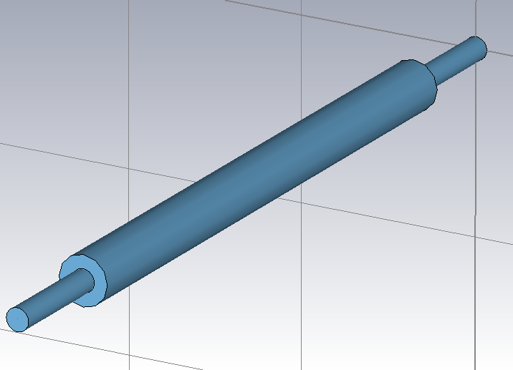
Broadband impedance of step transitions
The imaginary part of the transverse impedance is weakly dependent on the cavity length below 1 GHz
b = 17. 25 mm
d = 78 mm
L2
For the main SPS cavity like structures the first resonating mode is well above 1 GHz (r<80 mm)

Slide 29
Broadband impedance of step transitions
L2

Slide 30
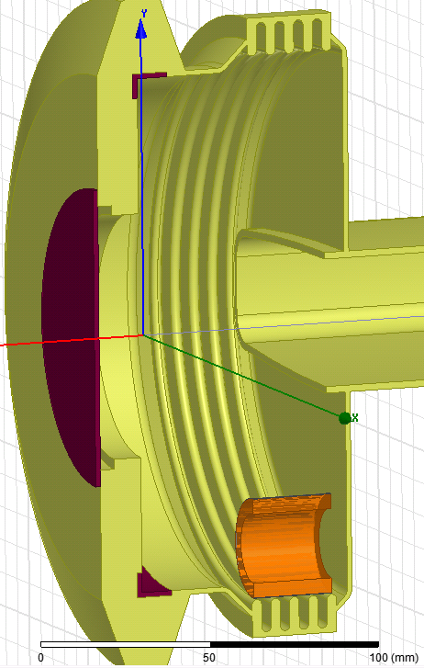
Broadband impedance of step transitions
Flange Type | Enamel | Bellow | Num. of elements | Resistor
BPV-QD | Yes | Yes | 90 | No
BPH-QF | Yes | Yes | 39 | Long
QF-MBA | Yes | Yes | 83 | Short
MBA-MBA | Yes | Yes | 14 | Short
QF-QF | No | Yes | 26 | Short
QD-QD | Yes | No | 99 | No
QF-QF | No | No | 20 | No
BPH-QF | Yes | Yes | 39 | Long
QD-QD | No | No | 75 | No
QD-QD | Yes | No | 99 | No
Courtesy of Jose E. Varela

Slide 31
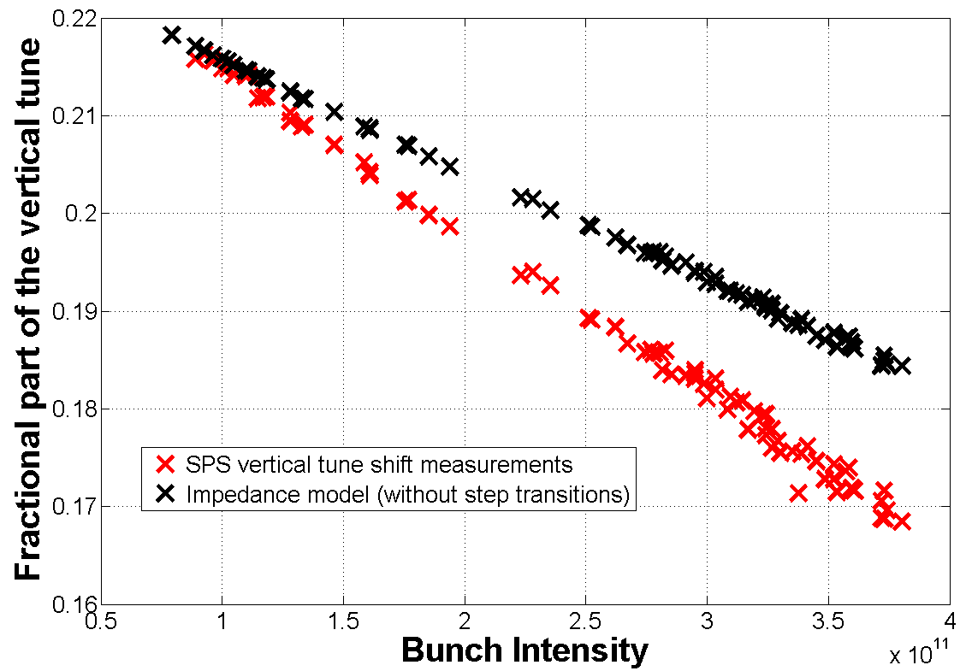
Vertical coherent tune shift
20 %
40 %
60 %
80 %
100 %
Step transitions seem to explain almost the totality of the missing tune shift

Slide 32
Broadband impedance of step transitions: longitudinal plane
L
Weak dependence on L

Slide 33
Overview
SPS transverse impedance model
Broadband impedance of step transitions
Future update of the model
Summary

Slide 34
New elements to be added in the model
Simulations are ongoing or must be finalized
Septa
Wire scanner
Non standard elements (special transitions, valves)
Update due to future installations
New wire scanner
New kicker for high bandwidth feedback system
New MSI-V septum

Slide 35
New elements to be added in the model
Simulations are ongoing or must be finalized
Septa
Wire scanner
Non standard elements (special transitions, valves)
Update due to future installations
New wire scanner
New kicker for high bandwidth feedback system
New MSI-V septum

Slide 36
EM model of the stripline kicker including transitions

Slide 37
Longitudinal impedance
Lt is the length of the cavity like structure
Short length (below 0.1 m) of the cavity like structure would avoid narrow resonances below 2 GHz
The impedance is strongly dependent on the cavity like structure length

Slide 38
Transverse impedance
Impedance [Ohm/m]
The impedance is strongly dependent on the cavity like structure length
Impedance [Ohm/m]

Slide 39
Transverse impedance
Impedance [Ohm/m]
The effective vertical impedance for 10 stripline kicker modules is expected to be about 0.5% of the total SPS vertical impedance

Slide 40
Overview
SPS transverse impedance model
Broadband impedance of step transitions
Future update of the model
SPS Longitudinal impedance model
Summary

Slide 41
Summary and next steps
The SPS impedance model (kicker, wall, cavities, BPMs) explains about 70% of the measured vertical coherent tune shift
Transition pieces seem to be able to explain a large part of the remaining 30%
More realistic model of transition pieces
Update of the model including septa and wire scanner
Continuously update of the model according to new installations and modifications

Slide 42
Thank you for your attention

