Slide 1
Latest longitudinal simulations with the SPS impedance model
A. Lasheen, T. Argyropoulos
Acknowledgements: E. Shaposhnikova, J. E. Varela
LIU-SPS BD WG 26/06/2014

Slide 2
Outline
Impedance model
Reminder of the different set of measurements obtained in 2012 – 2013.
Long bunches (25 – 30 ns) with RF off.
Synchrotron frequency shift at injection.
Bunch length measurements versus Intensity at the SPS flat top.
Simulation results
Summary

Slide 3
Longitudinal impedance model
Travelling wave cavity model (+1 HOM resonator)
Jose E. Varela – SPS upgrade meeting 27/03/14
BPMs (BPHs + BPVs) (resonators)
Jose E. Varela – SPS upgrade meeting 22/05/14
Flanges (resonators)
Jose E. Varela – SPS upgrade meeting 22/05/14
Y chambers (resonators)
Jose E. Varela – SPS upgrade meeting 22/05/14
Kickers (impedance table)
Carlo Zannini – SPS upgrade meeting 27/03/14
Resistive wall (impedance table)
Carlo Zannini – SPS upgrade meeting 27/03/14

Slide 4
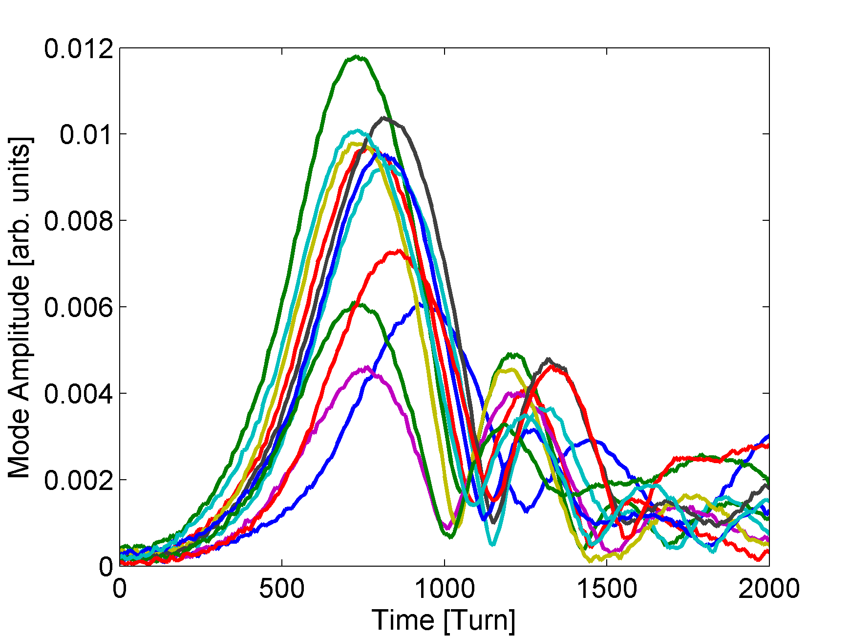
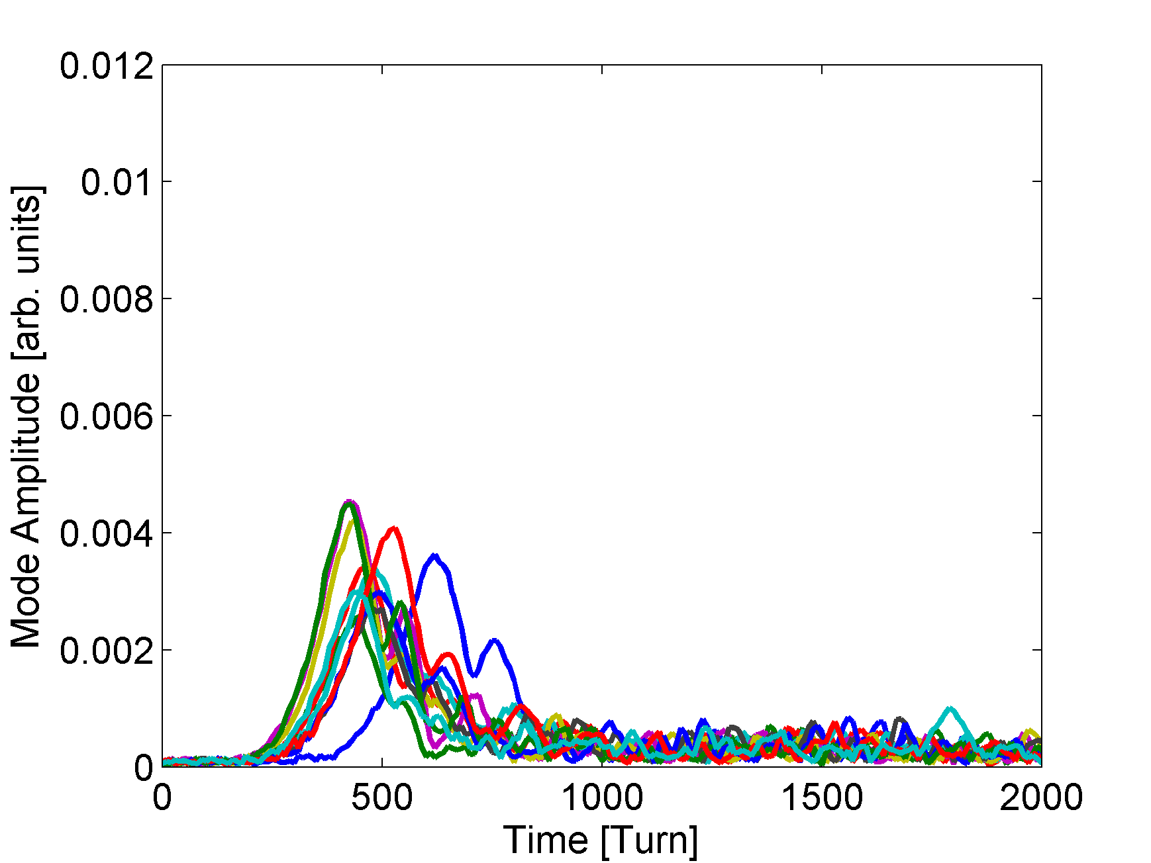
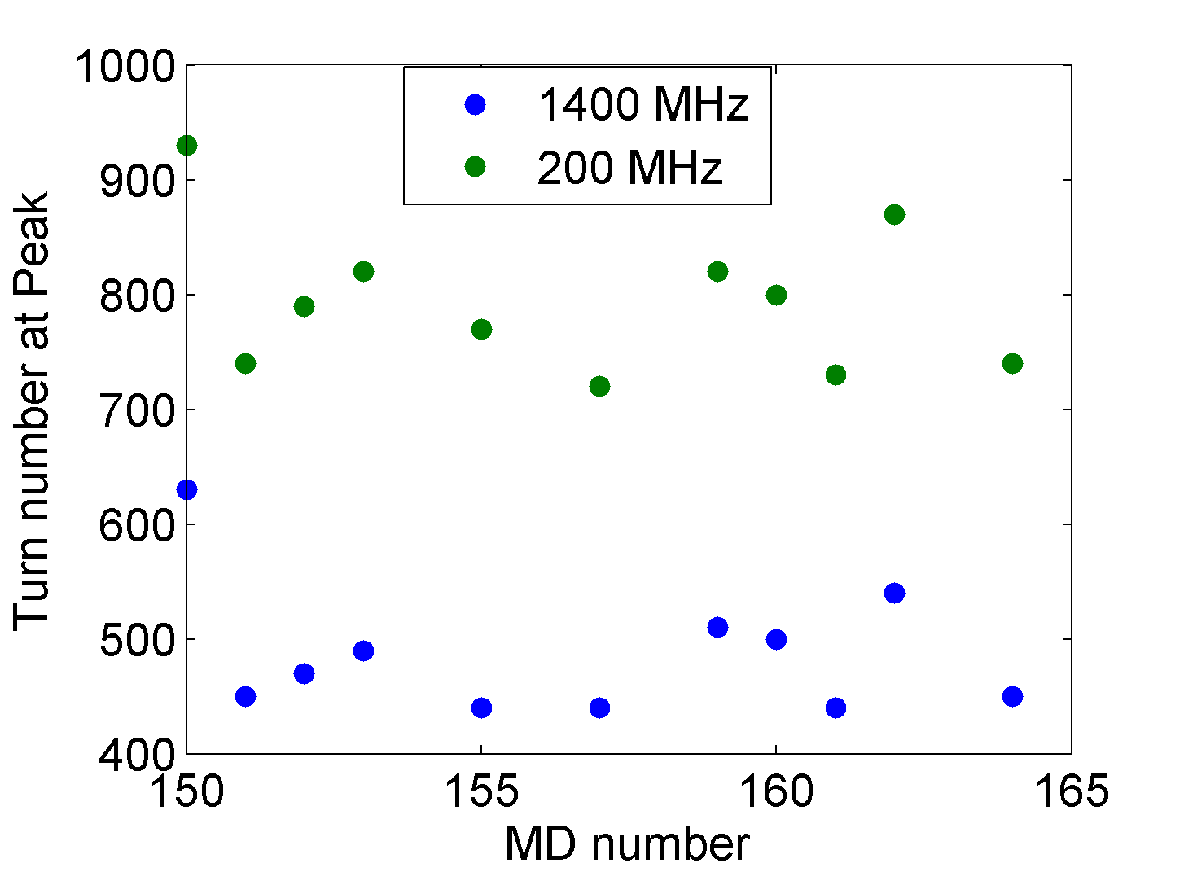
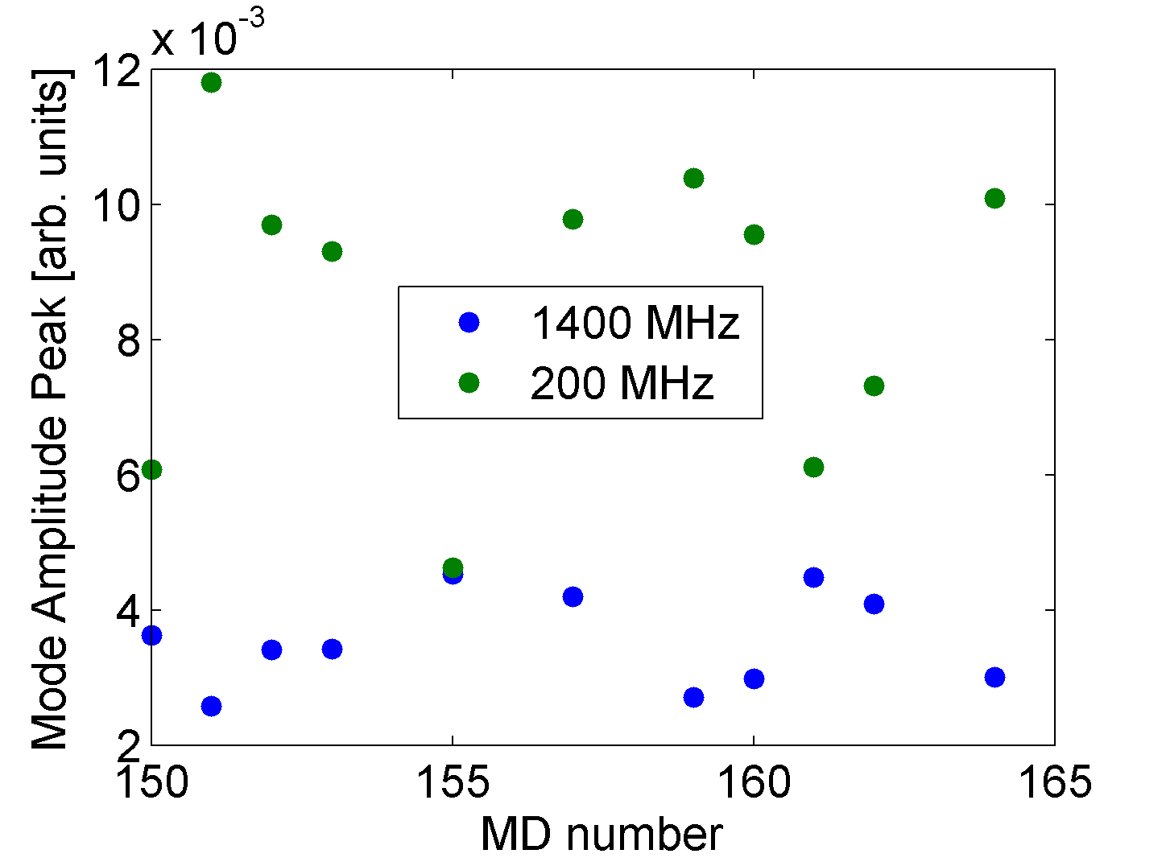
Long bunches - measurements
Measurements show a big scatter from shot to shot. Example with Q26 and intensity N~1x10¹¹ p. Similar at all intensities and also in Q20
200 MHz Mode evolution
1400 MHz Mode evolution
Strong dependence on the initial distribution
Correlation of the
growth time
Anti-correlation of the
amplitude

Slide 5
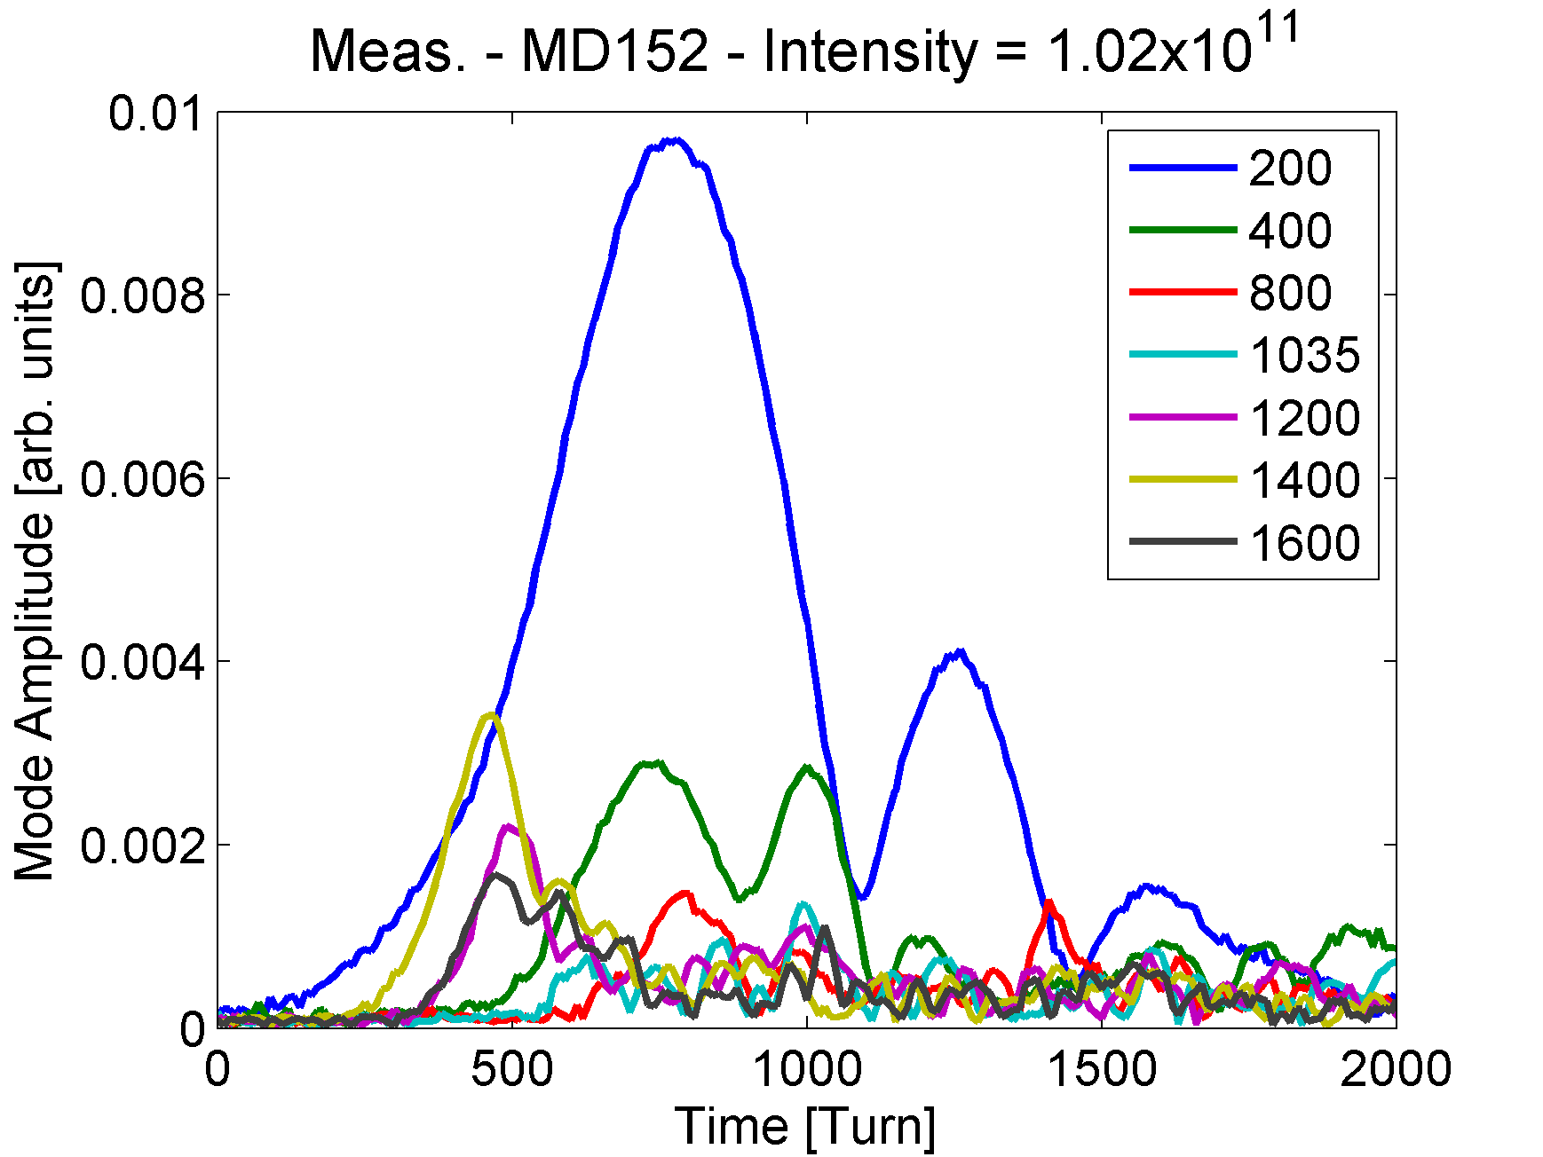
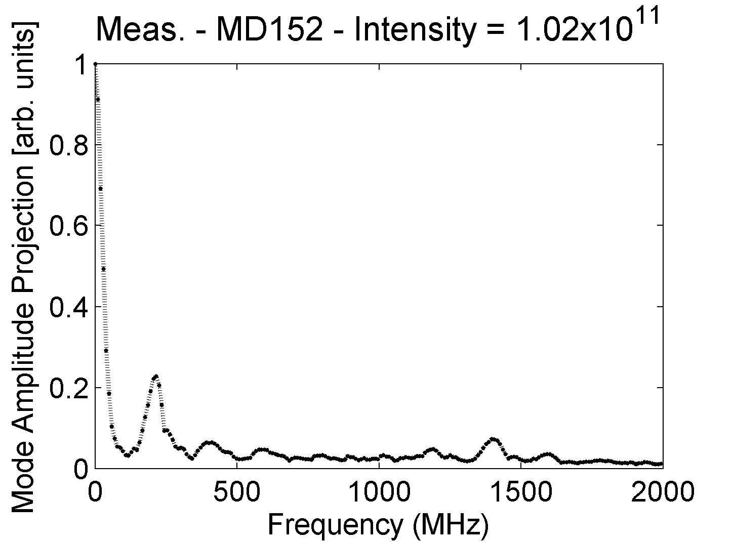
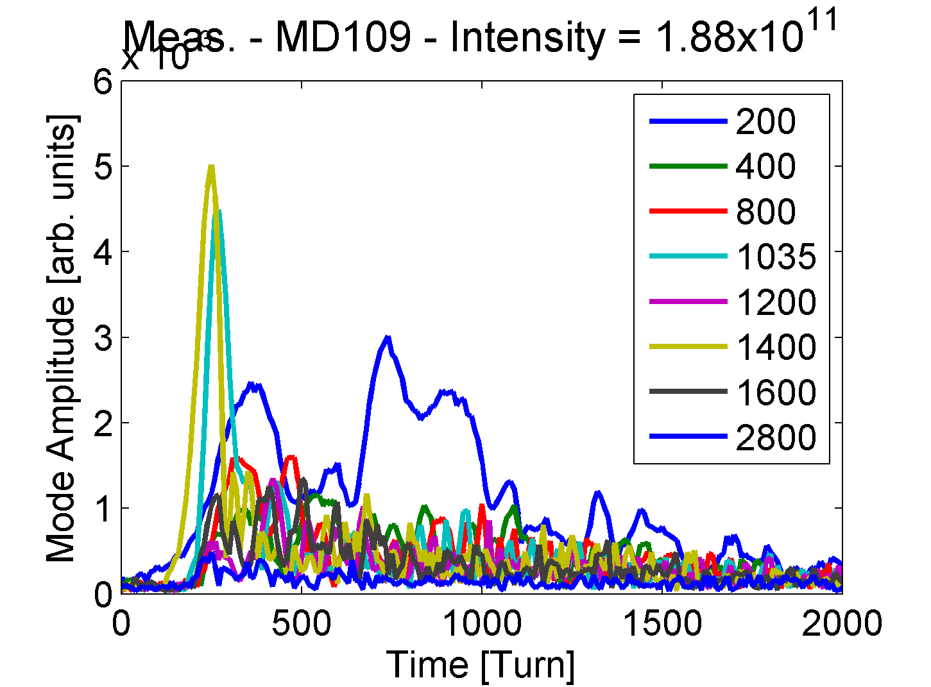
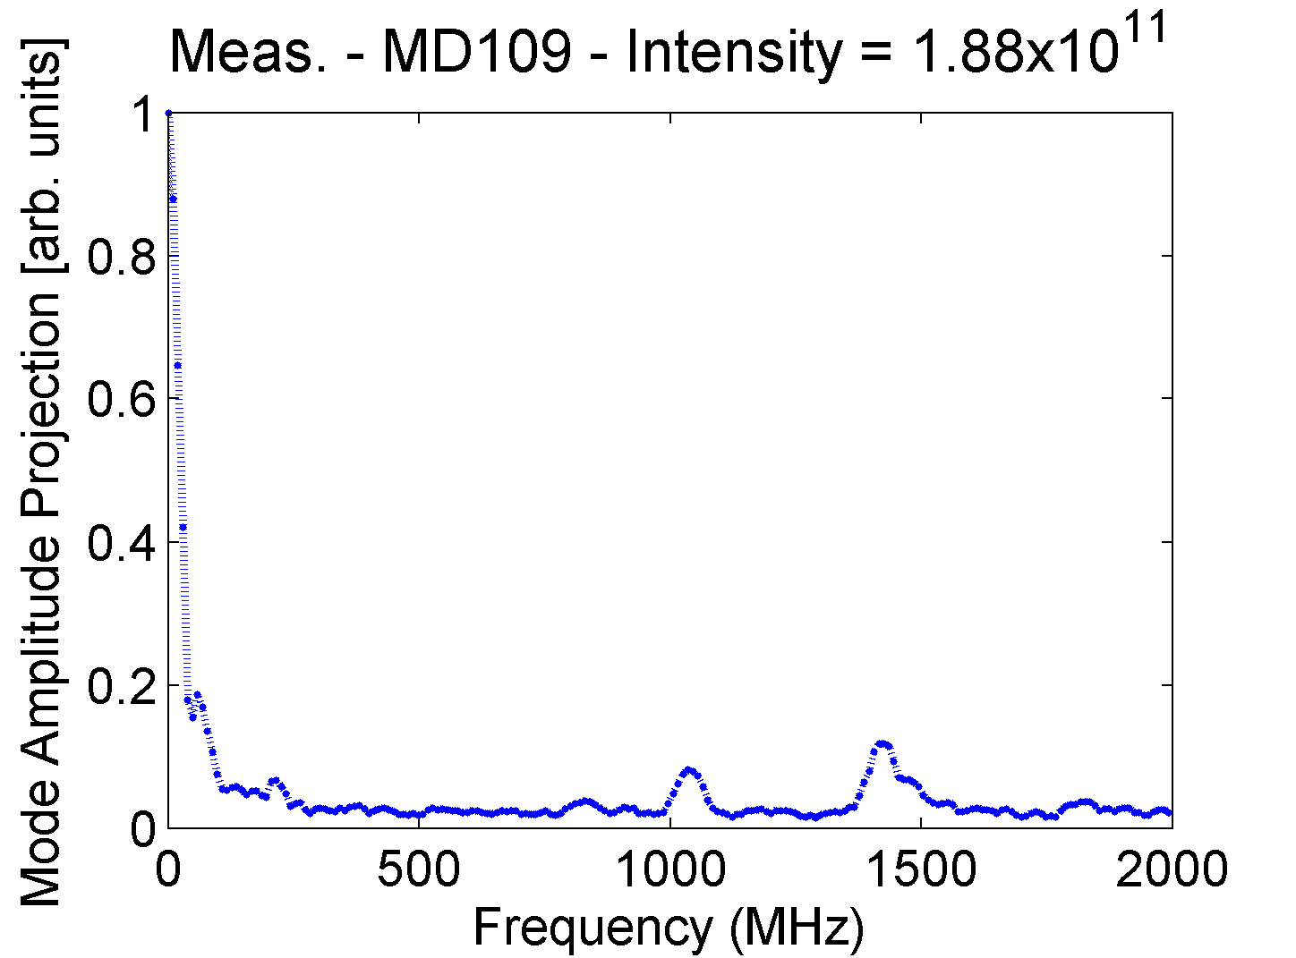
Long bunches - measurements
Measurement with N=1x10¹¹ p (close to the average) used for comparison
Also a peak at 1.035 GHz is observed at higher intensities (N>1.8x10¹¹ p)
1.4 GHz
1.035 GHz

Slide 6
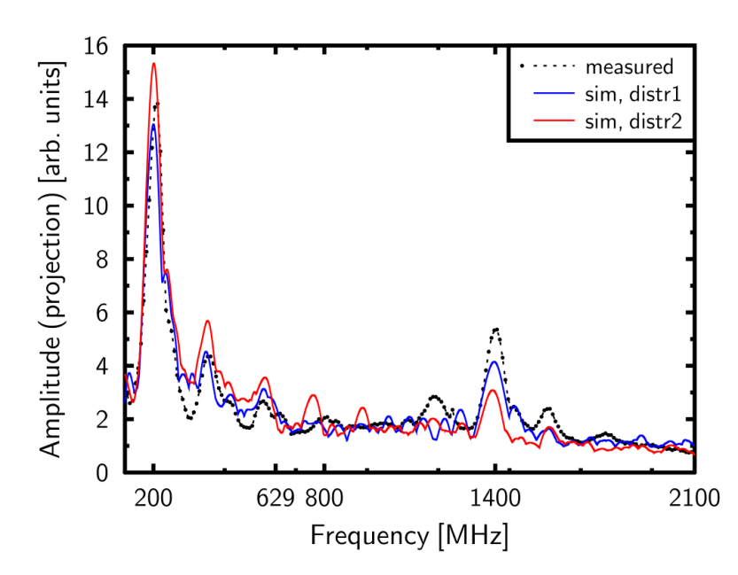
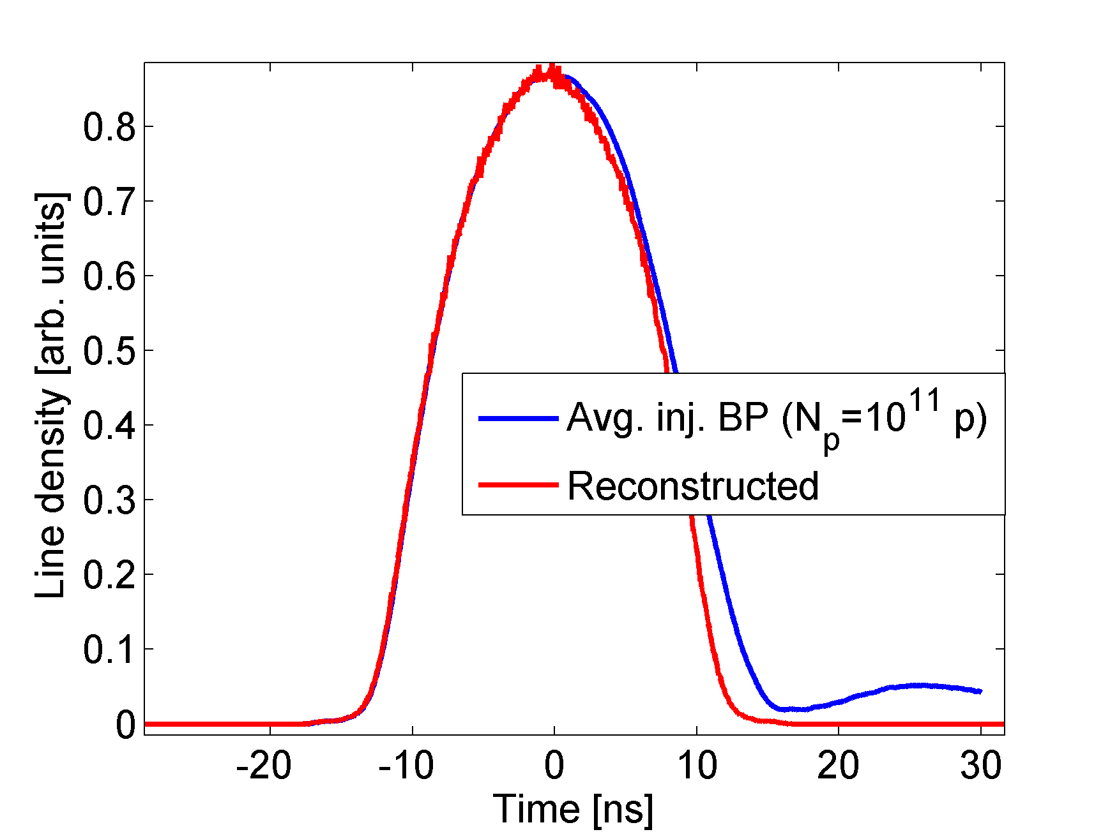
Long bunches - simulations
Strong dependence in the particle distribution seen also in simulations with distributions obtained in the PS from tomoscope → distribution generated from the bunch profiles injected into the SPS
Strong dependence on the numerical noise → simulations with 5M macroparticles.
Dependence on the initial bunch length → stronger peak at 1.4 with shorter bunches.
Reconstructed distributions (tomoscope)
Example with N=1x10¹¹ and τ = 26 ns

Slide 7
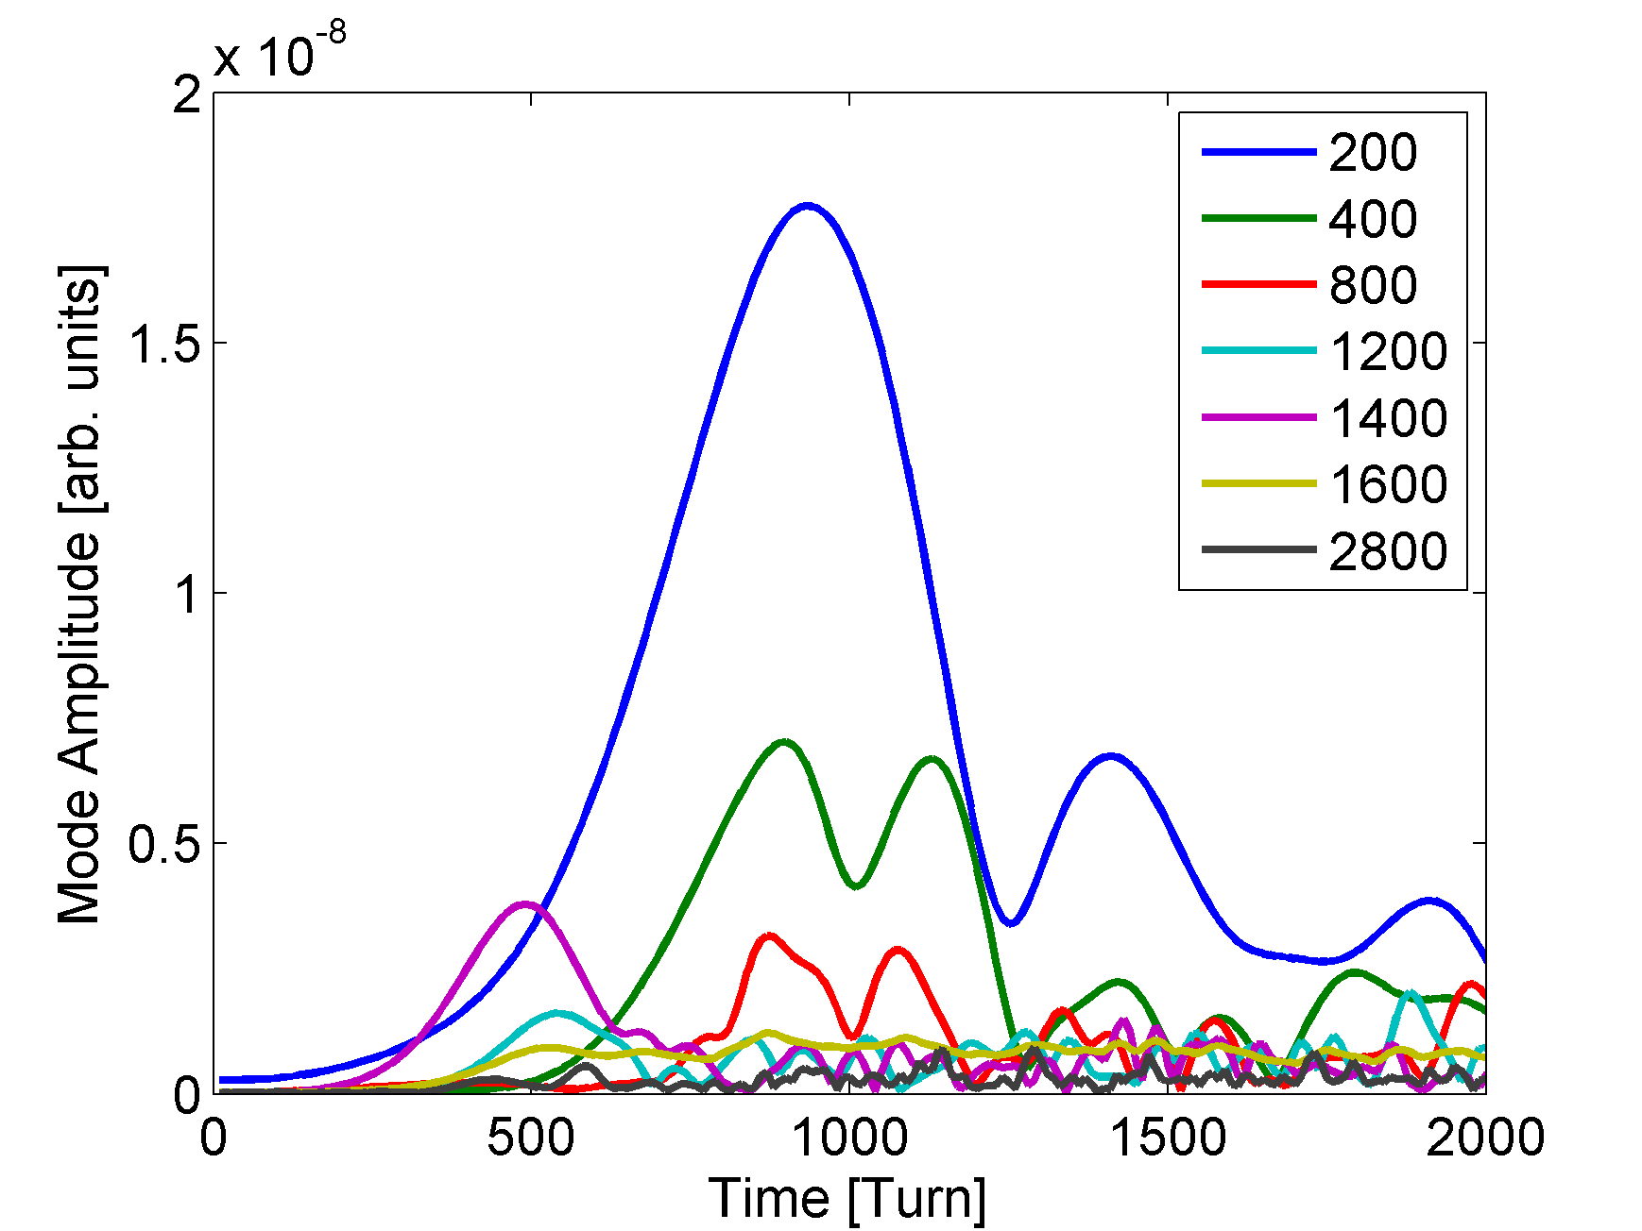
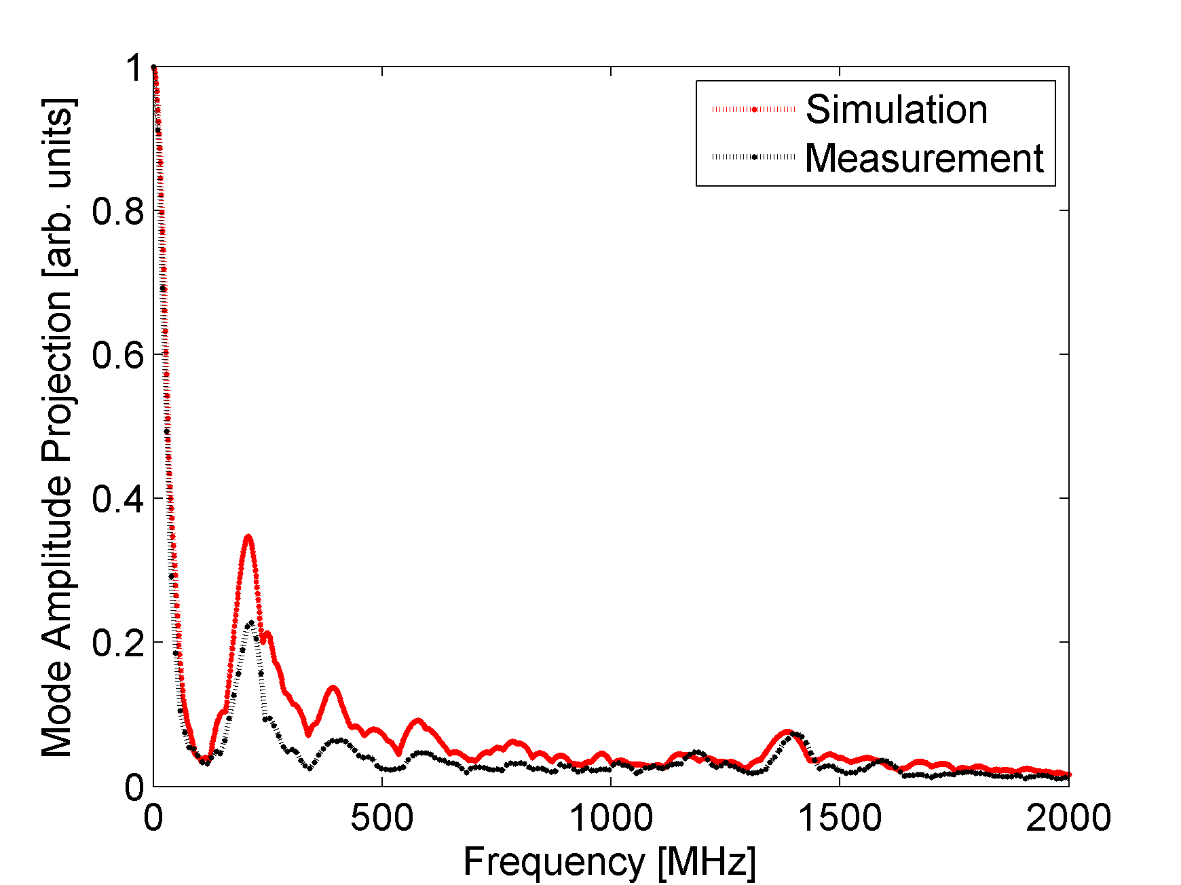
Long bunches - simulations
Results obtained with the reconstructed distribution of N=1x10¹¹ and τ = 26 ns using the current SPS impedance model.
Stronger peak at 200 MHz
Same at 1.4 GHz
Similar growth rate for the 1.4 GHz but slower for the 200 MHz for this distribution
The ratio A_{200/}A₁₄₀₀ bigger compared to the measurement
Not very clear side bands at 1.2 GHz and 1.6 GHz
Measurement

Slide 8
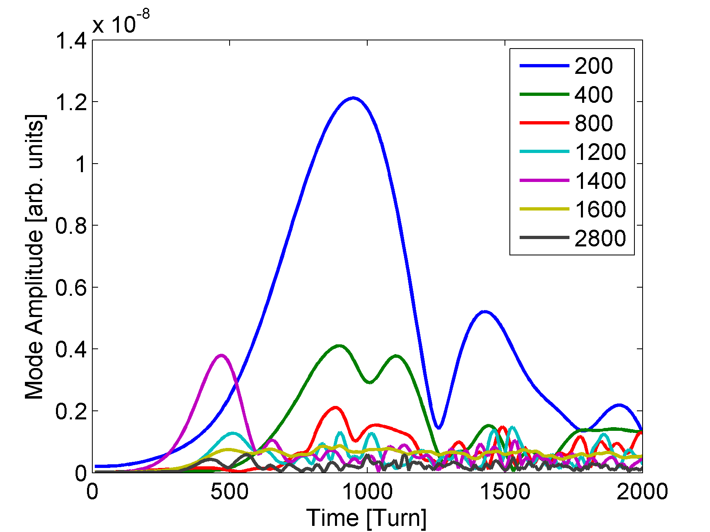
Long bunches - simulations
Increasing the R/Q of the 1.4 GHz peak in the flanges by ~10% we get the correct ratio A_{200/}A₁₄₀₀ = 2.8
But all the previous comments are still valid.

Slide 9
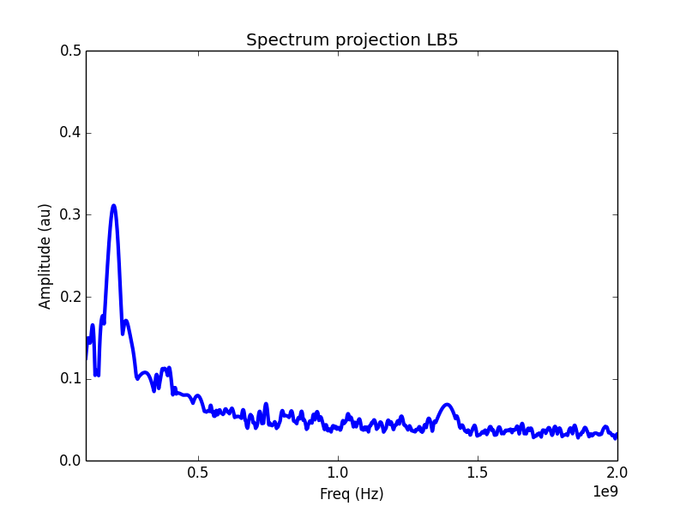
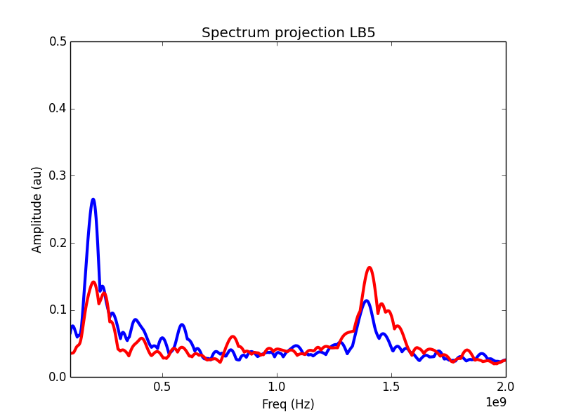
Long bunches - simulations
Simulations for Q20 give strange results, the peak around 1.4 GHz is very low (or absent). These simulations have to be checked
Simulating also for different assumptions of the damping resistors of the flanges affects also the results → more accurate information is necessary
Q20 simulation
With damping resistors
Without damping resistors

Slide 10
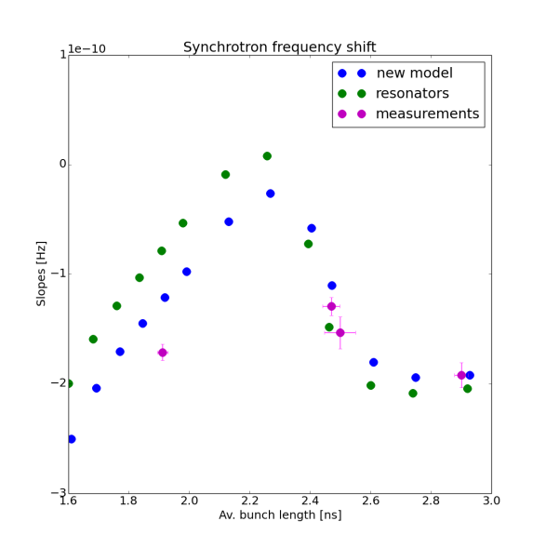
Synchrotron frequency shifts - simulations
Reminder:
Bunch length oscillations at injection for short bunches
Each point corresponds to the slope of the frequency as a function of intensity
The injected bunch is parabolic (and results are very dependent on bunch profile…)

Slide 11
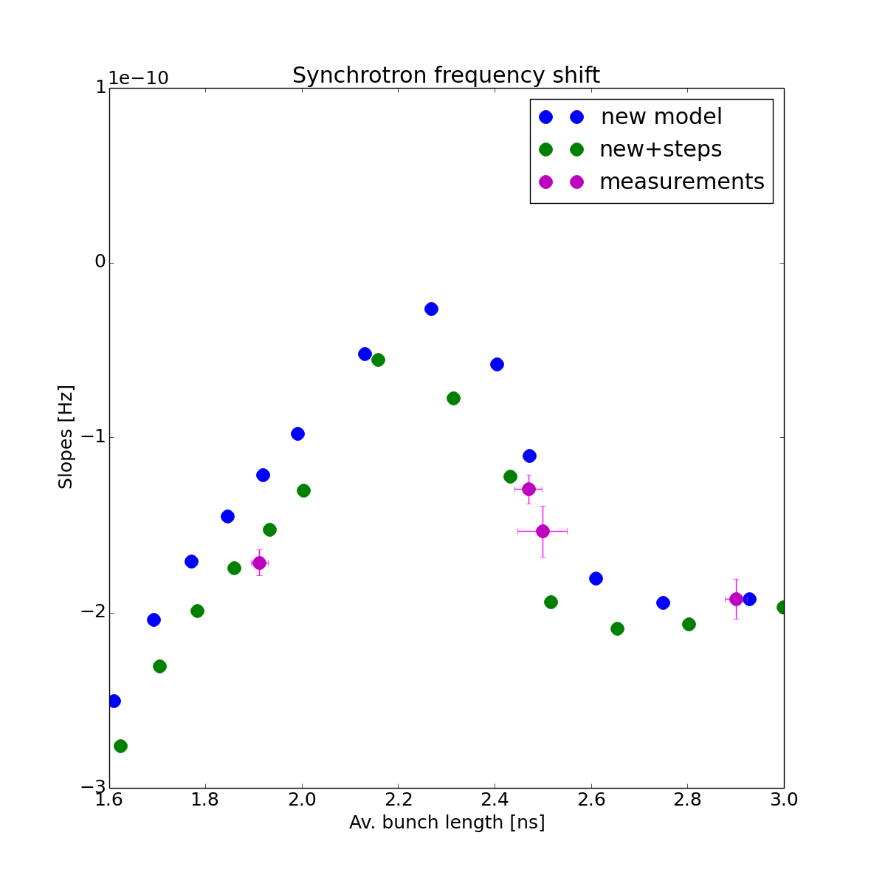
Synchrotron frequency shifts - simulations
Adding steps:
$ℑ{\left\{\frac{Z}{n}\right\}}_{steps}\sim$ 0.5 Ohms
Good agreement, but…

Slide 12
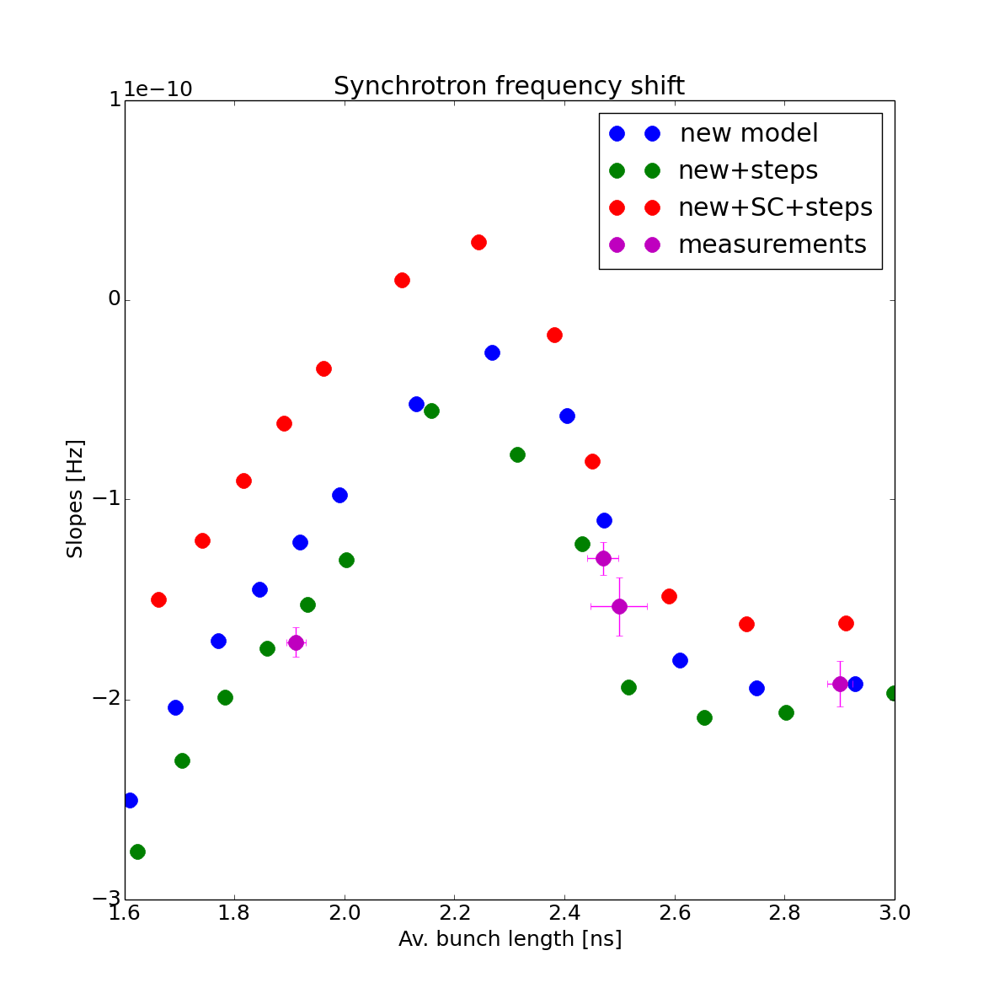
Synchrotron frequency shifts - simulations
Adding space charge:
Steps:
$ℑ{\left\{\frac{Z}{n}\right\}}_{steps}\sim$ 0.5 Ohms
Space charge (approximation, needs to be refined):
$ℑ{\left\{\frac{Z}{n}\right\}}_{SC}\sim$ -1.5 Ohms
Overall missing impedance:
$ℑ{\left\{\frac{Z}{n}\right\}}_{missing}\sim$ 1 Ohms
More measurements needed

Slide 13
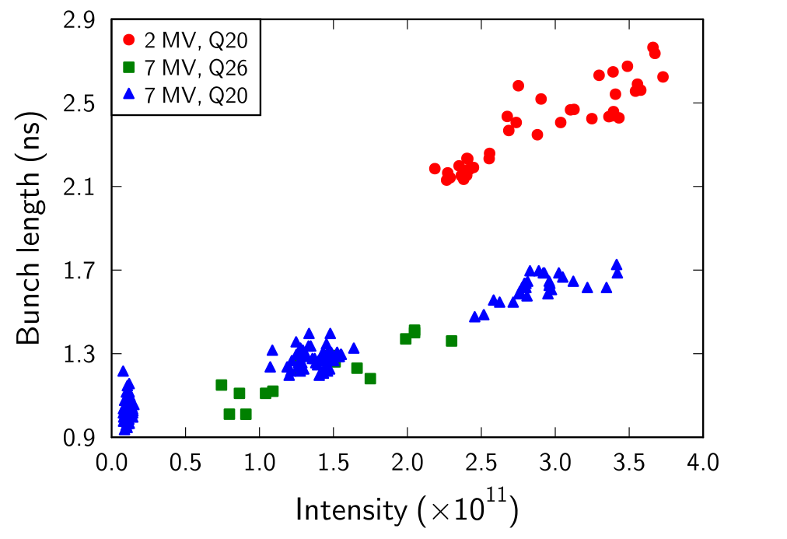
SPS flat top
Measurements at flat top show an increase in the bunch length versus intensity which can not be explained by the potential well distortion → $ℑ\left\{Z/n\right\}\sim$15 Ohms is needed → blow-up by a microwave instability?
Preliminary simulations in Q20 with the current impedance model to try to reproduce the measured data:
Generating the distribution (parabolic, Gaussian) matched to the SPS bucket at flat top (V₂₀₀ = 7 MV and V₈₀₀ = 0.65 MV)
Tracking over 50E3 turns to observe the bunch length evolution.

Slide 14
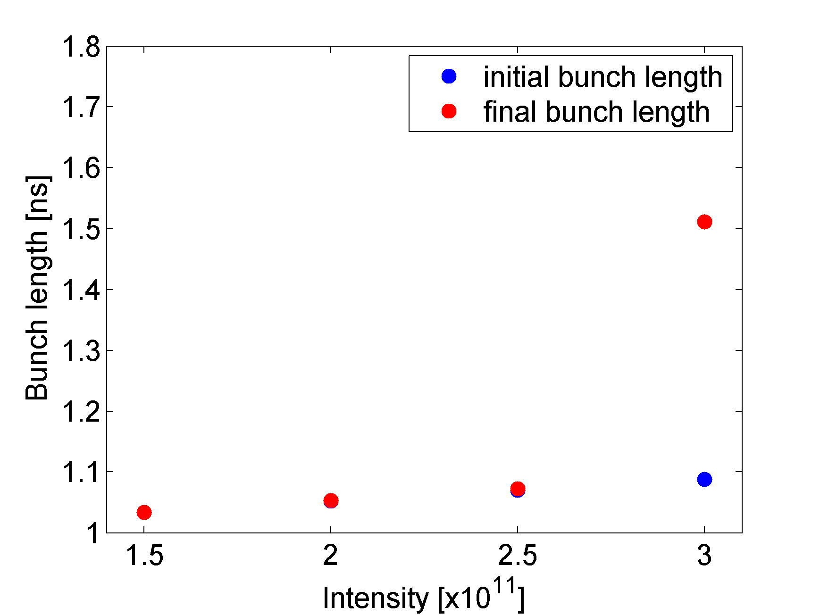
SPS flat top
Including an extra broad band impedance at 1.3 GHz with $ℑ\left\{Z/n\right\}$ = 1.5 Ohms at low frequencies (take into account the missing inductive part) and increasing the impedance of the flanges by 20% still not sufficient.
Threshold found from simulations is N > 2.5x10¹¹ p
Example of parabolic bunch with ε=0.4 eVs
More simulations are planned:
with different RF voltages
more accurate implementation of the missing impedance
different particle distributions (for Gaussian bunches the threshold is even higher)
simulating through energy ramp

Slide 15
Conclusions and plans
Though it seems that some impedance is still missing, the latest impedance model shows improvement in the simulations
Future improvement of the impedance model will be simulated
Effect of the couplers in travelling wave cavities
Proportion of damping resistors in the flanges
Space charge
Steps
…
Simulations are very dependent on the input distribution
Bunch generation will be refined (tracking in PS with intensity effects, …)
MDs needed to have more data
Synchrotron frequency shift (+ at higher energy to reduce space charge effects)

Slide 16
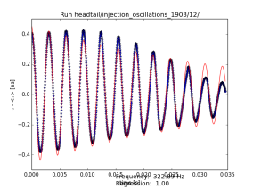
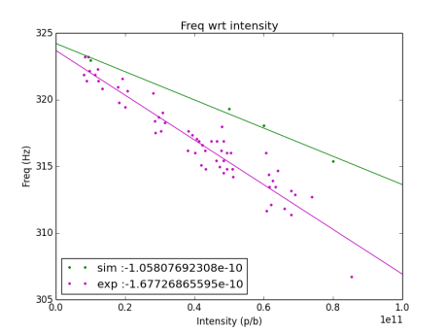
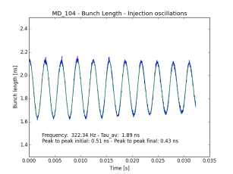
Extra slides – synchrotron frequency shift
Simulation
Slopes
Measurement

Slide 17
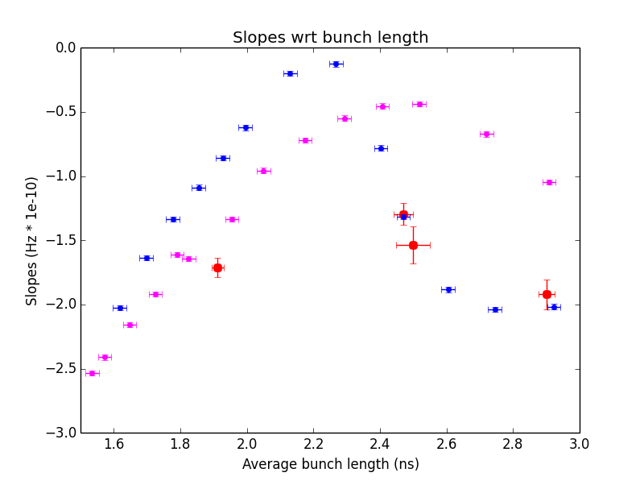
Extra slides – synchrotron frequency shift
Parabolic (blue)
Gaussian (magenta)

