Slide 1
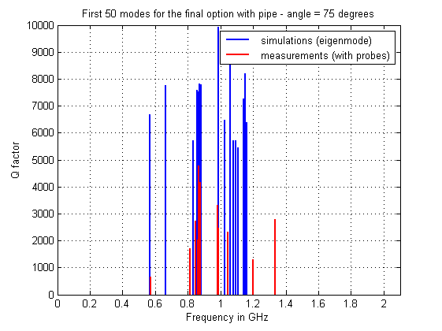
Update on SPS wire scanners
Current wire scanner tanks:
All wire scanners will be reinstalled with tungsten wire
One wire scanner only will benefit from the new shielding plates
Simulations and bench measurements show a beneficial effect of the plates, much less obvious for the wire (should not be worse though)
→ to be seen how it behaves next year
New wire scanner tank (empty):
“Similar” modes in simulations and measurements
Measurements show a much lower Q for certain modes than in simulations
Therefore installation confirmed, but for a limited time for the prototype only. Tests with the scanner should also be performed.

