Slide 1
Update on the SPS impedance model and results of the recent SPS survey
Jose E. Varela and Thomas Bohl

Slide 2
Outline
The 2014 SPS Longitudinal Impedance Model
Cavities
Flanges
BPMs
Other Stuff
Total SPS Longitudinal Impedance Model
Machine Survey
Conclusions

Slide 3
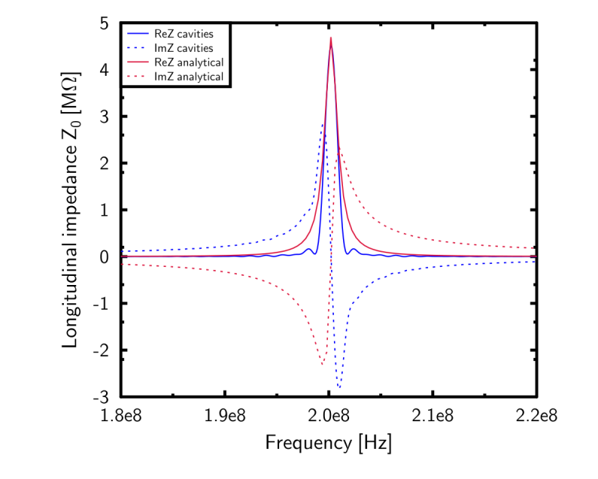
Current Impedance Model of the Cavities
Updated in LIU-SPS BD WG meeting 19/09/2013. Talk of H. Timko.
Element | f [GHz] | a (μs) | Z [kΩ] | Q | R/Q [Ω]
200 TWS - 43 cell | 0.200 | 3.56 | 1752 | G. Dome SPS/ARF/77-11 | -
200 TWS - 54 cell | 0.200 | 4.47 | 2760 |  | -
800 TWS | 0.800 | 2.07 | 1938 |  | -
200 TWS HOM | 0.629 | - | 388 | 500 | 780
$$Z\left(f\right)=R \left\{{\left(\frac{sin\left(\frac{a(f−f_{r})}{2}\right)}{\frac{a(f−f_{r})}{2}}\right)}^{2}−2i\frac{a\left(f−f_{r}\right)−sin⁡(a\left(f−f_{r}\right))}{{(a(f−f_{r}))}^{2}}\right\}$$
$W\left(t\right)=\frac{2R}{\tilde{a}}\left(1−\frac{t}{\tilde{a}}\right)cos\left(ω_{r}t\right)$, where $\tilde{a}=\frac{a}{2π}$.

Slide 4
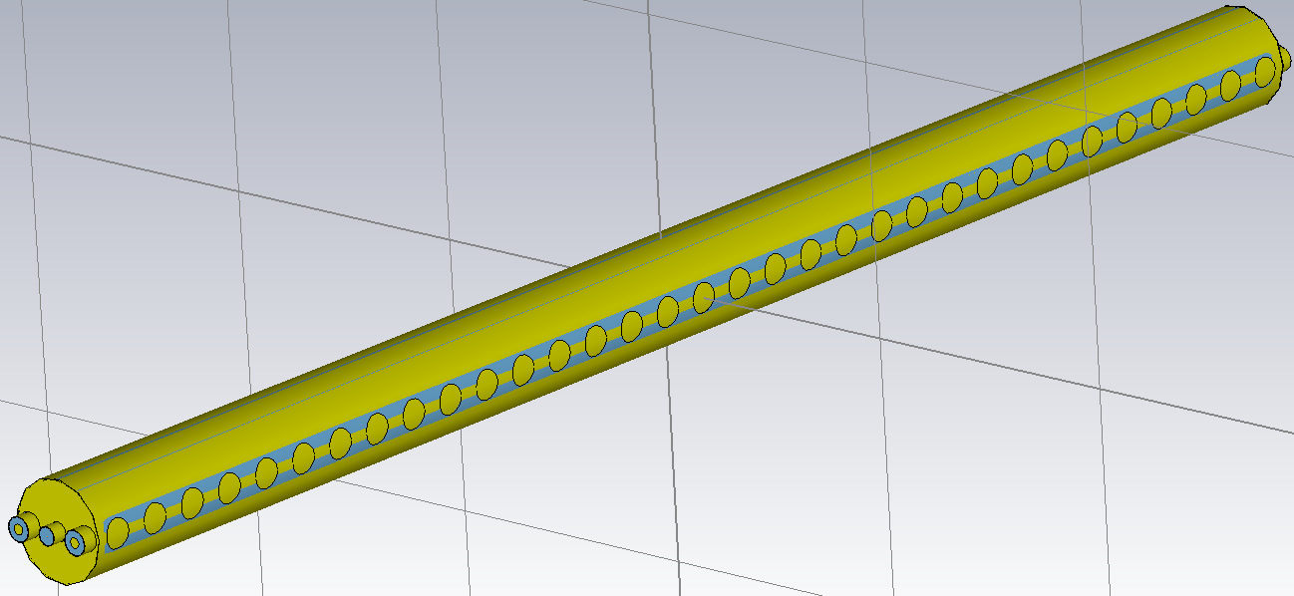
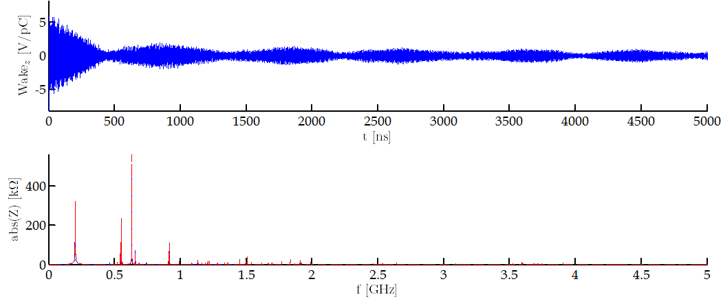
200MHz 3 Tank Cavity (I)
200MHz 3 tank cavity
Main couplers, sort of, accounted for
No HOM couplers
Simulation not converged
There are HOM couplers to damp this resonance.
Impedance of the HOMs.
Simulation not converged
Impedance higher than expected (by me)
Values could be due to the main couplers
Change of cavity behaviour (Standing Wave)

Slide 5
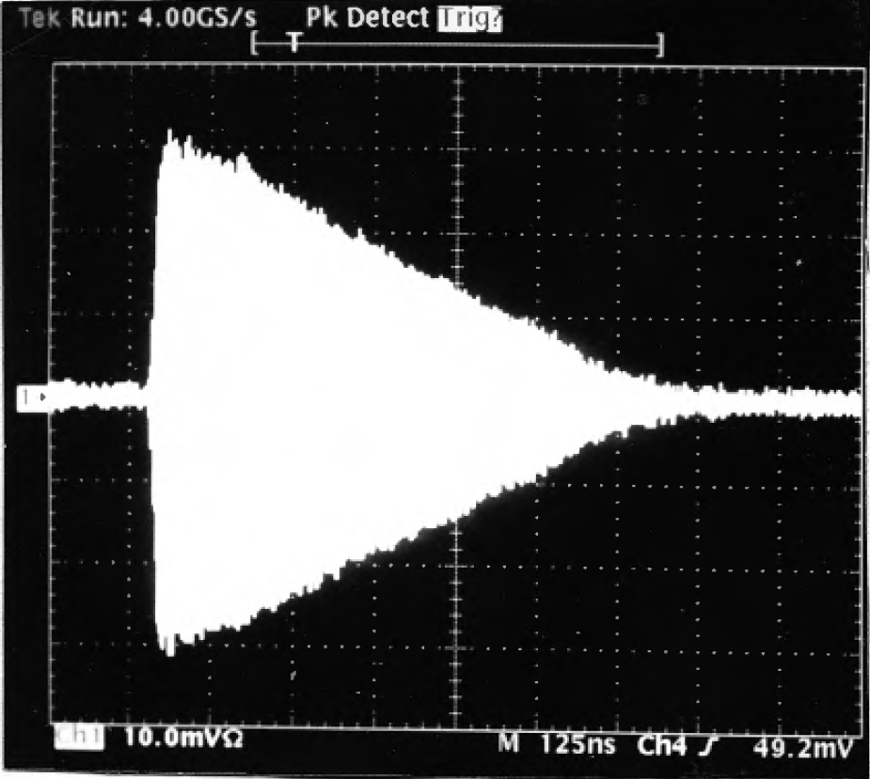
Beam induced 200MHz cavity signal
Courtesy of Thomas Bohl
( Filtered signal )

Slide 6
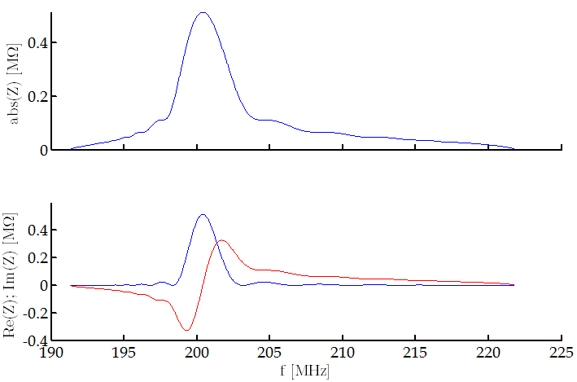
200MHz 3 Tank Cavity (II)
Asymmetric Impedance Characterization
Element | f [GHz] | a (μs) @ f | Z [kΩ] @ f | Q | R/Q [Ω]
200 TWS - 32 cell | 0.200 | - | 515 | G. Dome SPS/ARF/77-11 | -

Slide 7
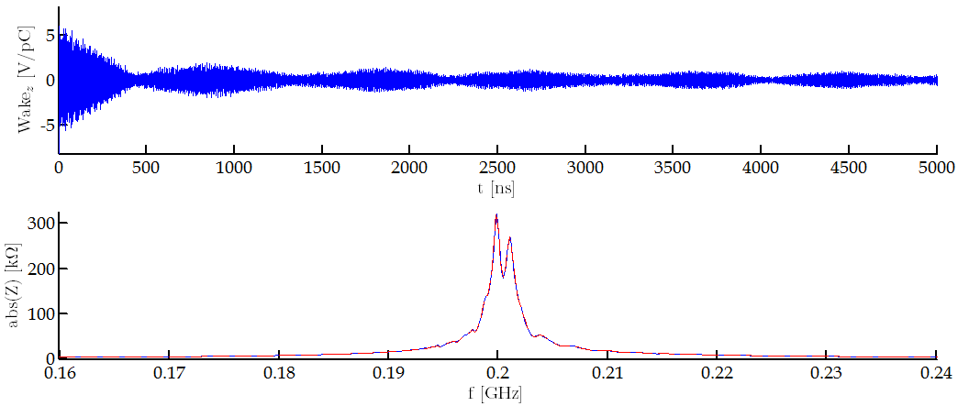
200MHz 3 Tank Cavity (III)
200MHz 3 tank cavity
Main couplers, sort of, accounted for
No HOM couplers
Simulation not converged
Effect of the main couplers
Also observed via different simulations
Very dependant on the matching of the couplers

Slide 8
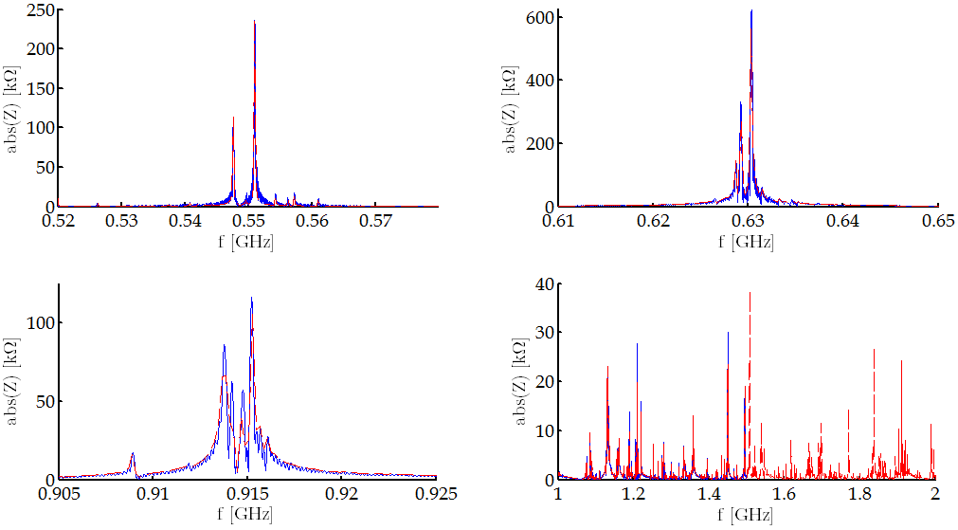
200MHz 3 Tank Cavity (III)
Almost standing wave resonances
Very high impedance values
(to be further checked)

Slide 9
200MHz 3 Tank Cavity (IV)
Impedance characterization of the SPS TWCs (200 & 800MHz) is complicated.
Careful consideration of the main couplers and HOM couplers is needed.
Simulations and measurements are not straight forward.

Slide 10
Outline
The 2014 SPS Longitudinal Impedance Model
Cavities
Flanges
BPMs
Other stuff
Total SPS Longitudinal Impedance Model
Machine Survey
Conclusions

Slide 11
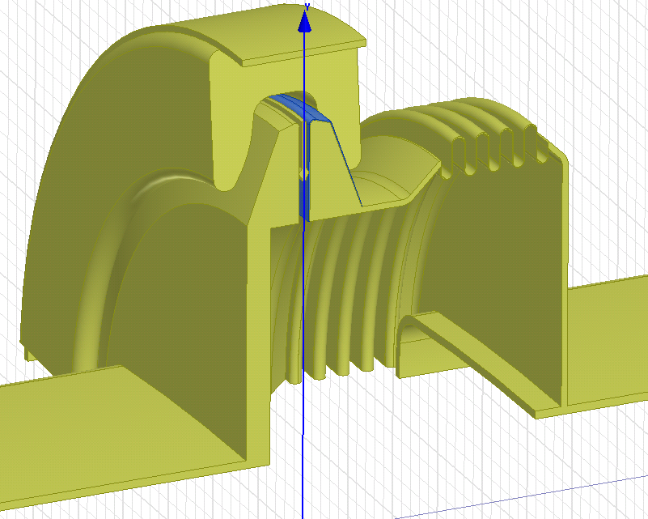
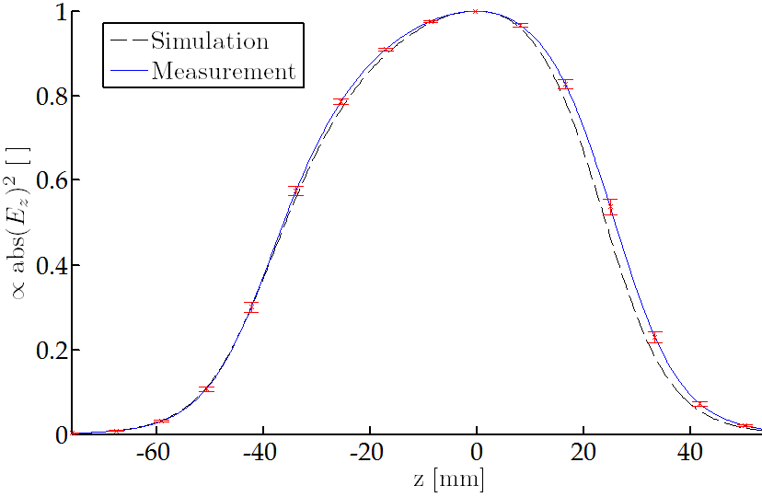
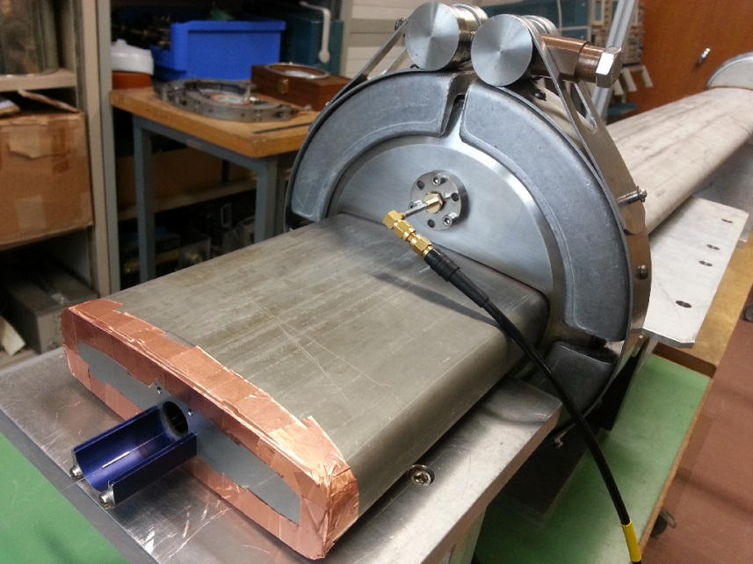
Bead-pull Measurements
 |  | Damping Resistor | fres [GHz] | Q |  | R/Q [Ω]
MBA – QF Non enamelled | Sim. | No | 1.415 | 1800 |  | 82
 | Meas. | No | 1.401 | 1100 | ≈ 5.5 | 85 ± 2.5%
 | Meas. | Short | 1.395 | 200 |  | 81 ± 2.5%
MBA – MBA Enamelled | Sim. | No | 1.410 | 285 |  | 75
 | Meas. | No | 1.415 | 270 | ≈ 3.5 | 79 ± 5%
 | Meas. | Short | 1.415 | 75 |  | 65 ± 5%

Slide 12
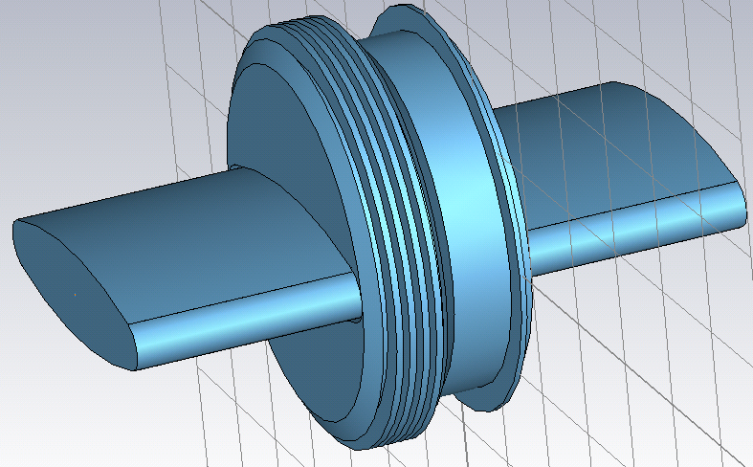
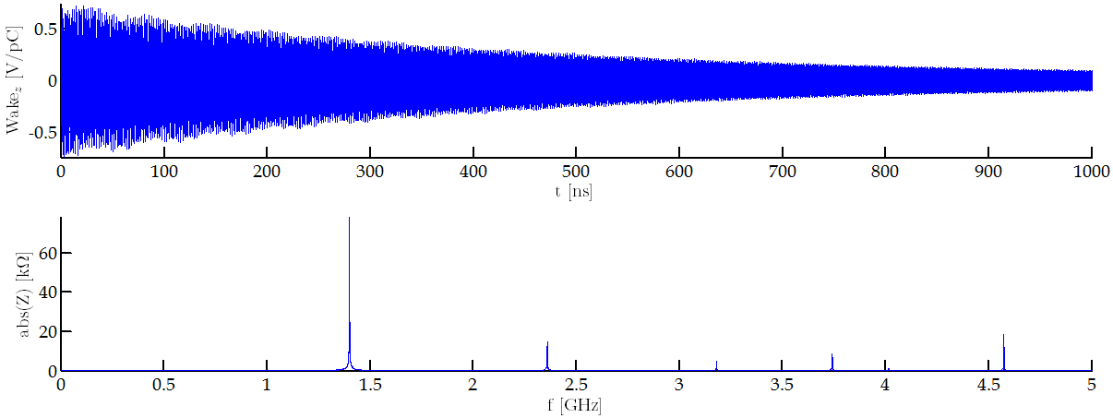
New CST simulations (I)
Non-enamelled QF-QF flange
Simulation not converged
Higher frequency resonances identified
Further investigation via measurements

Slide 13
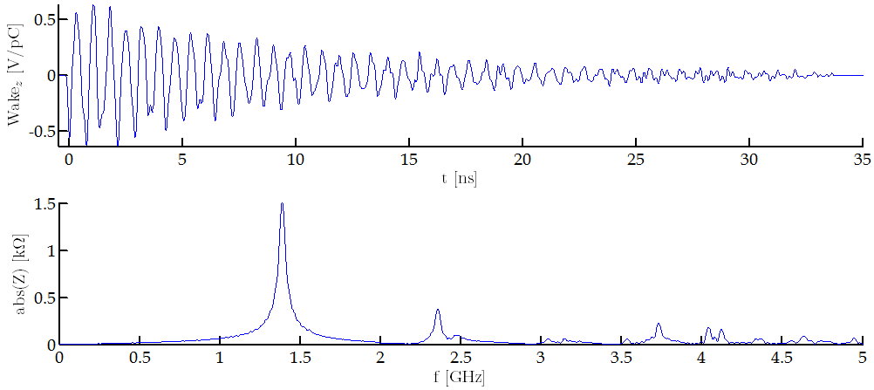
New CST simulations (II)
Non-enamelled QF-QF flange with damping resistor
Converged simulation
Calibration of CST parameter underway
Using the measured resistance of the niquel-chrome (100 Ω) with the ohmic sheet model.
Q = 25
It should be around 250.

Slide 14
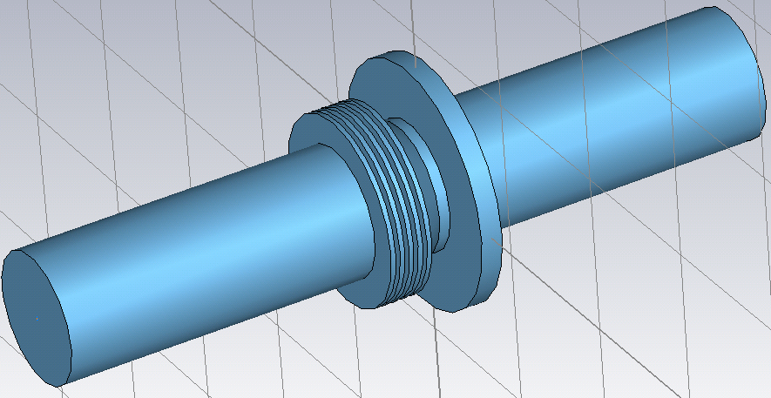
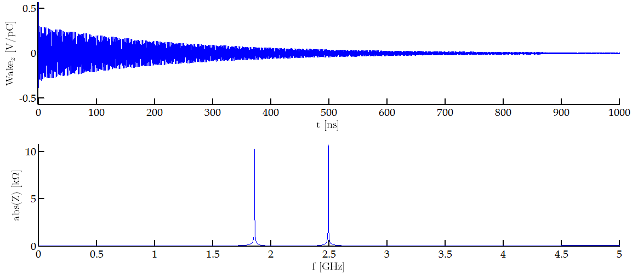
New CST simulations (III)
Non-enamelled QD-QD flange
Simulation converged.
Additional resonance found
The 1.8GHz resonance in good agreement with previous HFSS simulation.

Slide 15
Updated Flange Total Impedance
Element | Enam | Res. * | Num. | f [GHz] | Z [kΩ] | Q | R/Q [Ω]
Flanges [ Simulation Table ] * Damping Resistors have not been included in Simulations. This column states whether or not the flange SHOULD have a damping resistor inside (and its type). ** The enamelled QF-MBA case is assumed to be identical to the measured enamelled MBA-MBA flange. Should be very close in reality. *** Survey by Jose A. Ferreira (18/26 flanges surveyed). ! Damping resistor presence percentage is assumed to be identical to the *** case. !! The effect of the LONG damping resistors has not been estimated. In this table, it is assumed to be identical to a SHORT damping resistor. m Indicated entries that have been measured in the lab. | Yes | No | 90 | 1.210 | 633 | 315 | 2010
 | Yes | Long | 39 | 1.280 | 499 | 200 !! | 2495
 | Yes | Short | 90% of 83 ! | 1.415** | 364 | 75 ** | 4856** ± 5%
 | Yes | No | 10% of 83 ! | 1.415** | 177 | 270 ** | 656** ± 5%
 | Yes | Short | 90% of 14 ! | 1.415m | 61.4 | 75 | 819 ± 5%
 | Yes | No | 10% of 14 ! | 1.415m | 29.9 | 270 | 110 ± 5%
 | No | Short | 90% of 26 *** | 1.395m | 379 | 200 | 1895 ± 2.5%
 | No | No | 10% of 26 *** | 1.401m | 243 | 1100 | 221 ± 2.5%
 | Yes | No | 99 | 1.570 | 17.4 | 55 | 316
 | No | No | 20 | 1.610 | 588 | 980 | 600
 | Yes | Long | 39 | 1.620 | 61 | 60 !! | 1016
 | No | Yes | 75 | 1.861 | 771 | 810 | 952
 | Yes | No | 99 | 1.890 | 187 | 175 | 1070
 | No | Yes | 75 | 2.495 | 814 | 1190 | 685

Slide 16
Outline
The 2014 SPS Longitudinal Impedance Model
Cavities
Flanges
BPMs
Other Stuff
Total SPS Longitudinal Impedance Model
Machine Survey
Conclusions

Slide 17
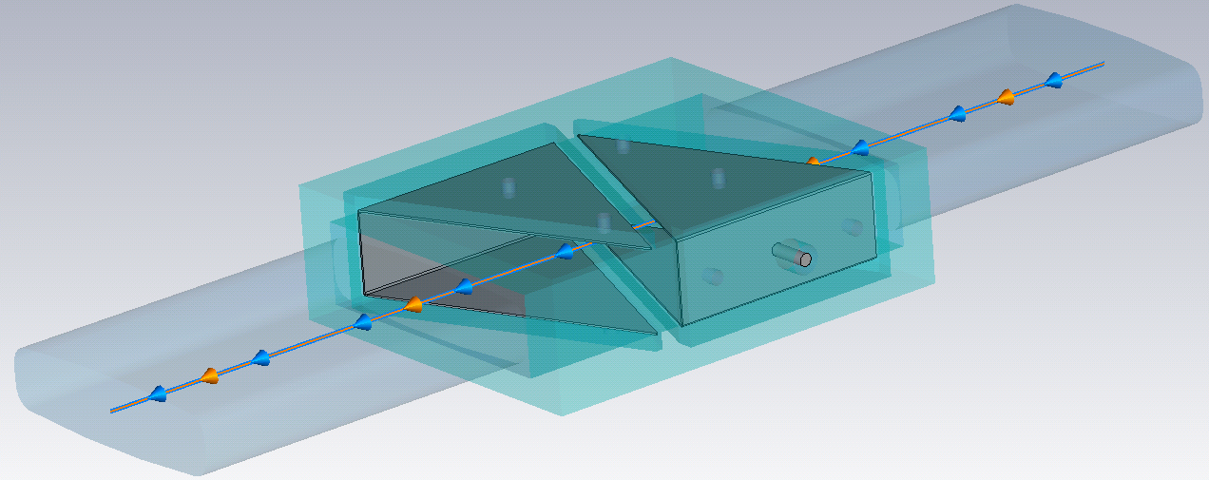
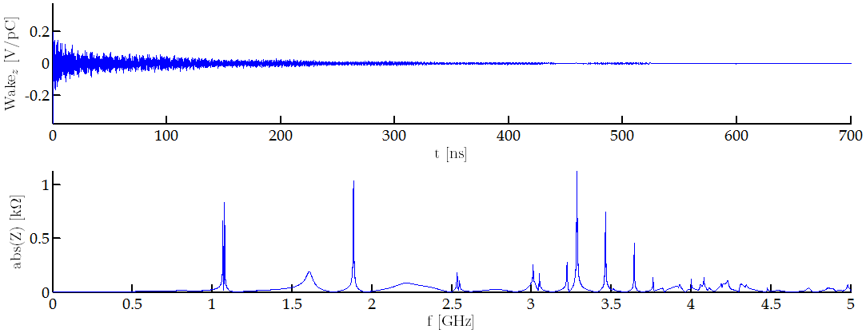
New BPH simulation
CST wake field simulation for the SPS BPHs.
Model provided by Benoit/Carlo.
Lossy metals now accounted for.

Slide 18
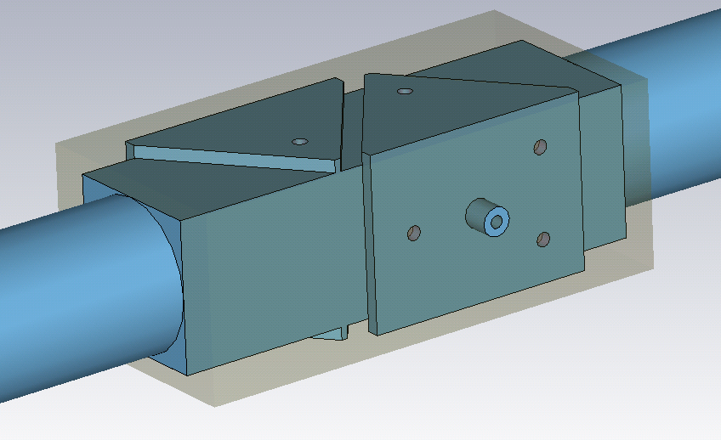
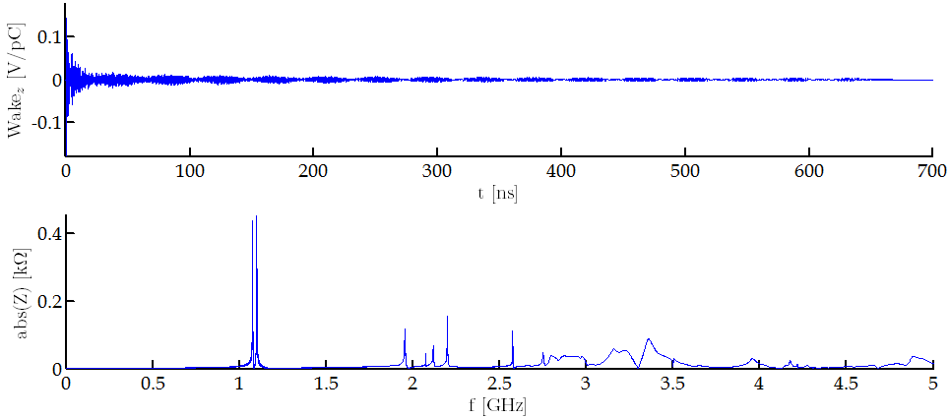
New BPV simulation
CST wake field simulation for the SPS BPVs.
Model provided by Benoit/Carlo.
Lossy metals now accounted for.

Slide 19
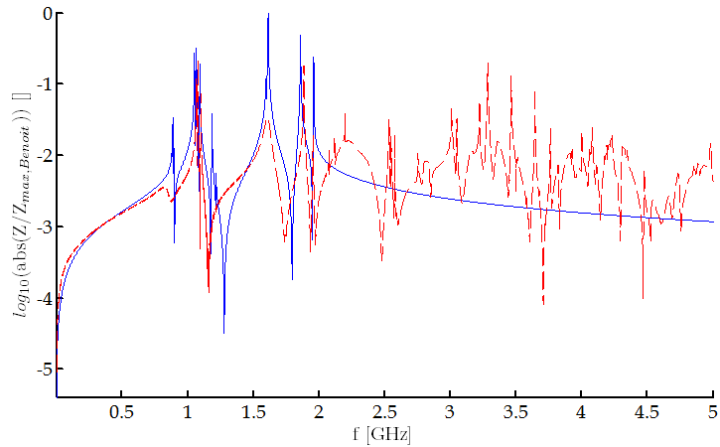
Total BPM Impedance - Comparison
New Z for the 1.6GHz peak 20kΩ
Q = 40
Previous Z for the 1.6GHz peak 600kΩ
Q = 685
Blue – Previous
Red - New

Slide 20
Outline
The 2014 SPS Longitudinal Impedance Model
Cavities
Flanges
BPMs
Other stuff
Total SPS Longitudinal Impedance Model
Machine Survey
Conclusions

Slide 21
COLDEX – Y Chamber
Element | f [GHz] | Z [kΩ] | Q | R/Q [Ω]
COLDEX Y Chamber Impedance calculated by P. Kardasopoulos [Impedance meeting 14-04-2014] Three of these in the SPS. | 0.696 | 281 | 7400 | 38
 | 0.910 | 134 | 8415 | 16
 | 1.069 | 42 | 7980 | 5
 | 1.078 | 68 | 7810 | 8.6
 | 1.155 | 52 | 6660 | 7.8
 | 1.232 | 45 | 5870 | 7.7
 | 1.343 | 41 | 7820 | 5
Cut-off frequency of a circular waveguide with vertical PMC symmetry 1.12GHz.

Slide 22
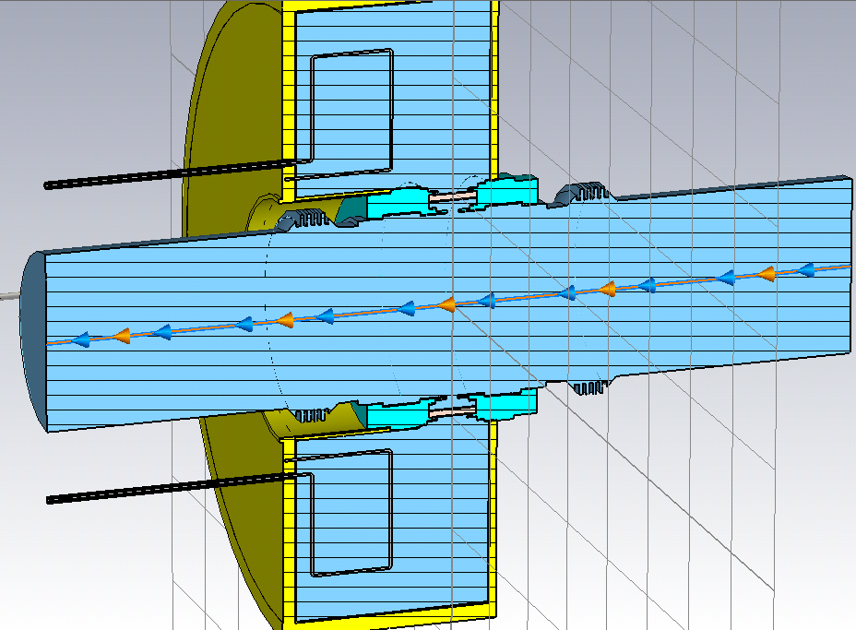
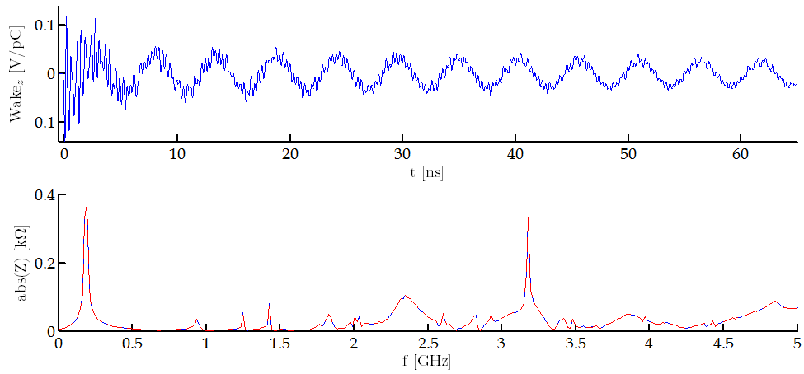
AEPs
Phase pick-ups
Very first simulation results
Four of these in the SPS
Apparently not so high impedance
Difficult to simulate

Slide 23
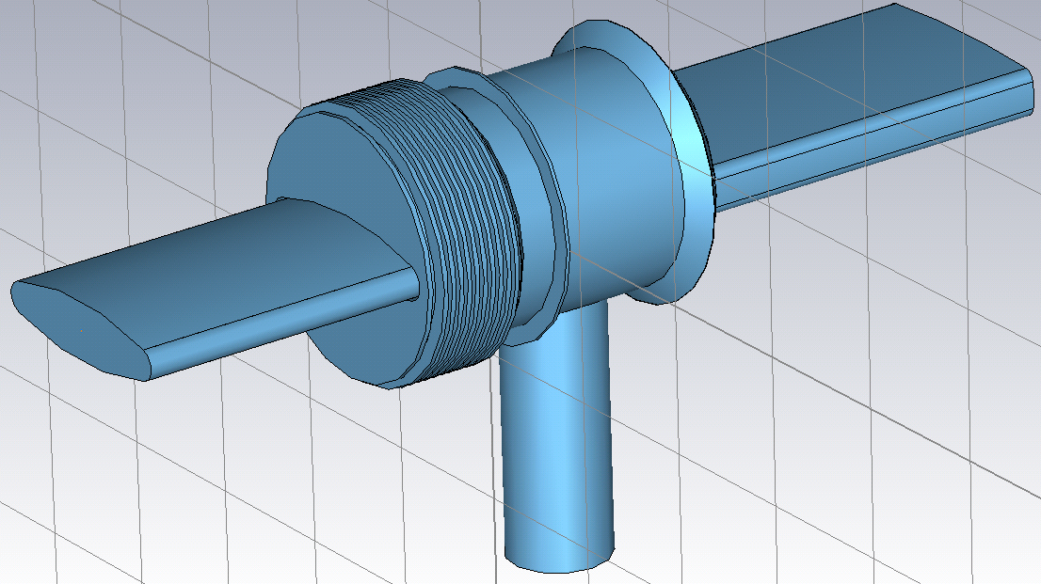
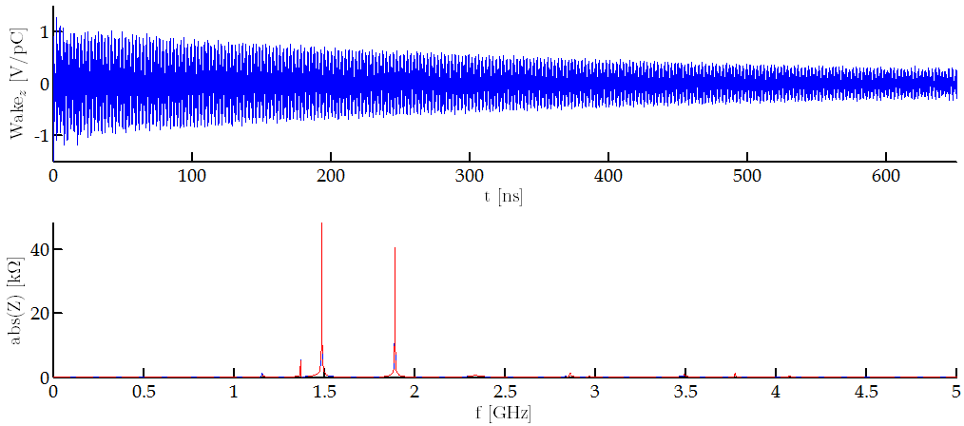
Unshielded Pumping Ports
QF – MBA unshielded Pumping Port
17 in the SPS
Not converged simulations
Values not close to those obtained via HFSS
No damping resistors considered

Slide 24
Some time ago…
Element | Resistor* | Type | Num. | f [GHz] | Z [kΩ] | Q | R/Q [Ω]
Unshielded Pumping Ports ! Measurements under preparation. * Damping Resistors have not been included in Simulations. This column states whether or not the flange SHOULD have a damping resistor inside (and its type). ** Inappropriate way of simulating the structure. Values have some error. *** Inappropriate way of simulating the structure. Values may have a VERY LARGE error.
 | 2*Long | MBA-QF ! | 17 | 1.397 ** | 383 | 2107 | 182
 |  |  |  | 1.560 *** | 2686 | 2801 | 958
 |  |  |  | 1.987 *** | 381 | 3718 | 102
 |  |  |  | 2.000 *** | 1972 | 3045 | 648
 |  | Other | 25 | ?
Measurements will give an answer.
Expected for the second half of June.

Slide 25
Outline
The 2014 SPS Longitudinal Impedance Model
Cavities
Flanges
BPMs
Other stuff
Total SPS Longitudinal Impedance Model
Machine Survey
Conclusions

Slide 26
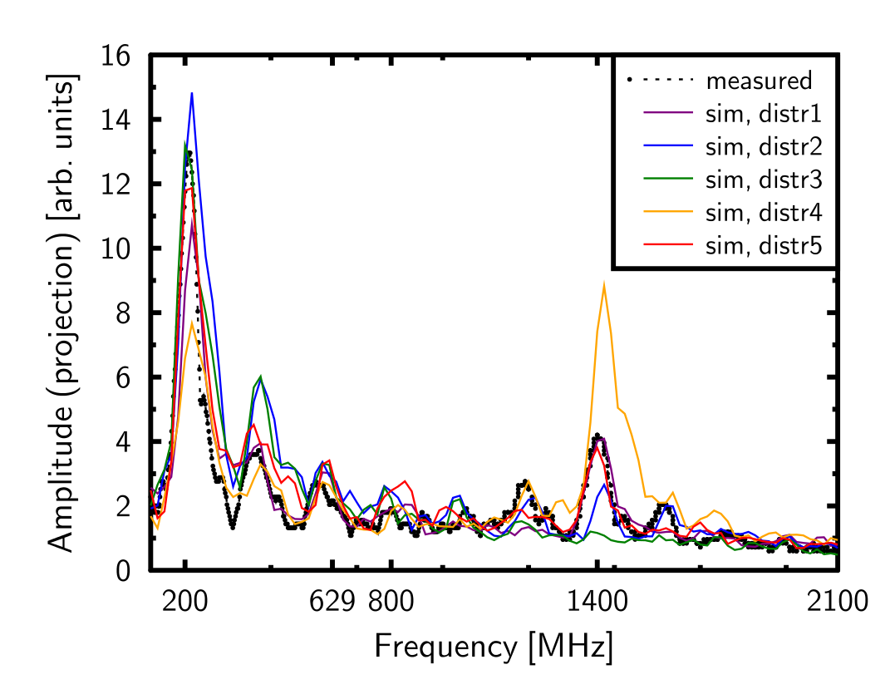
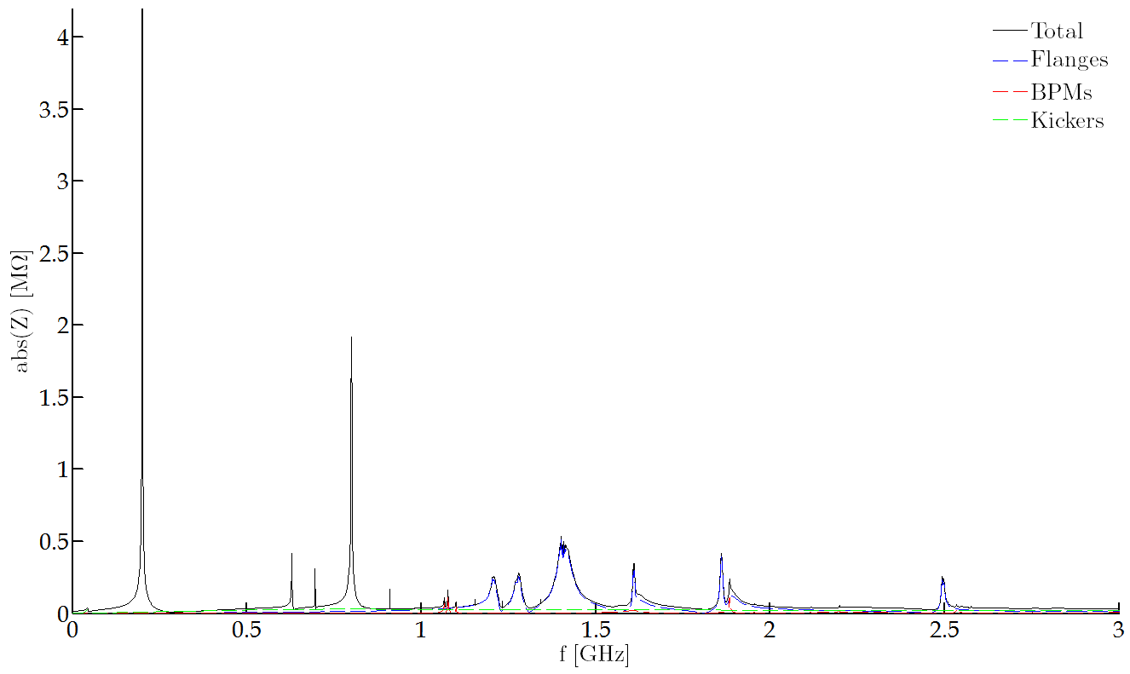
Total 2014 SPS Longitudinal Impedance Model (I)
200 MHz TWC
800 MHz TWC
Scattered 1.4 GHz resonance

Slide 27
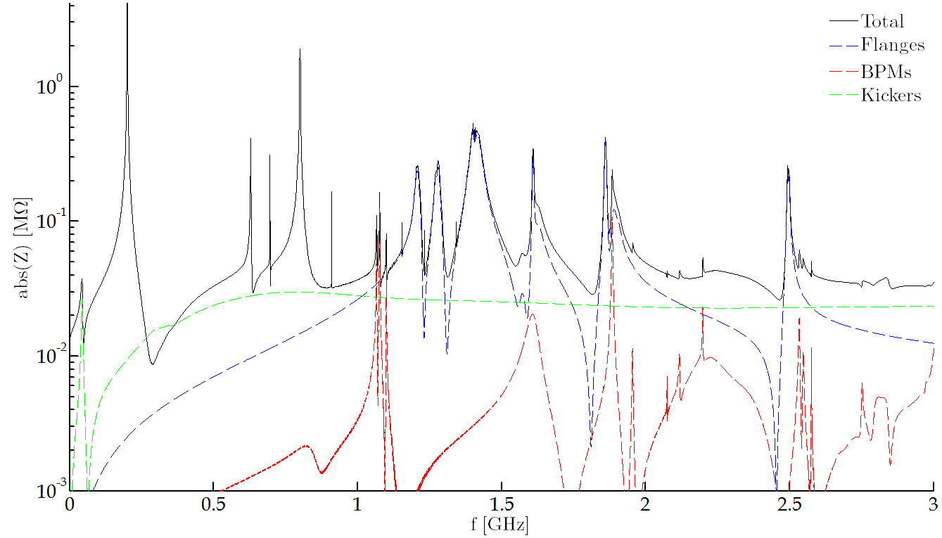
Total 2014 SPS Longitudinal Impedance Model (II)
New flange Resonance
200 MHz TWC
HOM
Y-Chamber
Kickers
Serigraphy peak

Slide 28
Outline
The 2014 SPS Longitudinal Impedance Model
Cavities
Flanges
BPMs
Other stuff
Total SPS Longitudinal Impedance Model
Machine survey
Conclusions

Slide 29
Machine Survey
The goal was to check the accuracy of layouts.
Only differences between layouts-reality will be commented.
High impedance elements present in layouts are considered to be known.
Accuracy disclaimer
LSS 1 & 2 not checked.
Sometimes is difficult to see if a flange is enamelled, has the vetronite, etc…
Some parts of the machine were still opened at the time of this suvey.
Survey carried out with the help of Thomas Bohl.

Slide 30
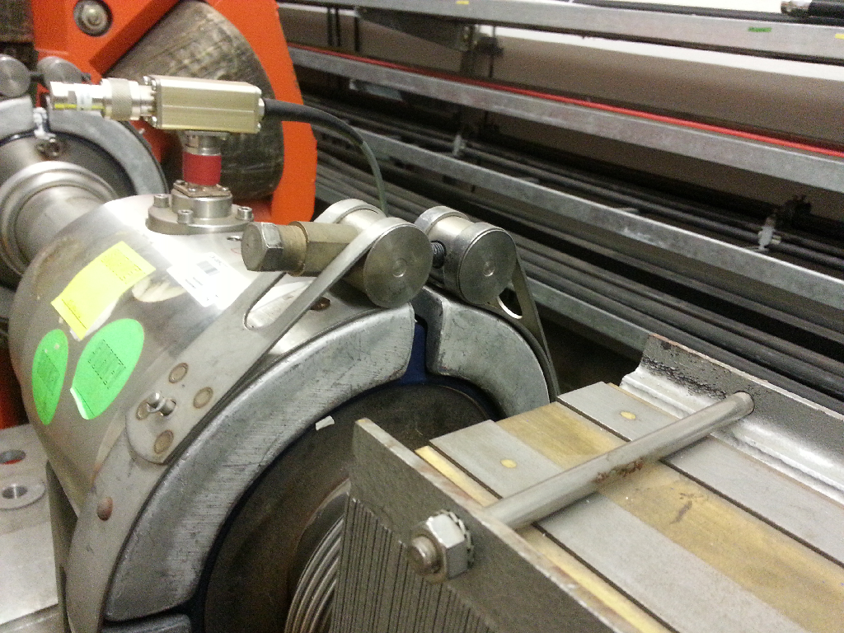
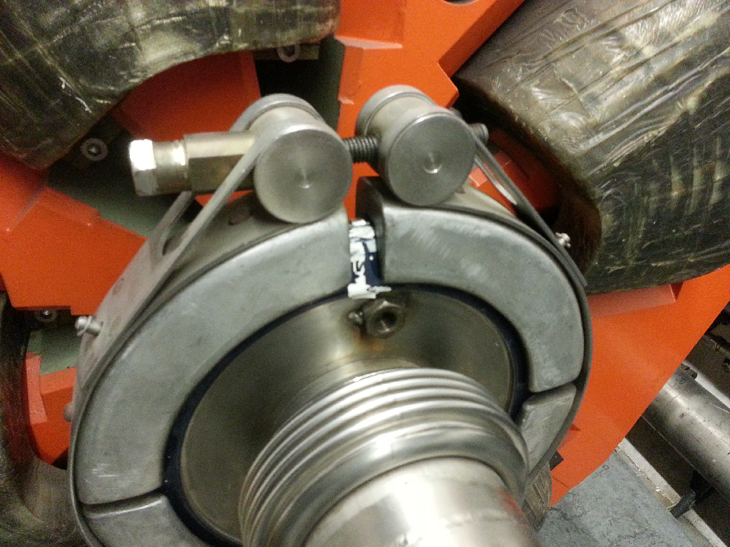
Flanges without vetronite

Slide 31
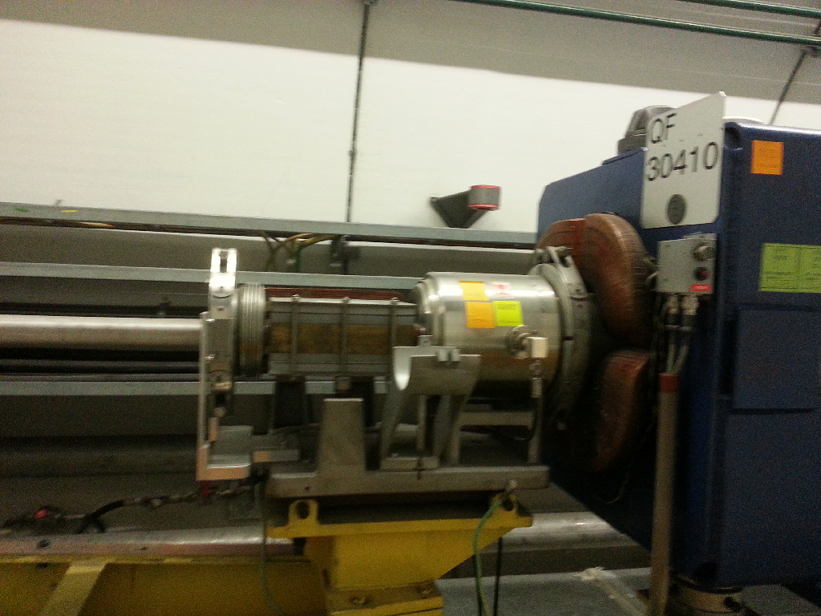
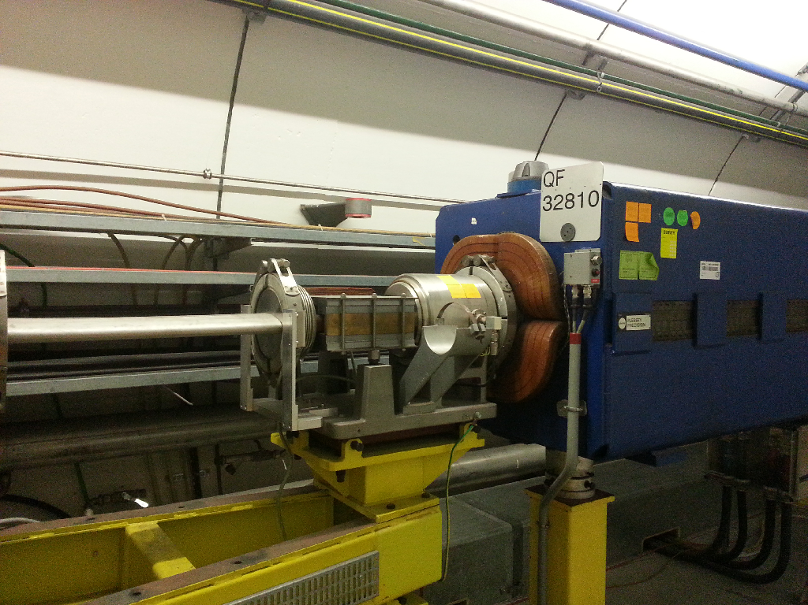
Grounded Flanges

Slide 32
Flanges
Number of elements per sextant
Enamelled flanges without vetronite
2 / 8 / 6 / 0 / 2 / 0
Grounded clamps
3 / 0 / 4 / 1 / 7 / 5
Flanges with/without bellow
2 / 2 / 1 / 4 / 3 / 1
Enamelled flanges found
1 / 9 / 12 / 0 / 0 / 0
Non-enamelled flanges found
0 / 2 / 0 / 6 / 0 / 0
In general, not too high numbers.
Impedance wise the most relevant numbers are the discrepancies with bellows

Slide 33
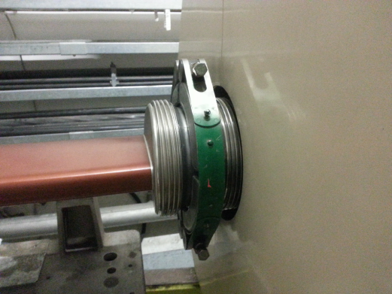
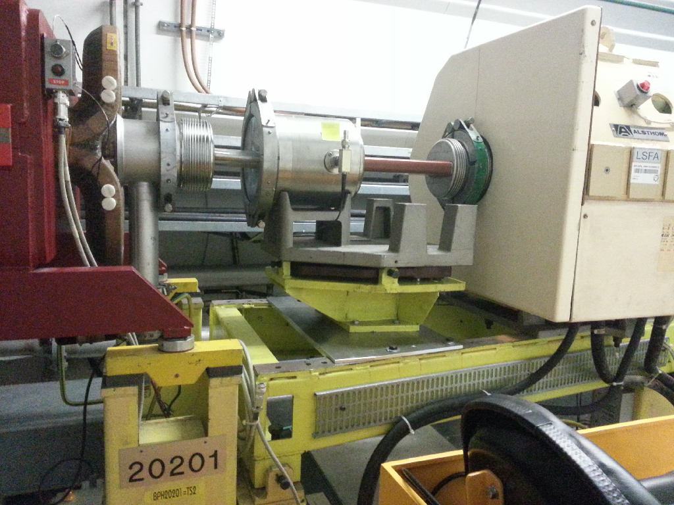
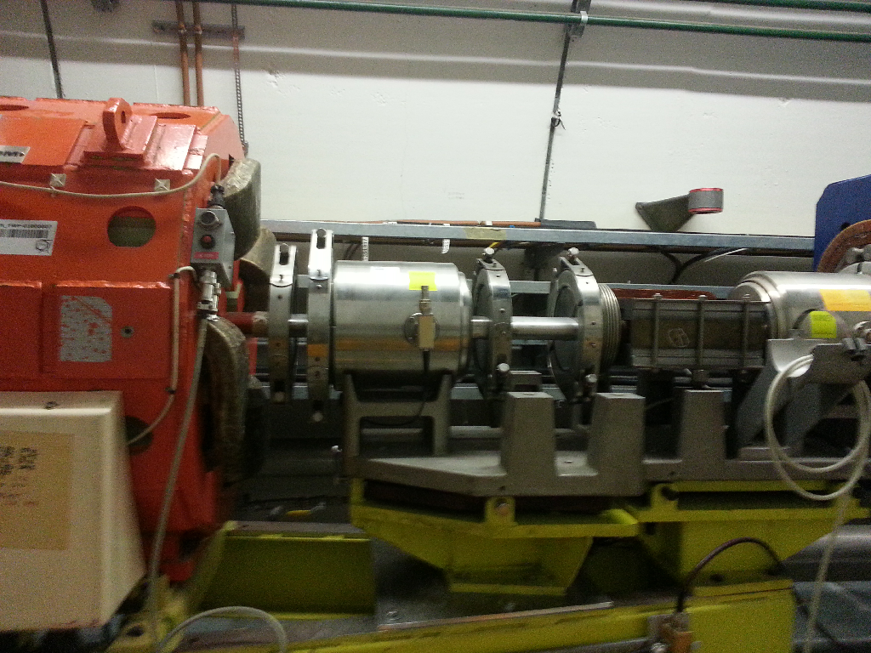
BPHs
Additional BPHs at 20201 and 20401 not in the layouts
No vetronite (neither side)
Double short bellows

Slide 34
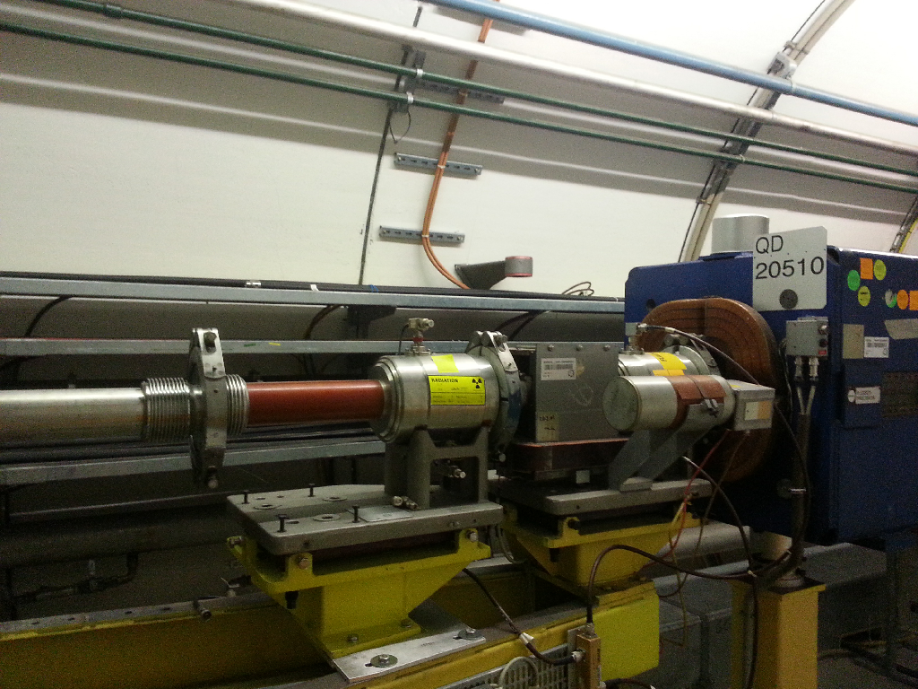
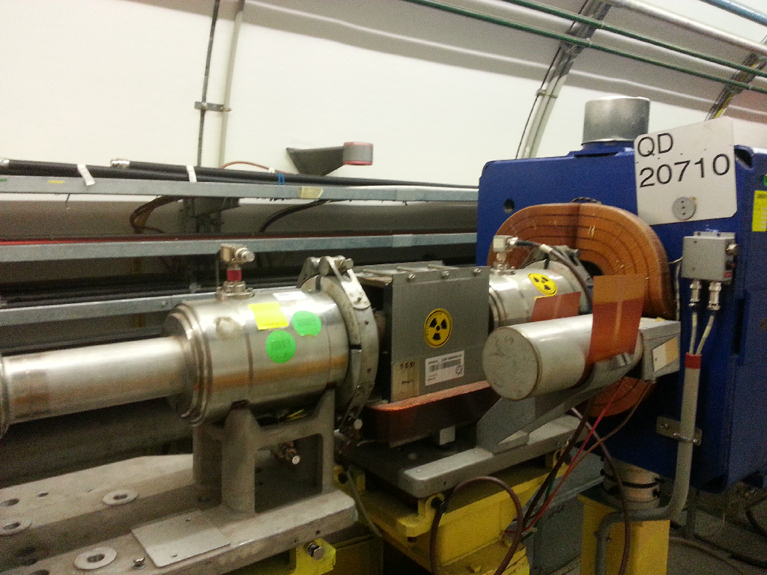
BPVs
BPVs at 20501 and 20701 not in the layouts
No vetronite (neither side)

Slide 35
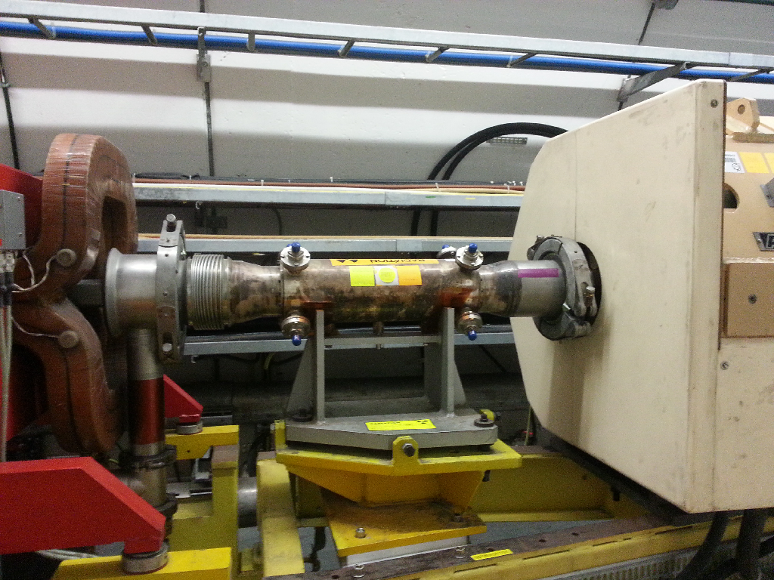
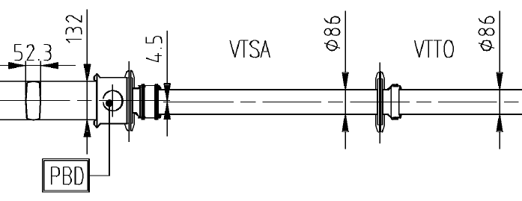
Relocated Pick-ups (I)
31101
Moved from 31931

Slide 36
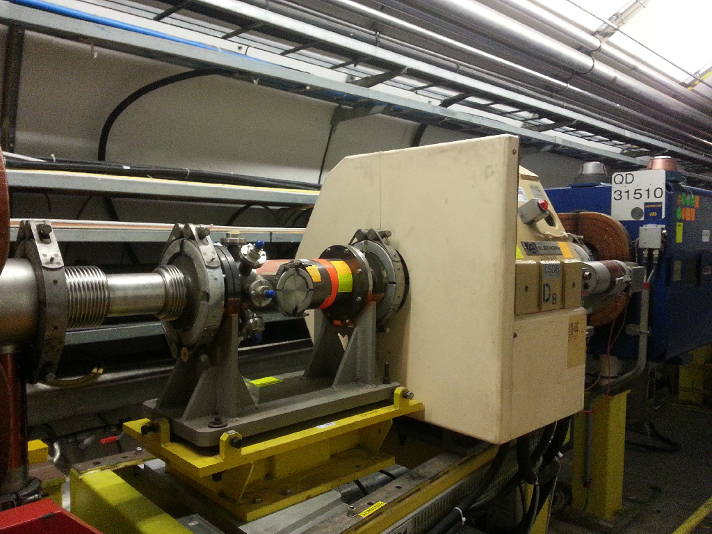
Relocated Pick-ups (II)
Moved from 31932

Slide 37
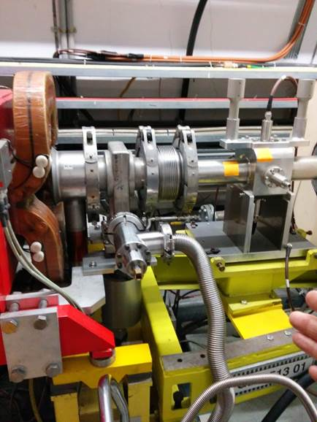
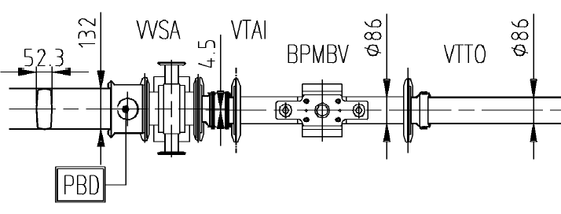
Wrong beam pipe
Position 51301
156mm beam pipe between two QD pipes
Found by Jose Antonio.
There should be a QD bellow according to layouts

Slide 38
Outline
The 2014 SPS Longitudinal Impedance Model
Cavities
Flanges
BPMs
Other stuff
Total SPS Longitudinal Impedance Model
Machine survey
Conclusions

Slide 39
Conclusions
The longitudinal impedance model for the SPS has been updated.
TWCs and unshielded pumping ports, next elements to be characterized
A survey of the SPS was carried out.
Discrepancies between layouts and reality not so worrying.

