Slide 1
Longitudinal space charge on the SPS flat bottom s LIU-SPS Beam Dynamics Working Group 11/12/2014
A. Lasheen Acknowledgments: H. Bartosik, E. Shaposhnikova, L. Wang (SLAC)

Slide 2
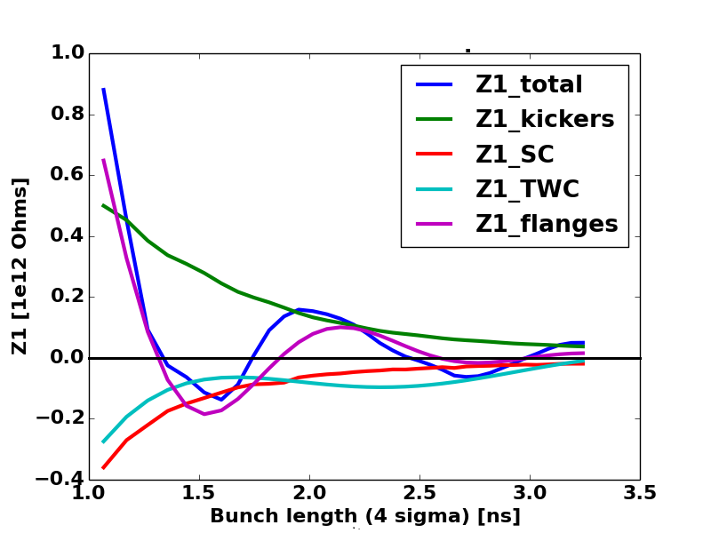
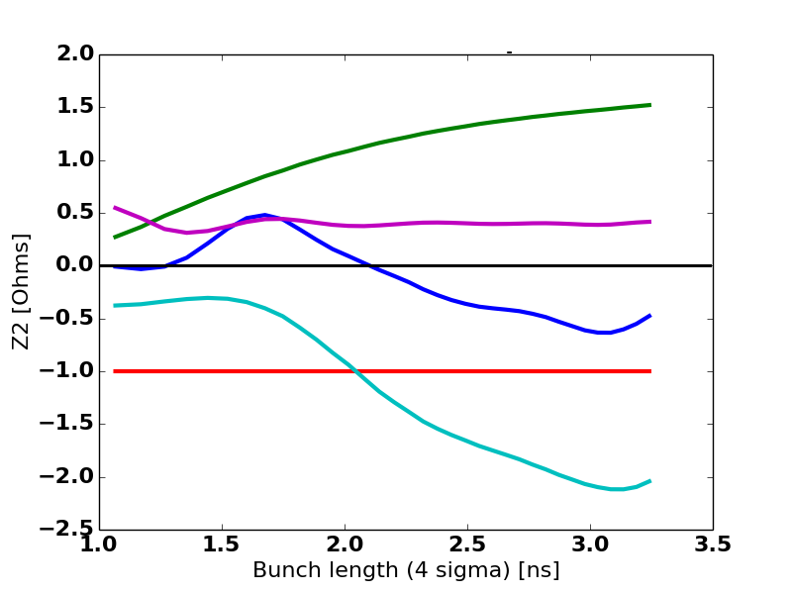
Motivations
Longitudinal space charge impedance is not negligible on the SPS flat bottom.
As measurements probing the impedance (synchrotron frequency shift, long bunches) were done at flat bottom, space charge needs to be included in simulations in order to test the accuracy of our impedance model.
Effective impedances for a parabolic bunch (space charge in red)
Zeffective, Incoherent shift
Zeffective, Coherent shift

Slide 3
Analytical calculations
First estimations of space charge impedance were done analytically (E. Shaposhnikova)
$$\frac{Z}{n}=−\frac{iZ_{0}β}{2γ^{2}} g$$
Geometrical factor for a bi-gaussian round beam in a round vacuum chamber (b=chamber radius, $σ_{r}$=1RMS beam size, K. Y. Ng) $g_{1}=C+2\ln\left(\frac{b}{\sqrt{2}σ_{r}}\right) ;C=0.55721$
Geometrical factor for a uniform elliptic beam in an elliptic vacuum chamber (b=chamber semi-axis, a=beam semi-axis, S. Koscleniak) $g_{2}=\frac{b_{1}b_{2}}{b_{1}^{2}+b_{2}^{2}}+2\ln\left(\frac{b_{1}+b_{2}}{a_{1}+a_{1}}\right)$
Combination to have a bi-gaussian round beam in an elliptic vacuum chamber (b=chamber semi-axis, $σ_{r}$=1RMS beam size) $g_{3}≈C+2\ln\left(\frac{b_{1}+b_{2}}{2\sqrt{2}σ_{r}}\right)$

Slide 4
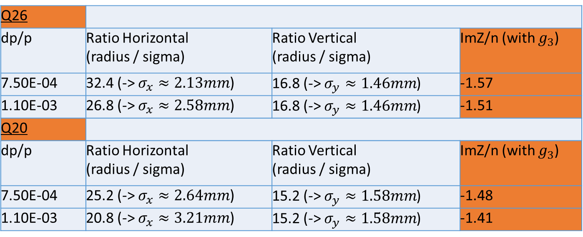
Transverse parameters
Normalized transverse emittance : $ε_{norm}=1.1 μm$
H. Bartosik
Q26:
Tunes (H/V): 26.13/26.18
Average beta functions (H/V): 54.78/54.33 m
Average beam pipe radius (H/V): 6.91e-02/2.46e-02 m
Average dispersion (H/V): 1.96/0.00 m
Q20:
Tunes (H/V): 20.13/20.18
Average beta functions (H/V): 63.02/62.55 m
Average beam pipe radius (H/V): 6.67e-02/2.40e-02 m
Average dispersion (H/V): 3.10/0.00 m
Q26
dp/p | Ratio Horizontal (radius / sigma) | Ratio Vertical (radius / sigma) | ImZ/n (with $g_{3}$)
7.50E-04 | 32.4 (-> $σ_{x}≈2.13mm$) | 16.8 (-> $σ_{y}≈1.46mm$) | -1.57
1.10E-03 | 26.8 (-> $σ_{x}≈2.58mm$) | 16.8 (-> $σ_{y}≈1.46mm$) | -1.51
Q20
dp/p | Ratio Horizontal (radius / sigma) | Ratio Vertical (radius / sigma) | ImZ/n (with $g_{3}$)
7.50E-04 | 25.2 (-> $σ_{x}≈2.64mm$) | 15.2 (-> $σ_{y}≈1.58mm$) | -1.48
1.10E-03 | 20.8 (-> $σ_{x}≈3.21mm$) | 15.2 (-> $σ_{y}≈1.58mm$) | -1.41

Slide 5
Longitudinal space charge code
The longitudinal space charge impedance code (LSC) is developed at SLAC by L. Wang.
Its function is to compute the space charge impedance for any kind of geometries for the beam distribution and for the vacuum chamber.
Not all options and features could be tested yet, but first simulations were done in order to have first values of impedance to be compared with the previous analytical results

Slide 6
Longitudinal space charge code
The geometry used in LSC was a bi-gaussian beam in a rectangular chamber.
The estimated impedance from analytical formulas and the value given by the LSC code give comparable results, with a systematic shift of ~0.2 Ohms for the LSC code. This shift might come from the assumptions done in the geometrical factor $g_{3}$
Q26
dp/p | ImZ/n (with g3) | ImZ/n (with LSC code)
7.50E-04 | -1.57 | -1.38
1.10E-03 | -1.51 | -1.32
Q20
dp/p | ImZ/n (with g3) | ImZ/n (with LSC code)
7.50E-04 | -1.48 | -1.29
1.10E-03 | -1.41 | -1.22

Slide 7
Longitudinal space charge code
Some (very) preliminary test cases were studied to compare the LSC code with the analytical formulas presented above.
The geometry used was a uniform elliptical beam, in an elliptical chamber (corresponding to the geometrical factor g2, with b1=3.335cm and b2=1.2cm)
 | ImZ/n (with g2) | ImZ/n (with LSC code) | Ratio LSC/analytical
a1 = 1.1mm a2 = 0.8 mm | -1.64 | -1.54 | 0.939
a1 = 2.2mm a2 = 1.6 mm | -1.30 | -1.25 | 0.962
a1 = 3.3 mm a2 = 2.4 mm | -1.10 | -1.06 | 0.964

Slide 8
Space charge impedance in BLonD
Several possibilities
Time domain -> from a broad-band resonator with very high resonant frequency
Frequency domain -> from a pure imaginary impedance
From the line density derivative $V_{induced}\left(t\right)=−\frac{q N }{2π } \frac{Z/n}{f_{0}} \frac{dλ}{dt}$
The main encountered issue is numerical noise
Depending on the number of slices and number of macroparticles
Smoothing can be difficult and give unphysical results (especially for unstable beams)

Slide 9
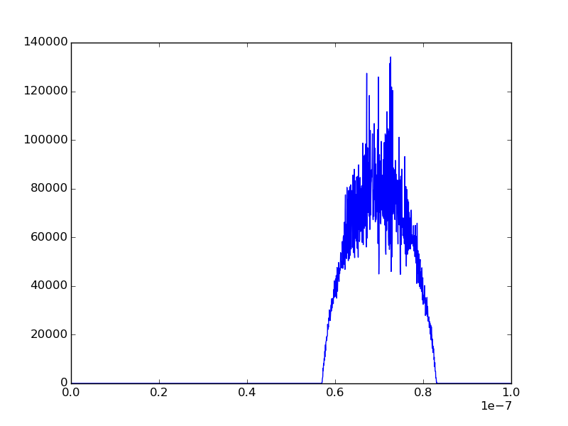
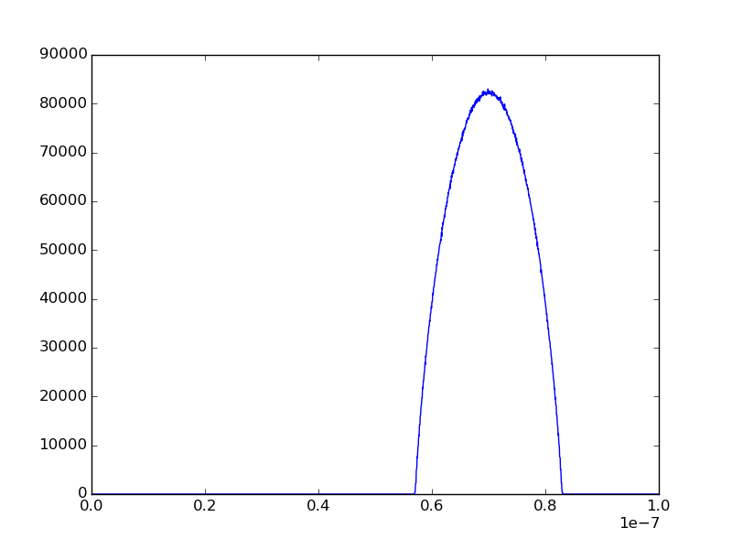
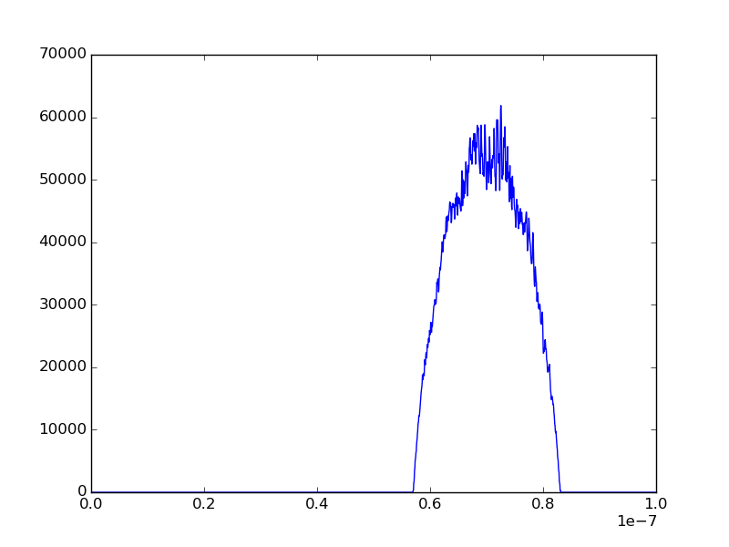
Long Bunches simulations in Q20
After 100 turns debunching with space charge and the SPS impedance model
After 100 turns debunching without space charge and with the SPS impedance model

Slide 10
Perspectives
The impedances obtained from different analytical geometrical factors will be compared with the LSC code for testing.
A more accurate combination of vacuum chamber geometry (elliptic) and beam distribution (non round bi-gaussian) will be used to estimate more accurately the SPS space charge impedance.
All impedances calculated here are on axis. Averaging the impedance over the transverse beam size will be considered.

Slide 11
Extra slides

Slide 12
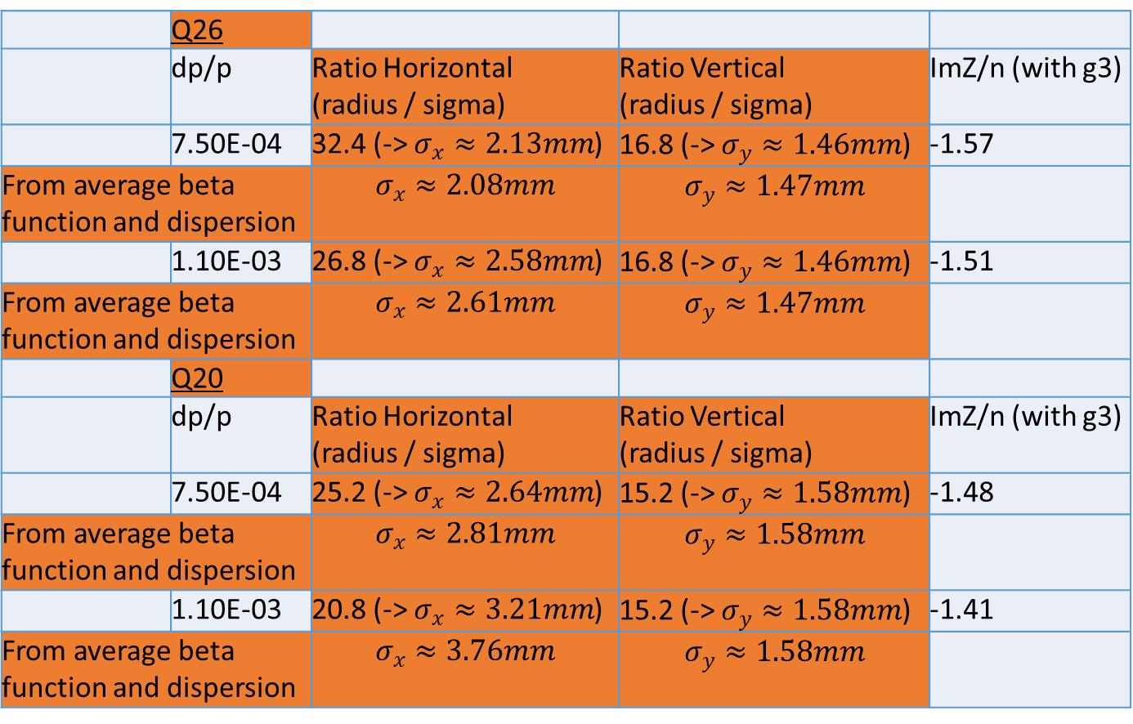
Transverse parameters
Normalized transverse emittance : $ε_{norm}=1.1 μm$ and $σ= \sqrt{εβ+{\left(D\frac{δp}{p}\right)}^{2}}$
 | Q26
 | dp/p | Ratio Horizontal (radius / sigma) | Ratio Vertical (radius / sigma) | ImZ/n (with g3)
 | 7.50E-04 | 32.4 (-> $σ_{x}≈2.13mm$) | 16.8 (-> $σ_{y}≈1.46mm$) | -1.57
From average beta function and dispersion |  | $$σ_{x}≈2.08mm$$ | $$σ_{y}≈1.47mm$$
 | 1.10E-03 | 26.8 (-> $σ_{x}≈2.58mm$) | 16.8 (-> $σ_{y}≈1.46mm$) | -1.51
From average beta function and dispersion |  | $$σ_{x}≈2.61mm$$ | $$σ_{y}≈1.47mm$$
 | Q20
 | dp/p | Ratio Horizontal (radius / sigma) | Ratio Vertical (radius / sigma) | ImZ/n (with g3)
 | 7.50E-04 | 25.2 (-> $σ_{x}≈2.64mm$) | 15.2 (-> $σ_{y}≈1.58mm$) | -1.48
From average beta function and dispersion |  | $$σ_{x}≈2.81mm$$ | $$σ_{y}≈1.58mm$$
 | 1.10E-03 | 20.8 (-> $σ_{x}≈3.21mm$) | 15.2 (-> $σ_{y}≈1.58mm$) | -1.41
From average beta function and dispersion |  | $$σ_{x}≈3.76mm$$ | $$σ_{y}≈1.58mm$$

Slide 13
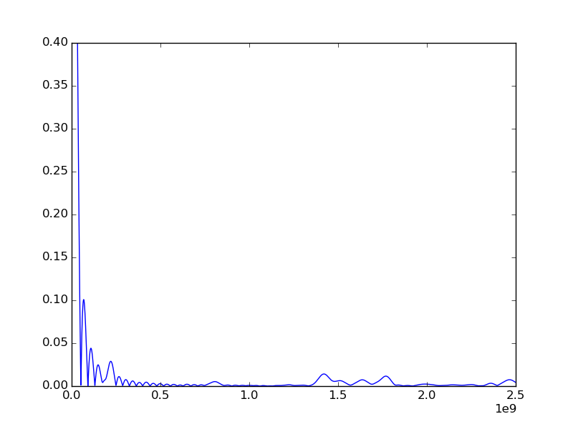
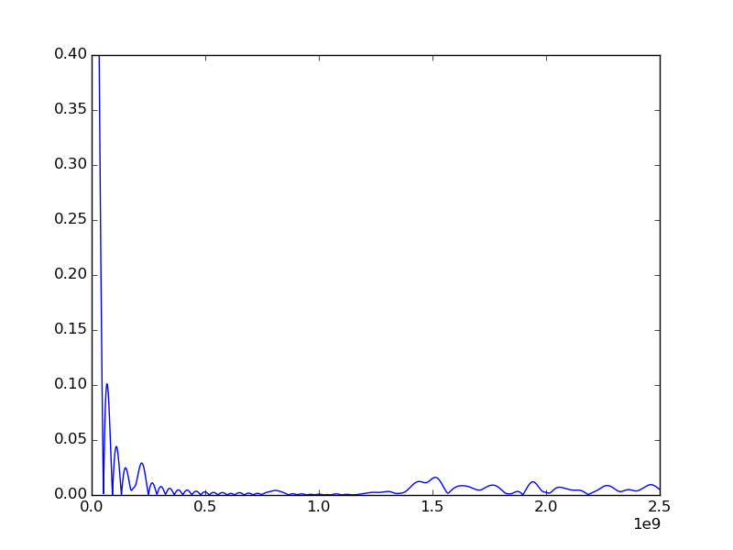
Noisy beam spectrum
Without space charge
With space charge

