Slide 1
OBSERVATION OF TRANSVERSE INSTABILITY WITH DAMPER
SPS Scrubbing Run 8.-10. Dec 2014
Extracted from the e-logbook:
http://elogbook.cern.ch/eLogbook/eLogbook.jsp?shiftId=1060005

Slide 2
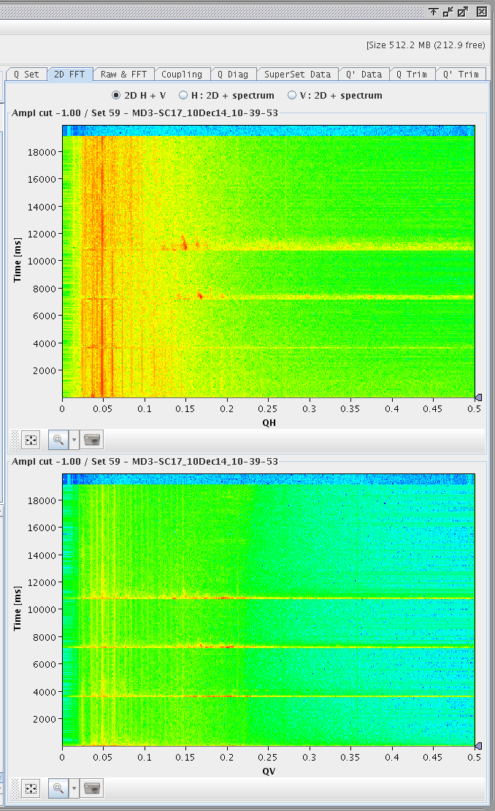
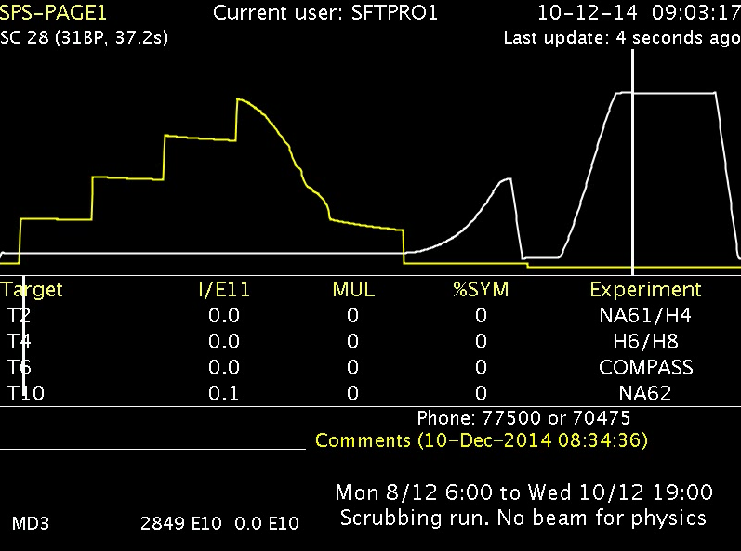
ACTIVITY IN HORIZONTAL PLANE
4th injection (@ 10800 ms)
Data during MD3 cycle (25ns, no splitting)
Recorded: 4th injection (@ 10800 ms)

Slide 3
ACTIVITY IN HORIZONTAL PLANE
4th injection (@ 10800 ms)
OBSERVATION 2
OBSERVATION 1
12 ms <==> 567 turns

Slide 4
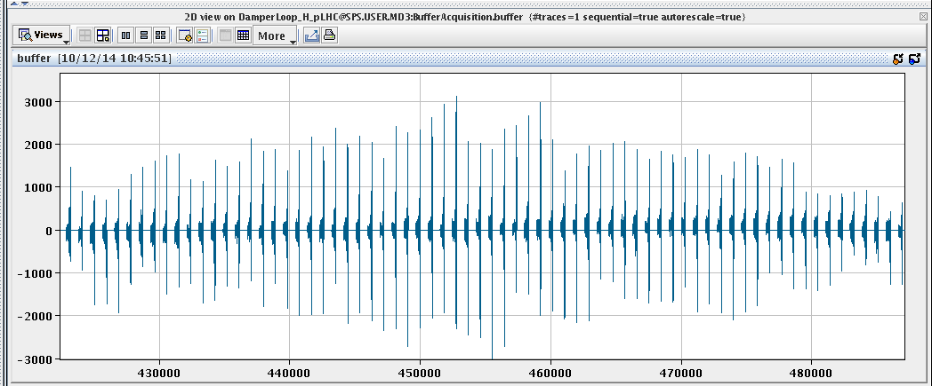
OBSERVATION 1
INJECTION DAMPING
(damper, chromaticity)
approx. 1 ms
1 turn
~70 turns

Slide 5
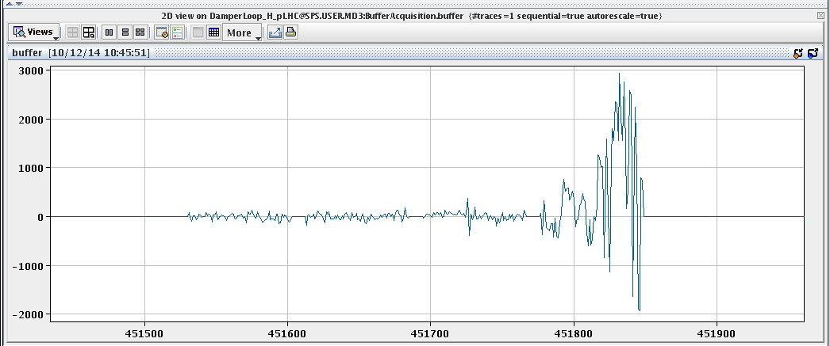
OBSERVATION 1
activity in the last injected batch
(+1st order roll-off
of damper gain)
1st batch
2st batch
3rd batch
4th batch

Slide 6
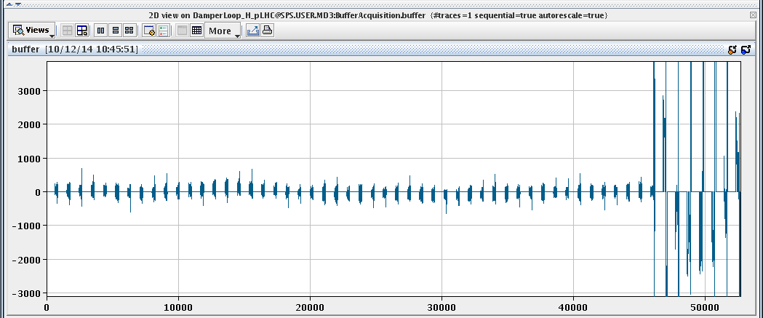
OBSERVATION 2
before injection, i.e. 3 batches circulating
Injection kicker activity
Evaluate the last turn
BEFORE the injection

Slide 7
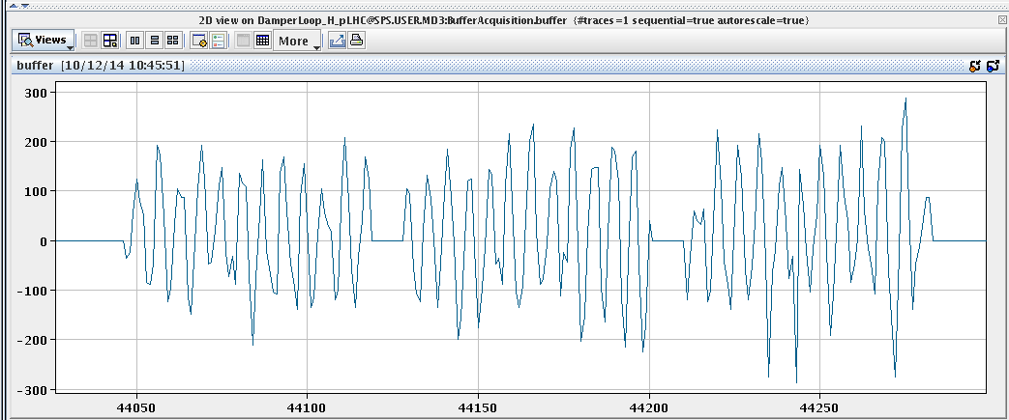
OBSERVATION 2
1st batch
2st batch
3rd batch
regular pattern across the batch(es), low in oscillation amplitude

Slide 8
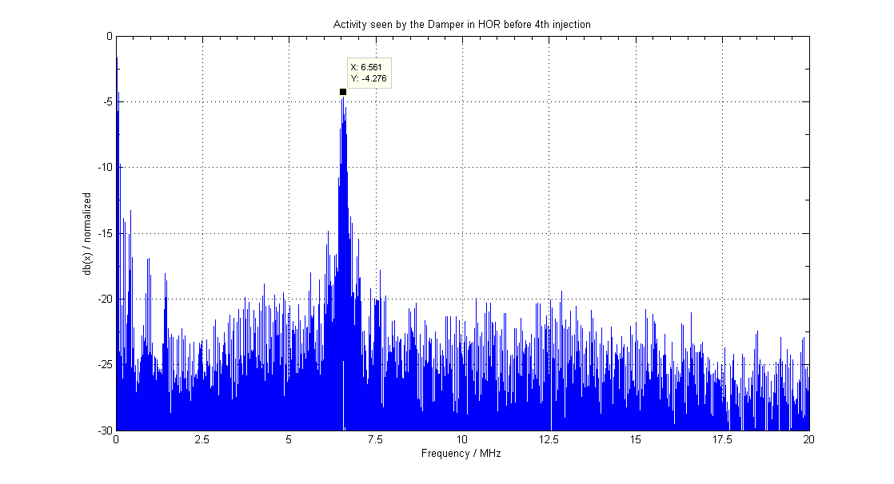
OBSERVATION 2
~ 6.6 MHz
FFT
However damper set-up OK up to 20 MHz …

Slide 9
HAPPY TO DISCUSS
THANK YOU

