Slide 1
New Contributions to the SPS Longitudinal Impedance Model
Jose E. Varela
Many thanks to Bruno Balhan, Cedric Baud (TE-ABT) and Rene Brulc (VAT)

Slide 2
Outline
Introduction
Long QD Bellows
The BBS Tanks
Comments on the ZS and the MSE/MSTs
The SPS Longitudinal Impedance Model
Conclusions

Slide 3
Introduction
This presentation will cover:
Update of the SPS Longitudinal Model:
Two additional elements (88 positions) have been characterized as part of the continuous effort to improve the longitudinal impedance model of the SPS.
The BBS tanks: 3 beam scrappers and 4 belonging to UA9.
Comments on the ongoing analysis of:
Electrostatic septa (ZS); 5 + 1 tanks
MSE / MSTs; 25 tanks
Plots of the updated longitudinal impedance model

Slide 4
Outline
Introduction
Long QD Bellows
The BBS Tanks
Comments on the ZS and the MSE/MSTs
The SPS Longitudinal Impedance Model
Conclusions

Slide 5
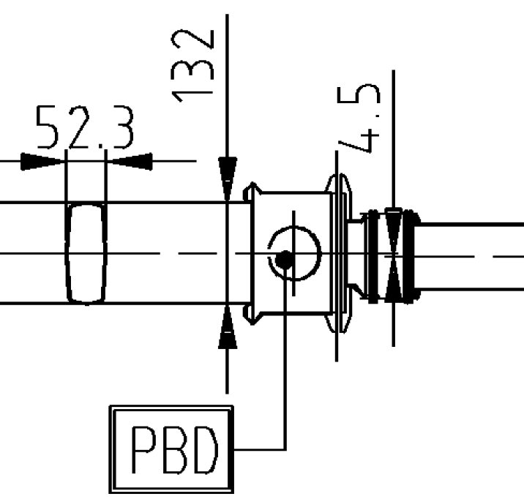
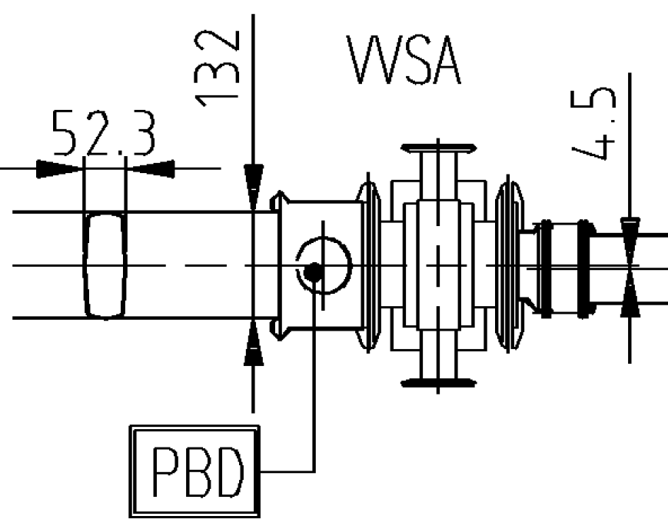
Long QD Bellows
Long QD bellows were not included in my original flange count, mainly since they were not expected to resonate at 1.4GHz.
Later analysis revealed significant impedance coming from the QD bellows due to mechanical implementation (around 2.3GHz).
There are two main types of positions
Shielded PP – Long QD Bellows (71)
Shielded PP – VVSA – Long QD Bellows (17)

Slide 6
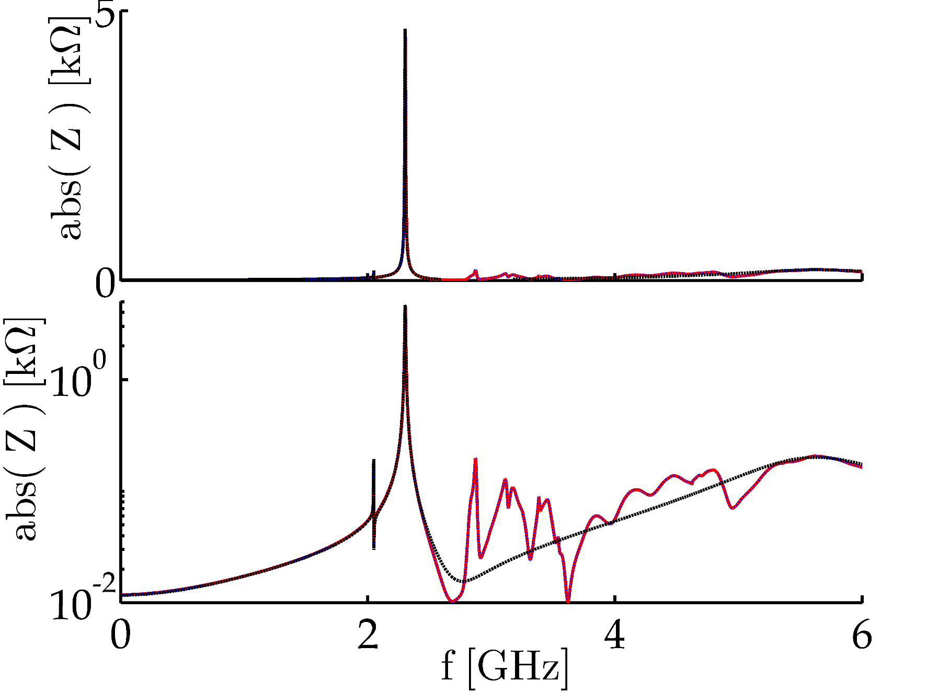
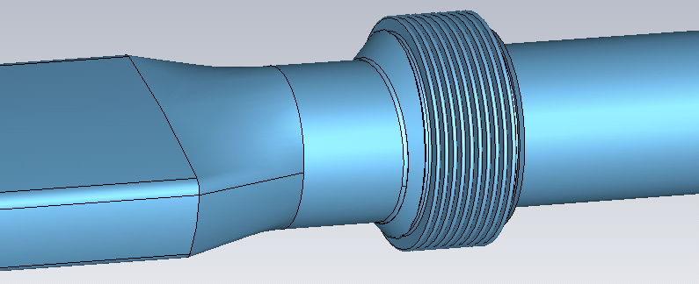
Shielded PP – Long QD Bellows
f [GHz] | Z [kΩ] | Q | R/Q [Ω]
0.001 | 0.0117 | 0.00005 | 234000
2.048 | 0.165 | 2000 | 0.08
2.302 | 4.65 | 480 | 9.7
5.5 | 0.2 | 5 | 40
Perfect pumping port shield assumed.

Slide 7
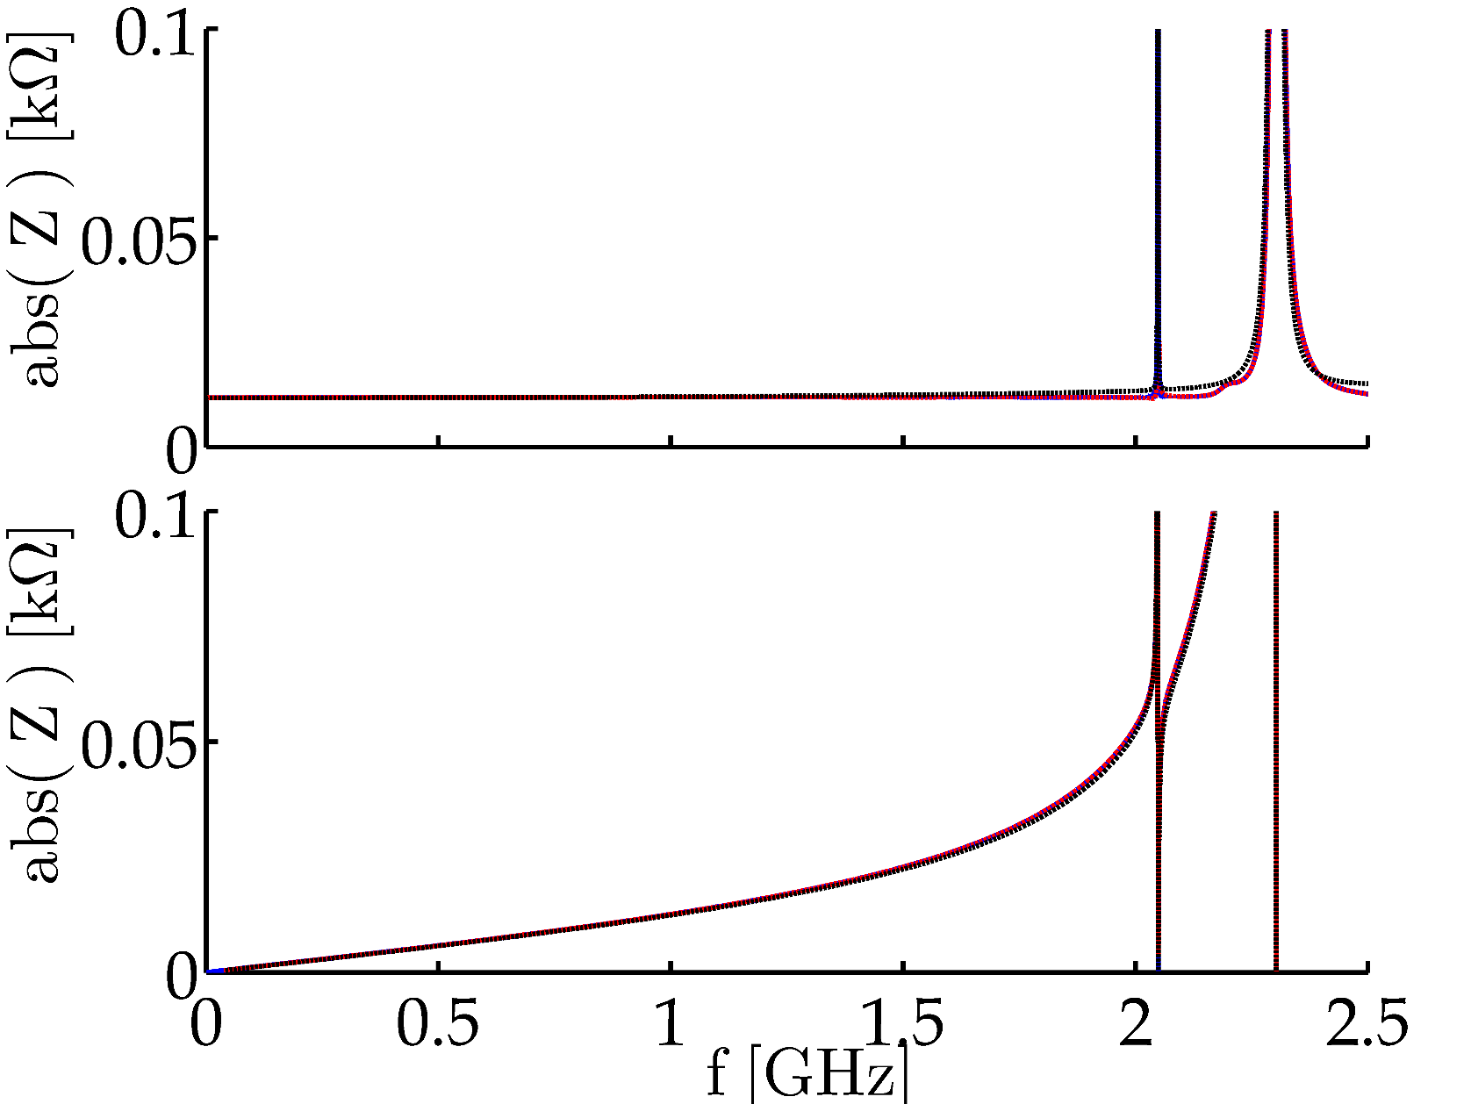
Shielded PP – Long QD Bellows
f [GHz] | Z [kΩ] | Q | R/Q [Ω]
0.001 | 0.0117 | 0.00005 | 234000
2.048 | 0.165 | 2000 | 0.08
2.302 | 4.65 | 480 | 9.7
5.5 | 0.2 | 5 | 40
Re
Perfect pumping port shield assumed.
Im

Slide 8
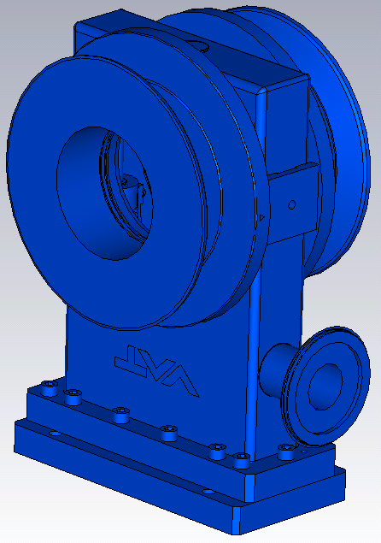
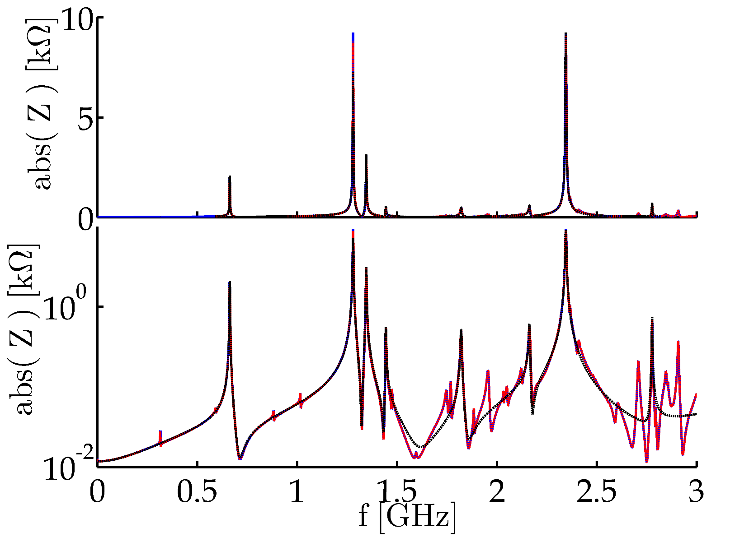
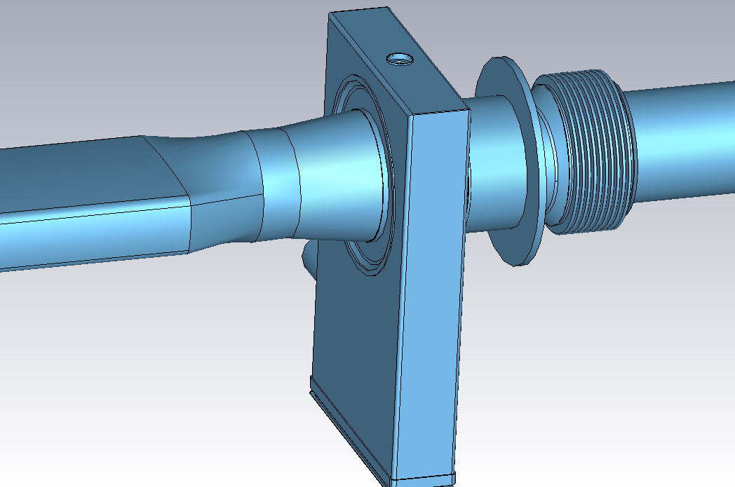
Shielded PP – VVSA – Long QD Bellows
Valve model courtesy of Rene Brulc (VAT).
f [GHz] | Z [kΩ] | Q | R/Q [Ω]
0.001 | 0.0118 | 0.00005 | 236000
0.663 | 2.08 | 420 | 5
1.28 | 9.24 | 680 | 13.6
1.345 | 3.13 | 500 | 6.2
2.345 | 9.24 | 600 | 15.4
Perfect pumping port shield assumed.

Slide 9
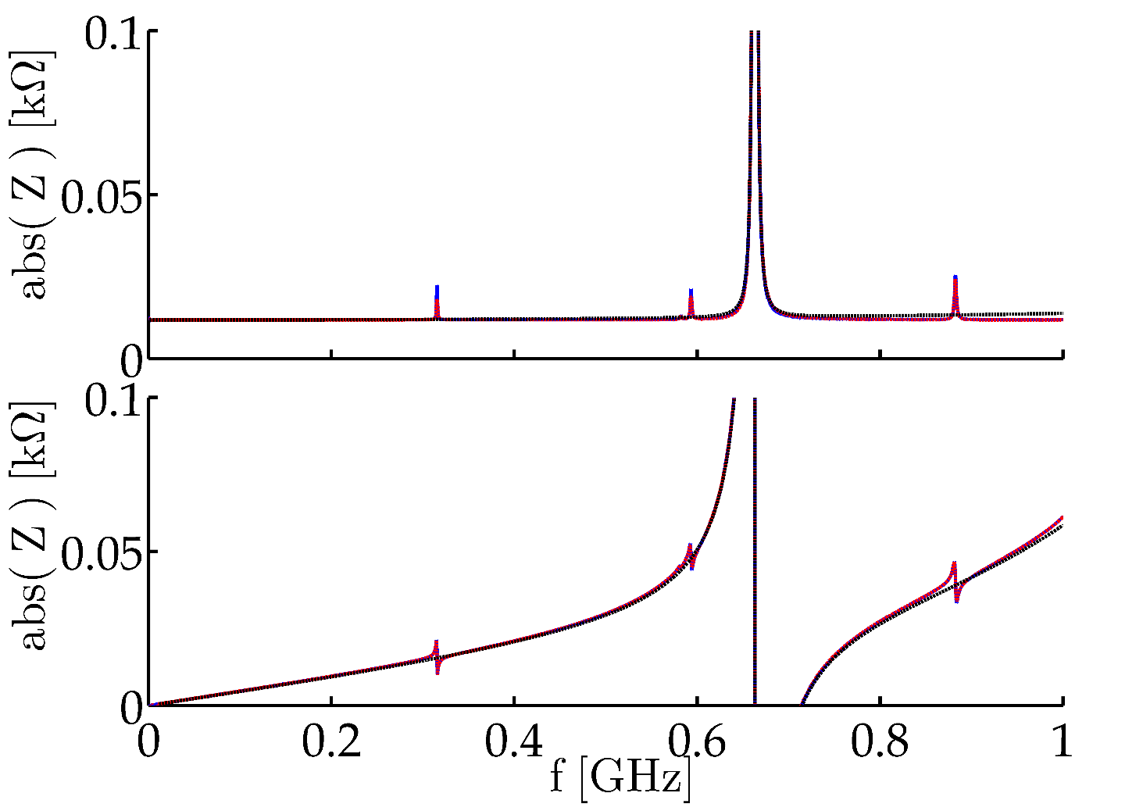
Shielded PP – VVSA – Long QD Bellows
Perfect pumping port shield assumed.
Re
Valve model courtesy of Rene Brulc (VAT).
Im

Slide 10
Outline
Introduction
Long QD Bellows
The BBS Tanks
Comments on the ZS and the MSE/MSTs
The SPS Longitudinal Impedance Model
Conclusions

Slide 11
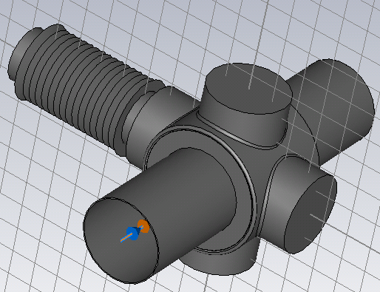
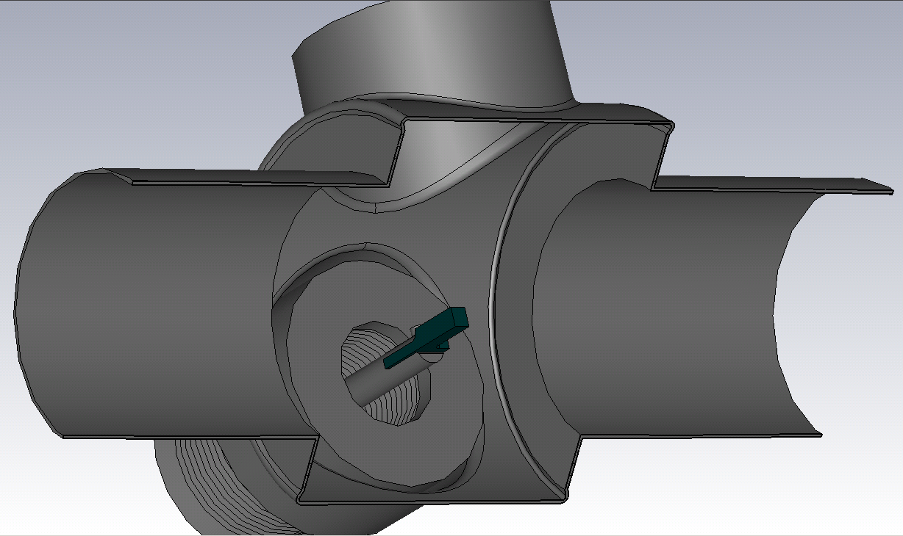
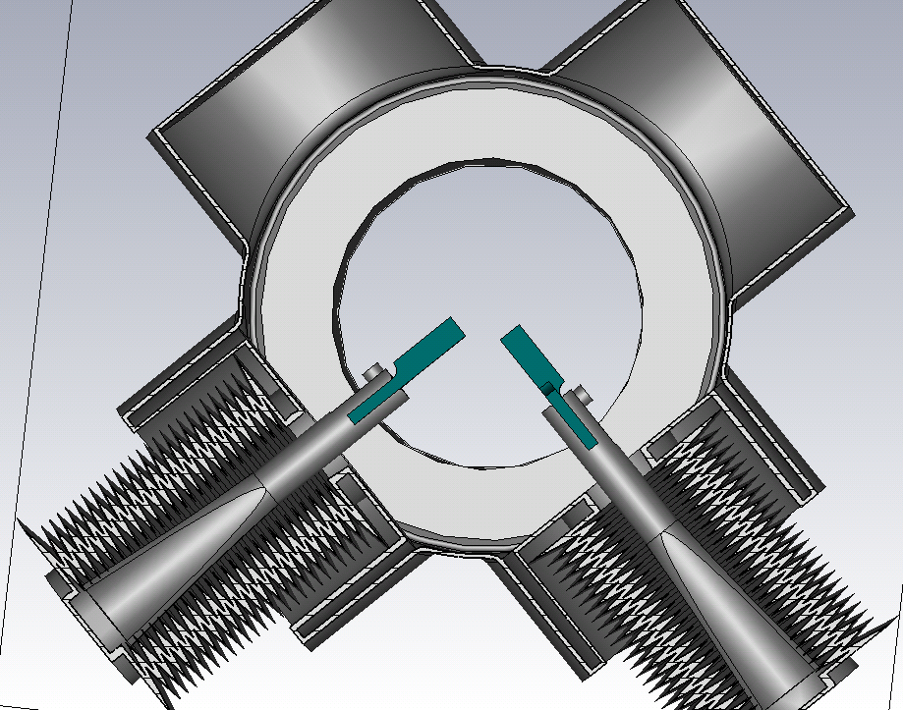
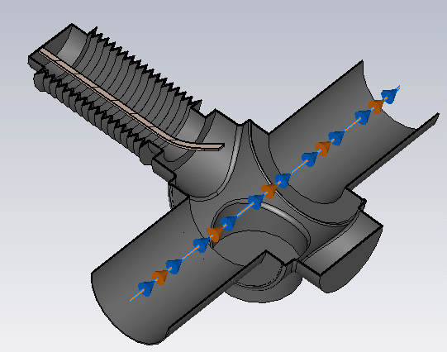
BBS tanks
There are 7, so-called, BBS tanks (BSHVs in layout database):
4 belong to UA9
(two of them are empty)
3 Beam Scrappers ?

Slide 12
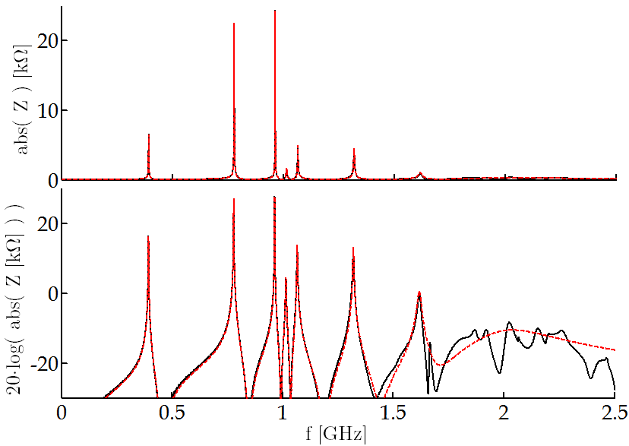
Beam Scrappers
The model was built from layouts.
The arms are placed as in layouts.
Graphite was simulated as isotropic material even though it is anisotropic.
Provisional Results.
f [GHz] | Z [kΩ] | Q | R/Q [Ω]
0.394 | 6.6 | 390 | 17
0.780 | 22.6 | 1080 | 21
0.965 | 24.4 | 2080 | 11.7
1.067 | 4.95 | 500 | 9.9
1.32 | 4.52 | 400 | 11.3

Slide 13
UA9 Cherenkov Detector
The model was built from a layout provided by A. Danisi.
The position of the arm might differ.
Quartz in retracted position.
Provisional results.
f [GHz] | Z [kΩ] | Q | R/Q [Ω]
0.912 | 67 | 4900 | 13.7
1.308 | 62 | 5500 | 11.3

Slide 14
Outline
Introduction
Long QD Bellows
The BBS Tanks
Current on the ZS and the MSE/MSTs
The SPS Longitudinal Impedance Model
Conclusions

Slide 15
ZS
The impedance of the ZS was studied before
Simulations by B. Salvant (latest update 19/09/2013).
Wire measurements were carried out by H. Day (talk on the 30/01/2014).
These studies clearly showed that:
The impedance of a single ZS is very complicated (many low-frequency resonances)
Accurate impedance characterization requires considering the 5 septa as they are installed.
Therefore, the goal is to run a five ZS tank simulation since measuring the five tank emsemble is not possible.
However, let’s start with two.

Slide 16
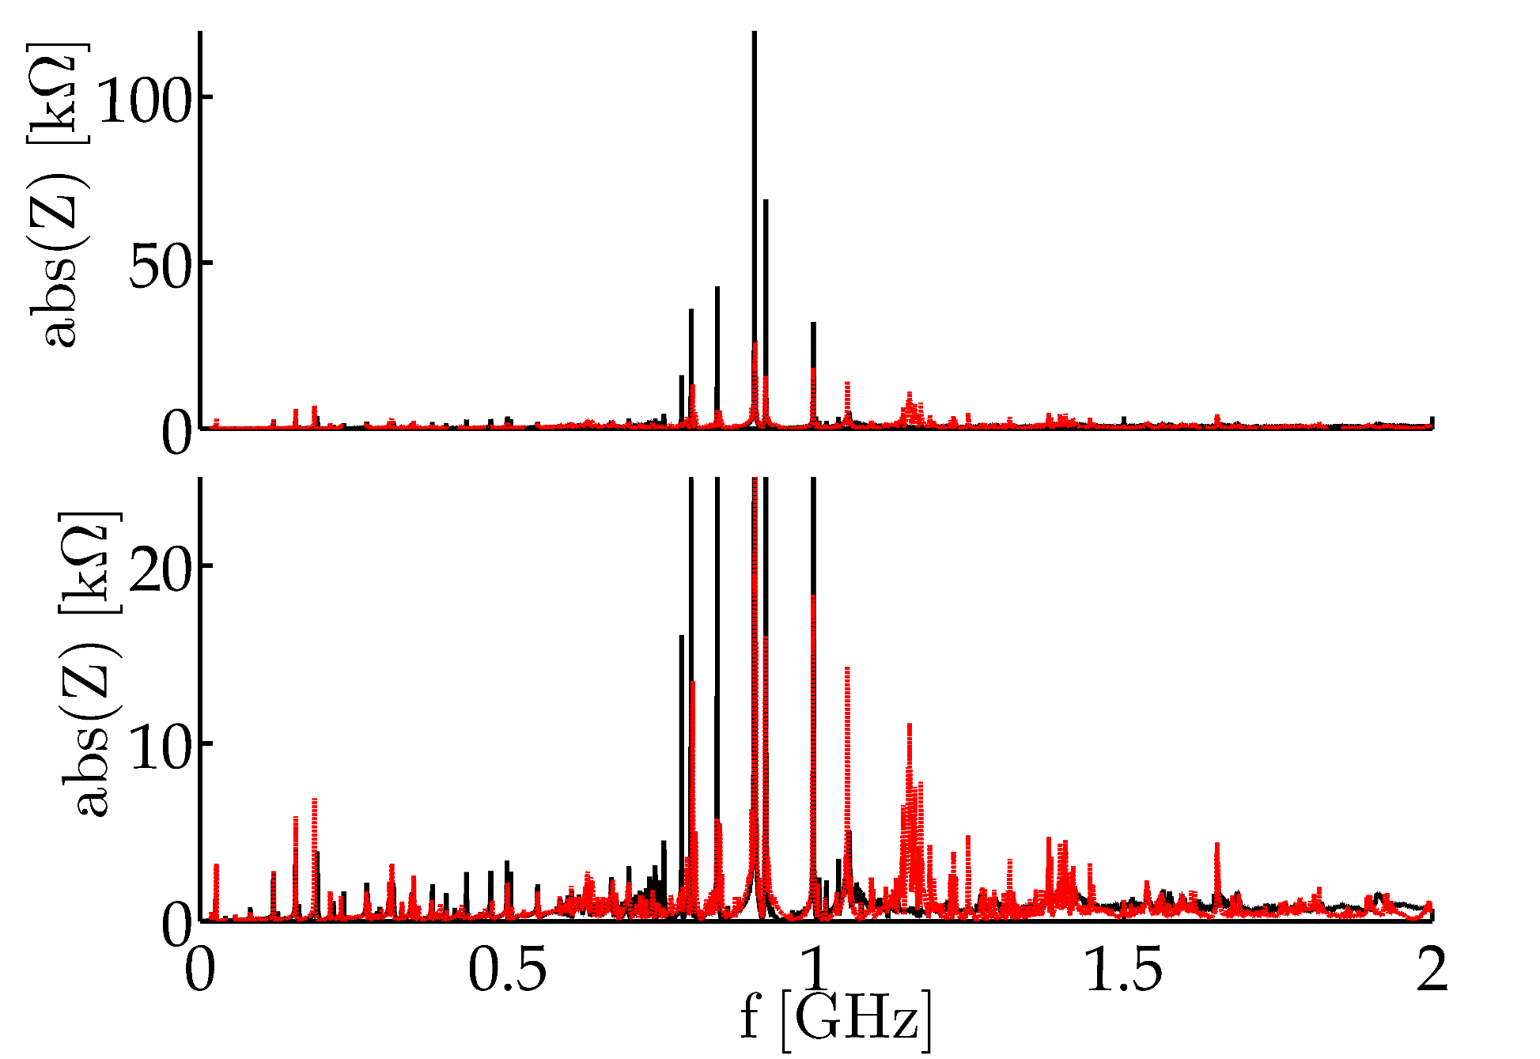
ZS
Two ZS Simulation (red) vs Sum of the Impedances of Different Elements (black)
Resonances coming from the pumping modules.
Damping resistors not included in simulations.

Slide 17
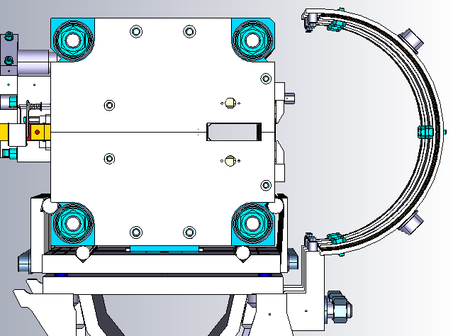
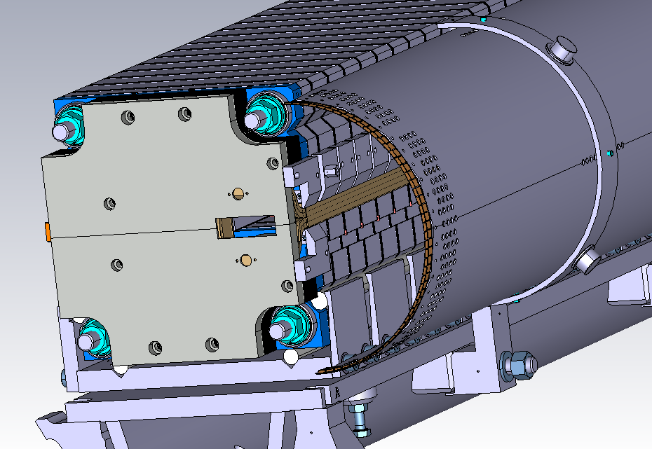
MSE / MST
Similar to the ZS case. We have five tanks in a row with pumping modules in between.
The objective is, again, to simulate the five tanks together
In order to do so, an electromagnetic characterization of the laminated core is needed.
Many thanks to Bruno Balhan and Cedric Baud for providing the 3D model and core laminations for measurements.

Slide 18
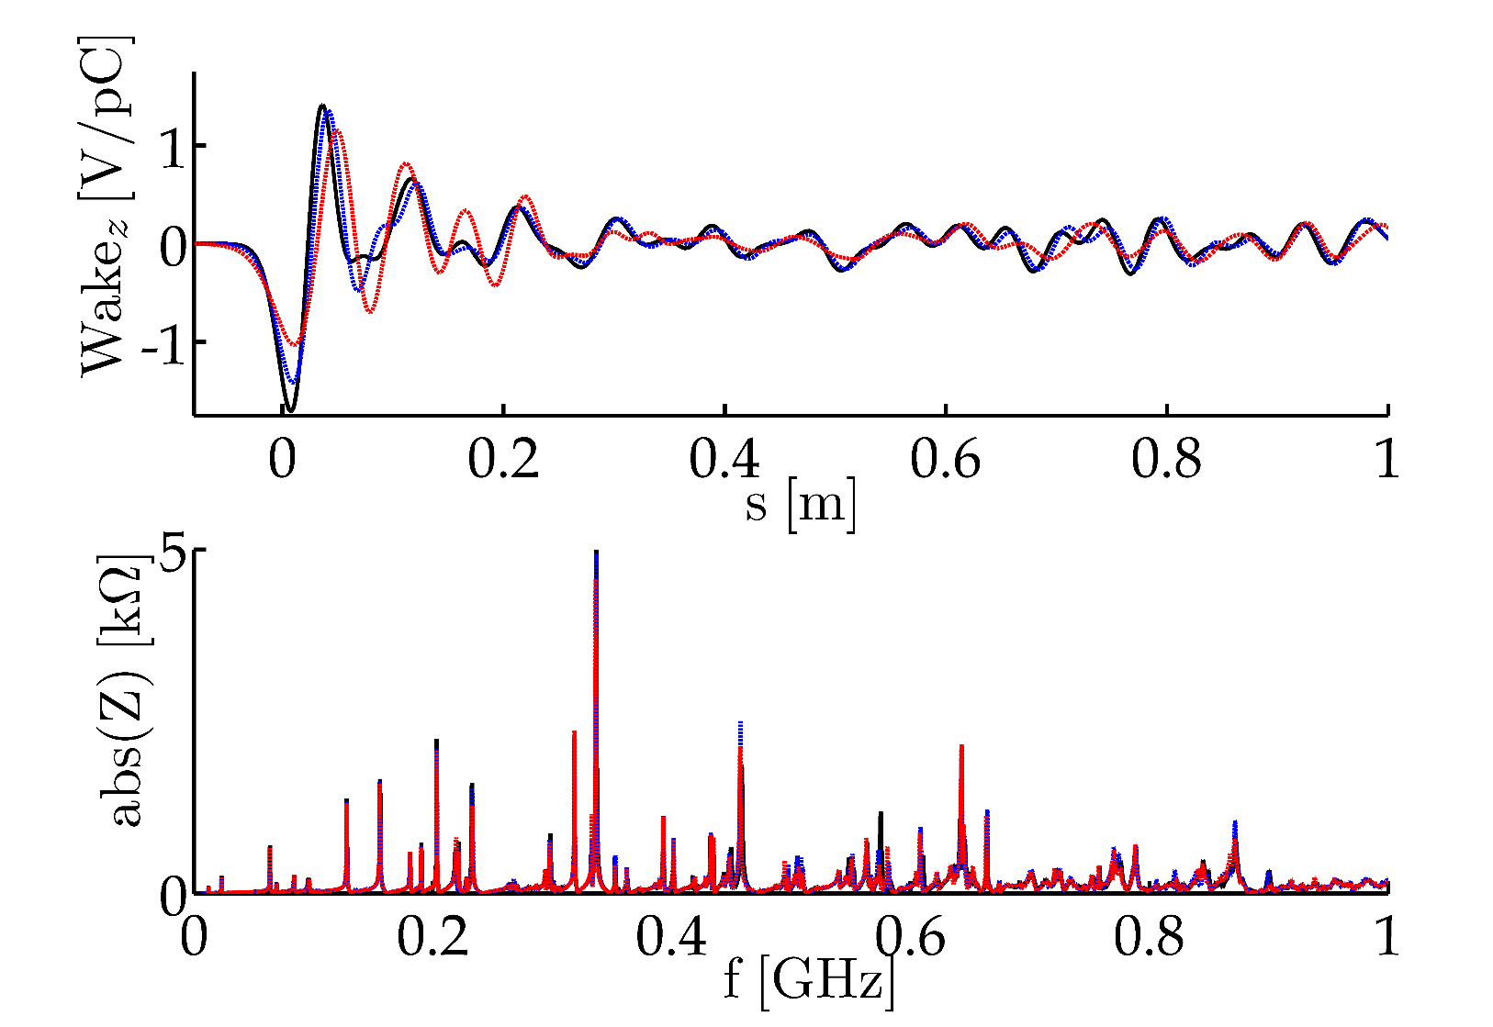
MSE / MST
Results depend heavily on the electromagnetic behaviour of the laminated core.
First convergence studies of a single MSE tank

Slide 19
Outline
Introduction
Long QD Bellows
The BBS Tanks
Comments on the ZS and the MSE/MSTs
The SPS Longitudinal Impedance Model
Conclusions

Slide 20
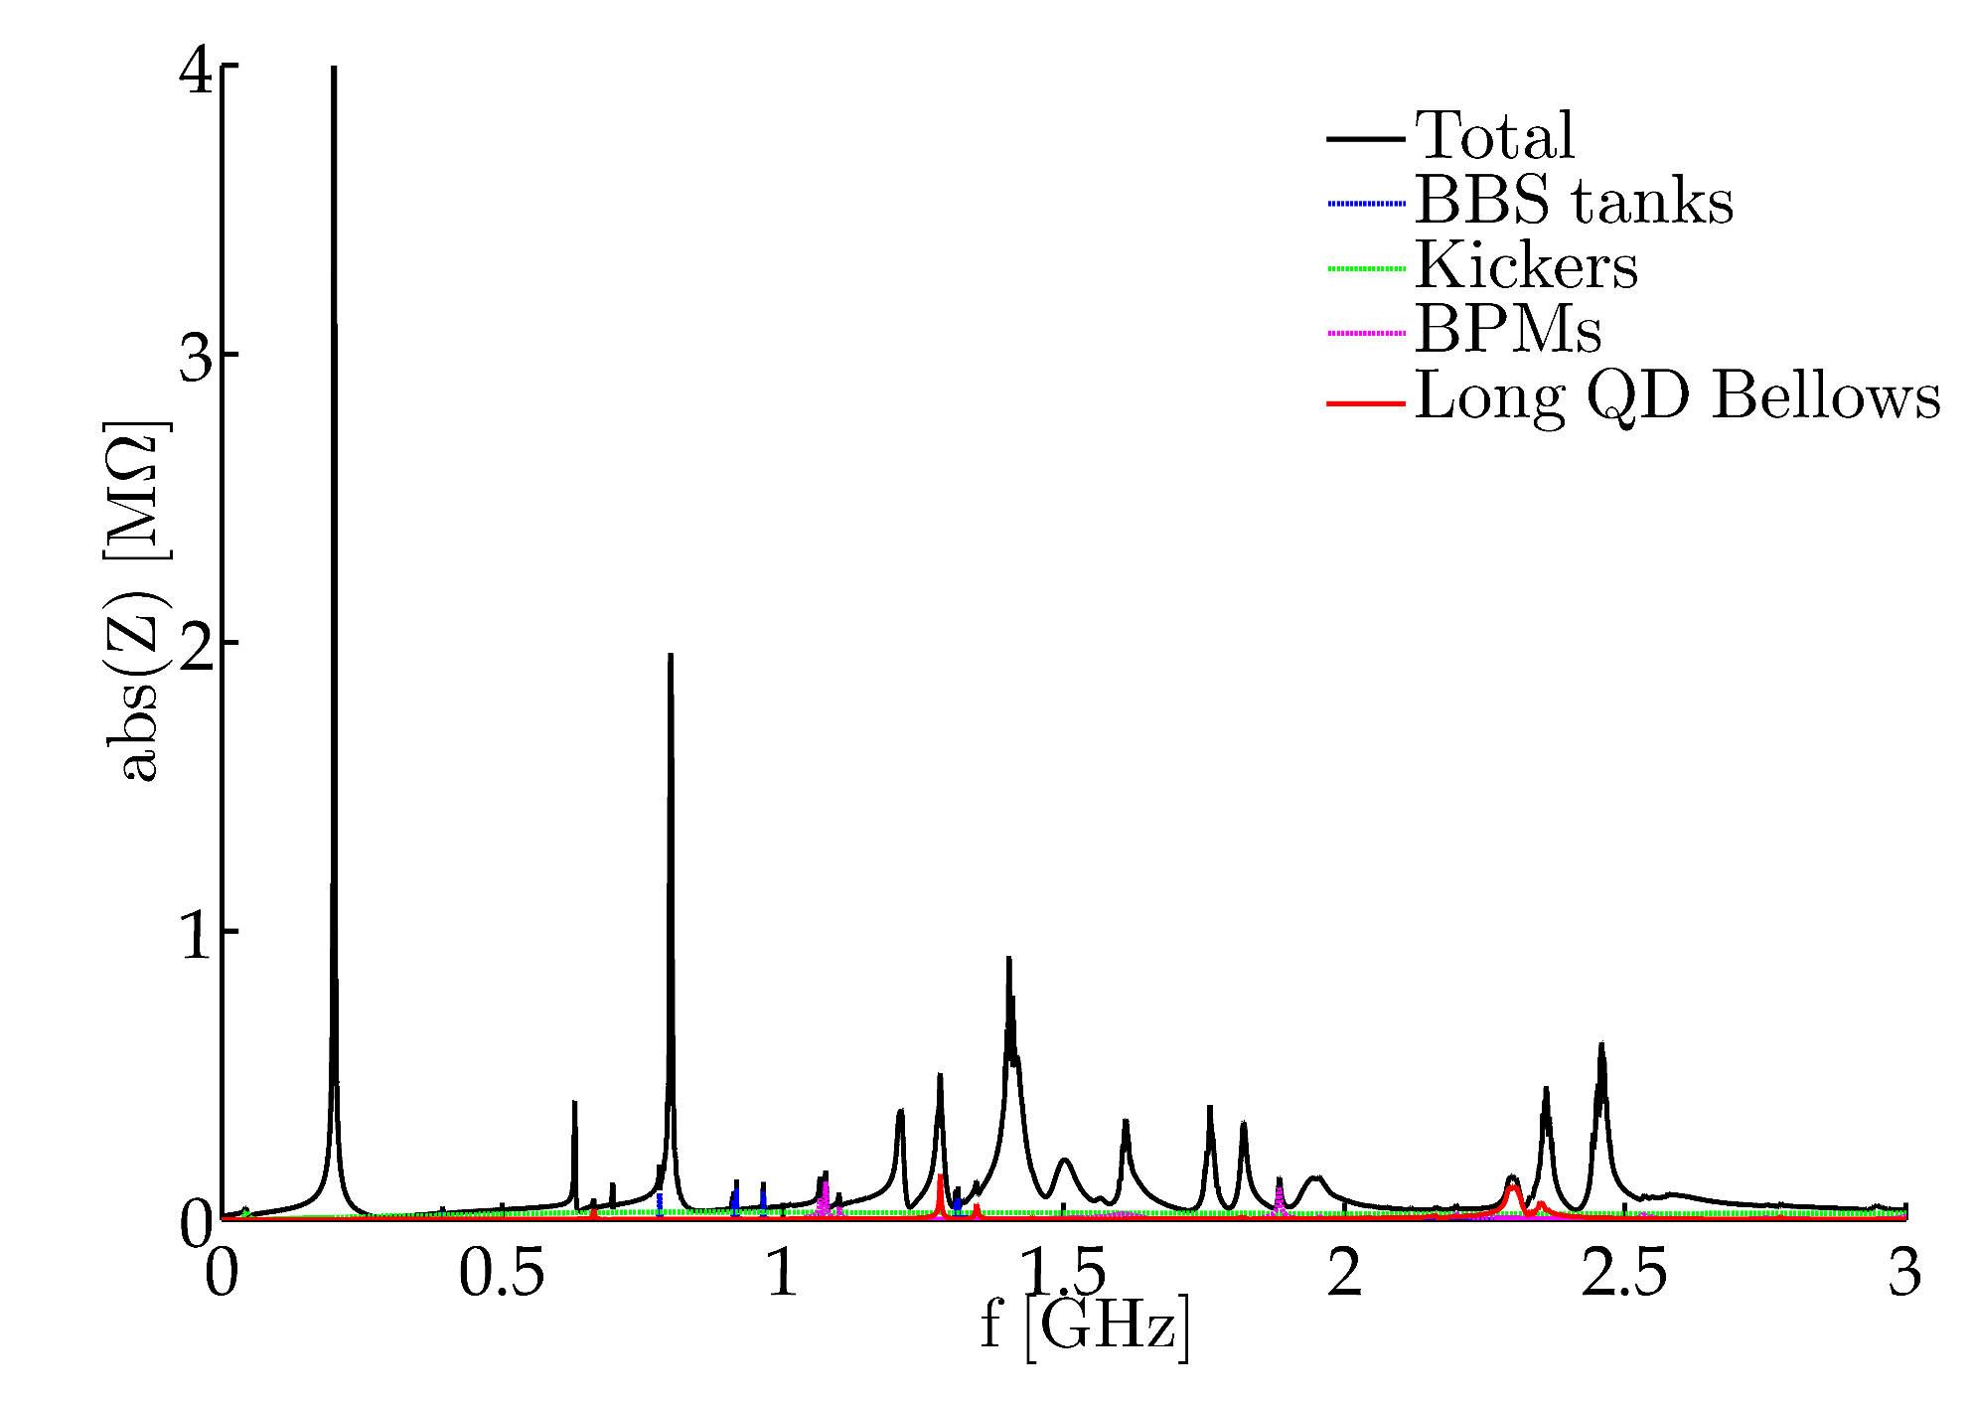
Longitudinal Impedance Model
Updates to the model:
Updated kicker impedance (all MKEs serigraphed)
BBS tanks
Long QD Bellows
To note:
0% Non-conform PP Shields
Resonances Scattered 2.5%

Slide 21
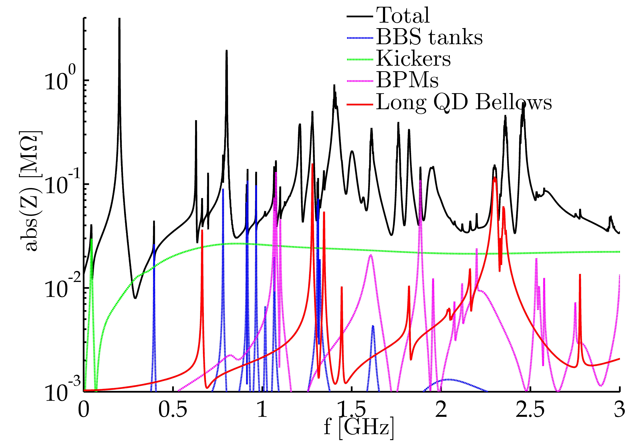
Longitudinal Impedance Model

Slide 22
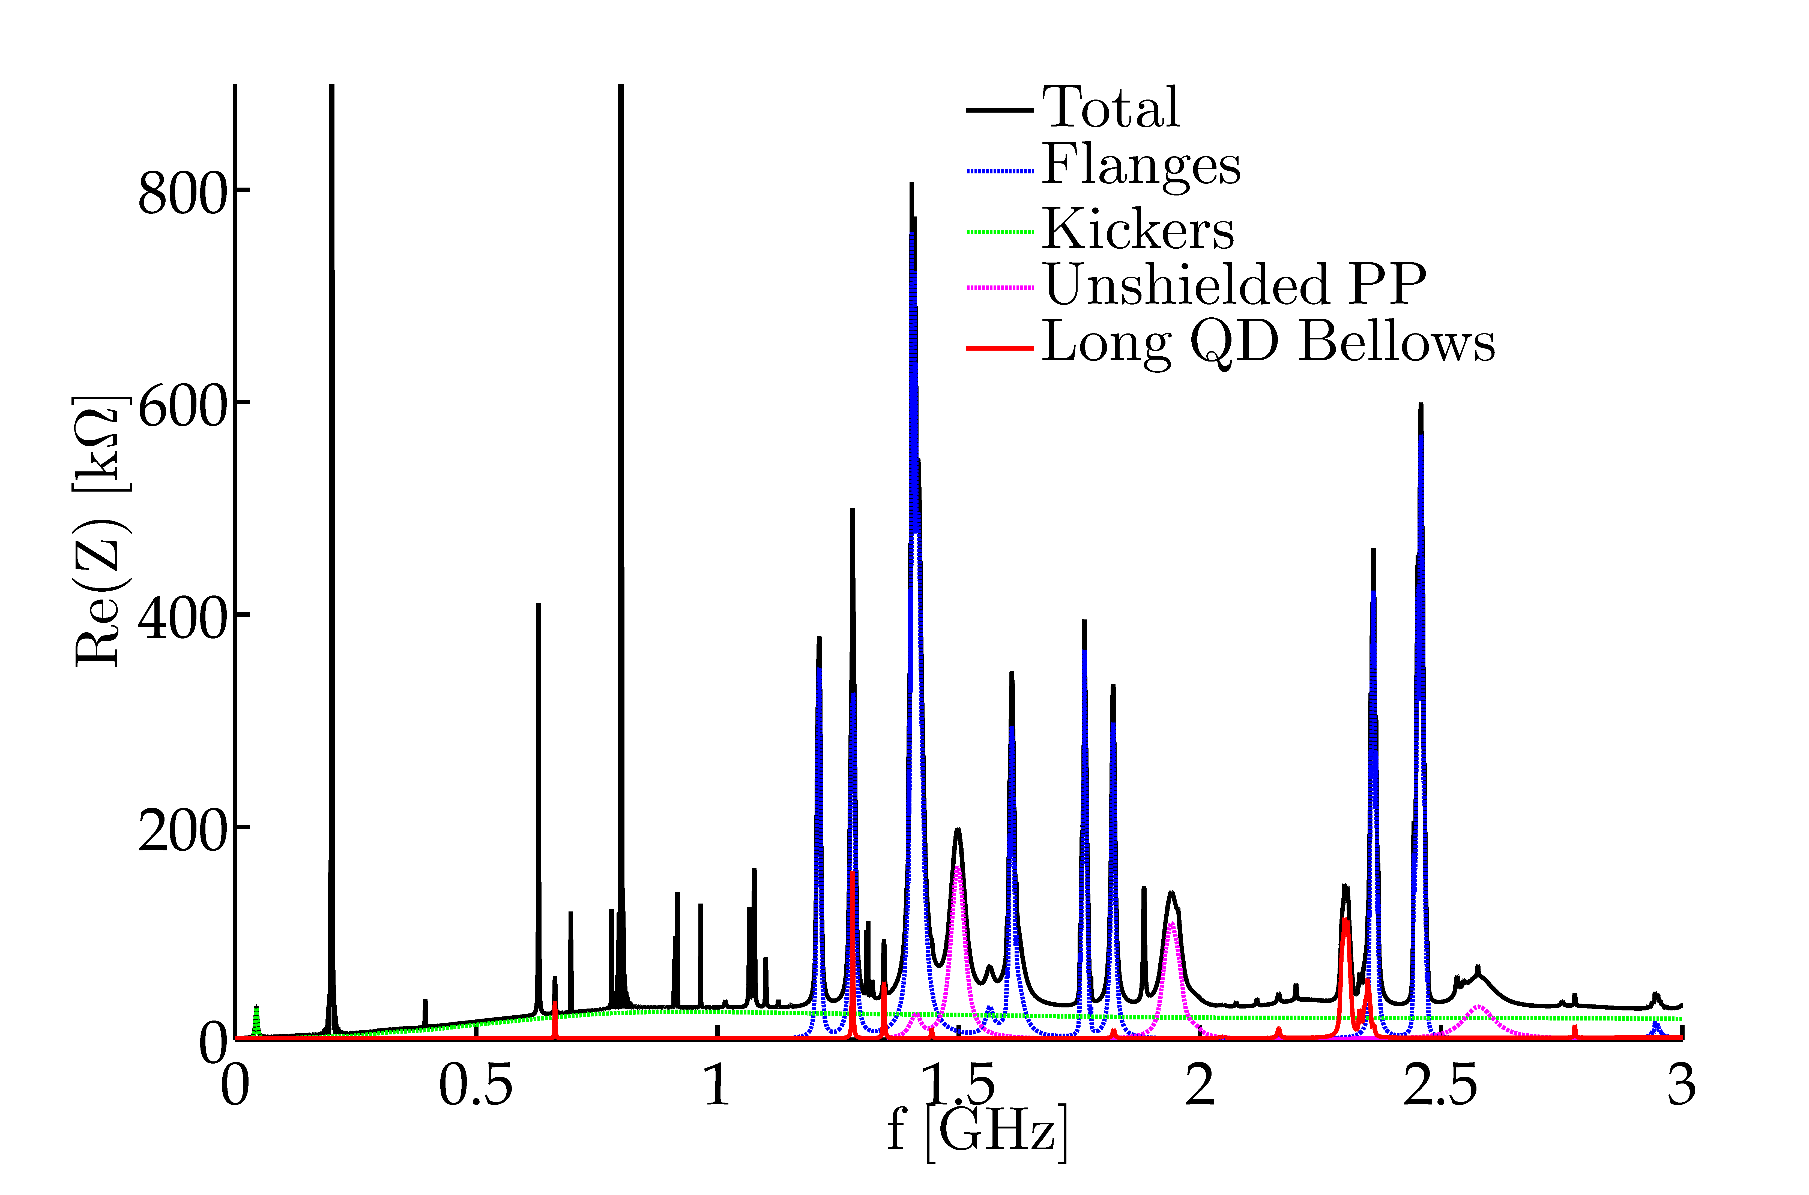
Longitudinal Impedance Model

Slide 23
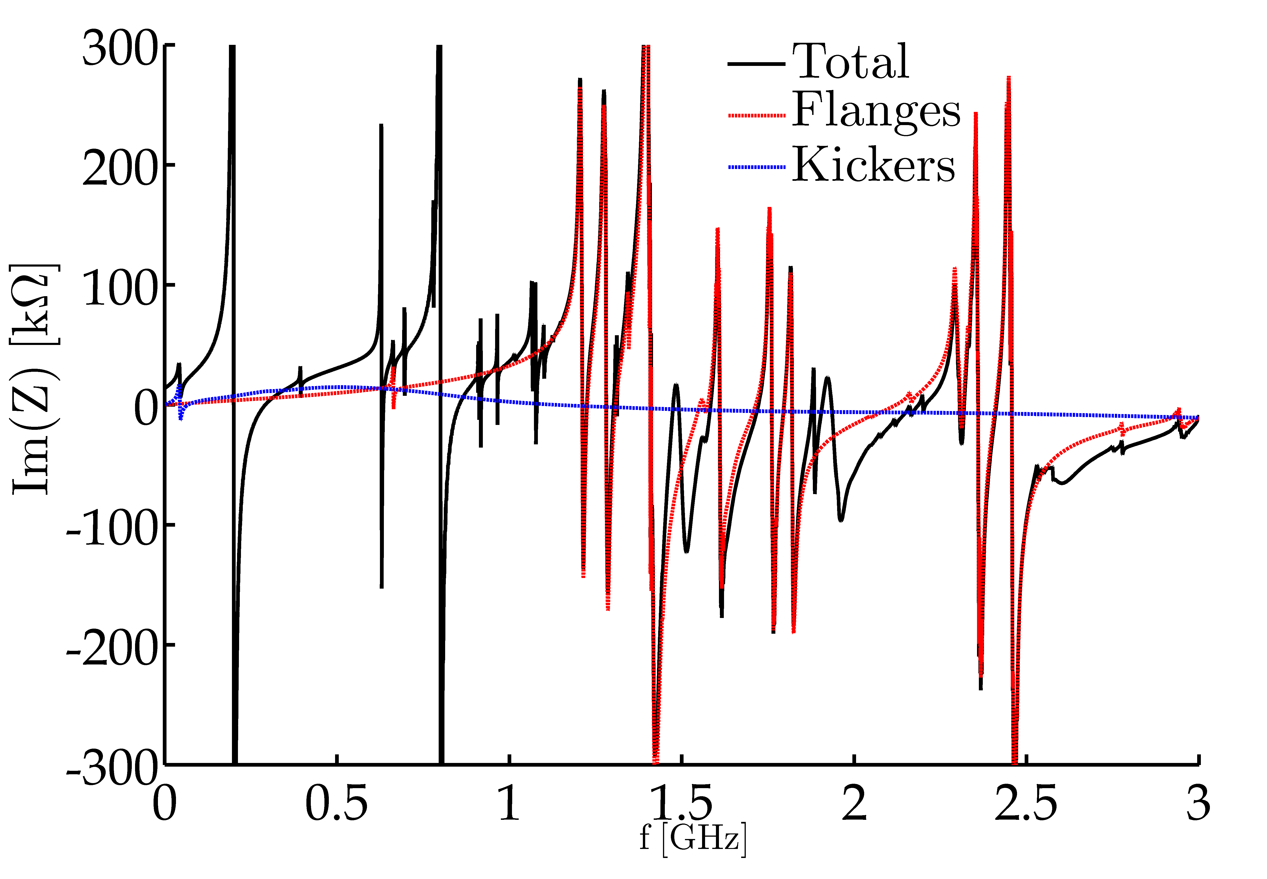
Longitudinal Impedance Model

Slide 24
Outline
Introduction
Long QD Bellows
The BBS Tanks
Comments on the ZS and the MSE/MSTs
The SPS Longitudinal Impedance Model
Conclusions

Slide 25
Conclusions
Impedance Model has been updated:
About 330kΩ at 2.3GHz, R/Q = 690 Ω
The 17 VVSA positions give significant impedance (150kΩ at 1.3 and 2.3GHz )
‘High-Q’ resonances of the BBS tanks
Next impedance sources to be included:
33 VVSB positions
Surroundings to be checked
6 ZS
5 tank simulations necessary
CST crashing randomly is slowing down the analysis
Thanks to Michal and John (IT-PES) for their help
25 MSE/MSTs
Laminated core has to be characterized
Again, 5 tank simulations necessary.
CST crashing randomly is slowing down the analysis
Thanks to Michal and John (IT-PES) for their help

