Slide 1
End-of-year talk
LIU-SPS BD WG meeting 11.12.14

Slide 2
Our meetings in 2014
During year - 10 meetings of LIU-SPS BD WG
(less than usual 12, but more than in 2013 :-)
Main topics:
SPS impedance – 16 talks…
MDs, instabilities
Main speakers:
6 talks: J. Varela
5 talks: T. Argyropoulos
4 talks: H. Bartosik, A. Lasheen
Many thanks to all other speakers!
Minutes: thanks a lot to Hannes!

Slide 3
Summary of 2014 beam studies
Beam re-commissioning after LS1
E-cloud - SPS scrubbing: strong e-cloud for high intensity and doublets
Preparation of 25 ns beams (8b4e, BCMS) - OK
Pushing intensity of 25 ns beam to the maximum:
high losses (limited by e-cloud?)
Preparation of doublets for LHC scrubbing
- new (longer) magnetic cycle – was not needed yet
- LLRF, transverse damper : room for improvement?
SPS MDs: frequency shifts, instability thresholds and growth rates

Slide 4
Main achievements in 2014
Improved SPS impedance model (+ X-mas inspection by Vacuum Group)
New simulation code (BLonD)
Particle simulations and their agreement with measurements for a single bunch (both in transverse and longitudinal plane)
LIU Day on 11.04.14 & Chamonix talks: other upgrade options
SPS MDs: new data to be analysed…

Slide 5
Priorities for BD studies in 2015
Two important decisions to be taken (for LS2?):
aC-coating versus scrubbing – end 2015
SPS impedance reduction (flanges) – mid 2015
Measurements with multi-bunch beams:
Scrubbing run
12 -… 72 bunches (different intensity, FB&FF off/on)
Simulations of multi-bunch beams:
Code development (BLonD) - optimisation
Ramp & Phase Loop & FF/FB
Doublets for LHC: losses, long ramp, bunch rotation
Measurements with new 800 MHz beam control

Slide 6
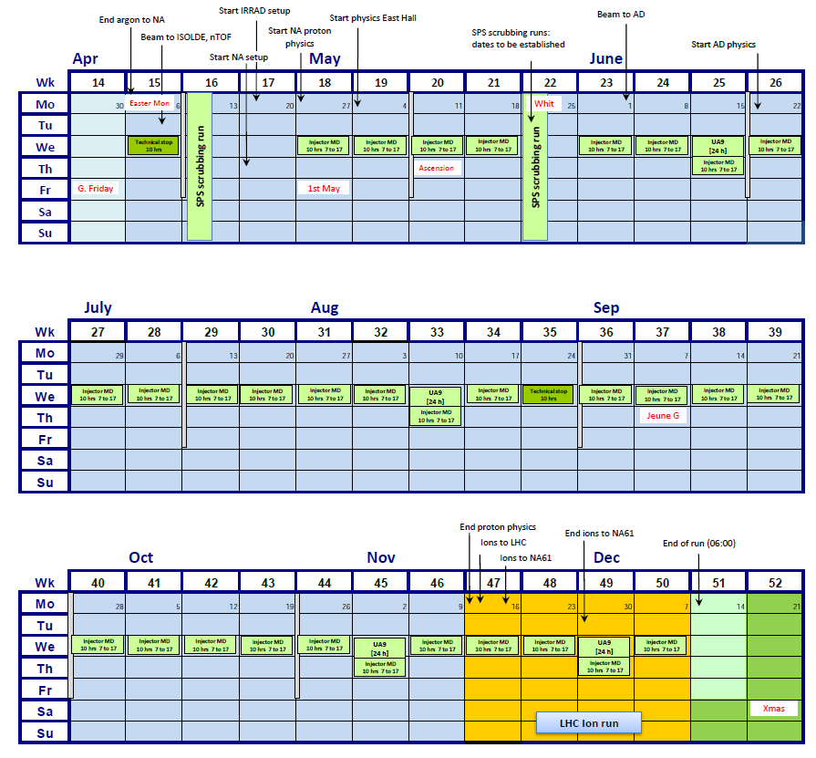
Large number of MDs!

Slide 7
Merry Christmas! Happy New Year!

