Slide 1
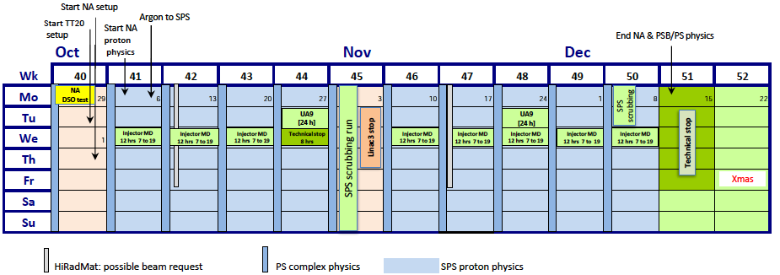
Schedule v1.7
Transverse measurements (optics, impedance, SC, instabilities)
Longitudinal measurements (impedance, SC, instabilities (CB, μw) )
Ar setup
Ar setup
Ar setup
Ar setup
Ar setup
Ar setup
Longitudinal
Dedicated MDs in SPS
W41: 12h 25ns performance recovery + aperture measurement on SFTPRO
Up to 72 bunches accelerated to 110 GeV on nominal LHC filling cycle. Up to 72 bunches on the short FB MD cycle. FT beam for aperture scans.
Transverse damper set up for LHC beams in the morning + 2h in the afternoon for the exchange of the H1 damper amplifier
Electron cloud signals on strip monitors seem stronger than before LS1. High pressure rise on MKP (very close to interlock limit of 2e-7), ZS, newly installed magnets. Much lower dynamic pressure rise in the two a-C coated FODO cells. Problems of losses at injection and poor lifetime at 26 GeV. Measured transverse emittances around 3um.
12 bunches for longitudinal instability threshold measurement and tests of bunch rotation at flat top (different intensities from injectors)
Measurements of bunch-by-bunch emittance with 72b on MD cycle. No visible sign of blow up along the batch. Strong pressure rise in the arcs, perhaps relation with bad lifetime?

Slide 2
Schedule v1.7
Transverse measurements (optics, impedance, SC, instabilities)
Longitudinal measurements (impedance, SC, instabilities (CB, μw) )
Ar setup
Ar setup
Ar setup
Ar setup
Ar setup
Ar setup
Longitudinal
Dedicated MDs in SPS
W41: 12h 25ns performance recovery + aperture measurement on SFTPRO
W42: 4h coast setup + 8h 800 MHz
W43: 7h coast setup + 2h in-jaw BPM collimators + 2h TT2/TT10 optics + 1h Ions LL RF
W45 (Scrubbing Run): 7d scrubbing run + 8h 800 MHz
W46: 12h doublet on standard LHC cycle
W47: 12h Collimator alignment with in-jaw BPMs
W48: 4h sponge material UA9 + 8h 800 MHz
W49: 6h transverse + 6h longitudinal setup of doublet beam on slow cycle
W50: 2+1 days of scrubbing with doublet beam + 80b transfer from PS + (8b+4e) + 6h 800 MHz

