Slide 1
Benchmarking the SPS transverse impedance model: headtail growth rates
C. Zannini, H. Bartosik, G. Iadarola, G. Rumolo, B. Salvant
Acknowledgment: M. Barnes, T. Bohl, F. Caspers, E. Chapochnikova, H. A. Day, E. Métral, V.G. Vaccaro, J.E. Varela

Slide 2
Overview
SPS transverse impedance model
Benchmarking of the model
Previous benchmarks
Headtail growth rates
Q20 optics
Q26 optics
Conclusions and future plans

Slide 3
Overview
SPS transverse impedance model
Benchmarking of the model
Previous benchmarks
Headtail growth rates
Q20 optics
Q26 optics
Conclusions and future plans

Slide 4
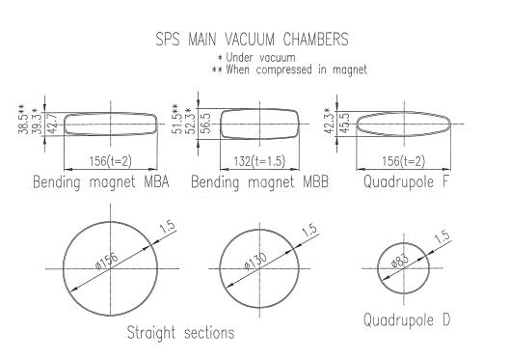
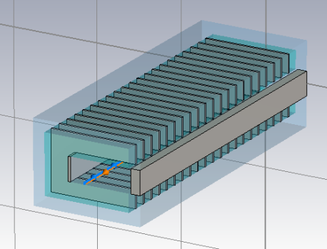
SPS transverse impedance model
Elements included in the database:
Wall impedance that takes into account the different SPS vacuum chambers (analytical calculations)
Kickers (CST 3D simulations)
RF cavities (200 MHZ and 800 MHz) without couplers (CST 3D simulations)
Broadband impedance of step transitions (CST 3D simulations)
Horizontal (BPH) and vertical (BPV) beam position monitors (CST 3D simulations)
Beam pipe
Kickers
RF cavities
Step transitions
BPH
BPV

Slide 5
SPS transverse impedance model
Elements included in the database:
Wall impedance that takes into account the different SPS vacuum chambers (analytical calculations)
Kickers (CST 3D simulations)
RF cavities (200 MHZ and 800 MHz) without couplers (CST 3D simulations)
Broadband impedance of step transitions (CST 3D simulations)
Horizontal (BPH) and vertical (BPV) beam position monitors (CST 3D simulations)
Beam pipe
Kickers
RF cavities
Step transitions
BPH
BPV

Slide 6
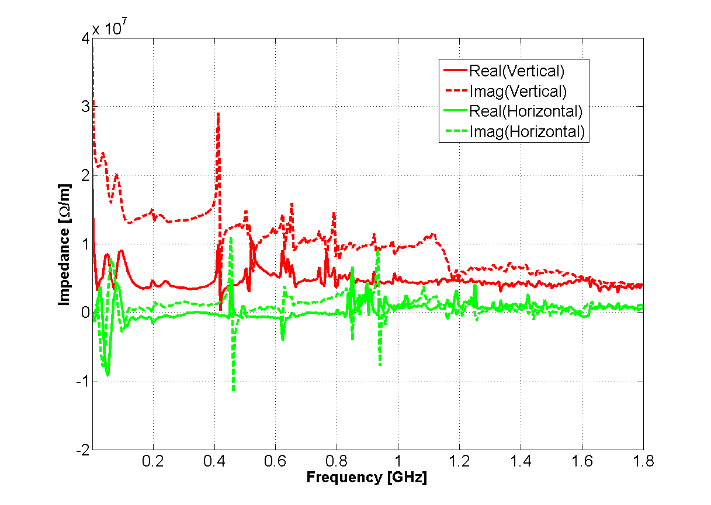
SPS transverse impedance model

Slide 7
Overview
SPS transverse impedance model
Benchmarking of the model
Previous benchmarks
Headtail growth rates
Q20 optics
Q26 optics
Conclusions and future plans

Slide 8
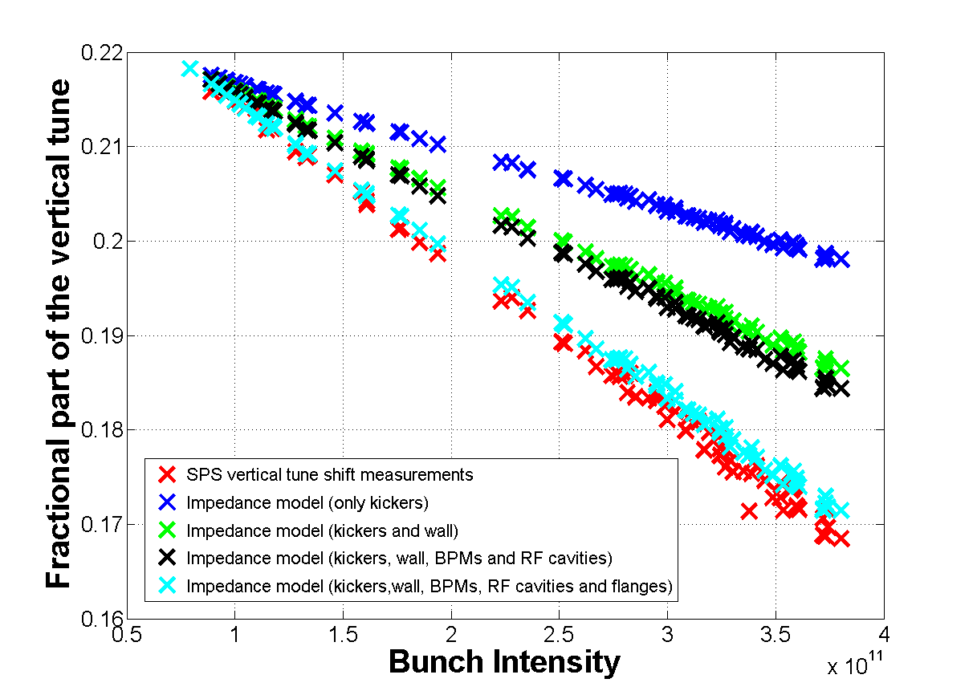
Benchmarking the SPS transverse impedance model: coherent tune shift
Vertical coherent tune shift: Measurements performed in September 2012
20 %
40 %
60 %
80 %
100 %
The SPS impedance model explains more than 90% of the measured vertical coherent tune shift

Slide 9
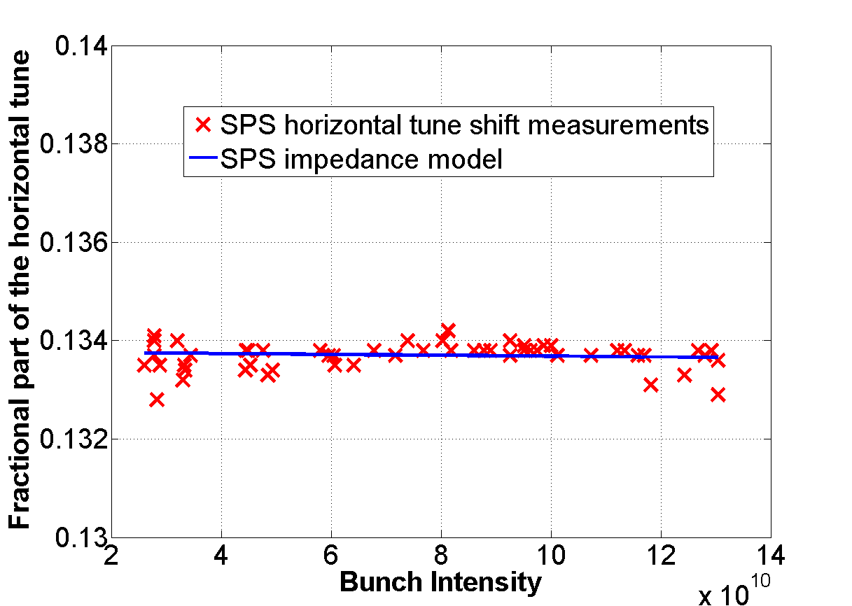
Benchmarking the SPS transverse impedance model: coherent tune shift
Horizontal coherent tune shift: Measurements performed in February 2013
The SPS impedance model predicts a very small horizontal tune shift (almost flat) in agreement with the measurements

Slide 10
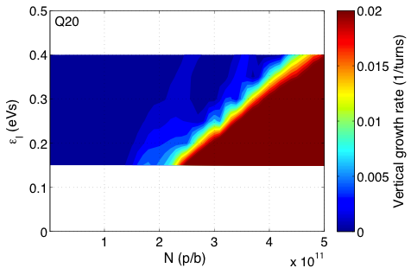
Benchmark of the SPS transverse impedance model: TMCI thresholds
Two regimes of instability in measurements
Fast instability threshold with linear dependence on ε_{l}
Slow instability for intermediate intensity and low ε_{l}
Very well reproduced with HEADTAIL simulations
SPS impedance model includes kickers, wall, BPMs and RF cavities
Direct space charge not included
measurements
HEADTAIL simulations
nominal
Island of slow instability
4.5x10¹¹ p/b
@ 0.35 eVs
10

Slide 11
Benchmark of the SPS transverse impedance model: TMCI thresholds
measurements
HEADTAIL simulations
nominal
Island of slow instability
4.5x10¹¹ p/b
@ 0.35 eVs
11

Slide 12
Benchmark of the SPS transverse impedance model: TMCI thresholds
measurements
HEADTAIL simulations
nominal
Island of slow instability
4.5x10¹¹ p/b
@ 0.35 eVs
12

Slide 13
Overview
SPS transverse impedance model
Benchmarking of the model
Previous benchmarks
Headtail growth rates
Q20 optics
Q26 optics
Conclusions and future plans

Slide 14
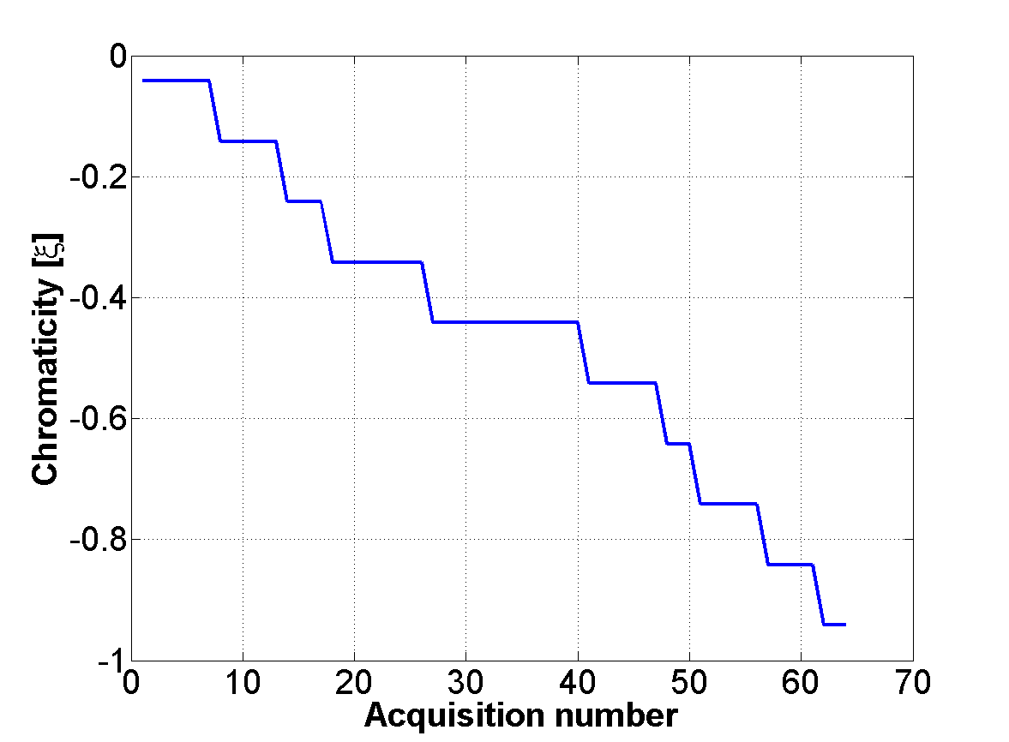
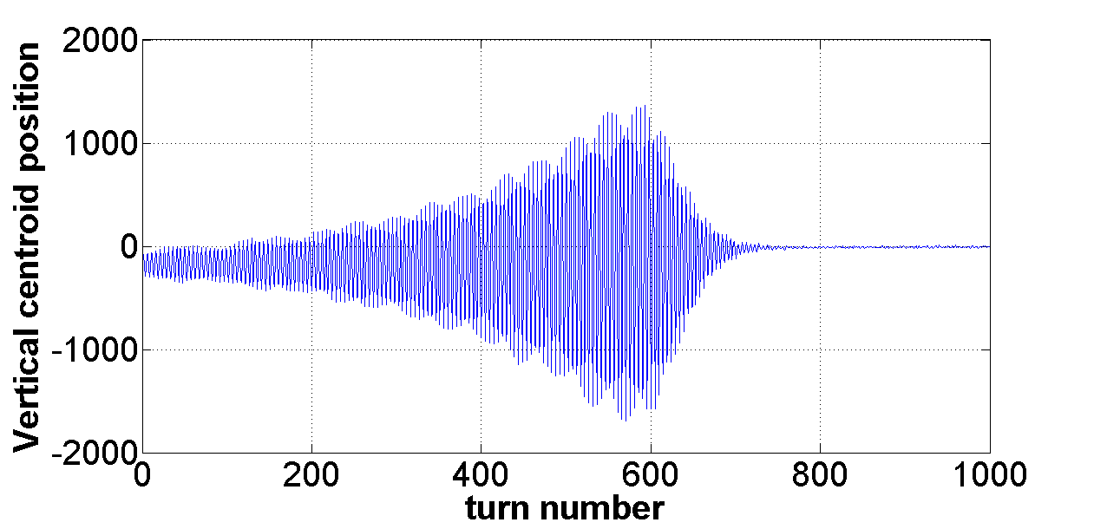
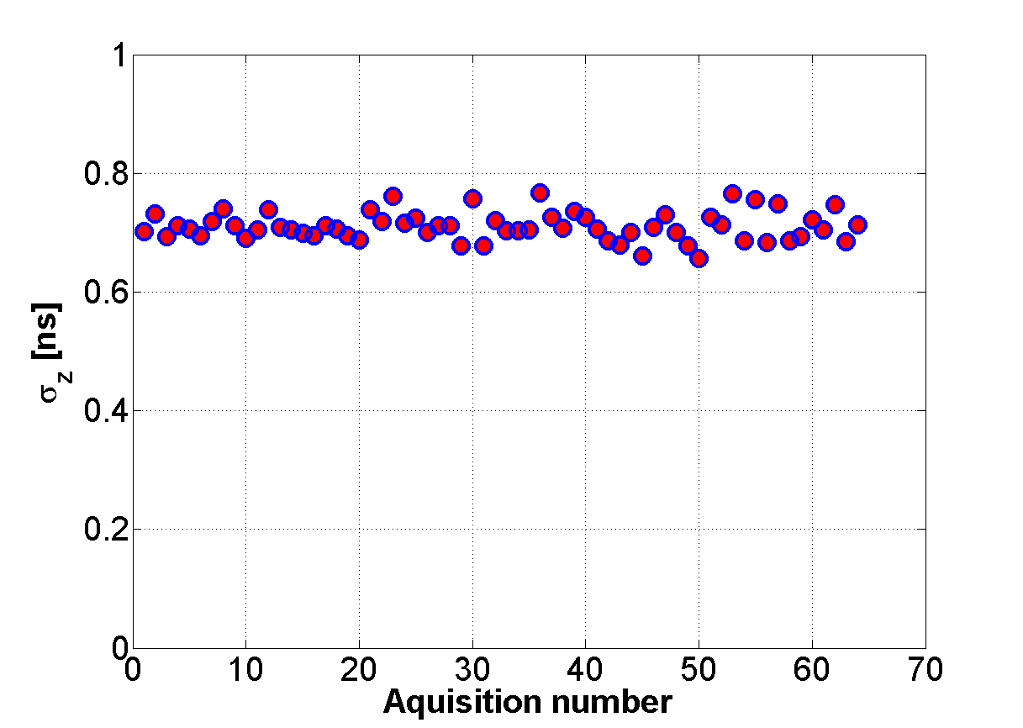
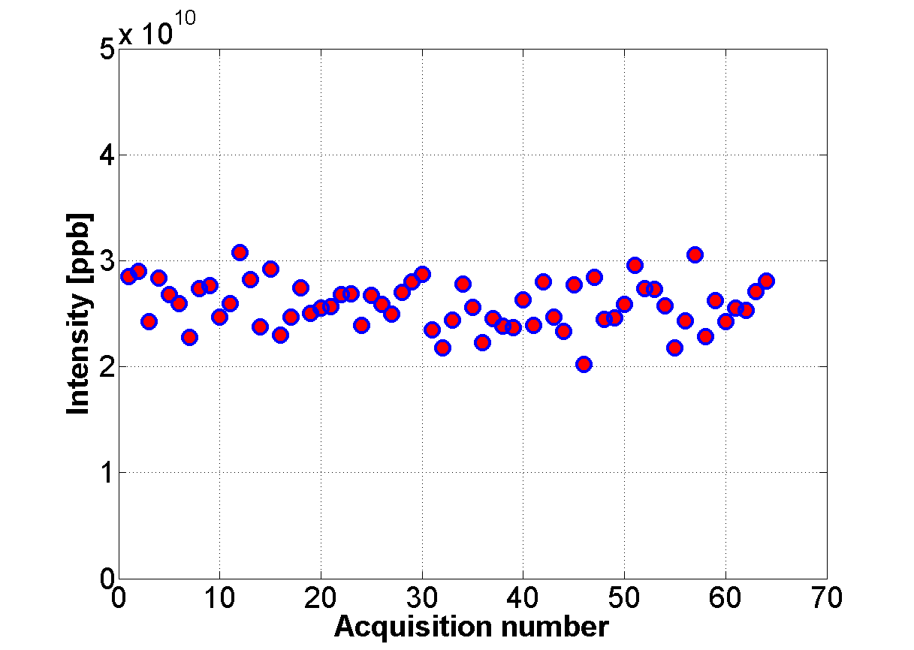
Growth rate versus chromaticity: Measurements
Measurements performed on February 2013
ξ = ξ(ACNR)

Slide 15
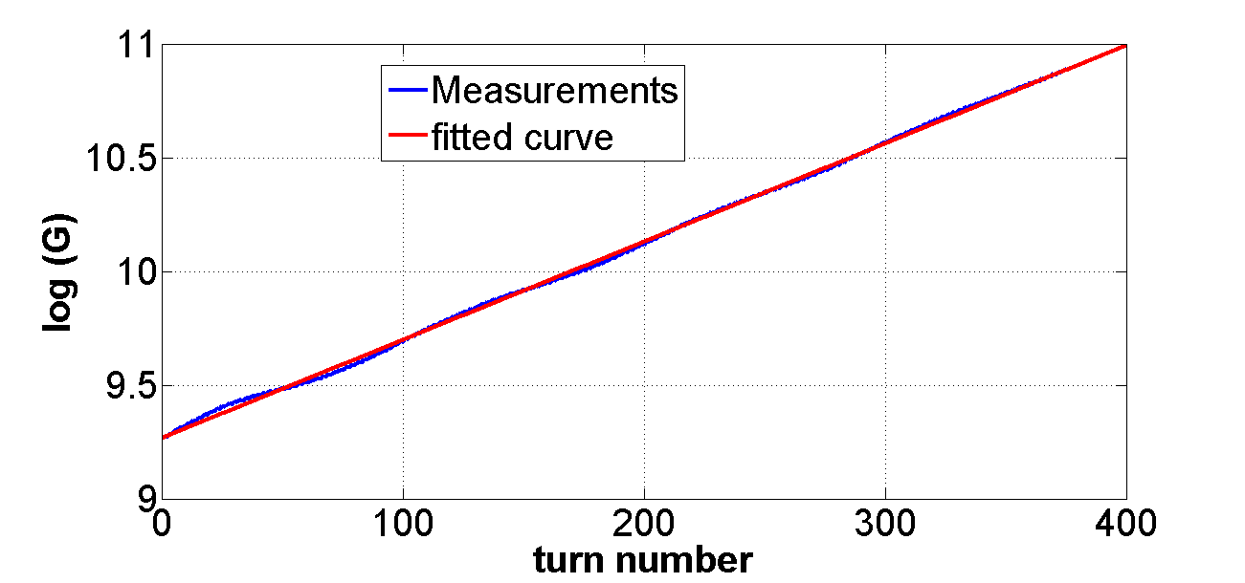
Growth rate measurements
Amplitude of peak in FFT
H. Burkhardt, G. Rumolo, F. Zimmermann, “Coherent Beam Oscillations and Transverse Impedance in the SPS”, 2002.

Slide 16
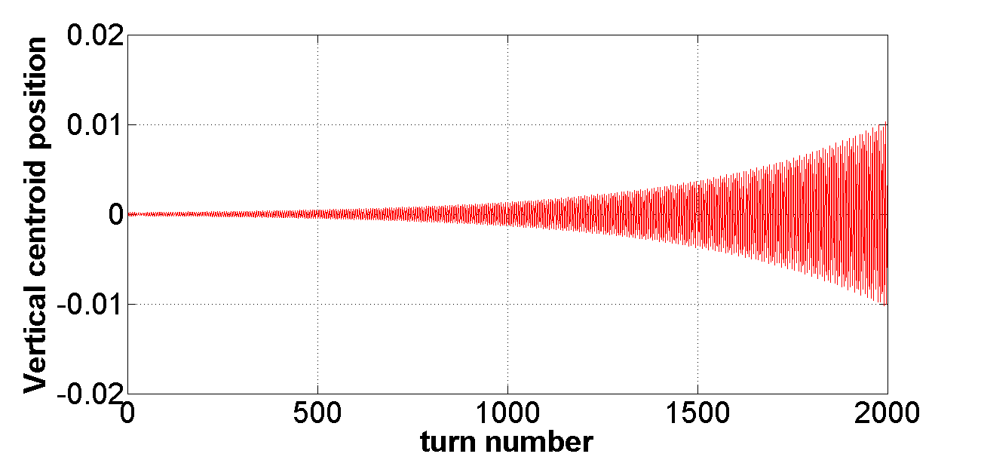
Growth rates versus chromaticity: comparing measurements and impedance model
Analytical
SPS impedance model
HEADTAIL
simulation
Non linear chromaticity
Double RF system
Same as used for TMCI studies

Slide 17
Growth rates versus chromaticity: comparing measurements and impedance model
Strong indication that the SPS transverse impedance model is close to reality up to 500 MHz

Slide 18
Growth rates versus chromaticity: comparing measurements and impedance model
The SPS impedance model explains about 90% of the measured headtail growth rates

Slide 19
Comparing measurements and impedance model: intra-bunch motion
ξ = -0.04

Slide 20
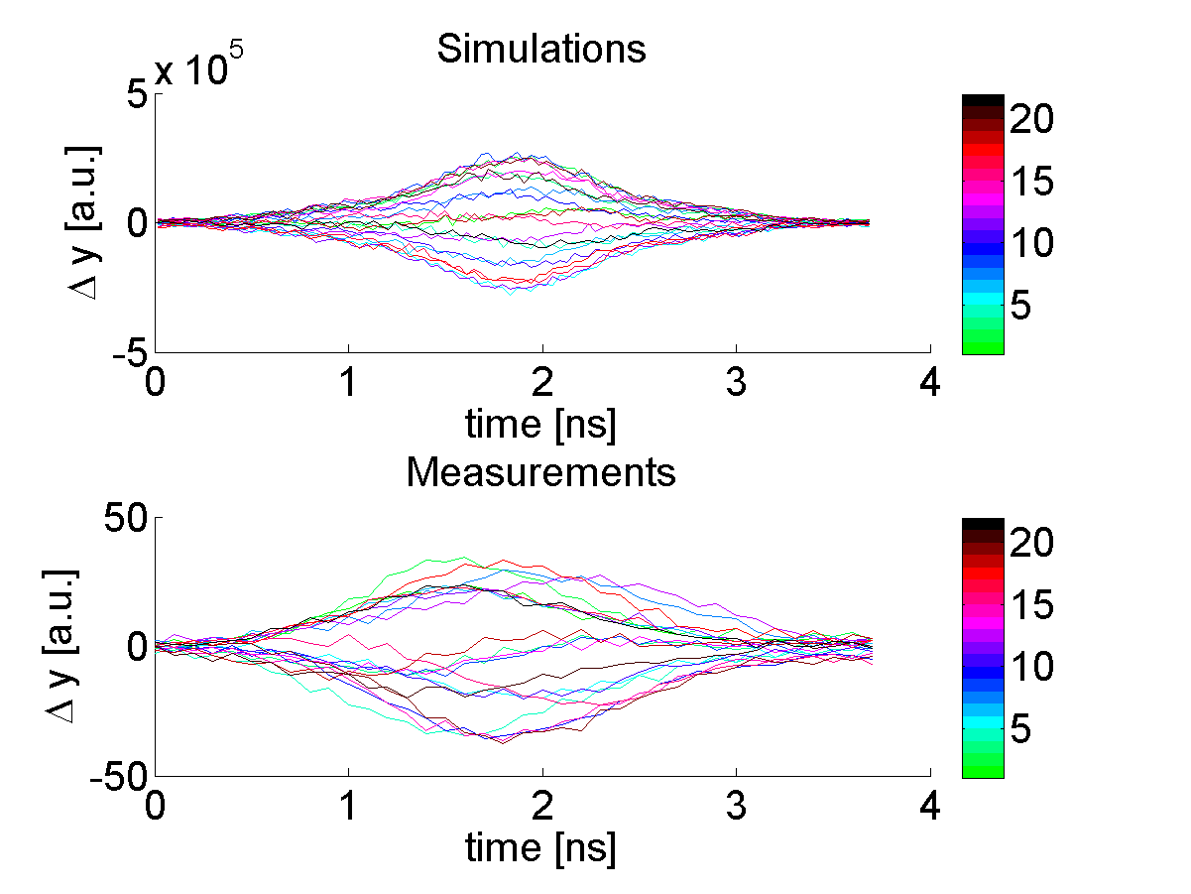
Comparing measurements and impedance model: intra-bunch motion
ξ = -0.14

Slide 21
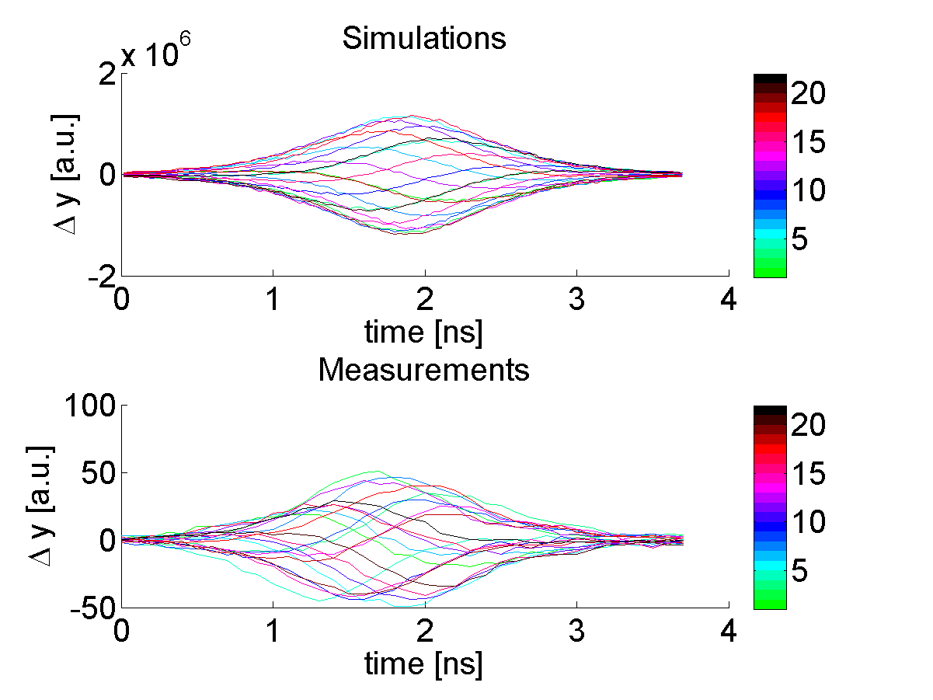
Comparing measurements and impedance model: intra-bunch motion
ξ = -0.34

Slide 22
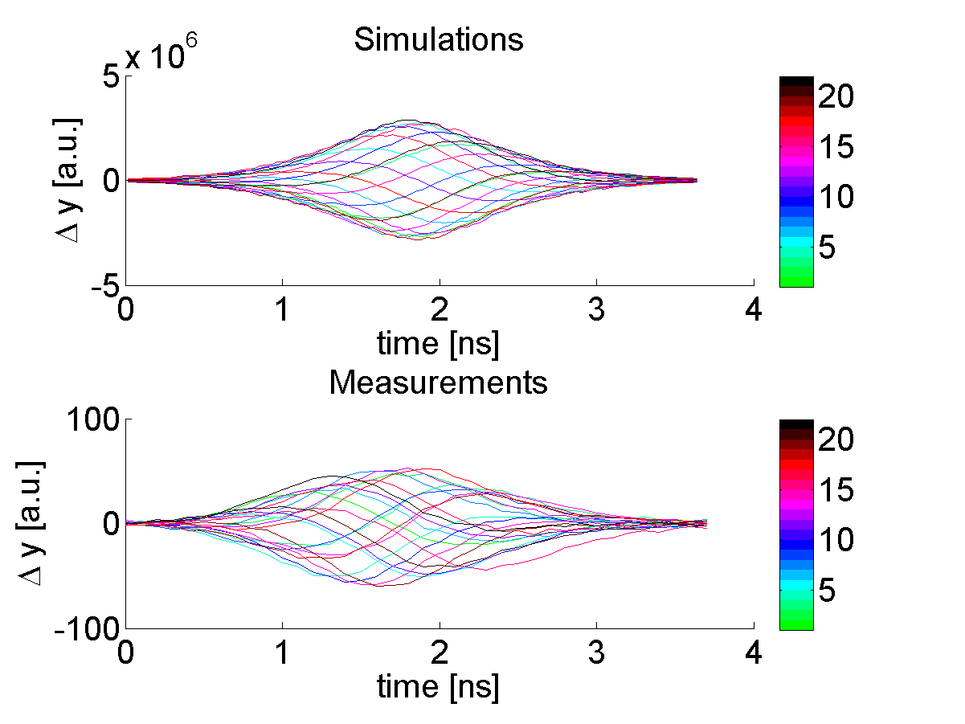
Comparing measurements and impedance model: intra-bunch motion
ξ = -0.54

Slide 23
Comparing measurements and impedance model: intra-bunch motion
ξ = -0.74

Slide 24
Comparing measurements and impedance model: intra-bunch motion
ξ = -0.84

Slide 25
Comparing measurements and impedance model: intra-bunch motion
ξ = -0.94

Slide 26
Overview
SPS transverse impedance model
Benchmarking of the model
Previous benchmarks
Headtail growth rates
Q20 optics
Q26 optics
Conclusions and future plans

Slide 27
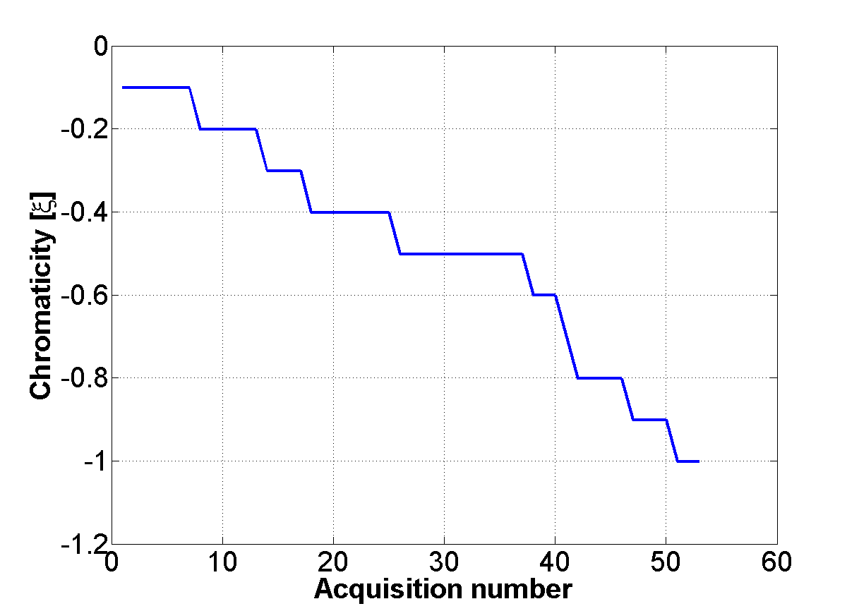
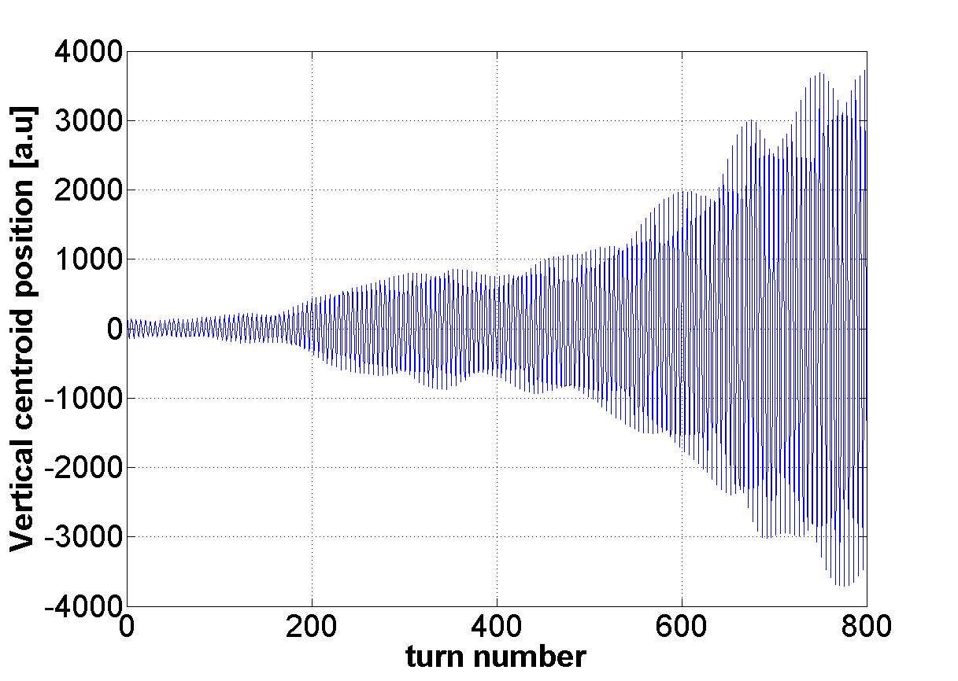
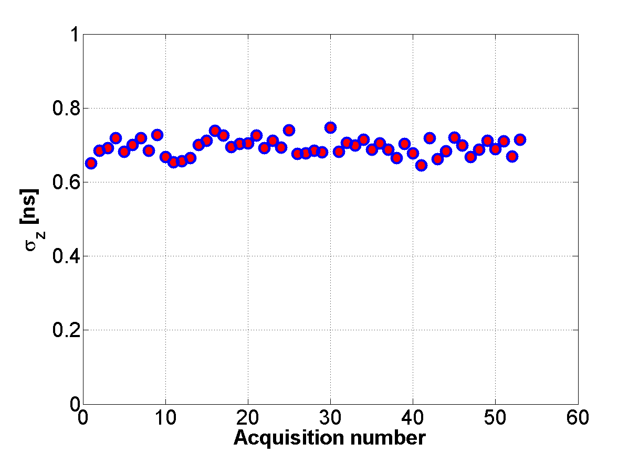
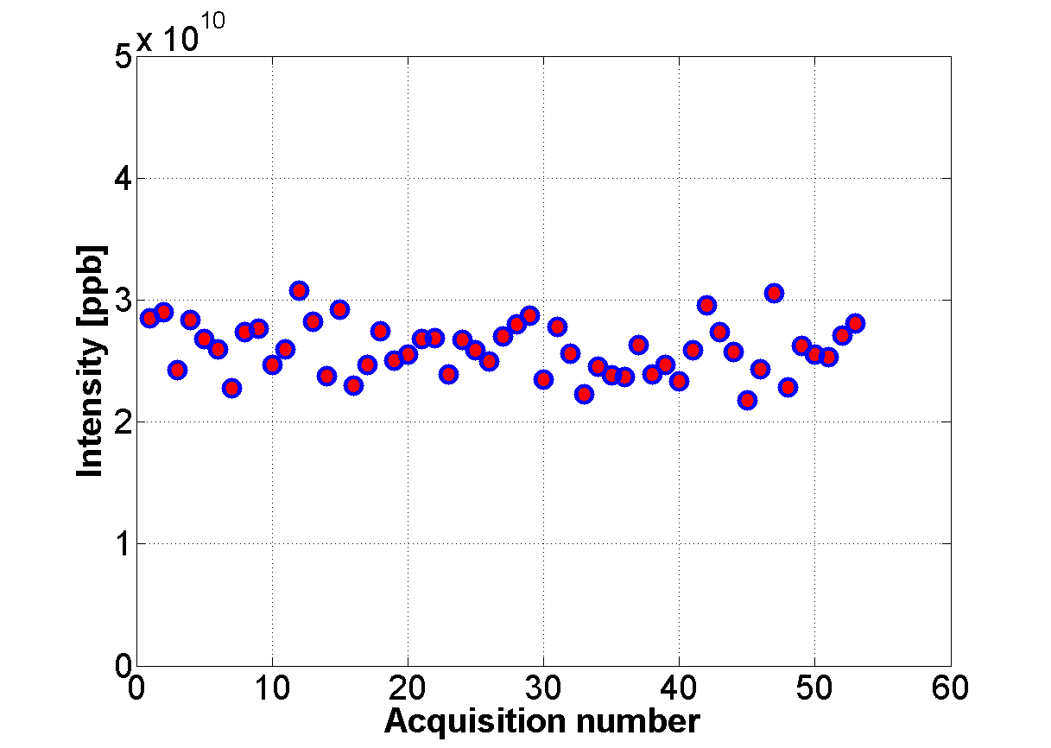
Growth rate versus chromaticity: Measurements
Measurements performed on February 2013
ξ = ξ(ACNR)

Slide 28
Growth rates versus chromaticity: comparing measurements and impedance model
Strong indication that the SPS transverse impedance model is close to reality up to 1.8 GHz

Slide 29
Growth rates versus chromaticity: comparing measurements and impedance model
The SPS impedance model explains about 90% of the measured headtail growth rates

Slide 30
Overview
SPS transverse impedance model
Benchmarking of the model
Previous benchmarks
Headtail growth rates
Q20 optics
Q26 optics
Conclusions and future plans

Slide 31
Conclusions and future plans
HEADTAIL simulations with the SPS impedance model explains the frequency dependent behaviour of the headtail growth rates for both Q20 and Q26 optics
The simple analytical formula seems to work much better for Q20 than for Q26 (to be further investigated)
Headtail growth rates measurements in the horizontal plane

Slide 32
Thank you for your attention

Slide 33
Appendix

Slide 34
Growth rate versus chromaticity: Measurements
Fitting curves

Slide 35
Growth rate versus chromaticity: Measurements
Beam Intensity measured at the PS

Slide 36
Growth rate versus chromaticity: Measurements

Slide 37
Growth rate versus chromaticity: Measurements

Slide 38
Headtail growth rates: analytical calculation

