Slide 1
Synchrotron frequency shift as a probe of the CERN SPS reactive impedance s HB2014 – 11/13/14
A. Lasheen, T. Argyropoulos, J. Esteban Müller, D. Quartullo, E. Shaposhnikova, H. Timko, J. Varela Campelo

Slide 2
Introduction
Bunch length oscillations (quadrupolar $m=2$) at injection in the SPS ($26 GeV/c$, above transition) are measured and analyzed in order to measure the synchrotron frequency shift as a function of intensity.
This shift is due to the convolution of the reactive part of the impedance and the bunch spectrum, and is divided in two contributions : the incoherent frequency shift (from the stationary bunch distribution) and the coherent frequency shift (from the perturbation) [1]
$$f_{s,m}\left(N_{b}\right) ≈ m f_{s}^{\left(0\right)} +m Δf_{inc}\left(N_{b}\right)+Δf_{coh}\left(m,N_{b}\right)$$
Measurements and simulations were compared in order to test the current SPS impedance model, and a dependency with emittance (~ bunch length) and the distribution type was observed and analyzed.

Slide 3
Outline
Introduction
Measurements
Simulations
Analytical work
Conclusions

Slide 4
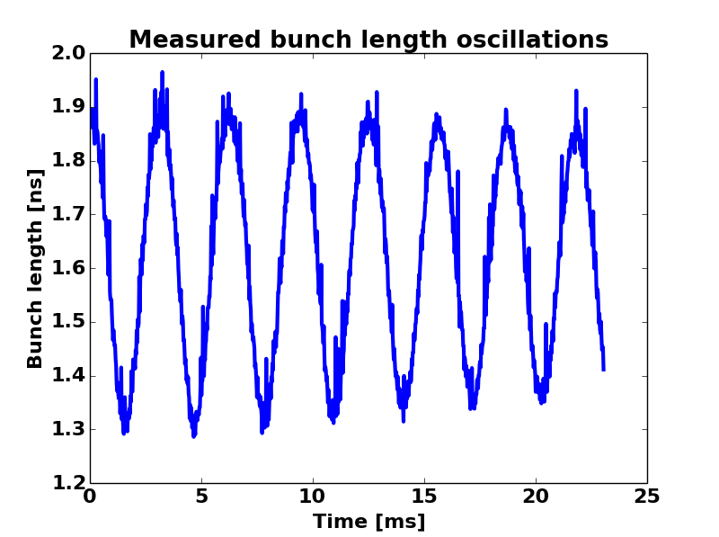
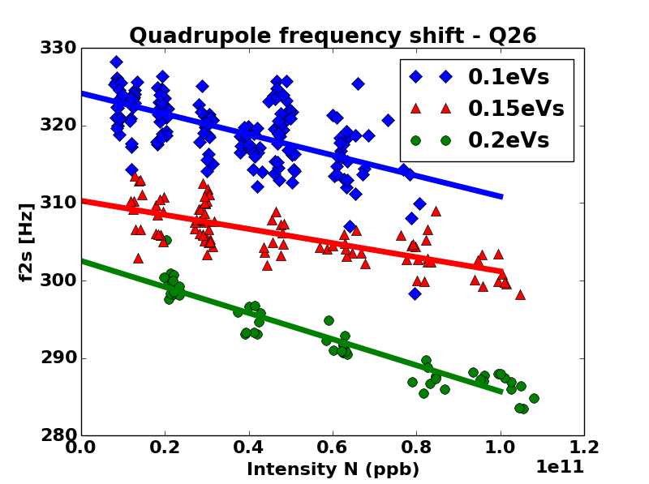
Measurement method
A mismatch bunch is injected in the SPS and its quadrupole oscillations are measured and analyzed
Bunch length is defined as $τ=4σ_{RMS}$
Scanning intensities ($1⋅{10}^{10} to 8⋅{10}^{10}$) and emittances (0.1eVs to 0.2 eVs)

Slide 5
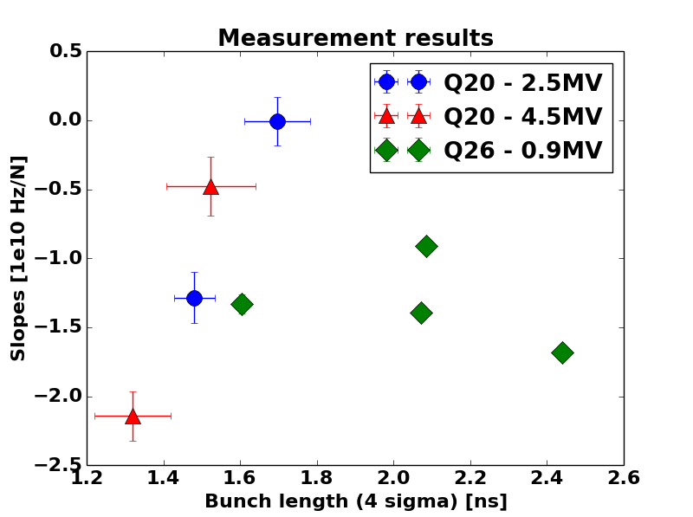
Measurement results
Each point in simulations corresponds to the slope of the quadrupole frequency shift as a function of intensity, for bunches of the same bunch length.
Two different optics: Q26 and Q20 (slopes were scaled to Q26 – 0.9MV in order to be compared on the same plot).
Dependency as a function of bunch length was obtained first in simulations and confirmed with Q20 measurements.

Slide 6
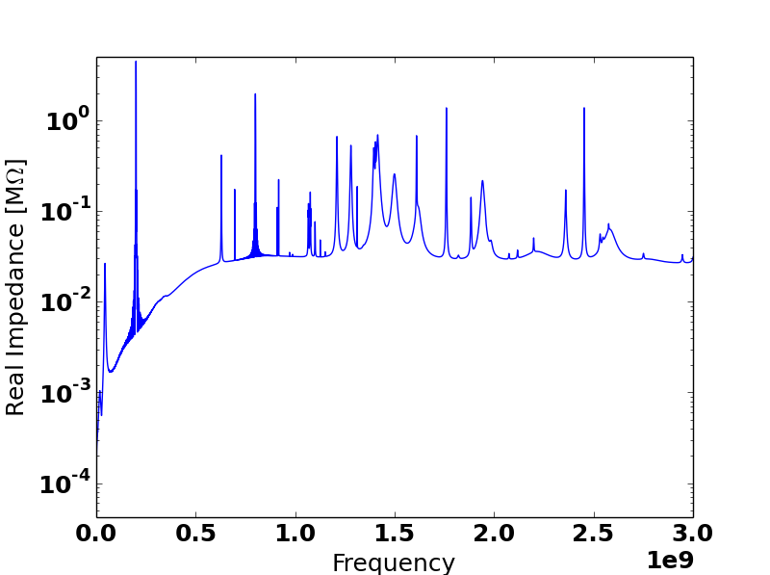
Simulations – Impedance model
Actual SPS impedance model (log scale) [2]
Main reactive impedance:
Kickers (inductive)
Vacuum flanges (inductive)
RF systems (capacitive)
Space charge (capacitive) [3]
Vacuum flanges
RF systems
Kickers (background)

Slide 7
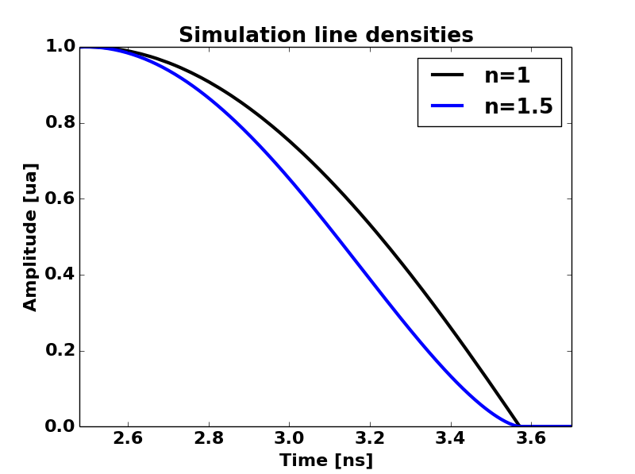
Simulation method
Using BLonD simulation code [4]
Binomial profile at injection
$$λ\left(t\right)=λ_{0}{\left(1−{\left(\frac{t}{τ}\right)}^{2}\right)}^{n}$$
$n=1$: Parabolic line density
The bunch length $τ$, the intensity and the momentum spread are scanned, in order to cover the full panel including measurements

Slide 8
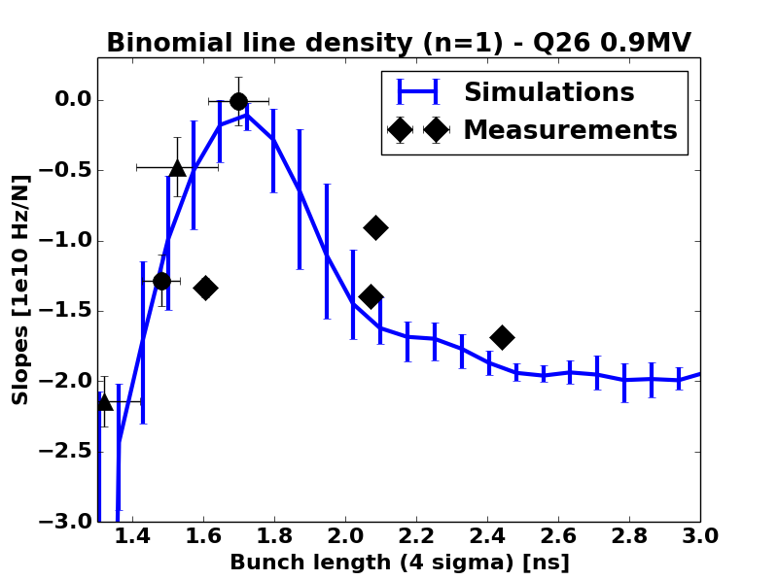
Simulation results – Q26
A non monotonous dependency of the slope as a function of bunch length is observed in simulations
Slopes were scaled to Q26 – 0.9MV in order to be compared on the same plot
The error bars in simulations are due to the range of momentum spread
The simulations give a good agreement with measurements.

Slide 9
Analytical work
Numerical computation of the incoherent frequency shift [5]
This shift is due to the stationary spectrum of the bunch
$$f_{2s}\left(N\right)≈2 f_{s}^{\left(0\right)}\left(1+\frac{αNZ_{1}}{2}\right) \\ Z_{1}= \int_{−∞}^{+∞}{\frac{df}{f_{0}} σ_{0}\left(f\right) ℑ\left(Z\left(f\right)\right) \frac{J_{1}\left(f\hat{τ}\right)}{f_{0}{\hat{τ}}/2}} \\ slope\left(\hat{τ}\right)≈α Z_{1}\left(\hat{τ}\right) f_{s}^{\left(0\right)}\left(\hat{τ}\right)$$
In measurements, the bunch length oscillations mainly comes from tail particles (high $\hat{τ}$) for a small mismatch
Above transition, $α<0$, so inductive impedance give $Z_{1}>0$ so the slope is steeper (vice-versa for capacitive impedance)
$f_{s}^{\left(0\right)}$ : synchrotron frequency
$Z_{1}$ : effective impedance
$σ_{0}$ : stationary bunch spectrum
$\hat{τ}$ : single particle oscillations amplitude

Slide 10
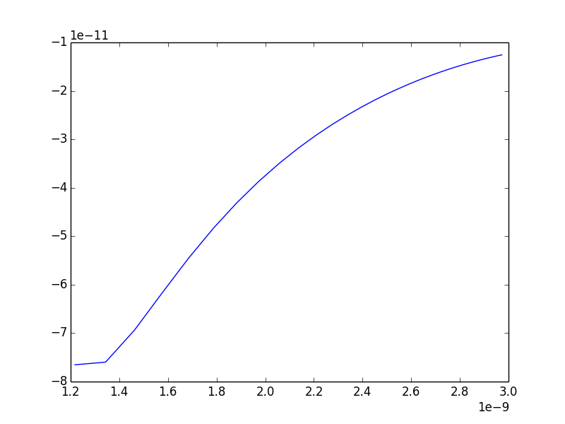
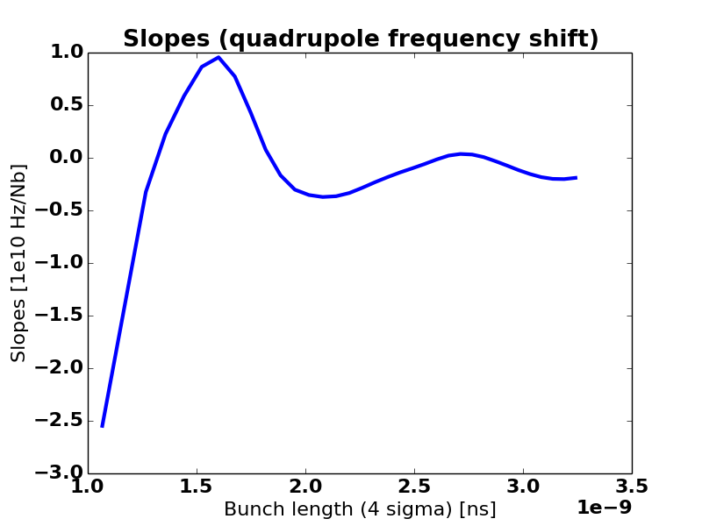
Analytical results
Gaussian
Parabolic
Comparing parabolic and gaussian line densities
The gaussian distribution is sampling more inductive impedance
The parabolic distribution is sampling inductive or capacitive depending on the bunch length

Slide 11
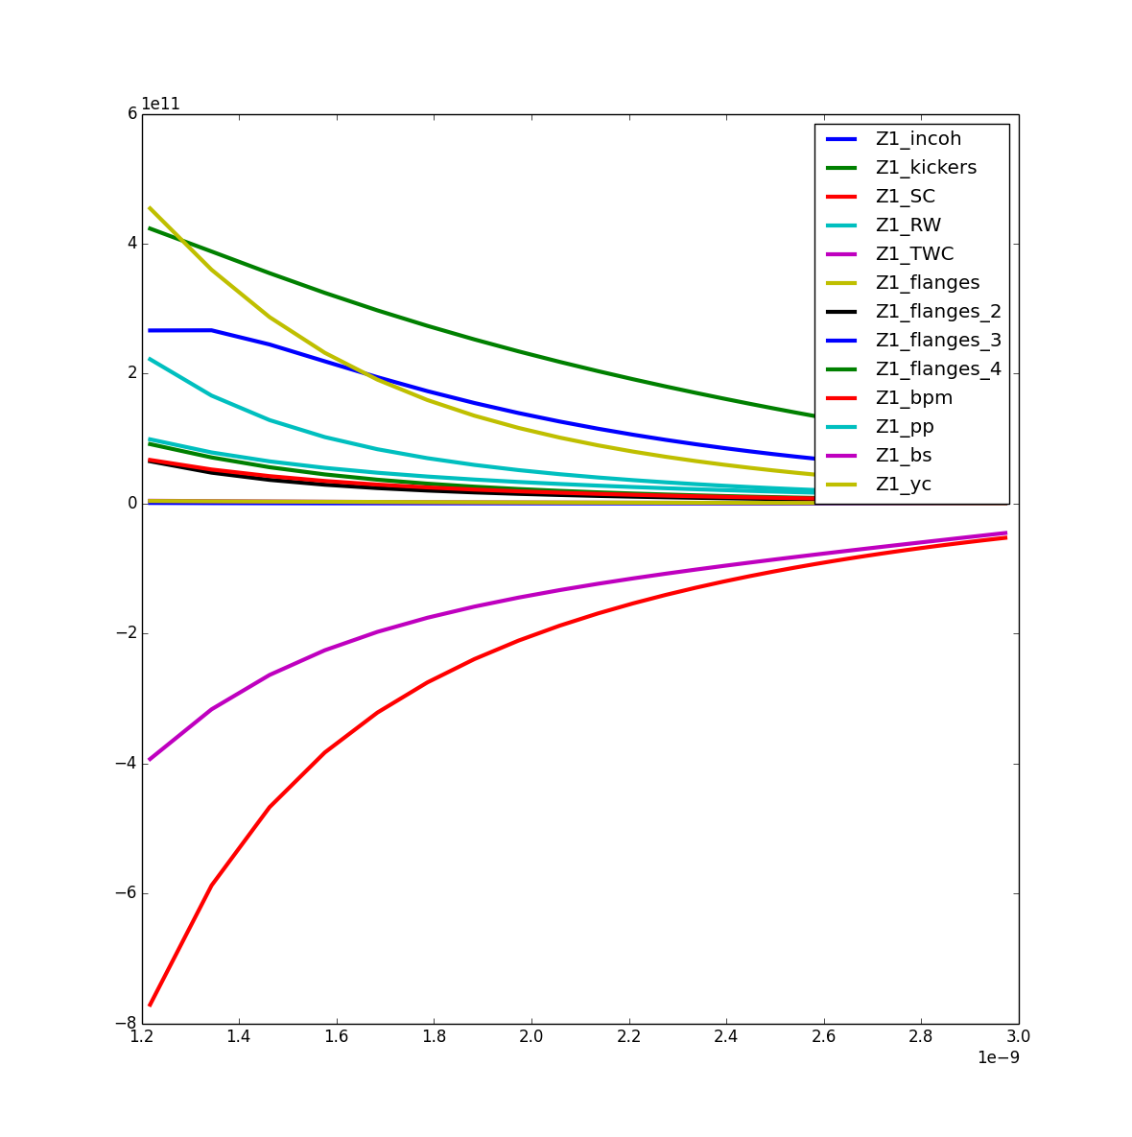
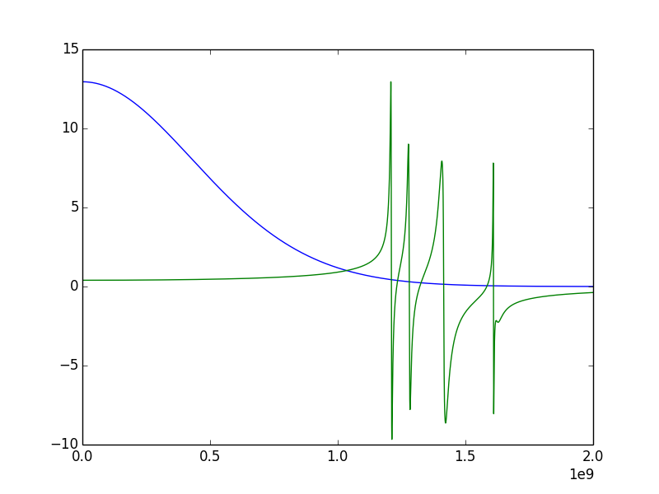
Analytical results – Gaussian
Slope as a function of bunch length
Z1
Bunch length
Spectrum & flanges impedance
The impedance type (inductive vs. capactive) does not change as a function of bunch length for the incoherent frequency shift

Slide 12
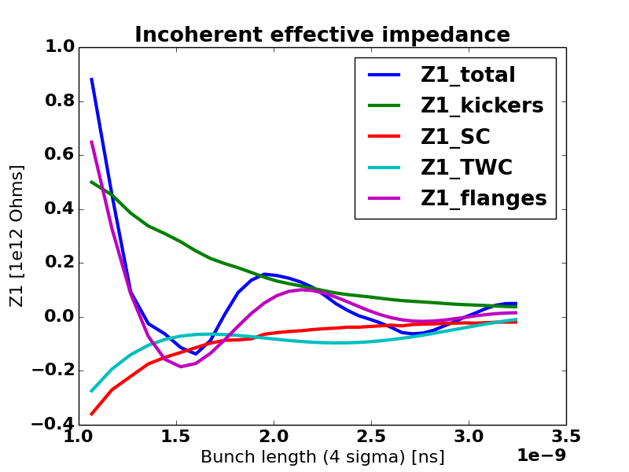
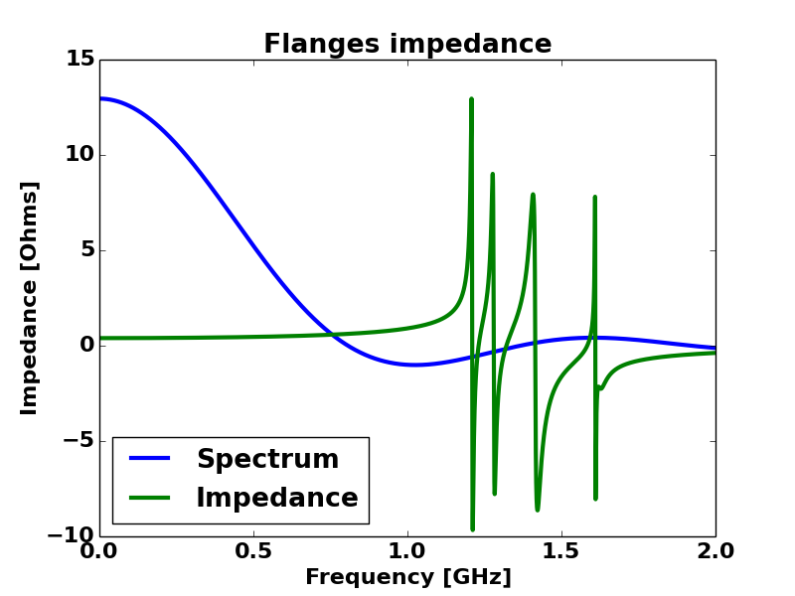
Analytical results – Parabolic
The impedance type (inductive vs. capactive) changes as a function of bunch length for the flanges -> the slope is not monotonous because of the flanges for the incoherent shift

Slide 13
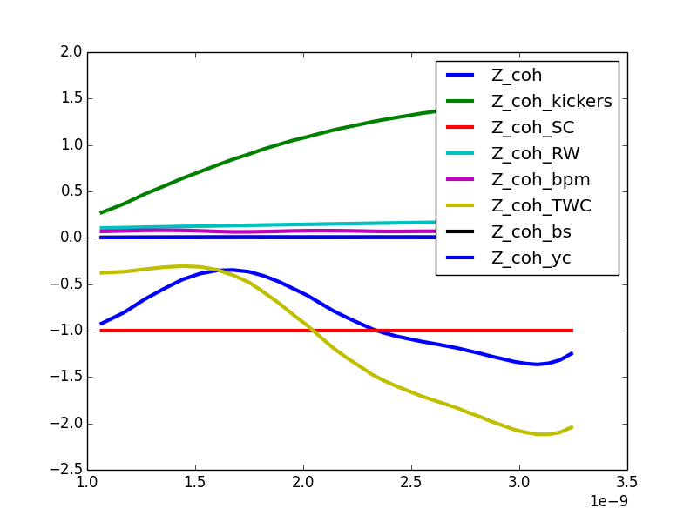
Analytical results – Coherent shift
Coherent effective impedance
Coherent frequency shift was estimated for the quadrupolar case and has a non negligible effect on the slope [6].
The coherent shift goes in the opposite direction than the incoherent shift (capacitive impedance leads to a steeper slope and vice-versa), and is due to the perturbation on the bunch distribution with respect to the stationary bunch distribution.
The ratio between the incoherent and coherent effects in measurements, as a function of bunch length is difficult to estimate, but may explain the discrepancy between simulations and analytical calculation. Measurements should be compared to simulations in the same conditions.

Slide 14
Conclusions
Analytical
The incoherent quadrupole frequency shift has a dependency with bunch length due to the coupling with high frequency impedances (flanges)
More measurements are foreseen by generating a small mismatch by increasing the RF voltage in the SPS, in order to have smaller perturbations.
Measurements at higher energies are planed in order to eliminate the space charge impedance.
Information on the synchrotron frequency shift are needed in order to apply emittance blow-up with RF noise. The dependency with bunch length is to be known in order to apply correctly the RF noise.

Slide 15
References
[1] E. Shaposhnikova et al., «Measurements of Quadrupole Frequency Shift Below Transition», AB-Note-2004-047 MD, CERN, Geneva, Switzerland, May 14, 2004.
[2] J. Varela Campelo, «SPS Impedance Model Update», Meetings of the LIU-SPS Beam Dynamics Working Group, CERN, Geneva, Switzerland (2014), http://paf-spsu.web.cern.ch/paf-spsu/meetings/2008.htm
[3] L. Wang, «The geometry effect of the space charge impedance LSC code», ICFA mini-Workshop on “Electromagnetic wake fields and impedances in particle accelerators" , Erice, Italy, 2013
[4] BLonD code: https://github.com/dquartul/BLonD/
[5] K. Y. Ng, «Physics of Intensity Dependent Beam Instabilities», Ed. World Scientific Publishing, 2006
[6] A. Chao, «Physics of Collective Beam Instabilities in High Energy Accelerators», Ed. John Wiley & Sons, 1993

Slide 16
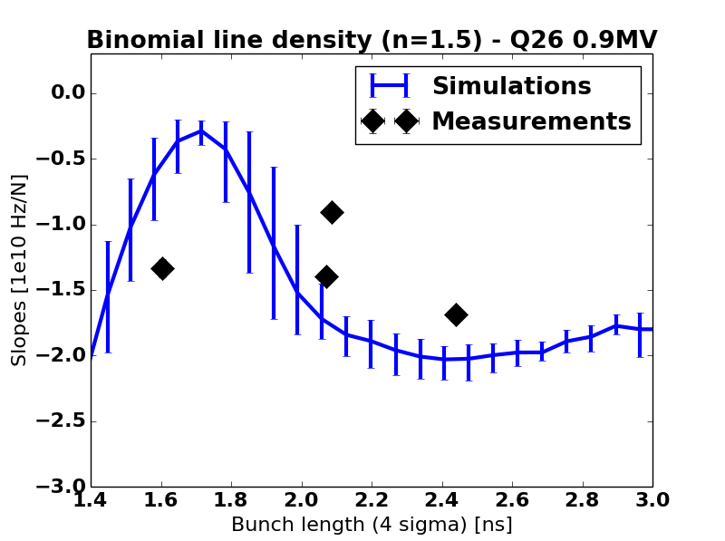
Simulation results – Q26
Simulations with another n in the binomial line density
The slope amplitude range is less wide than for the parabolic case
The limit is obtained for the gaussian profile ($n→∞$)

Slide 17
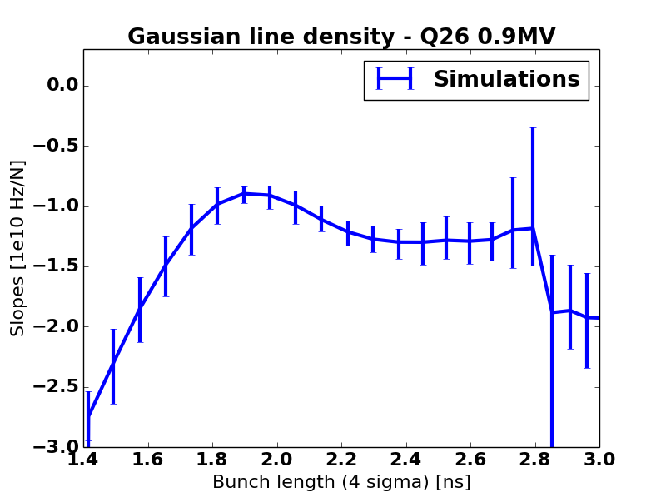
Simulation results – Q26
The extreme case is for the gaussian density, for which the slope maximum around 1.8ns is the lowest.

Slide 18
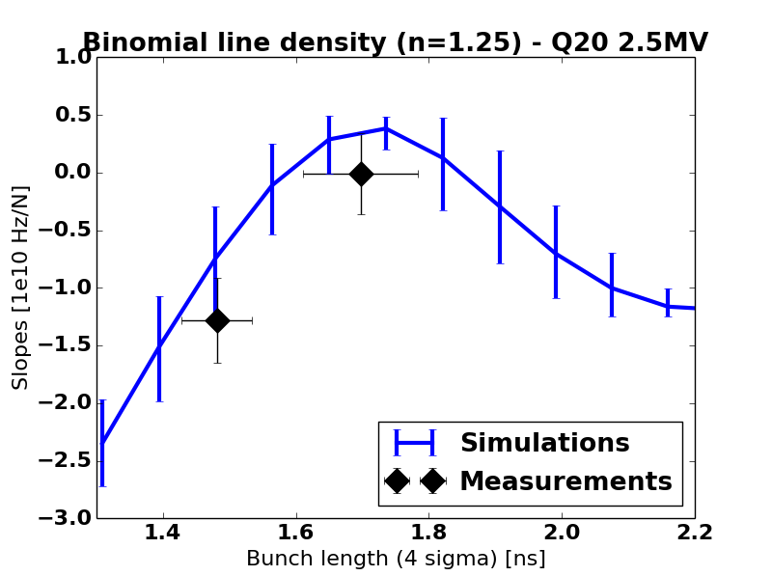
Simulation results – Q20
The same properties were seen with simulations and measurements with the Q20 optics.

Slide 19
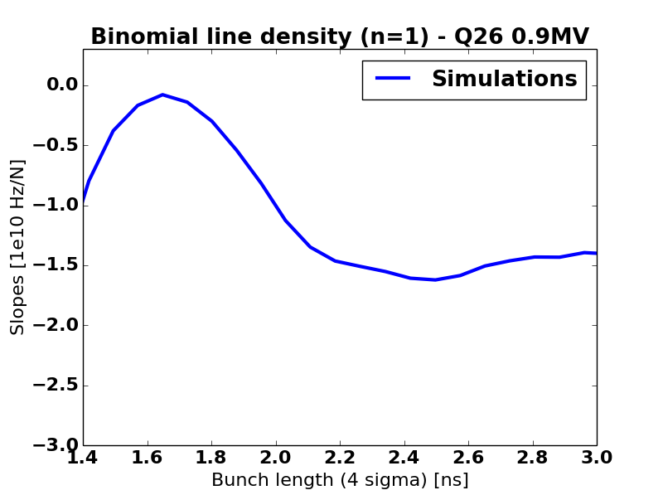
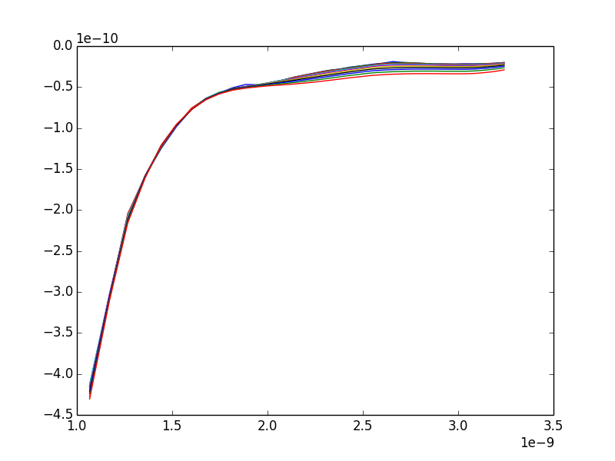
Removing flanges
By removing the flanges impendance from simulations and the analytical calculation. We still see a non monotonous behavior of the slope as a function of bunch length in simulations.
The discrepancy at higher bunch length might be due to filamentation, higher coherent frequency shift…

