Slide 1
2014 scrubbing run: hot news from the CCC
H. Bartosik, G. Iadarola, G. Rumolo,
Many thanks to T. Argyropoulos, T. Bohl, E. Carlier, H. Damerau, J. Esteban Muller, B. Goddard, S. Hancock, W. Höfle, V. Kain, G. Kotzian, K. Kornelis, K. Li, G. Papotti, M. Schenk, E. Shaposhnikova, M. Taborelli, D. Valuch,
and SPS OP crew

Slide 2
Scrubbing run
Week 45
Monday
Tuesday
Wednesday
Thursday
Friday
Saturday
Sunday
Monday
Prepared machine for scrubbing
MKP4 vacuum interlocks optimized for scrubbing
During LS1 the MKP4 module was exchanged with a new one (E. Carlier) + intervention due to problem on water manifold in August
High static pressure level (~1e-7 mbar) since beginning of the run, not significantly improving
Dynamic pressure rise with LHC beams → was expected to be limitation during scrubbing run
Therefore, ABT suggested to raise SW interlock from 2e-7 mbar to 4e-7 mbar but decrease HW interlock from 1e-6 to 6e-7 mbar
Scrubbing cycles setup
COLDEX moved into IN position
No impact on beam lifetime
Started maximizing integrated beam intensity on scrubbing cycle
limited by TIDVG vacuum interlock (which is mainly there to protect the MKP) — agreed with EN-STI and TE-ABT to raise interlock from 4e-7 to 6e-7 mbar

Slide 3
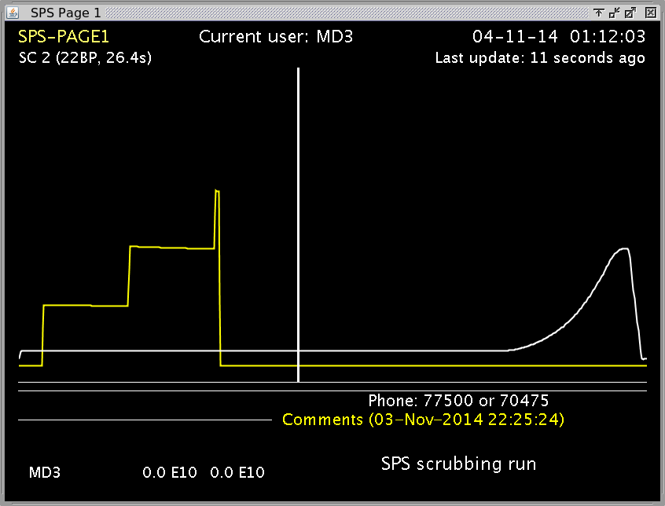
Monday (Nov. 3)

Slide 4
Scrubbing run
Week 45
Monday
Tuesday
Wednesday
Thursday
Friday
Saturday
Sunday
Tuesday
transverse emittance around 3um for 1.2e11 p/b (3 batches)
setup of 200 MHz LL RF on acceleration cycle (1 batch) for 6h
reached 4 batches on FB with dump at 13s
ZS spark rate interlock reached a couple of times
now limited by MKP4 vacuum level
related also to the beam induced heating (presently MKP4 at ~44 deg)
reduced number of batches during the night due to vacuum interlocks on MKP4
Measurements with lower chromaticity
Acquisitions with high bandwidth pickups
No clear evidence of e-cloud instability; due to Q20 …
MKP4 SW interlock reached several times

Slide 5
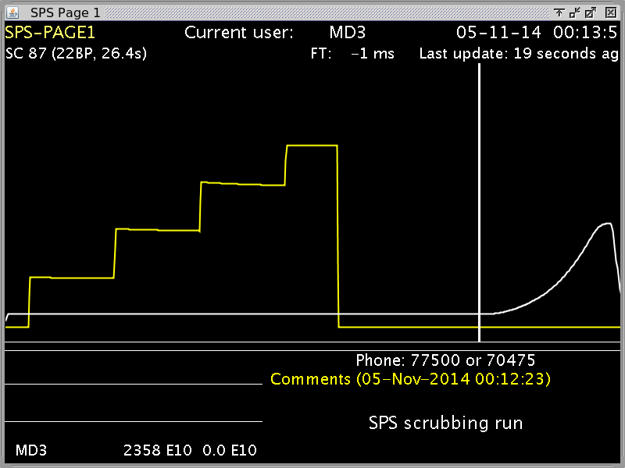
Tuesday (Nov. 4)

Slide 6
Tuesday (Nov. 4)

Slide 7
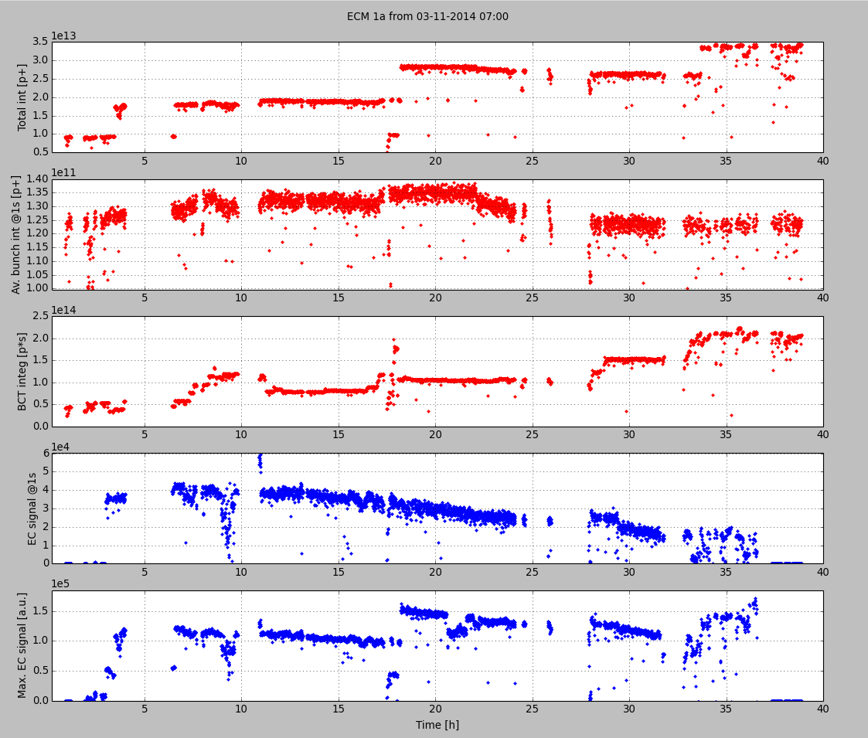
Tuesday (Nov. 4) – Ecloud monitor
MBA - StSt

Slide 8
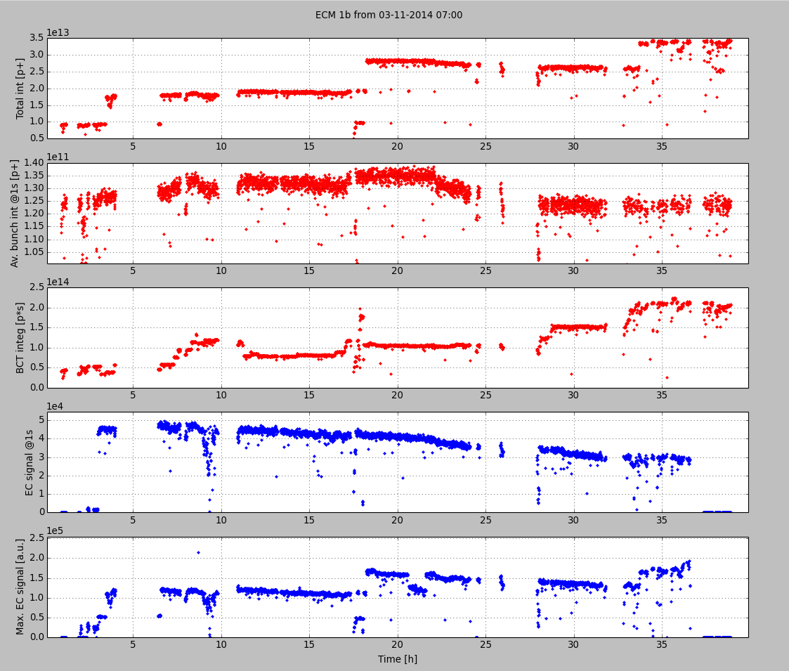
Tuesday (Nov. 4) – Ecloud monitor
MBB - StST
MBB - StSt

Slide 9
Scrubbing run
Week 45
Monday
Tuesday
Wednesday
Thursday
Friday
Saturday
Sunday
Wednesday
MD on 800 MHz (from 10:00 to 00:45)
Meeting with TE-ABT about the MKP4 threshold
Raise MKP4 SW interlock to 5e-7 mbar
Raise TIDVG interlock to 1.2e-6 mbar (agreed with EN-STI)
started setting up the doublet beam on MD1
started transverse damper setup on doublet
mains tripped during the night (4h no beam)

Slide 10
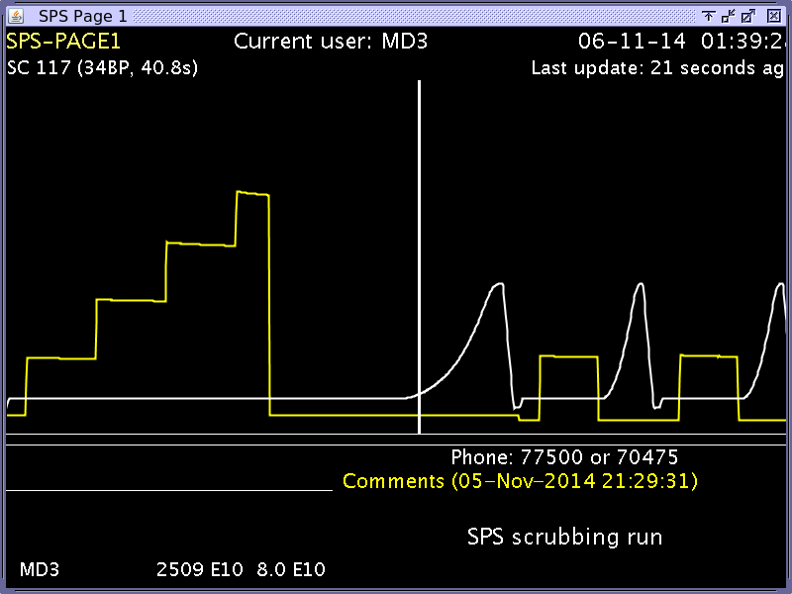
Wednesday (Nov. 5)

Slide 11
Scrubbing run
Week 45
Monday
Tuesday
Wednesday
Thursday
Friday
Saturday
Sunday
Thursday
Scrubbing with up to 5 batches nominal LHC beam
Problems with heating TT2 magnets due to high duty cycle
In parallel: SPS-LHC synchronization tests
Tonight:
Acceleration of as many batches as possible

Slide 12
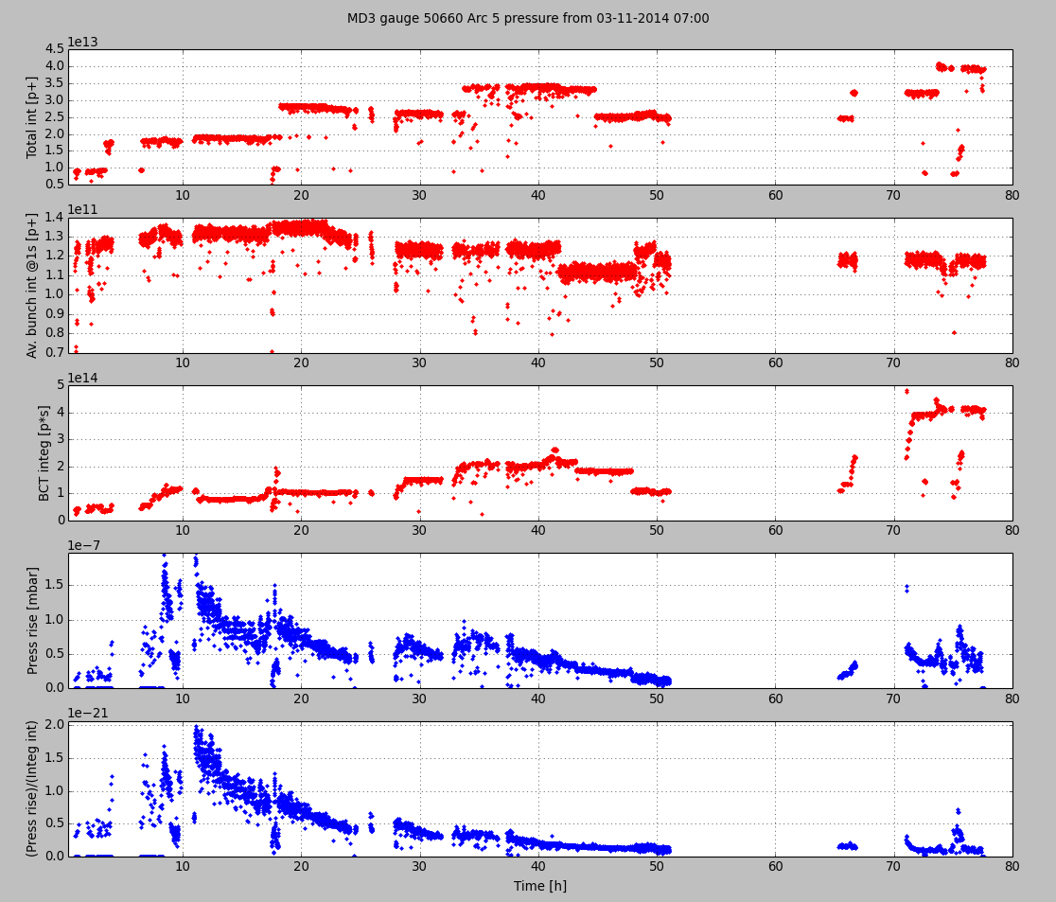
Present status: pressure gauge in Arc 5

Slide 13
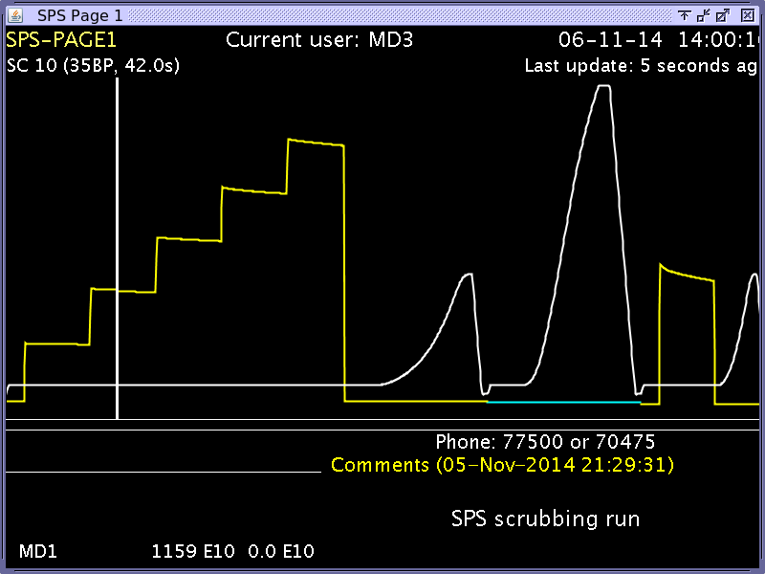
Present status

Slide 14
Present status: Emittances 4 batches

Slide 15
Thank you for your attention!

