Slide 1
Preliminary planning for SPS MDs (a proposal to be discussed)
https://ab-mgt-md-users.web.cern.ch/ab-mgt-md-users/2014/index.html
G. Rumolo and H. Bartosik
LIU-SPS BD meeting, 4 September 2014

Slide 2
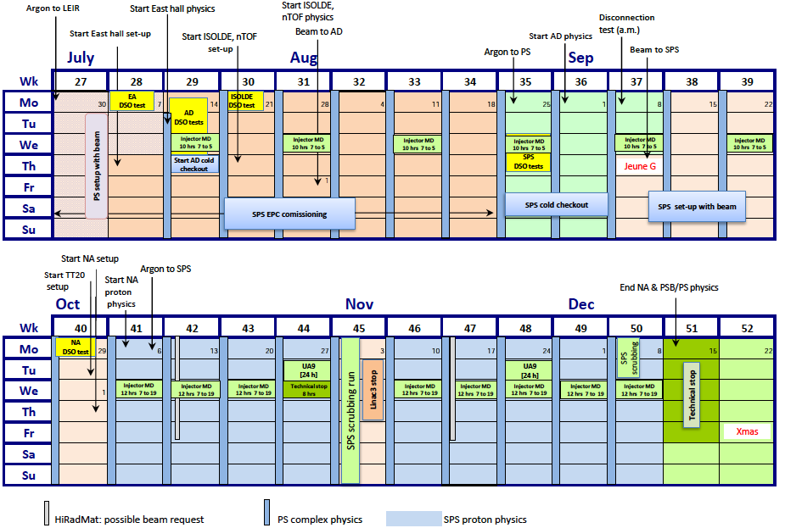
Schedule v1.7 (29/08/14)
Scrubbing run
Start of MDs @SPS
96h dedicated MD time @SPS + 2 x 24h UA9
Scrubbing run
Wednesday slots to be moved: from 06:00-18:00 to avoid shift handover and late machine recovery after MDs

Slide 3
Schedule v1.7
Start of MDs @SPS
Mini-scrubbing
96h dedicated MD time @SPS + 2 x 24h UA9
Scrubbing run
Wednesday slots to be moved: from 06:00-18:00 to avoid shift handover and late machine recovery after MDs

Slide 4
Schedule v1.7
Ar setup
Ar setup
Ar setup
Ar setup
Ar setup
Ar setup

Slide 5
Schedule v1.7
Transverse measurements (optics, impedance, SC, instabilities)
Longitudinal measurements (impedance, SC, instabilities (CB, μw) )
Ar setup
Ar setup
Ar setup
Ar setup
Ar setup
Ar setup
Longitudinal

Slide 6
Schedule v1.7
Week 41
8h: 800 MHz commissioning with beam (shift before performance recovery)
4h: LHC beams
Transverse measurements (optics, impedance, SC, instabilities)
Longitudinal measurements (impedance, SC, instabilities (CB, μw) )
Ar setup
Ar setup
Ar setup
Ar setup
Ar setup
Ar setup
Longitudinal

Slide 7
Schedule v1.7
Week 42
12h: 50 ns and 25 ns performance recovery (std and BCMS). Electron cloud studies (effect of filling pattern, bunch intensity, BCMS vs. std, etc.). In parallel, doublet @26 GeV?
Transverse measurements (optics, impedance, SC, instabilities)
Longitudinal measurements (impedance, SC, instabilities (CB, μw) )
800 MHz
Ar setup
Ar setup
Ar setup
Ar setup
Ar setup
Ar setup
Longitudinal

Slide 8
Schedule v1.7
Week 43
4h: Set up coast (UA9 in Week 44)
8h: Collimator alignment with in-jaw BPMs
Transverse measurements (optics, impedance, SC, instabilities)
Longitudinal measurements (impedance, SC, instabilities (CB, μw) )
800 MHz
LHC beams
Ar setup
Ar setup
Ar setup
Ar setup
Ar setup
Ar setup
Longitudinal

Slide 9
Schedule v1.7
Week 46
12h: Doublet on standard LHC cycle → from single bunch to two batches, attempt to accelerate. Test LHC electronics on BPMs.
Transverse measurements (optics, impedance, SC, instabilities)
Longitudinal measurements (impedance, SC, instabilities (CB, μw) )
800 MHz
LHC beams
Coast
Ar setup
Ar setup
Ar setup
Ar setup
Ar setup
Ar setup
Longitudinal

Slide 10
Schedule v1.7
Week 47
12h: 800 MHz commissioning, shift after performance recovery
Transverse measurements (optics, impedance, SC, instabilities)
Longitudinal measurements (impedance, SC, instabilities (CB, μw) )
800 MHz
LHC beams
Coast
Doublet I
Ar setup
Ar setup
Ar setup
Ar setup
Ar setup
Ar setup
Longitudinal

Slide 11
Schedule v1.7
Week 48
4h: Qualification of sponge material on UA9 set up
8h: Collimator alignment with in-jaw BPMs
Transverse measurements (optics, impedance, SC, instabilities)
Longitudinal measurements (impedance, SC, instabilities (CB, μw) )
800 MHz
LHC beams
Coast
Doublet I
800 MHz
Ar setup
Ar setup
Ar setup
Ar setup
Ar setup
Ar setup
Longitudinal

Slide 12
Schedule v1.7
Week 49
6h: Doublet on long LHC cycle → transverse set up
6h: Doublet on long LHC cycle → longitudinal set up
Transverse measurements (optics, impedance, SC, instabilities)
Longitudinal measurements (impedance, SC, instabilities (CB, μw) )
800 MHz
LHC beams
Coast
Doublet I
800 MHz
Coast
Ar setup
Ar setup
Ar setup
Ar setup
Ar setup
Ar setup
Longitudinal

Slide 13
Schedule v1.7
Week 50
12h: Doublet optimization
Transverse measurements (optics, impedance, SC, instabilities)
Longitudinal measurements (impedance, SC, instabilities (CB, μw) )
800 MHz
LHC beams
Coast
Doublet I
800 MHz
Coast
Doublet II
Ar setup
Ar setup
Ar setup
Ar setup
Ar setup
Ar setup
Longitudinal

