Slide 1
Studies for an SPS optics with intermediate gamma transition
G. Arduini, H. Bartosik, G. Iadarola, Y. Papaphilippou, G. Rumolo, E. Shaposhnikova, B. Salvant, C. Zannini
LIU SPSU-BD, 4. September 2014

Slide 2
Vertical instability at SPS injection
TMCI is one of the main intensity limitations for LHC beams in Q26 optics
Simplified scaling law for TMCI threshold intensity:
η phase slip factor
ε_{l} longitudinal emittance
β_{y} vertical beta-function
  N_{th} ~ |η|ε_{l}/β_{y}
Q26 optics: γ_{t} = 22.8
Q20 optics: γ_{t} = 18
V200 = 1.4 MV
V200 = 4 MV

Slide 3
Vertical instability at SPS injection
TMCI is one of the main intensity limitations for LHC beams in Q26 optics
Simplified scaling law for TMCI threshold intensity:
η phase slip factor
ε_{l} longitudinal emittance
β_{y} vertical beta-function
  N_{th} ~ |η|ε_{l}/β_{y}
Q26 optics: γ_{t} = 22.8
Q20 optics: γ_{t} = 18
V200 = 1.4 MV
V200 = 4 MV
Lower transition energy γ_{t} in Q20 optics
η about 2.8 times higher @injection
TMCI threshold raised from 1.6e11 to >4e11 p/b
for HL-LHC 25 ns beams need “only” ~2.6e11 p/b

Slide 4
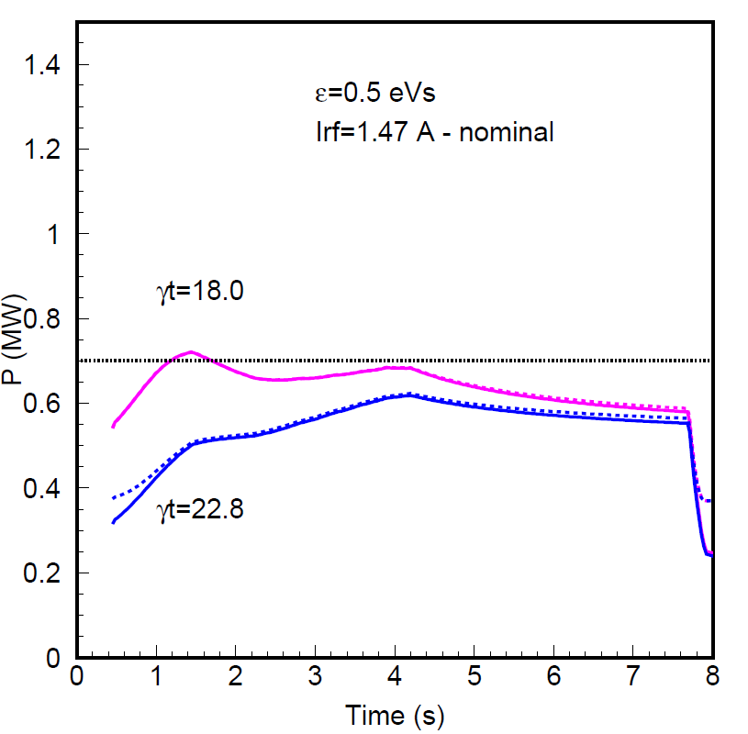
Motivation for intermediate transition energy
  In Q20, higher RF voltage and more RF power is needed during acceleration
Possible solutions, if RF power remains a limitation after LIU RF upgrade
  Reduced ramp rate => longer cycle
  Optics with intermediate transition energy aiming at a better balance between RF power requirements and TMCI threshold
1.15e11 p/b -- 0.5 eVs
2.1e11 p/b -- 0.6 eVs
Q20
Q26
After LIU upgrade:
2 cavities @1.6 MW
4 cavities @1.05 MW
Q20
present power limit
present power limit
Q26

Slide 5
Intermediate transition energy
studies in
1998
Q20
Q26
“Q22” came up already during Brainstorming Session on Beam Parameters for the High Luminosity LHC, 2011 (Y. Papaphilippou et al)
“Q22”
Considerations
  Avoid tunes in the region around multiples of machine periodicity, i.e. 24
  Assume the fractional tunes (x,y) = (0.13, 0.18) well established in Q26 and Q20
  Q22 (γ_{t}=20) seems the most interesting option …

Slide 6
Optics comparison
Q20
Q22
Slight reduction of beta functions and dispersion => no aperture problems in Q22
Dispersion in straight sections slightly increased, but matching TT10 is feasible
Q22 has equivalent low order resonances as Q20 and Q26 => expect similar performance in strong space charge regime, but to be checked in MDs

Slide 7
Prediction from SPS impedance model
SPS transverse impedance model
  includes kickers, resistive wall, BPMs and RF cavities and the flanges
  reproduces ~ 95% of measured vertical coherent tune shift

Slide 8
Prediction from SPS impedance model
SPS transverse impedance model
  includes kickers, resistive wall, BPMs and RF cavities and the flanges
  reproduces ~ 95% of measured vertical coherent tune shift
HEADTAIL simulations with wake fields from SPS impedance model in order to estimate TMCI thresholds for nominal longitudinal emittance (0.35 eVs) and scaled RF voltage
0.35 eVs
Q26: good agreement with measured threshold (model: Q’_{y} =1 + Q’’_{y} + Q_{y}’’’)
Q26 measured threshold

Slide 9
Prediction from SPS impedance model
SPS transverse impedance model
  includes kickers, resistive wall, BPMs and RF cavities and the flanges
  reproduces ~ 95% of measured vertical coherent tune shift
HEADTAIL simulations with wake fields from SPS impedance model in order to estimate TMCI thresholds for nominal longitudinal emittance (0.35 eVs) and scaled RF voltage
0.35 eVs
Q26: good agreement with measured threshold (model: Q’_{y} =1 + Q’’_{y} + Q_{y}’’’)
Q20: slightly pessimistic prediction compared to measured threshold (model: Q’_{y} =1 + Q’’_{y} + Q_{y}’’’)
Q26 measured threshold
Q20 measured threshold

Slide 10
Prediction from SPS impedance model
SPS transverse impedance model
  includes kickers, resistive wall, BPMs and RF cavities and the flanges
  reproduces ~ 95% of measured vertical coherent tune shift
HEADTAIL simulations with wake fields from SPS impedance model in order to estimate TMCI thresholds for nominal longitudinal emittance (0.35 eVs) and scaled RF voltage
0.35 eVs
Q26: good agreement with measured threshold (model: Q’_{y} =1 + Q’’_{y} + Q_{y}’’’)
Q20: slightly pessimistic prediction compared to measured threshold (model: Q’_{y} =1 + Q’’_{y} + Q_{y}’’’)
Predicted threshold in Q22 close to the 2.6e11 p/b required for HL-LHC (model: Q’_{y} =2) => should be ok, since 2 out of 8 MKE kickers can be removed (were needed for CNGS) …
Q26 measured threshold
Q20 measured threshold
required for HL-LHC

Slide 11
Summary and conclusion
Q20 optics provides large intensity margin w.r.t. TMCI at injection, but more RF power and RF voltage is needed during acceleration compared to Q26
Studied Q22 optics with transition energy in between Q26 and Q20
  As alternative to Q20 in case RF power remains limitation even after LIU upgrade
  Has equivalent low order resonances as Q20 and Q26
  Acceptable from aperture point of view + rematching of TT10 is feasible
  SPS impedance model predicts TMCI threshold close to the target intensity for HL-LHC beams => should be ok, but would need to be checked experimentally
Q22 optics can be considered worth studying experimentally if
  RF power and voltage limitation during acceleration in Q20 cannot be overcome by other means (e.g. reduced ramp rate)
  other benefits are expected (e.g. longitudinal stability at flat top, …)

