Slide 1
SPS Enamelled flanges Simulations & Measurements
Fritz Caspers and Jose E. Varela

Slide 2
Outline
Introduction
Simulations
Measurements
Next Steps
Conclusions

Slide 3
Introduction
We are tracking down a, possibly, 1.4GHz microwave instability in the SPS.
We are working now to asses the possibility that the enamelled flanges are the ones responsible of this instability.
Several Wake field simulations and measurements have been carried out.

Slide 4
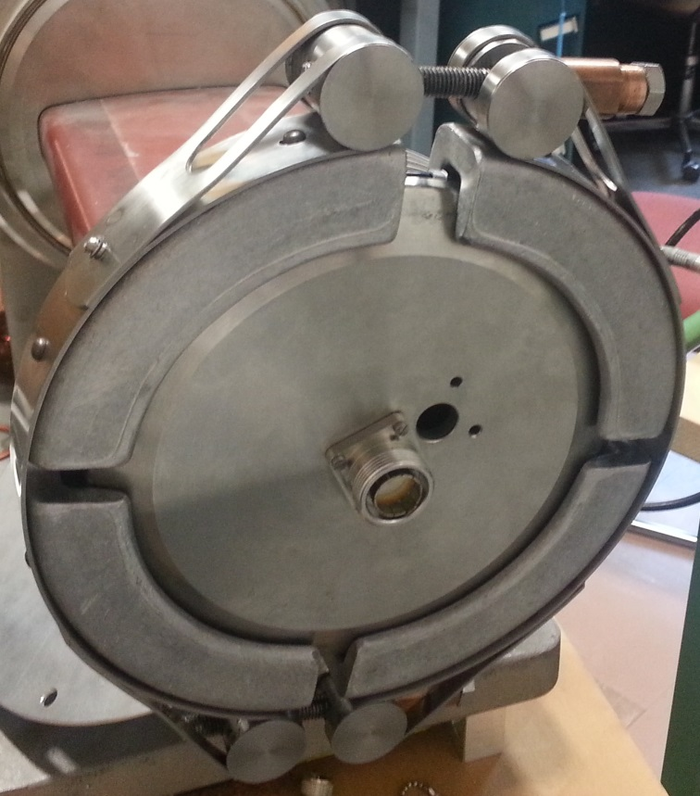
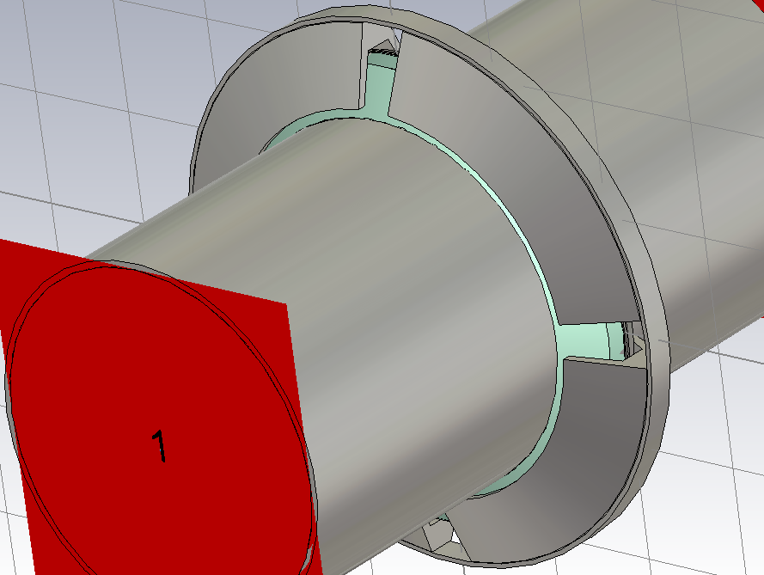
Simulations
A new model has been built. Several 30Mcell wake field simulations (≈1.5 days/sim.) have been carried out.
Electromagnetically complex structure - Very resource demanding.

Slide 5
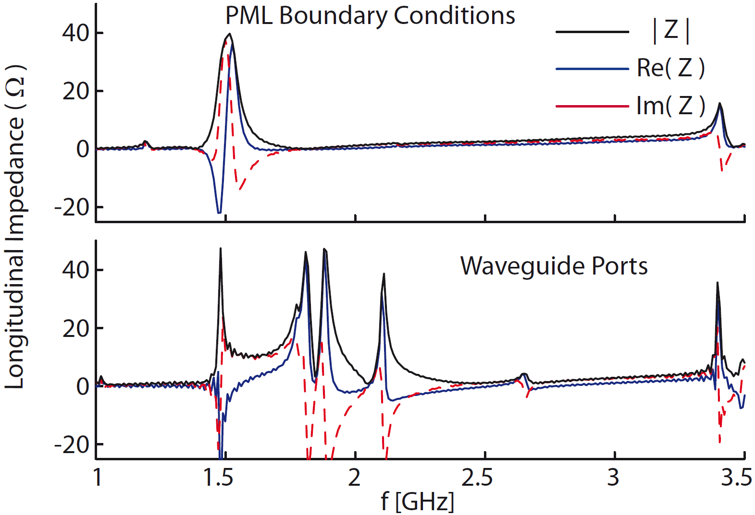
Simulations
Simulation results are NOT consistent. Further research, together with the impedance group, is going on.
On the bright side:
All simulations show impedance peaks around 1.4 and 3.4.

Slide 6
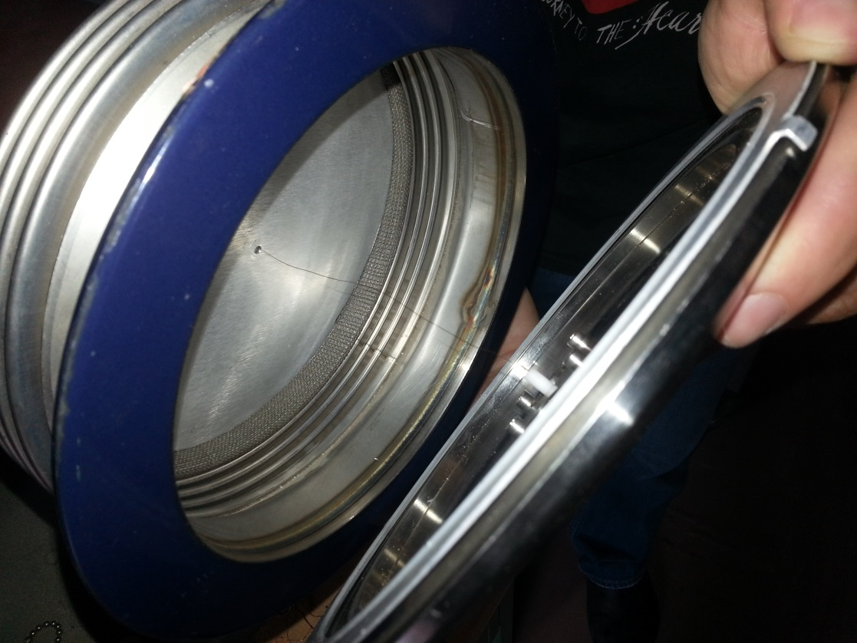
Measurements
Several different measurements have been carried out. No meaningful results have been obtained jet.
Until now we have encountered several difficulties:
The enamel flange available was not isolating.
The pick-ups along the ring are “floating”, i.e. they are not grounded in the tunnel.
The “ensemble”, flange + bellow, has many resonances around the frequency of interest. We have found that it is very difficult to sort them out.

Slide 7
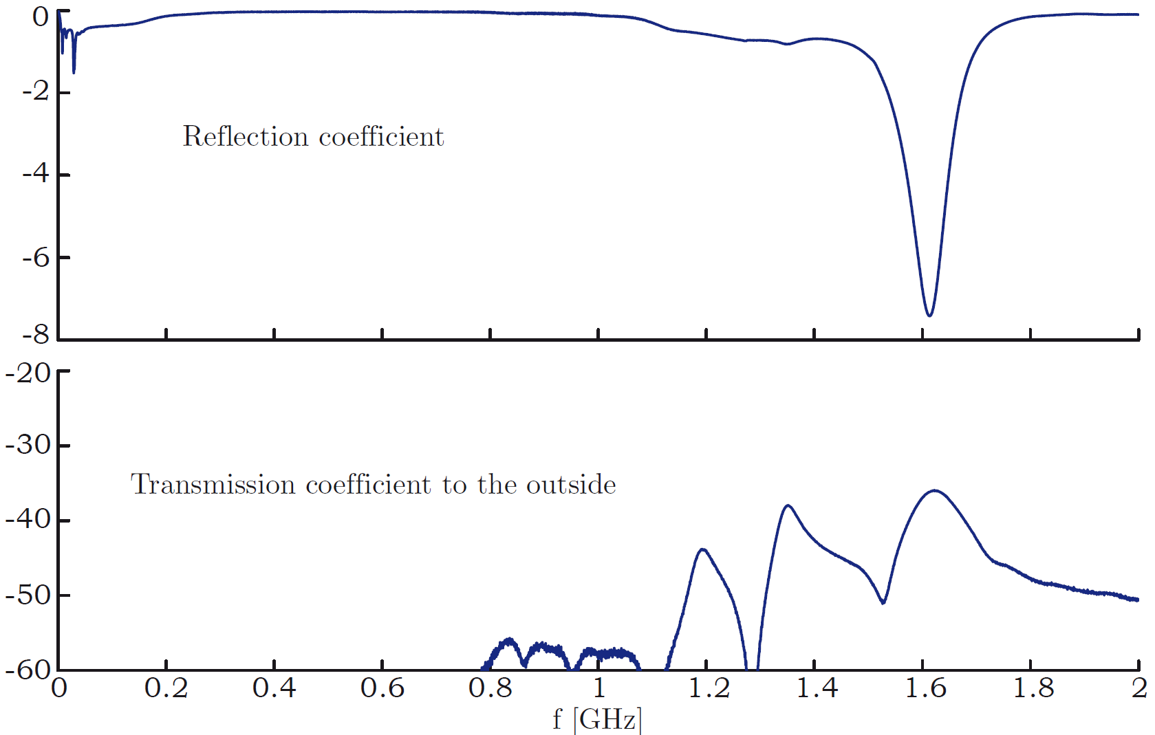
Measurement
Measured scattering parameters of the wire measurement set-up.

Slide 8
Next Steps
Carefully study the work of G. Dome back in 1973-74.
He made a theoretical study and carried out several measurements on “all” the bellow + beam pipe combinations.
As a result, a number of bellow now have “resistors” to damp the resonances.

Slide 9
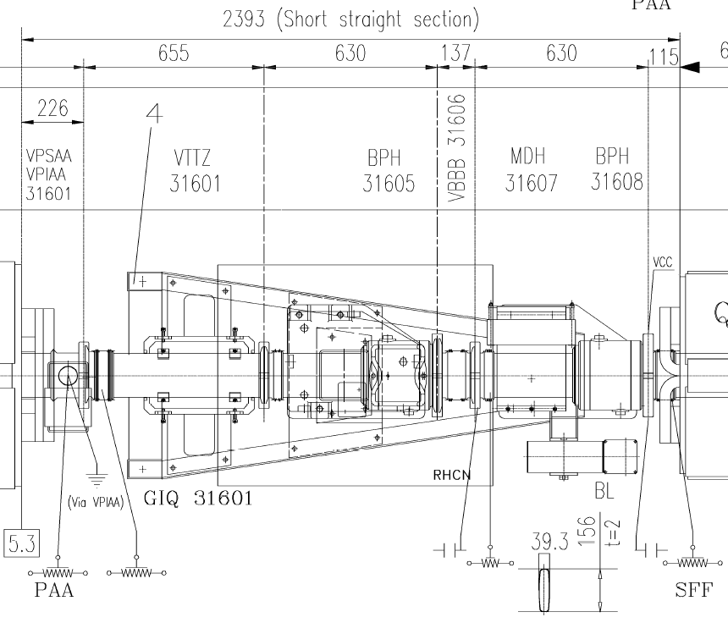
Next Steps
Simulations:
Discuss the results with the impedance working group.
Include the “real” environment of the flanges. Study all possible combinations.

Slide 10
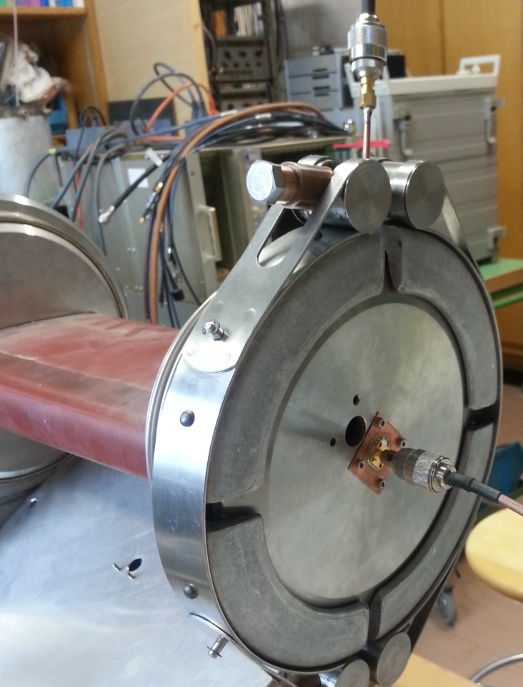
Next Steps
Measurements
Consider stop trying to sort out the harmful resonance between the many that we see and focus our efforts in trying to measure what the “beam sees”.
Try to find a “naked” flange. The fact that the flange is attached to the pickup makes our life difficult.

Slide 11
Conclusions
The problem under consideration is very complex.
Simulations have not provided consistent results.
“Trees don’t let us see the forest” when we try to measure.
Work in progress – any ideas are welcomed.

Slide 12
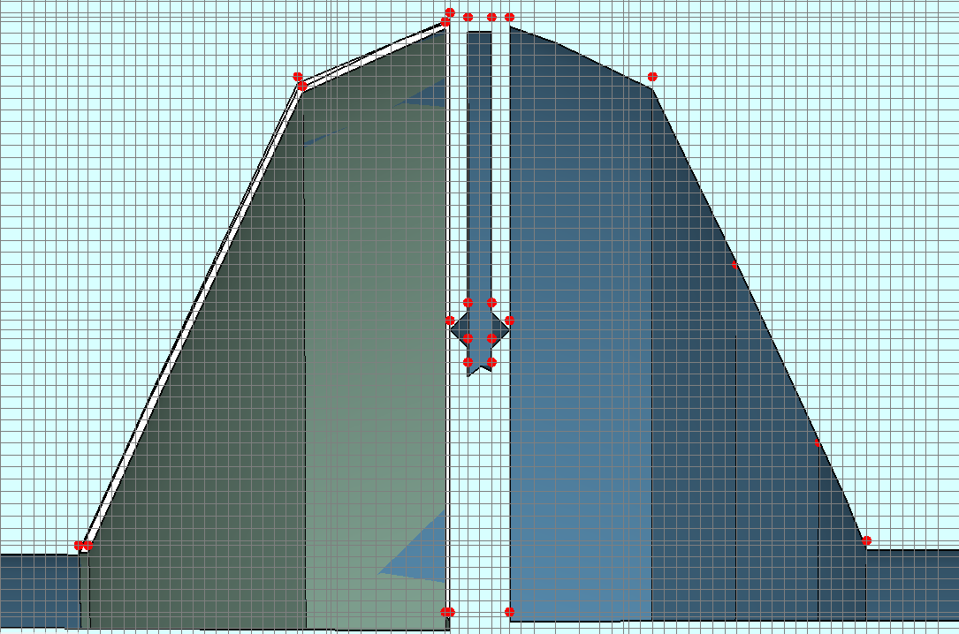
Simulations (additional)
A 30Mcell simulation allows “accurate” modelling of the structure.

