Slide 1
Bunch lengthening at SPS flat top
Theodoros Argyropoulos, Thomas Bohl,
Elena Shaposhnikova, Helga Timko
BE-RF-BR

Slide 2
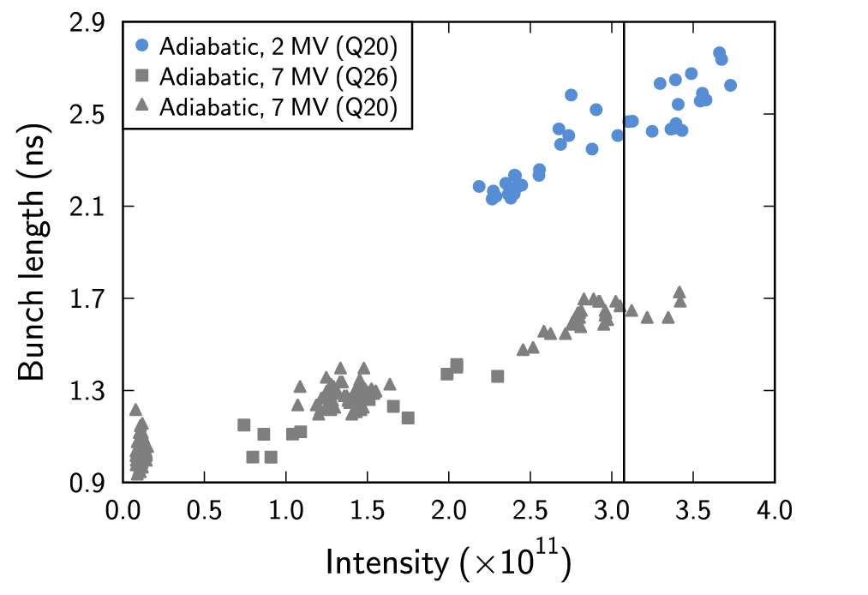
Motivation
LHC MD (Q26, Q20)
Required: same bunch length for different intensities
Was not possible, although bunches were stable (at least for Q20, no dipole or quadrupole oscillations were seen)
800 MHz RF was on for stability
Tried controlled emittance BUP
AWAKE MDs (Q26, Q20)
Same effect was seen
Bunch length increase
Was more than expected
Factor 2 over (0 – 3.5)×10¹¹ p

Slide 3
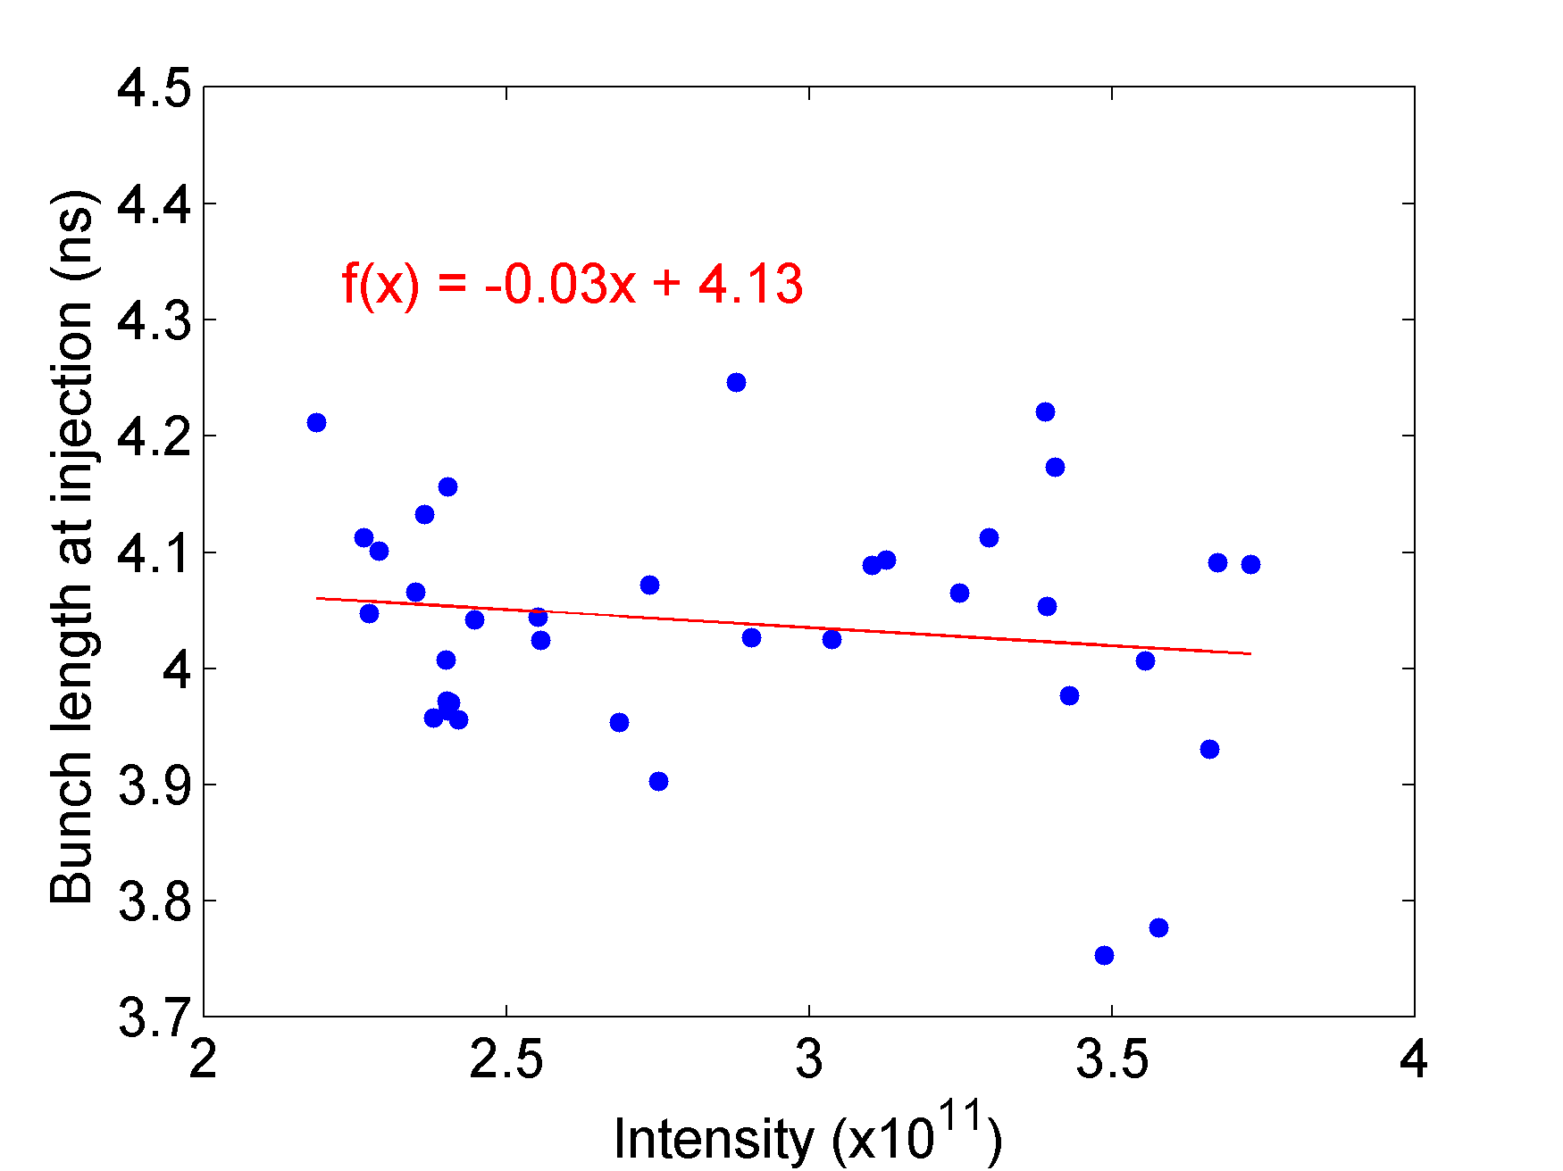
Reason?
What causes this bunch lengthening?
Injected parameters?
The bunch length at injection
turned out to be constant
Potential-well distortion?
Since we’ve seen no signs of instability
What is the impedance needed to explain it?

Slide 4
Potential-well distortion
Due to the beam-induced voltage (above transition, for inductive impedance), higher-intensity bunches see a lower V_{eff} → increased bunch length
Estimates based on Laclare’s formula
$$τ^{4}+DN\left(\frac{Z_{0}^{}}{n}\right){τ_{0}}_{}^{3}τ −{τ_{0}}_{}^{4}=0 ,$$
where $τ=τ\left(N\right)$, $τ_{0}=τ\left(N=0\right)$, $D =−\frac{12e^{2}\left|η\right|Q_{s}}{2πRp_{s}{ω_{s0}}_{}^{3}{τ_{0}}_{}^{3}}=−\frac{12e}{V_{RF}h\cos{φ}{ω_{0}}_{}^{2}{τ_{0}}_{}^{3}}=const.$
Assumes a parabolic line density
Assumes that the beam sees a constant imaginary impedance (Z/n)

Slide 5
Fit of PWD, data set 1
Q20 data
Measured for a wide intensity range
Fitted values:
$$τ_{0}=0.95 ns$$
$$\frac{Z_{0}}{n}=\left(15.7 ±0.1\right) Ω$$
For all other data
Fitting τ₀ is difficult (small intensity range covered)

Slide 6
Fit of PWD, data set 2
Q20 data
Measured for AWAKE
Only stable cases included
Assumed value:
$$τ_{0}=0.95 ns$$
Fitted value:
$$\frac{Z_{0}}{n}=15.1 Ω$$

Slide 7
For Q26
Bunch length at zero intensity
Scaling from the value fitted to Q20 data (0.95 ns):
$${τ_{0}^{}}_{}^{Q26}= {\left(\frac{η^{Q26}}{η^{Q20}}\right)}^{\frac{1}{4}}{τ_{0}^{}}_{}^{Q20}$$
With flat bottom values
η_{FB}^{Q26} = 6.15×10⁻⁴, η_{FB}^{Q20} = 1.78×10⁻³ → τ₀^{Q26} = 0.73 ns
With flat top values
η_{FB}^{Q26} = 1.92×10⁻³, η_{FB}^{Q20} = 3.08×10⁻³ → τ₀^{Q26} = 0.84 ns
Tried 0.7 ns and 0.8 ns; better fit for 0.7 ns

Slide 8
Fit of PWD, data set 3 (fit 1)
Q26 data
Measured during LHC MD
No BUP applied in the SPS
Assumed value:
$$τ_{0}=0.7 ns$$
Fitted value:
$$\frac{Z_{0}}{n}=\left(14.8 ±0.3\right)Ω$$

Slide 9
Fit of PWD, data set 3 (fit 2)
Q26 data
Measured during LHC MD
No BUP applied in the SPS
Assumed value:
$$τ_{0}=0.8 ns$$
Fitted value:
$$\frac{Z_{0}}{n}=\left(13.8 ±0.4\right)Ω$$

Slide 10
Fit of PWD, data set 4 (fit 1)
Q26 data
Measured during LHC MD
Slight BUP in the SPS
Assumed value:
$$τ_{0}=0.7 ns$$
Fitted value:
$$\frac{Z_{0}}{n}=\left(15.9 ±0.4\right)Ω$$

Slide 11
Fit of PWD, data set 4 (fit 2)
Q26 data
Measured during LHC MD
Slight BUP in the SPS
Assumed value:
$$τ_{0}=0.8 ns$$
Fitted value:
$$\frac{Z_{0}}{n}=\left(14.9 ±0.4\right)Ω$$

Slide 12
In summary…
The imaginary Z/n can be estimated from PWD
From fitting several data sets
${τ_{0}^{}}_{}^{Q20}≈(0.9−1.0) ns$
${τ_{0}^{}}_{}^{Q26}≈\left(0.7−0.8\right) ns$
For the same injected bunches, longer bunches are expected in Q20
Average imaginary $\frac{Z_{0}}{n}≈15 Ω$

Slide 13
Open question remaining
On the other hand, Z/n can be estimated also from the shift of f_{s} with intensity on flat bottom
We estimate $\frac{Z_{0}}{n}≲5 Ω$
About 1.5 Ω from a theoretical fit to exp. data (rough estimate)
About 3 Ω from simulations with constant Z/n (best fit to exp.)
We are lacking about a factor of 3—5 to explain the flat top behaviour.
(1) Assumed a constant Z/n. Need simulations with full impedance model for comparison.
(2) Is microwave instability causing the observed bunch lengthening? See Theodoros’ talk

