Slide 1
Considerations for the low-frequency impedance of enamel coated flanges in the PS, booster and in the SPS
F. Caspers, J. Bento, H. Damerau

Slide 2
PS

Slide 3
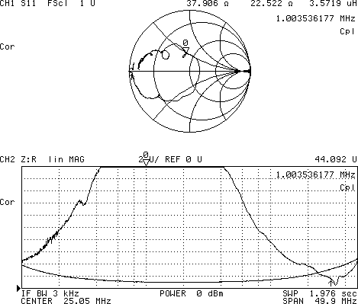
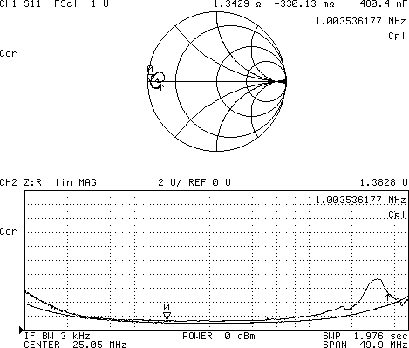
Introduction
• Isolated vacuum flanges (~ 200) to avoid ground loops and the associated field perturbation
• Problem: Each of the isolated flanges + ground loop forms a resonator (f_{res} ≅ 1.5 MHz, Q ≅ 1)
→ Solution: RF bypass to reduce impedance and resonance frequency of parasitic resonator
R. Cappi, PAC’89, pp. 2012-2014
OPEN
OK
R_{1MHz} ≅ 1 Ω
R_{1MHz} ≅ 40 Ω

Slide 4
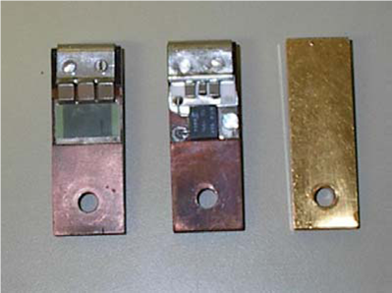
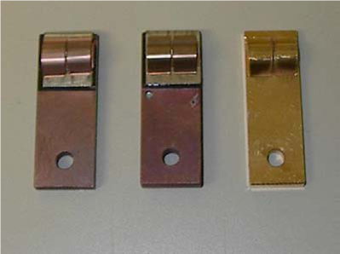
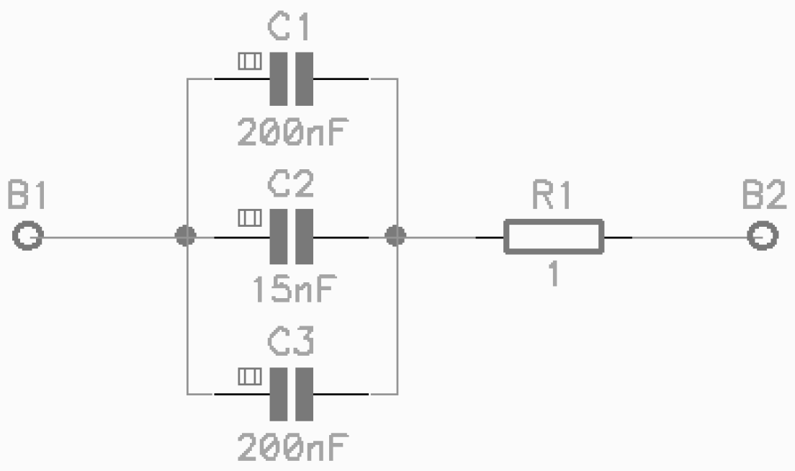
Measurements during the 2009 run
Schematics:
59 mm
59 mm
Old
New
Short
IRF, 08/07/2009
09/06 to 10/06/2009: Vacuum leak in the PS (SS52)
1 Ω resistor of RF bypass was found to be open, traces of arcing
Measurements of beam induced voltage across the bypass
Power and voltage found to be well within resistor specification
Measured > 30% of bypasses
No further broken bypass found

Slide 5
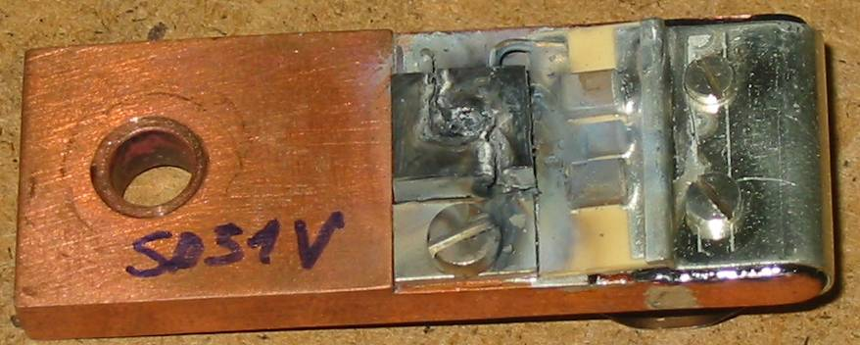
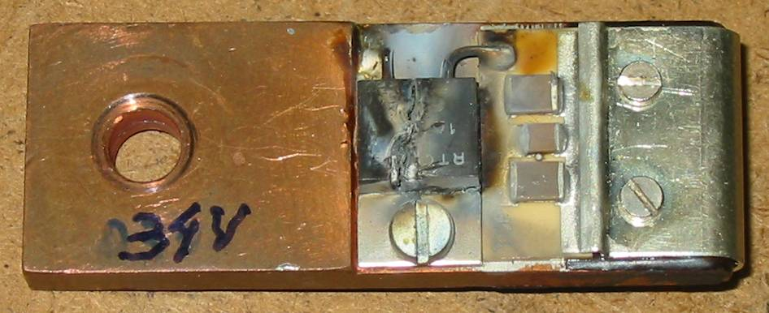
Measurement campaign 2009/2010
All bypasses measured at the end of 2009/2010 shut-down
What was found…
2 Bad contacts: SS47 (aval) , SS59 (amont)
3 RF bypasses with their resistors broken (two of them burnt):
SS21 (amont), SS34 (aval), SS51 (aval)
However: Only bypasses with the new damping resistor affected

Slide 6
Summary since start-up 2009
Total
Broken
New type bypasses
24
1+3
17 %
Old type bypasses
126
0
0 %
Broken resistor!
PSB type ‘pince’ bypass
6
0
0 %
Short-circuits
46
0
0 %
All 24 new type bypases were changed against old type in 2010
Smaller average power of old damping resistors (~ 10 W) seems sufficient
No further resistor breakdown found in 2011 and 2012
Present situation:
Total
Old type bypasses
151
PSB type ‘pince’ bypass
5
Short-circuits
46

Slide 7
SPS

Slide 8
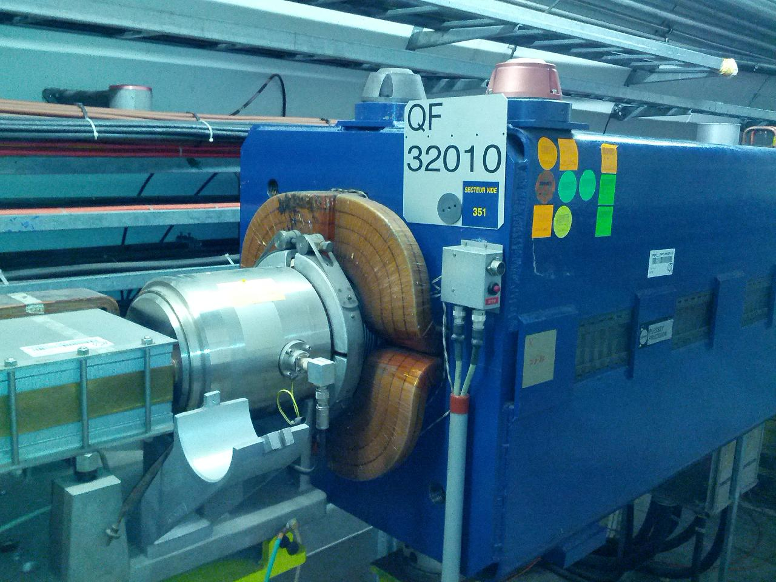
Measurement Setup
BPM

Slide 9
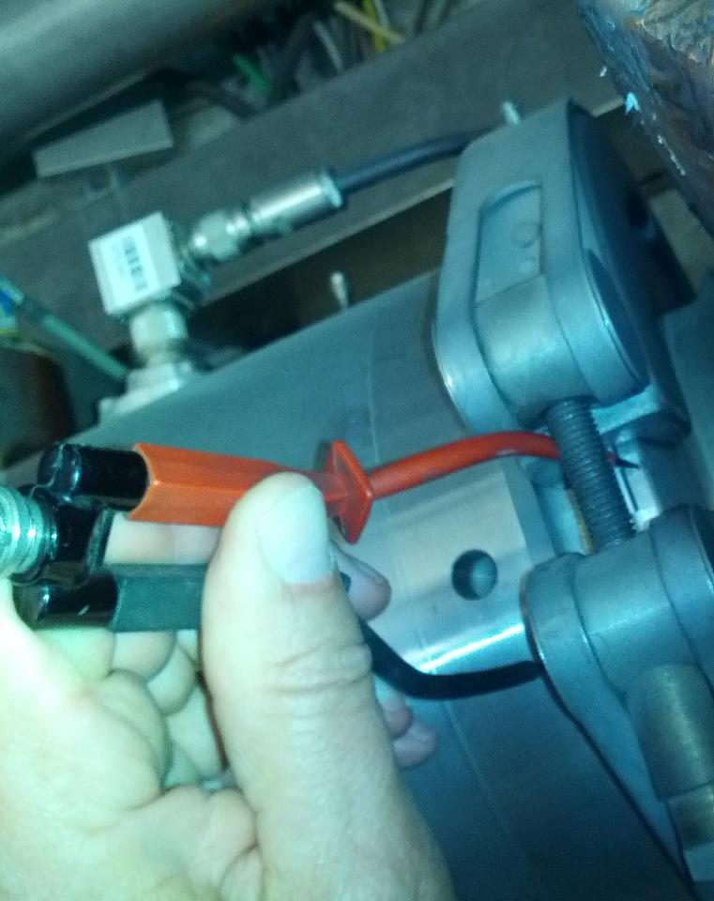
Measurement Setup
Measurement on flange near QF32010

Slide 10
Measurement Results (S₁₁) Imaginary part

Slide 11
Measurement Results (S₁₁) Real part

Slide 12
Measurement Results (S₁₁) Lin MAG

Slide 13
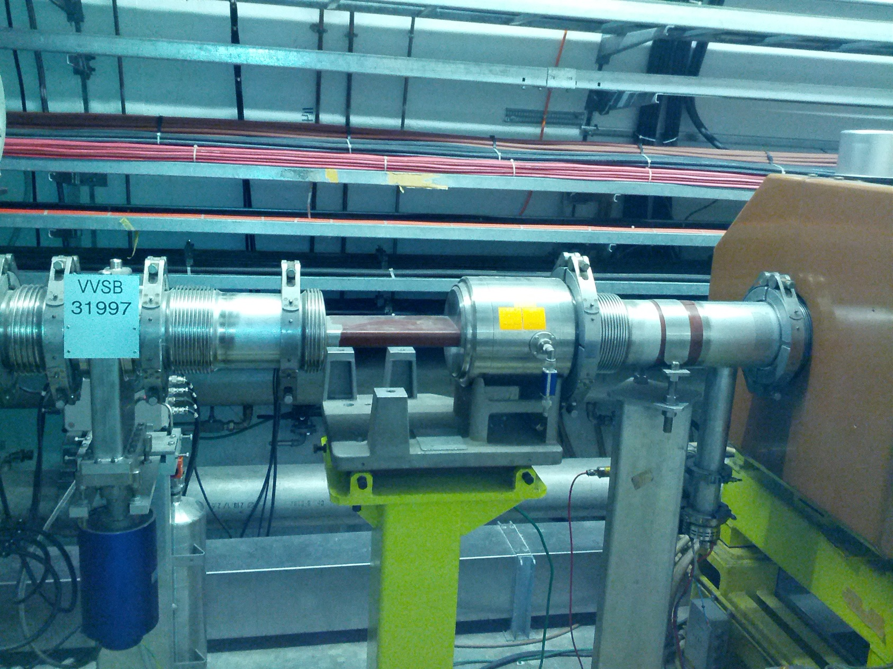
Measurement Setup on flange near VVSB31997
Left
Meas.
Right
Meas.

Slide 14
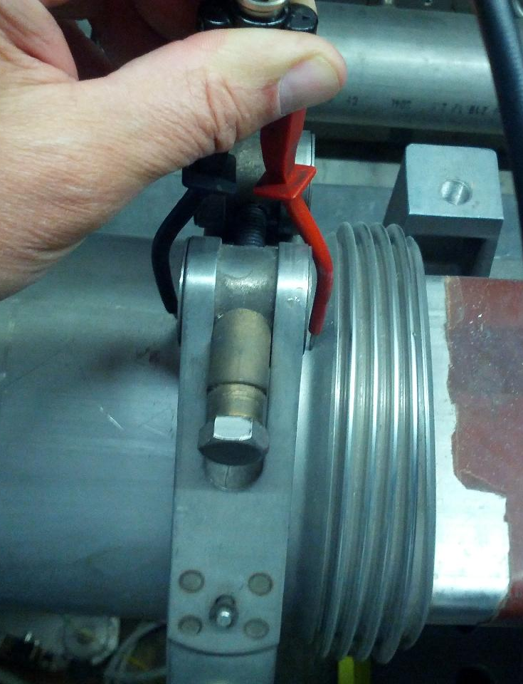
Measurement Setup
Measurement on flange near VVSB31997
(Left Measurement)

Slide 15
Measurement Results (S₁₁) Imaginary part Left Measurement

Slide 16
Measurement Results (S₁₁) Real part Left Measurement

Slide 17
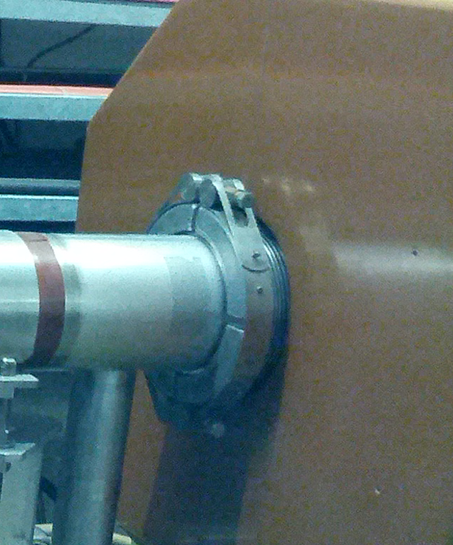
Measurement Setup
Measurement on flange near VVSB31997
(Rigt Measurement)

Slide 18
Measurement Results (S₁₁) Imaginary part Right Measurement

Slide 19
Measurement Results (S₁₁) Real part Right Measurement

Slide 20
Measurement Results (S₁₁) Real and Imaginary part on a Short Circuit

