Slide 1
SPS flanges Simulations & Measurements Update
Fritz Caspers and Jose E. Varela

Slide 2
Outline
Introduction
Impedance List Update
Damping Resistors in Simulations
Conclusions

Slide 3
Introduction
We continue to search for possible causes of the suspected 1.4GHz microwave instability in the SPS.
Last element of the list was simulated and impedance has been included in the table.
Small study on the possibility of including the damping resistors in simulations has been carried out.

Slide 4
Outline
Introduction
Impedance List Update
Damping Resistors in Simulations
Conclusions

Slide 5
Total Flange Impedance
Flange Type | Enamel | Bellow | Num. of elements | Freq. [GHz] | Impedance | Q | R/Q [Ω] | Resistor
BPV-QD | Yes | Yes | 90 | 1.21 | 633kΩ | 315 | 2010 | No
BPH-QF | Yes | Yes | 39 | 1.28 | 1.03MΩ | 400 | 2496 | Long
QF-MBA | Yes | Yes | 83 | 1.41 | 1.6MΩ | 268 | 5985 | Short
MBA-MBA | Yes | Yes | 14 | 1.41 | 297kΩ | 285 | 1040 | Short
QF-QF | No | Yes | 26 | 1.41 | 3.767MΩ | 1828 | 2061 | Short
QD-QD | Yes | No | 99 | 1.57 | 17kΩ | 55 | 317 | No
QF-QF | No | No | 20 | 1.61 | 588kΩ | 980 | 600 | No
BPH-QF | Yes | Yes | 39 | 1.62 | 121kΩ | 120 | 1014 | Long
QD-QD | No | No | 75 | 1.8 | 651kΩ | 881 | 739 | No
QD-QD | Yes | No | 99 | 1.89 | 186kΩ | 175 | 1070 | No
No damping resistors included in simulations.
The ‘Resistor’ column states whether or not each element should have a resistor.

Slide 6
Outline
Introduction
Impedance List Update
Damping Resistors in Simulations
Conclusions

Slide 7
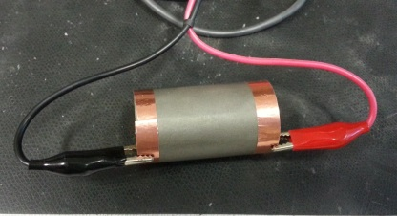
Damping Resistor DC Measurement
A 4-wire DC measurement was taken on a long damping resistor as shown in the Figure.
The measured resistance was 160Ω.
A conductivity value of
15.7 S/m for the
Nickel-Chrome layer was deduced from the measured value.

Slide 8
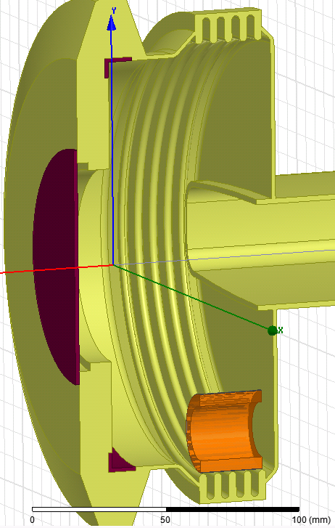
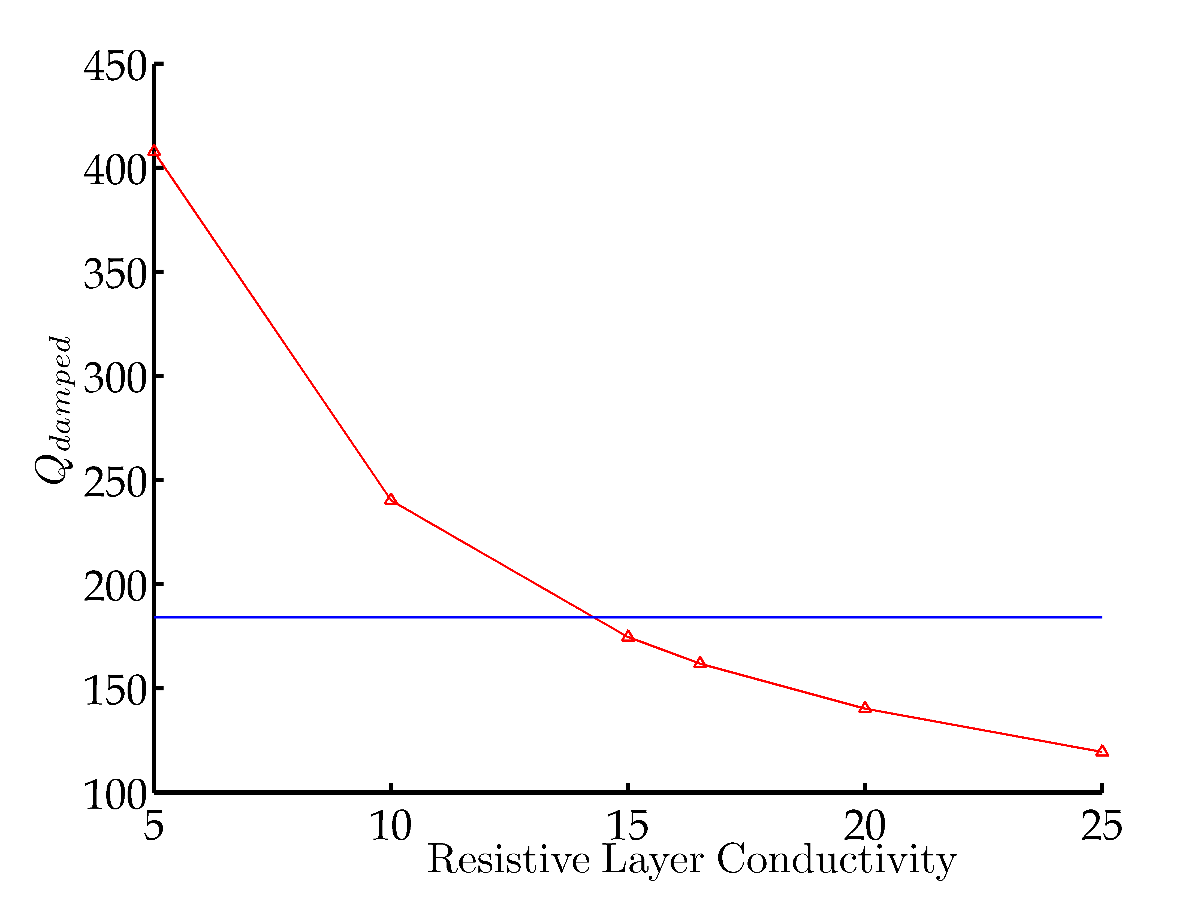
Damping Resistor in Simulations
 | Simulation no Resistor | Simulation with Resistor | Meas. no Resistor | Meas. with Resistor
f [GHz] | 1.423 | 1.414 (-0.68%) | 1.417 | 1.411 (-0.42%)
Q₀ | 1910 | 174 | 1930 | 186
6% rel. error
The volume of the resistor represents around 1.5% of the total cavity volume.

Slide 9
Outline
Introduction
Impedance List Update
Damping Resistors in Simulations
Conclusions

Slide 10
Conclusions
All the elements in the original flange list have been analysed.
The impedance, Q and R/Q values have been provided for the bigger resonances.
A ‘calibration’ of the conductivity value to be used in simulations for the Nickel-Chrome has been carried out.

