Slide 1
SPS Impedance Model: Latest Results from Simulations
Theodoros Argyropoulos, Elena Shaposhnikova, Helga Timko, Jose Varela
BE-RF-BR

Slide 2
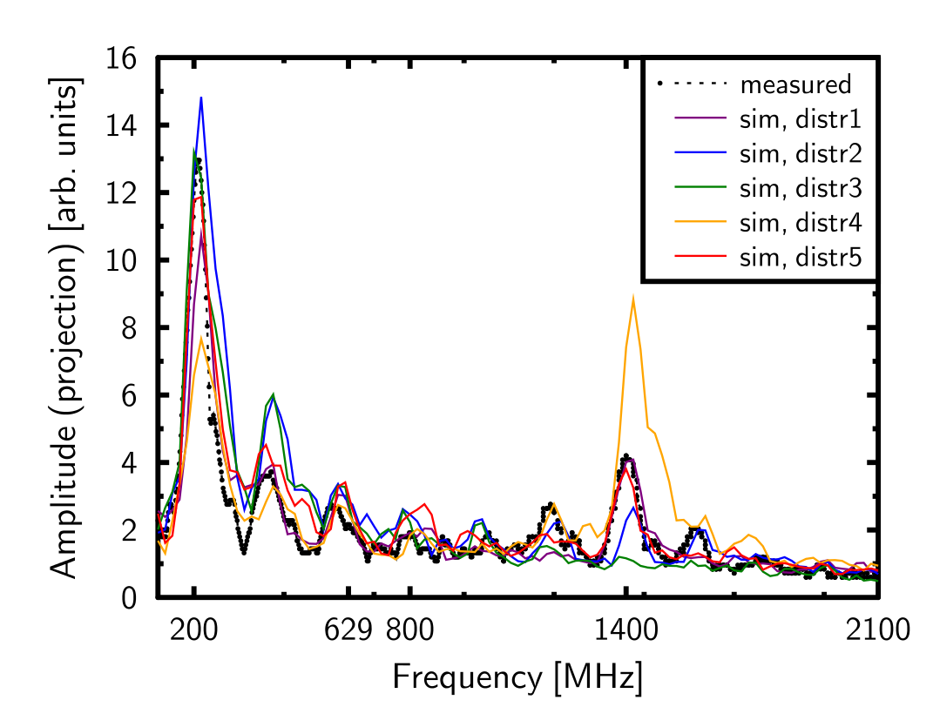
Status at the previous meeting
No BPM&Zs impedance
Damping resistors, w/ R/Q increased; ~15 % higher R_{sh} at 1.4 GHz
Simulated w/ different measured distributions
Fits on average
N.B. non-linear scaling between amplitude and impedance

Slide 3
Uncertainties in our simulations
Sources of uncertainty in simulations
Longitudinal phase-space distribution
Can affect the outcome largely!
Impedance model
Flanges
Kickers
In-between Zs
200 MHz and 800 MHz cavities
Let’s try to reduce first some of these uncertainties.

Slide 4
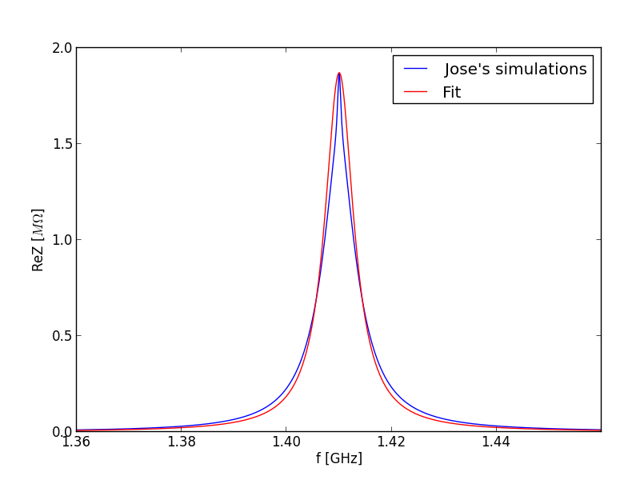
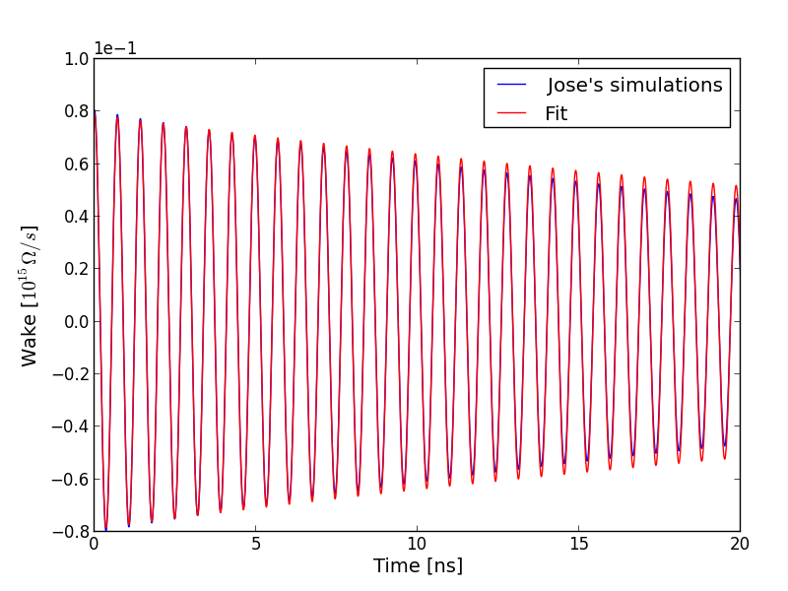
Impedance model: Flanges
For simplicity: model with single BB resonator
f_{r} = 1.41 GHz, Q = 210, R_{sh} = 1.871 MΩ

Slide 5
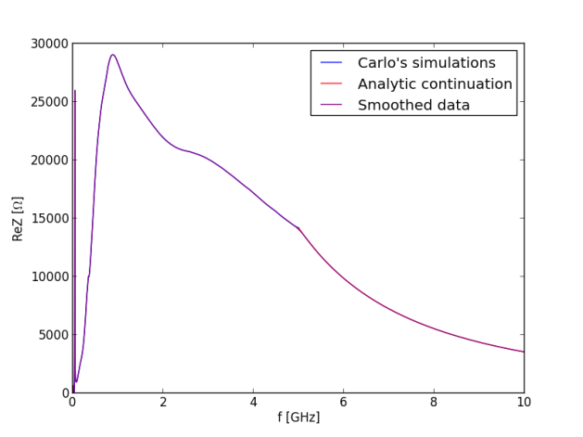
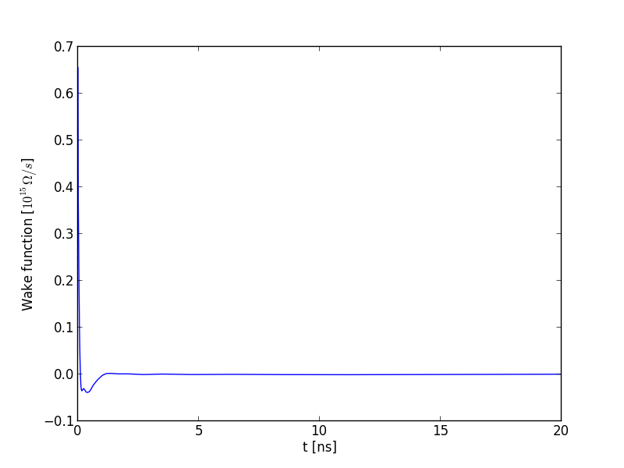
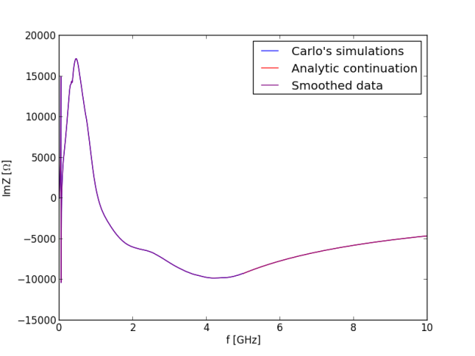
Impedance model: Kickers
Wake obtained as an FFT of Carlo’s data ← updated!
Using an analytic continuation of ReZ ~ 1/f² and ImZ ~ 1/f

Slide 6
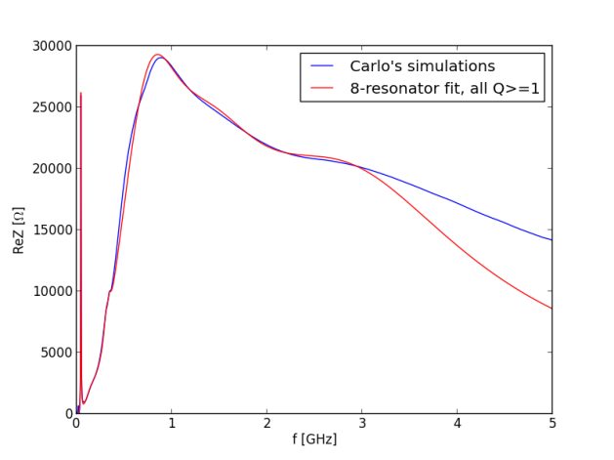
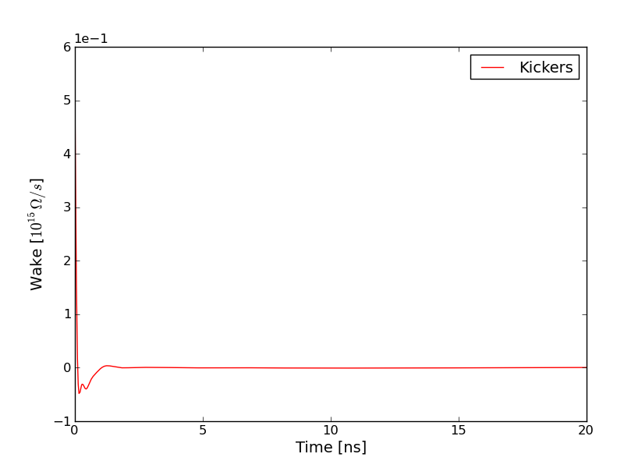
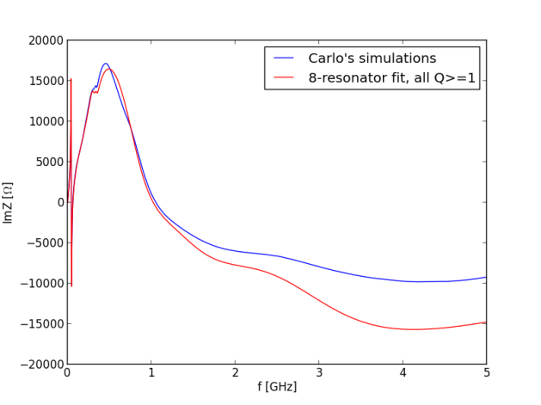
Impedance model: Kickers
Wake obtained as a resonator fit
An 8-resonator model (red) gives a very similar wake

Slide 7
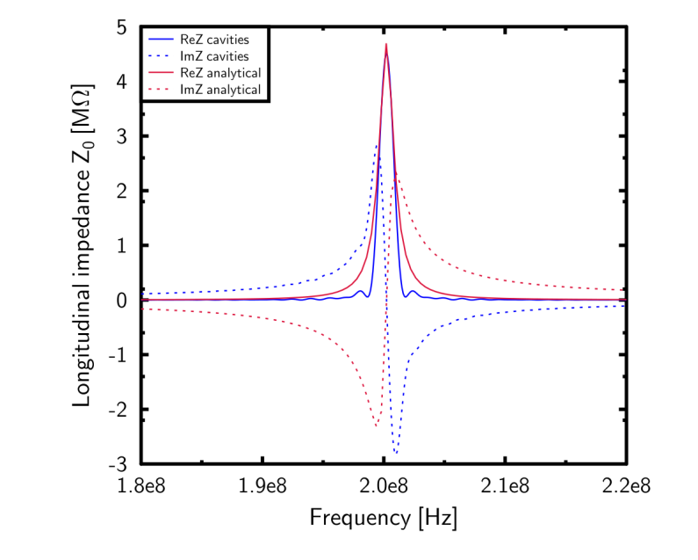
Impedance model: Cavities
A more accurate model of the SPS TW cavities
Following G. Dôme (CERN-SPS/ARF/77-11, 1977)
$$Z\left(f\right)=R \left\{{\left(\frac{sin\left(\frac{a(f−f_{r})}{2}\right)}{\frac{a(f−f_{r})}{2}}\right)}^{2}−2i\frac{a\left(f−f_{r}\right)−sin⁡(a\left(f−f_{r}\right))}{{(a(f−f_{r}))}^{2}}\right\}$$
$W\left(t\right)=\frac{2R}{\tilde{a}}\left(1−\frac{t}{\tilde{a}}\right)cos\left(ω_{r}t\right)$, where $\tilde{a}=\frac{a}{2π}$.
Less impedance than before
Cavity | R (MΩ) | a (μs)
200 MHz Short | 2×0.876 | 3.56
200 MHz Long | 2×1.38 | 4.47
800 MHz | 2×0.969 | 2.07

Slide 8
SPS impedance in total
f_{r} (GHz) | R_{sh} (MOhm) | Q | R/Q (kOhm)
0.629 | 0.388 | 500 | 0.78
0.885 | 0.0146 | 482 | 0.030
0.892 | 0.0198 | 493 | 0.040
1.052 | 0.1597 | 773 | 0.207
1.062 | 0.1903 | 773 | 0.246
1.069 | 0.0454 | 654 | 0.069
1.092 | 0.0570 | 667 | 0.085
1.185 | 0.0116 | 610 | 0.019
1.215 | 0.0012 | 624 | 0.002
1.598 | 0.0426 | 672 | 0.063
1.613 | 0.5975 | 686 | 0.871
1.859 | 0.2951 | 896 | 0.329
1.960 | 0.0721 | 1993 | 0.036
0.550 | 0.2275 | 1000 | 0.228
1.050 | 0.2275 | 1250 | 0.182
1.41 | 1.871 | 210 | 8.91
+ cavity & kicker impedance
200 MHz HOM
BPMs
Zs (?)
Flanges

Slide 9
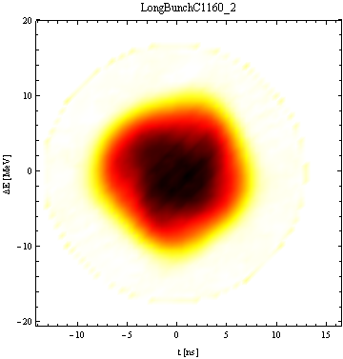
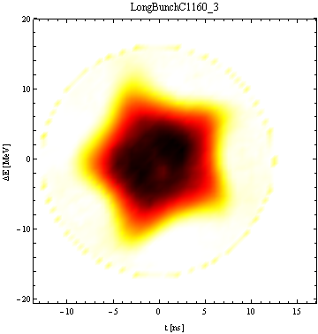
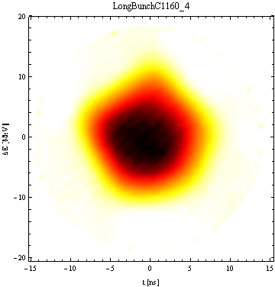
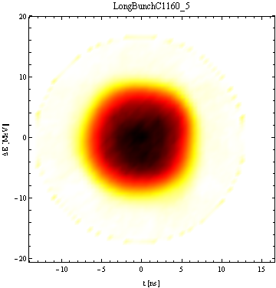
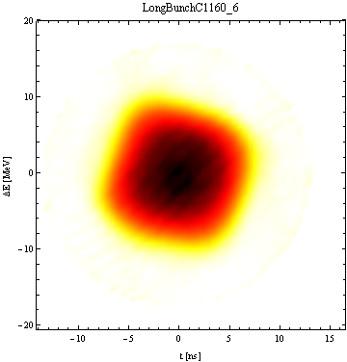
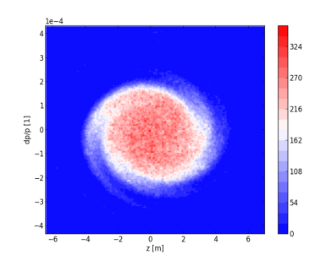
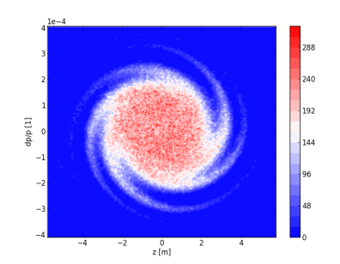
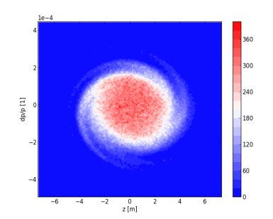
Distributions: from tomoscope
At PS flat top C1160 – measured within ~5 ms
D1
D2
D3
D4
D5
D6
At injection to the SPS (after tracking in ESME)
D1
D2
D3
D4
D5
D6
D2

Slide 10
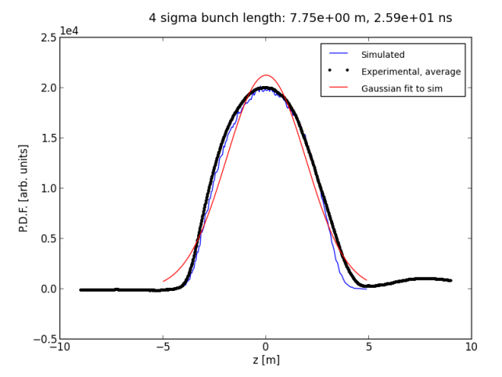
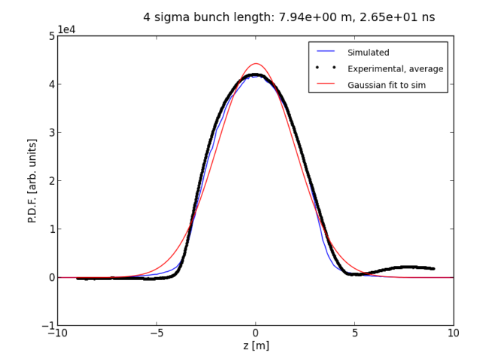
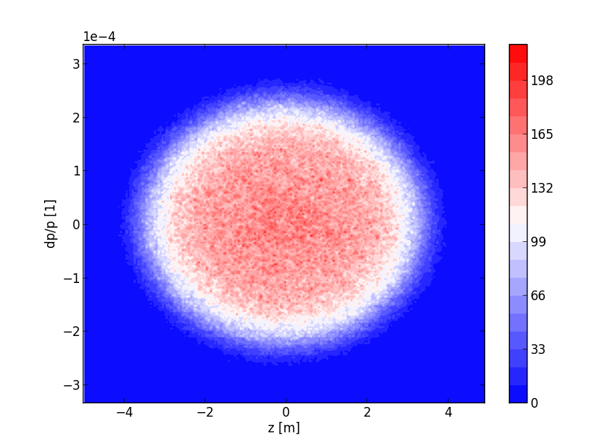
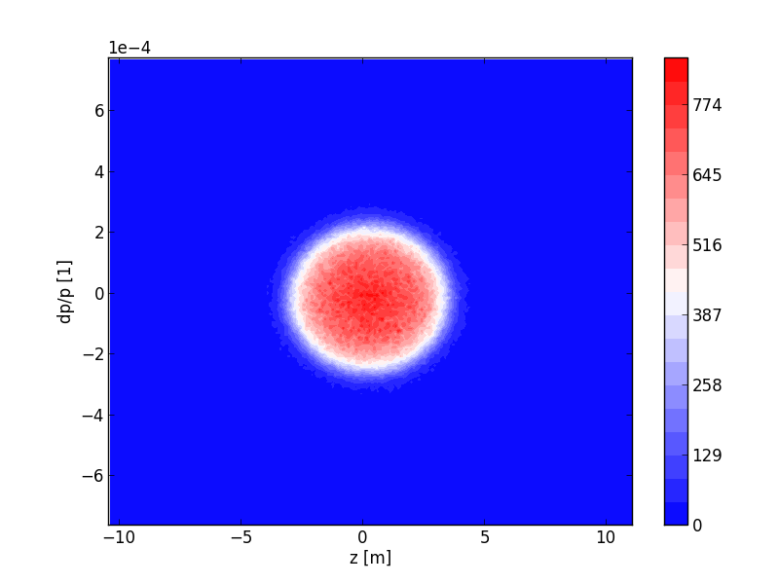
Distributions from average profile
Reconstructed average
Reconstructed + Gaussian
25.9 ns
26.5 ns

Slide 11
Reconstructed distribution
Amplitude evolution
Projection
Doesn’t fit the measurements: 1.4 GHz grows too fast, 200 MHz too slowly

Slide 12
Reconstructed + Gaussian
Amplitude evolution
Projection
Better: 1.4 GHz is more reasonable, but 200 MHz is still too slow

Slide 13
Measured distributions, 1×10¹¹
Amplitude evolution
Projection
Better, but growth rates are still not perfect, hence the sidebands cannot be seen

Slide 14
Measured distributions, 8×10¹⁰
Amplitude evolution
Projection
In measurements, 8×10¹⁰ was the threshold of 1.4 GHz instability.
This is correctly reproduced here, but the 1.4 GHz growth rate is sill not correct

Slide 15
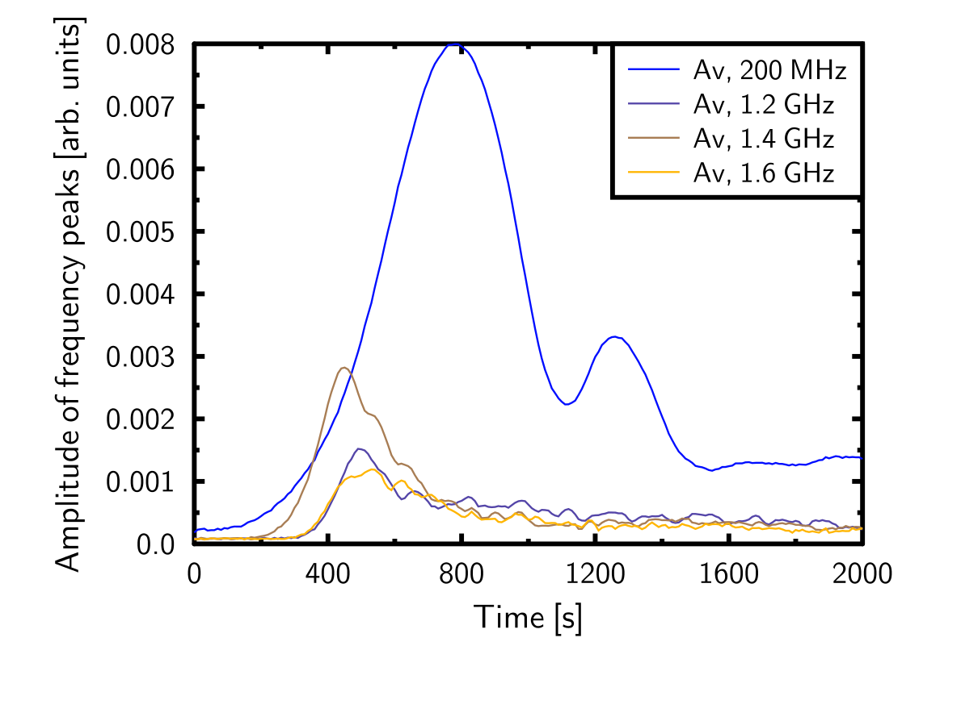
Sidebands at 1.2 GHz and 1.6 GHz
Sidebands observed experimentally
Are due to the interaction between 200 MHz and 1.4 GHz
When the 2 modulations
overlap, the sidebands
always follow the 1.4 GHz
When there is no overlap,
no sidebands are seen

Slide 16
Why are sidebands important?
Source of 1.4 GHz peak: flanges
Now we are confident: flange impedance is sufficient to explain the 1.4 GHz peak in the de-bunching spectrum
Is this impedance harmful?
Does it lead to microwave instability?
Need simulations with RF on to answer this question
→ Need an accurate SPS impedance model
→ Need to know whether missing sidebands are due to a wrong distribution or an incomplete impedance model (or both)

Slide 17
Conclusions, Plans
1.4 GHz peak identified
Flange impedance is enough to explain the peak
Importance of the 1.4 GHz impedance
Not yet fully understood
Too many uncertainties in our model
Will have to find an impedance model that explains all our measurements; only then we can know whether or not the 1.4 GHz impedance is harmful

