Slide 1
Present status of the SPS longitudinal impedance model
C. Zannini and G. Rumolo
Thanks to: T. Argyropoulos, M. Barnes, E. Chapochnikova, E. Métral, N. Mounet, B. Salvant

Slide 2
Overview
Status of the longitudinal SPS impedance model
Wall Impedance model
Kicker Impedance model
Summary

Slide 3
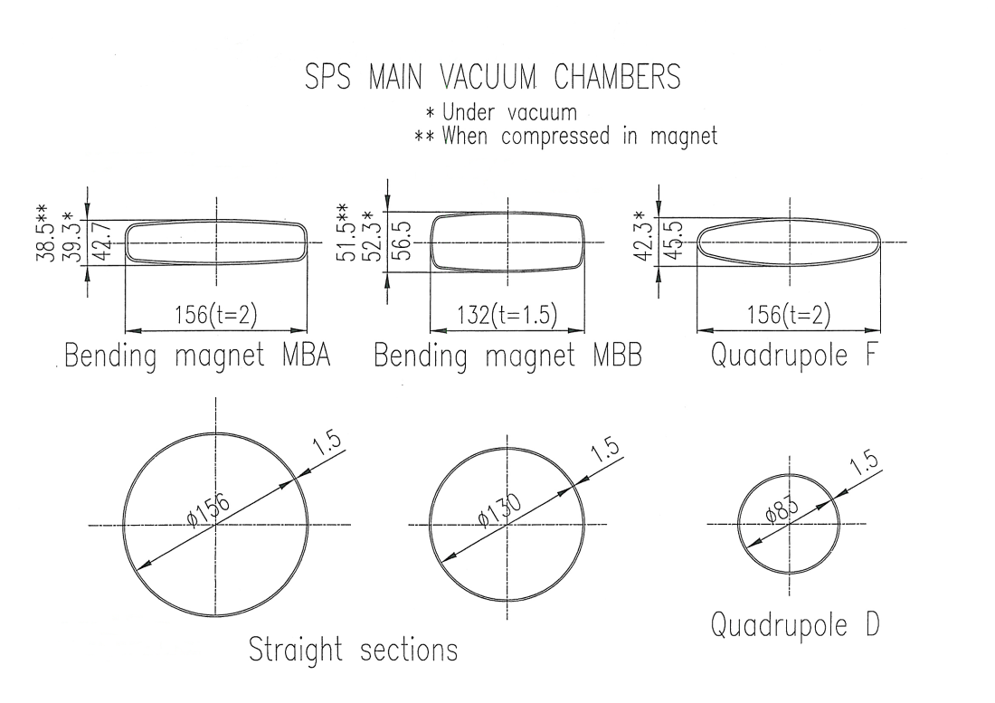
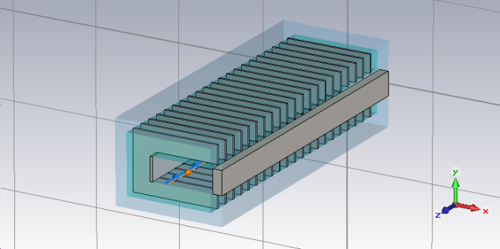
Status of the SPS longitudinal impedance model
Elements included in the database:
Realistic model that takes into account the different SPS vacuum chambers weighted by the respective length
19 kickers (CST 3D simulation)
Wall impedance
Kickers
Notes:
Specificare che la cavita’ e’ quella a 200 MHz

Slide 4
Overview
Status of the longitudinal SPS impedance model
Wall Impedance model
Kicker Impedance model
Summary

Slide 5
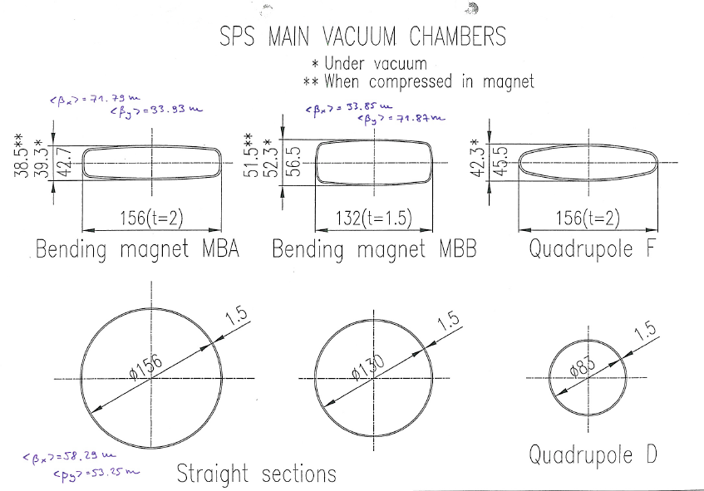
Wall impedance model
1. Different vacuum chambers weighted by the respective length and beta function
2. The iron in the magnets is also taken into account

Slide 6
Wall Impedance model
The wall impedance is defined as the sum of the resistive wall impedance and the indirect space charge.
Calculation based on analytical calculations
Tlwall (based on Transmission Line theory)
Longitudinal: resistive wall impedance
Transverse: resistive wall impedance + indirect space charge
ImpedanceWake2D (based on the field matching theory)
Longitudinal: wall impedance
Transverse: wall impedance
F. Roncarolo, F. Caspers, T. Kroyer, E. Métral, N. Mounet, B. Salvant, and B. Zotter. Comparison between laboratory measurements, simulations and analytical predictions of the transverse wall impedance at low frequencies. Phys. Rev. ST Accel. Beams, 12(084401), 2009.

Slide 7
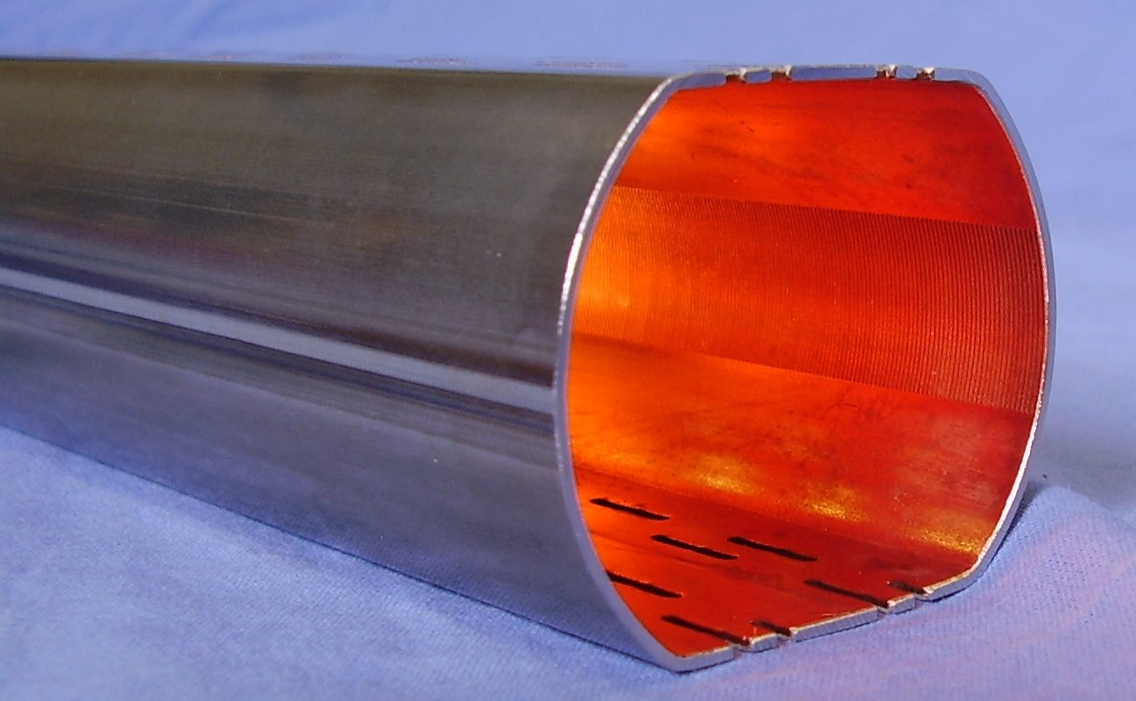
Comparison with ReWall: PEC boundary
TL model
Copper 0.05 mm
S.steel 1 mm
Boundary: PEC
Re-Wall
Copper 0.05 mm
S.steel 1 mm Boundary : Quasi PEC
L= 1 m
γ=10000
The agreement with ReWall is very good

Slide 8
Comparison with ReWall: Vacuum boundary
γ=10000
L= 1 m
TL model
S.steel 1 mm Boundary : Vacuum
Re-Wall
S.steel 1 mm Boundary : Vacuum
There is a perfect agreement with the ReWall code

Slide 9
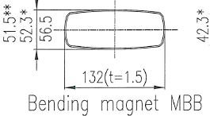
Comparison with ReWall: Conductive boundary
γ=10000
L= 1 m
TL model
S.steel 1.5 mm Boundary : silicon-steel
Re-Wall
S.steel 1.5 mm Boundary : silicon-steel
There is a perfect agreement with the Re-Wall code

Slide 10
Longitudinal wall impedance
Calculation performed with ImpedanceWake2D

Slide 11
Longitudinal wall impedance
Old calculation
New calculation
Accounts for the iron in the magnet
Includes the indirect space charge term
Does not account for the iron in the magnet
Does not include the indirect space charge term

Slide 12
Overview
Status of the longitudinal SPS impedance model
Wall Impedance model
Kicker Impedance model
Summary

Slide 13
Kicker impedance model

Slide 14
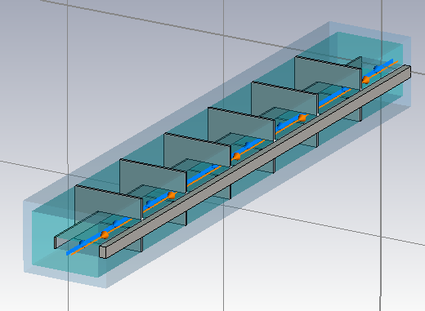
SPS extraction kicker (MKE)

Slide 15
MKE kicker with serigraphy

Slide 16
Comparing MKE with and without serigraphy
f=44 MHz

Slide 17
Experimental confirmations
The impedance model of the SPS extraction kicker can explain the beam induced heating observed in the SPS machine
Bench impedance measurements are in reasonable agreement with the impedance model
C. Zannini, G. Rumolo. “MKE heating with and without seigraphy”, Presented at the SPSU meeting, 2 August 2012, http://paf-spsu.web.cern.ch/paf-spsu/

Slide 18
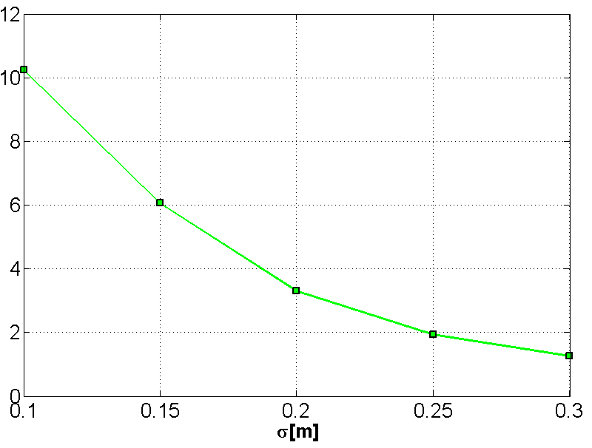
Beam induced heating
Beam induced heating
Power loss from the impedance model
Bunchlength during the experiment

Slide 19
Comparing longitudinal impedance measurements and model for the MKP-L module

Slide 20
Longitudinal kicker impedance model
As for the MKEs for a better estimation of the low frequency behavior (below few tens of MHz) dedicated simulations are needed also for the other kickers.

Slide 21
Longitudinal kicker impedance model: MKEs
Tsutsui model overestimates the MKEs impedance contribution because of the serigraphy

Slide 22
Longitudinal kicker impedance model: MKEs
Tsutsui model overestimates the MKEs impedance contribution because of the serigraphy

Slide 23
Longitudinal kicker impedance model: MKEs
MKEs contribution very low due to the effect of the serigraphy: considering only the kicker impedance we should have a situation similar to 2001

Slide 24
Longitudinal kicker impedance model: MKEs
MKEs contribution very low due to the effect of the serigraphy: considering only the kicker impedance we should have a situation similar to 2001

Slide 25
Overview
Status of the transverse SPS impedance model
Status of the longitudinal SPS impedance model
Wall Impedance model
Kicker Impedance model
Summary

Slide 26
Summary
Longitudinal impedance model
The Wall impedance of SPS has been estimated
The tools used for the calculations have been successfully benchmarked
The kicker impedance model has been discussed
Benchmarks with beam observations and wire measurements have been presented
Differences with respect to the Tsutsui model have been showed

Slide 27
Thank you for your attention

